Slide 1
Title: ANN & CNN Model Implementation for Classification and Regression Tasks Group Members: Cybil Fatima (SP23-BAI-013) Esha Alvi (SP23-BAI-015)

Slide 2
ANN with Classification - Overview
Dataset: Breast Cancer Wisconsin (Diagnostic)
569 samples, 30 features
Class labels: Malignant (1) or Benign (0)
Model:
Input layer, two hidden layers (ReLU), output layer (sigmoid)
Binary Cross-Entropy Loss
Optimizers: Adam vs. SGD

Slide 3
ANN Classification - Training Performance
Adam Optimizer outperforms SGD in training and testing metrics.
EPOCHS | OPTIMIZER | LR | ACCURACY | PRECISION | RECALL | F1_SCRE
40 | ADAM | O.OO1 | 91 | 89 | 98 | 93
40 | SGD | 0.01 | 87 | 85 | 90 | 87

Slide 4
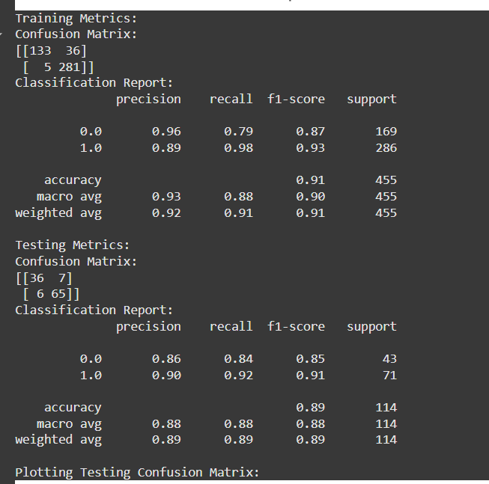
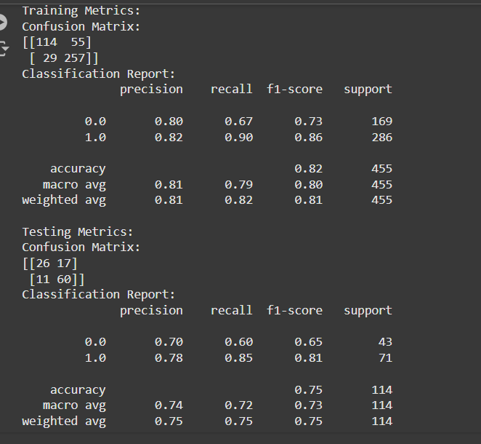
ANN Classification - Training Performance RESULTS

Slide 5
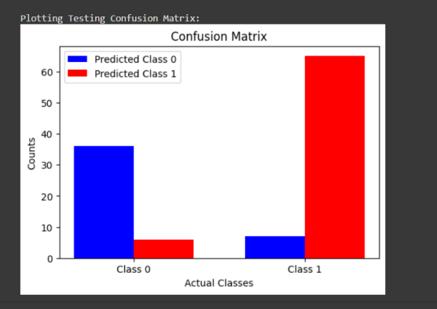
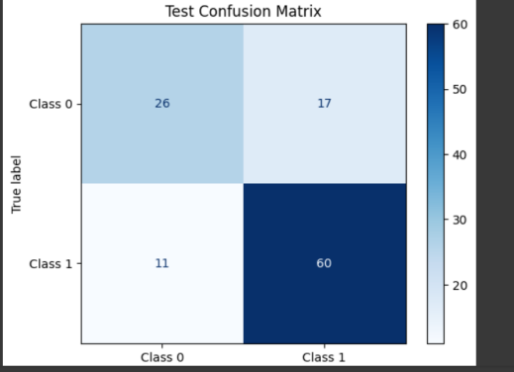
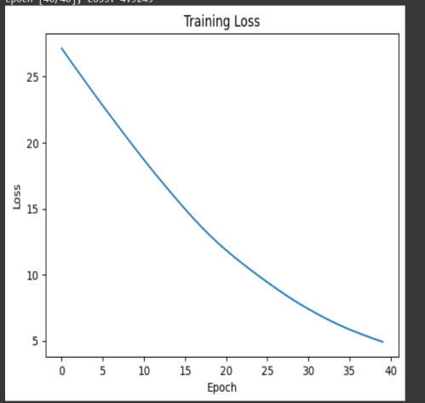
ANN Classification - Training Performance RESULTS

Slide 6
ANN Classification - Observations & Conclusion
Loss and Convergence:
Adam converges faster, showing lower loss after 40 epochs (0.2456 vs 0.3265 with SGD).
Training & Testing Performance:
Adam: Higher accuracy (91% vs 87%), recall (98% vs 90%), F1-score (93% vs 87%).
Adam provides better generalization, especially for testing data.

Slide 7
ANN Linear Regression Task - Overview
Dataset: California Housing
8 features, training size: 16,512, test size: 4,128
Target range: 0.14999 - 5.00001
Model:
Approaches: Batch, Mini-Batch, Stochastic Gradient Descent (SGD)
Convergence achieved by early stopping (10 epochs)

Slide 8
Linear Regression - Performance Metrics (Batch/Mini-Batch)
Training Technique | Epochs | Training Loss | Validation Loss | MSE | MAE | Training Time
Batch/Mini-Batch Gradient Descent | 10 | 0.0071 | 0.4556 | 0.2841 | 0.3659 | 3.83 s
Stochastic Gradient Descent | 100 | 0.2593 | N/A | 0.2829 | 0.3666 | 978.03 s
Mini-Batch Gradient Descent is faster and more efficient than SGD.

Slide 9
Linear Regression: Key Observations & Results
Training Metrics:
Batch/Mini-Batch Gradient Descent:
Training Loss: 0.0071, Validation Loss: 0.4556
MSE: 0.2841, MAE: 0.3659, Training Time: 3.83s
SGD:
Training Loss: 0.2593, MSE: 0.2829, MAE: 0.3666
Training Time: 978.03s
Hyperparameter Tuning:
Learning Rate: 0.0001/0.0005, Epochs: 32, Batch Size: 64
Key Insights:
Batch/Mini-Batch: Faster, smoother convergence in fewer epochs.
SGD: Slower convergence, requires more epochs.
Optimization: Combining Batch into Mini-Batch balances performance & efficiency.

Slide 10
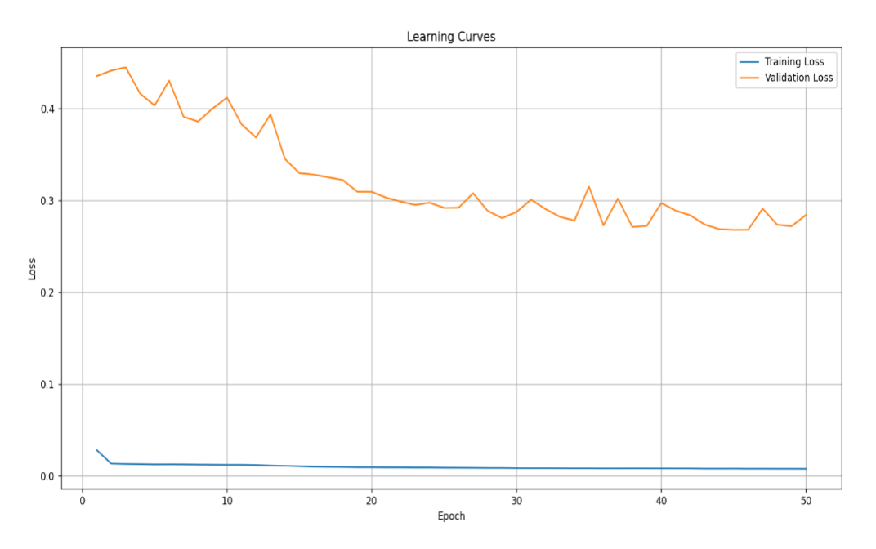
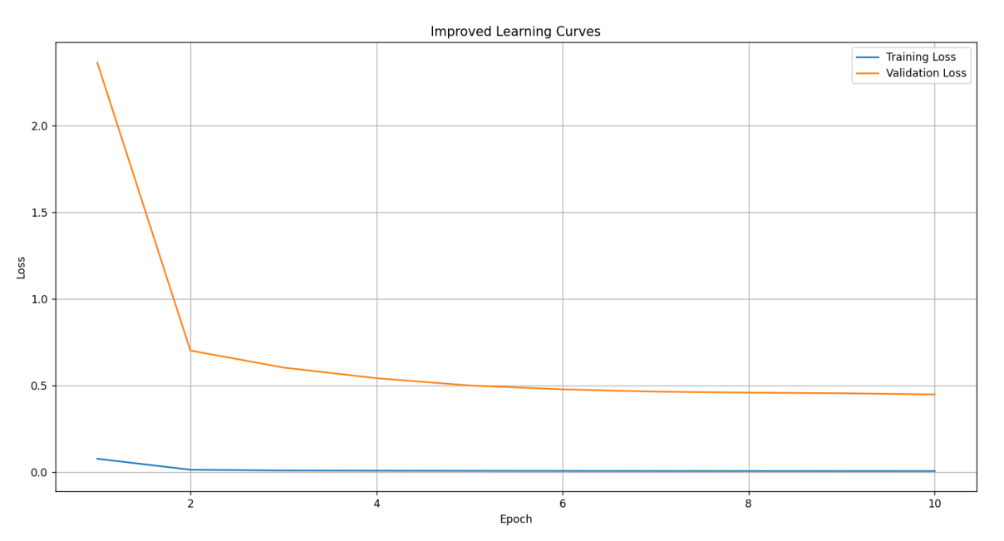
Linear Regression: Key Observations & Results

Slide 11
CNN with Classification - Overview
Dataset: CIFAR-10
60,000 32x32 color images, 10 classes, 50,000 training, 10,000 test images
Model:
Convolutional layers with max-pooling, batch normalization
Evaluated with different optimizers: Adam, SGD
Preprocessing: Image normalization and one-hot encoding

Slide 12
CNN Classification: Optimizer & Kernel Size Comparison
Model Architecture: 3 convolutional layers, max-pooling, batch normalization, fully connected output layer
Optimizers: Adam, SGD
Kernel Size: 3x3 (Best performance)
Results:
Adam Optimizer:
Test Accuracy: 0.7597, Test Loss: 0.7882
Training Accuracy: 0.8942, Training Loss: 0.3025
SGD Optimizer:
Test Accuracy: 0.7511, Test Loss: 0.7614
Training Accuracy: 0.8636, Training Loss: 0.3838
Key Insights:
Adam consistently outperforms SGD in accuracy and loss.
3x3 Kernel strikes the best balance between performance and efficiency.

Slide 13
CNN Classification - Optimizer Comparison
Metric/Optimizer | Adam | SGD
Test Loss | 0.7882 | 0.7614
Test Accuracy | 0.7597 | 0.7511
Training Accuracy (Final Epoch) | 0.8942 | 0.8636
Training Loss (Final Epoch) | 0.3025 | 0.3838
Val Accuracy (Final Epoch) | 0.7090 | 0.7167
Val Loss (Final Epoch) | 1.2553 | 0.9743
Training Time (per Epoch) | ~443s | ~442s
Adam Optimizer outperforms SGD in terms of test accuracy and loss

Slide 14
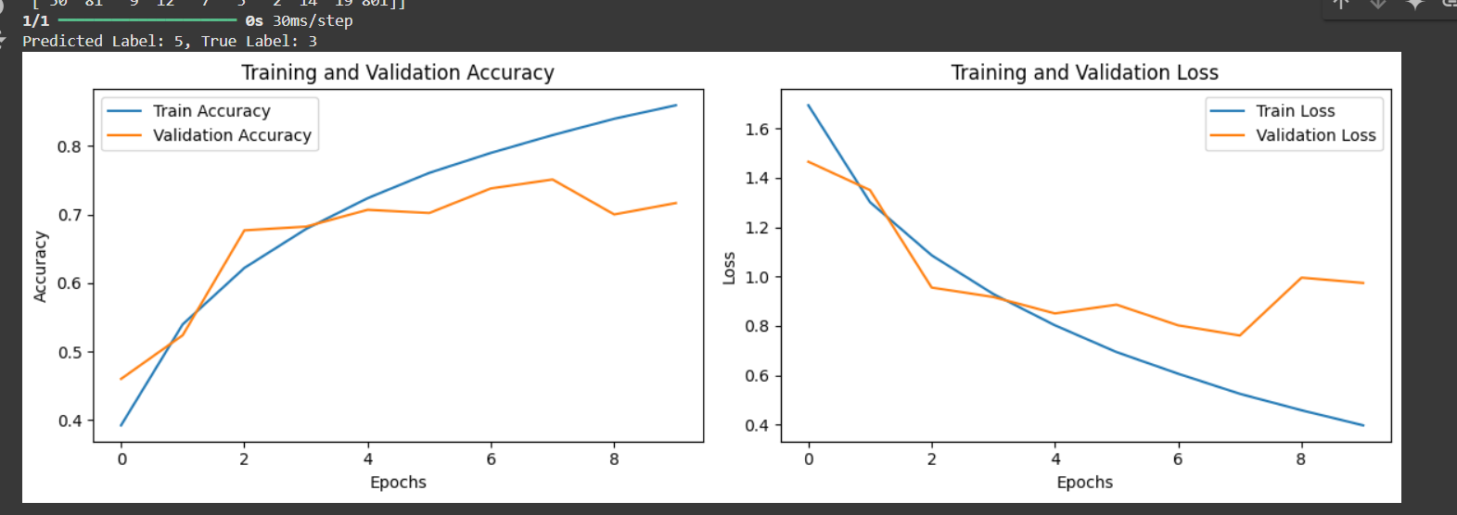
CNN Classification - Classification Report
Adam: Precision = 0.77, Recall = 0.76, F1-score = 0.76
SGD: Precision = 0.75, Recall = 0.75, F1-score = 0.75
Confusion Matrix
Class | Adam: True Positives | Adam: False Negatives | SGD: True Positives | SGD: False Negatives
0 | 815 | 185 | 790 | 210

Slide 15
Final Discussion & Conclusion
ANN Classification:
Adam provides faster convergence and better results than SGD.
Linear Regression:
Mini-Batch Gradient Descent offers optimal performance with fewer epochs.
CNN Classification:
Adam optimizer outperforms SGD in terms of accuracy, training time, and loss.

