Slide 1
GO FISH 2.0
Autonomous Fish-Following Robot
HSV vision + LiDAR sensing on a Raspberry Pi, driving a VEX V5 chassis through a maze while tracking a goldfish in real time.
Madison Carney & Alexis Phan
Ocean Lab, P6
Navya Arora & Esha Madamalla
Sys Lab, P7

Slide 2
Objective
Build an autonomous robot that navigates a maze while tracking a live goldfish target in a tank above it — using HSV color vision for the fish and LiDAR for the walls, all running in real time on a Raspberry Pi.
The same robot doubles as the data-collection rig for an oceanography study on goldfish learning.
Robotics
Computer Vision
Oceanography
Go Fish 2.0 · Systems & Ocean Lab 2026
1 / 27

Slide 3
Hypothesis
If
goldfish are trained with spaced repetition and built-in breaks,
then
they will learn the task faster and retain the association longer than fish trained in longer, less frequent sessions.
The robot serves as the consistent measurement instrument that makes this comparison possible — every fish is tracked the same way, every session.
Go Fish 2.0 · Systems & Ocean Lab 2026
2 / 27

Slide 4
Justification — Biological
Goldfish navigate using landmarks, environmental cues, and associative memory.
Their lateral pallium is homologous to the mammalian hippocampus — the same region responsible for spatial memory and navigation.
Prior work has already shown that goldfish can be taught to navigate to a target zone (2022 navigation experiment).
We extend this line of work by measuring movement objectively, instead of relying on visual observation.
Takeaway: there is biological reason to expect goldfish to learn a spatial task — and reason to measure it more precisely.
Go Fish 2.0 · Systems & Ocean Lab 2026
3 / 27

Slide 5
Justification — Technical
Manual observation of fish movement is inconsistent, time-consuming, and imprecise.
An HSV-based computer-vision system enables continuous, real-time tracking of the fish's position from an overhead camera.
Adding a 360° LiDAR lets the robot map the maze around it without colliding into walls — something a camera alone cannot reliably do.
Running everything on a Raspberry Pi keeps the system inexpensive, repeatable, and accessible.
Together: a quantitative, automated way to collect movement data across many fish and many sessions.
Goal of the technical stack: reliable data, not impressive ML. The simplest detector that works is the right detector.
Go Fish 2.0 · Systems & Ocean Lab 2026
4 / 27

Slide 6
Relevant Studies
Crawford et al.
Blane et al.
Yang et al.
FINDING
FINDING
FINDING
Structured training schedules improve learning speed and retention in fish.
Goldfish learn behaviors through social cues; movement reflects learning.
Spaced repetition improves memory and long-term retention.
RELEVANCE
RELEVANCE
RELEVANCE
Justifies our two training schedules.
Confirms tracking movement is a valid proxy for learning.
Informs our spacing comparison.
LIMITATION
LIMITATION
LIMITATION
Relied on manual observation — limited precision.
No quantitative, real-time tracking.
Not paired with automated behavioral tracking.
Go Fish 2.0 · Systems & Ocean Lab 2026
5 / 27

Slide 7
PART 1
Robot & Code
The hardware, the sensors, the loop that ties them together.
6 / 27

Slide 8
Chassis Design — Model 1
First Prototype
Pros
Generous open frame — room for Pi, LiDAR, and cabling
Four-wheel layout for stable forward motion
Cons
Hard to secure the tank mount to the body
Frame lacked enough support for the loaded water tank
Top-down schematic
Go Fish 2.0 · Systems & Ocean Lab 2026
7 / 27

Slide 9
Chassis Design — Model 2 (current)
Reinforced Design
ADOPTED
Pros
Strong structural support — handles water-tank weight without flex
More resistant to damage; the tank mount stays seated
Cons
Denser frame leaves less room to route wiring
Some Pi / LiDAR cabling had to be re-planned around supports
Cross-bracing for tank load
Go Fish 2.0 · Systems & Ocean Lab 2026
8 / 27

Slide 10
What Was Built Last Year
Last year's system was a starting point, not a finished product. Here is what actually ran on it:
Detection used HSV color filtering — YOLO was tested but dropped because it was too slow on the Pi.
Raspberry Pi processed the camera feed and sent commands to an Arduino Mega.
The Arduino drove stepper motors using time-based pulses (run for X ms).
LiDAR was proposed but never fully integrated into the loop.
Movement was inconsistent — overshoot and drift were common, and there was no obstacle awareness.
Key takeaway: HSV ran reliably; the rest of the pipeline (motor control, obstacle handling) was the weak link.
Go Fish 2.0 · Systems & Ocean Lab 2026
9 / 27

Slide 11
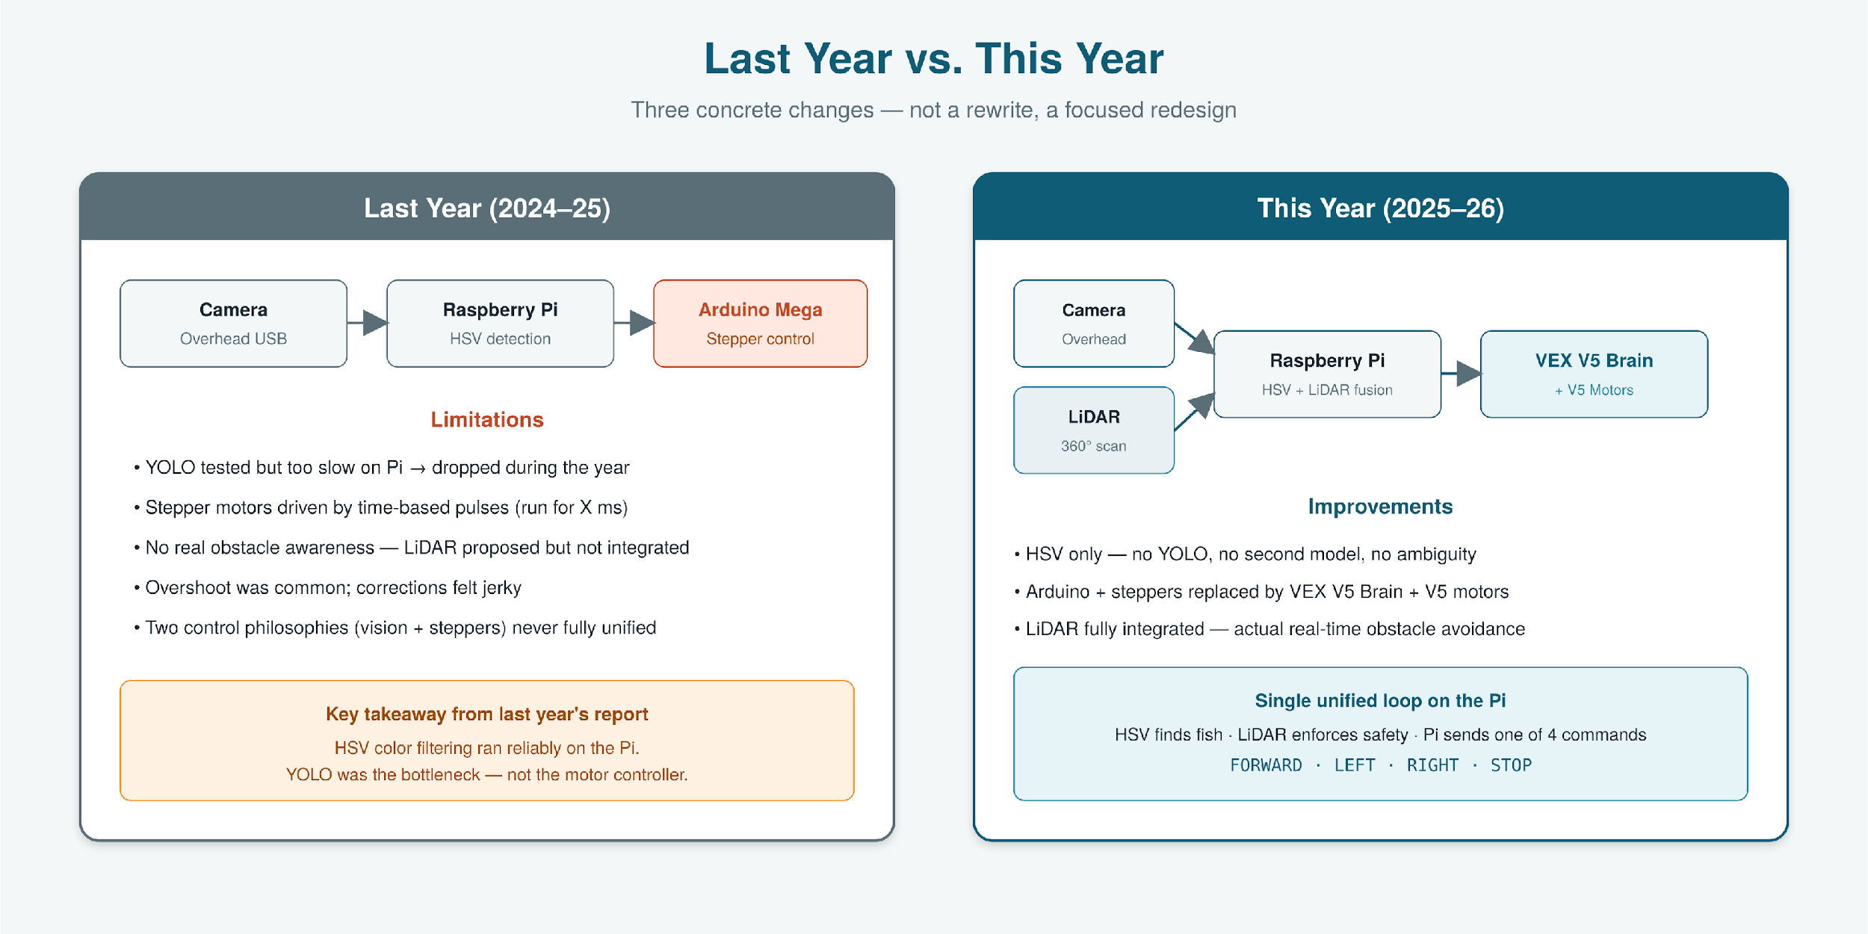
How This Year Improves the System
Go Fish 2.0 · Systems & Ocean Lab 2026
10 / 27

Slide 12
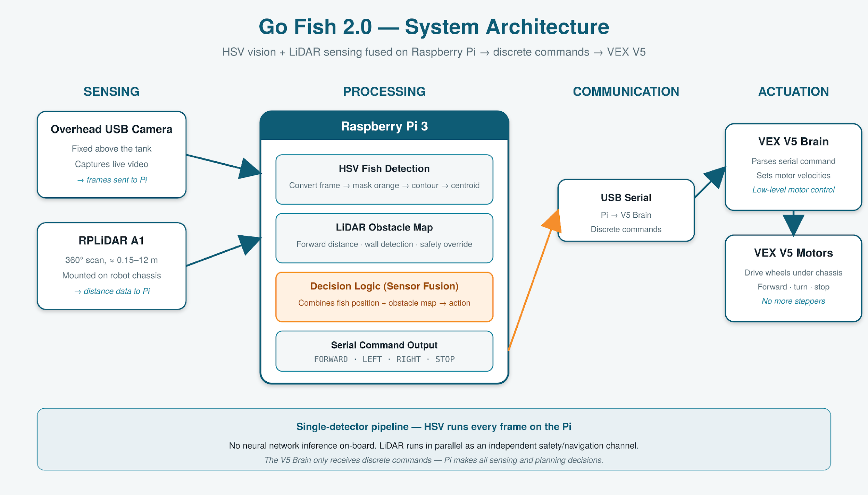
System Architecture
Go Fish 2.0 · Systems & Ocean Lab 2026
11 / 27

Slide 13
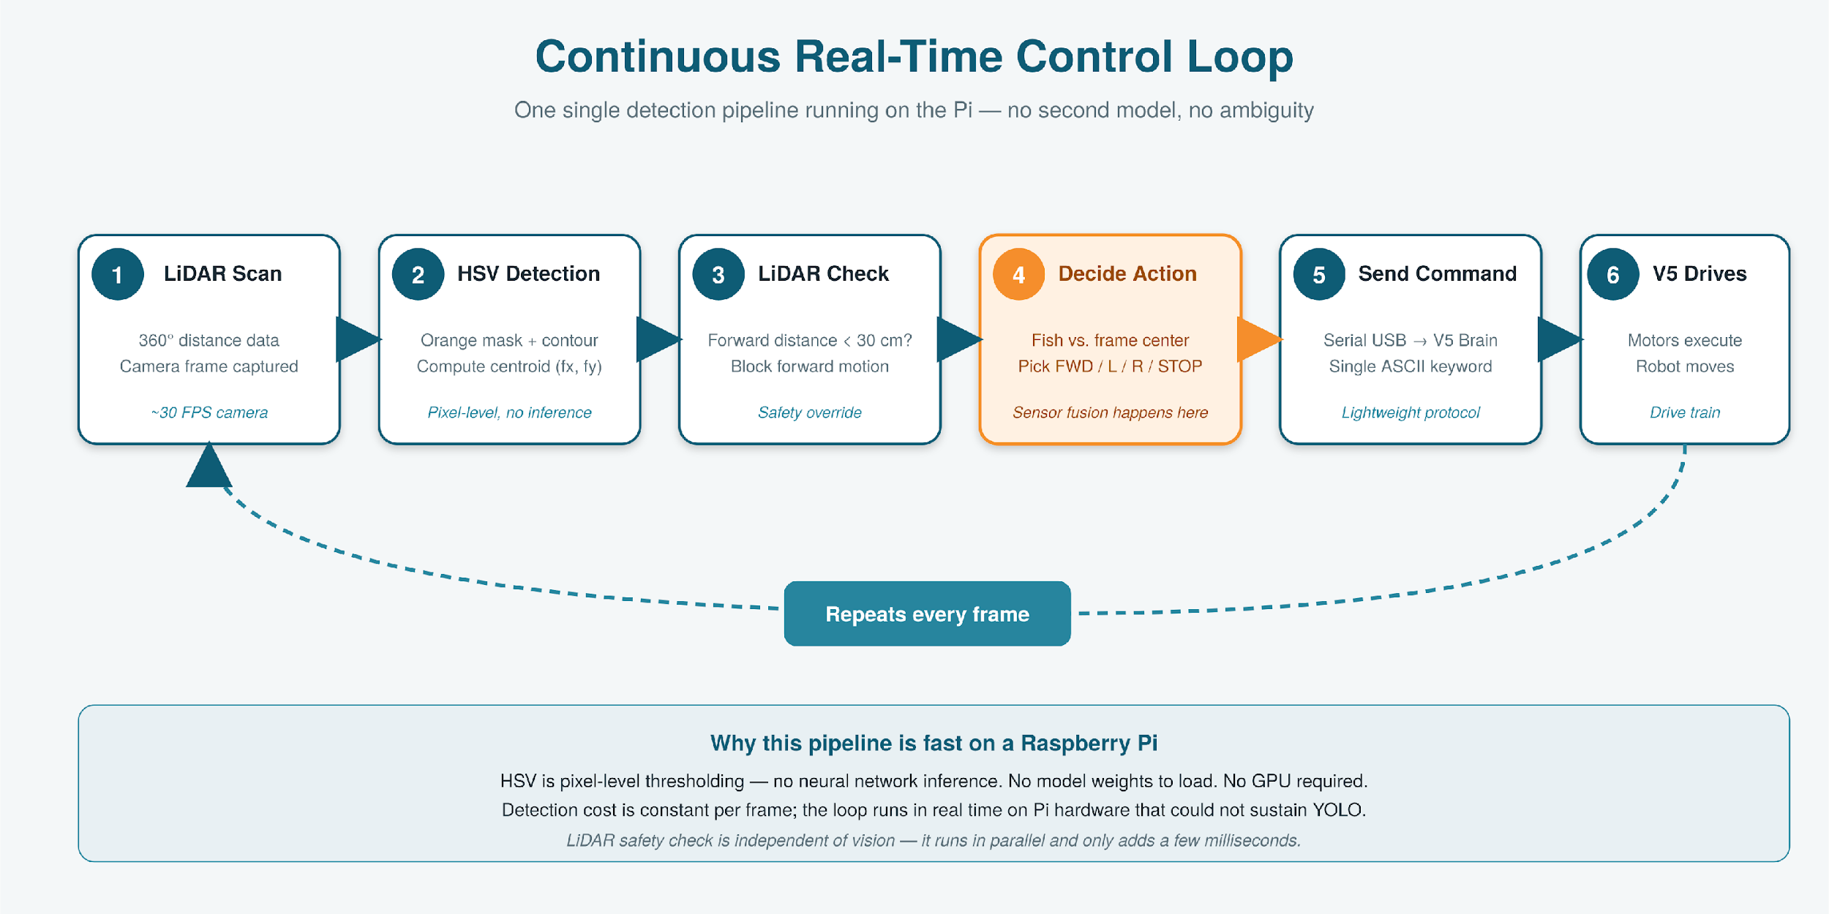
Real-Time Control Loop
Go Fish 2.0 · Systems & Ocean Lab 2026
12 / 27

Slide 14
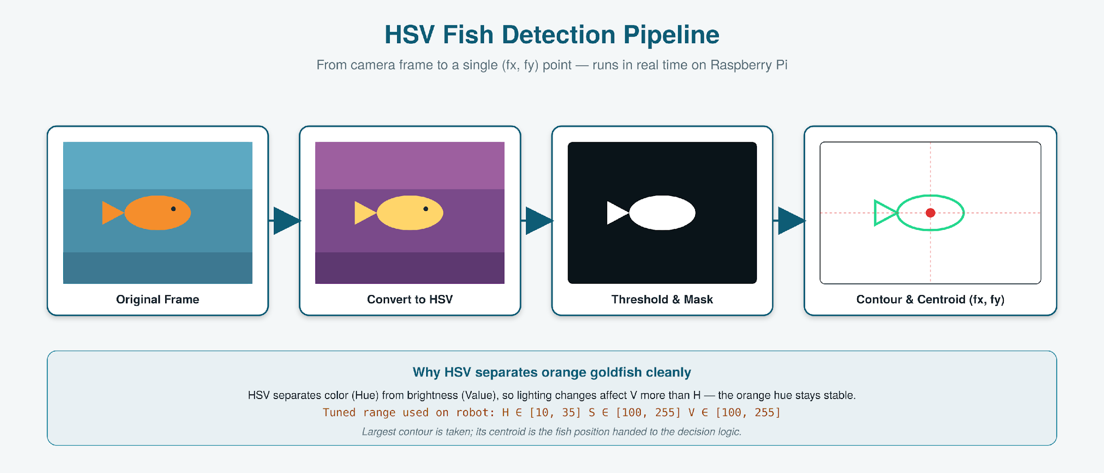
HSV Fish Detection
Go Fish 2.0 · Systems & Ocean Lab 2026
13 / 27

Slide 15
Why HSV — and Only HSV
HSV gives us everything we need
Why we did not run YOLO this year
Pixel-level thresholding — no neural network inference
No model weights to load — boots and runs immediately
Very low CPU load — leaves headroom for LiDAR processing
Real-time frame rate on Pi 3 — no GPU required
Orange goldfish in a fixed tank = ideal target for color thresholding
YOLO inference on a Pi 3 is the bottleneck — ~0.2–0.5 s per frame (2–5 FPS).
No control change downstream (velocity or discrete commands) can speed up detection — the slowest step sets the loop speed.
Running HSV + YOLO together on every frame would be slower than YOLO alone — strictly worse than the choice we made.
Our goldfish are a fixed bright color in a controlled tank, so HSV is sufficient on its own.
Go Fish 2.0 · Systems & Ocean Lab 2026
14 / 27

Slide 16
LiDAR — Hardware
RPLiDAR A1M8
WayPonDEV — 2D laser scanning sensor
Measurement
2D LiDAR (laser scanning)
Range
≈ 0.15 m – 12 m
Accuracy
± 1–2 cm short range; decreases with distance
Coverage
Full 360° scan, ~5–10 Hz
Output
Distance per angle, millimeters (we convert to cm)
360° around the chassis
Go Fish 2.0 · Systems & Ocean Lab 2026
15 / 27

Slide 17
LiDAR — Safety & Obstacle Avoidance
Pi reads the forward-facing LiDAR distance every cycle.
Distance is converted from millimeters to centimeters.
If forward distance < 30 cm and the action is FORWARD, the Pi suppresses FORWARD and sends STOP instead.
Below 20 cm, the Pi sends STOP unconditionally — emergency halt.
The V5 Brain only ever sees post-safety commands; it does not need to know about LiDAR.
Pi-side safety override
fwd_cm = lidar_forward()
action = decide(fish_pos, frame)
if action == "FORWARD":
if fwd_cm < 20:
action = "STOP"
elif fwd_cm < 30:
action = "STOP"
send_serial(action) # → V5 Brain
Go Fish 2.0 · Systems & Ocean Lab 2026
16 / 27

Slide 18
Pi → VEX V5 Communication
Instead of computing motor velocities on the Pi, we let the V5 Brain handle low-level motor control. The Pi sends a single ASCII keyword over USB serial; the V5 program looks it up and drives the motors. This keeps the Pi free for vision and LiDAR.
FORWARD
LEFT
RIGHT
STOP
Both drives forward at fixed speed
Pivot in place — right > left
Pivot in place — left > right
All motors to zero
Why discrete commands here
• Easier to reason about while debugging the maze run
• No floating-point command stream to parse on the V5
• The V5's onboard PID handles the smoothness we used to fake in software
Go Fish 2.0 · Systems & Ocean Lab 2026
17 / 27

Slide 19
PART 2
Training
Six goldfish, two schedules, one tracking system.
18 / 27

Slide 20
The Goldfish
1
2
3
Mr. Hannum Jr
Melvin
Boo
4
5
6
Home Depot
Big Stuff
Bob
Go Fish 2.0 · Systems & Ocean Lab 2026
19 / 27

Slide 21
Materials & Methods
10 / 03 / 25
10–12 / 25
12 / 05 / 25
Wed & Fri
Tanks set up
2-month cycling
Goldfish introduced
Weekly training
Materials
Tank & Setup
VEX V5 robotics kit (chassis + brain + motors)
Raspberry Pi 3, USB camera, RPLiDAR A1
12″ × 12″ × 12″ glass tank, filter, black foam board
Water testing kit, goldfish pellets
Tanks cycled for ~2 months before introducing fish
Black foam board reduces reflections during tracking
Overhead USB camera mounted above each session tank
Same lighting setup for every session — keeps HSV thresholds stable
Go Fish 2.0 · Systems & Ocean Lab 2026
20 / 27

Slide 22
Training Groups
Group 1
Group 2
Once weekly
Twice weekly
Wednesdays only
Wednesdays & Fridays
10 minutes per fish
5 minutes per fish
2 minutes on / 2 minutes off
No breaks during the session
3 goldfish in this group
3 goldfish in this group
Go Fish 2.0 · Systems & Ocean Lab 2026
21 / 27

Slide 23
Training Schedule
Wednesday · Groups 1 + 2
Friday · Group 2 only
10:25–10:40
Acclimate fish 1; set up robot & maze
10:25–10:45
Acclimate fish 2; set up robot & maze
10:40–10:55
Train fish 1; acclimate fish 4
10:45–11:00
Train fish 2; acclimate fish 4
10:55–11:10
Train fish 4; acclimate fish 5
11:00–11:15
Train fish 4; acclimate fish 5
11:10–11:25
Train fish 5; acclimate fish 2
11:15–11:30
Train fish 5; cleanup, record data
11:25–11:30
Reset for Group 2
11:30–11:40
Train fish 2; acclimate fish 3
11:40–11:50
Train fish 3; acclimate fish 6
11:50–12:00
Train fish 6; cleanup, record data
Go Fish 2.0 · Systems & Ocean Lab 2026
22 / 27

Slide 24
Linking Training to Tracking
Training side
Tracking side
Fish learn to approach food cues at a specific zone of the tank.
Robot follows the fish in real time, recording where it goes.
Spaced repetition + reward
Predictable behavior over time
Movement patterns reveal learning
HSV detection every frame
Position logged automatically
Same instrument for every fish
Training ensures the behavior; tracking turns that behavior into data.
Go Fish 2.0 · Systems & Ocean Lab 2026
23 / 27

Slide 25
Results
What we observed
91%
The robot corrected its path in real time as the fish moved — no manual intervention during sessions.
Repeated food-based conditioning increased movement toward the target zone over time, suggesting early associative learning.
Shorter, more frequent sessions (Group 2) kept fish more responsive than longer sessions with breaks (Group 1).
LiDAR successfully prevented the robot from contacting maze walls during sessions.
average HSV fish-tracking rate
Over all training sessions
across 6 fish, 2 schedules
Go Fish 2.0 · Systems & Ocean Lab 2026
24 / 27

Slide 26
Conclusion
Built an autonomous fish-following robot that runs entirely on a Raspberry Pi and VEX V5 stack — no Arduino, no steppers, no second detector.
HSV color tracking proved sufficient for orange goldfish in a controlled tank; the simpler detector kept the loop real-time.
Integrating LiDAR turned the robot from a follower into a maze navigator — the missing piece from last year is now part of every cycle.
Used the robot as the measurement instrument for an oceanography learning study across two training schedules.
Early evidence: shorter, more frequent sessions outperformed longer spaced ones with breaks.
The simplest detector that works is the right detector — pairing it with LiDAR did more for performance than any model upgrade would have.
Go Fish 2.0 · Systems & Ocean Lab 2026
25 / 27

Slide 27
Future Work
1
Predictive tracking
Add a Kalman filter so the robot can lead the fish slightly rather than chase it, smoothing motion when the fish darts.
2
Multi-fish tracking
Extend HSV detection to track multiple fish simultaneously, comparing individual learning curves directly.
3
Larger / dynamic mazes
Use LiDAR to build a live occupancy map for mazes too big to memorize, enabling reconfigurable test environments.
4
More training schedules
Run more spacing variants and longer studies to test how durable the learning effect is over weeks, not days.
5
Open-source release
Package the HSV + LiDAR pipeline and V5 communication code so other labs can run the same experiment.
Go Fish 2.0 · Systems & Ocean Lab 2026
26 / 27

Slide 28
Thank you.
We'd like to thank…
Dr. Stickler
for being our wonderful lab director
Dr. Yilmaz
for helping us with the code
Mr. Seyler
for help designing and building the robot
Mr. Hannum & Dr. Linch
for their aura
The Ocean Lab
for support and feedback throughout the year
27 / 27

