Slide 1


Pharma
Welcome to our innovative website, where we showcase our pharmaceutical expertise and cutting-edge solutions. Explore our world-class products and services designed to improve your health and well-being.

Slide 2
WEB PAGE:
HEADER
A website header is a visual typographic strip or menu that typically runs across the top of a website.
FOOTER
The website footer is the section of content at the very bottom of a web page.
1
2
3
MAIN BODY
the main part of a web page, where information and content are presented to visitors.

Slide 3
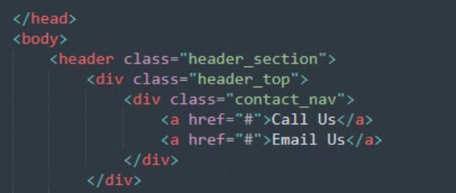
header:
write the basic starting pattern of html by using <html tag
first we have used nav bar in which we have added div bar and also added class
then we use <a tag with href attribute to creates a hyperlink to web pages

Slide 4
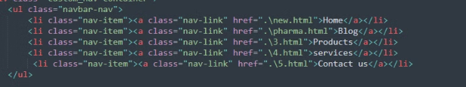
then we have used <ul bar to created unordered lists
after this we used <li bar to list items like home, blog, products, services and contact us
<a> tag is also used here with href attribute to specifying the URL

Slide 5
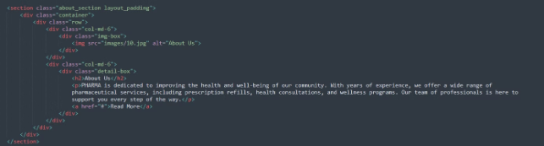
main body:
<section tag is a structural HTML element used to group together related elements.
we use <img tag also for embed an image in a web page
the <h2> heading will generally appear slightly smaller in font than the <h1> heading.
<p> tag creates a paragraph on our webpage

Slide 6
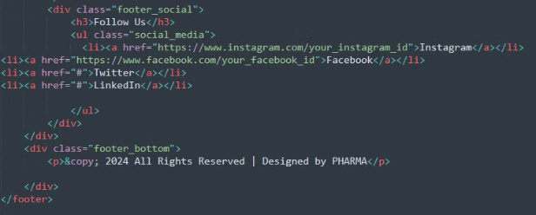
footer:
in the bottom of page we use <footer to help visitors by adding information and navigation options at the bottom of web pages.
we use a &copy also as it is an HTML entity that represents the copyright symbol (©).

Slide 7

Blogs:
Services:
Check out our blog for the latest health tips, medication updates, and medical news. We share expert advice and useful information to help you stay informed and healthy.
We provide various services to support your health, including personalized consultations, prescription management, and home delivery.
Products:
contact us:
At PHARMA, we offer a wide range of modern medicines to meet your health needs. Our products are developed with the latest research to ensure they are safe and effective.
If you have any questions or need help, visit our Contact Us page. You can reach us by phone, email, or through our online form. We’re here to assist you with any inquiries you may have.

Slide 8
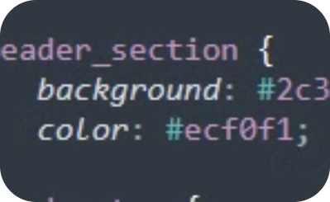
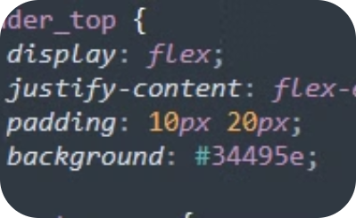
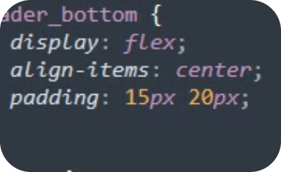
header_section
header_top
header_bottom
In CSS styling, the header-top and header-bottom sections are used to organize and style different parts of the header for better layout and design control.

Slide 9
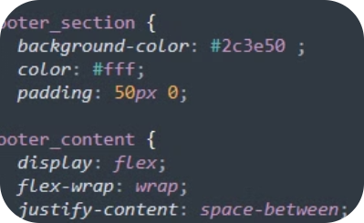
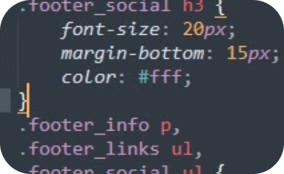
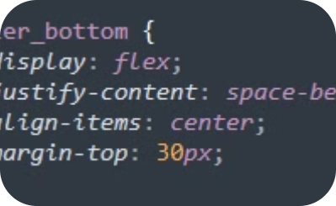
footer_section
footer_content
footer_bottom
In CSS styling, the footer-section and footer-bottom sections are used to organize and style different parts of the header for better layout and design control.

Slide 10
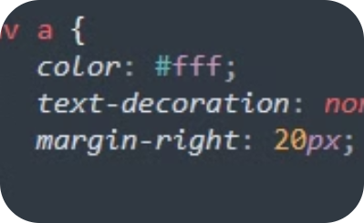
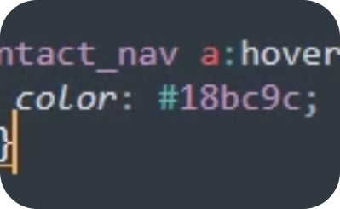
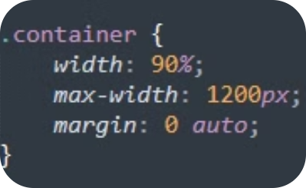
.nav
body
.container
In CSS styling nav use to style different parts, container wraps content to control layout and spacing, ensuring consistent design across different screen sizes and hover effect is used to change the appearance of an element when a user hovers their cursor over it.

Slide 11
FINAL PROJECT
WEBSITE (PHARMA)
DUA ASHFAQ (SP24-BSCS-0079)
ESHAAL ATIF (SP24-BSCS-0087)
HAREEM RAFIQ (SP24-BSCS-0062)
AMNA IMAM (SP24-BSCS-0058)

