Slide 1


SMART INDIA HACKATHON 2025
Problem Statement ID : 25030
Problem Statement Title :Al-Based Crop Recommendation for Farmers
Theme :Agriculture & Rural Development
PS Category : Software
Team ID :
Team Name :Solvocrats
1

Slide 2


Proposed Solution:
Solvocrats
AI-based system to recommend the most suitable crop.
Inputs: soil parameters (N, P, K, pH, organic carbon) + weather conditions. Integrate real-time weather & market price APIs.
Suggest alternate crops to reduce failure risk. Predict yield, profitability, and give decision insights. Provide farmer-friendly mobile app.
Low-cost, scalable, and easy to adopt in rural India. Suggest actionable steps (e.g., fertilizer use, pH balance).
2

Slide 3

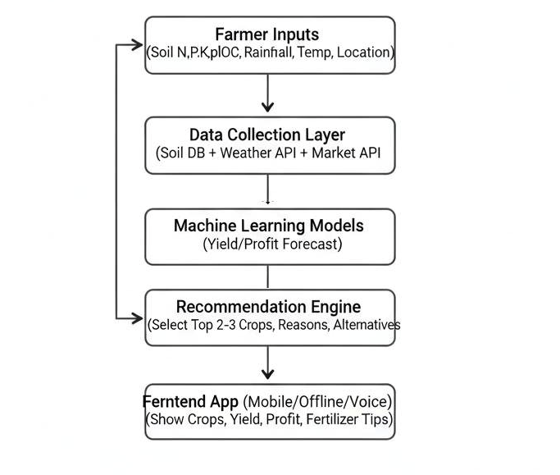
TECHNICAL APPROACH
Solvocrats
Technologies to be used :
Frontend: React Native / Flutter (mobile app) Backend: FastAPI/Flask (Python)
ML Models:
Soil & crop suitability:
Yield & profit forecast: LSTM/Random Forest.
Firebase APIs: OpenWeatherMap API
SoilDatabase Deployment: Stream Lit Cloud
Methodology:
Soil parameters (manual entry or defaults from regional data) Weather info (API-based)
Farmer location
Pre-trained classification model predicts suitable crops Considers soil + weather + historical yield data
Output Recommends 1-3 best crops with reasons
Shows expected yield and profitability

Slide 4
FEASIBILITY & SCALABILITY
Solvocrats
Feasibility:
Works offline-first , sync when online. use existing datasets and & APIs.
CHALLENGES :
Low connectivity in villages.
Limited digital literacy among rural farmers. Language barrier
Strategies to overcome:
Voice assistant, multilingual support Use location based soil parameters.
→ easy usability.

Slide 5
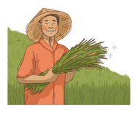
IMPACT AND BENEFITS
Solvocrats
IMPACT ON TARGET AUDIENCE :
Replace traditional work with ai making farming more reliable. Farmers: Higher income, better crop decisions.
Government: less burden of subsidies/loan waivers..
Benefits:
Farmers earn 8-10% higher margin.
Reduce financial risks and achieve consistent earnings. Efficient resource use.

Slide 6
RESEARCH AND REFERENCES
Solvocrats
Kaggle Crop Recommendation Dataset - Public dataset for training ML crop models.
https://www.kaggle.com/datasets/atharvaingle/crop-recommendation-dataset
ICAR (Indian Council of Agricultural Research) Research on crop productivity & soil. data. https://icar.org.in
FAO (Food and Agriculture Organization) Reports on sustainable crop suitability. https://www.fao.org Research Papers on ML in Agriculture (Springer, IEEE, Elsevier) Studies on Al for crop prediction. https://link.springer.com
https://ieeexplore.ieee.org https://www.sciencedirect.com

