Slide 1
LABMENTIX · CYBERSECURITY TRAINING PROGRAM
Caesar & Vigenère
Cipher Tool
PLAINTEXT
Meet at the old bridge at midnight
+3
Cipher Desk: encrypt, decrypt and break classical ciphers entirely in the browser
CIPHERTEXT
Phhw dw wkh rog eulgjh dw plgqljkw
Mohammed Eshaan
Trainer: Ganesh Kuche | Batch: 1 September 2026
Notes:
Introduce the project: Cipher Desk is a single-file, offline web tool that encrypts, decrypts and breaks the Caesar and Vigenère ciphers.

Slide 2


INTRODUCTION
Why classical ciphers?
The lesson
The gap
Caesar and Vigenère are no longer secure, yet they show the ideas behind modern cryptanalysis: key space, frequency analysis and statistical attacks.
Learners read about frequency analysis without seeing it work. Most online tools only encrypt and decrypt, need a known key, or send the text to a server.
Cipher Desk: one offline, self-contained tool that encrypts with a chosen key, then attacks the result automatically without it.
Cipher Desk | Labmentix Cybersecurity Training Program
2
Notes:
Classical ciphers are not secure, but they teach the ideas behind modern cryptanalysis. The gap: most tools only encrypt/decrypt, need a key, or send text to a server.

Slide 3
INTRODUCTION
Project objectives
1
Implement Caesar and Vigenère encryption and decryption that preserve case, spaces, digits and punctuation
2
Build an automatic Caesar breaker using chi-squared scoring against English letter frequencies
3
Build an automatic Vigenère breaker: Index of Coincidence for key length, per-column frequency analysis for the key
4
Design a clear, responsive interface with six modes (encrypt, decrypt, break for each cipher) and one-click copy
5
Test correctness and measure how reliable the breakers are as the ciphertext gets shorter
Cipher Desk | Labmentix Cybersecurity Training Program
3
Notes:
Five objectives, from correct encryption to measuring how reliable the breakers are.

Slide 4





TOOLS AND ENVIRONMENT
Tools & environment
HTML5 / CSS3
Vanilla JavaScript (ES6)
Web browser
Node.js 24.18.1
Google Fonts
Page structure and responsive layout with grid and flexbox
All cipher logic, statistics and UI wiring
Running and manually testing the tool
Repeatable tests of the core functions outside the browser
Spectral and JetBrains Mono, with Georgia and system monospace fallbacks
One file: index.html. Markup, stylesheet and script together, with no build step, framework or backend. All processing happens on the user’s device, so no text or key is sent over the network.
Cipher Desk | Labmentix Cybersecurity Training Program
4
Notes:
Everything is one HTML file. Node.js is used only for repeatable tests of the core functions.

Slide 5
METHODOLOGY
How Cipher Desk works
Caesar
Shift one character
Encrypt / decrypt
Break
caesarShiftChar keeps case; non-letters pass through
Decrypt is encrypt with the negative shift
Try all 26 shifts, rank with chi-squared, report the best
26 keys
Vigenère
Keyword
Encrypt / decrypt
Break
Cleaned to A–Z; key index advances only on letters
Decrypt builds an inverse key (26 minus value)
IC finds the key length; each column is solved as a Caesar cipher
keyword
Six modes in the sidebar: Encrypt, Decrypt and Break for each cipher. Only the letters A–Z change.
Cipher Desk | Labmentix Cybersecurity Training Program
5
Notes:
Both ciphers share one shift function. Decryption reuses encryption, and the Vigenère breaker reuses the Caesar breaker on each column.

Slide 6
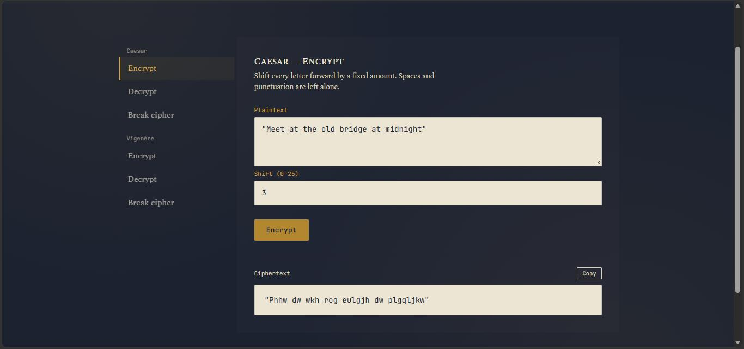
METHODOLOGY
Caesar: encrypt & decrypt
function caesarShiftChar(ch, shift){
const s = ((shift % 26) + 26) % 26;
const code = ch.charCodeAt(0);
if (ch >= 'A' && ch <= 'Z')
return ALPHABET[(code-65+s) % 26];
else if (ch >= 'a' && ch <= 'z')
return ALPHABET[(code-97+s) % 26]
.toLowerCase();
return ch; // non-letters unchanged
}
Caesar Encrypt tab: shift 3 turns “Meet at the old bridge at midnight” into “Phhw dw wkh rog eulgjh dw plgqljkw”
Only A–Z are changed; case, spaces, digits and punctuation pass through
Decrypt calls encrypt with the negative shift, so there is one piece of logic to verify
26
possible shifts: a tiny key space
Cipher Desk | Labmentix Cybersecurity Training Program
6
Notes:
One function shifts a single character. A double modulo keeps negative shifts valid, so decryption is simply the negative shift.

Slide 7
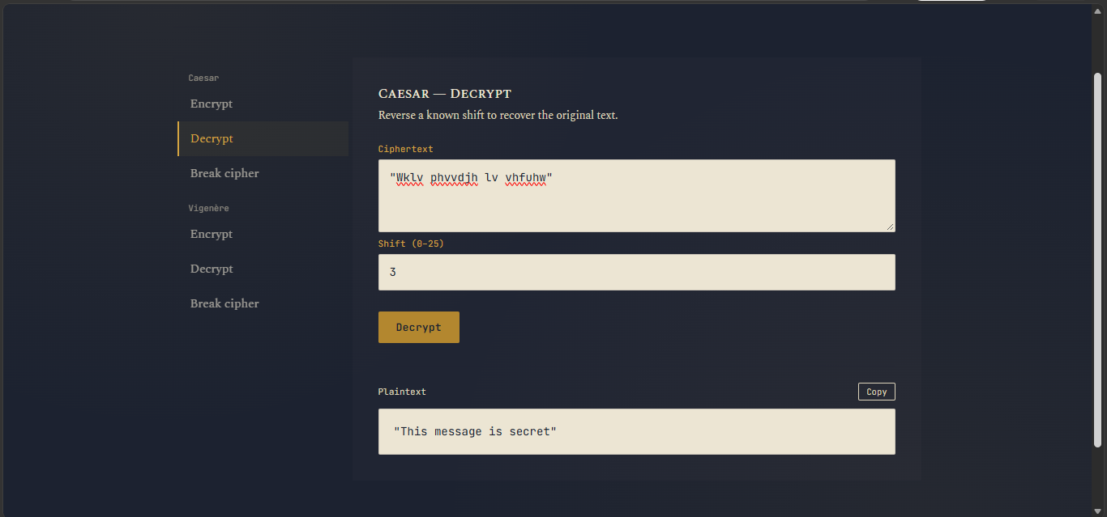
METHODOLOGY
Breaking Caesar
1
Decrypt the text with every shift, 0 to 25
2
Score each candidate: chi-squared of its letter counts against English frequencies
3
The lowest score is the most English-like; that shift is reported
Caesar tab: “Wklv phvvdjh lv vhfuhw” becomes “This message is secret” with shift 3
for (const letter of ALPHABET){
const observed = counts[letter] || 0;
const expected = ENGLISH_FREQ[letter]
/ 100 * n;
score += (observed - expected) ** 2
/ expected;
}
E 12.7%
T 9.1%
letter E in English
letter T in English
Cipher Desk | Labmentix Cybersecurity Training Program
7
Notes:
With only 26 keys, the breaker decrypts with every shift and scores each candidate against English letter frequencies. Lowest chi-squared wins.

Slide 8
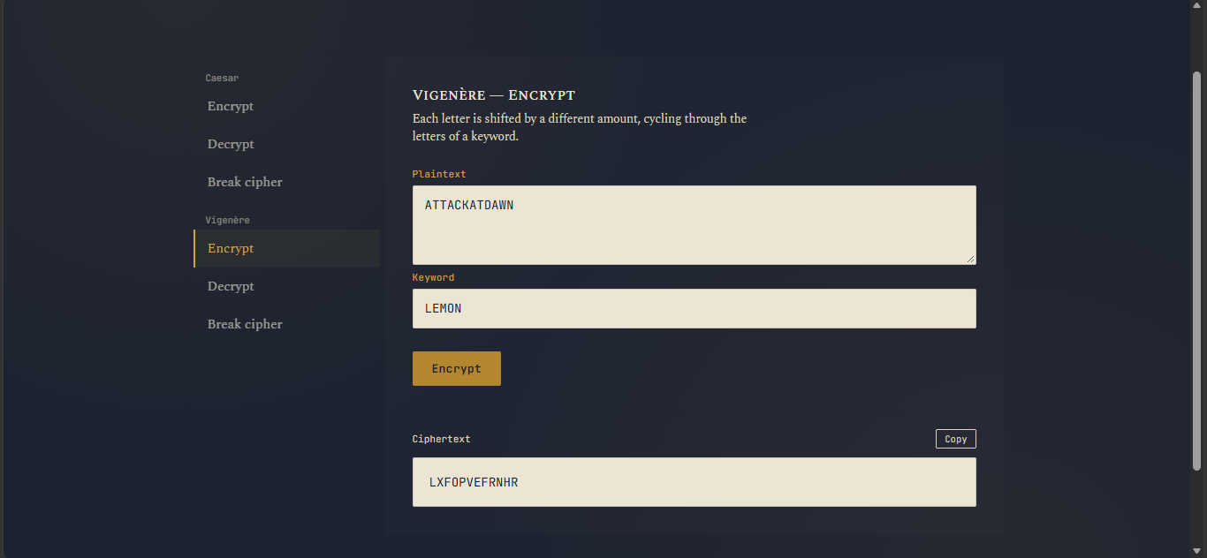
METHODOLOGY
Vigenère encryption
Keyword is cleaned to letters only and converted to upper case
Each letter is shifted by the next key letter; spaces and punctuation do not use up key characters
Decrypt builds an inverse key (26 minus each value) and reuses encrypt
const shift = key.charCodeAt(
keyIndex % key.length) - 65;
result += caesarShiftChar(ch, shift);
keyIndex++; // only for letters
Vigenère Encrypt tab with keyword LEMON: ATTACKATDAWN becomes LXFOPVEFRNHR
Standard test vector: ATTACKATDAWN + LEMON = LXFOPVEFRNHR
Cipher Desk | Labmentix Cybersecurity Training Program
8
Notes:
Each letter is shifted by the next key letter. The key index only advances on letters. Verified with the standard ATTACKATDAWN / LEMON vector.

Slide 9
METHODOLOGY
Breaking Vigenère
1
2
3
4
Split
Score with IC
Solve columns
Decrypt
For each length k, split the letters into k columns
Average the columns’ IC; the highest average gives k
Each column is a Caesar cipher; its shift is a key letter
The recovered key goes to vigenereDecrypt; show key and plaintext
0.067
0.038
IC = Σ f(f−1) / N(N−1)
IC of English text
IC of random letters
chance that two random letters match
Cipher Desk | Labmentix Cybersecurity Training Program
9
Notes:
Two stages: estimate the key length with the Index of Coincidence, then solve each column as its own Caesar cipher.

Slide 10
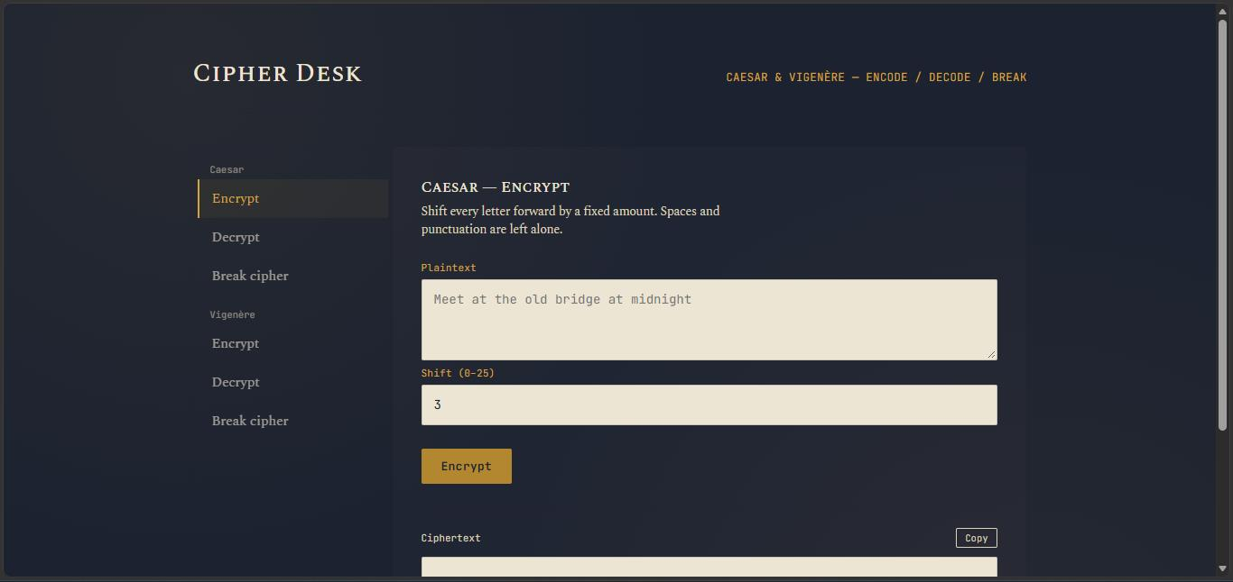
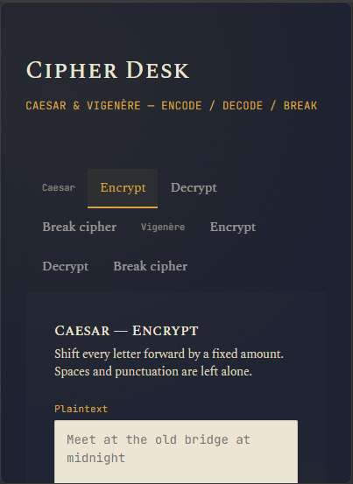
METHODOLOGY
The interface
Desktop: sidebar tabs and the active panel
Narrow (mobile-width) window
Six modes · one column below 720 px · output via textContent, never innerHTML · one-click Copy
Cipher Desk | Labmentix Cybersecurity Training Program
10
Notes:
Two-column desk: sidebar tabs on the left, active panel on the right. Collapses to one column under 720 px. Results are written with textContent, never innerHTML.

Slide 11



METHODOLOGY
Testing approach
Known vectors
$ node test.js
Vig enc LEMON: LXFOPVEFRNHR
rt caesar 0/1/13/25: true
rt vig ("Key-Word!"): true
break caesar, shifts 3/7/19: recovered correctly
ATTACKATDAWN + LEMON must give LXFOPVEFRNHR
Round trips
decrypt(encrypt(x)) = x for Caesar shifts 0, 1, 13, 25 and Vigenère key “Key-Word!”
578
6
Breaker trials
Opening paragraph of A Tale of Two Cities (578 letters), six keys, cut to different lengths
letters in the test passage
keys: LEMON, CIPHER, KEY, SECURITY, SHIELD, VAULT
Cipher Desk | Labmentix Cybersecurity Training Program
11
Notes:
The core functions were copied into a Node.js script and tested with known vectors, round trips, and breaker trials on a 578-letter passage.

Slide 12
RESULTS
How much text is enough?
0/6
1–3/6
4/6
5/6
6/6
6/6
keys correct
keys correct
keys correct
keys correct
keys correct
keys correct
100 letters
150–250
300–400
450
500
578
Ciphertext length, six keys tested (LEMON, CIPHER, KEY, SECURITY, SHIELD, VAULT)
Below about 300 letters: unreliable
From about 500 letters: 6 of 6
A 100-letter text with a 5-letter key leaves about 20 letters per column, too few to trust letter counts.
The plaintext was recovered for every key at 500 and 578 letters.
Cipher Desk | Labmentix Cybersecurity Training Program
12
Notes:
Vigenère breaker reliability by ciphertext length across six keys. Unreliable below about 300 letters; 6 of 6 at 500 letters and above.

Slide 13



RESULTS
Key findings
Exact encryption and decryption
Caesar breaker works on short text
Round trips returned the original text on a mixed sentence with capitals, digits and punctuation, and the standard test vector matched.
Correct shift found for 12-letter and 28-letter samples. Only a handful of samples were tried, so very short texts may still fail.
Detected key is often a repeat
Everything stays local
LEMON came back as LEMONLEMON… (length 20). The plaintext was still 100% correct: IC peaks at multiples of the true length (0.073 at k = 5 vs about 0.041–0.049 elsewhere).
No request carries user text, and results use textContent, so there is no injection path.
Cipher Desk | Labmentix Cybersecurity Training Program
13
Notes:
Four headline observations. The repeated-key behaviour is a display quirk: a repeated key still decrypts identically.

Slide 14
CHALLENGES
Challenges & solutions
Challenge | How it was solved
Keeping case, spaces, digits and punctuation intact | Handled upper- and lower-case ranges separately in one function; every other character is returned unchanged
Aligning the Vigenère key when text has spaces and punctuation | Advanced the key index only on letters and stripped non-letters from the keyword
Avoiding duplicate decryption logic | Caesar: negate the shift. Vigenère: build an inverse key. Both reuse the encrypt function
Ranking the 26 Caesar candidates | Chi-squared score against standard English letter frequencies; pick the minimum
Wrong keys on short ciphertext, repeated keys on long ciphertext | Tested several keys and lengths, documented the minimum useful length (about 500 letters) and noted the limitation on the page
Cipher Desk | Labmentix Cybersecurity Training Program
14
Notes:
Each challenge led to a design choice that kept the code small and testable.

Slide 15






LEARNING OUTCOMES
Learning outcomes
Shift ciphers are modular arithmetic; decryption is the same operation with a negative key
Chi-squared scoring against English letter frequencies is enough to break a 26-key cipher
The Index of Coincidence (about 0.067 English vs 0.038 random) exposes a repeating key length
Statistical attacks depend on sample size: 500 letters works, 100 fails, and measuring this is part of evaluating an attack
Building and testing a dependency-free browser tool: safe output with textContent, responsive CSS grid
Repeating keys are weak, which motivates one-time pads and modern ciphers such as AES
Cipher Desk | Labmentix Cybersecurity Training Program
15
Notes:
Six things learned, from modular arithmetic to why repeating keys motivated one-time pads and AES.

Slide 16
CONCLUSION
Conclusion & future scope
Conclusion
Future scope
All five objectives met: six modes in one offline file
Encryption and decryption exact; Caesar breaker worked on every short sample; Vigenère breaker recovered the plaintext in every trial from 500 letters
Weak spots: short Vigenère ciphertext, and a key reported in repeated form
Classical ciphers cannot protect real data, and a statistical attacker needs very little
Report the shortest key length (test divisors of the detected length)
Add Kasiski examination and an IC chart for each length
Show the top few candidate keys or shifts with their scores
Support other languages and accented letters
Add more ciphers (Atbash, Playfair, XOR) and an automated test library
Cipher Desk | Labmentix Cybersecurity Training Program
16
Notes:
Cipher Desk met all five objectives. The main weaknesses are short Vigenère ciphertext and the repeated form of the key. Future scope targets both.

Slide 17
REFERENCES
Thank you
[1] Caesar cipher (Wikipedia)
[2] Vigenère cipher (Wikipedia)
[3] Index of coincidence (Wikipedia)
[4] Letter frequency (Wikipedia)
[5] Chi-squared test (Wikipedia)
[6] Kasiski examination (Wikipedia)
[7] MDN Web Docs (HTML, CSS, JavaScript, Clipboard API)
[8] Google Fonts: Spectral and JetBrains Mono
[9] Dickens, A Tale of Two Cities (public domain)
Questions?
Mohammed Eshaan
Trainer: Ganesh Kuche | Batch: 1 September 2026
Cipher Desk | Labmentix Cybersecurity Training Program
17
Notes:
Close and invite questions.

