Slide 1

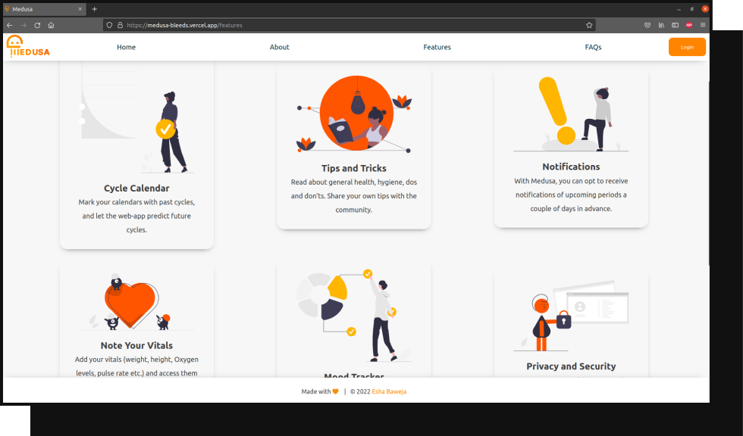
Esha Baweja | 209301151​
Assignment 3
Problem Statement: Lack of Menstrual Awareness, Health, and Hygiene.
Idea 1
MEDUSA - Menstrual Duration and Symptom Analyser (medusa-bleeds.vercel.app/) A web application designed purely with the purpose of tracking people’s hormonal cycle, keeping their vitals in check, and predicting future periods.

Slide 2
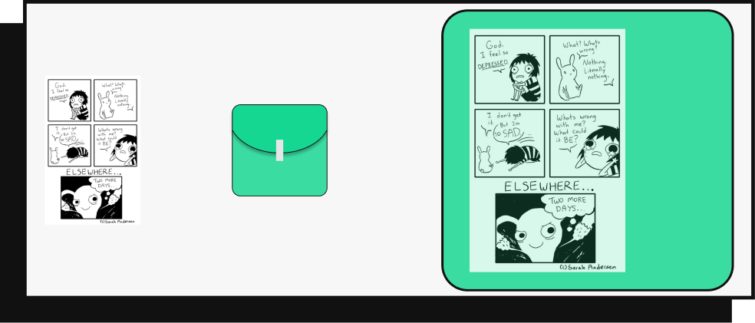
Esha Baweja | 209301151​
Assignment 3
Problem Statement: Lack of Menstrual Awareness, Health, and Hygiene ​
Idea 2
Adding useful information on sanitary pad wrappers instead of the usual adorable doodles. Or a special series of pads with such info printed all over them in the form of comics. This will make the information more readily available to kids.
+
=
Mood swings are a perfectly normal symptom of PMS!

Slide 3

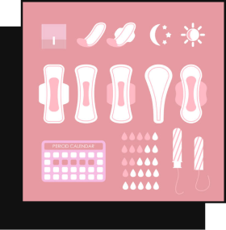
Esha Baweja | 209301151​
Assignment 3
Problem Statement: Lack of Menstrual Awareness, Health, and Hygiene ​
Idea 3
Idea 4
Interactive educational blogs where people share their experiences with PMS, menstruation, menopause, and what others should expect to happen during those times. An option to login and add your own comments to posts.
Leveraging new-age media like social network reels and YouTube channels to create and share content in the form of instructional, informative, and even autobiographical videos. These must be curated in such a way which even a 10-year-old could follow.

Slide 4


Esha Baweja | 209301151​
Assignment 3
Problem Statement: Lack of Menstrual Awareness, Health, and Hygiene ​
Idea 5
Idea 6
In order to reduce the stigma associated with periods, and to make them easier to understand, we may use gamified learning. A board game about the menstrual cycle, or an application where you earn rewards by answering questions about menses.
For those with disabilities, it may be difficult to use conventional menstrual management products like pads or cups. These can be replaced with diapers: disposable undergarments which can easily absorb the discharge while being easy to use.

Slide 5

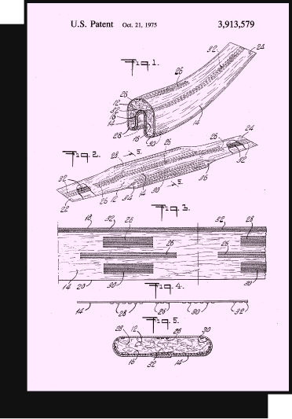
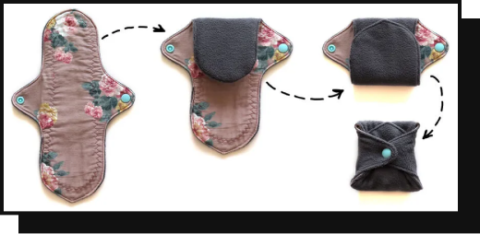
Esha Baweja | 209301151​
Assignment 3
Problem Statement: Lack of Menstrual Awareness, Health, and Hygiene ​
Idea 7
Sustainable and eco-friendly menstrual management can be achieved by switching to menstrual cups, reusable cloth napkins, or flushable pads. Such biodegradable/sustainable products would be preferred by environmentalists.

