Slide 1

MANIPAL UNIVERSITY JAIPUR
SIGN-UP INFORMATION VALIDATION
(using Python)
Name: Esha Baweja
Reg.No.: 209301151
Presented to: Mr. Jaya Krishna

Slide 2

INTRODUCTION

Slide 3
WHAT IS A SIGN-UP PAGE?
It is a registration page on most websites which enables users and organizations to independently register and gain access to your system.
EXAMPLES OF METHODS OF SIGN-UP
1) Using their email ID and password.
2) Using their phone number.

Slide 4
WHAT ARE THE ADVANTAGES OF SIGNING UP?
Sign-ups are used :
to capture user info, specifically emails and contact numbers
to advertise long run products and services
to charge for some content or offer varied levels of access for users
to make registered users feel special by giving them access to exclusive content
to help users begin where they left off when they last logged in

Slide 5
ALGORITHMS

Slide 6
EMAIL ADDRESS VALIDATION
Start.
Input email ID.
If there are whitespaces in it, print "Invalid" and stop.
Check if exactly one '@' is present in the input string. If yes,split the local part and domain.
Check if local part starts with a letter. If not, print "Invalid" and stop.
Check if the domain is present in a given list of domains. If not, print "Invalid" and stop.
Email is valid. Print "Valid".
Stop.

Slide 7
PASSWORD VALIDATION
Start. Take user input Password.
Check whether password length is between 8 to 16 characters. If not, print "Invalid" and stop.
Traversing through the password, check whether password contains any space. If yes, print "Invalid" and stop.
Check whether password contains at least one digit(0-9). If not, print "Invalid" and stop.
Check whether password contains at least one lowercase letter(a-z). If not, print "Invalid" and stop.
Check whether password contains one uppercase letter(A-Z). If not, print "Invalid" and stop.
Check whether password contains at least one special character ( @, #, %, &, !, $, etc….). If not, print "Invalid" and stop.
Password is Valid. Print "Valid".
Stop.

Slide 8
PHONE NUMBER VALIDATION
Start.
Input contact number.
Split the number.The last ten digits would be the phone number, and the rest would be the country code.
Check whether the mobile number has only digits. If not, print "Invalid". Stop.
Check if the country code is valid, using the list of codes. If not, print "Invalid". Stop.
Check whether phone number starts with 0. If it does, print "Invalid". Stop.
Phone number is valid. Print "Valid phone number."
Stop.

Slide 9
FLOWCHARTS

Slide 10
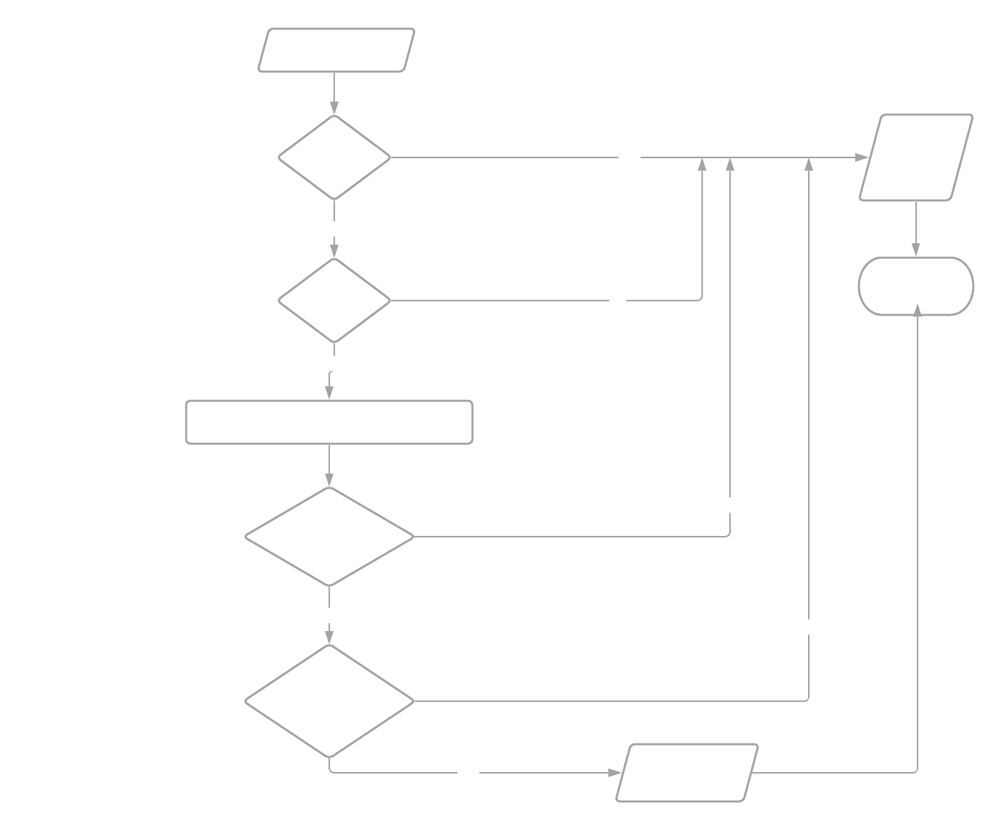

Slide 11


Slide 12


Slide 13
PROGRAMS AND
THEIR OUTPUTS

Slide 14
#A simple program to validate the email input by the user.
email = str(input("Enter email id:"))
ats=0
for i in email:
if (i==' '):
print ("Invalid email ID.")
if (i=='@'):
ats=ats+1
domains = [
"aol.com", "att.net", "comcast.net", "facebook.com", "gmail.com", "gmx.com", "googlemail.com",
"google.com", "hotmail.com", "hotmail.co.uk", "mac.com", "me.com", "mail.com", "msn.com",
"live.com", "sbcglobal.net", "verizon.net", "yahoo.com", "yahoo.co.uk",
"email.com", "fastmail.fm", "games.com" , "gmx.net", "hush.com", "hushmail.com", "icloud.com",
"iname.com", "inbox.com", "lavabit.com", "love.com" , "outlook.com", "pobox.com", "protonmail.ch", "protonmail.com", "tutanota.de", "tutanota.com", "tutamail.com", "tuta.io",
"keemail.me", "rocketmail.com" , "safe-mail.net", "wow.com" , "ygm.com" ,
"ymail.com", "zoho.com", "yandex.com", "bellsouth.net", "charter.net", "cox.net", "earthlink.net", "juno.com",
"btinternet.com", "virginmedia.com", "blueyonder.co.uk", "freeserve.co.uk", "live.co.uk",
"ntlworld.com", "o2.co.uk", "orange.net", "sky.com", "talktalk.co.uk", "tiscali.co.uk",
"virgin.net", "wanadoo.co.uk", "bt.com",

Slide 15
"sina.com", "sina.cn", "qq.com", "naver.com", "hanmail.net", "daum.net", "nate.com", "yahoo.co.jp", "yahoo.co.kr", "yahoo.co.id", "yahoo.co.in", "yahoo.com.sg", "yahoo.com.ph", "163.com", "yeah.net", "126.com", "21cn.com", "aliyun.com", "foxmail.com",
"hotmail.fr", "live.fr", "laposte.net", "yahoo.fr", "wanadoo.fr", "orange.fr", "gmx.fr", "sfr.fr", "neuf.fr", "free.fr",
"gmx.de", "hotmail.de", "live.de", "online.de", "t-online.de", "web.de", "yahoo.de",
"libero.it", "virgilio.it", "hotmail.it", "aol.it", "tiscali.it", "alice.it", "live.it", "yahoo.it", "email.it", "tin.it", "poste.it", "teletu.it",
"mail.ru", "rambler.ru", "yandex.ru", "ya.ru", "list.ru",
"hotmail.be", "live.be", "skynet.be", "voo.be", "tvcablenet.be", "telenet.be",
"hotmail.com.ar", "live.com.ar", "yahoo.com.ar", "fibertel.com.ar", "speedy.com.ar", "arnet.com.ar",
"yahoo.com.mx", "live.com.mx", "hotmail.es", "hotmail.com.mx", "prodigy.net.mx",
"yahoo.ca", "hotmail.ca", "bell.net", "shaw.ca", "sympatico.ca", "rogers.com",
"yahoo.com.br", "hotmail.com.br", "outlook.com.br", "uol.com.br", "bol.com.br", "terra.com.br", "ig.com.br", "itelefonica.com.br", "r7.com", "zipmail.com.br", "globo.com", "globomail.com", "oi.com.br","muj.manipal.edu"
]

Slide 16
if (ats==1): #a valid email address has exactly one 'at' sign
x = email.split("@")
local_part = x[0]
domain = x[1]
if local_part[0].isalpha():
for i in domains:
if (i == domain):
print("Email ID validated.")
else:
print("Invalid email ID.")
else:
print("Invalid email ID.")

Slide 17
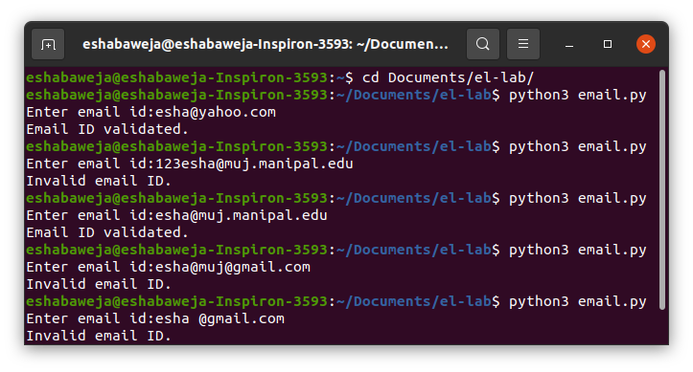
Output for email-validator program

Slide 18
#A program to validate password
password = input("Enter password containing atleast one digit, one special character, one uppercase, and one lowercase letter with length between 8 and 16 characters: ")
count_up =0
count_low =0
count_num =0
count_spec =0
special_chars = ['!', '@','#','$','%','^','&',
'*','(',')','-','_','.']
if (len(password)>7 and len(password)<17):
for i in password:
if i == ' ':
print("Password should not contain white spaces.")
break
elif i.isupper(): #checking atleast one uppercase
count_up = 1
elif i.islower(): #checking atleast one lowercase
count_low = 1

Slide 19
elif i.isdigit(): #checking atleast one digit
count_num = 1
elif i in special_chars:
count_spec = 1
else:
print("Password length should be between 8 to 16 characters.")
if (count_up==1 and count_low==1 and count_num ==1 and count_spec==1):
print("Password validated.")
else:
print("Invalid password.")

Slide 20
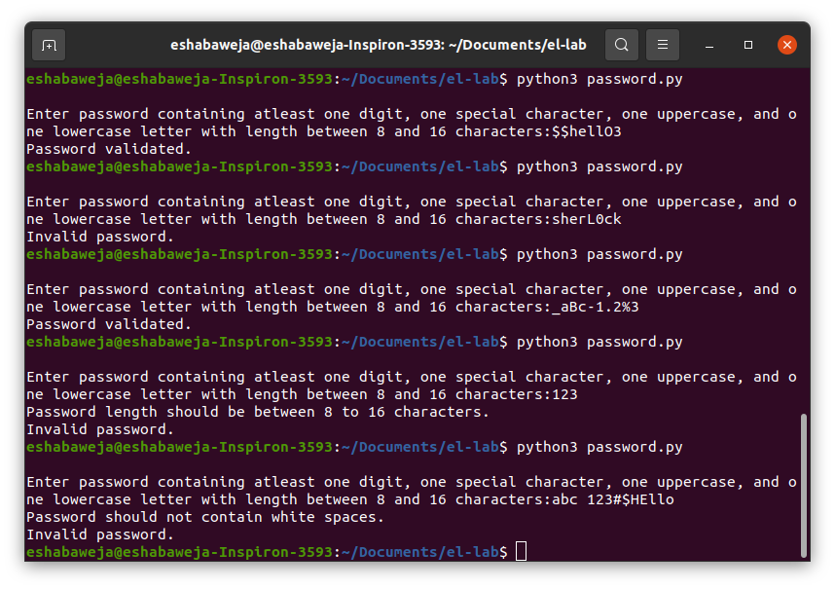
Output for password-validator program

Slide 21
#A simple program to check a phone number
num = input("\nEnter mobile number with country code:")
mob,coun = 0,0 #flags
country_codes = ["+93","+355","+213","+1-684","+376","+244","+1-264","+672","+1-268","+54","+374","+297",
"+61","+43","+994","+1-242","+973","+880","+1-246","+375","+32","+501","+229","+1-441",
"+975","+591","+387","+267","+55","+673","+359","+226","+257","+855","+237","+1","+238",
"+1-345","+236","+235","+56","+86","+53","+61","+57","+269","+243","+242","+682","+506",
"+225","+385","+53","+357","+420","+45","+253","+1-767","+1-809","+1-829","+670","+593",
"+20","+503","+240","+291","+372","+251","+500","+298","+679","+358","+33","+594","+689",
"+241","+220","+995","+49","+233","+350","+30","+299","+1-473","+590","+1-671","+502",
"+224","+245","+592","+509","+504","+852","+36","+354","+91","+62","+98","+964","+353",
"+972","+39","+1-876","+81","+962","+7","+254","+686","+850","+82","+965","+996","+856",
"+371","+961","+266","+231","+218","+423","+370","+352","+853","+389","+261","+265","+60",
"+960","+223","+356","+692","+596","+222","+230","+269","+52","+691","+373","+377","+976",
"+1-664","+212","+258","+95","+264","+674","+977","+31","+599","+687","+64","+505","+227",
"+234","+683","+672","+1-670","+47","+968","+92","+680","+970","+507","+675","+595","+51",
"+63","+48","+351","+1-787","+1-939","+974","+262","+40","+7","+250","+290","+1-869","+263",
"+1-758","+508","+1-784","+685","+378","+239","+966","+221","+248","+232","+65","+421",
"+386","+677","+252","+27","+34","+94","+249","+597","+268","+46","+41","+963","+886","+967",
"+992","+255","+66","+690","+676","+1-868","+216","+90","+993","+1-649","+688","+256","+380",
"+971","+44","+1","+598","+998","+678","+418","+58","+84","+1-284","+1-340","+681","+260"]

Slide 22
if (len(num)>=10 and len(num)<=16):
country_code = num[0:-10] #using string slices
mobile_no = num[-10:len(num)] #the last ten digits would be the mobile number
if (mobile_no.isdigit() and mobile_no[0] != '0'): #checking mobile number is valid
mob = mob+1
for i in country_codes: #checking country code is valid
if (i == country_code):
coun = coun+1
if (mob==1 and coun ==1):
print("Phone number is valid.")
else:
print("Invalid phone number.")

Slide 23
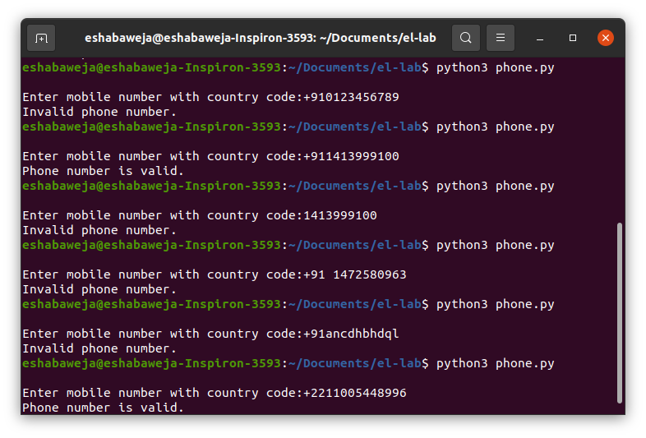
Output for phone number validator program

Slide 24
THANK YOU

