Slide 1



F I | N A | N C | I | A | L
C U | S T O M |  |  | E R
C O | M P L A |  |  | I N T S
A N | A L Y T I |  |  | C S
R E | P O R T
B Y E S H A J A I S WA L
*Please use presentation mode

Slide 2
Index
Data Cleaning & Manipulation with Logics.
Tableau Dashboard glimpse and link.
Some - Quick Insights.
Insights with Actions & Suggestions.
Gen AI Based improvements on Data
End Slide
-Page 3
-Page 4
-Page 5
-Page 6, 7
-Page 8
-Page 9

Slide 3

Data Cleaning & Manipulation with Logics.
During exploration, it was evident that the data was extremely unclean. Here's the approach taken to clean it. Note - We Have used Adv-Excel & Tableau. Logics will remain same in SQL, Python, Excel.
Identified Missing Data & Fixed - (Too Much Missing Data) Using Excel for Data Format
State: Filled using company name and zip code. •
Issue: Filled using sub-issues.
Sub Product: Filled using Filled issues.
Product: Filled using sub-products.
Consumer Disputed?: Filled using company public response.
Date Received: Filled using date sent to the company.
Consent Provided: Filled using non-null "submitted via" entries.
Standardized the date format for both "Date received"
and "Date sent to company.“
Corrected manual data entry errors and resolved column mismatches.
Added State names based on two-letter abbreviations.
Extracted and created the week from the "Date received."
Untimely Response: Marked "No" if timely response is
present.
These steps resulted in transforming 34% of unusable into usable data and increased accuracy (Imputed 22,358 data points)

Slide 4
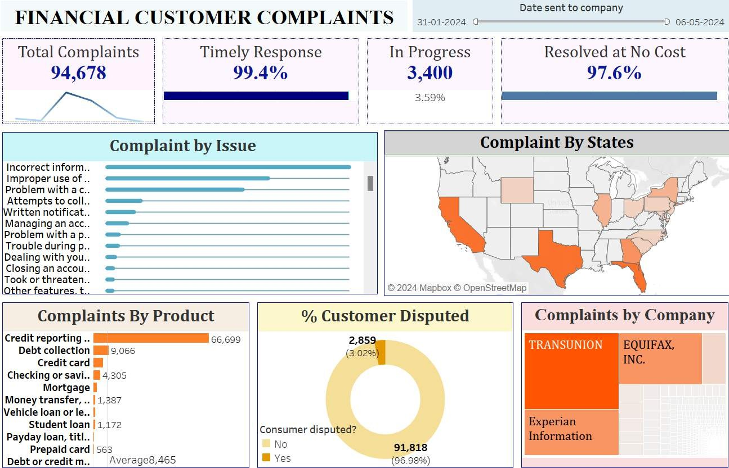
Tableau Dashboard glimpse and link

Slide 5
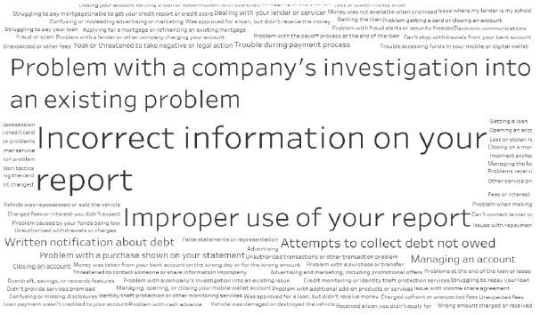
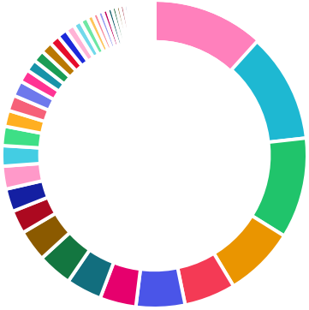

Some Quick Insights💡
52% Complaints are from Top 6 State's - Texas, Florida, California, Georgia, New York, Illinois .
64% of the Complaints are of 3 top Companies are Transunion INC, Experian INC, EQUIFAX INC.
66% Complaints are Sub-Product - “Credit reporting related Issues”.
Only 3.05% Complaints were raising Dispute Out of which 3.02 where Timely Responded .
Top 3 Issues Contribute to 71% of total Issues faced. Out of which 44% resolution were :
“Company has responded to the consumer and the CFPB and chooses not to provide a public response”.
Pending Case's are 3400 and AVG pending Since is 115 Days.
Texas Florida California Georgia New York Illinois
Pennsylvania North Carolina
Wyoming New Jersey South Carolina Maryland
_{1111%1%1%}1%0%0%00%0%0%00%0%0%0%0%0%0%0%%
12%
₁₁1%%%
TRANSUNION INTERMEDIATE HOLDINGS, INC.
₁1%%
1%%
1%
12%
2%
2%
State Wise Complaints
Company Wise Complaints
2%
2%
2%
2%
Experian Information Solutions Inc.
2%
2%
3%
4%
11%
7%
EQUIFAX, INC.
4% _{4% 5%}
5%

Slide 6
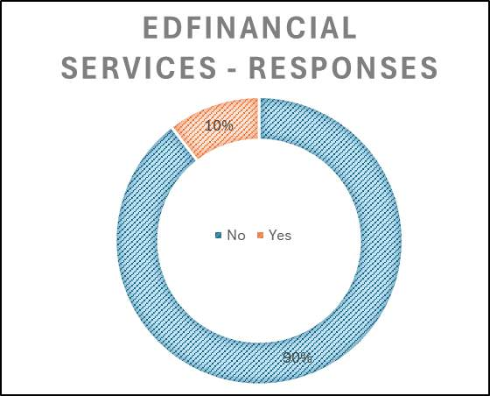
Company Wise Insights📊
“EdFinancial Services” demonstrates a significant issue with timely responses to complaints
Out of 135 complaints, 89% were not responded to promptly.
This highlights a critical area for improvement in their customer service operations to enhance overall service quality and customer satisfaction.
High Volume of 'In Process’ - 4% (3400)
EQUIFAX, INC., Experian Information Solutions Inc., & TRANSUNION INTERMEDIATE HOLDINGS, INC.
have a combined total of 3,022 complaints that are still In Process. This represents 88% of the total complaints which are Pending with an Average of 116 Days.
Company Name | In Process | Days Since
EQUIFAX, INC. | 1454 | 116
Experian Information Solutions Inc. | 1146 | 114
TRANSUNION INTERMEDIATE HOLDINGS, INC. | 422 | 119
Total - | 3022 | 116

Slide 7


Weekday’s Resource Optimization
Percentage Breakdown:
Complaints peak mid-week from Tuesday to Thursday, each with 17% of total complaints.
Sunday accounts for only 6% of the total complaints, making it the least
problematic day.
The weekend (Saturday and Sunday) sees fewer complaints compared to weekdays.
Action:
The table indicates that Sundays have the lowest number of complaints,
amounting to approximately 1/3rd of the daily average.
Therefore, it would be efficient to reduce the number of in-house employees working on Sundays and reassign them to Wednesdays.
which consistently experience the highest number of complaints.
Impact :
This reallocation would optimize resource use and improve service handling during peak complaint days.
Weekday | Complaints | %
Sunday | 5227 | 6%
Saturday | 12670 | 13%
Friday | 14423 | 15%
Monday | 14825 | 16%
Thursday | 15697 | 17%
Tuesday | 15917 | 17%
Wednesday | 15919 | 17%
Grand Total | 94678 | 100%

Slide 8
Using AI to Transform “Customer Narratives” into Clear and Actionable Scripts.
Copy & Paste in Python IDE
Problem Statement:
The "Customer Narrative" column contains text written in a personal, random manner, which complicates efficient query comprehension.
This inconsistency slows down the process of understanding customer
needs and queries.
Proposed Solution:
Creating a directive to simplify textual data.
Getting in list and join on original data.
Benefits:
Improved clarity: Simplified narratives retain original meaning, making them easier for companies to understand and act upon.
Enhanced responsiveness: Companies can address customer needs more promptly and accurately based on clearer insights
Example:
Input - In accordance with the Fair Credit Reporting Act this creditor has violated my rights under 15 USC 1681 Section 602 states that I have the right to privacy 15 USC 1681 Section 601 A section 2 it also states a consumer reporting agency can not furnish account without my written instructions. Under 15USCS 1666B a creditor may not treat a payment on account under an open end consumer credit plan as late for any purpose
.
Output - This creditor has violated my rights under the Fair Credit Reporting Act. According to 15 USC 1681 Section 602, I have the right to privacy. Additionally, 15 USC 1681 Section 601 A section 2 states that a consumer reporting agency cannot furnish account information without my written instructions. Moreover, under 15 USC 1666B, a creditor may not classify a payment on an open-end consumer credit plan as late for any reason.
import os
import pandas as pd
import pandas_gbq as pd_gbq
import openai
import time
from datetime import datetime, timedelta
from IPython.display import clear_output
#Load Customer Complaints dataset
main =pd.read_excel(r"C:\Users\Rahul Jaiswal\Downloads\Customer Complaints.xlsx",sheet_name='Complaints Data')
openai.api_key = "Enter Your API Key"
start_time = time.time()
#Testing on 100 Narratives
test = main.head(1)
columns = ['Complaint_ID', 'Consumer_complaint_narrative', 'Simplified_narrative']
df = pd.DataFrame(columns=columns)
for i in range(len(test['Complaint ID'])):
Comment = test["Consumer complaint narrative"][i]
print("No of Rows Processed:",i)
context ='''
Simplification Task for Customer Complaint Data
Objective: Simplify the given customer complaint data while maintaining its literal meaning and ensuring no loss of information. The goal is to make the data easier to read and understand.
Instructions:
Maintain Key Details: Ensure all important details such as dates, names, transaction details, and specific complaints are retained.
Use Clear Language: Replace complex or technical terms with simpler, more understandable language where possible. Concise Formatting: Reduce unnecessary words or repetitive phrases. Aim for clear and concise sentences.
Logical Flow: Organize the information in a logical sequence, such as chronological order or by grouping related issues together. Highlight Key Points: Use bullet points or numbered lists to highlight key points or steps taken by the customer or the company.

Slide 9

Thank You.
Please refer to the Shared el & more drilled down & further analysis.
Tableau Dashboard for
Exc
Email – eshajaiswal.2903@gmail.com

