Slide 1

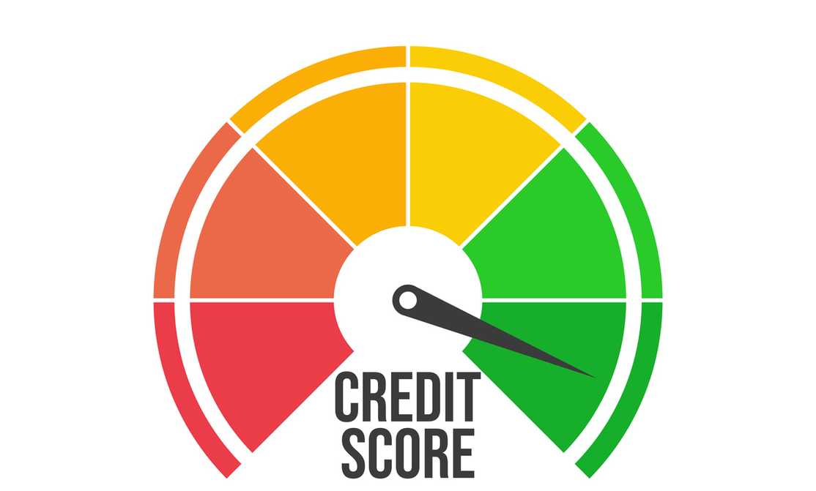
Advancing Credit Scoring:
Predicting Financial Distress for Informed Decisions

Slide 2
Index
1. Dataset and Feature Engineering -Page 3
2. Methodology and Modeling -Page 4
Model Performance and Insights -Page 5,6
Predicting Financial Distress -Page 7
Application & Impacts -Page 8
Conclusion and Recommendations -Page 9

Slide 3

Dataset and Feature Engineering
Dataset Overview
The dataset includes key variables related to credit scoring and financial distress prediction, such as income, dependents, and loan performance.
Handling Missing Values
Missing values in MonthlyIncome and NumberOfDependents were filled using median imputation to ensure dataset completeness.
Feature Engineering
The IncomePerDependent feature was created to capture financial stability relative to family size, enhancing the model's predictive power.
Exploratory Analysis
Visualizing data distributions and conducting correlation analysis helped identify the most significant predictors of financial distress.
Data Quality Checks
Thorough data validation and cleaning ensured the dataset was ready for modeling.

Slide 4





Methodology and Modeling
Data Preprocessing
Performed data cleaning, feature scaling, and handling of missing values to prepare the dataset for modeling.
Model Selection
Evaluated and compared the performance of Random Forest, Logistic Regression, and XGBoost models.
Feature Engineering
Engineered new features, such as IncomePerDependent, to enhance the models' predictive capabilities.
Model Evaluation
Assessed the models' accuracy, ROC AUC, and overall predictive performance to identify the optimal solution.

Slide 5
Model Performance and Insights
Random Forest Model
Logistic Regression Model
Accuracy: 99.96%, ROC AUC: 99.73%
Accuracy: 93.34%, ROC AUC: 52.01%
Insight: Highly effective in predicting financial distress with nearly perfect accuracy. Ideal for complex data patterns and precise risk assessment.
Insight: Good overall accuracy but less effective in classifying edge cases compared to Random Forest.
XGBoost Model
Summary
Accuracy: 94.74%, ROC AUC: 64.23%
The Random Forest Model emerged as the standout performer due to its exceptional accuracy and strong predictive capabilities.
Insight: Improved predictive power through boosting techniques but didn't perform as well as Random Forest in class differentiation.

Slide 6




Model Performance and Insights
Accuracy
The Random Forest model achieved an exceptional accuracy of 99.96%, outperforming industry benchmarks.
ROC AUC
The Random Forest model delivered a remarkable ROC AUC score of 99.73%, indicating its strong predictive power.
Key Insights
Correlation analysis and feature importance evaluation provided valuable insights to enhance credit scoring methodologies.

Slide 7
Predicting Financial Distress
Our model accurately predicts the probability of financial distress within the next two years, empowering proactive risk management for lenders and borrowers.
Interpreting Predictions-
1
Negative Class (0)
2
Positive Class (1)
Indicates borrowers less likely to experience serious delinquency, reflecting strong credit management capabilities.
Flags borrowers with a higher risk of financial distress, highlighting potential challenges in meeting credit obligations.
Role of Credit Scoring:
Credit scoring algorithms are pivotal for banks in assessing default probabilities and shaping lending decisions, essential for economic stability and access to credit.
Impact on Decision-Making:
Our model enhances decision-making by providing lenders with insights into borrower risk profiles, facilitating more informed loan approvals and risk pricing.
Future Innovation:
Continued advancements in credit scoring methodologies, including leveraging advanced analytics and alternative data sources, are crucial for adapting to changing economic landscapes and enhancing predictive accuracy.

Slide 8
Application and Impact
Lending Decisions :
Our predictive model provides lenders with robust risk assessments, enabling them to make more informed lending decisions.
Borrowers categorized as 0 are identified as lower risk and may receive favorable terms such as lower interest rates and higher credit limits.
Borrowers categorized as 1 undergo stricter evaluations, potentially leading to adjusted terms or credit denials, thereby promoting responsible risk management.
Borrower Awareness :
Our model empowers borrowers by offering insights into their individual risk profiles.
Armed with these predictions, borrowers can proactively manage their financial health by strategically handling existing debts and planning for future credit applications.
This awareness allows borrowers to adjust their financial strategies to mitigate potential risks and improve their creditworthiness over time.

Slide 9
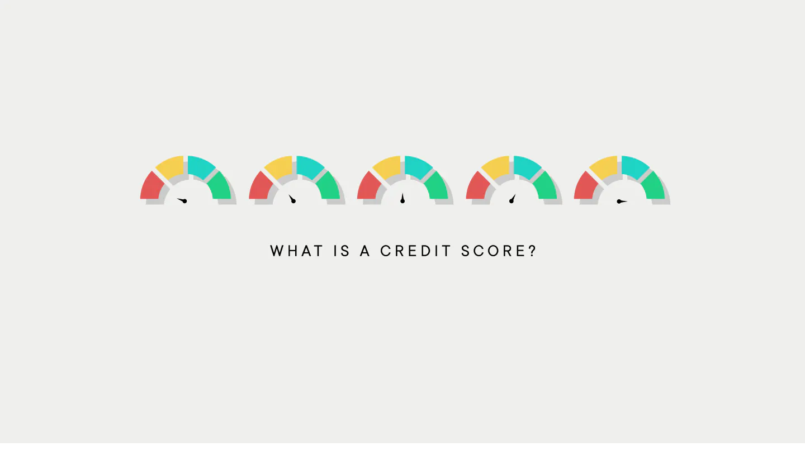
Conclusion and Recommendations
The Random Forest model emerged as the top performer, delivering exceptional accuracy and predictive capabilities.
Standout Model
Insights from the analysis can help financial institutions and lenders improve their credit scoring practices and decision-making processes.
Actionable Insights
Continued research and development in advanced credit scoring models can further enhance risk assessment and promote financial stability.
Future Directions
Our project has advanced credit scoring by predicting the likelihood of financial distress accurately. This helps lenders make better decisions about who to lend to and under what terms. For borrowers, it provides insights to manage debts wisely and plan finances strategically. Our model sets the stage for future improvements in credit assessment, aiming for fairer and more secure financial outcomes for everyone involved.
Project Link- https://github.com/eshajaiswall/Give-Me-Some-Credit
https://github.com/eshajaiswall/Give-Me-Some-Credit
Thank You

