Slide 1
EXPLORATORY DATA ANALYSIS
Bank Marketing Campaign
Understanding Customer Subscription Patterns
Your Name · November 2026

Slide 2
OVERVIEW
Why this project?
01
02
03
Real outcomes
Big question
Goal
Phone campaign data with clear yes/no subscription results
Who subscribes to a term deposit after a marketing call?
Find patterns the bank can use for better targeting
Bank Marketing Campaign | EDA
02 / 15

Slide 3
DATASET
At a glance
11,162
17
UCI
Rows / contacts
Columns / features
Kaggle bank source
Bank Marketing Campaign | EDA
03 / 15

Slide 4
DICTIONARY
Key columns explained
Profile
age, job, marital, education — who the customer is
Finance
balance, housing, loan, default — money and debt
Campaign
contact, duration, campaign, month — this call
History
pdays, previous, poutcome — past campaign results
Target
deposit — did they subscribe? (yes / no)
Bank Marketing Campaign | EDA
04 / 15

Slide 5
RESEARCH
Eight questions we answered
1
2
3
4
Overall subscription rate?
How is age distributed?
Which jobs appear most?
Duration vs subscription?
5
6
7
8
Housing loan effect?
Best contact channel?
Education group rates?
Job & marital differences?
Bank Marketing Campaign | EDA
05 / 15

Slide 6
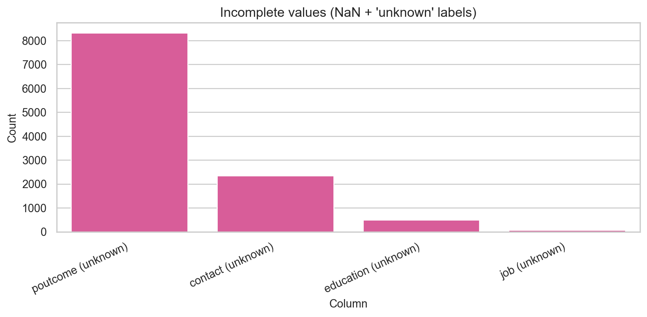
CLEANING
Missing values graph
What this shows: True NaNs = 0. Bars show 'unknown' labels. We kept them as a real category so we do not lose valid contacts.
Bank Marketing Campaign | EDA
06 / 15

Slide 7
CLEANING
Duplicates and data types
0
repeated rows found
What this shows: No duplicates to remove. Month was ordered; yes/no flags added; numeric columns were already correct.
Bank Marketing Campaign | EDA
07 / 15

Slide 8
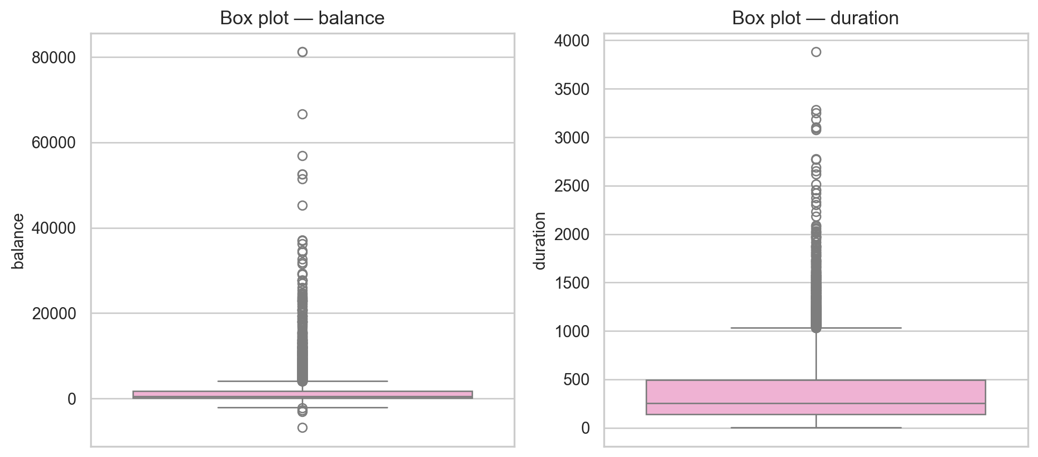
CLEANING
Outlier box plots
What this shows: IQR flags high balance and long duration points. We KEPT them — they are real wealthy clients and real long calls.
Bank Marketing Campaign | EDA
08 / 15

Slide 9
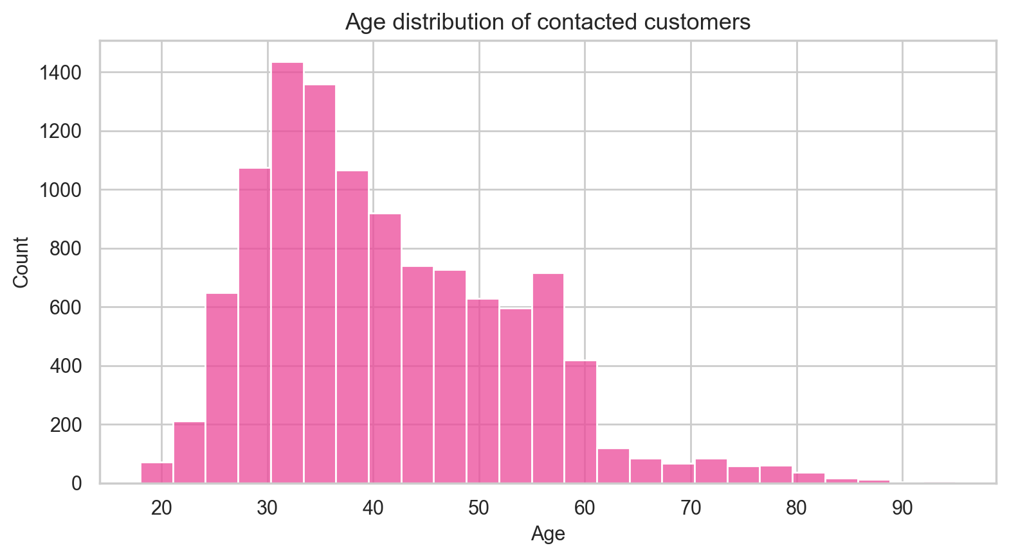
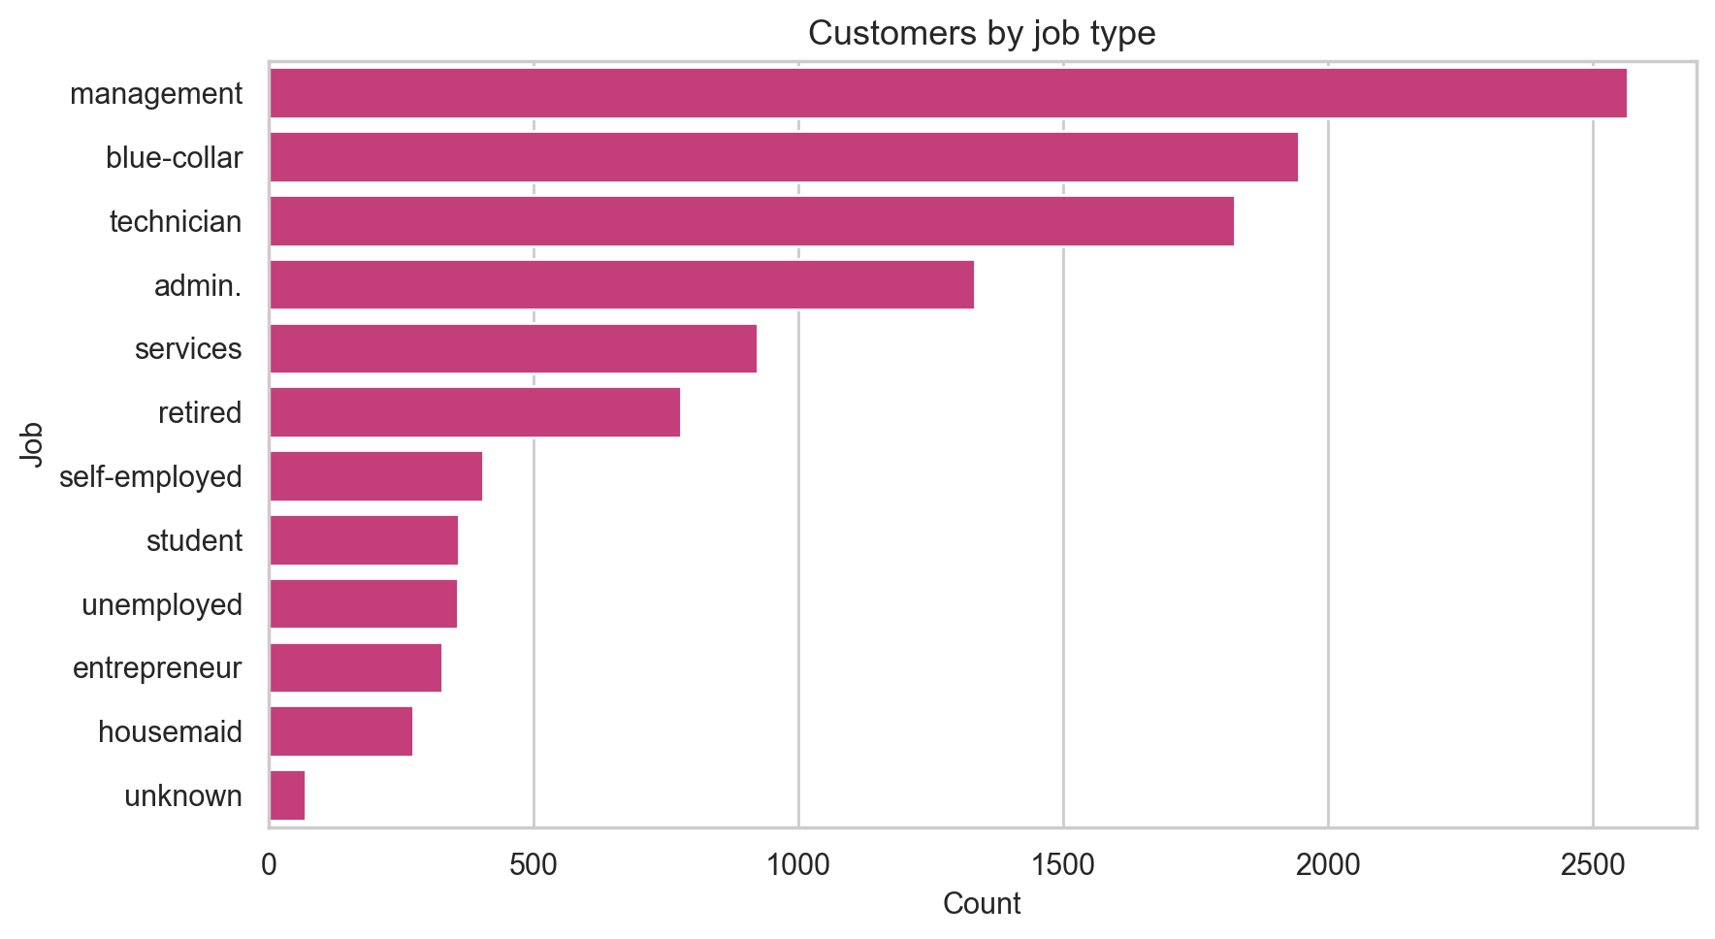
UNIVARIATE
Single-column patterns
Age graph: most customers are 30-40 years old (working-age peak).
Jobs graph: management, blue-collar, and technician were contacted most.
Bank Marketing Campaign | EDA
09 / 15

Slide 10
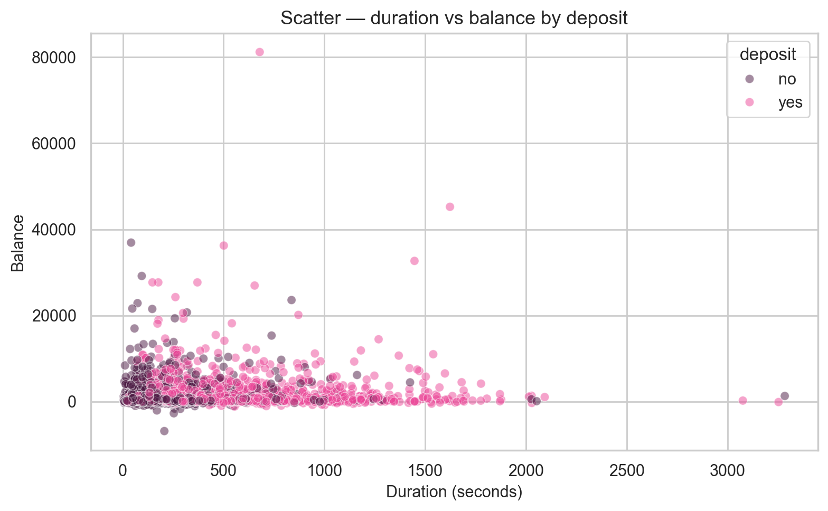
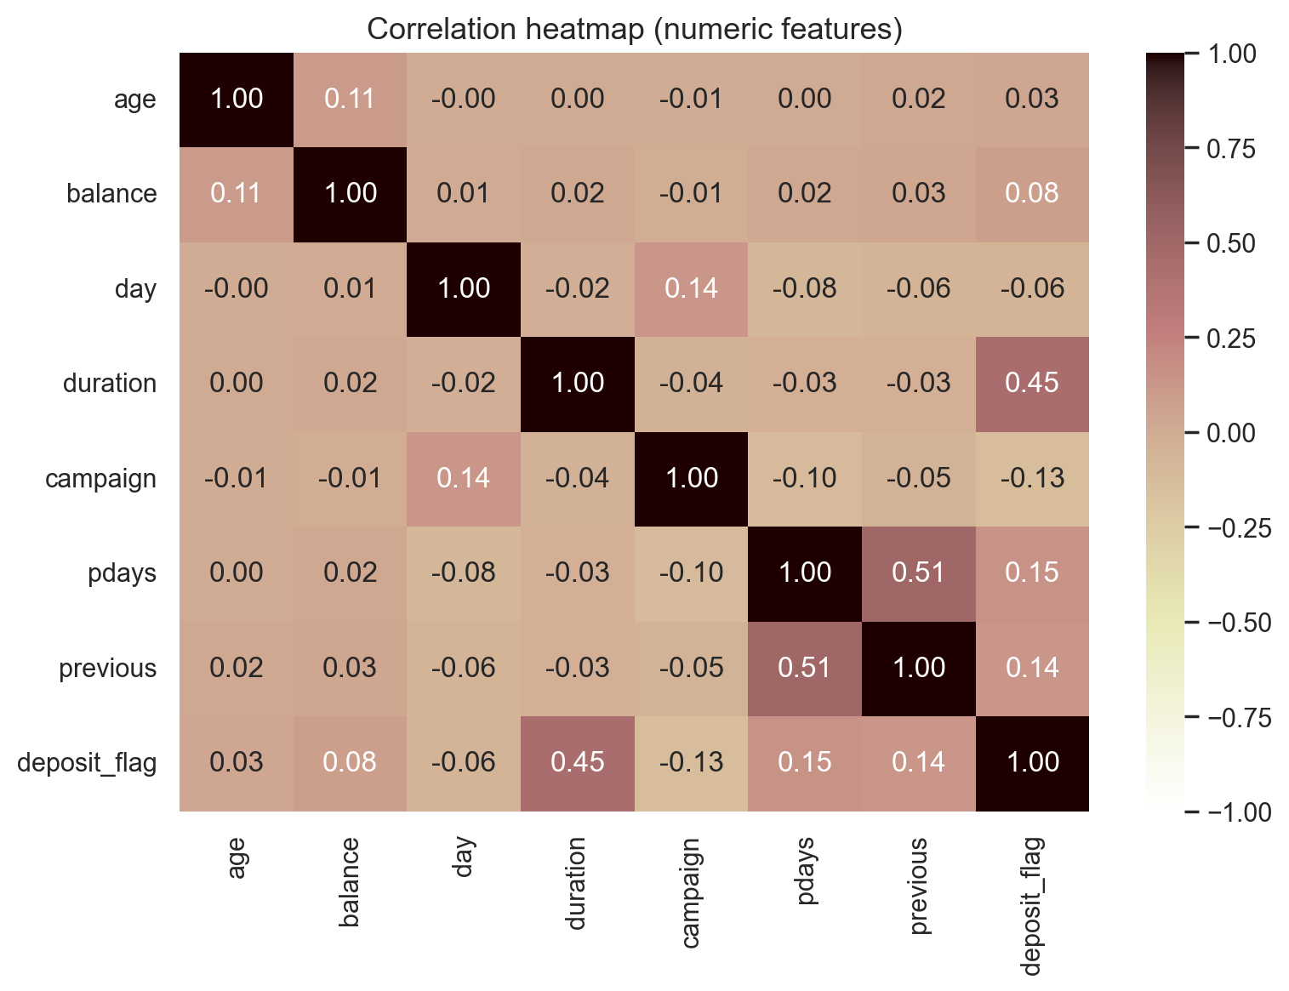
BIVARIATE
Relationships between variables
Scatter: longer calls cluster with deposit=yes more than balance alone.
Heatmap: strongest link to subscription is call duration.
Bank Marketing Campaign | EDA
10 / 15

Slide 11
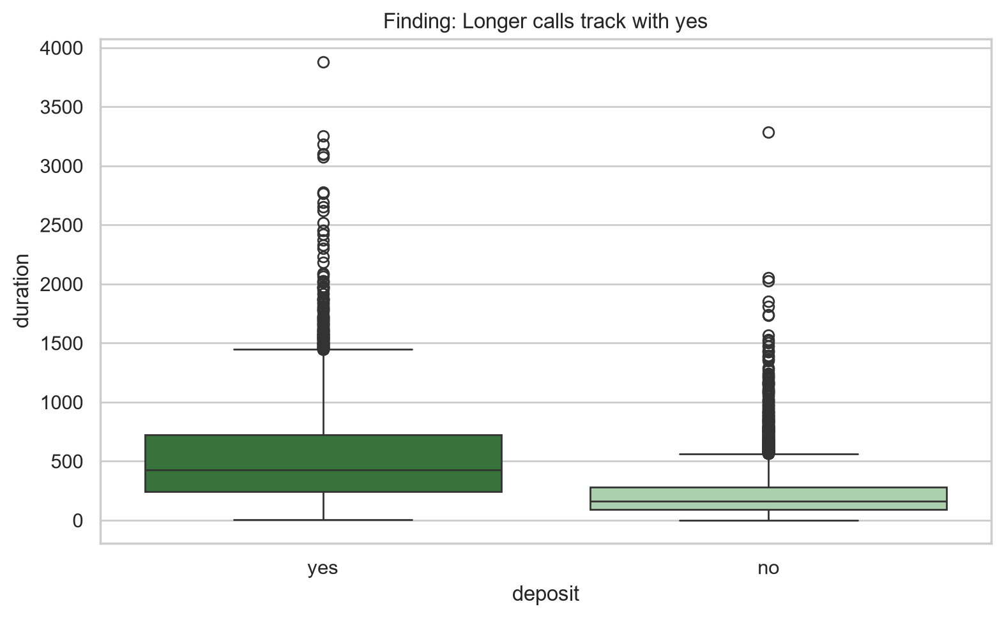
FINDING 01
Longer calls strongly track with yes
What this shows: Box plot compares duration by deposit. Yes median ~426s vs No ~163s — longer talks convert better.
Bank Marketing Campaign | EDA
11 / 15

Slide 12
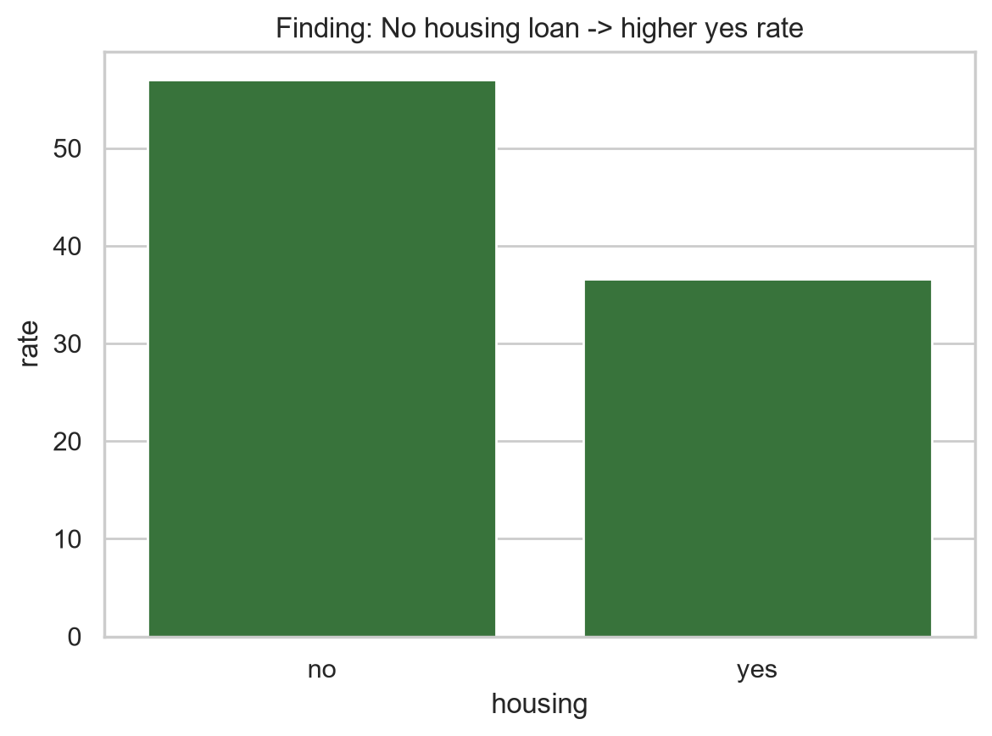
FINDING 02
No housing loan means higher conversion
What this shows: Bar chart of subscription rate by housing loan. No loan ~57% yes; with loan ~37% yes.
Bank Marketing Campaign | EDA
12 / 15

Slide 13
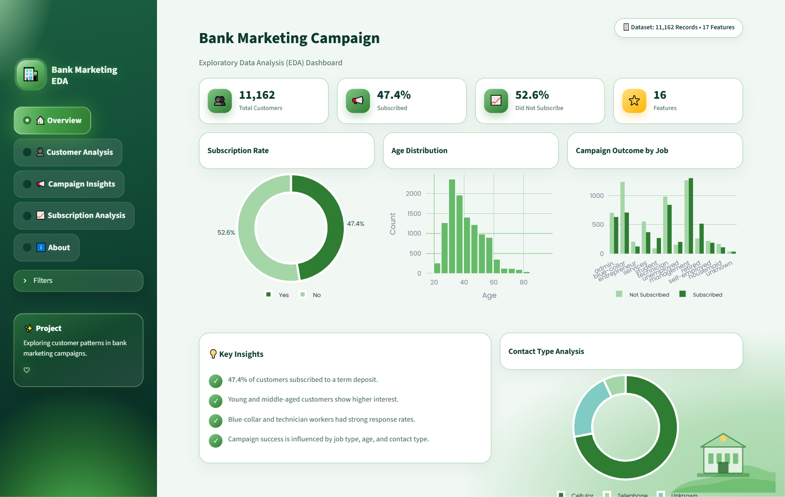
PRODUCT
Interactive Streamlit dashboard
What this shows: Live app view: filters, KPIs, Plotly charts for univariate, bivariate, and group comparison.
Bank Marketing Campaign | EDA
13 / 15

Slide 14
WRAP-UP
3 findings · 1 action
01
02
03
Duration drives yes
Housing loan effect
Segments matter
Longer calls align with subscriptions (426s vs 163s)
No loan converts higher (~57% vs ~37%)
Job, education, and contact channel shift odds
ACTION
Prioritise cellular outreach to customers without housing loans
Bank Marketing Campaign | EDA
14 / 15

Slide 15
Thank you
Questions?
GitHub · Streamlit live app
Add your links here

