Slide 1

DEPARTMENT OF INFORMATION TECHNOLOGY, ELECTRONICS & COMMUNICATIONS
GOVERNMENT OF GOA • FINAL PROJECT REVIEW
Mobile Tower Monitoring and Management System
(MTMMS)
A Centralized Tri-Platform GIS Infrastructure & Asset Governance Platform
CANDIDATE DETAILS (INDIVIDUAL PROJECT)
Esham Uday Chari
Roll Number: 23B-IT-503 | Information Technology
Goa College of Engineering (GEC), Farmagudi, Ponda, Goa
DEPARTMENT MENTOR & INSTITUTION
Ms. Soniya Usgaonkar
Department Mentor | Academic Year: 2026–2027
Department of Information Technology, Government of Goa
Mobile Tower Monitoring and Management System (MTMMS) | DoIT, Government of Goa
Slide 1 of 12

Slide 2
DEPARTMENT OF INFORMATION TECHNOLOGY, GOVT. OF GOA • [ INTRODUCTION ]
Project Overview, Purpose & Target Users
• Project Overview: MTMMS is a centralized digital governance platform to monitor, track, and manage mobile towers across Goa.
• Primary Purpose: Digitizes tower asset dossiers, geospatial coordinates, multi-tenant telecom leases, and statutory revenue compliance.
• Application Domain: Public sector telecommunications infrastructure management and state Right-of-Way (RoW) administration.
• Statutory Authority: Developed for the Department of Information Technology, Electronics & Communications (DoIT), Government of Goa.
• Intended Users: State IT directors, taluka administrative officers, municipal revenue inspectors, and on-site field survey teams.
Mobile Tower Monitoring and Management System (MTMMS) | DoIT, Government of Goa
Slide 2 of 12

Slide 3
DEPARTMENT OF INFORMATION TECHNOLOGY, GOVT. OF GOA • [ PROBLEM STATEMENT ]
Challenges in State Telecom Infrastructure Governance
• Rapid Telecom Expansion: Surging 4G/5G mobile tower growth across diverse Goan topography requires systematic digital oversight.
• Absence of Geospatial Visibility: Lack of verified GPS mapping to identify exact tower locations, physical heights, and regional tower density.
• Complex Multi-Carrier Sharing: Multiple telecom operators share physical masts with unlinked tenancy agreements and varying contract periods.
• Statutory Rent & Revenue Tracking: Delayed tracking of land lease terms, municipal permissions, and computation of statutory late surcharges.
• Need for Unified Governance: State authorities require a single verified source of truth connecting office administrators with field inspection teams.
Mobile Tower Monitoring and Management System (MTMMS) | DoIT, Government of Goa
Slide 3 of 12

Slide 4
DEPARTMENT OF INFORMATION TECHNOLOGY, GOVT. OF GOA • [ OBJECTIVES & SCOPE ]
Core Goals and Project Boundaries
CORE PROJECT OBJECTIVES
• Main Objective: Build a centralized tri-platform GIS system to monitor, audit, and manage mobile towers across Goa.
• Digital Registry: Maintain complete dossiers of towers, antenna mast specifications, power backup, and land classifications.
• GIS Mapping: Provide interactive Leaflet map visualization with verified GPS coordinates and 4-tier filtering.
• Multi-Tenant Auditing: Map telecom operators (Airtel, Jio, Vi, BSNL) sharing physical masts, spectrum, and lease dates.
• Statutory Billing Engine: Automate annual rent calculation, detect overdue arrears, and generate official Form VII Notices.
PROJECT SCOPE & BOUNDARIES
• State-Wide Coverage: Encompasses all mobile towers across North Goa and South Goa districts.
• 12 Statutory Talukas: Covers all 12 talukas including Bardez, Tiswadi, Ponda, Salcete, and Mormugao.
• Dual Land Categories: Governs infrastructure on both Government municipal land and private landholder plots.
• Tri-Platform Access: Delivers synchronized access for web consoles, desktop workstations, and mobile devices.
Mobile Tower Monitoring and Management System (MTMMS) | DoIT, Government of Goa
Slide 4 of 12

Slide 5
DEPARTMENT OF INFORMATION TECHNOLOGY, GOVT. OF GOA • [ PROPOSED SOLUTION ]
System Overview & Key Functional Capabilities
• Centralized Tri-Platform Solution: Seamlessly synchronizes React 19 Web, Electron 44 Desktop, and Flutter Native Android mobile applications.
• Interactive GIS Spatial Map: Renders real-time tower pins, clustered density markers, and administrative boundaries using Leaflet engine.
• 4-Tier Location Hierarchy: Structured hierarchy organizing infrastructure by District → Constituency → Taluka → Area (101 locations).
• Multi-Tenant Tenancy Tracking: Tracks co-located telecom carriers per mast, recording allocated antenna slots and active lease agreements.
• Form VII Notice Generator: Auto-generates official Government of Goa rent demand notices with mandated 5% statutory late surcharges.
• Multi-Network Connectivity: Supports UDP 41588 zero-config discovery on Wi-Fi and secure HTTPS cloud tunneling for remote 4G/5G mobile access.
Mobile Tower Monitoring and Management System (MTMMS) | DoIT, Government of Goa
Slide 5 of 12

Slide 6
DEPARTMENT OF INFORMATION TECHNOLOGY, GOVT. OF GOA • [ ARCHITECTURE ]
Enterprise Multi-Tier System Architecture
TIER 1 — TRI-PLATFORM PRESENTATION LAYER
React 19 Web Portal
Administrative console, GIS mapping, and analytics
Electron 44 Desktop
Standalone workstation client for office data entry
Flutter Android App
On-site field surveys with hardware GPS logging
TIER 2 — GATEWAY & NETWORKING LAYER
UDP Port 41588 Beacon
Auto-discovery of server on local Wi-Fi subnets
HTTPS Cloud Tunnel
Secure Localtunnel gateway for remote 4G/5G mobile access
Stateless SimpleJWT
Cryptographic bearer tokens with role-based access control
TIER 3 — BACKEND API & BUSINESS LOGIC LAYER (DJANGO REST FRAMEWORK)
Tower Asset Registry
Structural specifications, heights, and mast types
4-Tier Location Resolver
Relational mapping across District, Taluka, and Area
Statutory Rent Engine
Annual rent calculation, 5-yr review cycles, Form VII
TIER 4 — RELATIONAL DATA PERSISTENCE LAYER (MYSQL 8.0)
3NF Normalized Schema
11 relational tables eliminating data redundancy
Decimal(10, 7) Coordinates
Millimeter-level GPS accuracy preventing GIS drift
Referential Cascades
Foreign key constraints protecting historical audit records
Mobile Tower Monitoring and Management System (MTMMS) | DoIT, Government of Goa
Slide 6 of 12

Slide 7
DEPARTMENT OF INFORMATION TECHNOLOGY, GOVT. OF GOA • [ METHODOLOGY & WORKFLOW ]
End-to-End Processing Steps and Data Flow
STEP 1: FIELD SURVEY
Mobile data logging &
hardware GPS capture
STEP 2: API GATEWAY
SimpleJWT auth &
bounding box validation
STEP 3: PERSISTENCE
MySQL 3NF schema &
foreign key integrity
STEP 4: OUTPUT & AUDIT
Leaflet GIS mapping &
Form VII notice output
INPUT CAPTURE & VALIDATION PIPELINE
• Physical Asset Attributes: Structural height, mast classification (ground/rooftop), and carrier spectrum.
• Hardware GPS Logging: Direct sensor reading from field mobile phone during physical site audits.
• Goa Bounding Box Checks: Strict validation enforcing coordinates within 14.8°N–15.8°N, 73.6°E–74.4°E.
• Stateless Authentication: SimpleJWT header verification guarding all mutating API operations.
PERSISTENCE & GOVERNANCE DELIVERABLES
• Normalized 3NF Storage: Foreign key relational mapping linking towers, owners, areas, and operators.
• Interactive GIS Map: Real-time Leaflet vector map plotting pins with dynamic marker clustering.
• Automated Financial Accrual: Monthly lease calculation, 5-year review cycle tracking, and arrears detection.
• Form VII Notice Export: Print-ready Government of Goa statutory demand notice with 5% late penalty.
Mobile Tower Monitoring and Management System (MTMMS) | DoIT, Government of Goa
Slide 7 of 12

Slide 8
DEPARTMENT OF INFORMATION TECHNOLOGY, GOVT. OF GOA • [ TECHNOLOGIES USED ]
Full-Stack Software Ecosystem and Toolchain
BACKEND API ENGINE
• Python 3.12 & Django 5.1: Enterprise web framework and secure ORM engine
• Django REST Framework: Modular ViewSets and ModelSerializers for REST endpoints
• SimpleJWT 5.3: Stateless JSON Web Token authentication with auto-refresh
DATABASE PERSISTENCE
• MySQL 8.0 Server: Enterprise ACID relational database engine
• 3NF Relational Schema: 11 normalized tables with zero data redundancy
• Decimal(10, 7) Data Types: Millimeter-level GPS coordinate storage without GIS drift
CLIENT APPLICATIONS
• React 19 & TypeScript: Administrative web portal with component state management
• Electron 44 Runtime: Standalone native Windows desktop workstation application
• Flutter 3.x & Dart: Cross-platform native Android mobile app for field audits
GIS & NETWORKING
• Leaflet.js & OpenStreetMap: Interactive geospatial mapping with marker clustering
• UDP Port 41588 Sockets: Custom broadcast daemon for zero-config Wi-Fi pairing
• Localtunnel Gateway: Automated HTTPS cloud tunnel for remote 4G/5G mobile access
Mobile Tower Monitoring and Management System (MTMMS) | DoIT, Government of Goa
Slide 8 of 12

Slide 9
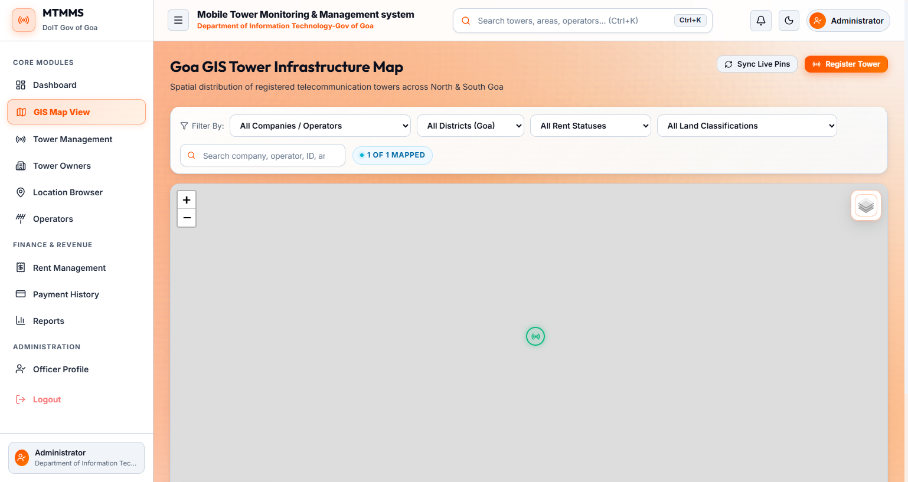
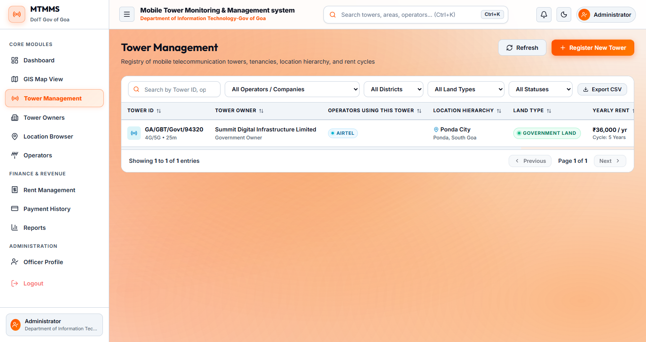
DEPARTMENT OF INFORMATION TECHNOLOGY, GOVT. OF GOA • [ IMPLEMENTATION ]
Core Functional Modules and Application Screens
• Tower Asset Module: Maintains structural heights, mast classifications (ground/rooftop), power sources, and live statuses.
• 4-Tier Geographic Hierarchy: Relational navigation: District → Constituency → Taluka → Area across 101 seeded Goa locations.
• Tenancy Management Engine: Junction table mapping co-located carriers (Airtel, Jio, Vi, BSNL) and spectrum bands.
• Interactive GIS Map View: Plots verified GPS coordinates with marker clustering and interactive tower popup tooltips.
• Form VII Notice Generator: Produces official Government of Goa rent demand notices with 5% statutory late penalty.
Interactive Leaflet GIS Map: Verified tower marker at Ponda Police Station (15.402° N).
Tower Asset Registry: Live record GA/GBT/Govt/94320 (Height 25m, Airtel, Govt Land).
Mobile Tower Monitoring and Management System (MTMMS) | DoIT, Government of Goa
Slide 9 of 12

Slide 10
DEPARTMENT OF INFORMATION TECHNOLOGY, GOVT. OF GOA • [ INDIVIDUAL CONTRIBUTION ]
Work Completed & Technical Challenges Resolved
WORK PERSONALLY COMPLETED (ESHAM UDAY CHARI)
• 100% Individual Ownership: Engineered the full system end-to-end under the mentorship of Ms. Soniya Usgaonkar at DoIT Goa.
• Backend REST API: Architected all 9 Django REST applications, ViewSets, serializers, and SimpleJWT authentication.
• Database Schema Design: Normalized legacy records into a 3NF MySQL schema covering 11 tables and 101 Goa locations.
• Tri-Platform Clients: Built React 19 web portal, packaged Electron 44 desktop client, and developed Flutter mobile app.
KEY CHALLENGES FACED & RESOLUTIONS
• Challenge 1 — Mobile Wi-Fi Discovery: Phones could not detect backend IP on local Wi-Fi due to changing DHCP subnets.
• Resolution 1: Built a custom UDP broadcast beacon daemon in Python (discovery_service.py) on port 41588.
• Challenge 2 — Inaccurate GPS Data: Transposed coordinate records placed towers incorrectly in the Arabian Sea.
• Resolution 2: Enforced strict Goa state bounding-box coordinate validation and interactive map pickers.
• Challenge 3 — Remote Field Access: Integrated Localtunnel HTTPS cloud gateway for field audits over cellular 4G/5G data.
Mobile Tower Monitoring and Management System (MTMMS) | DoIT, Government of Goa
Slide 10 of 12

Slide 11
DEPARTMENT OF INFORMATION TECHNOLOGY, GOVT. OF GOA • [ RESULTS & TESTING ]
Verification Outcomes, System Performance & Limitations
• Production-Ready System Delivery: Successfully deployed unified tri-platform system operating across local LAN and 4G/5G networks.
• Verified Core Features: Real-time tower registration, sub-50ms API response latency, and instant cross-platform data synchronization.
• Automated Unit & API Testing: Validated Django model constraints, cascade delete rules, and 200/201/400/401 HTTP codes via Postman.
• Field GPS Calibration: Calibrated phone hardware GPS readings against known Google Maps coordinates in Goa, confirming sub-meter accuracy.
• Current System Limitations: System manages administrative and financial data, but currently lacks live IoT power sensor telemetry.
Mobile Tower Monitoring and Management System (MTMMS) | DoIT, Government of Goa
Slide 11 of 12

Slide 12
DEPARTMENT OF INFORMATION TECHNOLOGY, GOVT. OF GOA • [ CONCLUSION & FUTURE SCOPE ]
Project Summary, Learnings & Future Enhancements
PROJECT OUTCOMES & LEARNINGS
• Successful Project Delivery: Engineered an enterprise telecommunications infrastructure governance system for DoIT Goa.
• 100% Digital Governance: Replaced manual records with centralized relational database, GIS mapping, and automated ledgers.
• Tri-Platform Operational Access: Connected administrative web consoles, office desktop workstations, and mobile field audit tools.
• Zero Revenue Leakage: Automated annual rent computation, lease renewal tracking, and Form VII statutory notices.
• Engineering Learnings: Mastered full-stack architecture, cross-platform tooling, raw UDP networking, and public sector IT standards.
POSSIBLE FUTURE ENHANCEMENTS
• Future Scope 1 — IoT Edge Telemetry: Connect IoT sensors to monitor battery bank voltages, generator fuel, and power outages in real time.
• Future Scope 2 — AI Coverage Heatmaps: Integrate RF propagation algorithms to model 4G/5G coverage shadows across Goa's hilly terrain.
• Future Scope 3 — Drone Survey AI: Use drone cameras and computer vision to inspect physical masts for antenna tilt and structural rust.
• Future Scope 4 — Public Citizen Portal: Launch a portal for citizens to view EMF safety certificates and lodge network coverage grievances.
Mobile Tower Monitoring and Management System (MTMMS) | DoIT, Government of Goa
Slide 12 of 12

