Slide 1

PROJECT : Riphah Tour and Travel Agency
Presented To: Prof. Basharat Hussain
Muhammad Esham Qureshi (36511)
Abdullah Janjua (37642)

Slide 2
Main Components
Introduction
GUI
Threading
JDBC
File Serialization
Sockets

Slide 3
GUI

Slide 4
GUI
Splash Screen
Add Customer
Update Customer
Delete Customer
View All Customer
Check package
Book Package
View book packages

Slide 5
GUI
View hotels
Book hotel
View book hotel
Destinations
Payment
Log File

Slide 6
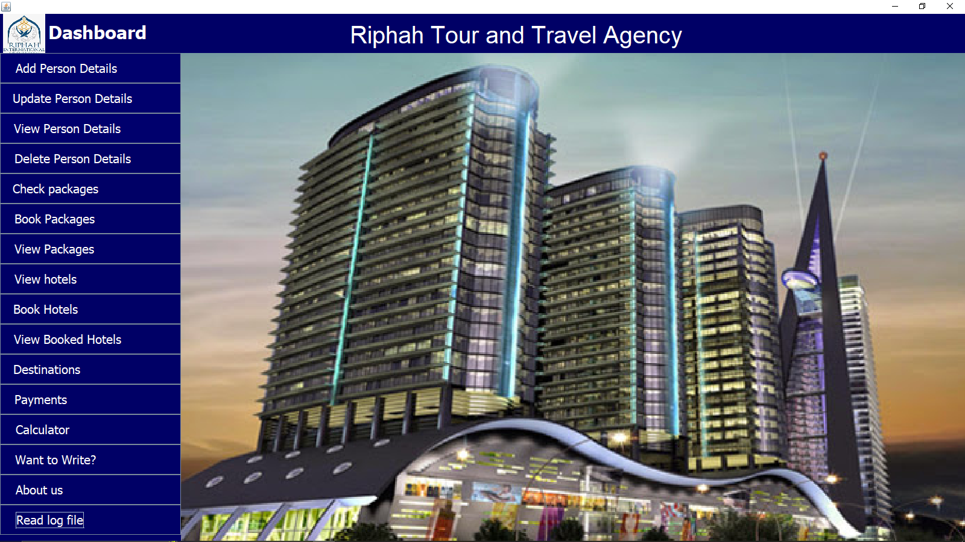

Slide 7
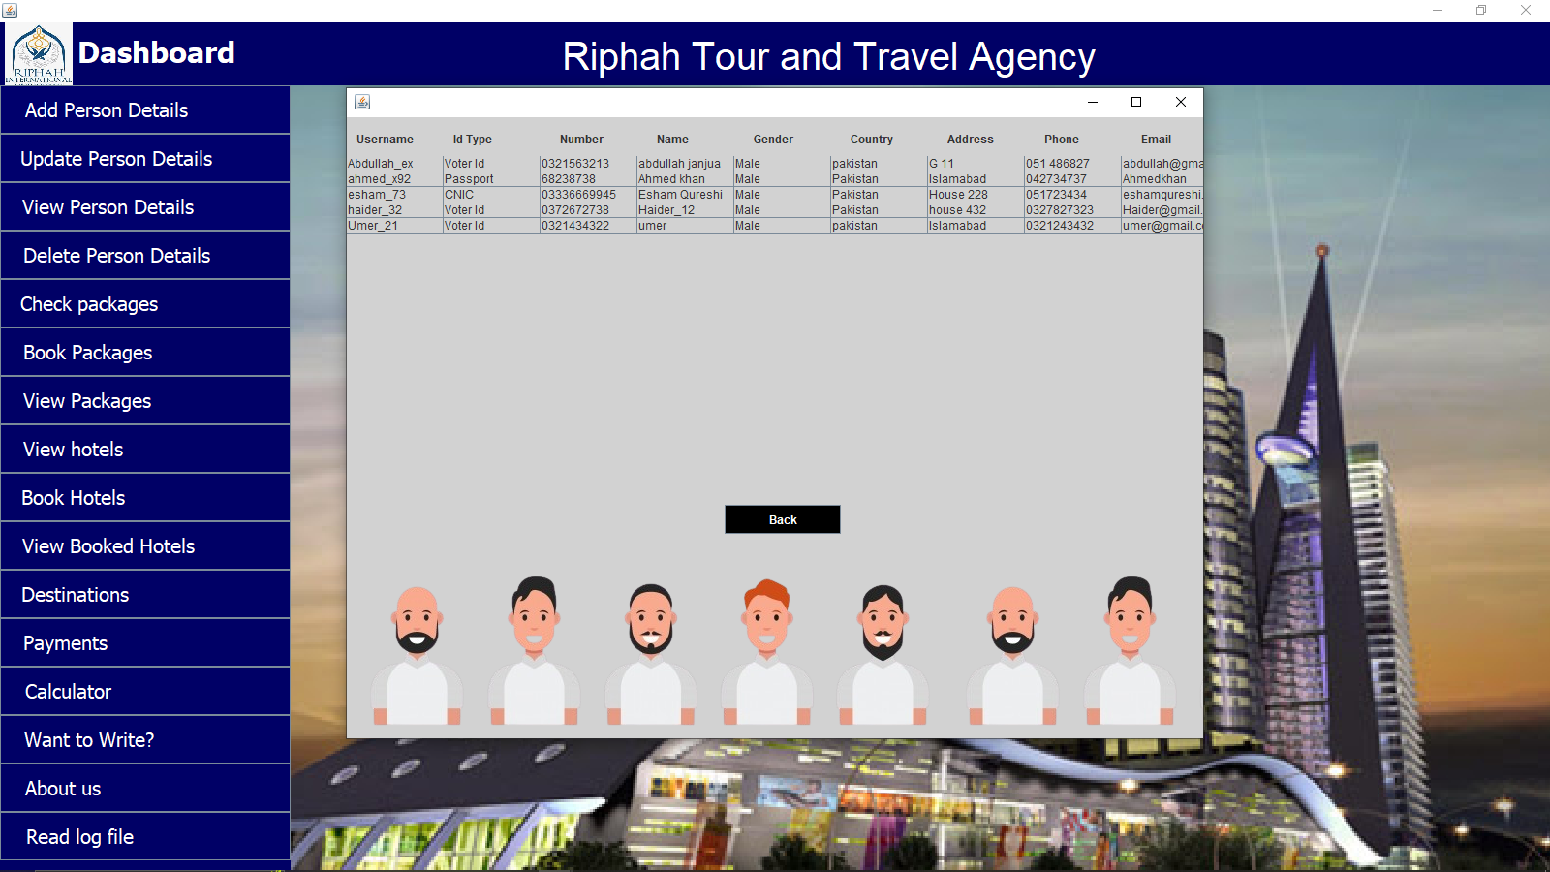
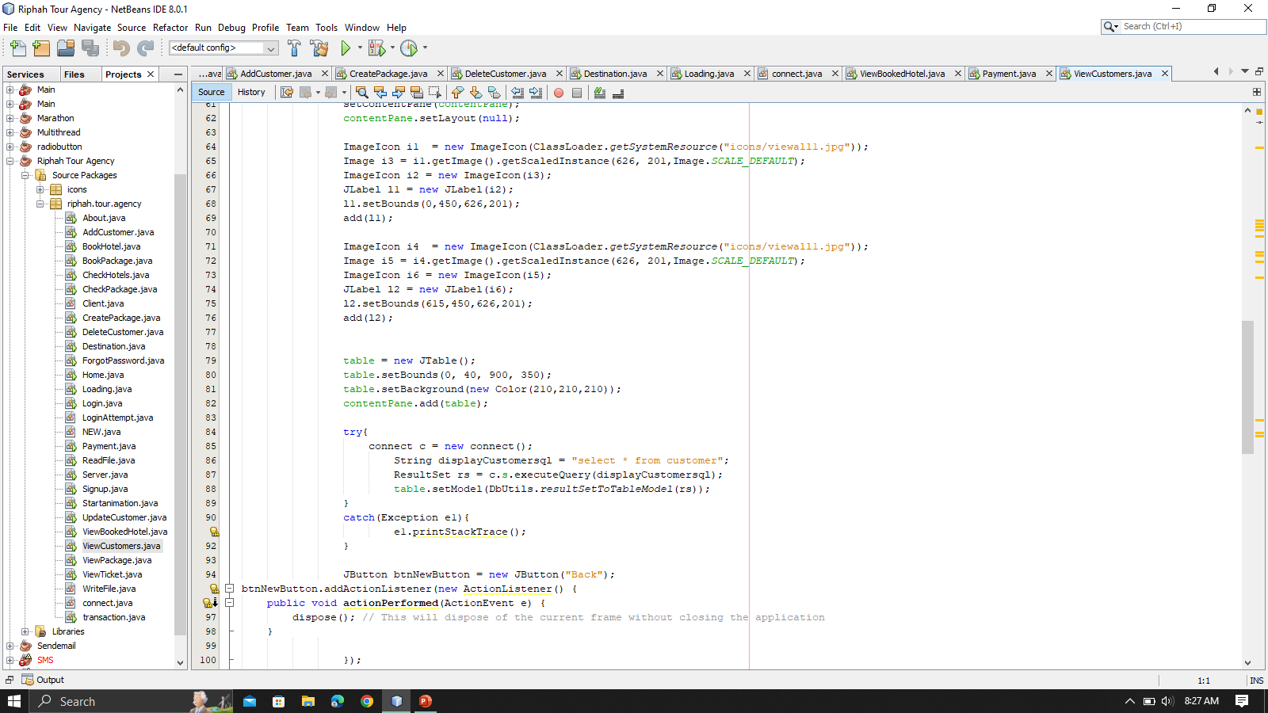
View All Customer

Slide 8
JDBC

Slide 9
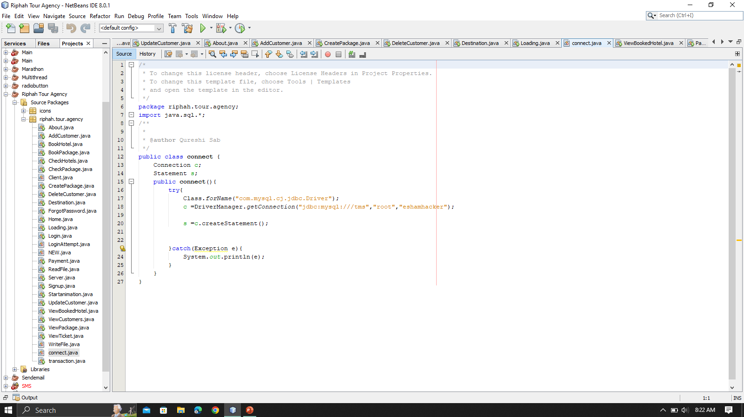
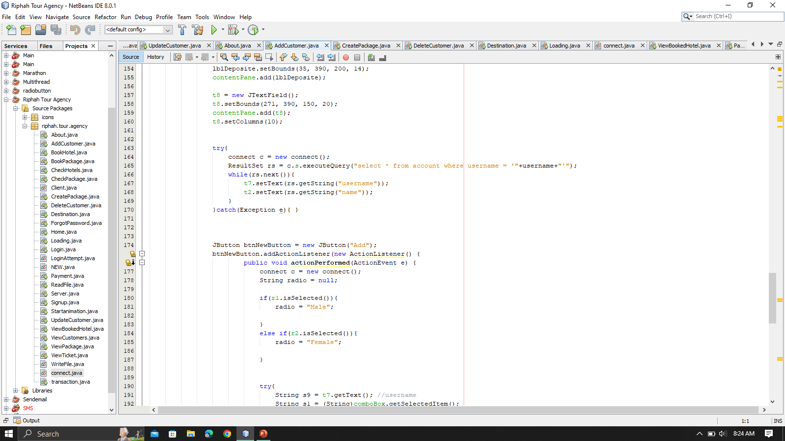

Slide 10
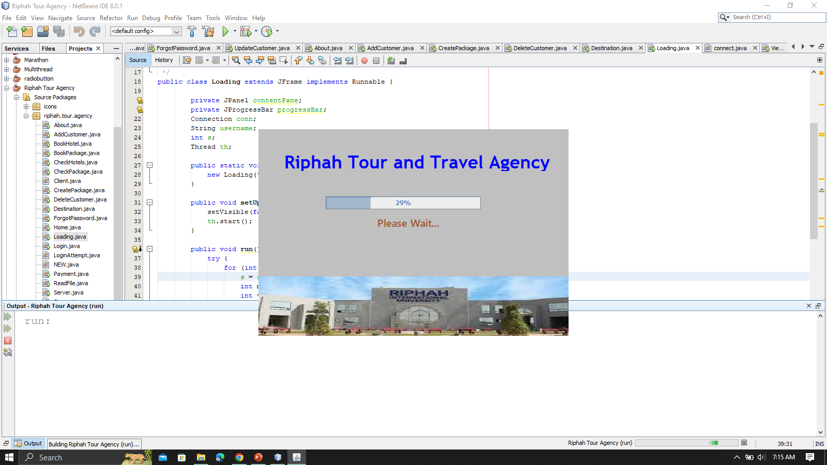
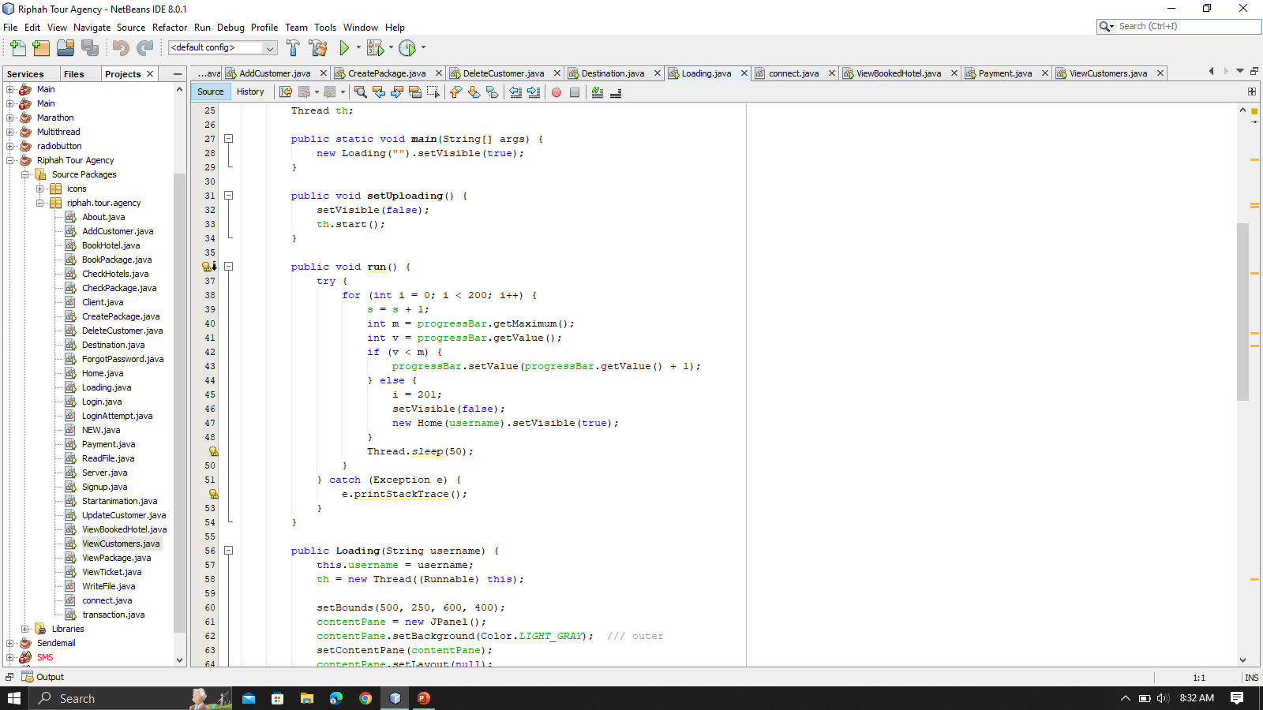
Threading

Slide 11
File Serialization

Slide 12
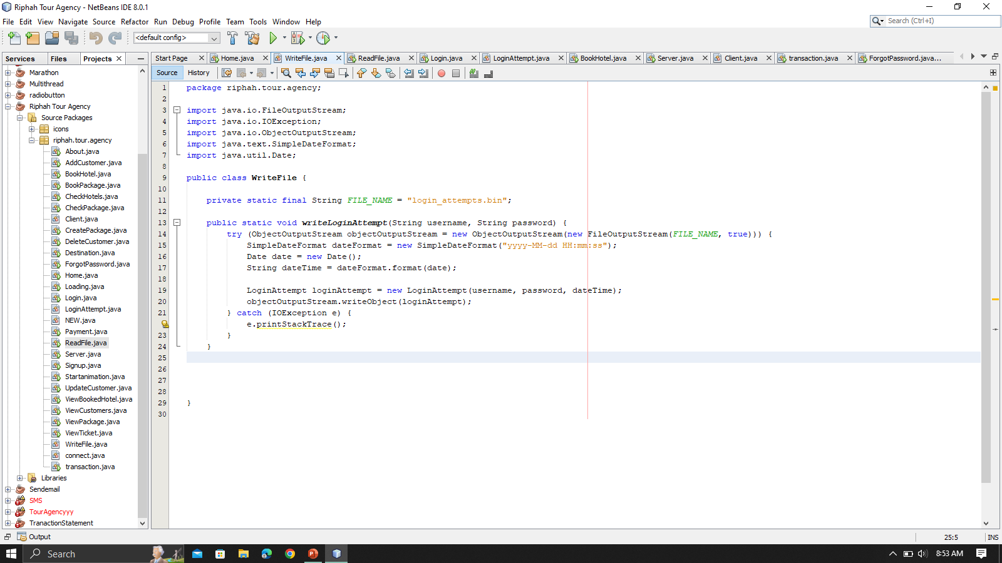
File Serialization

Slide 13
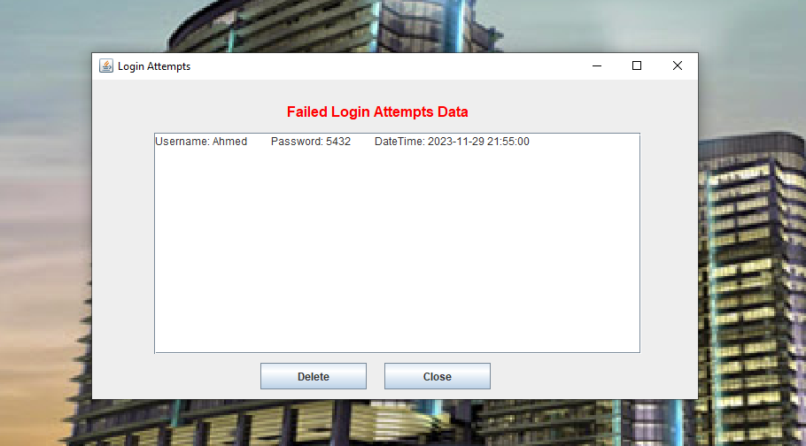

Slide 14
Sockets

Slide 15
public static void main(String[] args) {
int portNumber = 54321;
while(true){
try (ServerSocket serverSocket = new ServerSocket(portNumber)) {
System.out.println("Server is waiting for client connection on port " + portNumber)
// Wait for a client to connect
Socket clientSocket = serverSocket.accept();
System.out.println("Client connected");
// Create input and output streams for communication with the client
BufferedReader in = new BufferedReader(new InputStreamReader(clientSocket.getInputStream()));
PrintWriter out = new PrintWriter(clientSocket.getOutputStream(), true);
String inputLine;
while ((inputLine = in.readLine()) != null) {
System.out.println("Client: " + inputLine);
// Send a response back to the client
out.println("Booking Confirmed.... "); }

Slide 16
public void req( {
String serverAddress = "localhost";
int portNumber = 54321;
// Create a socket and connect to the server
Socket socket = new Socket(serverAddress, portNumber);
// Create input and output streams for communication with the server
PrintWriter out = new PrintWriter(socket.getOutputStream(), true);
BufferedReader in = new BufferedReader(new InputStreamReader(socket.getInputStream()))
) {
// Hardcoded message to send to the server
String messageToSend = "Please Confirm the Booking";
// Send the hardcoded message to the server
out.println(messageToSend);
// Receive and print the server's response
System.out.println("Server: " + in.readLine());
}

Slide 17
Let’s take a view of Project

