Slide 1

Parallel and Distributed Computing
BY
Tajamul Shahzad
Lecturer at Riphah international university Islamabad

Slide 2
Teacher Introduction
Join Riphah Since March 2022
Did MSCS from Bahria University.
BSCS from Arid Agriculture university.

Slide 3
Course Introduction
Parallel and Distributed Computing
Pre-Requisities : OOP + Databases

Slide 4
Marks Distribution
Quizzes + Activities: 25 %
Class Participation: 5%
Project: 15%
Midterm: 25%
Final Exam: 30 %
*Tentative

Slide 5
Class rules
Half absent after 20 minutes will be marked.
Failed to bring a working setup laptop in class will result in an absent
Misbehavior will result in negative marking in class participation marks
Cheating will be marked as zero
No change in quiz/mid/final marks will be entertained in the final week of the semester.
Make efforts during the semester
No personal favors will be given at the end.

Slide 6
Let’s start this course!

Slide 7
What is computing?
Process to complete a given goal-oriented task using computer technology
Ex. Structuring, Processing, Managing Information
Notes:
https://www.khanacademy.org/computing/ap-computer-science-principles/algorithms-101/x2d2f703b37b450a3:parallel-and-distributed-computing/a/parallel-computing
Quinn, M. J. (2015). Parallel Programming in C with MPI and OpenMP. McGraw-Hill Education.

Slide 8
What is Parallel?
In Mathematics: Parallel means two lines that never intersect
Ex. Equal sign =
Notes:
https://www.khanacademy.org/computing/ap-computer-science-principles/algorithms-101/x2d2f703b37b450a3:parallel-and-distributed-computing/a/parallel-computing
Quinn, M. J. (2015). Parallel Programming in C with MPI and OpenMP. McGraw-Hill Education.

Slide 9
What is parallel computing?
Parallel computing on a single computer uses multiple processors to process tasks in parallel [1].
Parallel computing involves the simultaneous execution of multiple computational tasks to solve a single problem. Tasks are broken down into smaller subtasks that can be executed concurrently, on multiple processors within a single computer (shared-memory parallelism) [2]
We will study more about tasks and parallelism and memory types in more detail later-on in this course.
Notes:
https://www.khanacademy.org/computing/ap-computer-science-principles/algorithms-101/x2d2f703b37b450a3:parallel-and-distributed-computing/a/parallel-computing
Quinn, M. J. (2015). Parallel Programming in C with MPI and OpenMP. McGraw-Hill Education.

Slide 10
What is distributed computing?
Distributed computing refers to the coordination and collaboration of multiple independent computers or nodes working together to achieve a common computational goal.
Each node typically has its own memory and processing capabilities and communicates with other nodes via a network. Tasks are distributed among these nodes, and each node works on its assigned portion of the problem independently [1].
Distributed computing is suitable for tasks that need to scale across multiple systems, like large-scale data processing, where resources are spread across different physical locations.
A distributed system is a collection of independent computers that appears to its users as a single coherent system[1].
Notes:
1. Tanenbaum, A. S., & van Steen, M. (2016). Distributed Systems: Principles and Paradigms. Pearson Education.

Slide 11
Difference?
Aspect | Parallel Computing | Distributed Computing
Task Execution | Multiple processors perform parts of a single task simultaneously. | Multiple computers execute different tasks or parts of a task across a network.
System Architecture | Typically uses shared memory and a single machine. | Involves multiple independent machines with distributed memory.
Communication | Communication between processors is usually faster due to shared resources. | Communication is slower due to network latency and inter-machine communication.

Slide 12
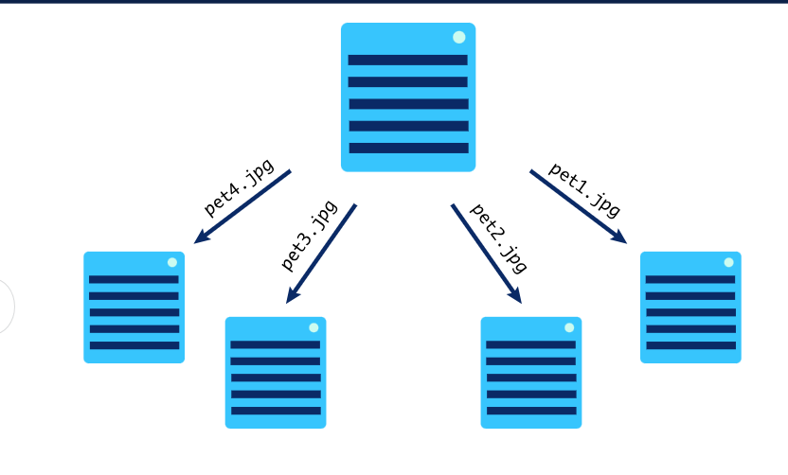
distributed computing
In a distributed computing approach, a managing computer would send the image information to each of the worker computers and each worker would report back their results.

Slide 13
Importance of parallel computing in modern world
Consider the example of weather forecasting from which we have to predict what will be weather in Rawalpindi in the next 2 days.
The model will check the atmosphere of some area of land let's say Punjab and split it into cubes of certain width , height, and depth.
Air pressure and temperature of all these cubes will be gathered and mathematical models will be applied on this information to predict weather.
To improve accuracy and reduce error cubes can be broken down into even more small cell resulting in more number of total cubes.
Processing this much number of cubes and all this information require additional computational resources
Else it will be difficult to forecast weather efficiently.

Slide 14
Importance of parallel computing in modern world
Parallel and distributed computing in other words help us to fasten real-world problem-solving in many domains.
Other applications of PDC include (but are not limited to ) artificial research, machine learning models training, protein discovery etc.

Slide 15
Introduction to parallelism : Formal start of parallel computing and programing

Slide 16
Sequential Computing
Usually, programs are written by keeping serial/sequential execution model in mind.
A program is composed of a sequence of instructions ( arithmetic , read or write from memory etc).
… to be run on a computer with a single processor.
Instructions are executed one after the other, only one at a time

Slide 17
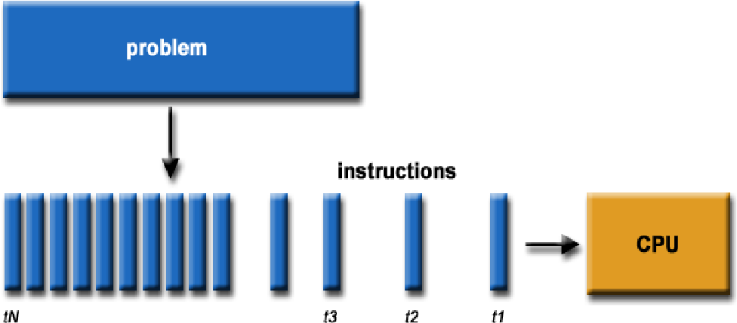
Sequential Computing
Notes:
Published in 2014
SERIAL COMPUTING vs. PARALLEL COMPUTING: A COMPARATIVE STUDY USING MATLAB

Slide 18
Execution time of a serial/sequential program
If a program has N instructions and the processor can execute F instructions per second, the total time T to run the program is simply N divided by F.
T=N / F
T is the execution time. N is the number of instructions in the program. F is the processor's speed, measured in instructions per second.
One could execute the program faster(i.e. reduce T) by augmenting the value of F and this has been the trend during more than 30 years of technology and computer architecture evolution.
Augmenting F means we still have the same model, but we will enhance the processors so that they will be able to execute more instructions per second
This is where parallelism comes into existence.

Slide 19
Parallel Execution of program
We split the program ( mentioned in the previous slide) into discrete parts, to be called tasks, and use multiple processors to execute those tasks at the same time.
As shown in next slide…

Slide 20
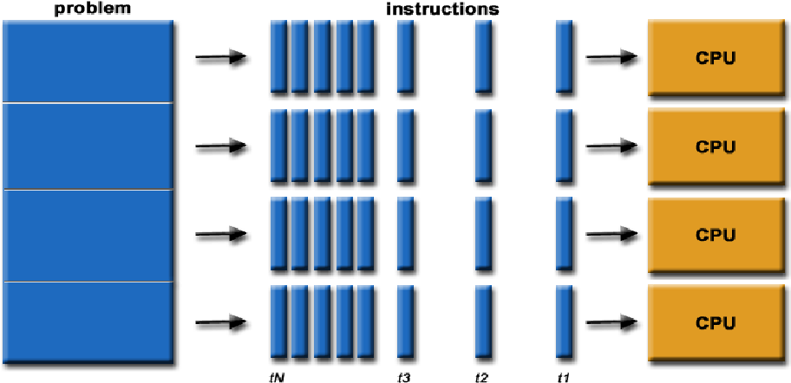
Parallel Execution
Notes:
4 tasks here

Slide 21
Parallel Execution
What about the data of the program?
The variables used in the program.
How they will be treated?
We will handle it according to shared memory and distributed memory architectures.

Slide 22
Parallel Execution
Ideally, each processor could receive 1/P of the program hence reducing its time execution by P.
T=(N/P) / F
Where P is the no of processors that we are using.
This formula shows the execution time when you use P processors. N / P means that each processor is responsible for handling 1/P (a fraction) of the total instructions N.
Since each processor is working on a smaller portion of the program, the execution time T is reduced.
If you have 4 processors (P = 4), each processor will handle 1/4 of the total instructions. Theoretically, this should reduce the execution time by a factor of 4, making the program run 4 times faster compared to using just one processor.

Slide 23
WHY we are building parallel systems
Rather than building ever-faster, more complex, monolithic processors, the industry has decided to put multiple, relatively simple, complete processors on a single chip.
Such integrated circuits are called multicore processors,
Core has become synonymous with the central processing unit, or CPU.
In this setting a conventional processor with one CPU is often called a single-core system.
Then these high-power multi-core processors are used to perform scientific computing in various fields.

Slide 24
WHY WE NEED TO WRITE PARALLEL PROGRAM
Most programs that have been written for conventional, single-core systems cannot exploit the presence of multiple cores.
For example, being able to run multiple instances of our favorite game program isn’t really what we want—we want the program to run faster with more realistic graphics.
To do this, we need to either rewrite our serial programs so that they’re parallel, or write translation programs, that is, programs that will automatically convert serial programs into parallel programs.
In short, to truly benefit from multi-core processors, we either need to update old programs or develop tools that can convert them into versions that can run faster by using all the available cores.

Slide 25
Motivation behind writing parallel programs cont.. SUPER COMPUTERS
Supercomputers are general-purpose computers that function at the highest operational rate or peak performance for computers.
E.g., weather modeling, climate research, and complex simulations
The performance of a supercomputer is commonly measured in floating-point operations per second (FLOPS) instead of million instructions per second (MIPS).
MIPS is often used for general-purpose processors but does not accurately reflect the performance of systems used for scientific computations

Slide 26
Difference of FLOPS and MIPS
Metric | FLOPS (Floating-Point Operations Per Second) | MIPS (Million Instructions Per Second)
Context | Supercomputer used for weather simulation | Personal computer executing a basic program
Task | Simulating atmospheric pressure changes across a global grid | Adding numbers in a list using a loop
Operation | Multiplying and adding floating-point numbers | Loading, adding, and storing numbers
Example | New Pressure=Current Pressure×Temperature Factor+Altitude Adjustment\text{New Pressure} = \text{Current Pressure} \times \text{Temperature Factor} + \text{Altitude Adjustment}New Pressure=Current Pressure×Temperature Factor+Altitude Adjustment | 1. Load number from memory 2. Add to accumulator 3. Store result back in memory
Performance | 1 quadrillion operations per second = 1 petaflop (1 PFLOPS) | 500 million instructions per second = 500 MIPS
Use Case | High-performance computing tasks, scientific simulations | General-purpose computing tasks

Slide 27
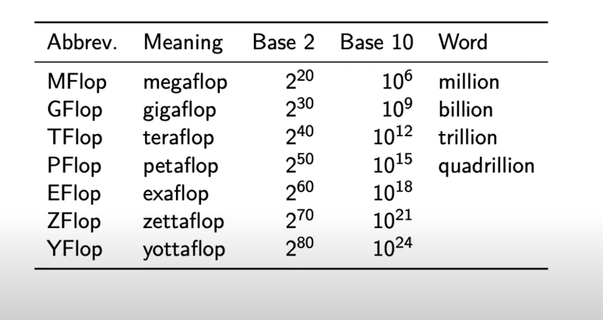

Slide 28

Motivation behind parallelism
This organization keeps track of top 500 fastest known computers around the world.
https://www.top500.org/lists/green500/2023/11/

Slide 29
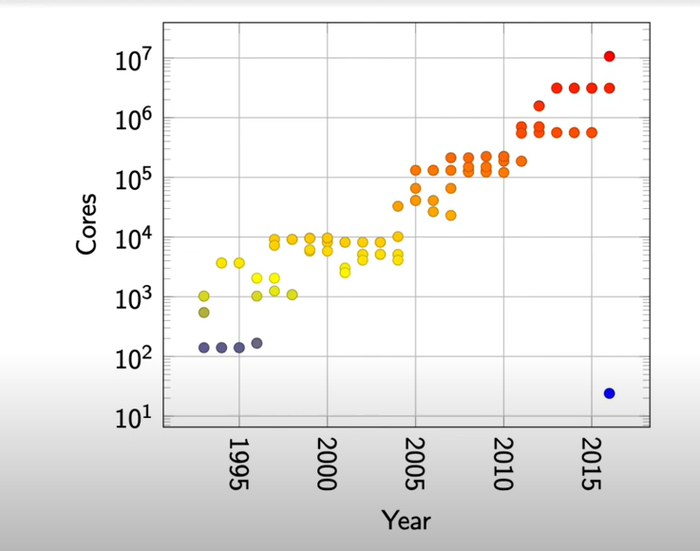
Processor cores
Notes:
10 million processor cores

Slide 30
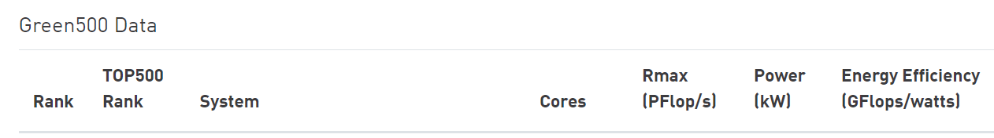

High performant computers are parallel machines

Slide 31
Tasks
Convert a simple loop that processes an array sequentially into a parallel loop.
Divide the array into chunks and compute the sum of each chunk in parallel using multiple processes.
Implementing a Simple Producer-Consumer Problem Objective: Use threads to implement the producer-consumer problem where the producer generates data, and the consumer processes it.
Implementing Parallel Matrix Multiplication Objective: Multiply two matrices in parallel by dividing the computation of the resulting matrix into independent tasks.
Parallel Sorting with Merge Sort Objective: Implement a parallel version of the merge sort algorithm using multiple threads.

Slide 32
Thank You

