Slide 1
Network Intrusion Detection System
Group 5
Joao Lucas Veras, Eshan Chawla, Uday Arora, Aryan Dandwekar

Slide 2
Contents
Main Idea
Work Done
Performance Metrics and Evaluation
Future Work

Slide 3
Main Idea

Slide 4

Problem and Motivation
Current modern network infrastructures face many different security threats
  Attacks from DDoS to application-layer attacks like SQL Injection
Traditional rule-based intrusion detection system have many flaws
  Can’t adapt to new patterns
  Overwhelmed by high-volume traffic
Question we asked ourselves
  How can we improve the current system?

Slide 5
Solution
Leverage predictive power of ML to create a Network Intrusion Detection System (NIDS)
  Accurate and capable to flexibly detect different attack signatures
Final outcome: Supervised machine learning framework utilizing NetFlow v3 dataset (NF-UNSW-NB15-v3)
  Preprocessing Utility
  Balancing and Sampling
  Model Benchmarking
Notes:
Explain regarding what ml does and how does it apply to this project

Slide 6
Work Done & Challenges Faced

Slide 7
Challenges and Implementation
Challenge 1 : Multiple Datasets and Netflow Versions [Learnings from Case Study]
Solution : Used the latest Netflow V3 to get multiple benchmark datasets like :
→ UNSW-NB15 [2,365,424 data flows , 5.4% attack samples]
Classes : Fuzzers, Backdoor, DoS, Exploits, Generic, Reconnaissance, Shellcode, and Worms.
→ ToN-IoT [27,520,260 data flows , 38.98% attack samples]
Classes : Backdoor, DoS, DDoS, Injection, MITM, Password, Ransomware, Scanning, and XSS.
→ BOT-IoT [16,993,808 data flows , 99.7% attack samples]
Classes : Reconnaissance, DDoS, DoS, and Theft.
→ CSE-CIC-IDS2018 [20,115,529 data flows , 12.9% attack samples]
Classes : BruteForce, Bot, DoS, DDoS, Infiltration, Web Attacks

Slide 8
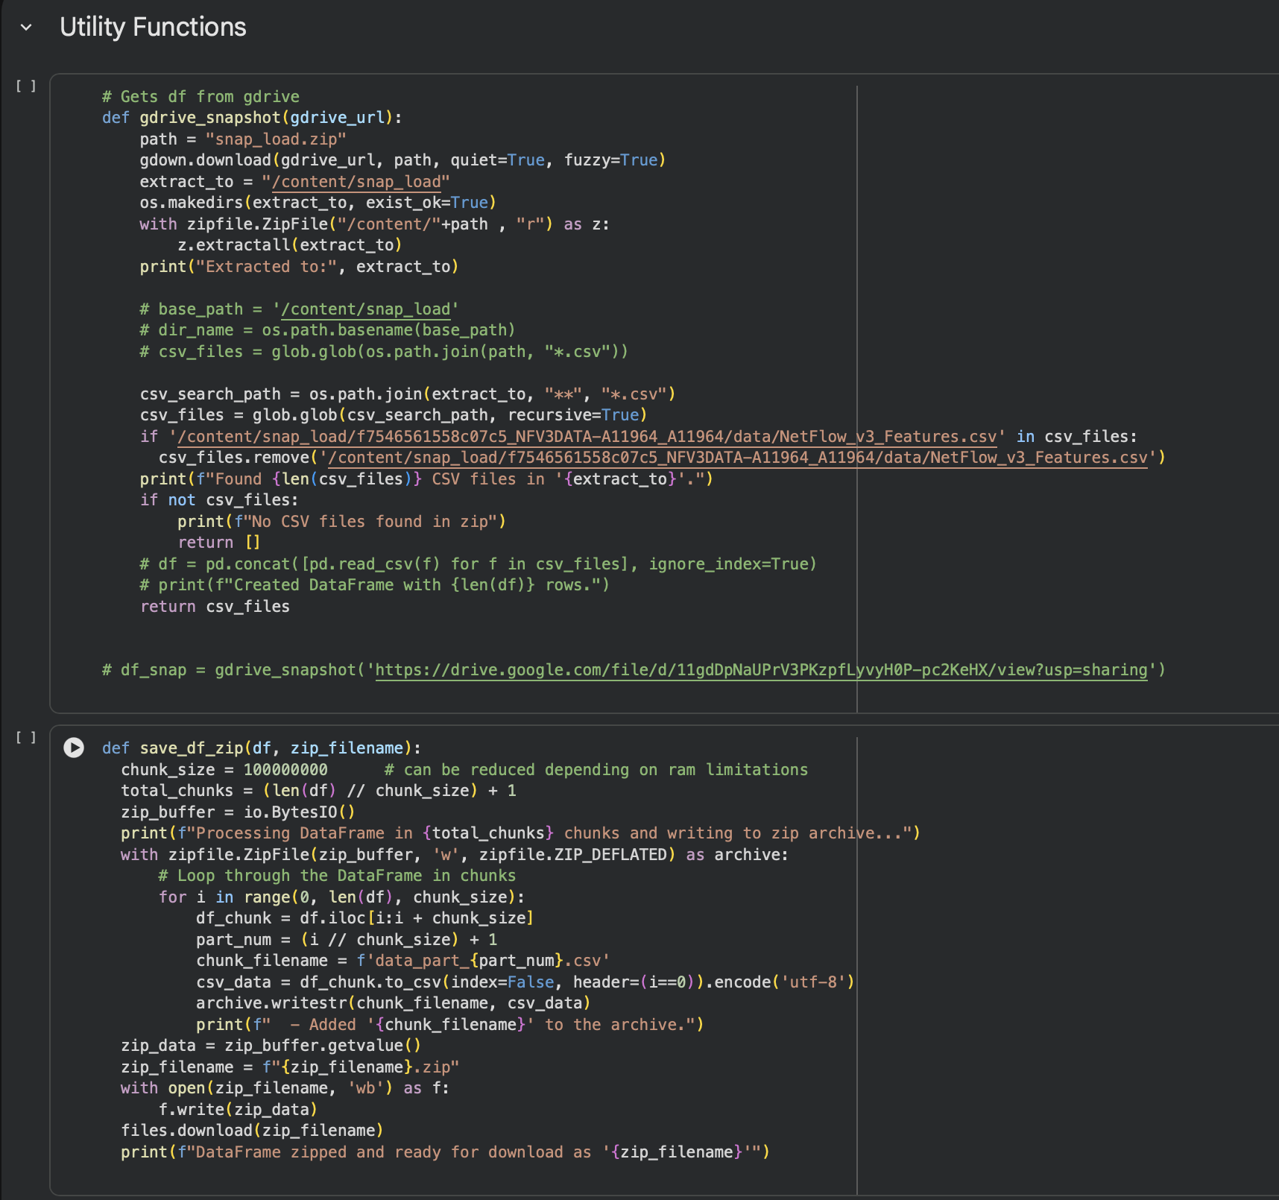
Challenges and Implementation
Challenge 2 : Very big dataset
66,995,021 records and 53 features
43 [Attributes] + 10 [Temporal features]
Solution :
Utility functions to download data frames and retrieve them from google drive to work efficiently made from the start along with a clear project structure.

Slide 9
Challenges and Implementation
Challenge 3 :
Testing binary classification for multiple attack types [12 variations]
→ 3 chosen models
→ 12 dataset versions [11 attack types + 1 multi class]
Testing binary classification for multiple attack types [12 variations]
→ 3 X 12 = 36 variations

Slide 10
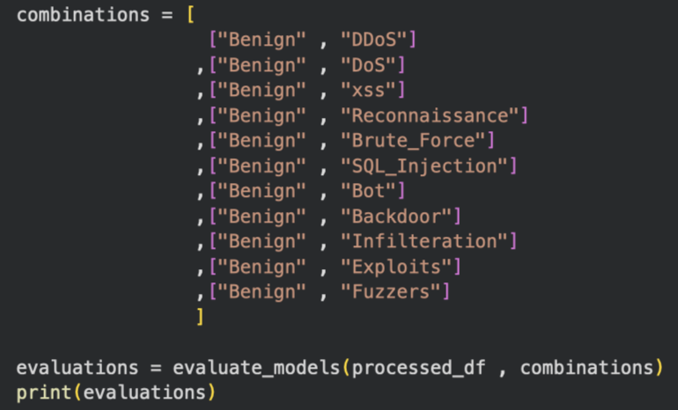
Challenges and Implementation
Solution :
Entire feature engineering, model training and evaluation pipeline is modular !
[Can be made into a package with minor changes in the future]
Results shared in next section

Slide 11
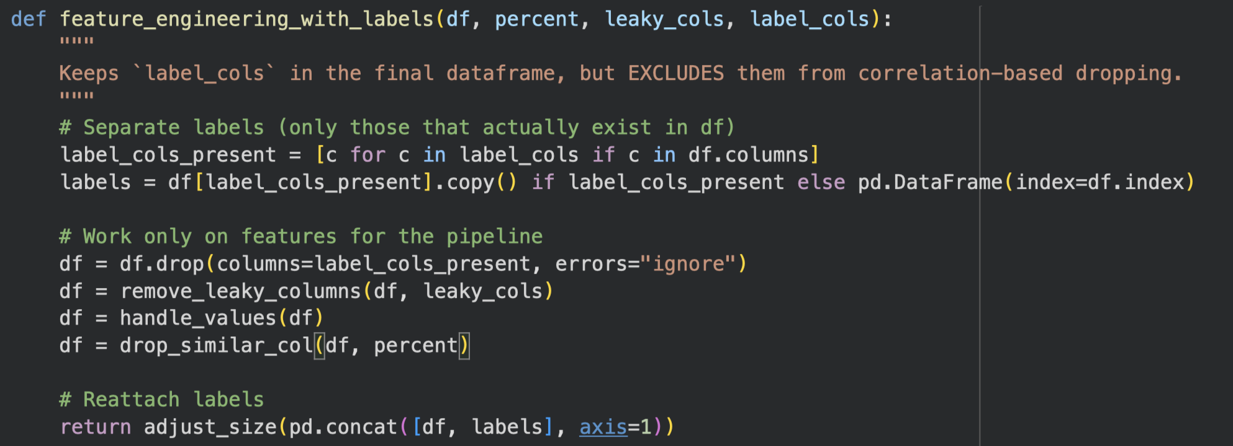
Feature Engineering Pipeline
Params : df , percentage_similarity, leaky_cols , label_cols

Slide 12
Feature Engineering Pipeline
Steps :
→ Seperate Labels
→ Remove leaky columns that can lead to overfitting
→ Handle infinite values and duplicate columns
→ Remove highly correlated columns [95% Threshold]
→ Reduce samples in every category [Max 300k records per category]

Slide 13
Models and Training
→ Logistic Regression [Baseline]
→ KNN [Distance Based]
→ Random Forest [Ensemble Learning]

Slide 14
Models, Metrics and Result Evaluation

Slide 15
Baseline Evaluation: Logistic Regression
Linear modeling struggled significantly, yielding a low 19.4% accuracy for multiclass classification.
Complex attacks like DDoS were detected with only ~52.6% accuracy, barely outperforming random chance.
High False Alarm Rates (~47.4% for DDoS) indicate the model cannot effectively separate attack traffic from noise.
The inability to generalize to Botnets (53.4% accuracy) confirms that linear boundaries are insufficient for NIDS.
Notes:
Why Chosen: Simple, fast baseline to test for linear patterns.
Performance: Worst performer; failed significantly on Multiclass and DDoS.
Critical Flaw: Extremely high False Alarm Rate (up to 47%).
Takeaway: Causes massive "Alert Fatigue" — unsuitable for real-world security.

Slide 16
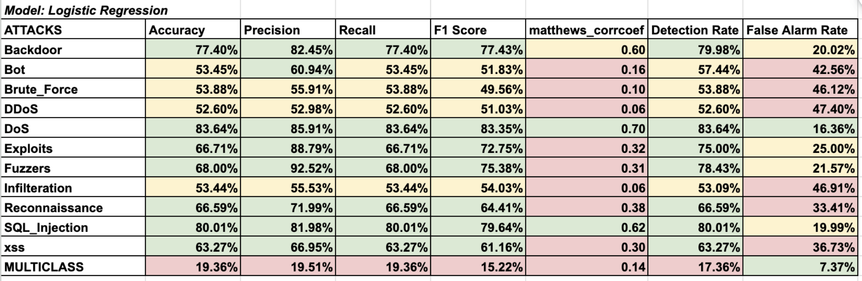
Baseline Model Results: Logistic Regression

Slide 17
Distance-Based Classification: K-Nearest Neighbor
The non-parametric approach improved multiclass accuracy to 87.0%, demonstrating better pattern recognition.
Botnet detection spiked to 99.9%, proving the model is highly effective against automated network threats.
Infiltration attempts were identified with 95.6% accuracy, significantly outperforming the baseline on stealthy attacks.
Despite improvements, the model still struggled with false alarms for DDoS traffic (~2.2%), requiring further optimization.
Notes:
Why Chosen: To test distance-based anomaly detection.
Performance: Significant improvement over Logistic Regression.
Weakness: Struggled with specific attacks like Backdoor.
Verdict: Better than baseline, but outperformed by Random Forest in multiclass scenarios.

Slide 18
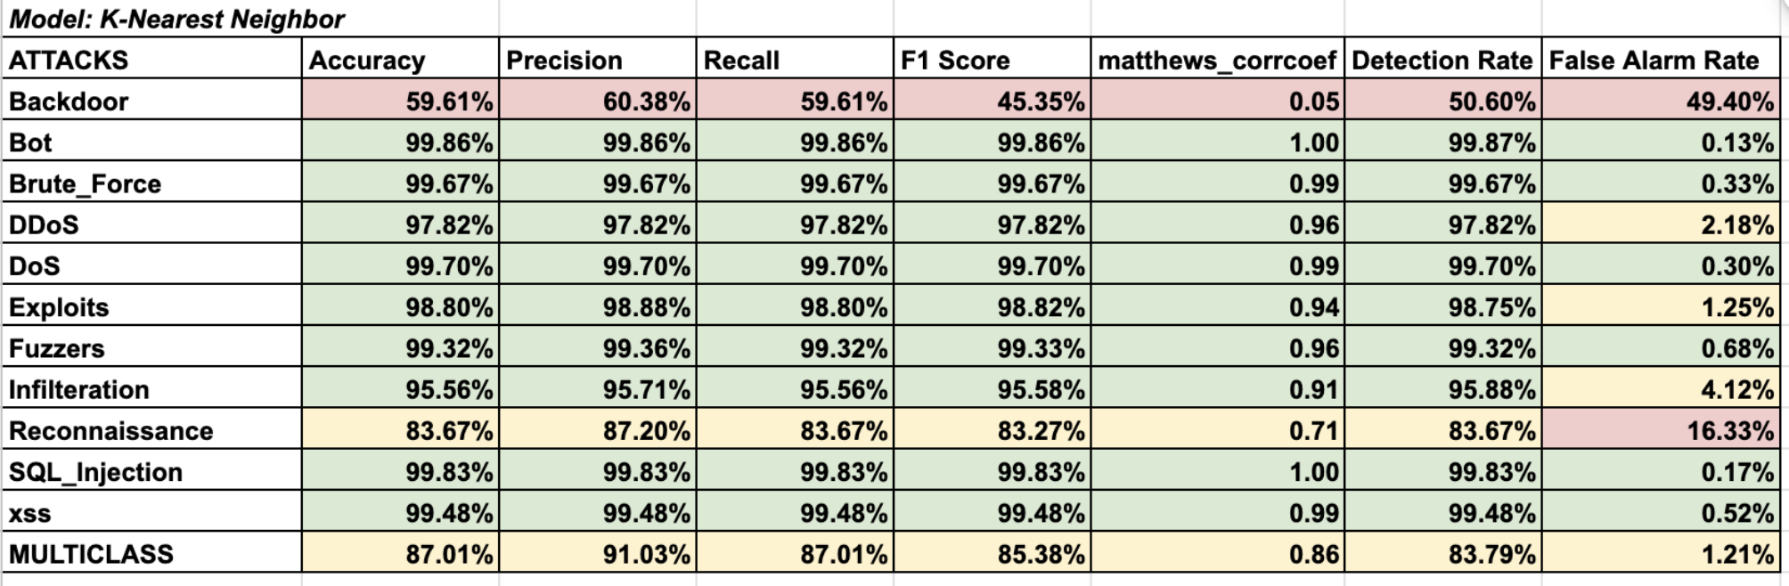
Distance-Based Model Results: K-Nearest Neighbor

Slide 19
Ensemble Method Analysis: Random Forest
The ensemble architecture achieved the highest stability with a superior 97.7% weighted average accuracy.
Critical DDoS attacks were identified with 99.6% precision, ensuring robust protection against service disruptions.
False Alarm Rates for high-volume attacks dropped to a negligible 0.3%, solving the reliability issues of simpler models.
Stealthy Infiltration attempts were captured with 96.5% accuracy, the best performance across all tested algorithms.
Notes:
Why Chosen: Ensemble architecture prevents overfitting (crucial for simulated datasets).
Performance: Best results (~98% accuracy); generalizes well across all attack types.
Key Win: Respectable False Alarm Rate (lowest ~2%) — solves the "Alert Fatigue" problem.
Observation: Models struggled with payload-reliant attacks (expected, as NetFlow lacks payload).
Surprise: They still detected some payload attacks (likely via behavioral side-effects).
Next Step: Need to validate on real-world traffic to ensure these results aren't just simulation artifacts. -> (Transition to Future Work)

Slide 20
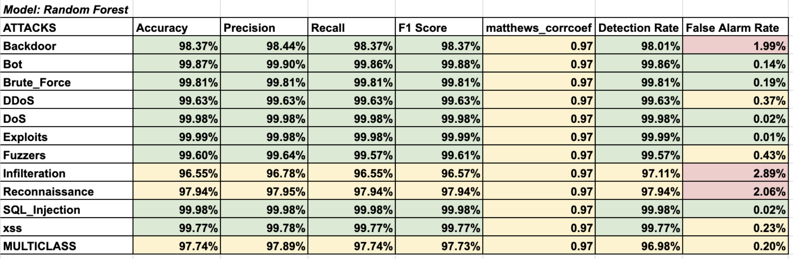
Ensemble Model Results: Random Forest

Slide 21
Recommendations and Future Works

Slide 22
Encrypted and Payload Content
Use TLS handshake features (cipher suite, certificate length, JA3 fingerprints)
Use statistical payload analysis (packet size, entropy, timing patterns)
Explore side-channel analysis for encrypted flows
Notes:
We want to make our model that could handle encrypted or payload-less traffic in the future. Instead of trying to see inside the payload, we’d rely on what’s still visible. One idea is to use TLS handshake features—things like the chosen cipher suite, certificate length, or even JA3 fingerprints—to build a kind of behavioral profile for each connection. On top of that, we can do statistical analysis of the payload characteristics we can see, such as packet size distributions, entropy, and timing patterns between packets. Together, these effectively become side-channel signals that help us spot suspicious encrypted flows, even when we can’t decrypt the data itself.

Slide 23
Hybrid Detection System
Combine NetFlow-based ML with Deep Packet Inspection (DPI)/host logs.
Working: Flow Model (First Layer)
Fast, Scalable which is the first filter.
Flags suspicious patterns (high volume, weird ports, unusual connections)
DPI/Host Analysis (Second Layer)
Triggered only for flagged flows
Check payload, system logs, malware signatures
Notes:
To make hybrid detection system, the idea is to combine our NetFlow-based model with deep packet inspection. In a hybrid setup, the model acts as a fast “First Pass” filter, whenever it flags something as suspicious, that automatically triggers a heavier analysis layer, like Deep Packet inspection or host-based logs that second layer can then look at the actual data content, system processes or malware signatures that the flow features can’t capture. So overall, you get the best of both worlds, speed and scalability from Netflow, plus forensic depth when you really need to zoom in.

Slide 24
Real-time network simulation & live model deployment
Simulate live DoS, DDoS, brute-force attempts
Send real traffic into the trained model via middleware
Measure latency, throughput, packet drop rate with model in loop
Notes:
The idea is to deploy our model in a virtual environment and then generate real traffic, including attacks such as DoS, DDoS, or brute-force attempts. That traffic would be converted into NetFlow-style features and sent to our trained model through a middleware layer. This will help us to check not only if the model still detects attacks correctly in a noisy real environment, but also measure important system metrics like latency, throughput, and packet drop rate.

Slide 25
Comparison with Deep Learning models
Move beyond basic ML to DL models such as
Convolutional Neural Network (CNN): Ideal for spatial feature extraction in packet headers or flow statistics.
Long-Short Term Memory (LSTM) Network: Capture temporal dependencies and sequential patterns in network traffic over time.
Notes:
Compare the current basic Machine Learning (like Random Forest, Logistic Regression, K-NN) to Deep Learning models such as Convolutional Neural Network for spatial feature extraction or Long Short-Term Memory (LSTM) networks to capture temporal dependencies in network traffic. Using DL models the ability of the model will be enhanced to identify complex, low-volume, and novel attacks that basic models might miss.

Slide 26
References
[1] Dataset Paper : Luay, M., Layeghy, S., Hosseininoorbin, S., Sarhan, M., Moustafa, N., & Portmann, M. (2025). Temporal analysis of NetFlow datasets for network intrusion detection Systems. arXiv (Cornell University). https://doi.org/10.48550/arxiv.2503.04404
[2] Case Study Paper: Sarhan, M., Layeghy, S., & Portmann, M. (2021). Towards a standard feature set for network intrusion detection system datasets. Mobile Networks and Applications, 27(1), 357–370. https://doi.org/10.1007/s11036-021-01843-0
[3] Code Notebook:
https://drive.google.com/file/d/1B4WhYcyInRXWl-pwRsj-9xrWHaSBYmq8/view?usp=sharing
[4] NIDS Dataset:
https://staff.itee.uq.edu.au/marius/NIDS_datasets/

