Slide 1
Network Intrusion Detection
TEAM 5
Mid Term Presentation
CMPE 257 sec-02
Group Members - Eshan Chawla, Aryan Dandwekar, Joao Lucas Veras, Uday Arora

Slide 2
Contents
Introduction and Approach
Idea Background and Objectives
Feature engineering
Model Training and Evaluation
Future Work and Scope
QnA
References

Slide 3
Project roadmap
Goal
Step 1
Step 2
Step 3
Step 4
Topic and Dataset Finalisation
Data Cleaning and Feature Engineering
Model Training and Benchmarking
Testing and Inference of system
Publishing work on Github
(Open Source)

Slide 4
Idea Background and Objectives

Slide 5
The price of data security ?
Need of ML ?
We want to build an machine learning system that detects attacks to an restricted network to avoid unauthorised access of proprietary data.
To do this we need and Network Intrusion Detection System which helps identify anomalies in network for threat detection

Slide 6
Types of Attacks
Dos / DDos
SQL Injection
XSS (Cross Site Scripting)
Malicious users try to overwhelm our servers by sending an enormous number of requests so that the real users suffer.
This is a very common vulnerability as exposed endpoints with no rate limiting of resource intensive operations can cost money.
Here an attacker impersonates SQL in the response to the website which gets executed at the server
This is a developer side vulnerability which can be avoided if you use good ORM’s and modern frameworks.
Attacker impersonates the server to run malicious scripts in the users browser to steal data, retrieve session tokens.
This is a very difficult attack to detect as for the server it is very difficult to know the exact state of the users system.

Slide 7
Work/Analysis done so far

Slide 8
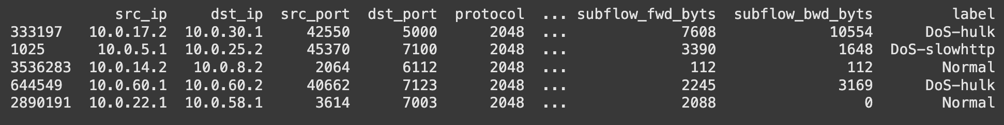
Overview of FLNet 2023 Dataset
Dataset size
  82 flow-based features
  3,653,136 records
Traffic Types
  Includes both benign traffic and wide range of attacks
    DoS and DDoS
    Web Attacks (XSS, SQLi, Command Injection)
    Infiltration
Generated by the Fraunhofer Institute for Communication, Information Processing and Ergonomics (FKIE)
Data was captured using a CORE-emulated environment
  Simulates large-scale ISP network that provides realistic and complex traffic patterns

Slide 9
Feature Engineering

Slide 10
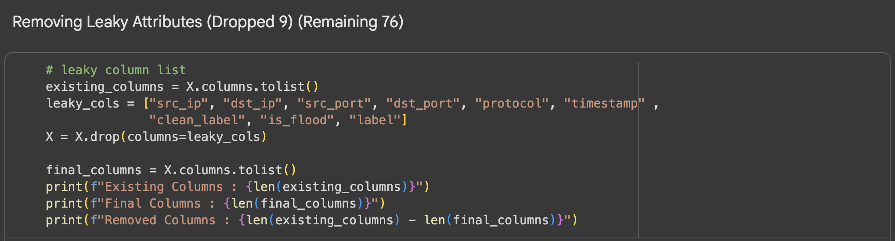
Removed Leaky Attributes
To prevent data leakage, which causes the model to learn information from the target variable and leads to unrealistically high accuracy and poor real-world performance.

Slide 11
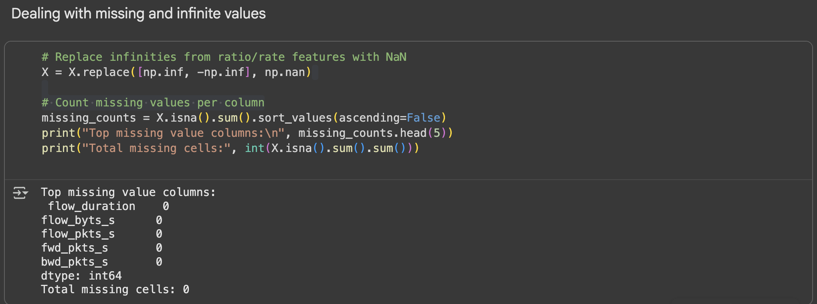
Checking for Missing and Infinite Values
To remove features that provide no useful information (constant values) or cause computational errors (infinite values) during model training.

Slide 12
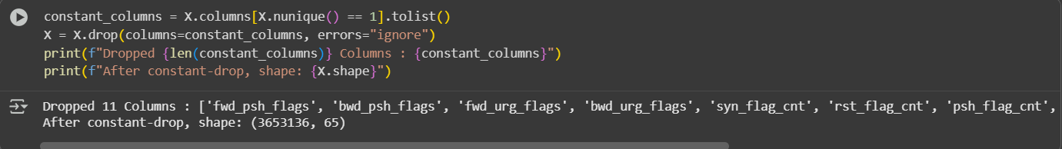
Dropping Constant Value Attributes
To eliminate features that don’t vary across samples, as they provide no predictive power to the model.

Slide 13
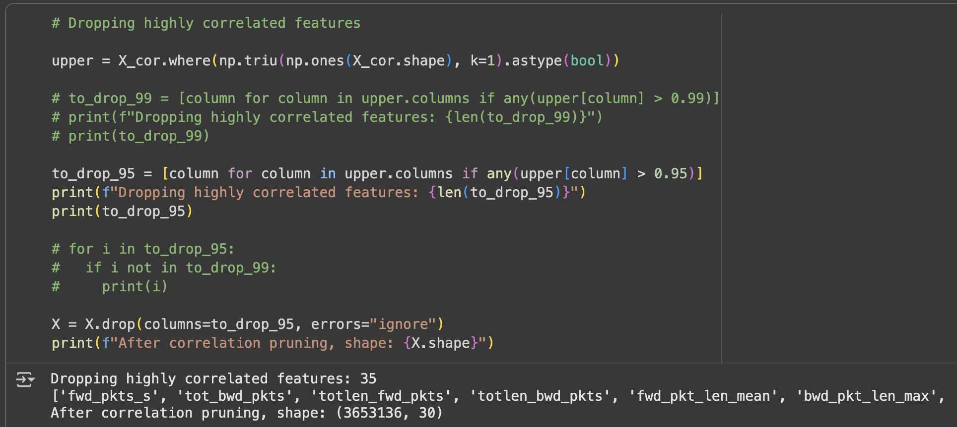
Dropping attributes with High Correlation
Dropping features that are highly correlated (correlation > 0.95) with other features to reduce redundancy and multicollinearity, ensuring the model learns from independent information.

Slide 14
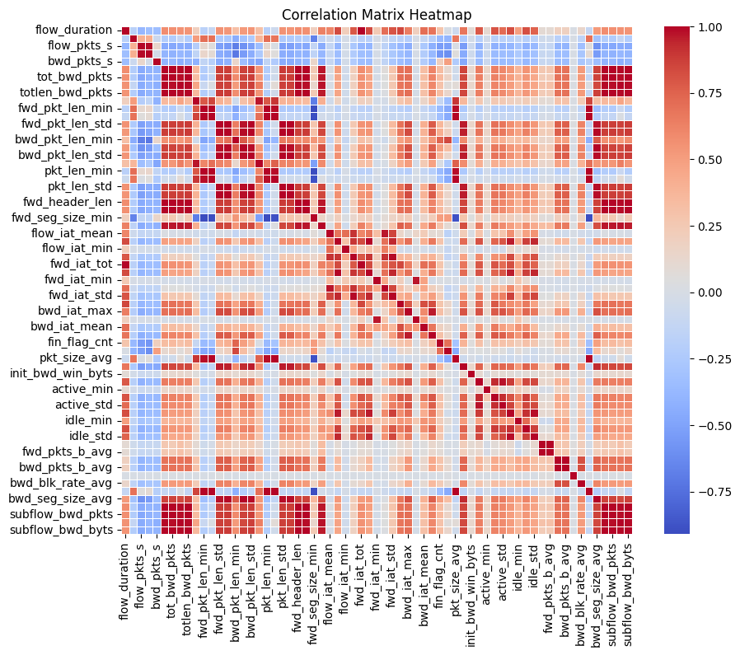
Corr Matrix before Feature Engineering

Slide 15
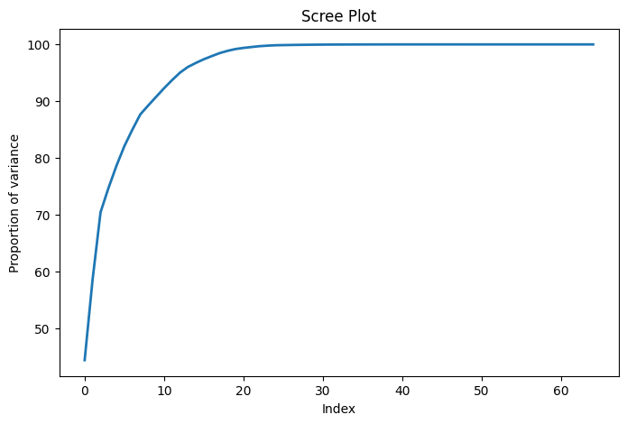
Scree Plot: PCA Variance Explained
(Full Feature Set)

Slide 16
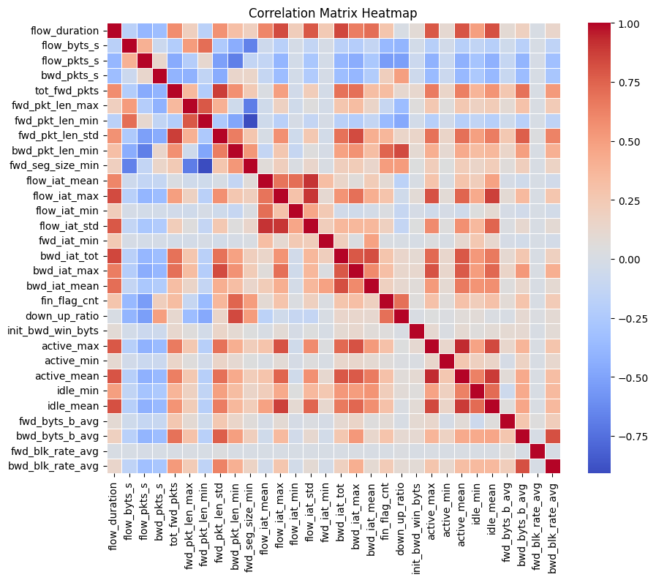
Corr Matrix after Feature Engineering

Slide 17
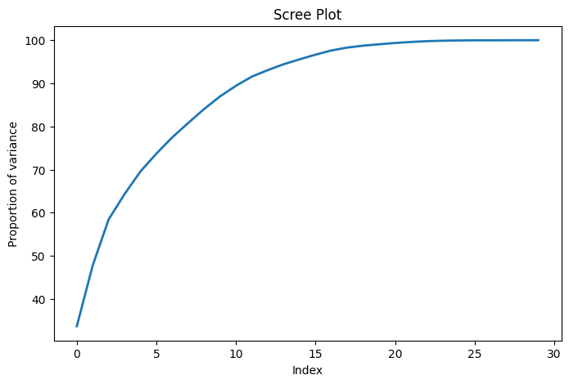
Scree Plot: PCA Variance Explained (Reduced Feature Set)

Slide 18
Initial Approach

Slide 19
Initial Training and Results
Step 4
Triggered feature correlation analysis to verify results.
Step 3
All models showed 99-100% accuracy could mean possible overfitting.
Step 2
Evaluated Accuracy, Precision, Recall, F1-score.
Step 1
Trained on DoS types + Normal traffic.

Slide 20
Why Supervised Learning First ?
Reasoning:
Dataset includes labeled attack types → ideal for supervised learning.
Enables quantitative model comparison (accuracy, F1, precision, recall).
Helps identify which NetFlow features separate attack vs. normal.
Provides baseline performance for later unsupervised detection (future goal).
Builds trust in model pipeline before generalizing to unseen attacks.
Challenge: Detecting and classifying malicious network traffic requires understanding how attack and normal flows differ.

Slide 21
Chosen ML Models and Rationale
Logistic Regression
Random Forest
Simple linear baseline for quick comparison.
Interpretable coefficients reveal important features.
Good for establishing benchmark classification accuracy.
Ensemble of decision trees capturing nonlinear patterns.
Reduces overfitting through averaging across trees.
Provides feature importance scores for interpretability.
1
1
Support Vector Machine
XGBoost
Used SVC for binary classification.
RBF kernel handles complex, nonlinear data better than linear/polynomial.
Smooth decision boundaries ideal for NetFlow features.
Gradient boosting algorithm for high performance on tabular data.
Handles feature interactions and imbalances effectively.
Offers feature importance ranking for explainability.
1
1

Slide 22
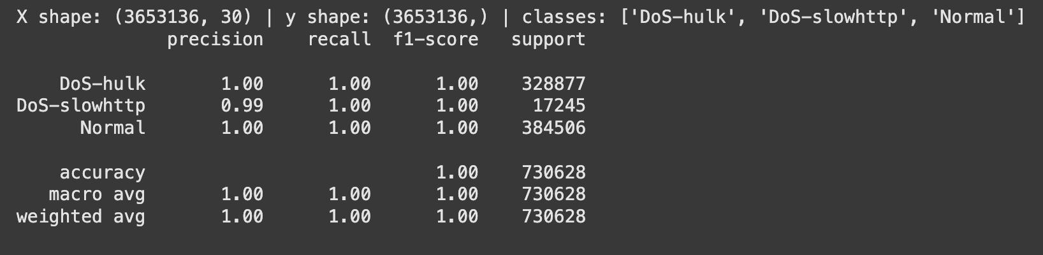
Results(SVM model) which made us test if the model was overfitting
*similar training results seen for other three models as well.

Slide 23
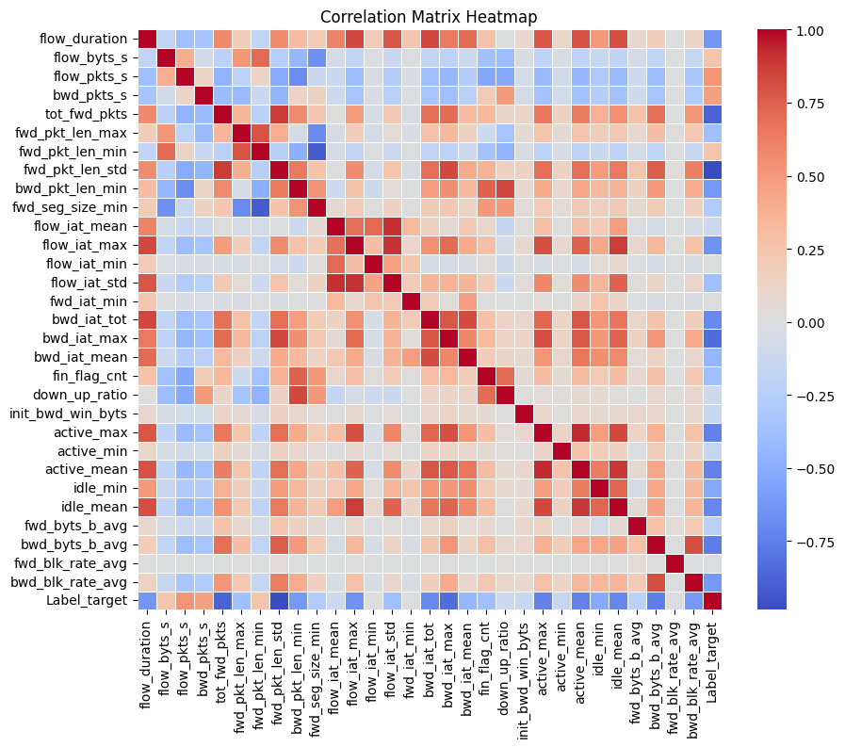
Heatmap for corr b/w Features & Label

Slide 24
Future Work and Scope

Slide 25
Future Work
Expand to Other Attacks in the Dataset
Implement Unsupervised Anomaly Detection
Real Time Simulation
Demonstrate trained model in a virtual environment/
Model will be implemented in middleware to prevent attacks in a real-time system attack scenario to showcase model application.
DDoS attack types
Infiltration attack types
Web-based attacks
  XSS Attacks
  SQLi Attacks
  Command Injection
Identify a time-series dataset
Research different unsupervised models
  iForest
  OCSVM
  Autoencoders
Implement models
Notes:
Unsupervised Learning: You plan to implement unsupervised anomaly detection. How do you plan to leverage the findings from this supervised approach to inform your unsupervised models?
Real-Time Implementation: One of your future goals is a real-time simulation. What challenges do you anticipate in deploying this model for real-time traffic analysis, particularly concerning inference speed and resource consumption?
Expanding Attack Types: Your future work includes detecting web-based attacks like SQL Injection and XSS. These attacks are often identified by their content (payload) rather than just network flow statistics. How will you adapt your feature set to handle these different types of threats?
False Positives: How would a system like this distinguish between a genuine DDoS attack and a legitimate, non-malicious traffic spike, such as a "flash crowd" event?
Extra information:

Slide 26
So in conclusion…

Slide 27

Any questions?
Ask away!

Slide 28
References
Dataset:
https://fkie-cad.github.io/COMIDDS/content/datasets/flnet2023/
Colab Notebook: https://colab.research.google.com/drive/147fRUwBCbiSsKXKJA5A8Bp4HE6uIkvEA?usp=sharing
Referred site:
https://machinelearningmastery.com/data-leakage-machine-learning/
Referred Paper:
https://journalofbigdata.springeropen.com/articles/10.1186/s40537-024-00886-w

Slide 29
Thank you

