Slide 1
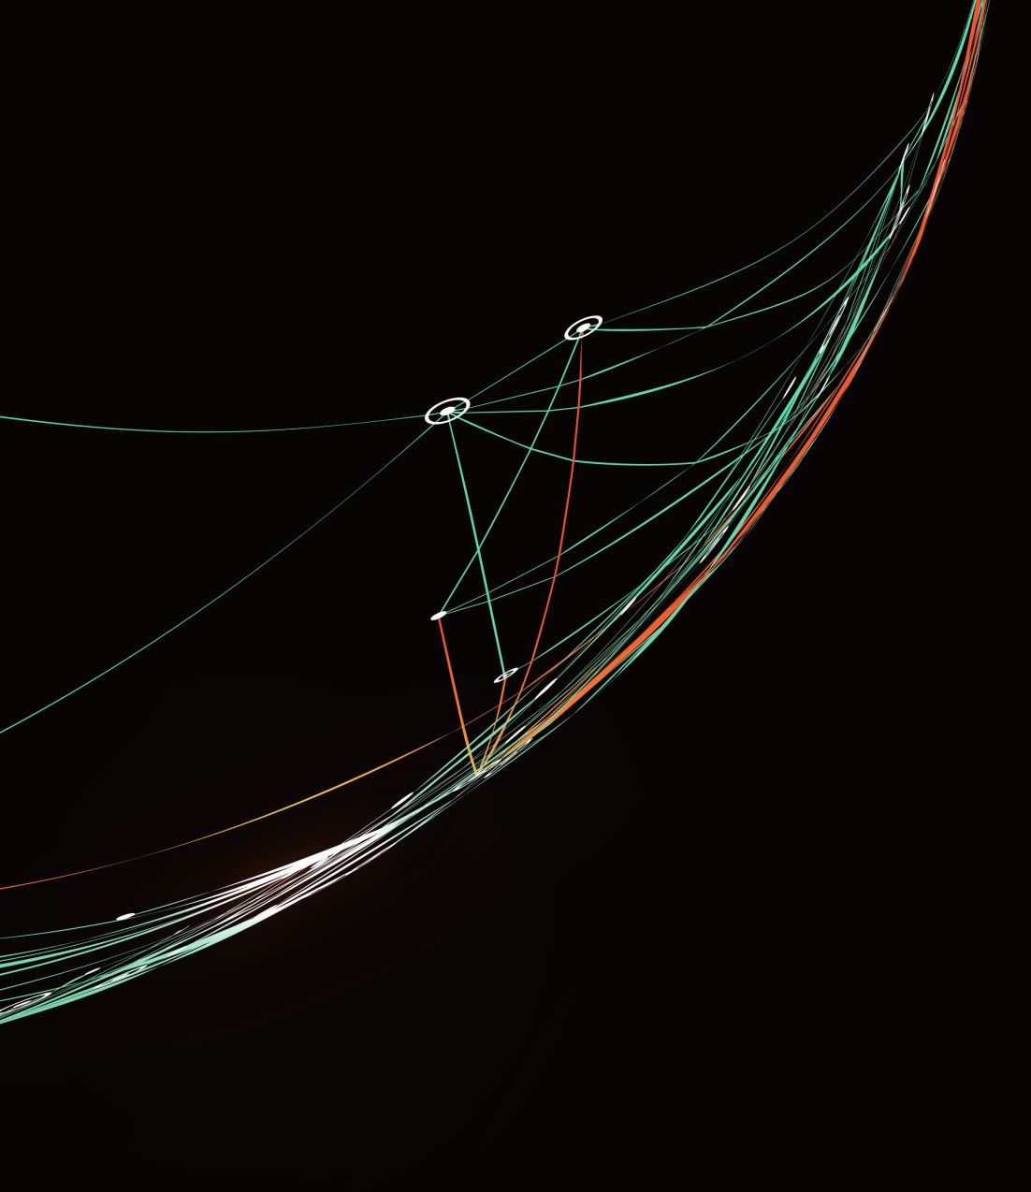
Decoding Kill Chains
Learn what makes an APT tick!

Slide 2

$whoami
Security Engineer @Qualys
Research Scholar (Ph. D) @NFSU
Full-time Foodie
Anime Enthusiast

Slide 3
Agenda
What’s a Kill Chain?
What’s an APT?
Dark Gate
Do you want to build a Kill Chain?
Playing Detective

Slide 4
What’s a kill chain?
A security model that breaks down a cyber-attack into 8 stages
Reconnaissance
Weaponization
Delivery
Exploitation
Installation
Command and Control
Actions
Monetization

Slide 5
What’s an APT?
A highly advanced and sophisticated threat actor, often backed by large amount of funds.

Slide 6
Dark gate
An APT group
Launched a malware campaign that exploited several Windows CVEs
Let’s look into one of their Kill Chain

Slide 7
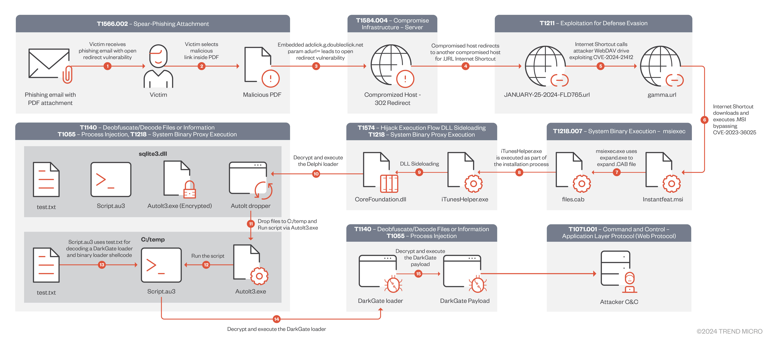

Slide 8
Stage 1 – dropping malware
Victim received an Email
Email contained a malicious PDF
PDF contains link to a web server
Web server redirects to URL file which redirects again
Second URL file opens an MSI bypassing MoTW

Slide 9
Stage 2 – malware attack
MSI expands to CAB file
Executes an EXE that sideloads DLL
Reach process injection
Drop more files to temp dir
More process injection
C2 connection

Slide 10
Do you want to build a kill chain?

Slide 11
What makes a kill chain work?
Exploit Chaining

Slide 12
A small kill chain
Malicious Website
CVE-2024-21412
CVE-2023-24880
WebDav Server

Slide 13
CVE-2024-21412
URL File Bypass
URL -> URL -> Payload

Slide 14
CVE-2023-24880
Mark of the Web Bypass
Executes malicious payload

Slide 15
PS
Demo is NOT weaponized
It is just a PoC
We are not discussing full exploits

Slide 16

Demo time

Slide 17
Playing detective
Every part of the kill chain needs to exploit some vulnerability
Most vulnerabilities are documented – they have CVEs
Detection can be as simple as software or kernel version

Slide 18

Q/A?

Slide 19

Thank You

