Slide 1


MGMT 690: Industry Practicum
Presented By Team 2:
Eshan Sharma
Hritwik Pal
Mansha Kalra
Ranojoy Sengupta

Slide 2

Agenda
Business Problem
Data Preprocessing
Exploratory Data Analysis
Model Building
Recommendations
Evaluation
Results

Slide 3
Business Problem
Choice of PID
PID: 519494.0
Product: Certified Angus Beef Boneless Chuckeye Roast
2nd highest number of records.
Avg. Beef consumption is 26.78 billion pounds (2016-2020) → Can be a good indicator of the industry
Reasoning
Demand Forecasting
Understand & predict customer demand to optimize the supply decisions of Meijer.

Slide 4




Data Preprocessing
Outlier Analysis
Type Casting
Feature Selection
Feature Engineering
Dropped rows with garbage values in the temperature variables. (less than 5% of the data)
Converted 4 features from object type to datetime type for further analysis
Dropped variables with all zero values (pr_drop_flg, adv_mid_wk_flg, adv_super_evnt_flg, adv_dgtl_circ_flg)
Dropped the transformed(ln) variables
“Holiday”: Stores whether the day had a holiday or not.
“sales_pdt_alt”: Total revenue calculated on a date level.

Slide 5
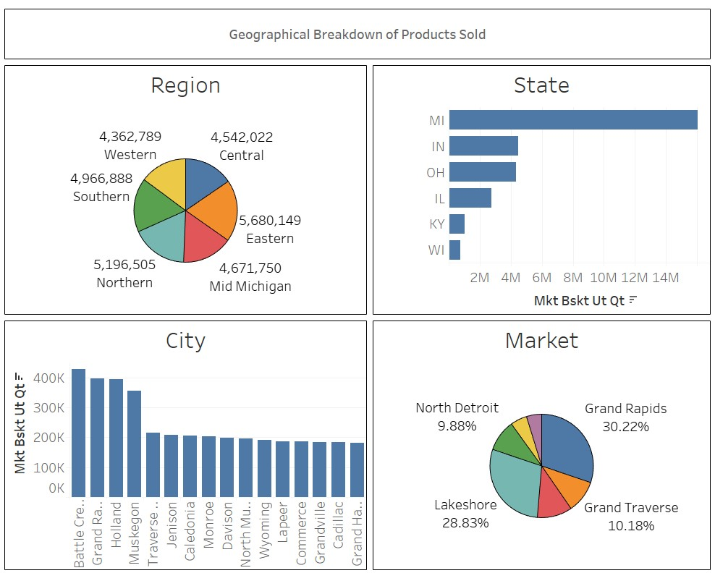




Exploratory Data Analysis
The Eastern Region contributes to over 19.3% of the sales, followed by Northern – 17.6% and Southern regions– 16.8%
Battle Creek, Grand Rapids and Holland are three cities with highest product quantities sold.
The state of Michigan has over 16M quantities sold- 4 times than second placed state Indiana.
In the market level, Great Rapids and Lakeshore dominate in terms of units sold over the years.

Slide 6
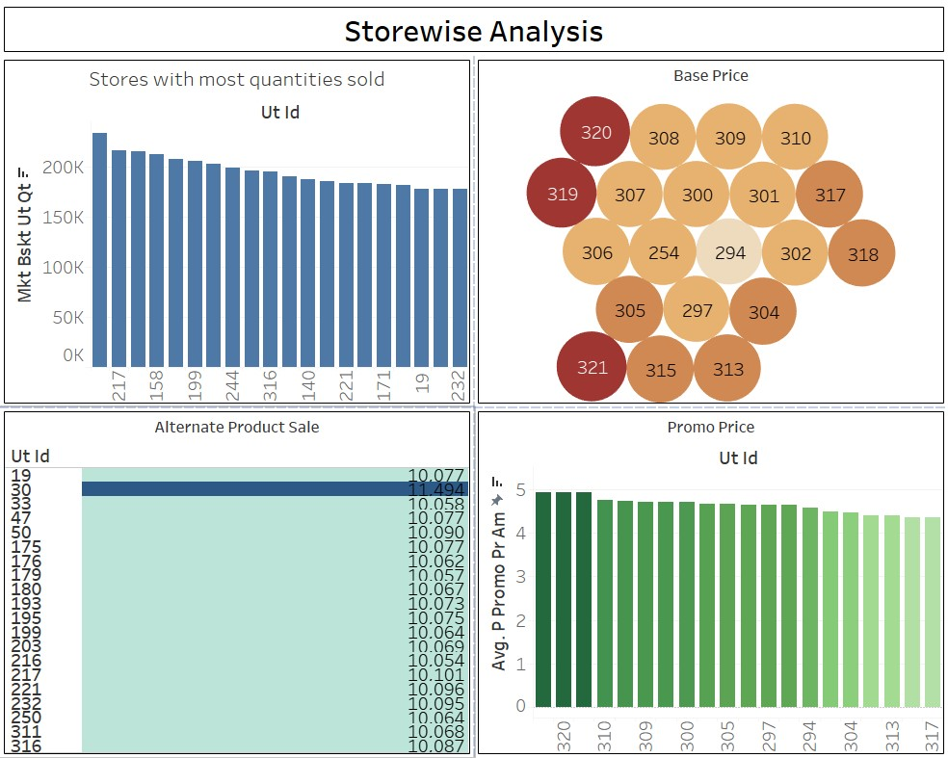




Exploratory Data Analysis
Stores 195, 217 and 33 are the top 3 stores in terms of units sold
Store 294 has the lowest average base price & stores 319,320, 321 have the highest average base price
Store number 30 has sold the most number of alternate product.
Stores 319, 320, 321 have the highest average promotional base price

Slide 7
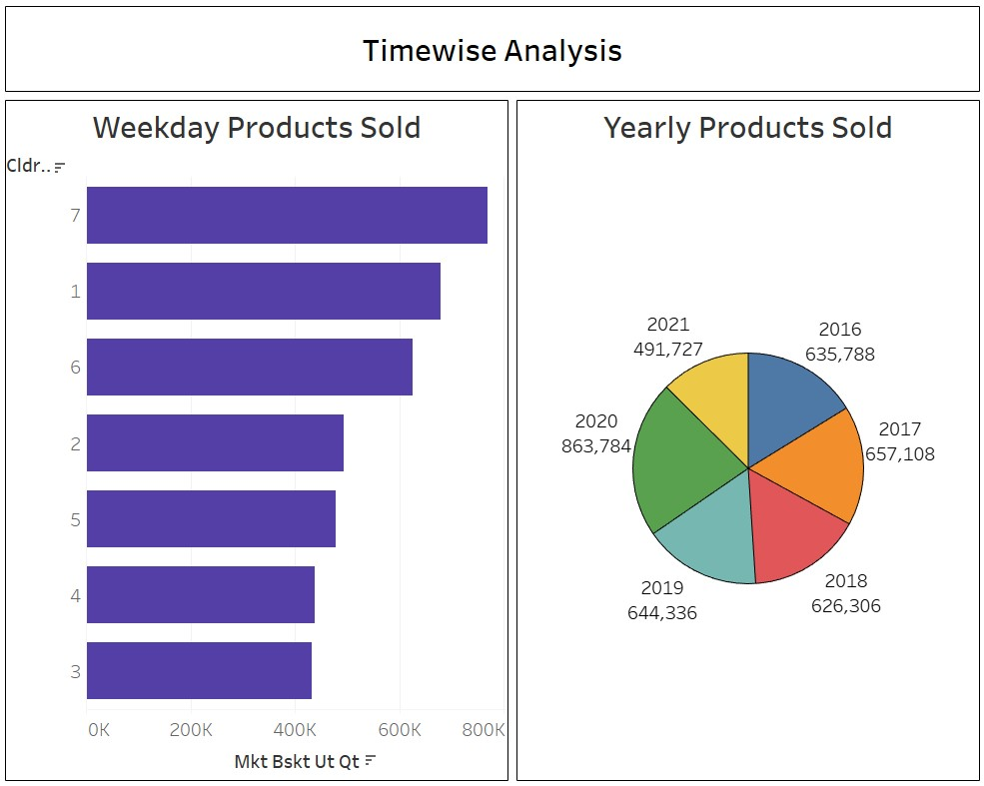


Exploratory Data Analysis
Saturdays, Sundays and Mondays experience the highest sales
2020 saw a peak in beef-consumption in the US with 2021 showing similar trajectory.

Slide 8
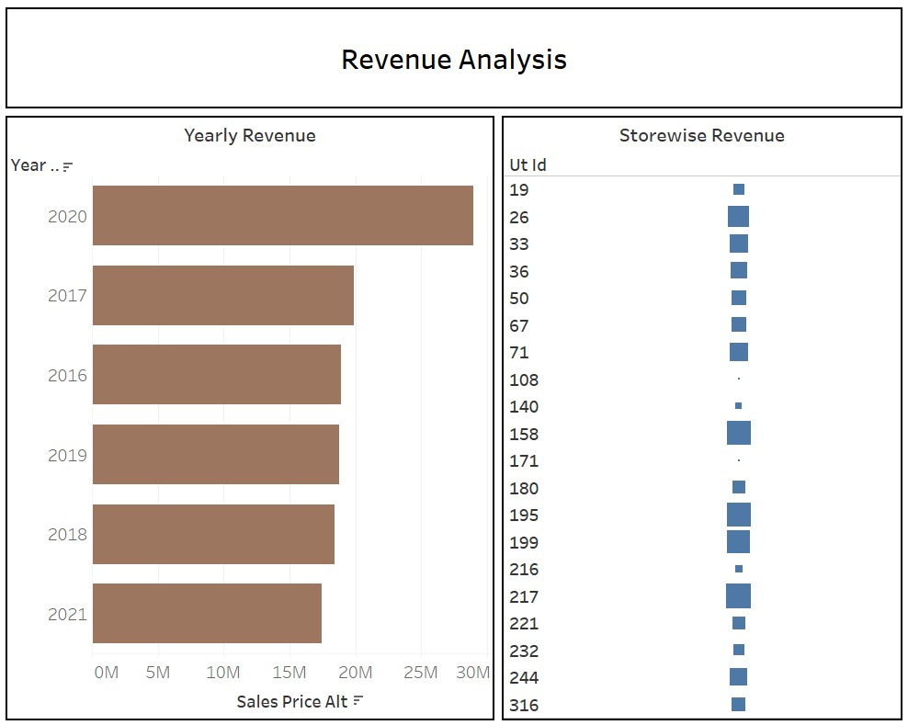

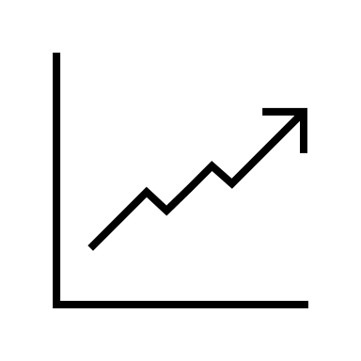

Exploratory Data Analysis
Over 28M in revenue was generated in the year 2020
Stores 26, 158, 195, 199 and 217 have generated a higher share of the total revenue
It’s a cold place. It’s full of iron oxide dust
Stores 171 and 108 have generated the least revenue and should be looked into

Slide 9
Model Building
XG Boost
Random Forest
Optimized Gradient Boosting Algorithm through parallel processing, pruning, handling missing values & regularization to avoid overfitting/bias.
Bagging-based algorithm where only a subset of features are selected randomly.
Deep Neural Network
Recurrent Neural Network
Typically Feed Forward Networks where the links between the layers are one way which is in the forward direction and they never touch a node again.
Models temporal information and processes a sequence of vectors by applying recurrence formula at every step

Slide 10




Model Selection Strategy
Model Training
Model Selection
Selection of the best model for forecasting based on the lowest WAPE
Model compilation, train, validation & test split
Models
Hyperparameter Tuning
Deep Neural Network, Recurrent Neural Network, XGBoost, Random Forest
Optimizing parameters: Learning rate, max depth, N-estimators

Slide 11


Model Evaluation
Model
Architecture
Evaluation
RNN
3 Layers (32,16,1) ; ReLU ; Adam
WAPE: 0.35
Random Forest
100 n-estimators ; random_state=0
WAPE: 0.34
DNN
3 Layers (32,8,1) ; ReLU ; Adam ;
WAPE: 0.34
XG Boost
Learning rate=[0.01,0.001,0.0001] ;
max_depth=[3,4,5] ;
n_estimators=[50,100,200,500]
WAPE: 0.32

Slide 12
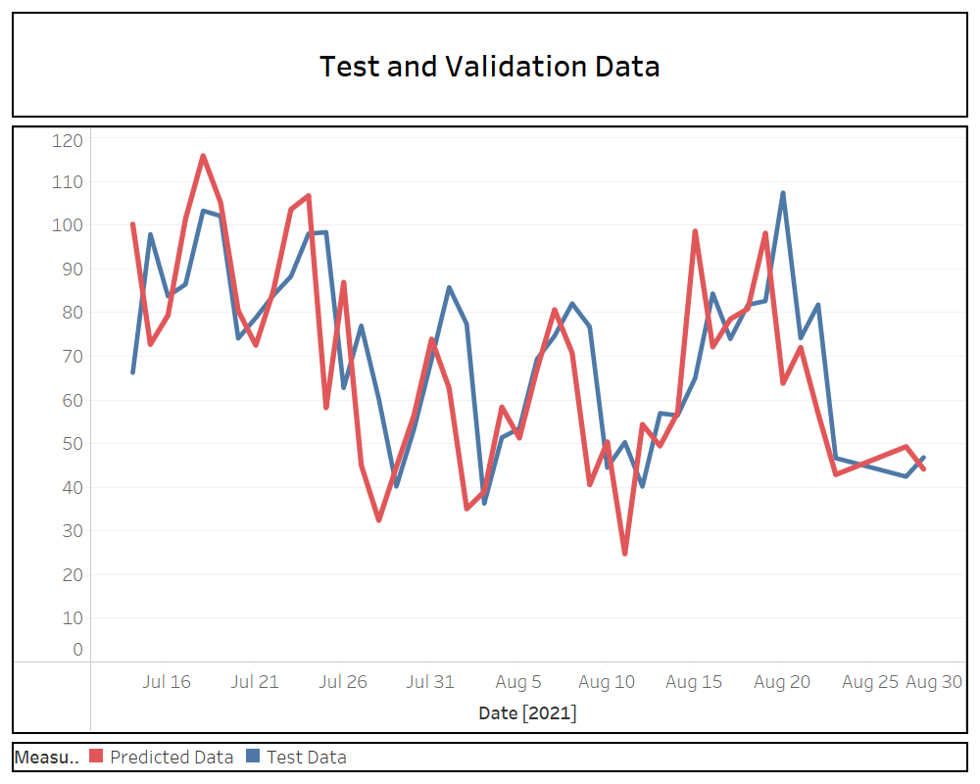
Model Validation
Store ID
71
WAPE:
0.2

Slide 13
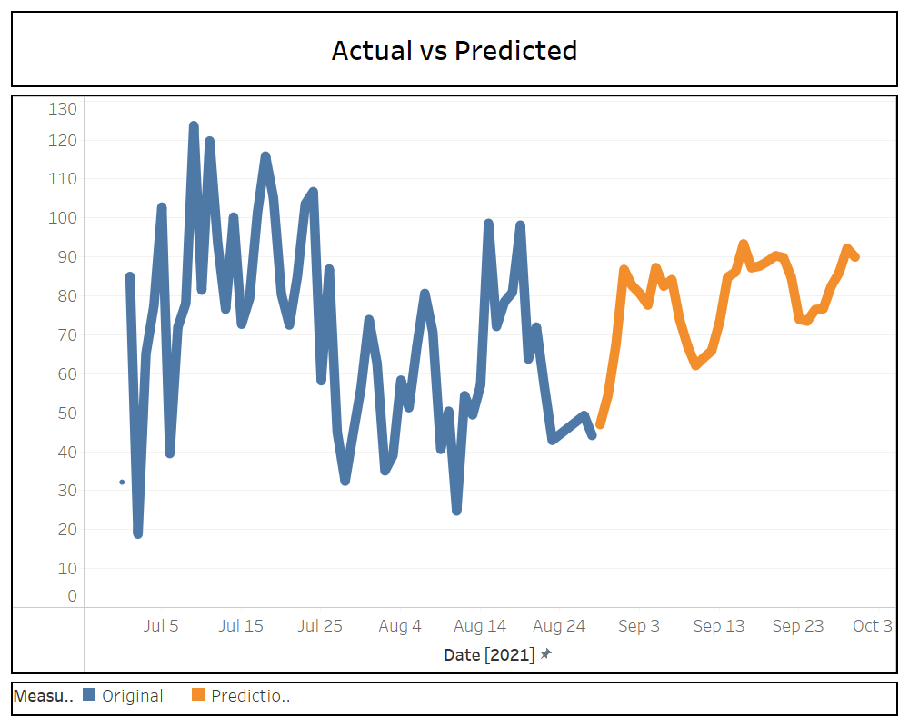
Forecasted Results
The predicted values show an upward trend in general
There is a predicted peak on September 16 & a dip on 10 September

Slide 14




Recommendations
Make combos with complementary products
Offers and Discounts on weekdays
to boost sales
Stock up on
beef roast around Sept 16th, 29th, 1st, to avoid losing sales
Track progress of stores
with less sales
in regular time interval

Slide 15


Thank You
- Team
Questions?

