Slide 1
Go introduction

Slide 2
Writing Go Programs
Written in file’s having an extension of .go
Things Needed
-> Text Editor
-> Compiler
Setting up the compiler (https://golang.org/dl/)

Slide 3
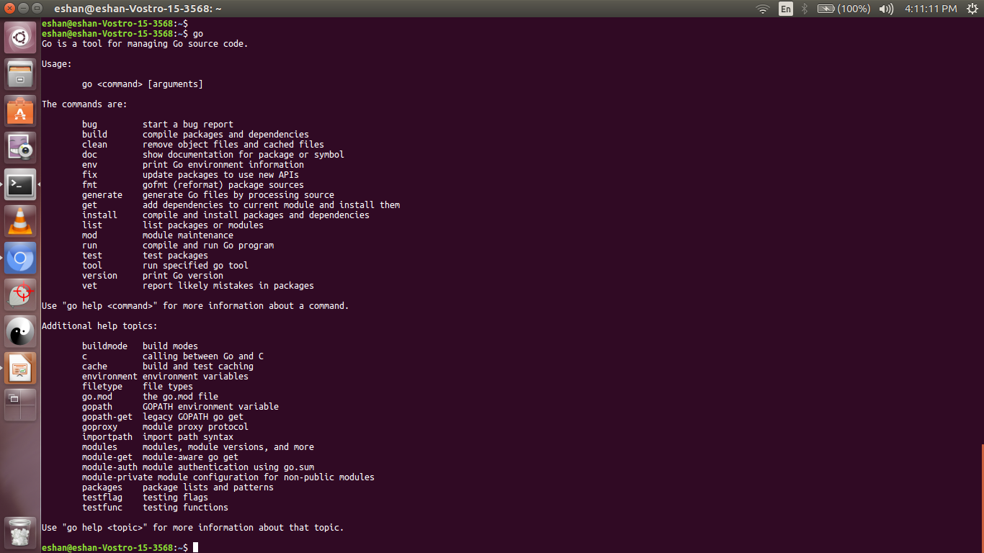
The “go” tool
Part of the go distribution

Slide 4
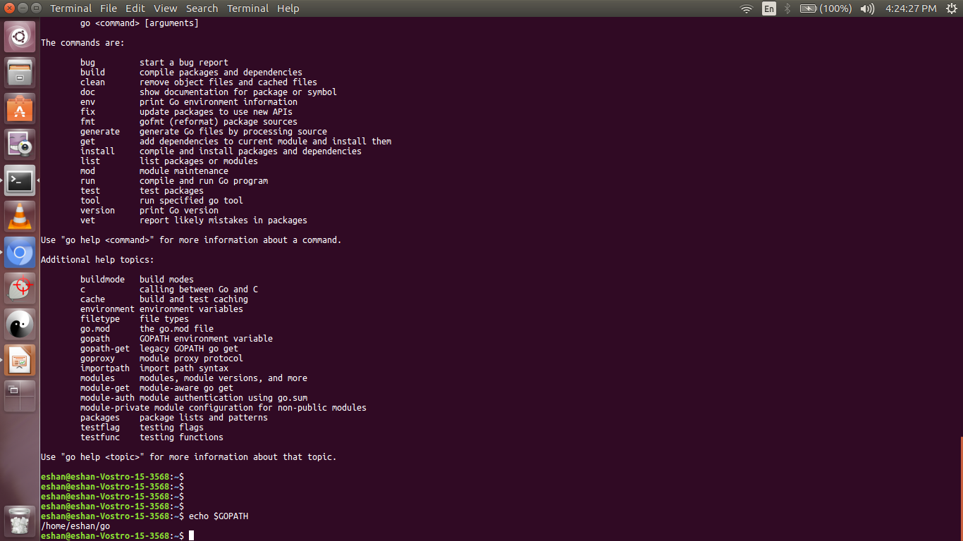
Writing your go code – Code Organization
Go Workspace – “GOPATH”

Slide 5
# A typical Go workspace
bin/
myapp # Executable binary
Hello # Executable binary
pkg/
github.com/callicoder/example/
numbers.a # Package archive
strings.a # Package archive
github.com/gorilla/
mux.a # Package archive
go.uber.org/
zap.a # Package archive
src/
github.com/callicoder/example/ # Project repository
.git/
myapp/
app.go # Executable program containing main package and function
numbers/ # Go Package (contains utility functions for working with numbers)
prime.go
prime_test.go
strings/ # Go Package (contains utility functions for working with strings)
reverse.go
trim.go

Slide 6
Running the first program
Hands-on demo (/home/eshan/sessions/go)
go build – create the binary executable
go install – install the executable binary in workspace’s bin directory
go run – runs the code directly

Slide 7
Go program structure
Basic Building Blocks
  Package Declaration
  Import Packages
  Functions
  Variables
  Statements and Expressions
  Comments

Slide 8
Datatypes
Categoried to
Boolean types --> boolean type takes to primitive constants true and false
Numeric types --> Arithmetic types e.g integer, float
String types --> A run of characters
Derived types --> Pointers, Arrays, Struct, Map etc.

Slide 9
Integer Types
uint8, uint16, uint32, uint 64, int8 .. int 64, uint, int
Float types
float32, float64
Arrays – a collection of items of the same type
Structure – combining multiple types to form a new user defined type
Pointer – stores the address of a variable

Slide 10
Thank you

