Slide 1

Coronary Heart Disease Risk Prediction
Team members :
Anuja Naik
Eshanee Thakur
Ritesh Pendurkar
Rohit Gulati

Slide 2
INTRODUCTION
Heart disease is the major cause of morbidity and mortality globally, it accounts for more deaths annually than any other cause. According to the WHO, approximately 31% of all global deaths are due to heart disease every year, and coronary heart disease is by far the most common and the most fatal
It is, however, difficult to identify high risk patients because of the multi-factorial nature of several contributory risk factors such as diabetes, high blood pressure, high cholesterol, etc.
Using machine learning (ML) classification algorithms we can predict whether a patient has a risk of developing coronary heart disease in the next 10 years

Slide 3
Objectives and goals
We will be implementing Machine Learning models to predict whether a patient will be diagnosed with coronary heart disease (CHD) in the next 10 years based on a few medical parameters associated with them
Using exploratory data analysis, we will gain insights about the data by checking the distribution of different features, correlation of features with each other and the target variable
We will be comparing classification metrics like accuracy , precision, F-1 score to identify the most efficient Machine Learning model

Slide 4
Dataset Specification
Dataset includes 4240 records and 15 attributes. Attributes vary from demographic, behavioral and medical risk factors
Demographic attributes: Sex, age
Behavioral attributes: Current Smoker, Cigs per day
Medical history: BPMeds, prevalent stroke, Prevalent Hyp, Diabetes
Current medical conditions: Cholesterol, Sys BP, Dia BP, BMI, heart rate, glucose level
Target variable: TenYearCHD

Slide 5
Libraries Used
Numpy
Pandas
Seaborn
Matplotlib
SciKit-Learn
KNeighborsClassifier
RandomForestClassifier
DecisionTreeClassifier
LogisticRegression
GridSearchCV, Classification_report, Confusion_matrix

Slide 6
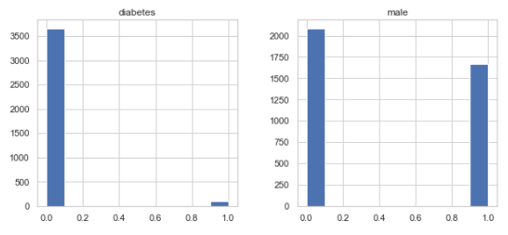
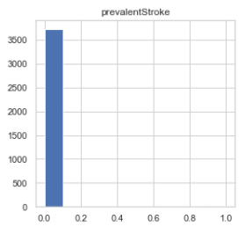
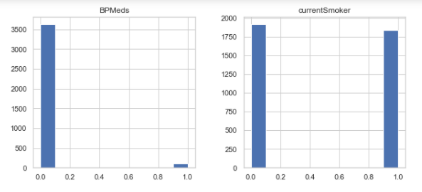
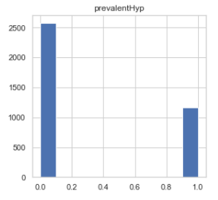
Exploratory Data Analysis
Based on the graphs generated for categorical values, we can see that the data for the prevalent stroke (prevalentStroke), diabetes, and blood pressure meds (BPMeds) is poorly balanced. Hence, we didn’t include these features in the training dataset.

Slide 7
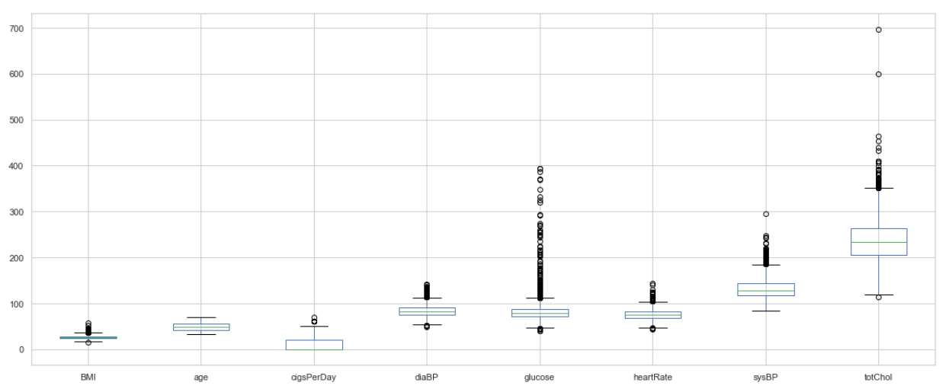
Exploratory Data Analysis
As part of the data analysis, we decided to plot box and whisker graph in order to determine the outlier values for the continuous features
We deduced that there are a greater number of outliers for certain features i.e., glucose, sysBP and totChol

Slide 8
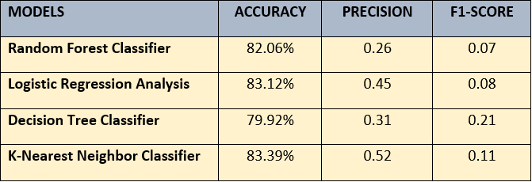
ML Model Comparison

Slide 9
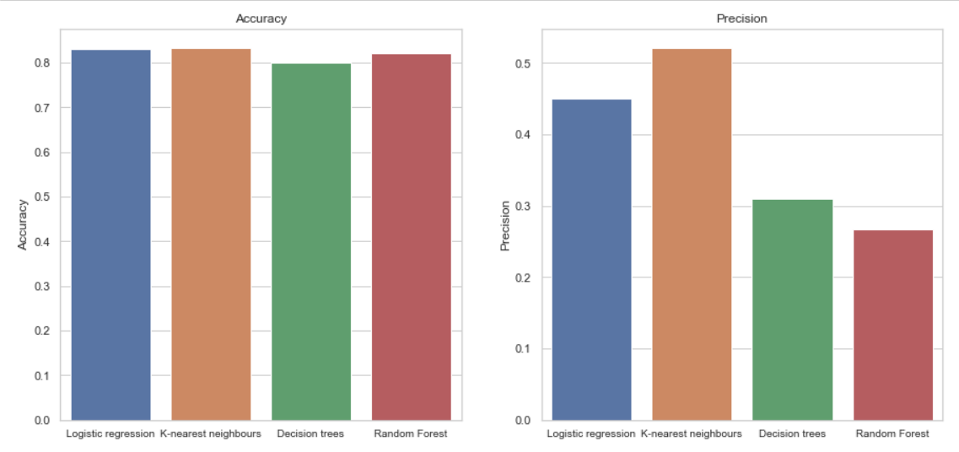
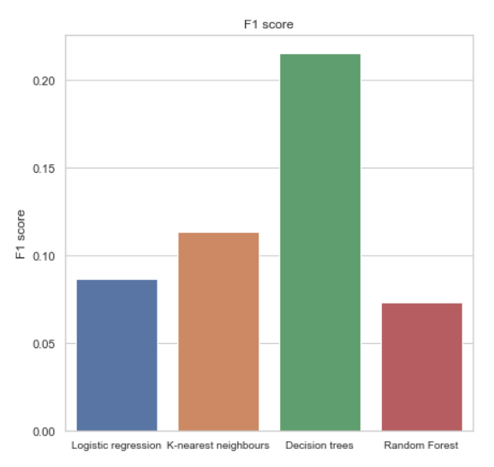
ML Model Comparison

Slide 10
Conclusion
Based on our exploratory data analysis, age, totChol, sysBP, diaBP, BMI, heartRate and glucose were identified as the top 6 features which had equally distributed data
Among the 4 classifiers, Logistic Regression and K-Nearest Neighbor classifiers had the best accuracy rates. However, the K-Nearest Neighbor classifier was the best performing model in terms of both accuracy and precision
We can see that the dataset is not equally balanced for the TenYearCHD feature (which is our target variable). As part of the future scope, we can use Smote technique which would help in improving the model’s sensitivity by balancing the datasets

