Slide 1

InShorts: Classifying and Summarizing Daily News (Team 4 Monday Batch)
Team Members:
Anuja Naik
Eshanee Thakur
Ritesh Pendurkar
Rohit Gulati
Shubham Mahajan

Slide 2
Introduction
There exists a large amount of information being stored in the electronic format and it has become a necessity to interpret and analyse data and extract facts that could help in decision-making
With the increase in the number of news it has got difficult for users to access news of his interest which makes it a necessity to categorize news so that it could be easily accessed
This will help users to access the news of their interest in real-time without wasting any time

Slide 3
Introduction contd.
We have implemented InShorts, a news classifier and a summarizing tool using Machine Learning approach
Using the supervised classification approach, we have implemented five machine learning models which predict the categories of news articles based on title
Using the Natural Language processing technique and TextRank algorithm the system extracts most important sentences from the news description and forms a short summary of the article

Slide 4
Approach
Classification is a difficult activity as it requires pre-processing steps to convert the textual data into structured form from the un-structured form
Text classification process involves following main steps for classification of news article:
Data collection
Pre-processing
Feature selection
Classification techniques application
Evaluating performance measures

Slide 5
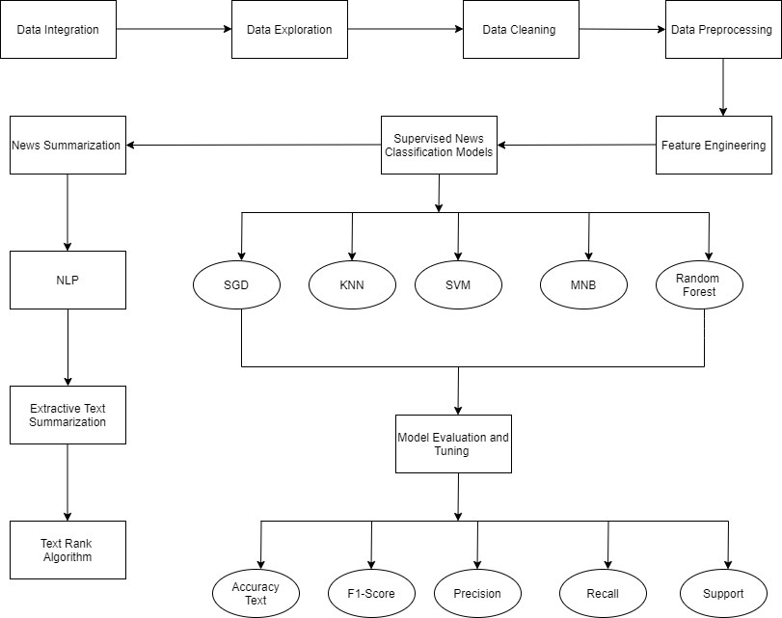
Flow Diagram

Slide 6
Data cleaning process
Special character and non ascii character cleaning: special characters such as “\n” double quotes must be removed from the text along with non ascii characters
Upcase/downcase: “Book” and “book” to be the same word and have the same predicting power. For that reason we have downcased every word
Punctuation signs: characters such as “?”, “!”, “;” have been removed
Stop words: words such as “what” or “the” won’t have any predicting power since they will presumably be common to all the documents. They may represent noise that can be eliminated

Slide 7
Data Pre-processing
Pre-processing refers to the transformations applied to our data before feeding it to the algorithm
Some specified Machine Learning model needs information in a specified format
For achieving better results from the applied model in Machine Learning the format of the data must be in a proper manner
We have performed data pre-processing on the raw dataset to convert it into a clean and useable dataset

Slide 8
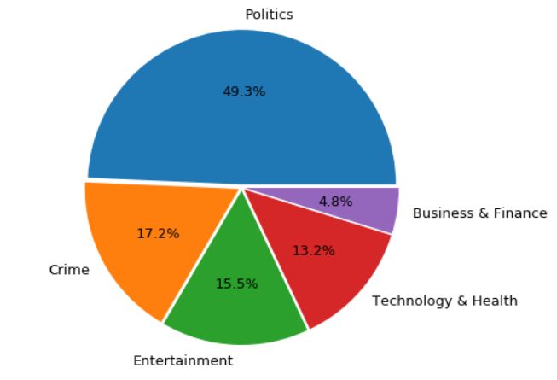
Feature Engineering
Feature engineering is the process of transforming data into features to act as inputs for machine learning models
For feature engineering we created clusters for categories
Initially there were around 170 categories which we grouped into 5 categories as below:
Entertainment
Health and Technology
Politics
Crime
Business and Finance

Slide 9
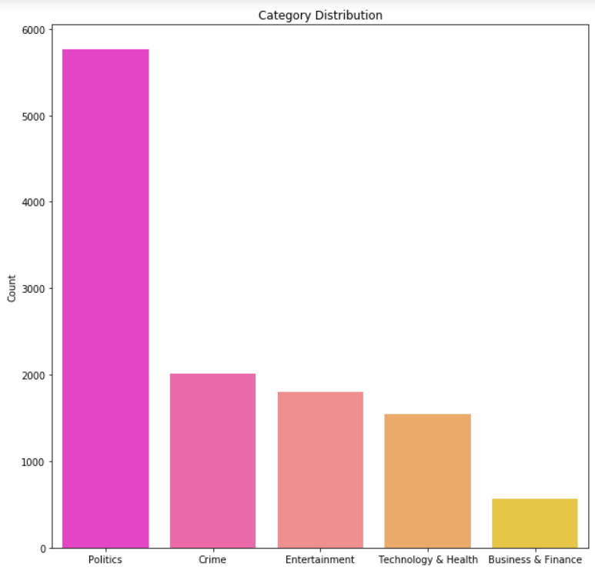
Category distribution of data

Slide 10
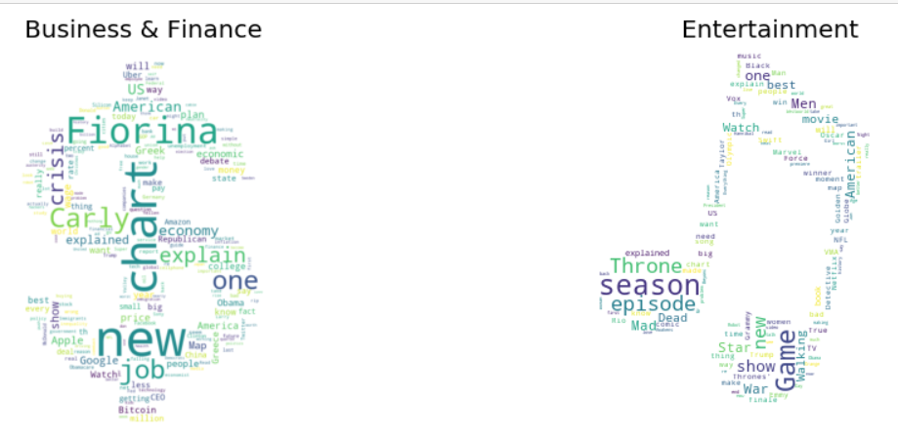
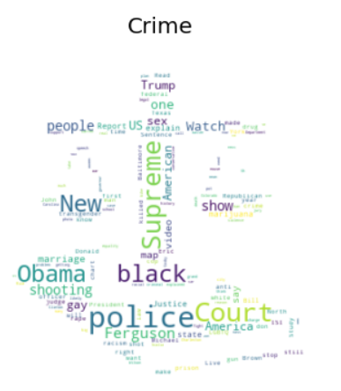
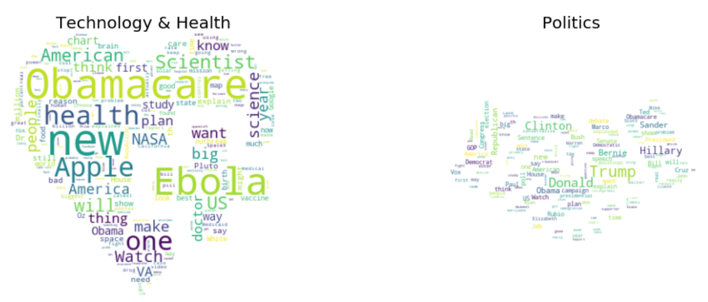

Slide 11
Libraries Used
Numpy:
NumPy is the fundamental package for scientific computing with Python
In our project we have implemented NumPy to convert confusion matrix to array in order to plot confusion matrix for each model.
Pandas:
Pandas is an open source, BSD-licensed library providing high-performance, easy-to-use data structures and data analysis tools for the Python programming language
We have implemented pandas to import a tsv file as a dataframe, concatenate multiple dataframe into a single dataframe and for other technicalities while generating the model

Slide 12
Libraries Used
SciKit-Learn:
Scikit-learn library is used to implement various algorithms like support vector machine, random forests, Gaussian Naive Bayes, Scalers, and kNN
In our project, we have used this library for model training and for calculating the model metrics like accuracy, score, etc
MatPlotLib:
Matplotlib is a plotting library for the Python programming language and its numerical mathematics extension NumPy
In our project, we use MatPlotLib to display a Bar Chart to visualize the news category distribution

Slide 13
Libraries Used
Seaborn:
Seaborn is a library for making statistical graphics in Python
It is built on top of matplotlib and closely integrated with pandas data structures
Seaborn aims to make visualization a central part of exploring and understanding data
We have implemented seaborn for mapping bar charts to map categories against the count of news articles derived from the dataset

Slide 14
ML Algorithms
Multinomial Naïve Bayes (MNB)
Random Forest
Support Vector Machine (SVM)
K-Nearest Neighbours (KNN)
Stochastic Gradient Descent (SGD)

Slide 15
Multinomial Naïve Bayes (MNB)
The multinomial Naive Bayes classifier is suitable for classification with discrete features (e.g., word counts for text classification)
Naïve Bayes classifier is a simple probabilistic classifier based on applying Bayes Theorem
This algorithm computes the posterior probability of the news belonging to different classes and it assigns the news to the category with the highest posterior probability

Slide 16
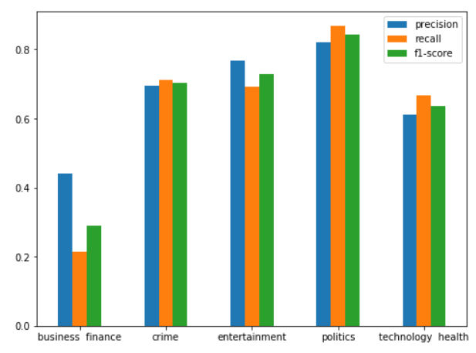
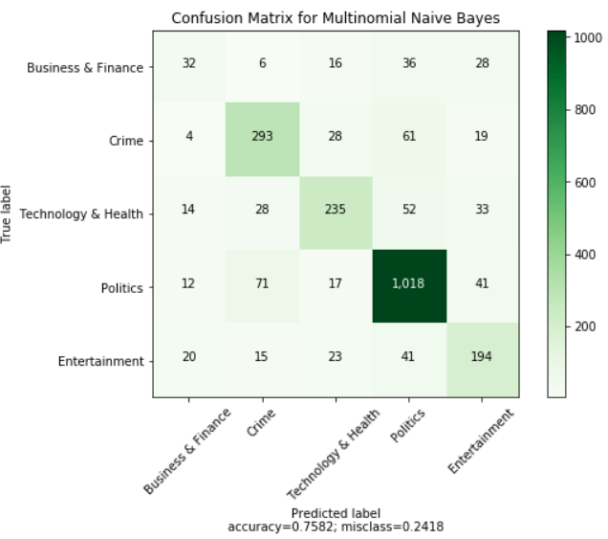
Results for MNB

Slide 17
Random Forest
A random forest is a meta estimator that fits the number of decision tree classifiers on various sub samples on the data set and use averaging to improve the predictor accuracy and control over fitting
As an ensemble method we thought random forest would perform better than decision trees

Slide 18
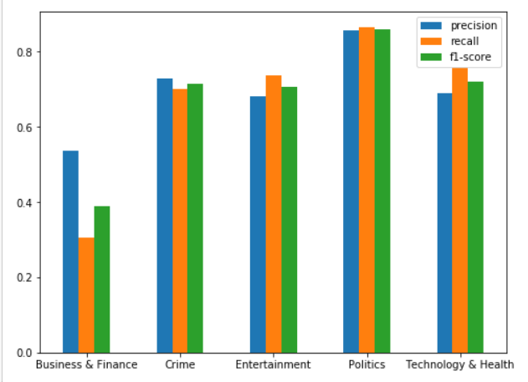
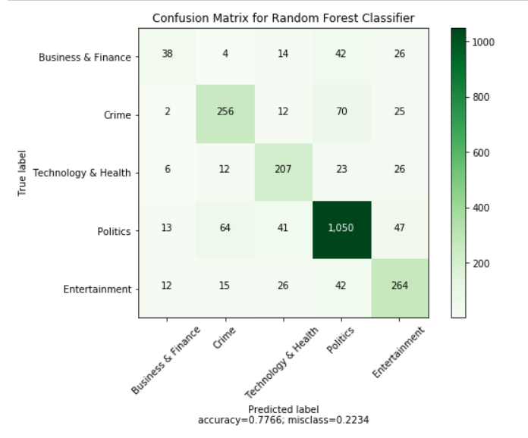
Results for Random Forest

Slide 19
Support Vector Machine (SVM)
Support Vector machines are a set of supervised learning method used for classification regression and outlier detection
It is advanced and does not have high time cost unlike the neural network
We have implemented scikit-learn SVC module to run the SVM algorithm.

Slide 20
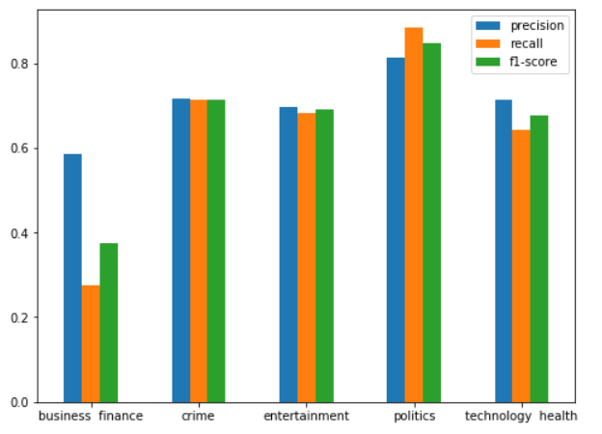
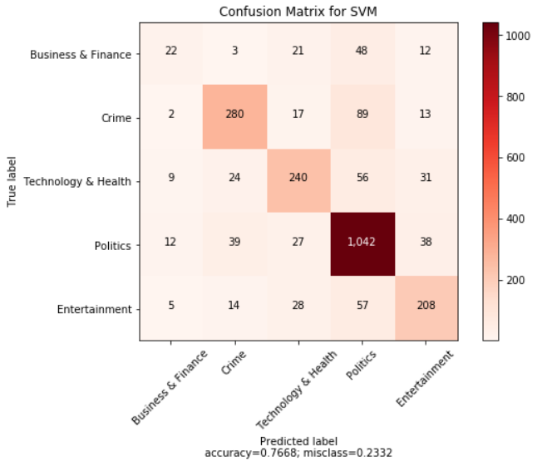
Results for SVM

Slide 21
K-Nearest Neighbours (KNN)
In pattern recognition, the k-nearest neighbors algorithm (k-NN) is a non-parametric method used for classification
The input consists of the k closest training examples in the feature space
An object is classified by a plurality vote of its neighbours, with the object being assigned to the class most common among its k nearest neighbors (k is a positive integer, typically small)
If k = 1, then the object is simply assigned to the class of that single nearest neighbor

Slide 22
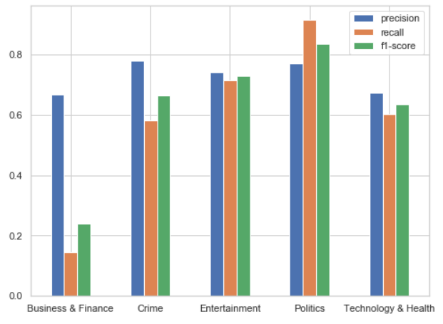
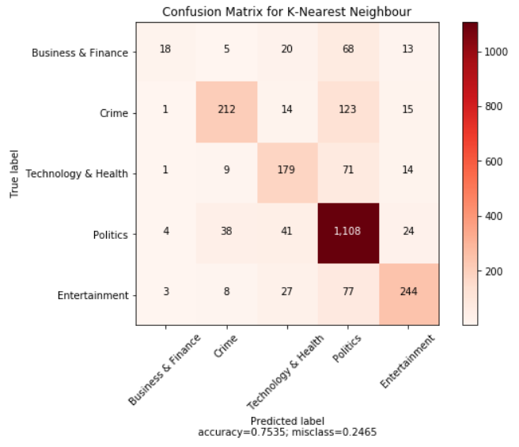
Results for KNN

Slide 23
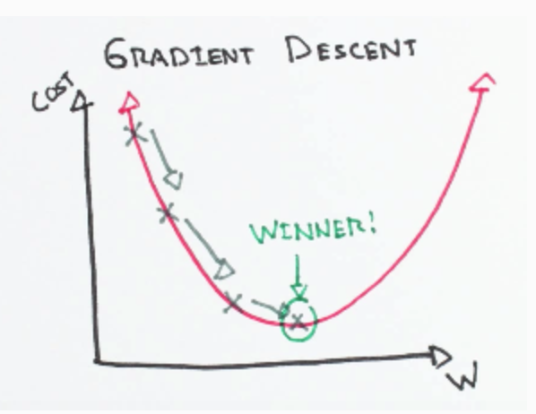
Stochastic Gradient Descent (SGD)
In Stochastic Gradient Descent, a few samples are selected randomly instead of the whole data set for each iteration
In Gradient Descent, there is a term called “batch” which denotes the total number of samples from a dataset that is used for calculating the gradient for each iteration
Multiple iterations take place until the minima is reached
The data sample is randomly shuffled and selected for performing the iterations.

Slide 24
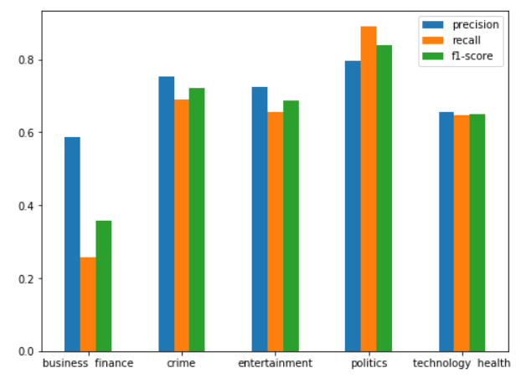
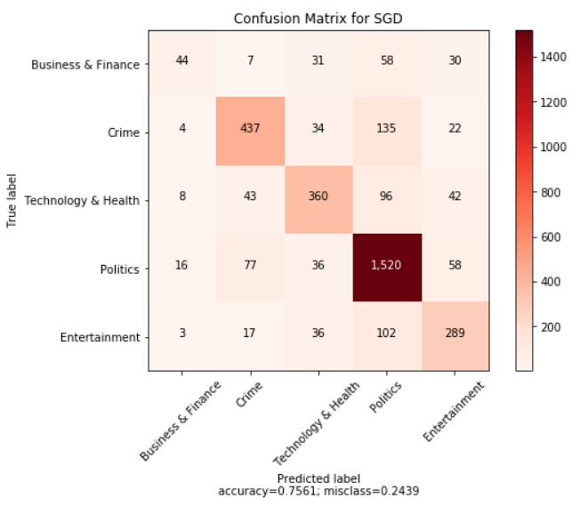
Results for SGD

Slide 25
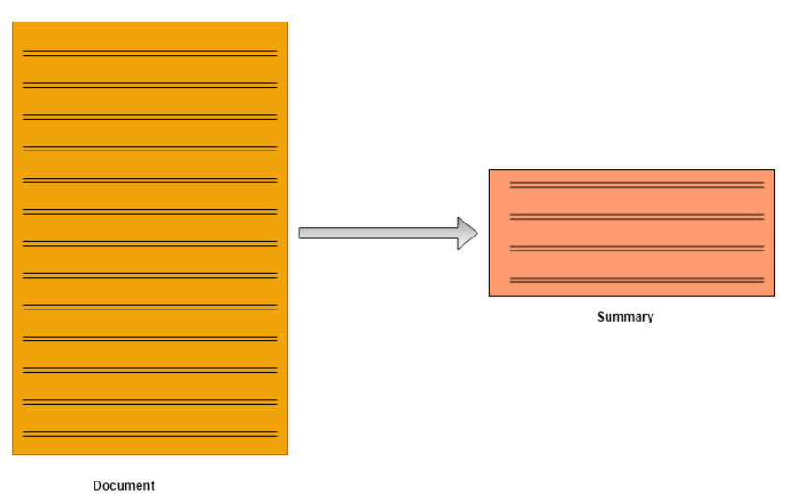
News Summarization using NLP
Summarization can be defined as a task of producing a concise and fluent summary while preserving key information and overall meaning.
Text Summarization is one of those applications of Natural Language Processing (NLP) which is bound to have a huge impact on our lives
In general there are two types: abstractive and extractive summarization

Slide 26
Extractive Summarization
Extractive methods attempt to summarize articles by selecting a subset of words that retain the most important points
This approach weights the important part of sentences and uses the same to form the summary
Different algorithm and techniques are used to define weights for the sentences and further rank them based on importance and similarity among each other
Input document → sentences similarity → weight sentences → select sentences with higher rank

Slide 27
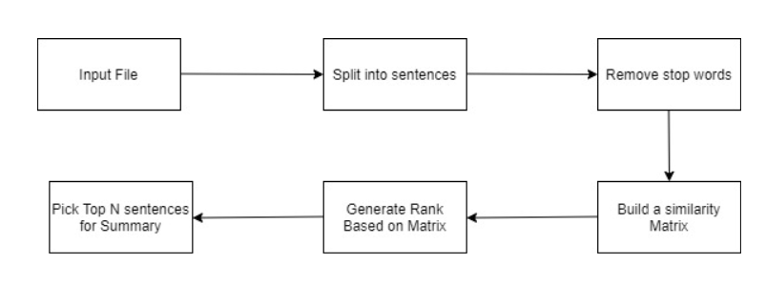
NLP implementation flow

Slide 28
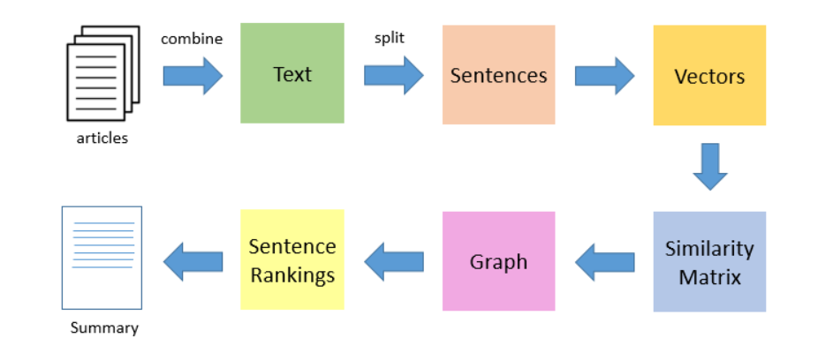
TextRank Algorithm
TextRank is an extractive and unsupervised text summarization technique

Slide 29
Result and Analysis
In our project, we have implemented the five Machine Learning Algorithms to classify the news articles based on some pre-defined categories
The Random forest classifier displayed best accuracy amongst all other models
Random forest classifier could classify the news article into categories with 77.66% accuracy

Slide 30
Comparison of results
MODELS | ACCURACY | PRECISION | RECALL | F1-SCORE | SUPPORT
Random Forest Classifier | 77.66% | 0.77 | 0.78 | 0.77 | 2337
Support Vector Machine Classifier | 76.68% | 0.76 | 0.77 | 0.76 | 2337
Multinomial Naïve Bayes Classifier | 75.82% | 0.75 | 0.76 | 0.75 | 2337
Stochastic Gradient Descent Classifier | 75.61% | 0.75 | 0.76 | 0.75 | 3505
K-Nearest Neighbor Classifier | 75.35% | 0.8 | 0.79 | 0.79 | 3360

Slide 31
Summarization result and analysis
In our project we have implemented the text rank algorithm which is a subset of Extractive and unsupervised text summarization technique
Our news articles contained more than 100 lines of text in the description which was converted into a 10-line summary without losing the integrity and the context of the article with the help of this NLP technique

Slide 32
Conclusion
The purpose of this project was to gain insights into the information retrieval field in terms of how classification and summarization functionality works
We have categorized the news article dataset with high accuracy into categories such as Entertainment, Politics, Crime, Health & Technology and Business & Finance and also created relevant visualizations for the same
We concluded that Random Forest Classifier model displayed the highest rate of accuracy amongst all the classifier models
We achieved summarization of news by implementing NLP techniques

Slide 33
References
Classification of News Dataset http://cs229.stanford.edu/proj2018/report/183.pdf
http://www.iosrjournals.org/iosr-jce/papers/Vol18-issue1/Version-3/D018132226.pdf
Luo, Congnan, Yanjun Li, and Soon M. Chung. "Text document clustering based on neighbors."
Scikit-learn Text Feature Extraction
https://scikitlearn.org/stable/modules/feature_extraction.html#text-feature-extraction
Scikit-learn Random Forest Classifier https://scikit-
learn.org/stable/modules/generated/sklearn.ensemble.RandomForestClassifier.html
Scikit-learn K-Nearest Neighbors Classifier https://scikit learn.org/stable/modules/generated/sklearn.neighbors.KNeighborsClassifier.html

Slide 34


