Slide 1

USA Wildfires (Project Team 4)
Team Members:
Anuja Naik
Eshanee Thakur
Ritesh Pendurkar
Rohit Gulati

Slide 2
Objective
With the recent events of forest wildfires happening across the globe, we decided to dive into data to develop some insights
The goal of the project is to analyze the wildfires in the United States over time and to try to understand the factors causing them, and ultimately increase awareness about climate change
We would be creating data pipelines to ingest data from multiple sources into target Azure SQL database
Further we would perform analysis on target database based on multiple metrics and visualize data using interactive dashboards and reports

Slide 3
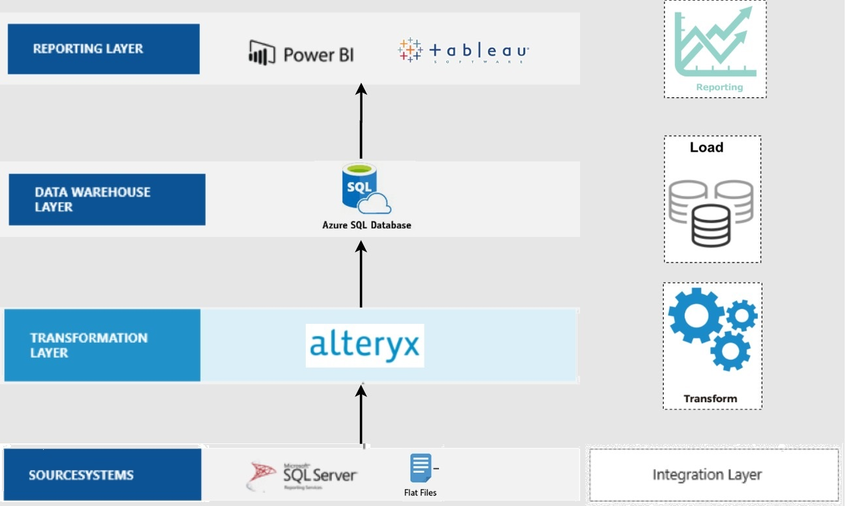
Architecture Diagram

Slide 4
ER Diagram

Slide 5
Data Integration Workflows

Slide 6
Data Integration Workflows

Slide 7
Azure Data Load

Slide 8
Azure Data Load

Slide 9
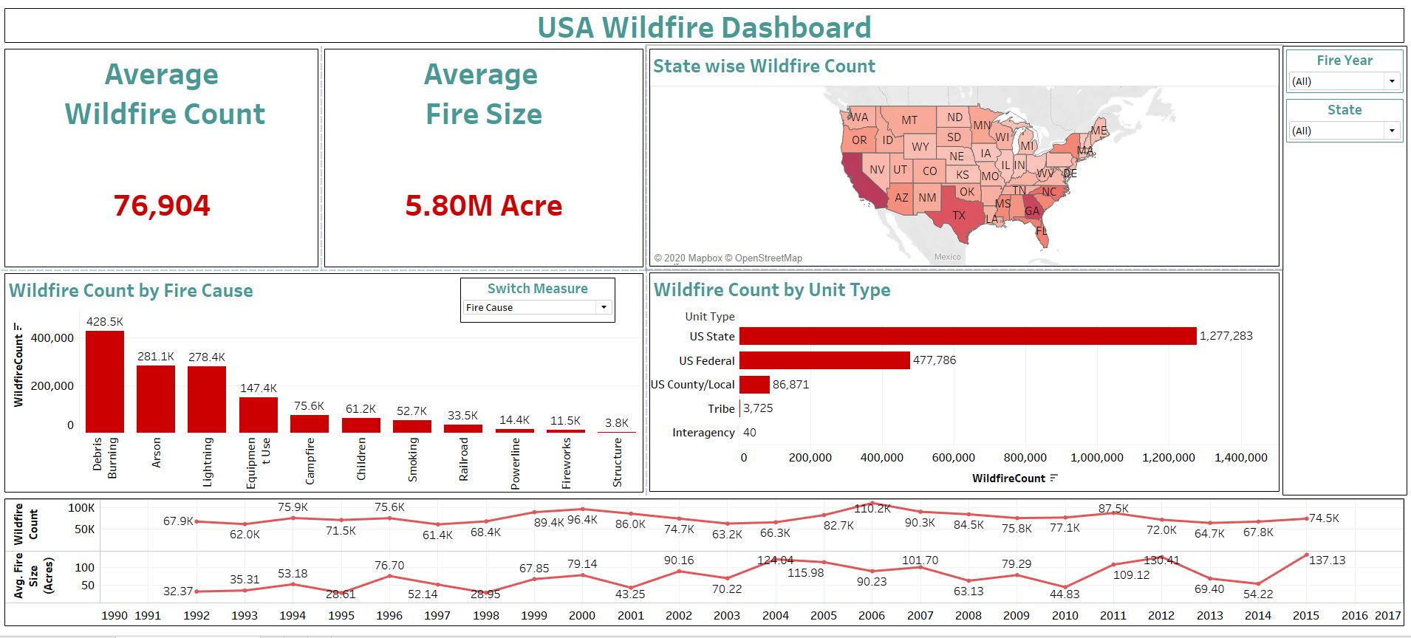
Tableau Dashboard

Slide 10
Tableau Dashboard Demo

Slide 11
Conclusion
In recent years we can see a linear increase in wildfire count which is surely an alarming concern.
The geographic representation of the number of wildfires in the US helped us analyze that California, Georgia and Texas are most wildfire prone states.
There are several factors that determine the cause of the fire but Debris Burning has the vast majority in all the states.
Even though the maximum wildfires were caused due to Debris Burning, the largest wildfires were due to Lightning.

Slide 12


