Slide 1
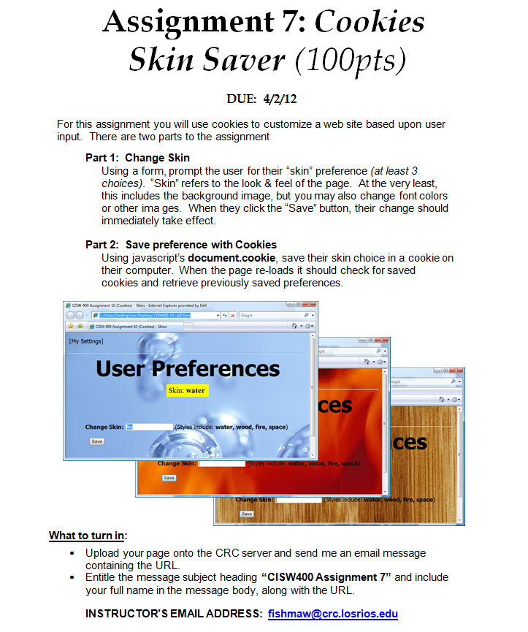
CISW 400 (Online) – Client-side Scripting for the Internet
PRESENTATION A7:
Assignment 7
Help
Tips, Hints,
& Examples
Cosumnes River College • Fishman • 2020
CISW 400 - CRC - Fishman 2020 / 2021

Slide 2
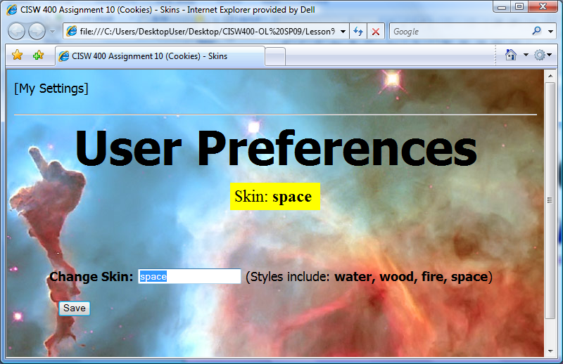
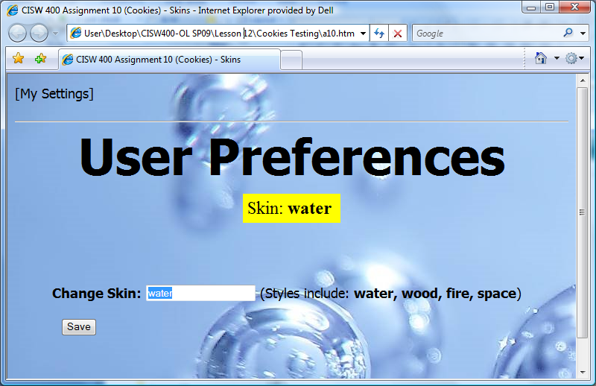
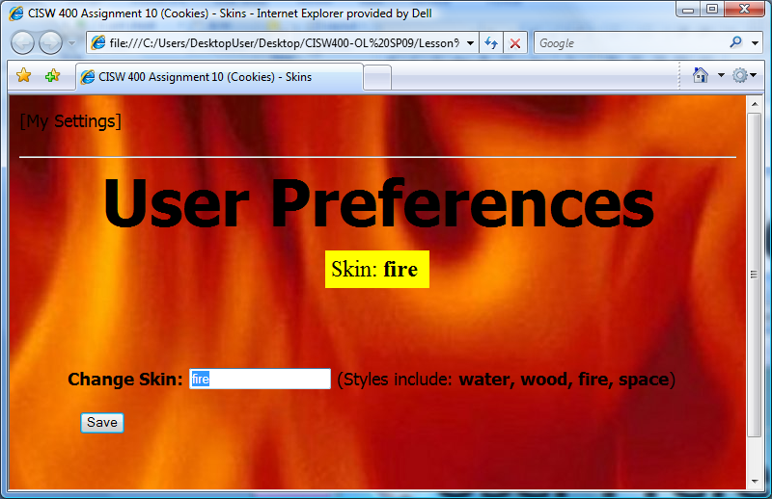
Assignment 7
Cookies Skin Saver
Use cookies to save the user’s preference for their webpage “skin”. If the user closes the browser and returns to the site at a later time, their last saved skin will come up.
CISW 400 - CRC - Fishman 2020 / 2021

Slide 3
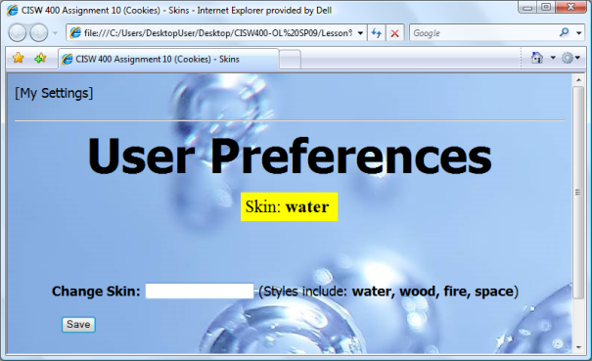
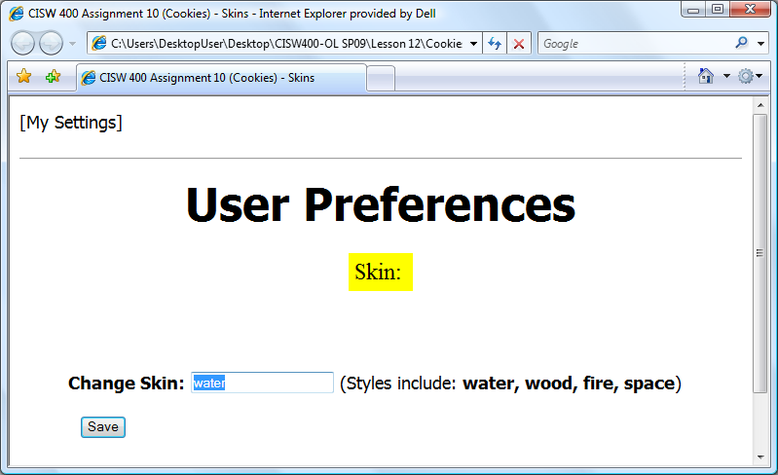
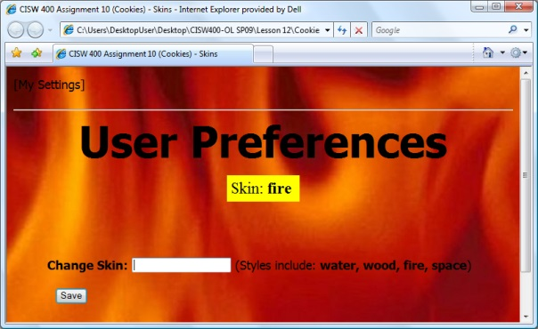
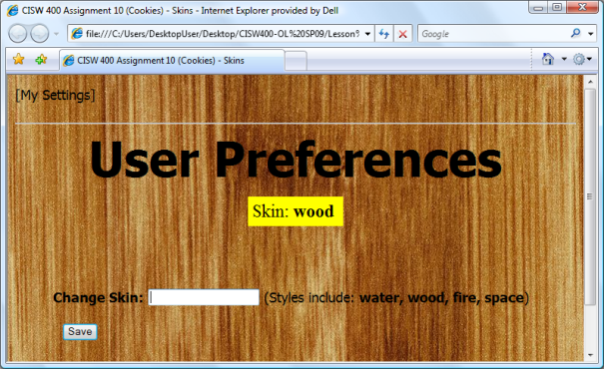
1. Create Page
First you’ll need to create a page and decide upon at least 3 themes (skins).
Include a form field for the user to change their skin preference
The initial skin can be blank or one of the user options.
Display current skin name.
Let the user know what their options are.
Have fun with the look & feel. This could be applied to any type of user customizable site, such as “My Ebay”, “My Yahoo”, “Instagram”, etc.
CISW 400 - CRC - Fishman 2020 / 2021

Slide 4
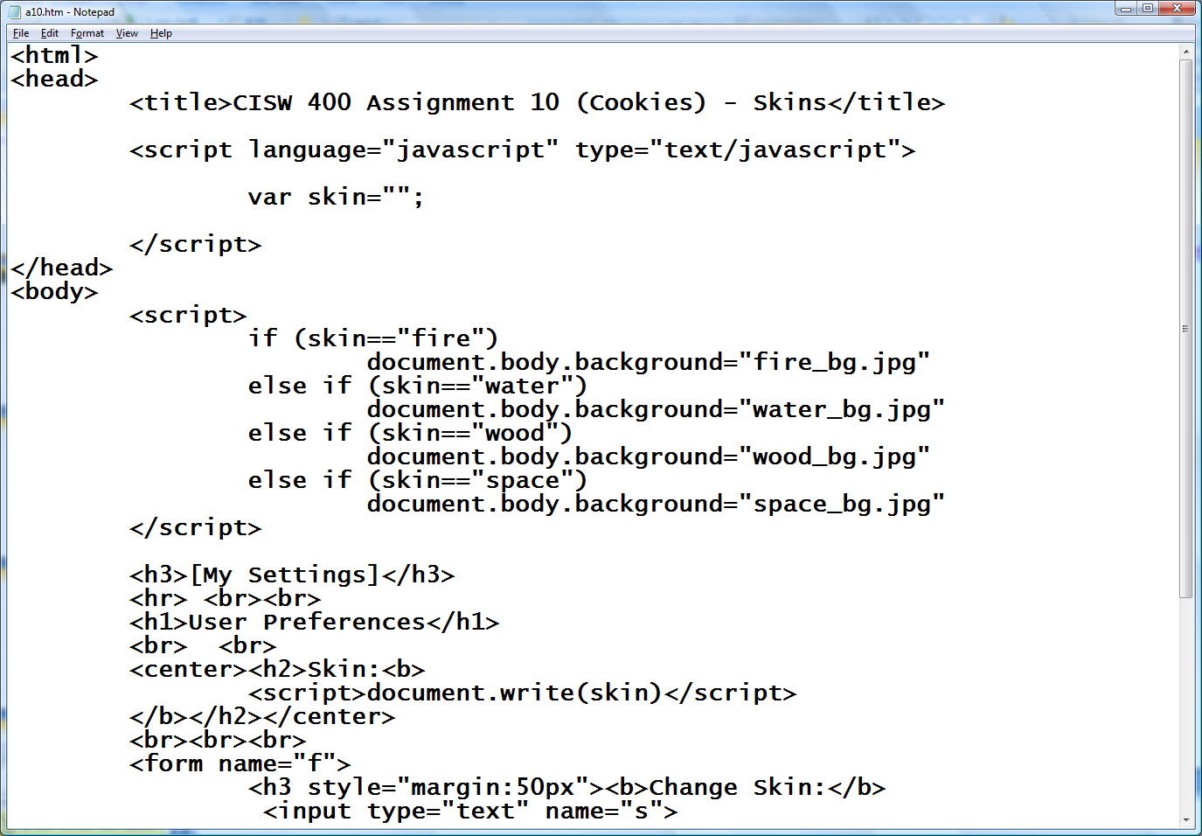
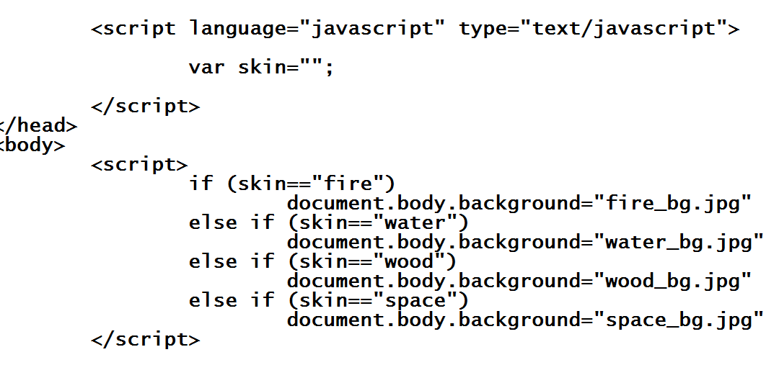
2. Changing Skin
When the user enters skin name, the page immediately changes:
We’ll insert more javascript here later.
To test the skins, you can set differ- ent values here.
Write skin name on page.
Change background image for each skin.
CISW 400 - CRC - Fishman 2020 / 2021

Slide 5
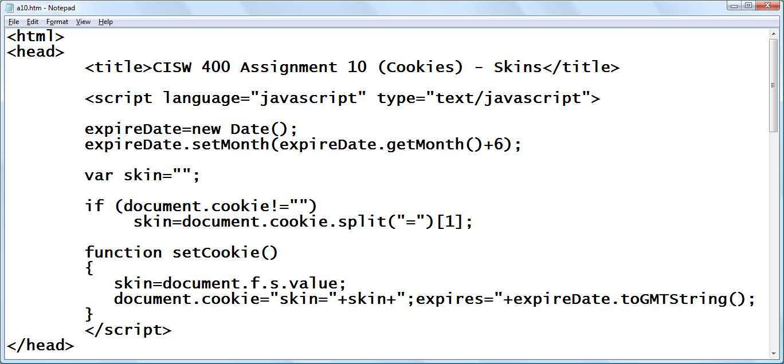
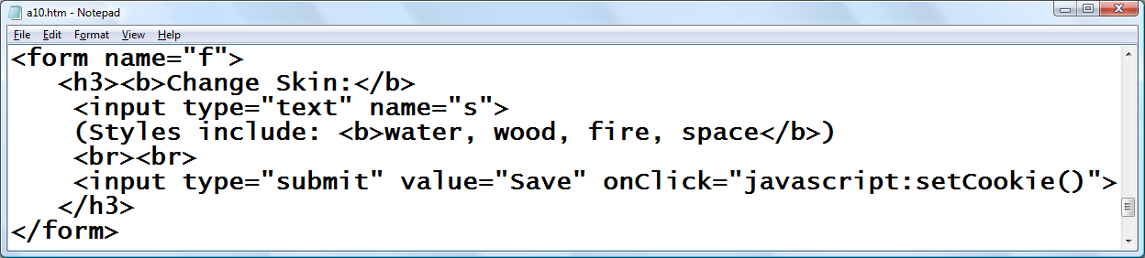
3. Saving Skin Change
Write a cookie function in the head which sets (saves) a cookie. Then add a function call to your submit button.
Initially check for existing cookie. If present, assign skin to saved cookie value.
Load
cookie
Set skin to value of field “s” from form “f”
Build & store cookie
CISW 400 - CRC - Fishman 2020 / 2021

Slide 6
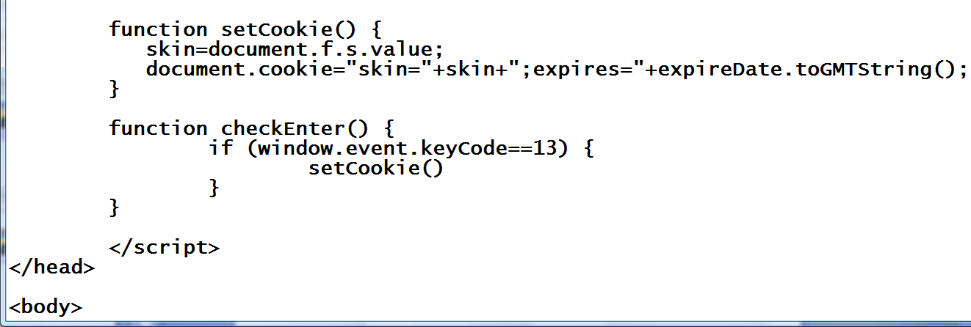
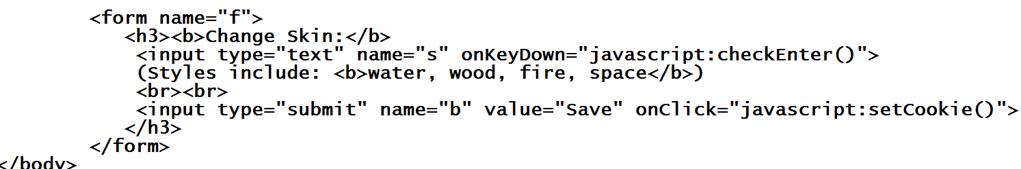
Extras
The following additional code will allow the user to either press the “ENTER” key or click the “SAVE” button.
“13” is the keyCode for the ENTER key.
Every time key is pressed, check for “ENTER”
CISW 400 - CRC - Fishman 2020 / 2021

Slide 7
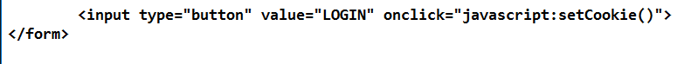
Extras
Note: Another option that may make your life easier, is to use a “generic button” instead of “submit button”:
Type=“button” will sometimes work better, because type=“submit” is a special case that tries to clear the page when clicked.
CISW 400 - CRC - Fishman 2020 / 2021

Slide 8
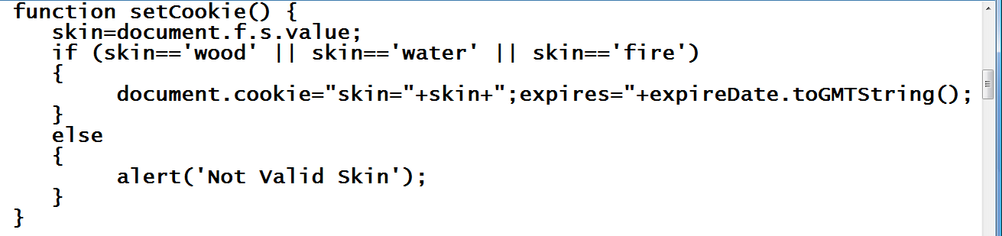
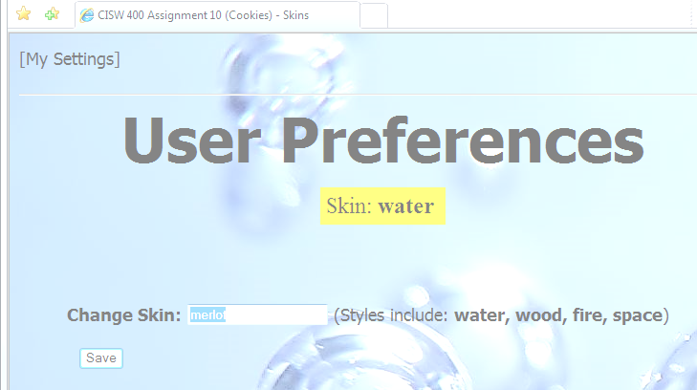
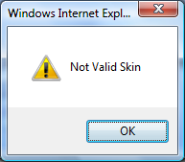
Extras
You may want to add an error check to prevent user input that does not match one of your skin names.
Only write cookie if they entered a valid skin name.
Otherwise, alert error message and don’t save cookie.
CISW 400 - CRC - Fishman 2020 / 2021

Slide 9
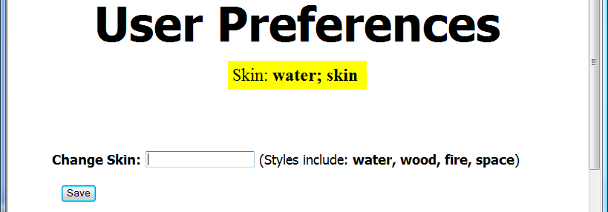
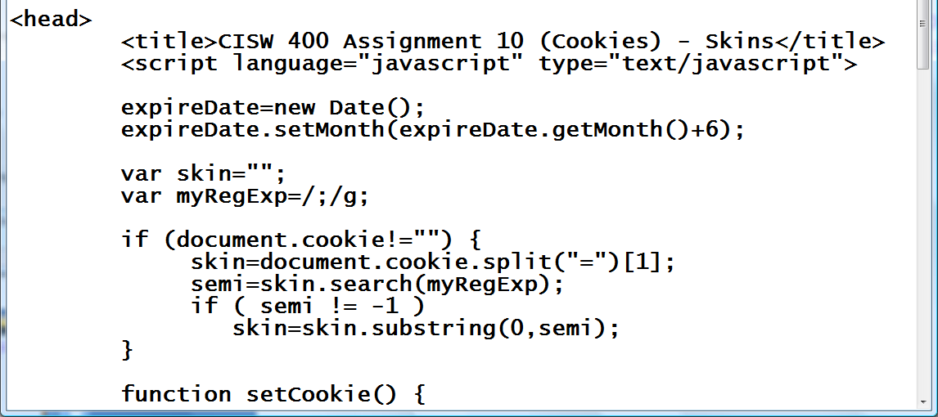
Troubleshooting
Some browsers may not store or retrieve the cookies the way that you intend. For example, MSIE sometimes includes the semi-colon and a few extra characters in the cookie.
The code below addresses
this issue:
Create a regular expression to do a global search for the semi-colon symbol.
If there is a semi-colon in the skin name, then re-assign skin to be only the characters before the semi-colon
CISW 400 - CRC - Fishman 2020 / 2021

Slide 10
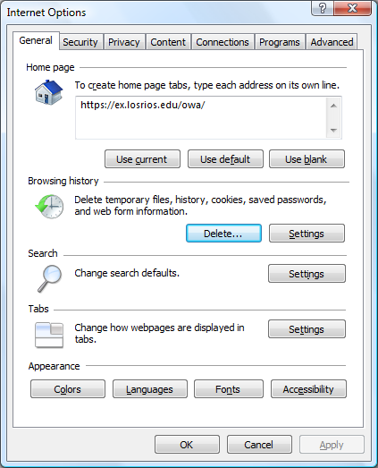
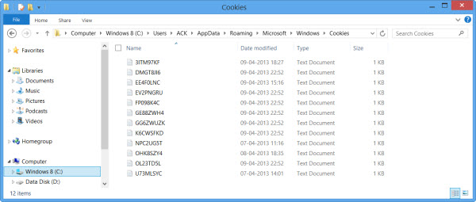
Testing
Clearing the Cookie Jar
When testing this assignment, you may need to remove cookie files from your computer before consecutive runs.
This can be done through Internet Options or manually.
In Windows 8, the “Cookie Jar” is located in C:\Users\username\AppData\Local\Microsoft\Windows\INetCookies
If necessary, do a Google search to find out where Cookies are stored on your
operating system.
CISW 400 - CRC - Fishman 2020 / 2021

