Slide 1
India's Auto Industry Evolution
Market Transformation, Economic Realities, and the Road to 2035

Slide 2
Two Decades of Disruption
How stringent regulations, expanding financing, and shifting fuel economics transformed the world's most dynamic mobility market (2006–2026).

Slide 3




India's Auto Market: By the Numbers
A Two-Wheeler Nation
3rd Largest, Yet...
EVs: Two Wheels First
India is the world's 3rd-largest auto market by volume — yet has only about 34 cars for every 1,000 people, versus roughly 850 in the US. This is a story of scale, not saturation.
Roughly 3 out of every 4 vehicles sold in India each year are two-wheelers. The country's real automotive story is playing out on two wheels, not four.
Electric two-wheelers already make up close to 7% of two-wheeler sales — more than double the electric share of new car sales in India.

Slide 4
Regulatory & Market Milestones
2021
2017
Policy Push: Launch of the National Vehicle Scrappage Policy and a multi-billion dollar PLI scheme for advanced batteries and components.
Safety & Tax Rollout: Nationwide GST simplifies logistics. Mandatory crash-test norms begin phasing in after poor Global NCAP results.
2014
2020
Efficiency Standards: Bureau of Energy Efficiency notifies India's first mandatory fuel-efficiency (CAFE) standards for passenger vehicles.
The Emission Leap: India leapfrogs directly from BS-IV to BS-VI, forcing a massive, expensive re-engineering of all fuel vehicles.

Slide 5


The Consumer Paradigm Shift
2006: The Utility Era
2026: The Value Era
Purchasing decisions were heavily constrained by upfront capital.
Consumers now evaluate the Total Cost of Ownership (TCO) and lifestyle image.
•
Primary Focus: Upfront price and maximum mileage ("Kitna deti hai?").
•
Primary Focus: 5-star NCAP safety ratings, connected tech, and automatic transmissions.
•
Brand Image: Trust meant reliability and cheap service networks.
•
Economic Shift: Willingness to pay a premium for features and safety, moving demand toward SUVs.
•
Afterthoughts: Safety features and premium infotainment were barely discussed in showrooms.
•
Awareness: Fuel efficiency remains important, but is balanced against high-tech utility.

Slide 6
The Cheapest Car That Couldn’t
2011
The Peak: Monthly sales top out around 9,000 units — modest for a mass-market bet, and already sliding as safety scares and brand stigma set in.
2008
2018
The Launch: Tata unveils the Nano as the “world’s cheapest car” at ₹1 lakh — roughly 206,000 pre-orders pour in during the first booking window alone.
The Collapse: Tata builds just 1 Nano in June before quietly discontinuing the line — down from tens of thousands of pre-launch orders a decade earlier.
The lesson: in a brand-conscious market, positioning a product as “cheapest” can cost more than its price tag.

Slide 7


Credit Expansion & Affordability
Historical Context (2006): Consumers preferred cash purchases or conservative bank loans. Debt was minimized.
The EMI Revolution: Today, low down payments, app-based loans, and long-term dealer financing are completely normalized.
Economic Concept (Credit Expansion): Easy access to credit structurally shifted purchasing power.
Market Impact: This financial leverage makes higher-priced vehicles feel "affordable," directly driving the massive market shift from entry-level hatchbacks to premium SUVs.

Slide 8
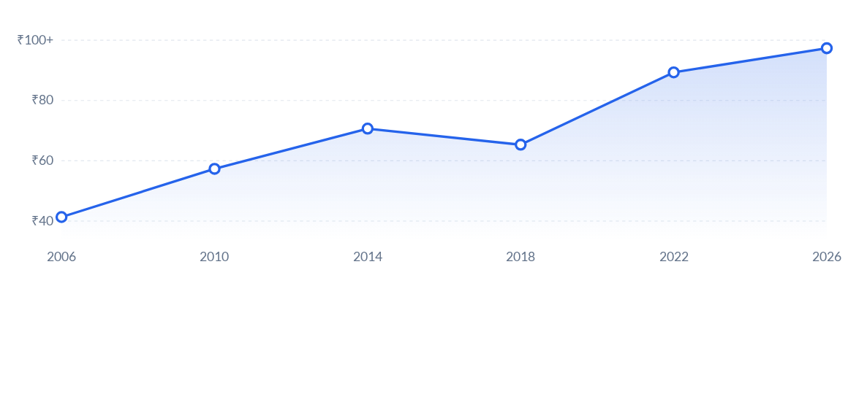
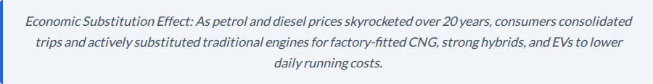
Fuel Price Economics & Demand Shift

Slide 9
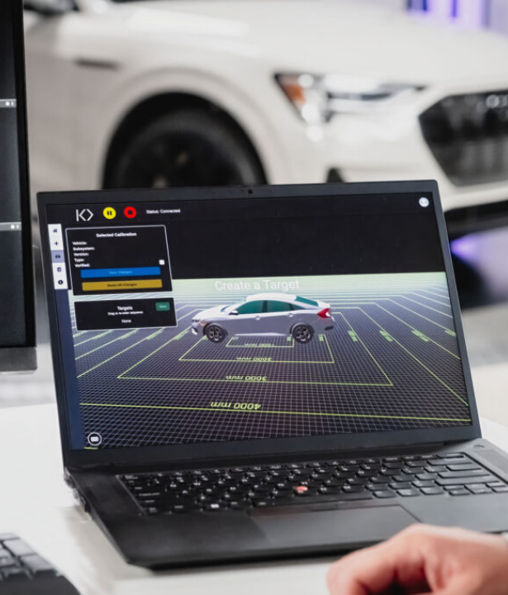
Dealership Evolution
The Analog Past: In 2006, operations relied on manual ledgers and walk-in sales. Competition was localized to single-brand dealers and neighborhood garages.
The Digital Present: Today, the primary sales funnel is online discovery. Operations require automated CRMs, tech-trained staff, and app-driven service updates.
The 2035 Vision: Dealerships will evolve into "Integrated Mobility Hubs." Primary revenue will shift from vehicle sales and oil changes to EV fleet management and software diagnostics.

Slide 10
The Regulatory Push (Correcting Externalities)
Internalizing Pollution Costs (BS-VI Leap) The aggressive jump from BS-IV directly to BS-VI forced automakers to localize advanced hardware. This structural disruption priced out legacy diesel engines and heavily hiked overall vehicle costs.
Accelerating Replacement (Scrappage Policy) By mandating fitness tests for older vehicles, government policy dictates exactly how long consumers keep a car, artificially accelerating the fleet replacement cycle toward cleaner technologies.
Supply-Side Intervention (PLI Scheme) To correct market bottlenecks, the government introduced a multi-billion dollar PLI scheme for advanced battery storage, aiming to localize manufacturing and lower the supply curve for EV tech.

Slide 11



The EV Equation (Consumer View)
Pull Factors
Friction Points
Market Reality
Consumers are highly drawn by ultra-low per-km running costs, a smooth driving experience, FAME subsidies, and the lifestyle image of driving connected, green tech.
Adoption is currently bottlenecked by high upfront premiums, intense highway range anxiety, and a severe lack of charging infrastructure in residential apartment complexes.
While policy subsidies offer real financial incentives, the uncertainty surrounding battery replacement costs and used-EV resale value continues to make mass-market buyers hesitate.

Slide 12
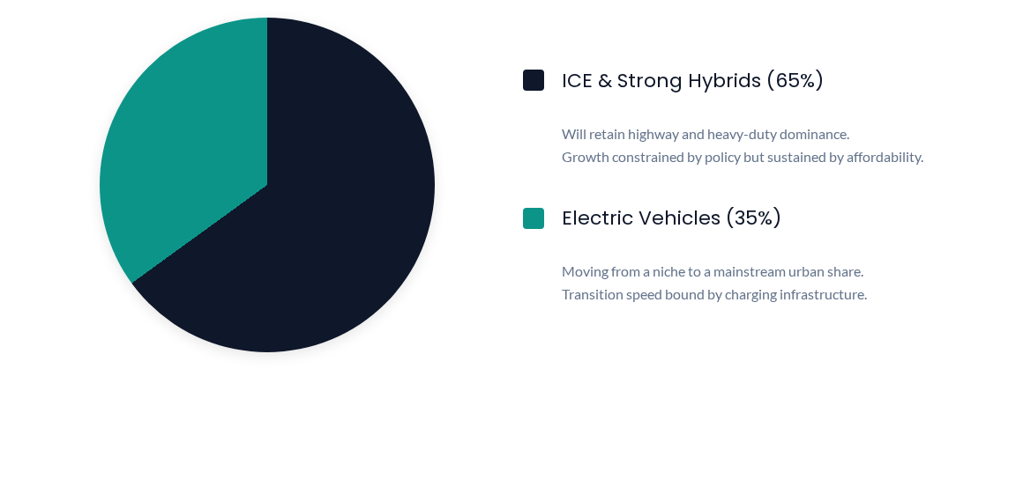
2035 Fleet Prediction

Slide 13


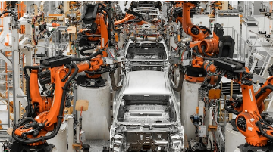
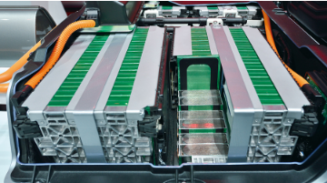
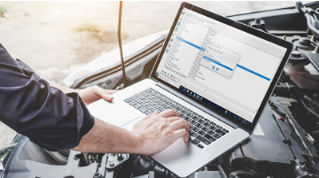
Strategic Imperatives for Automakers
1. Localize Supply
2. Diversify Powertrains
3. Service Transition
Leverage PLI schemes to localize advanced components and offset the high upfront costs of EV and BS-VII hardware.
Adapt or perish. Manufacturers must heavily invest in hybrids and EVs to survive the replacement cycle triggered by scrappage laws.
Retrain dealership networks to handle software diagnostics and high-voltage bays as traditional maintenance revenues decline.

Slide 14

Thank You

Slide 15
20 Years of Market Transformation
India's Automobile Industry — Fuel Vehicles (2006–2026)
Executive Report | Group 3 — Managerial Economics

Slide 16

Executive Summary & Regulatory Shifts
Executive Summary
What Changed (2006-2026)
Between 2006 and 2026, India's fuel-vehicle industry was reshaped less by any single event than by the compounding effect of regulation, financing, and shifting consumer priorities. A market once driven by price and mileage now runs on safety ratings, connected features, and total cost of ownership.
Regulation & Policy: BS-III (2005–10) to BS-IV (2010) to a direct leap to BS-VI in 2020, skipping BS-V entirely; GST (2017) simplified pricing; mandatory crash-test/safety norms (2017); National Vehicle Scrappage Policy (2021); ₹25,938 crore PLI scheme (2021) for components/batteries; E-Drive scheme (2023).
Emission and safety mandates forced two technology generations in a decade; GST and EMI-led financing changed how vehicles are priced and bought; and the entry of EV-focused challengers alongside the exit of established players (GM, 2017) shows a market whose competitive structure is actively being rewritten. Field interviews confirm the shift toward EVs is real but gradual, bottlenecked more by infrastructure and affordability than by intent.
Technology: MPFI and common-rail diesel became standard through the 2010s; safety tech (airbags, ABS) went from premium add-on to mandatory by 2017; BS-VI (2020) forced a hardware generation shift; connected-car and ADAS features reached mass-market trims by the early 2020s.
Competitive Landscape: Tata Nano (2008) and Tata's JLR acquisition opened the window; GM's 2017 exit showed how unforgiving the mass market had become; Kia and MG entered from 2019; Hyundai, Tata, and Mahindra built EV line-ups; Tesla's constrained 2025 entry closed the loop.

Slide 17

Market Disruptions & Economic Drivers
Consumer Behaviour & Disruptions
Why It Changed: Economics Behind the Shift
Consumer Behaviour & Financing: The default step-up purchase moved from two-wheelers to entry-level hatchbacks, aided by EMI culture; preference moved decisively toward SUVs; diesel's share declined as BS-VI raised costs; car buying shifted from showroom-led discovery to online research and video reviews.
•
Regulatory intervention (BS-VI, safety mandates) acted as a forced cost shock, raising the industry's minimum efficient scale smaller players struggled to keep up.
•
Rising fuel prices raised the effective price of driving, shifting demand along the elasticity curve toward mileage, CNG, hybrids, and now EVs.
Market Disruptions: The 2008–09 global financial crisis dented demand; COVID-19 (2020) halted production; the 2020–23 chip shortage cut output by up to 40% at points, leaving orders unfulfilled industry-wide.
•
EMI-led financing lowered the effective upfront price barrier, pulling demand toward costlier SUVs and premium trims even as headline prices rose.
New Business Models: The scrappage policy created a formal vehicle-recycling industry; subscription and long-term leasing emerged; digital-first, warranty-backed used-car platforms began formalising the resale market.
•
Entry and exit (GM) illustrate a contestable market: low switching costs and high consumer information punish manufacturers who misread demand.
•
Government policy (PLI, E-Drive, scrappage) functions as both a supply-side incentive and a demand-shaping tool.

Slide 18

Field Research, Outlook & Conclusion
Field Research: What the Market Is Saying
2035 Outlook
Consumers (5 interviewed): Unanimous shift from "price/mileage first" to safety, features, and total ownership cost. EMI is default. Rising fuel costs push choices toward CNG/hybrids/EVs, though charging access and resale uncertainty remain barriers.
•
Fuel vehicles will still make up the majority of India's fleet in 2035, but EVs are projected to move from roughly 2–5% to a mainstream 25–35% of new PV sales.
•
Policy direction is set: the government's 30% EV penetration target by 2030, backed by PLI and E-Drive, is a simultaneous demand- and supply-side push.
Business Owners (2 interviewed): Operations moved to CRMs. Competition includes online aggregators. Both are retrofitting workshops with high-voltage bays and expect 2035 revenue to lean heavily on EV service and software.
•
Battery costs are falling, but affordability remains a binding constraint, ruling out full EV dominance by 2035.
Industry Expert: Confirms the structural shift to SUVs and electrified powertrains. Expects ICE and strong hybrids to retain highway dominance through 2035, while urban mobility becomes overwhelmingly electric.
•
Import duty and localisation policy favour Indian-manufactured EVs over imports.
•
The scrappage policy will cycle a meaningful share of the old fleet out for replacement in exactly the 2030–2035 window.
Conclusion: Strategic Takeaway
•
Charging infrastructure not battery cost — is the binding constraint outside major cities.
Fuel vehicles are not disappearing by 2035, but R&D investment is shifting toward hybrid and EV platforms. Manufacturers who don't diversify risk losing share the same way GM lost it after misreading the mass market.

Slide 19
