Slide 1
BERKELEY MFE · CAPITOLIS INDUSTRY PROJECT
Monte Carlo CCR Engine
Full technical build: methods, formulas, variance reduction, calibration, and results
18
39
6
5
reporting nodes
risk factors
real bugs fixed
RNG methods compared
Technical Deep-Dive — Simulation Engine, Speed, Variance Reduction, Greeks, MPOR

Slide 2
What This Covers
1
Foundations
Data collection recap, pricer contract, trade inventory
2
Simulation engine
Hull-White rates, correlated GBM equities/FX, calibration
3
Speed optimization
Two real bottlenecks found + fixed, with measured before/after
4
Variance reduction
5 RNG techniques compared: option study + real 39-factor engine
5
Convergence & calibration
How many paths are enough; Hull-White 'a' calibrated from real data
6
Greeks & MPOR
Pathwise vs bump-reprice; margin period of risk exposure
2

Slide 3
Foundations (Recap)
16 trades, 5 real market data series, all independently validated
✓
Trades
8 Equity TRS (incl. 2 JPY compo), 4 Bond Forward, 4 Bond TRS — 3 counterparties
✓
USD rate curve
Bootstrapped from 33 live Databento SOFR futures; validated vs. Treasury.gov (13–46.5bp spread, smooth)
✓
Equity spots + FX
37 unique names (yfinance), live; USD/JPY spot, live
✓
Volatilities
Historical realized vol, 39 factors, 3yr daily history
✓
Correlations
39×39 matrix, PSD-confirmed, economically sanity-checked
3

Slide 4
Rate Model: Hull-White One-Factor
Gaussian, mean-reverting, exact closed-form bond prices at every node
SDE
Calibration inputs
dr(t) = [θ(t) − a·r(t)] dt + σ dW(t)
σ (vol)
0.63%
Realized SOFR spot vol — real data
Shifted-OU decomposition
r(t) = x(t) + α(t)
x(0)=0, α(t) fits today's REAL curve exactly
a (mean reversion)
0.0458
Calibrated from SOFR futures vol term structure, R²=0.82 — real data (was a 0.03 textbook guess)
Analytic bond price
P(t,T) = A(t,T)·exp(−B(t,T)·r(t))
No remaining disclosed-guess parameters in the rate model — both inputs come from real market data.
Verified: P(0,T) matches the real curve to 1e-9 at every tenor — an exact identity, not an approximation.
4

Slide 5
Equity + FX Model: Correlated GBM
37 equities + USDJPY, hybrid with the simulated short rate
USD-quoted equities
dS/S = (r(t) − q) dt + σ dW
JPY-quoted equities (drift uses an approximated JPY rate)
dS/S = (r(t) − diff_JPY−USD − q) dt + σ dW
USD/JPY FX
dFX/FX = diff_JPY−USD dt + σ_FX dW (JPY per USD)
diff_JPY−USD is a CONSTANT differential, backed out from REAL CME JPY futures (6J, Databento) vs. our own real USD curve via covered interest parity (≈0.7–1.1% depending on run) — real data, not assumed. Simplification: a constant, not a full second stochastic JPY curve — reasonable given only 2 of 16 trades are JPY compo.
5

Slide 6
Speed Optimization
Two real bottlenecks found and fixed — measured, not estimated
1
Exact analytic curve
replaces fixed-pillar interpolation
2
Fixed a Windows multiprocessing bug
(heavy imports re-run per worker)
0.206 ms → 0.019 ms per call
113 ms → 51 ms per scenario
10.6x faster
2.2x faster
+ removes ~2e-5 DF interpolation error — more accurate too
spawn re-executes driver-script top-level imports in every worker
Combined result
Full 16-trade, 2000-scenario, 18-node simulation: ~12 min (projected) → 93 seconds (~7.7x total)
6

Slide 7
Five Random-Number Techniques Compared
Pseudo-random
Baseline Mersenne Twister Gaussian draws
Antithetic
Pair each z with −z; cancels odd noise moments for near-linear payoffs
Moment-matched
Rescale draws so sample mean=0, std=1 exactly
Sobol (QMC)
Low-discrepancy quasi-random sequence → Normal via inverse CDF
Latin Hypercube
Stratifies each dimension's own marginal into equal bins
7

Slide 8
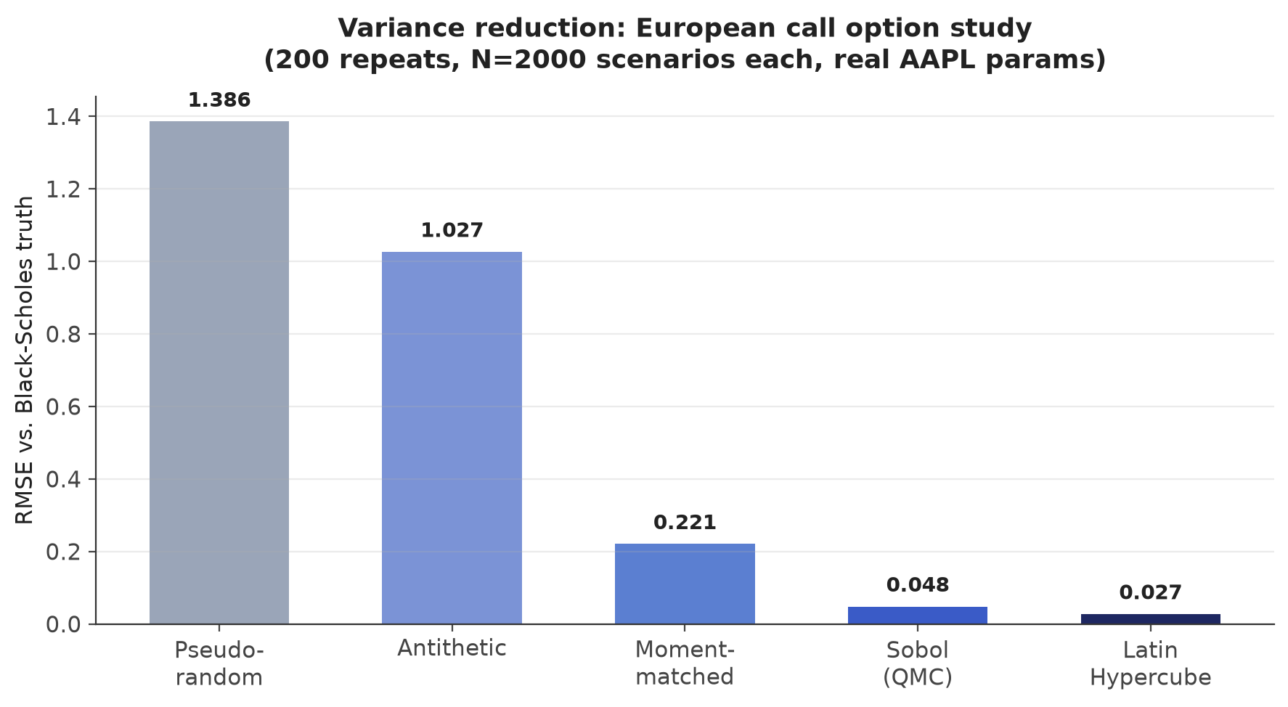
Variance Reduction: Controlled Option Test
European call, real AAPL spot/vol, known Black-Scholes truth
Latin Hypercube: ~50x lower RMSE than pseudo-random, at <4x the per-trial cost.
8

Slide 9
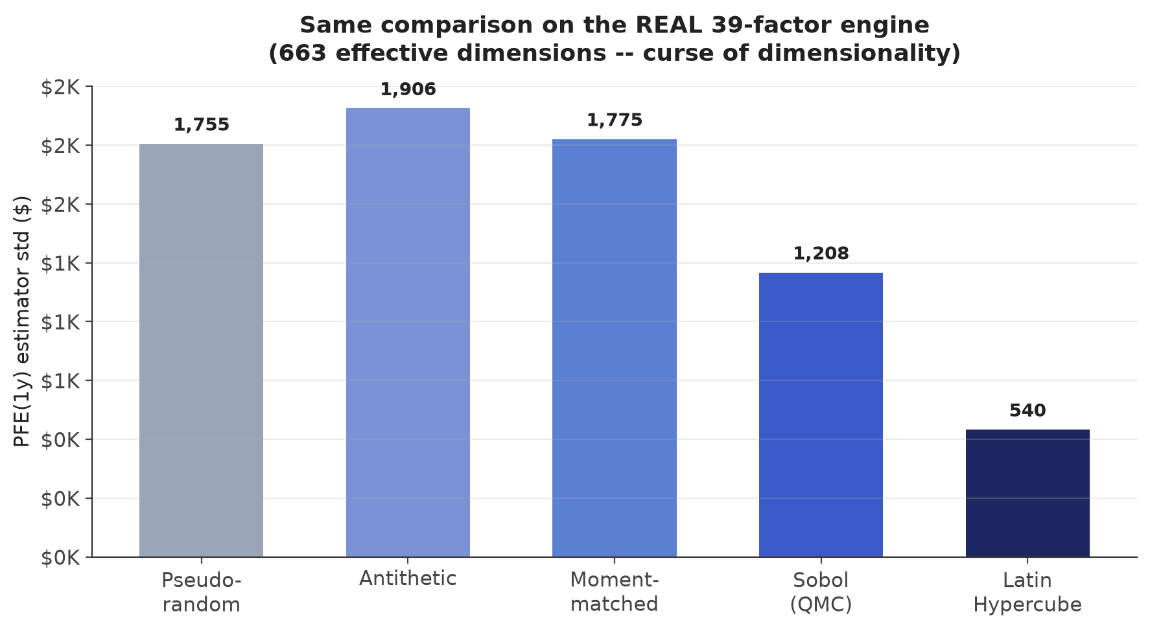
Variance Reduction: Does It Hold on the Real Engine?
39 factors × 17 time steps = 663 effective dimensions
Ranking compresses hard: antithetic/moment-matching show NO benefit at this dimensionality — Latin Hypercube still wins (3.25x).
9

Slide 10
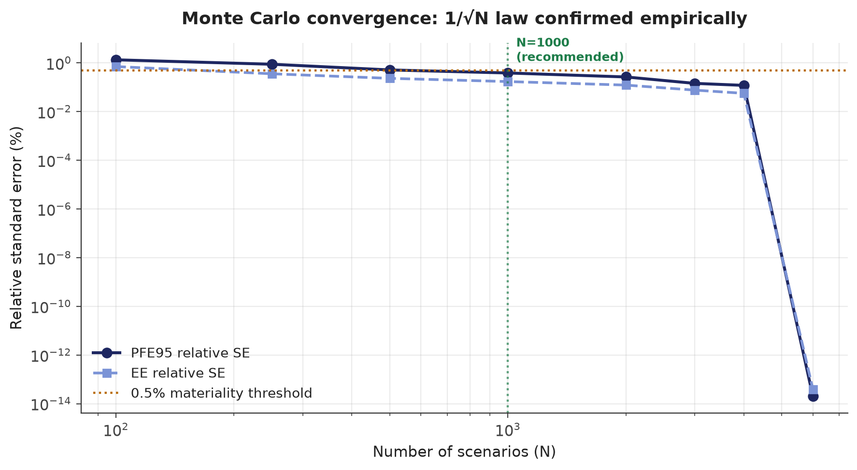
How Many Paths Are Enough?
Empirical convergence study — bootstrap resampling from a 6,000-scenario pool
Recommendation: N=1,000 for iteration (0.39% error, 73s); N=2,000–3,000 for reporting (0.1–0.3%, 2–3 min). Beyond ~4,000, sampling error is smaller than unquantified model assumptions — diminishing real value.
10

Slide 11
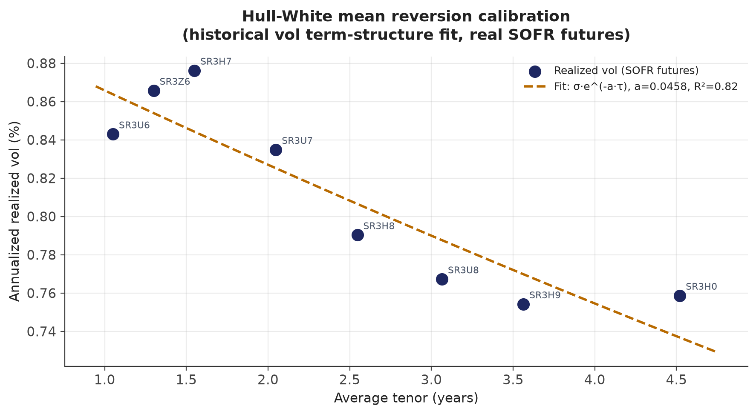
Hull-White Mean Reversion: Calibrated, Not Assumed
Historical volatility term-structure fit, 8 real SOFR futures contracts
σ_f(t,T) = σ·e^(−a(T−t)) — fit slope gives a=0.0458 (R²=0.82), replacing the earlier a=0.03 textbook guess.
11

Slide 12
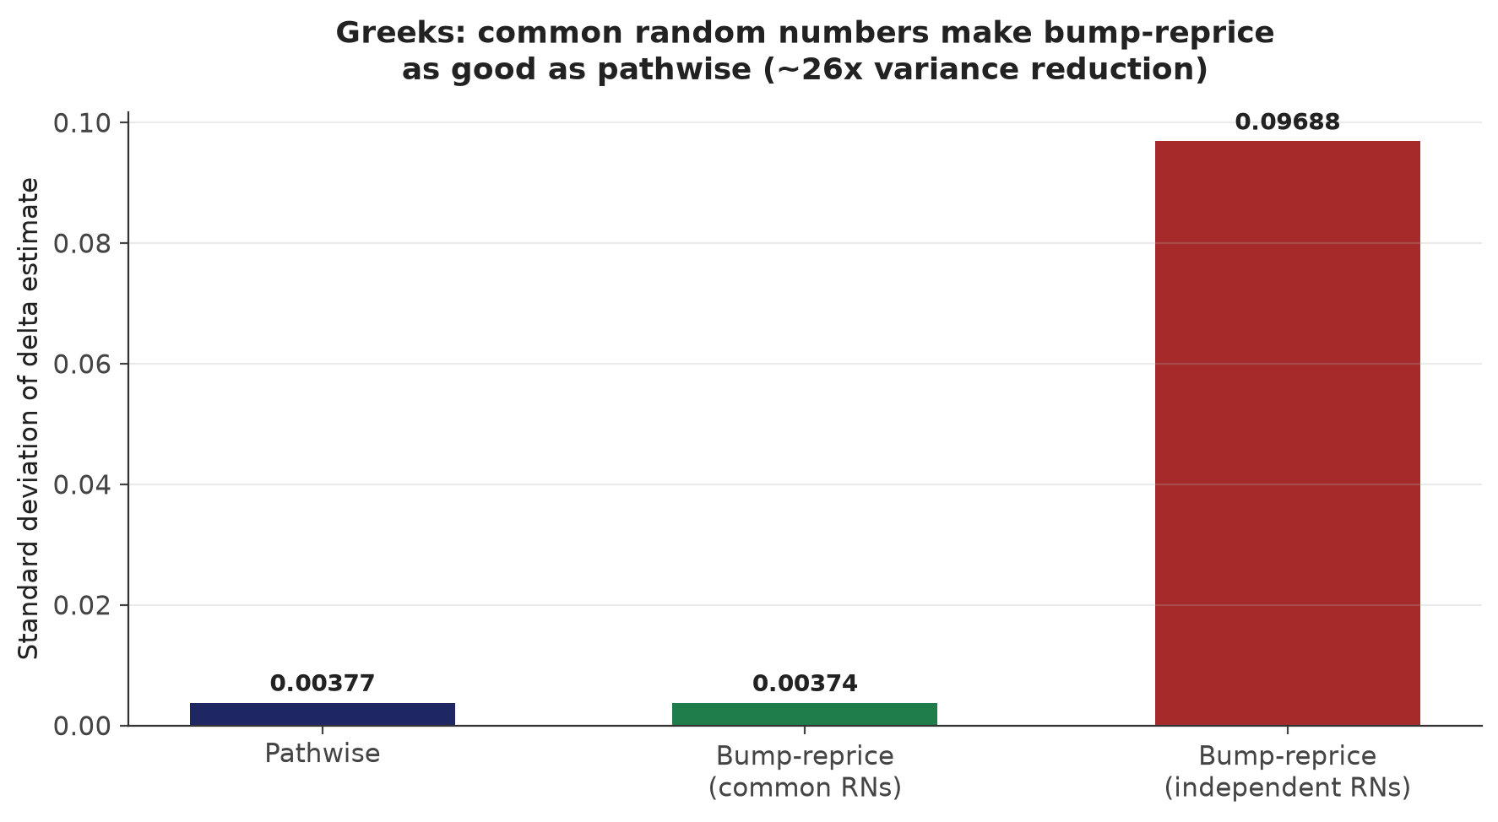
Extension to Greeks
Pathwise vs. bump-and-reprice, with and without common random numbers
Common random numbers make bump-and-reprice statistically indistinguishable from pathwise. Independent draws for the two legs make it ~26x worse — and biased. Bump-and-reprice + CRN is what generalizes to our real (non-differentiable-by-hand) book.
12

Slide 13
A Real Greek, on the Real Book
EQTRS_0003 — delta to its largest position (NL0009538784, 212,269 shares)
$10,803,019
NPV(0) @ spot 227.84:
−$212,269 / $1
Delta (exact, no MC needed):
Magnitude exactly matches the share count — a strong internal-consistency check for this linear payoff.
13

Slide 14
MPOR (Margin Period of Risk)
Was a 10-day MPOR used? No — the book is uncollateralized. Built and validated for when it applies.
Collateral held at reporting date t
C(t) = max(V(t) − threshold, 0)
Exposure at the (delayed) close-out date
Exposure(t) = max(V(t + MPOR) − C(t), 0) [same simulated path]
MPOR = 10 business days (ISDA SIMM / Basel standard). Implemented by inserting a look-ahead node exactly MPOR days after every reporting node, on the SAME simulated path — no separate simulation needed, since the engine already handles arbitrary non-uniform node spacing. threshold=$0 isolates the pure MPOR effect (full variation margin).
14

Slide 15
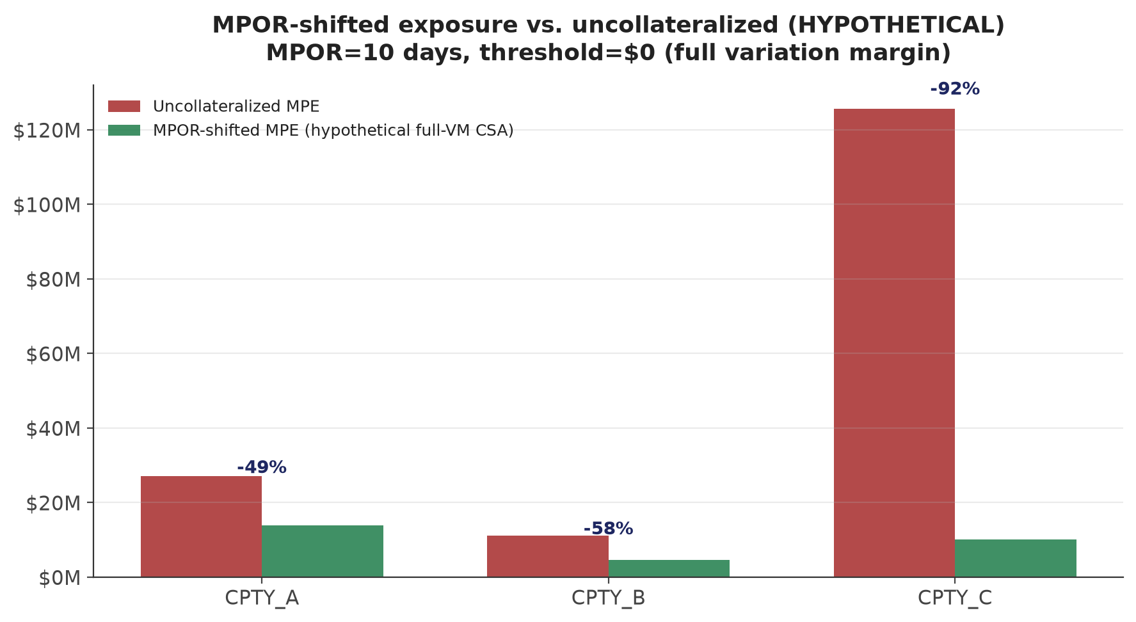
MPOR Results (Hypothetical CSA)
Real book has no CSA data — illustrative: threshold=$0, MPOR=10 days
CPTY_C's exposure is dominated by one $500M bond forward — collateralizing it removes 91.9% of the MPE.
15

Slide 16
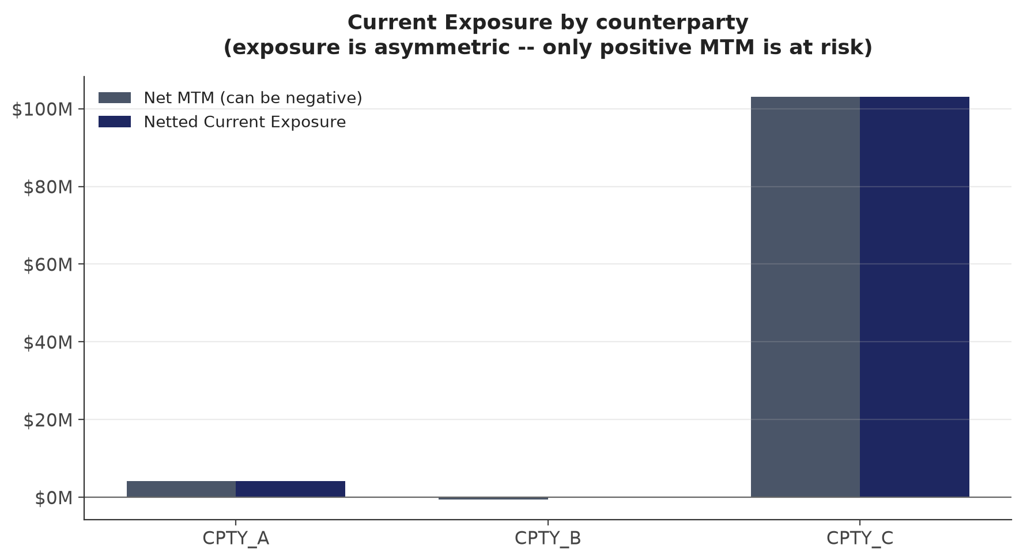
Current Exposure (Today, No Simulation Needed)
Exposure is asymmetric — only positive MTM is at risk
CPTY_B: $0 exposure — we currently owe more than we're owed. CPTY_C dominated by a single trade (concentration risk).
16

Slide 17
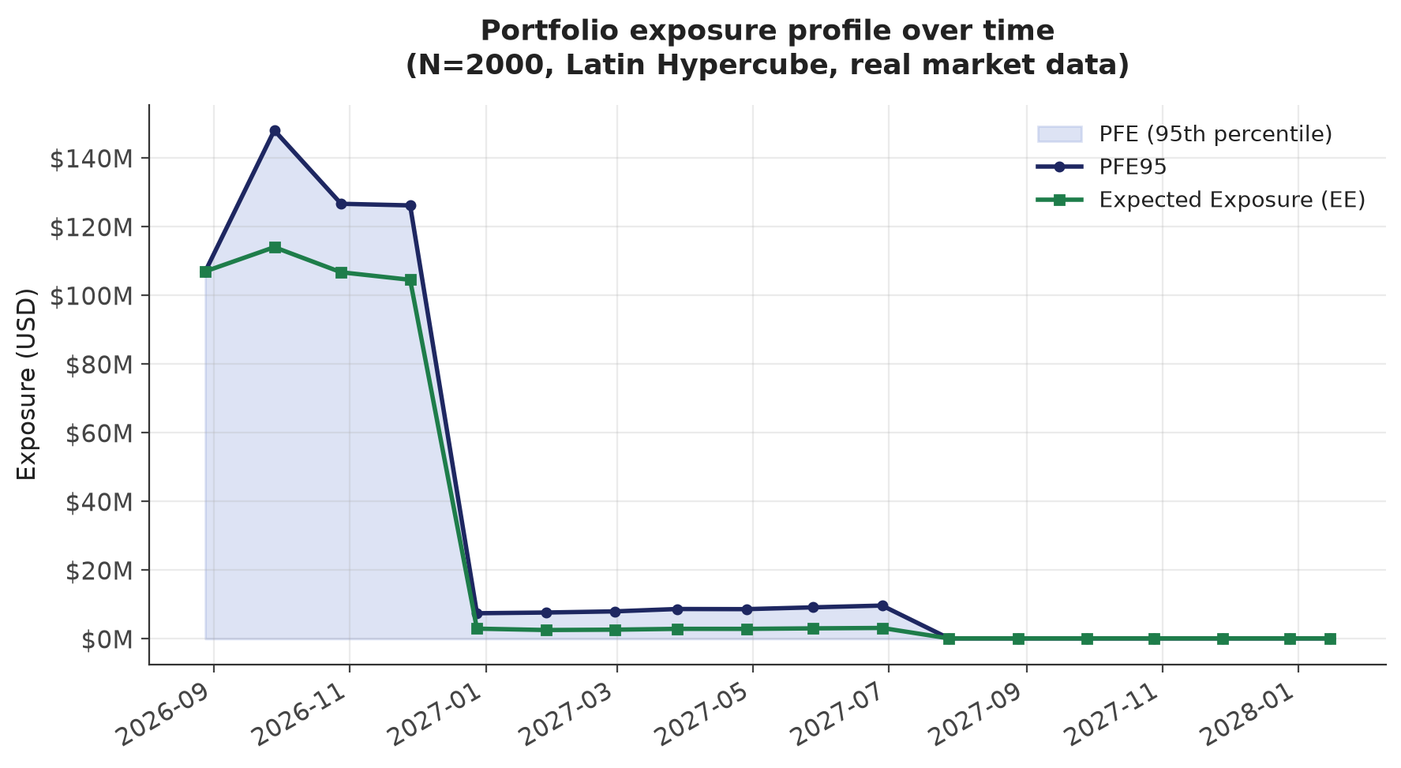
Portfolio Exposure Profile Over Time
N=2,000, Latin Hypercube, self-validated to 0.0000% vs. direct t=0 reprice
Collapses >94% by end of Dec 2026 as most trades mature; small residual tail to Jan 2028 (BTRS_0001). Risk management attention should concentrate on the next 4 months.
17

Slide 18
6 Real Bugs Found & Fixed
Every one caught by checking against something — a second source, a full run, a hand calc — not assumed
1
Ticker mismatch
BRK.B vs Yahoo's BRK-B silently failed lookups (2 places)
2
SOFR curve gap
Recently-expired contracts wrongly wrapped a decade forward — caught via Treasury cross-check
3
SOFR curve truncation
The FIX above then over-corrected, dropping genuinely far-dated live contracts — caught while calibrating Hull-White
4
US/Japan timestamp mismatch
Different market hours broke the historical data join (~70% blank → fixed)
5
Stale self-validation
A ~12.5hr-old cached comparison file showed false 7-15% 'discrepancies' from real overnight price moves
6
Curve-object mismatch
Internal consistency check used a different (less exact) curve object than the engine — now 0.0000% exact match
18

Slide 19
Next Steps
• PFE-sensitivity Greeks: d(PFE)/dS at a future node — same bump-reprice + CRN mechanism, applied to simulated paths
• Confirm actual CSA/margin terms with Capitolis — the current book is treated as uncollateralized by default
• Vectorized pricer reimplementation if scenario counts need to scale past ~10,000 (current bottleneck: ~1.2ms/npv() call)
• Quantify remaining model uncertainty (Hull-White mean reversion, vol proxy) — likely larger than residual MC noise
• FX forward points beyond spot, once a source is confirmed — minor simplification today, not a blocker
19

