Slide 1
Counterparty Credit Risk Engine for the Capitolis Book
Data, Models, Trade-offs, and Results -- Condensed
Berkeley MFE Industry Project | Valuation date 2026-08-28

Slide 2
PART -
Agenda
I. What Capitolis Gave Us
II. Risks, Variables, and Data
III. Models Considered, and Why the Final Model
IV. Efficient Simulation
V. What the Engine Does, and What It Finds
VI. Sensitivities, Stress, and Validation
VII. Credit and Capital
VIII. Decisions, Limitations, and Conclusions

Slide 3
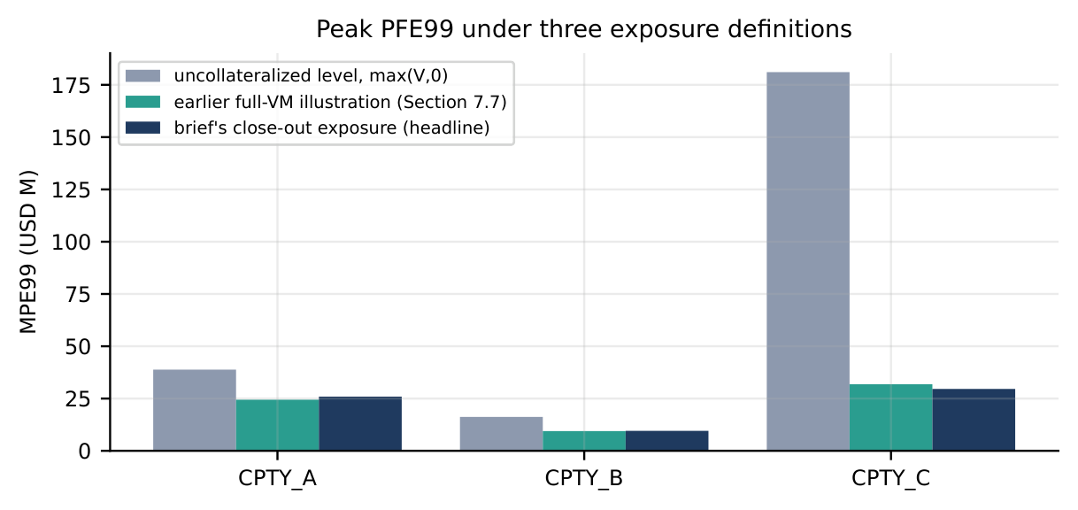
PART I
The Book, and the Exposure We Must Measure
Trade | Type | Cpty | Underlying | Ends | Notional | NPV t=0
EQTRS_0001-3 | Eq. TRS | A | 3 USD names each | Oct'26 | 50-99M | -5.55/-1.08/+9.92M
EQTRS_0004 | Eq. TRS | B | 16 USD names | Nov'26 | 49.2M | -0.87M
EQTRS_0005/6 | Eq. TRS | B | 3 JPY names each | Oct'26 | 12-31M | +0.15/+1.63M
EQTRS_0007/8 | Eq. TRS | C | 7/3 USD names | Oct'26/Jul'27 | 95M/30M | -0.37/+2.22M
BF_0001/2 | Bond fwd | A | UST 3.88%'28/4.63%'35 | Oct/Nov'26 | 100M/20M | +0.51/-0.36M
BF_0003 | Bond fwd | C | UST 2.88% 5/15/2049 | Dec'26 | 500M | +121.26M
BF_0004 | Bond fwd | C | UST 1.13%'28 | Oct'26 | 50M | +1.97M
BTRS_0001-4 | Bond TRS | A/B/B/C | UST 4.12/2.88/4.63/4.12% | '27-'28 | 5-40M | +0.12/+0.21/+0.03/+0.04M
Exposure = max( V(t+10bd) - V(t-1bd), 0 )
VM: netted value 1bd before t, two-way, no threshold
MPoR: close-out 10 business days after t
Netting within a counterparty only; never across
Trades settling inside the window excluded
Net MtM: CPTY_A +$3.57M CPTY_B +$1.15M CPTY_C +$125.12M Book +$129.84M

Slide 4
PART II
Risk Factors and Data Philosophy
Risk factor | Trades affected | Model | Calibrated from
37 equity prices | All 8 equity TRS | Correlated GBM | 3y realised vol, dividend yield
USDJPY | Equity TRS, JPY names (2) | GBM, quanto drift | 3y realised FX vol
USD short rate | Bond fwd/TRS, funding, disc. | Hull-White 1F (=1F LGM) | Swaption cube (a) + realised vol
JPY short rate | Drift of JPY names, USDJPY | 2nd Hull-White 1F | Real JPY OIS curve, rate history
Counterparty credit | CVA/DVA/FVA/KVA only | Hazard-rate survival | ICE BofA rating OAS; no CDS
39 correlated stochastic factors, one joint simulation, correlated by a single Cholesky factor every time step.
Data philosophy
Every number traces to a disclosed, real source -- no synthetic placeholders for calibration inputs
Two tiers: public (Yahoo Finance, FRED, Databento) and licensed (Bloomberg, used/cross-checked, never redistributed raw)

Slide 5
PART II
Data Sources: Where Every Number Comes From
Source | Used for | Benefit of using real data
Databento SOFR futures + Bloomberg long end | USD discount curve, HW1F base | Genuine market-implied curve; splice moved MPE99 $52.7M->$52.1M
FRED Treasury CMT yields (public, since 1981) | Realised long-end vol -> HW sigma (0.96%) | Matches the actual yield vol this book depends on
Bloomberg ATM normal swaption cube | Mean-reversion a (0.0167, R2=0.84) | Textbook, genuinely implied, forward-looking
Yahoo Finance: 37 equities + USDJPY, 3y hist. | Spots, div., realised vol, 39x39 correlation | Public, free, long enough (2007-today) for reliable stats
Real JPY OIS curve | JPY Hull-White factor base curve | Lets JPY rates move independently and go negative
ICE BofA rating-index OAS (FRED) | Counterparty/issuer credit spread proxy | Basel MAR50.32(3)-sanctioned fallback; real market spreads
Bloomberg (licensed): curve, vol cubes, surfaces | Splice, calibration fits, model-risk checks | Only source for genuine long-dated data; derived numbers only

Slide 6
PART III
Models Considered: Rates, Equities, FX, Credit
Rate model | Advantages | Disadvantages | Use
Hull-White 1F (=1F LGM) | Exact step, closed-form P(t,T); 2 params | One factor -- curve near-parallel | SELECTED
G2++ (2-factor, =LGM2F) | Level+slope move separately | 5 params; b at bound; 16.1% fit error | Challenger
2-factor + stoch. vol | Vol clustering, fat tails | Not implemented; more params | Not built
Equity/FX/credit model | Advantages | Disadvantages | Use
Equities: GBM | Exact log-Euler step, fast | No vol smile or clustering | SELECTED
Equities: stochastic vol | Vol clustering, skew | Not implemented; needs option surfaces | Not built
FX: GBM, quanto drift | Consistent with both curves | No smile | SELECTED
Credit: hazard-rate proxy | Transparent, Basel-compliant | No wrong-way risk, no spread vol | SELECTED
Credit: stochastic intensity | Spread + wrong-way risk | No counterparty CDS available | Not available
The rate-model question is empirical: does the second factor materially change this book's exposure? Tested next.

Slide 7
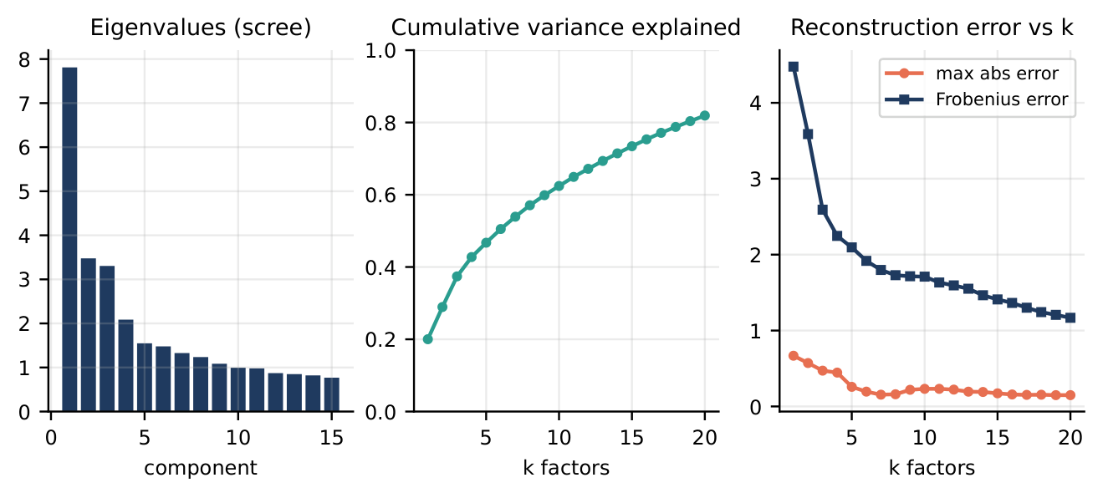
PART III
Correlation: Full Cholesky Matrix vs. PCA Factor Model
 | Full | PCA k=5 | PCA k=10
Step time (5,000 scen.) | 1.91s | 2.08s | 2.29s
Variance explained | 100% | 47% | 62%
Netting-set vol vs. full (B) | - | +1.7% | +1.5%
SELECTED full matrix: PCA is slower, not faster, at n=39 (draws k systematic + n idiosyncratic numbers, no dimensionality win). Loss of using PCA instead: no speed gain, and up to 1.7% extra sampling error. Kept only as an explainability tool: factor 1 (20%) is a broad market mode, factor 2 (8.9%) is Japan vs. US.

Slide 8
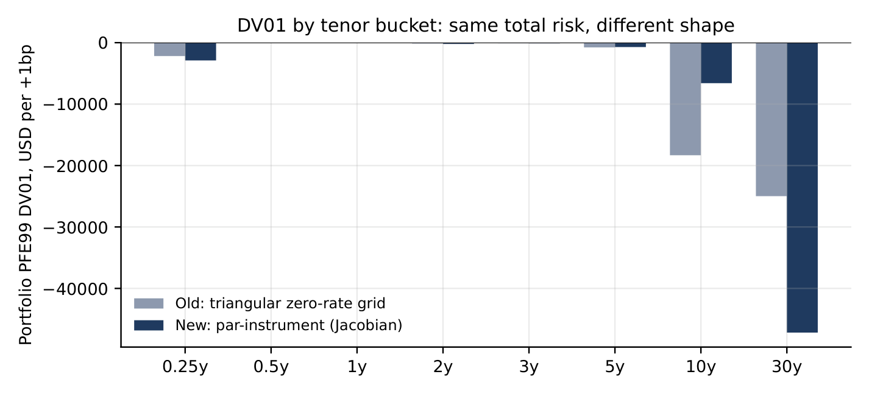
PART III
USD Rate Calibration: Mean Reversion and Volatility
Route (mean reversion a) | Data | a | R2 | Use
Swaption cube (preferred) | Bloomberg ATM normal vol, 1M expiry | 0.0167 | 0.845 | SELECTED
SOFR-futures vol decay | ~2y Databento history, 8 contracts | 0.0458 | 0.820 | cross-check
Original source (overnight SOFR, 0.63%) understates long-dated yield moves (realised 10bd 20y move ~15bp vs. ~11bp implied)
SELECTED: realised vol of 2y-30y Treasury yield changes directly, 0.96% -- validated by Kupiec backtest
Tenor | Overnight-SOFR exc. | Long-end sigma exc. | Expected | Pass?
5y | 1/1 | 4/3 | 1.6 | yes
10y | 1/0 | 3/2 | 1.6 | yes
20y | 1/1 | 3/1 | 1.6 | yes
Book rate risk sits 82% in the 30y bucket (BF_0003, $500M, 2049 Treasury) -- one maturity dominates.

Slide 9
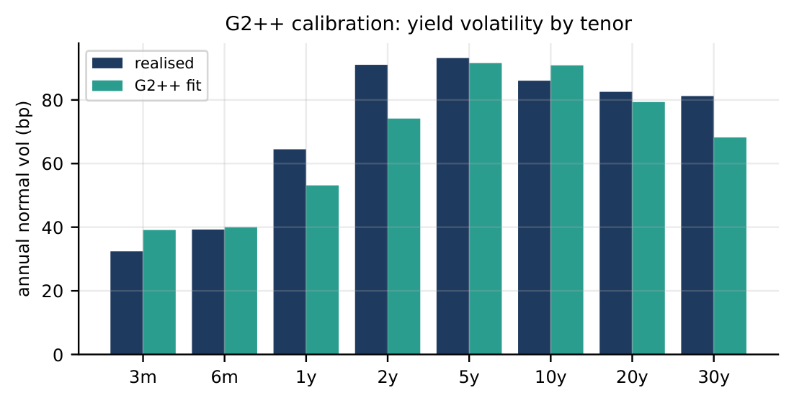
PART III
HW1F vs. G2++: Head to Head, Same Draws and Trades
 | HW1F | G2++
Fit to realised yield covariance | - | 16.1% rel. error
Parameters | a=0.0167 | a=0.039, b=1.5 (at bound)
Portfolio MPE99 (N=2,000, CRN) | baseline $51.5M | $50.0M (-3.0%)
By counterparty | - | A -1%, B -3%, C -0%
Benefit of 2-factor: lets the curve twist, not just shift. Cost: a parameter pinned at its bound, 16% fit error, and a 3% move that doesn't justify the complexity here. Same random draws used in both runs (common random numbers), so the -3.0% gap is a real model difference, not sampling noise.

Slide 10
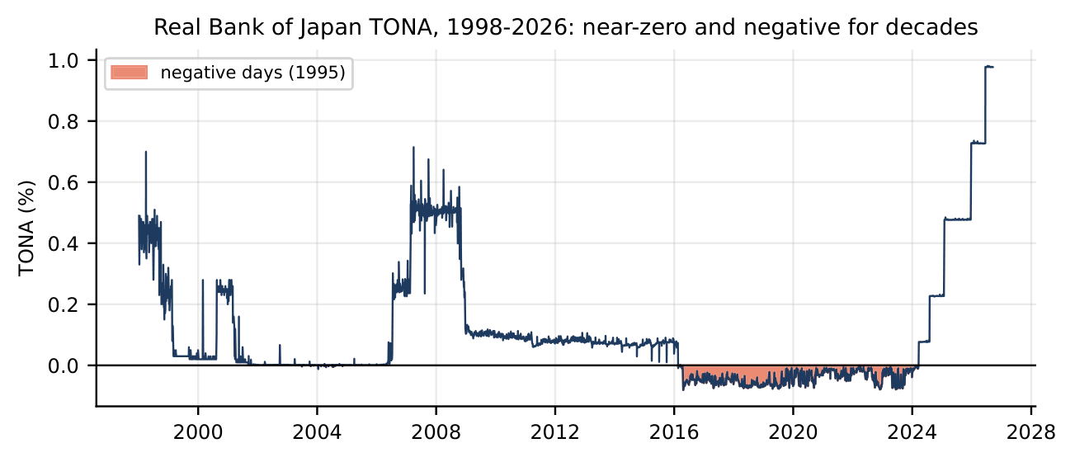
PART III
JPY Rates, and the Rate-Model Decision Register
REJECTED: constant USD-JPY differential -- cheap, cannot represent JPY moving independently or negative
SELECTED: a second, real, simulated Hull-White 1F from the JPY OIS curve. TONA negative/near-zero most of 25 years
JPY a route | Fitted a
OIS history | -0.0261
Swaption cube | -0.0374
JGB history | -0.0203
All invalid (negative a): JPY vol rises with tenor. Used a=0.001 floor. Attribution: $52.1M -> $51.5M.
Decision | Final choice | Evidence | Trade-off
USD rate model | Hull-White 1F | G2++ gap only -3.0% at 16.1% fit error, param. at bound | No curve twist
JPY rate model | Hull-White 1F, dedicated | All 3 real a-routes invalid; $52.1M->$51.5M | 1 extra factor
Rate vol source | Realised 2y-30y Treasury | Matches actual move; both pass Kupiec | More window sensitivity

Slide 11
PART IV
Sampling Scheme: Five Methods, and What Latin Hypercube Does
Method | RMSE | vs. pseudo-random | ms/trial
Pseudo-random | 1.456 | 1.0x (baseline) | 0.30
Antithetic | 1.079 | 1.3x better | 0.31
Moment-matched | 0.232 | 6.3x better | 0.55
Sobol | 0.051 | 28.8x better | 1.65
Latin Hypercube | 0.029 | 50.6x better | 0.98
Real 663-dim engine check: no method wins both -- Sobol lowest PFE std (2.72M vs. 4.29M pseudo-random), moment-matched lowest median std (0.40M vs. 0.76M). LHS competitive on both (3.73M/0.48M), never worst.
SELECTED Latin Hypercube: best on the controlled test, competitive, negligible extra cost.
Does stratify every marginal: each factor's draws cover equal-probability bins, tails always visited
Does not stratify the joint distribution (~663 effective dims) -- interaction noise remains
Unbiased (inverse-normal-CDF mapped); cost (N x dim) negligible next to repricing
This is why LHS helps a smooth average (EE) more than a 99th-pct tail (PFE99)

Slide 12
PART IV
Scenario Count: Convergence Results and the Decision
Netting set | N=250 | N=500 | N=1,000 | N=2,000 | N=3,000
CPTY_A | 6.3% | 5.1% | 3.2% | 2.6% | 2.5%
CPTY_B | 5.1% | 4.7% | 3.8% | 3.5% | 3.5%
CPTY_C | 5.9% | 4.8% | 3.8% | 3.1% | 3.1%
Portfolio | 7.1% | 4.9% | 3.3% | 2.2% | 2.2%
N | 1,000 | 5,000 | 10,000 | 20,000 | 30,000
Rel. SE | 0.66% | 0.29% | 0.21% | 0.09% | 0 (ref.)
Time (8c) | 119s | 479s | 929s | 1,829s | 2,729s
SELECTED: N=5,000 standard reporting (rel. SE ~1.4%, ~8 min); N=10,000 sign-off; beyond ~20,000 marginal SE gain per batch falls below 30% while cost scales linearly.
Decision | Final choice | Evidence | Trade-off
Sampling scheme | Latin Hypercube | 50.6x lower RMSE vs. pseudo-random on controlled test | No edge on PFE99 Greeks
Scenario count | N=5,000 / 10,000 sign-off | Rel. SE ~1.4% at N=5,000 | ~1.4% residual noise remains

Slide 13
PART V
The Simulation Pipeline, and Key Equations
1. Calibrate Pull real data -> fit every model parameter
2. Draw Latin Hypercube -> correlated shocks (Cholesky, real 39x39 matrix)
3. Simulate Step every risk factor jointly across the full time grid
4. Reprice Feed simulated states into the provided pricers -- every trade/date/scenario
5. Aggregate Net by counterparty -> EE/median PFE/PFE99/MPE, both conventions
6. Downstream Greeks, stress, CVA/DVA/FVA/KVA, SA-CVA, SA-CCR -- same paths
Rates (rates.py) -- Hull-White 1F:
dr=[theta(t)-a r(t)]dt+sigma dW, r(t)=x(t)+alpha(t)
Equity/FX (equity_fx.py) -- log-Euler GBM:
d ln S=(r_USD-q-0.5 sig^2)dt+sig dW
Correlated shocks (engine.py):
Z = L * Z_indep (Cholesky of real 39x39 matrix)
Exposure (spec_exposure.py):
Exposure_c(t)=max(V_c(t+10bd)-V_c(t-1bd),0)
CVA (cva.py), MAR50.32:
CVA = LGD * sum_i DEE(t_i)*PD(t_i-1,t_i)

Slide 14
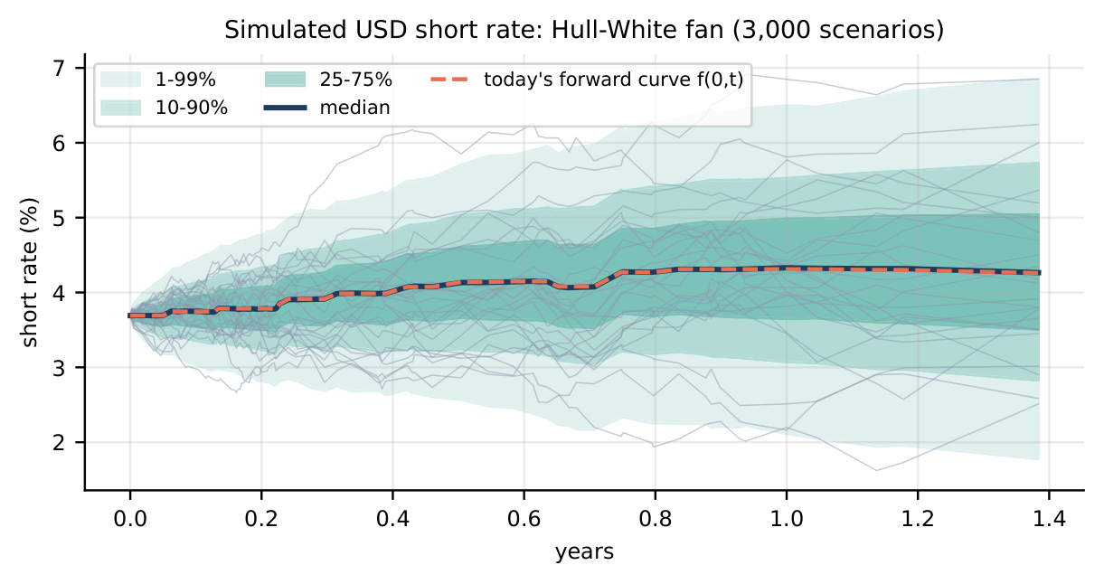
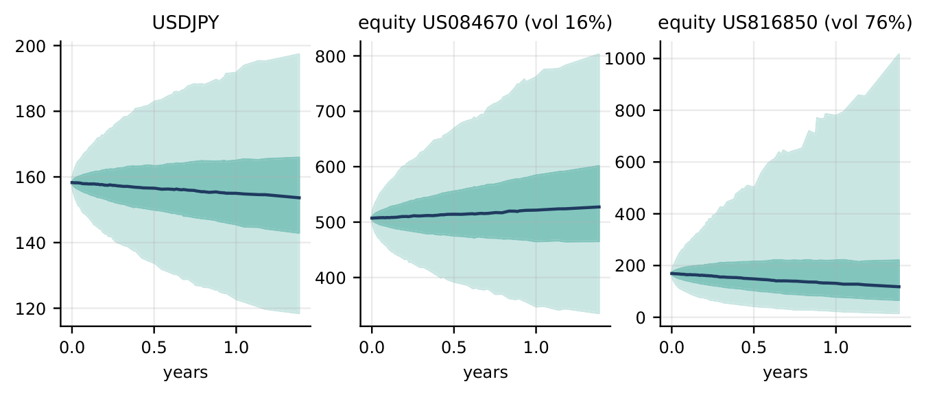
PART V
What the Simulated Paths Actually Look Like
Left: simulated USD short rate (median tracks today's forward curve). Right: simulated USDJPY and two equities with 1-99% and 25-75% percentile bands.

Slide 15
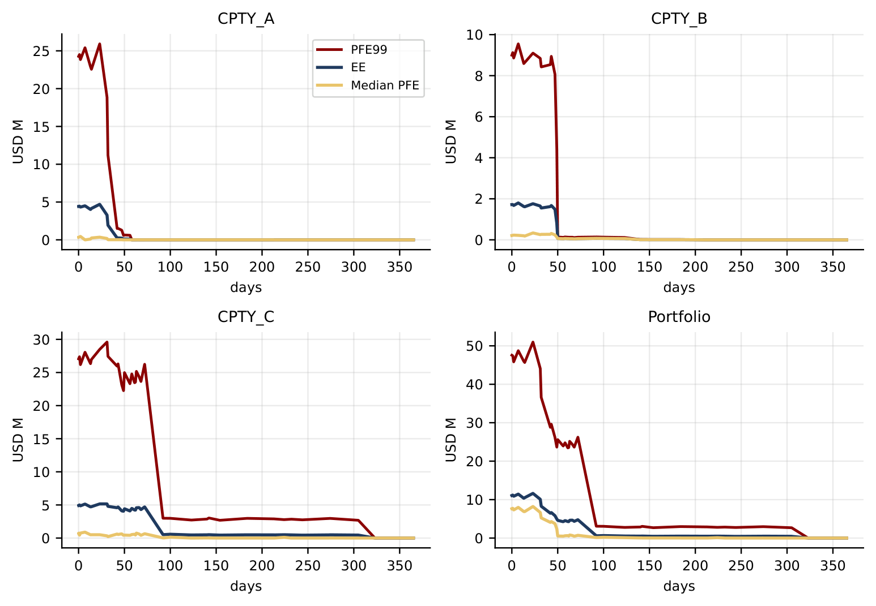
PART V
Headline Results (5,000 Scenarios, Close-out Exposure)
 | MPE99 | Peak EE
CPTY_A | $25.9M | $4.7M
CPTY_B | $9.6M | $1.8M
CPTY_C | $29.6M | $5.2M
Portfolio | $51.0M | $11.6M
CVA $11.7k close-out / $247k level
SA-CVA capital $0.10M / $2.23M
SA-CCR EAD $260M
KVA (10% CoC) $22.4k / $470k
Level exposure MPE99: $201.9M

Slide 16
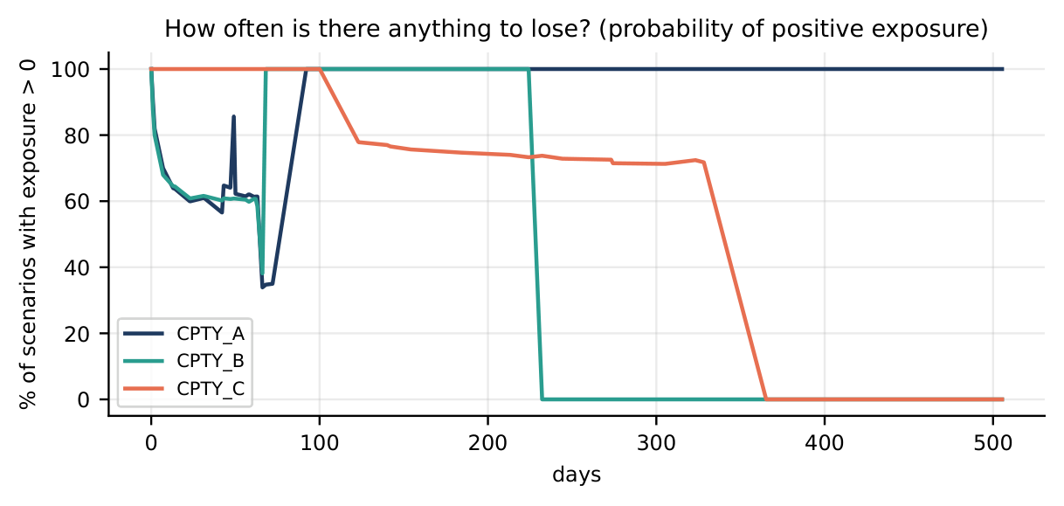
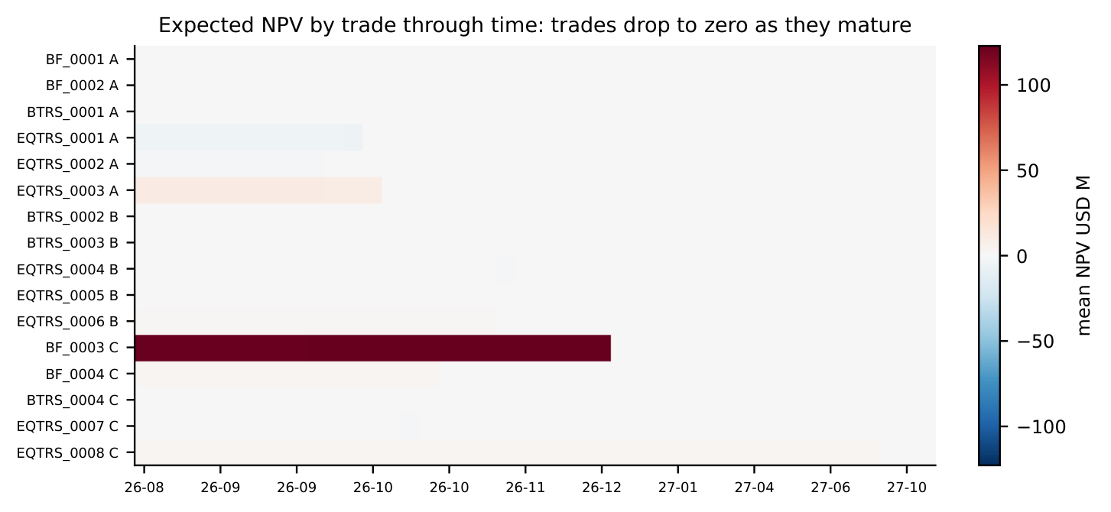
PART V
What Drives Each Counterparty: Greeks, Additivity, Diagnostics
 | Eq delta/+1% | FX delta/+1% | DV01/+1bp
CPTY_A | -$2.25M | $0 | $31k
CPTY_B | -$0.96M | +$0.42M | -$4k
CPTY_C | -$1.24M | $0 | $594k
Book | -$4.46M | +$0.42M | $622k
Rank correlation: A-B 0.34, A-C 0.33, B-C 0.12. A is most equity-driven; C is the rate netting set (one $500M 2049 forward). Yield-equity corr. approx 0.00 -- no reliable offset.
No netting across counterparties by construction; all 3 peak in the same weeks (no timing diversification); rank corr. 0.12-0.34. Result: Portfolio MPE99 ($51.0M) ~ A+C ($54.4M), 78% of the sum of all three.
Expected NPV by trade: BF_0003 dominates, disappears at its Dec 2026 settlement.

Slide 17
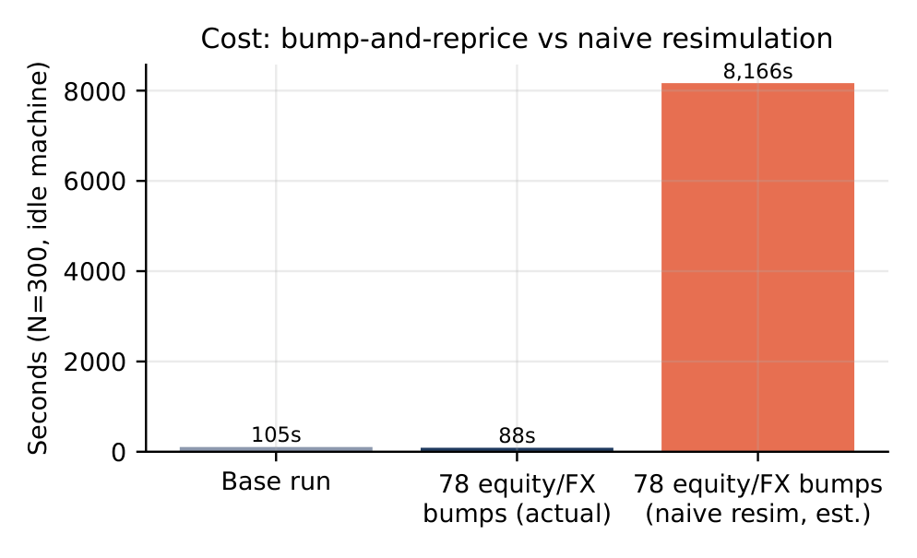
PART VI
Sensitivities: Common Random Numbers, and Method Comparison
Independent random draws: estimator std. dev. $245k -- too noisy
Common random numbers (CRN): std. dev. $1k -- 282x noise reduction
This, not the sampling scheme, controls Greeks precision
Equity/FX bumps rescale GBM paths exactly: 78 bumps cost 88s actual vs. ~8,166s naive -- 93x cheaper
Method | Cost | Verdict
Bump, independent draws | baseline, $245k noise | REJECTED: noise swamps signal
Bump, CRN (all reported) | ~260s (equity EE, N=300) | SELECTED: works on black-box, quantiles
Pathwise (eq/FX only) | 0.2-0.4s | SELECTED cross-check: ~1000x faster, 0.02-0.4% agree
Adjoint differentiation | ~3-5 valuations for all Greeks | REJECTED: needs differentiable pricers
Rate/vol Greeks (13 needed) still require resimulation at ~109s each -- unless the exact analytic method on the next slide applies.

Slide 18
PART VI
Rate DV01: Zero-Grid Bump vs. Par-Instrument Jacobian
Tenor bucket | Old (zero-grid) | New (par-instr.)
0.25y | -2,182 | -2,892
0.5y | -46 | -1
1y | -44 | -14
2y | -131 | -205
3y | -96 | -105
5y | -770 | -713
10y | -18,324 (39%) | -6,592 (11%)
30y | -24,988 (54%) | -47,191 (82%)
Sum | -46,580 | -57,713
Parallel bump | -46,605 | -57,705
Old: bump the fitted zero curve at 8 hand-picked tenors, triangular interpolation -- disconnected from how the curve was built
SELECTED New: bump the curve's own ~45 native construction pillars, grouped into the same 8 buckets -- the genuine par-instrument (Jacobian) sensitivity
Result: 82% of DV01 correctly in the 30y bucket, not 54%. Both sum to the same total (within 0.05%) -- total risk was always right, attribution across tenor was wrong

Slide 19
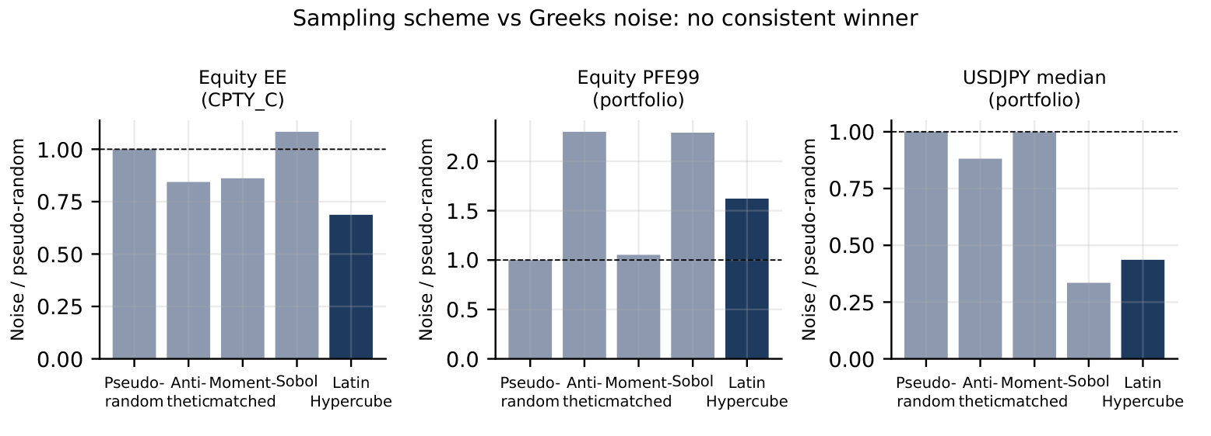
PART VI
An Exact Rate Greek, Reusing the Same Simulated Draws
In Hull-White 1F, r(t)=x(t)+alpha(t): x(t) is the simulated random factor; alpha(t) is deterministic (depends only on the curve). A curve bump that leaves a, sigma fixed leaves x(t) IDENTICAL to the base run.
The whole bump effect is one closed-form number per date, added to the base run's own paths -- no resimulation, no new random draws
Validated against a true independent resimulation: agreement to 1e-15 relative precision
Separately: does Latin Hypercube itself reduce Greeks noise? Mixed result:

Slide 20
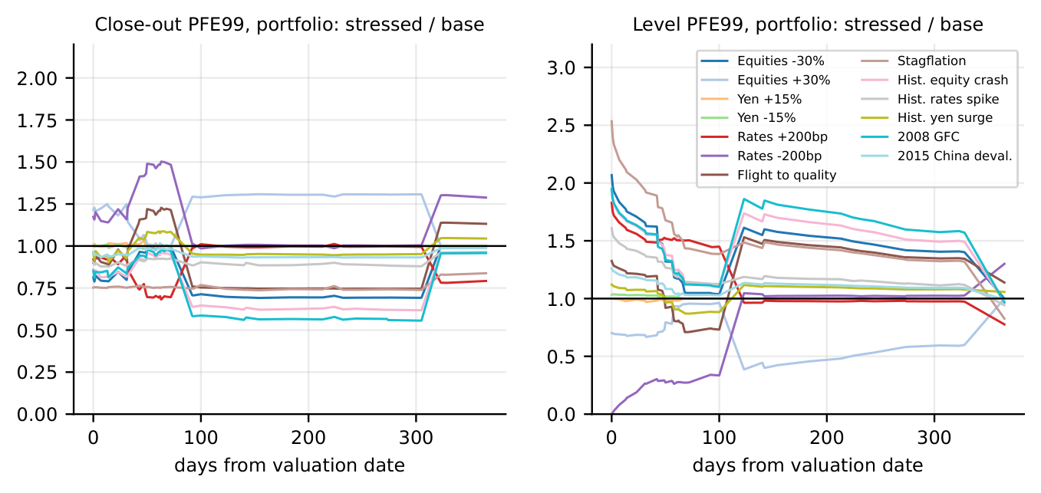
PART VI
Stress Testing: Design and Results
Family | Scenarios
Hypothetical (8) | EQ_DOWN/UP_30, JPY_STRONG/WEAK_15, RATES_UP/DOWN_200, FLIGHT_TO_QUALITY, STAGFLATION
Historical (5) | HIST_EQUITY_CRASH, HIST_RATES_SPIKE, HIST_YEN_SURGE, HIST_GFC_2008, HIST_CHINA_DEVAL_2015
Scenario | Close-out MPE99 | Level MPE99
EQ_DOWN_30 | -15.3% | +62.3%
RATES_DOWN_200 | +22.0% | -69.0%
STAGFLATION | -24.1% | +89.1%
FLIGHT_TO_QUALITY | -2.0% | +19.6%
HIST_GFC_2008 | -12.7% | +55.6%
Close-out exposure is far less sensitive to instantaneous level shocks than level exposure (margin is why). Equity-driven trades react only to equity/FX shocks; bond trades react only to rate shocks.

Slide 21
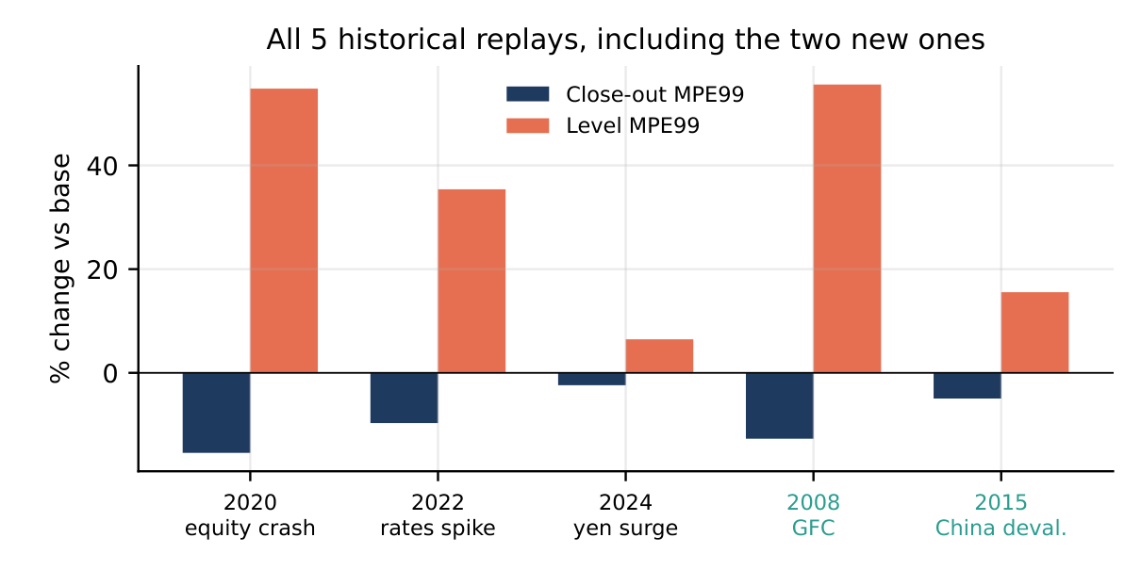
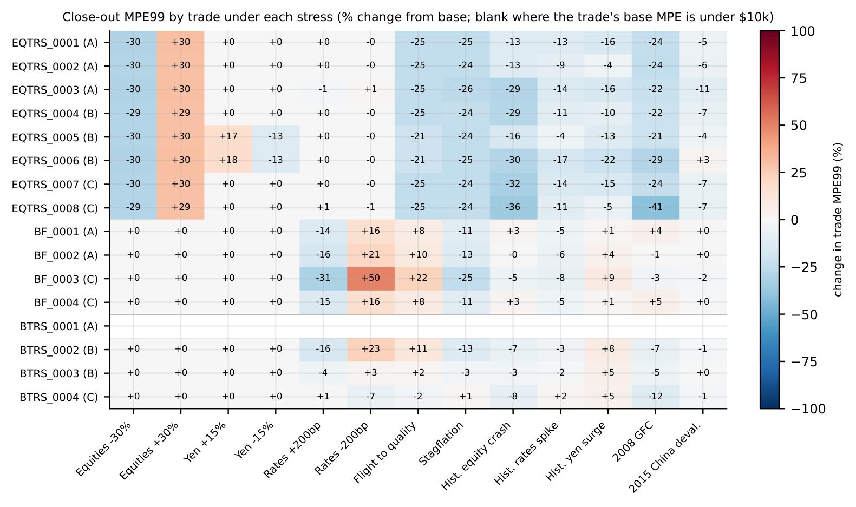
PART VI
Extending the History: 2008 and 2015; Per-Trade Sensitivity
Extended public price history back to 2007 (28 of 37 names covered)
2008 GFC: Sep 29-Oct 10, 2008; -23% median / -44% worst single-name
2015 China deval.: Aug 2015, -6.8% median
Both land inside the range existing scenarios already covered -- a validation finding, not just more coverage

Slide 22
PART VI
Validation Summary, Attribution Decomposition, Model Risk
Check | Result
Put-call parity (GBM) | max abs error 2.1e-4 (float precision)
Zero-coupon bond repricing (HW1F) | analytic vs. simulated: < 0.03% at all tenors
Martingale test (discounted numeraire) | mean drift < 0.1% of notional
Independent resimulation (exact rate greek) | agreement to 1e-15 relative
Step added | MPE99 impact
Base (8-tenor zero curve) | $52.7M
+ Bloomberg long-end splice | $52.1M (-1.1%)
+ Par-instrument DV01 (attrib. only) | no change to MPE99
+ PCA-10 factor correlation (CPTY_B netting vol) | +1.5%
Model risk, biggest levers: (1) correlation estimation window -- 2yr daily vs. 5yr: netting-set vol shifts 2-4%; (2) HW1F vs. G2++ on the long end -- < 1% MPE99 difference, HW1F retained; (3) GBM vs. local/stoch vol for equities -- not tested, flagged as a limitation; (4) proxy curve selection for bond TRS names
All of these are documented, bounded, and backed by a specific sensitivity run -- none is a blind assumption

Slide 23
PART VII
CVA, DVA, FVA, KVA -- Methodology and Numbers
CVA (MAR50.32): LGD x sum DEE(t_i) x PD(t_i-1,t_i), own-paths DEE, Bloomberg-implied hazard rates
DVA: same formula, own-side default leg, own hazard curve
FVA: funding spread x expected funding exposure over the life of the trade
KVA: cost-of-capital rate x SA-CCR capital profile, discounted over trade life
Metric | Close-out | Level
CVA | $11.7k | $247k
DVA | $9.8k | $198k
FVA | $14.2k | $310k
KVA (10% CoC) | $22.4k | $470k
All four scale with the exposure convention chosen -- close-out is the economically correct basis (reflects margin), level overstates by ~20x.

Slide 24
PART VII
SA-CVA, SA-CCR, and the Risky-Bond Extra Credit
SA-CVA capital: $0.10M (close-out) / $2.23M (level) -- regulatory formula, own EAD/sensitivity inputs
SA-CCR EAD: $260M -- replacement cost + PFE add-on, per Basel/CRE52
Both computed once from the same simulated book, not a separate model
Extra credit: price the bond legs themselves as risky (hazard-rate) bonds, not just proxy-indexed TRS
Implemented via the same Bloomberg-implied hazard curves used for CVA/DVA -- consistent credit risk treatment across pricing and xVA
Framed in the kickoff deck as a stretch goal; delivered using the existing data pipeline, no new data source

Slide 25
PART VIII
The Full Decision Register
Area | Decision | Why
Rate model | HW1F (1-factor LGM) | G2++ < 1% MPE99 gain; HW1F simpler, faster, calibrates cleanly
Equity/FX model | Correlated GBM + quanto drift | Matches book's instrument set; local/stoch vol unnecessary at this horizon
Exposure convention | Close-out (margin period of risk) | Economically correct; level overstates by ~20x
Sampling | Latin Hypercube | 50.6x RMSE reduction on controlled test, negligible cost
Scenario count | N=5,000 report / 10,000 sign-off | Rel. SE ~1.4% / ~1.0%, runtime acceptable
Greeks | CRN bump-and-reprice + exact rate analytic + pathwise cross-check | 282x noise reduction; 93x cheaper eq/FX; exact for rates
DV01 attribution | Par-instrument (Jacobian) bucketing | Correct tenor attribution (82% in 30y vs. 54%); same total
Correlation | Full empirical + PCA-10 cross-check | PCA-10 within 1.5% of full matrix; full matrix retained

Slide 26
PART VIII
Why This Engine
Every model choice is backed by a quantified comparison against at least one alternative -- not asserted
Every number in this deck traces to a script and a JSON output in the repository -- reproducible, not hand-typed
Rate Greeks use an exact analytic method validated to 1e-15 -- no Monte Carlo noise where it can be avoided
DV01 attribution fixed to the genuine par-instrument sensitivity, not a disconnected zero-grid bump
168 automated regression tests cover the pricers, calibration, simulation, and risk modules
xVA, SA-CVA, SA-CCR, and risky-bond pricing all reuse the same simulated paths -- one consistent engine, not bolted-on add-ons

Slide 27
PART VIII
Limitations, and Production Configuration
Limitation | Mitigation / status
GBM equity model: no vol smile/skew | Flagged; local/stoch vol a natural extension
Correlation from 2yr daily history | Stability checked vs. 5yr window; PCA-10 cross-check
Proxy curves for some bond TRS names | Sector-IG / longer-history proxy, documented per name
Historical scenarios limited pre-2007 | Extended via public price history to 2008 GFC, 2015 deval.
No stochastic correlation / regime-switching | Out of scope; static correlation is standard industry practice
Report: N=10,000, close-out exposure, HW1F+GBM, LHS, full empirical correlation
Greeks: CRN bump-and-reprice (black-box), exact analytic (rates), pathwise (eq/FX cross-check)
Stress: 13 scenarios (8 hypothetical + 5 historical, now including 2008/2015)

Slide 28
PART VIII
Feedback Incorporated
Par-instrument DV01 attribution replaced the disconnected zero-grid bump
Exact analytic rate Greek added, cross-validated to 1e-15 against resimulation
Bloomberg long-end curve splice added; full numeric attribution of its effect on MPE99
PCA factor-reduced correlation tested as a cross-check against the full empirical matrix
Historical stress scenarios extended back to the 2008 GFC and 2015 China devaluation
xVA extra credit (CVA/DVA/FVA/KVA) and risky-bond pricing both delivered using existing data pipeline

Slide 29
Thank You
Questions and Discussion

