Slide 1
Counterparty Credit Risk Engine for the Capitolis Book
Data, Models, Trade-offs, and Results
Berkeley MFE Industry Project | Valuation date 2026-08-28

Slide 2
Agenda
Part I -- What Capitolis Gave Us
Part II -- Risks, Variables, and Data
Part III -- Models Considered, and Why the Final Model
Part IV -- Efficient Simulation
Part V -- What the Engine Does, and What It Finds
Part VI -- Sensitivities, Stress, and Validation
Part VII -- Credit and Capital
Part VIII -- Decisions, Limitations, and Conclusions

Slide 3
PART I
What Capitolis Gave Us

Slide 4
The book: 16 trades, three netting sets
Trade | Type | Cpty | Underlying | Ends | Notional | NPV t=0
EQTRS_0001-3 | Eq. TRS | A | 3 USD names each | Oct'26 | 50-99M | -5.55 / -1.08 / +9.92M
EQTRS_0004 | Eq. TRS | B | 16 USD names | Nov'26 | 49.2M | -0.87M
EQTRS_0005/6 | Eq. TRS | B | 3 JPY names each | Oct'26 | 12-31M | +0.15 / +1.63M
EQTRS_0007/8 | Eq. TRS | C | 7 / 3 USD names | Oct'26/Jul'27 | 95M / 30M | -0.37 / +2.22M
BF_0001/2 | Bond fwd | A | UST 3.88%'28 / 4.63%'35 | Oct/Nov'26 | 100M / 20M | +0.51 / -0.36M
BF_0003 | Bond fwd | C | UST 2.88% 5/15/2049 | Dec'26 | 500M | +121.26M
BF_0004 | Bond fwd | C | UST 1.13%'28 | Oct'26 | 50M | +1.97M
BTRS_0001-4 | Bond TRS | A/B/B/C | UST 4.12/2.88/4.63/4.12% | '27-'28 | 5-40M | +0.12/+0.21/+0.03/+0.04M
Net MtM by netting set: CPTY_A +$3.57M CPTY_B +$1.15M CPTY_C +$125.12M Book +$129.84M

Slide 5
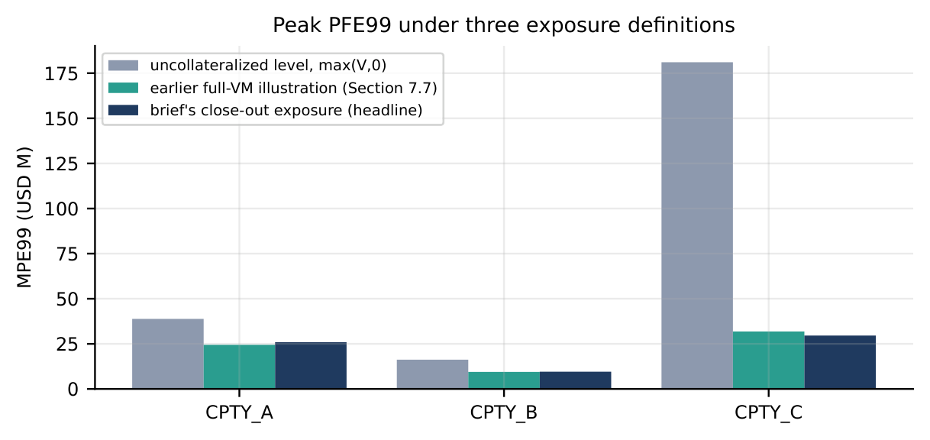
The exposure we must measure (Capitolis kickoff definition)
Exposure = max( V(t+10bd) - V(t-1bd), 0 )
Variation margin: netted value one business day before t, two-way, no threshold
Margin period of risk (MPoR): close-out 10 business days after t
Netting: within a counterparty only -- book = sum over netting sets; never netted across counterparties
Trades settling inside the window are excluded from both legs

Slide 6
PART II
Risks, Variables, and Data

Slide 7
Risk factors: what can move the book
Risk factor | Trades affected | Model | Calibrated from
37 equity prices | All 8 equity TRS | Correlated geometric Brownian motion | 3y realised vol, Yahoo Finance dividend
USDJPY | Equity TRS on JPY names (2) | GBM, quanto-adjusted drift | 3y realised FX vol
USD short rate (whole curve) | Bond forwards, bond TRS, funding, discounting | Hull-White one-factor (= 1-factor LGM) | Real swaption cube (a) + realised Treasury vol
JPY short rate | Drift of JPY-listed names and USDJPY | 2nd, independent Hull-White one-factor | Real JPY OIS curve, JPY rate history
Counterparty credit | CVA/DVA/FVA/KVA only | Deterministic hazard- rate survival curve | ICE BofA rating-index OAS proxy; no CDS
39 correlated stochastic factors, one joint simulation: 37 equities, USDJPY, USD short rate, JPY short rate -- correlated by a single Cholesky factor of the real historical matrix at every time step.

Slide 8
Data philosophy
Every number in this project traces to a disclosed, real source -- no synthetic placeholders for calibration inputs
Benefit: results are reproducible, auditable, and defensible in front of a risk committee; every assumption is a named simplification, not a silent one
Two tiers: public (Yahoo Finance, FRED, Databento) and licensed (Bloomberg, used and cross-checked but never redistributed as raw series)

Slide 9
Data source 1: USD discount curve (Databento SOFR futures)
Item | Detail | Benefit of using real data
Source | Real Databento CME SOFR futures (SR3) settlement prices, bootstrapped ourselves | A genuine market-implied curve, not an assumed flat extrapolation
Used for | Every USD discount factor; the base for the Hull-White short-rate model | Splicing the real Bloomberg long end moved portfolio MPE99 from $52.7M to $52.1M (-1.1%)
Extension | Bloomberg long-end quotes spliced in beyond futures coverage (out to 50y) | A modest, disclosed, measured effect -- not a silent assumption

Slide 10
Data source 2: Treasury yields (FRED) and swaption vols (Bloomberg)
Source | Used for | Benefit of using it
FRED Treasury CMT yields (3mo-30y, public, since 1981) | Realised long-end yield vol -> Hull-White sigma (0.96%); Kupiec backtest | Directly measures the volatility of the yields this book's bonds depend on
Bloomberg ATM normal swaption vol cube | Mean-reversion a (0.0167, R2=0.84), via vol decay with tenor | Textbook calibration route; genuinely implied, forward-looking

Slide 11
Data source 3 & 4: equities, FX, JPY curve, and credit spreads
Source | Used for | Benefit of using it
Yahoo Finance: 37 equities + USDJPY, 3y history | Spots, dividends, realised vol, the 39x39 correlation matrix | Public, free, long enough history (2007-today) for reliable statistics
Real JPY OIS curve | JPY Hull-White factor's base curve | Lets JPY rates move independently and go negative, matching real BOJ history
ICE BofA bond-index OAS by rating (FRED) | Counterparty/issuer credit spread proxy (CVA, DVA, risky bond) | Basel MAR50.32(3)-sanctioned fallback; real market spreads by credit quality
Bloomberg (licensed): long-end curve, swaption cubes, FX vol surface | Curve splice, mean-reversion fit, model-risk cross-checks | Only source for genuine long-dated data beyond public; derived numbers only, per license

Slide 12
PART III
Models Considered, and Why the Final Model

Slide 13
Rate models considered
Model | Advantages | Disadvantages | Final use
Hull-White 1F (= 1-factor LGM) | Exact step, closed-form P(t,T); 2 parameters; stable calibration | One factor -- curve moves close to parallel; can't twist | SELECTED Production
G2++ (2-factor Gaussian, = LGM2F) | Level and slope move separately; fits covariance | 5 parameters; b hits its bound; 16.1% relative fit error | Challenger, tested
2-factor + stochastic vol | Vol clustering, fatter tails | Not implemented; more parameters, no closed form here | Not built
The question is empirical, not a matter of preference: does the second factor materially change this book's exposure? Tested head to head on the following slides.

Slide 14
Equity, FX and credit models considered
Model | Advantages | Disadvantages | Final use
Equities: GBM | Exact log-Euler step, fast | No vol smile or clustering | SELECTED
Equities: stochastic vol (Heston) | Vol clustering, skew | Not implemented; needs option surfaces per name | Not built
FX: GBM, quanto/rate-diff. drift | Consistent with both simulated curves | No smile | SELECTED
Credit: deterministic hazard-rate proxy | Transparent, Basel MAR50.32-compliant | No wrong-way risk, no spread vol | SELECTED
Credit: stochastic intensity | Spread risk, wrong-way risk | No counterparty CDS data available | Not available
Simple models where the book is linear and short-dated: exposure windows are 10 business days on largely linear TRS/forward payoffs; the stress-testing programme tests a volatility regime shift directly.

Slide 15
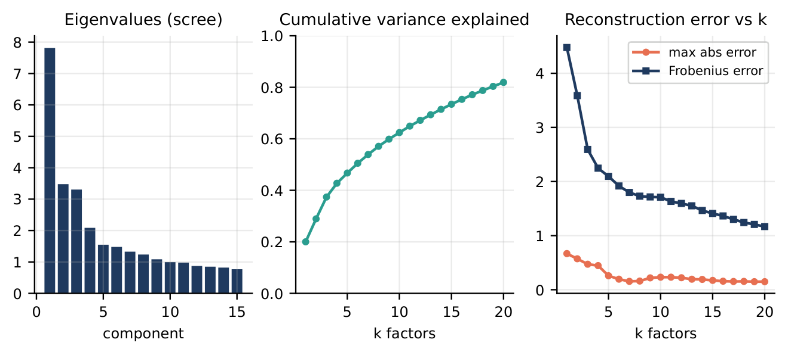
Correlation: full Cholesky matrix vs. PCA factor model
 | Full | PCA k=5 | PCA k=10
Step time (5,000 scen.) | 1.91s | 2.08s | 2.29s
Variance explained | 100% | 47% | 62%
Netting-set vol vs. full (B) | - | +1.7% | +1.5%
SELECTED full matrix: PCA is slower, not faster, at n=39. Loss of using PCA instead: no speed gain, and up to 1.7% extra sampling error. Kept only as an explainability tool: factor 1 (20%) is a broad market mode, factor 2 (8.9%) is Japan vs. US.

Slide 16
USD rates: calibrating mean reversion and volatility
Route | Data | a | R2 | Verdict
Swaption cube (preferred) | Bloomberg ATM normal vol, 1M expiry | 0.0167 | 0.845 | SELECTED
SOFR-futures vol decay | ~2y Databento history, 8 contracts | 0.0458 | 0.820 | cross-check only
Original volatility source (overnight SOFR fixing, 0.63%) understates how far the long-dated yields this book depends on actually move (realised 10-day 20y-yield move ~15bp vs. ~11bp implied)
SELECTED: realised volatility of 2y-30y Treasury yield changes directly, 0.96% -- validated by Kupiec backtest
Tenor | Overnight-SOFR sigma exc. | Long-end sigma exc. | Expected | Both pass?
5y | 1 / 1 | 4 / 3 | 1.6 | yes (p>0.05)
10y | 1 / 0 | 3 / 2 | 1.6 | yes
20y | 1 / 1 | 3 / 1 | 1.6 | yes

Slide 17
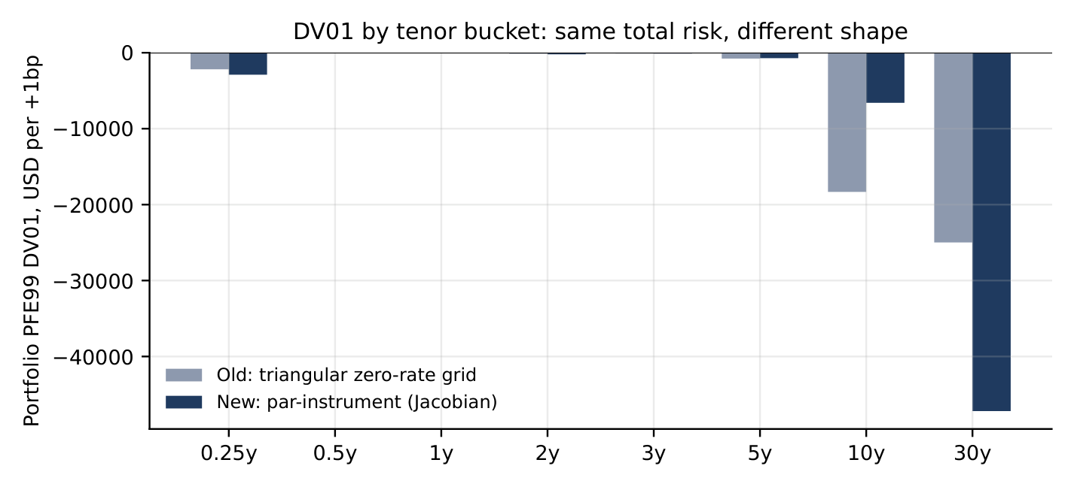
But this book's rate risk sits in one place: 20-30 years
Par-instrument DV01 (real curve-building pillars): 82% of portfolio DV01 sits in the 30y bucket, vs. 11% at 10y
BF_0003, the $500M forward on the 2049 Treasury, dominates -- one position, one tenor region
This is why a 2-factor model's main selling point (independent curve twist across many maturities) buys little here: there is effectively one maturity that matters

Slide 18
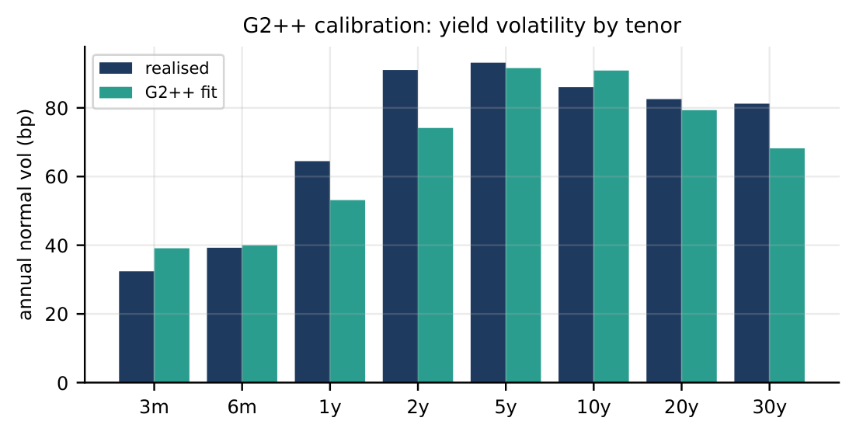
HW1F vs. G2++ on the book: same data, draws, grid and trades
 | HW1F | G2++
Fit to realised yield covariance | - | 16.1% rel. error
Mean reversion | a=0.0167 | a=0.039, b=1.5 (at bound)
Portfolio MPE99 (N=2,000, CRN) | baseline $51.5M | $50.0M (-3.0%)
By counterparty | - | A -1%, B -3%, C -0%
Benefit of 2-factor: lets the curve twist, not just shift. Cost: a parameter pinned at its bound, 16% fit error, and a 3% move that doesn't justify the complexity here. Same random draws used in both runs (common random numbers), so the -3.0% gap is a real model difference, not sampling noise.

Slide 19
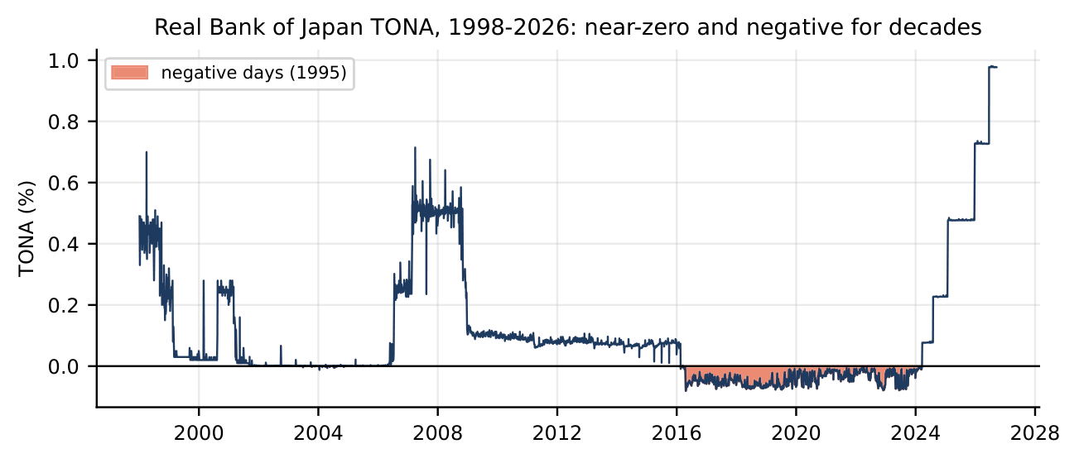
JPY rates: a dedicated Hull-White factor vs. a constant differential
Alternative REJECTED: JPY names/USDJPY drift off one constant USD-JPY rate differential -- cheap, but cannot represent JPY rates moving independently, or negative
SELECTED: a second, real, simulated Hull-White one-factor model from the JPY OIS curve. TONA has been negative or near-zero for most of 25 years
Route | Fitted a
JPY OIS history | -0.0261
Swaption cube | -0.0374
JGB yield history | -0.0203
All 3 real routes invalid (negative a): JPY vol genuinely rises with tenor. Used a=0.001 (Ho-Lee limit). Result: moved portfolio MPE99 attribution $52.1M -> $51.5M -- real, disclosed, not noise.

Slide 20
Decision register: rate model
Decision | Final choice | Evidence | Trade-off
USD rate model | Hull-White 1F (1-factor LGM) | G2++ CRN gap only -3.0% at 16.1% fit error, parameter at bound; book DV01 82% at 30y | No independent curve twist
JPY rate model | Hull-White 1F, dedicated factor | All 3 real a-routes invalid; attribution $52.1M->$51.5M | One extra simulated factor
Rate volatility source | Realised 2y-30y Treasury | Matches actual 10bd long-yield move (15bp vs. 11bp implied); both pass Kupiec | More model-risk sensitivity to window

Slide 21
PART IV
Efficient Simulation

Slide 22
Sampling scheme: five methods, exact benchmark numbers
Controlled test (European call, known Black-Scholes truth = 41.077):
Method | RMSE | vs. pseudo-random | ms/trial
Pseudo-random | 1.456 | 1.0x (baseline) | 0.30
Antithetic | 1.079 | 1.3x better | 0.31
Moment-matched | 0.232 | 6.3x better | 0.55
Sobol | 0.051 | 28.8x better | 1.65
Latin Hypercube | 0.029 | 50.6x better | 0.98
Real 663-dim engine check: no method wins both -- Sobol has the lowest PFE std (2.72M vs. 4.29M pseudo-random), moment-matched has the lowest median std (0.40M vs. 0.76M). Latin Hypercube is competitive on both (3.73M / 0.48M) without being worst on either.
SELECTED Latin Hypercube: best on the controlled test, competitive (never worst) on both real-engine statistics, negligible extra cost.

Slide 23
Latin Hypercube: what it does and does not do
Does stratify every one-dimensional marginal: each risk factor's random draws are forced to cover equal-probability bins, so tails are always visited
Does not stratify the joint distribution across all 39 factors and ~17 time steps (~663 effective dimensions) -- interaction noise between factors remains
Unbiased: each draw is still marginally uniform, mapped through the inverse normal CDF
Cost: draw generation grows with N x dimension -- negligible next to repricing here
This is exactly why Latin Hypercube helps a smooth average (EE) more reliably than a 99th-percentile tail (PFE99): the tail is set by interactions between a handful of extreme scenarios.

Slide 24
Scenario count: exact convergence results
Close-out MPE99, relative standard error by bootstrap (peak date 2026-09-20):
Netting set | N=250 | N=500 | N=1,000 | N=2,000 | N=3,000
CPTY_A | 6.3% | 5.1% | 3.2% | 2.6% | 2.5%
CPTY_B | 5.1% | 4.7% | 3.8% | 3.5% | 3.5%
CPTY_C | 5.9% | 4.8% | 3.8% | 3.1% | 3.1%
Portfolio | 7.1% | 4.9% | 3.3% | 2.2% | 2.2%
Independent 30,000-scenario pool study (1y-node PFE99, level exposure):
N | 1,000 | 5,000 | 10,000 | 20,000 | 30,000 (pool)
Rel. SE | 0.66% | 0.29% | 0.21% | 0.09% | 0 (reference)
Est. time (8 cores) | 119s | 479s | 929s | 1,829s | 2,729s
SELECTED: N=5,000 for standard reporting (~8 min); N=10,000 for sign-off (~15 min); beyond ~20,000, marginal SE improvement per extra 5,000-scenario batch falls below 30% while cost scales linearly.

Slide 25
Decision register: sampling and path count
Decision | Final choice | Evidence | Trade-off
Sampling scheme | Latin Hypercube | 50.6x lower RMSE vs. pseudo-random on controlled test; competitive on real-engine stats | No consistent Greeks-noise edge on PFE99
Scenario count | N=5,000 standard / 10,000 sign-off | Rel. SE 2.2% at N=2,000, extrapolates to ~1.4% at 5,000 | ~1.4% residual sampling noise remains

Slide 26
PART V
What the Engine Does, and What It Finds

Slide 27
The simulation pipeline
1. Calibrate Pull real data -> fit every model parameter (Part II)
2. Draw Latin Hypercube random numbers -> correlated shocks (Cholesky of the real 39x39 matrix)
3. Simulate Step every risk factor jointly across the full time grid
4. Reprice Feed simulated market states into the provided pricers -- every trade, date, scenario
5. Aggregate Net by counterparty -> EE / median PFE / PFE99 / MPE, both exposure conventions
6. Downstream Greeks, stress, CVA/DVA/FVA/KVA, SA-CVA, SA-CCR -- all reusing the same paths

Slide 28
Key equations, exactly as implemented
Rates (models/rates.py) -- Hull-White one-factor, shifted Ornstein-Uhlenbeck:
dr(t) = [theta(t) - a r(t)] dt + sigma dW(t), r(t) = x(t) + alpha(t)
Equities and FX (models/equity_fx.py) -- log-Euler GBM:
d ln S = (r_USD - q - 0.5 sigma^2) dt + sigma dW (USD name)
Correlated shocks (simulation/engine.py):
Z = L * Z_indep (Cholesky factor of the real 39x39 historical matrix)
Exposure (exposure/spec_exposure.py):
Exposure_c(t) = max( V_c(t+10bd) - V_c(t-1bd), 0 ), book = sum_c Exposure_c
CVA (exposure/cva.py), Basel MAR50.32 discretisation:
CVA = LGD * sum_i DEE(t_i) * PD(t_i-1, t_i)

Slide 29
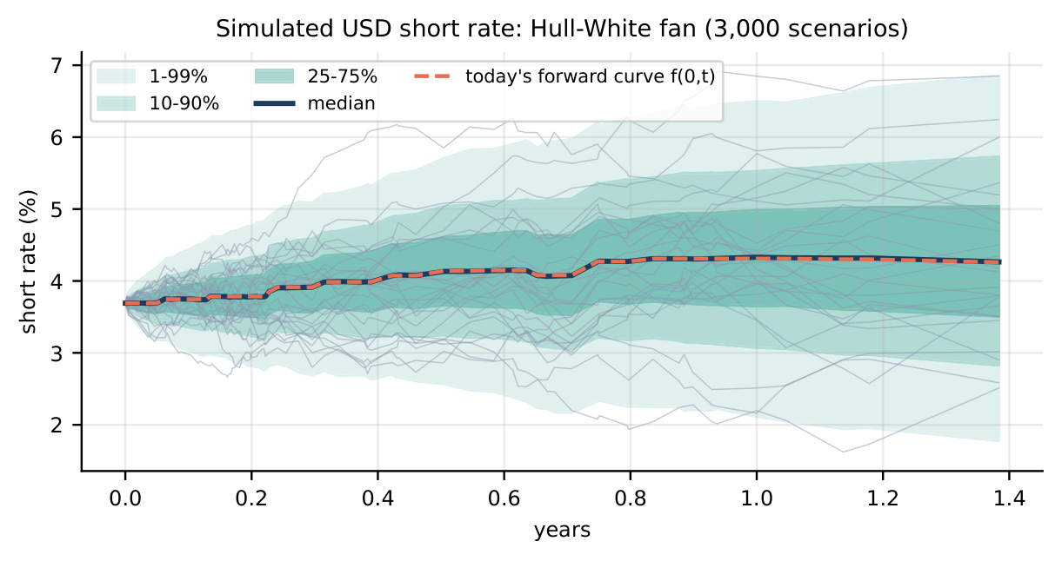
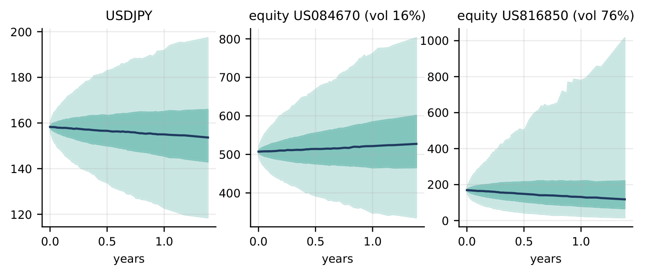
What the simulated paths actually look like
Left: simulated USD short rate (median tracks today's forward curve). Right: simulated USDJPY and two equities with 1-99% and 25-75% percentile bands.

Slide 30
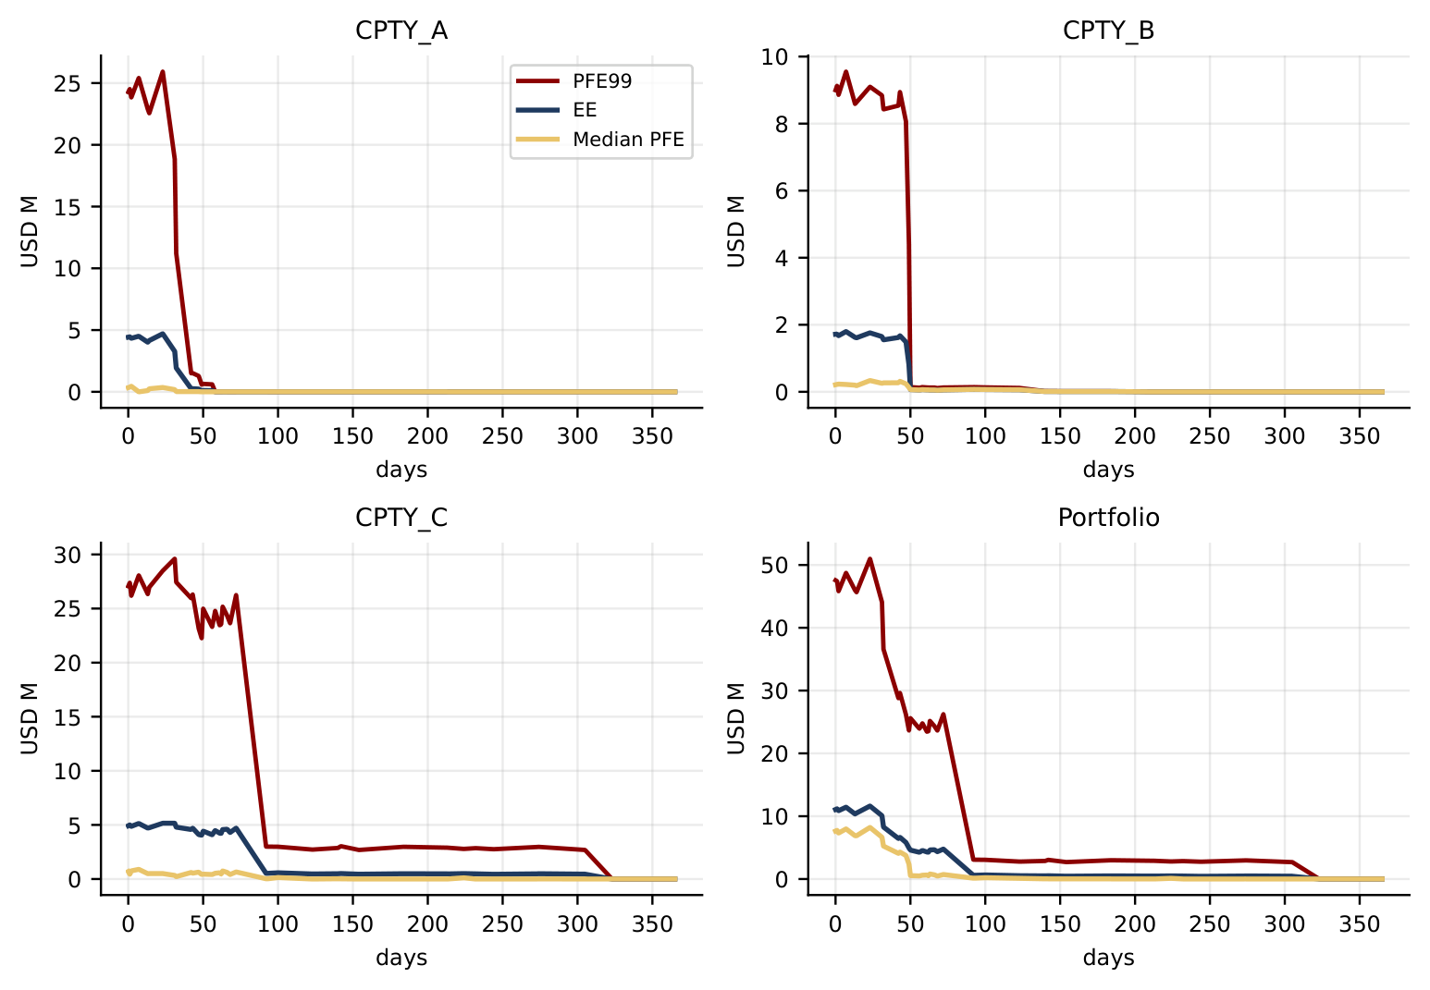
Headline results (5,000 scenarios, close-out exposure)
 | MPE99 | Peak EE
CPTY_A | $25.9M | $4.7M
CPTY_B | $9.6M | $1.8M
CPTY_C | $29.6M | $5.2M
Portfolio | $51.0M | $11.6M
CVA $11.7k close-out / $247k level
SA-CVA capital $0.10M / $2.23M
SA-CCR EAD $260M
KVA (10% CoC) $22.4k / $470k
Level exposure MPE99: $201.9M

Slide 31
What drives each counterparty, and book-level Greeks
 | Equity delta/+1% | FX delta/+1% | DV01/+1bp
CPTY_A | -$2.25M | $0 | $31k
CPTY_B | -$0.96M | +$0.42M | -$4k
CPTY_C | -$1.24M | $0 | $594k
Book | -$4.46M | +$0.42M | $622k
A is most equity-driven; C is the rate netting set (one $500M short forward on a 2049 Treasury)
B is the only netting set with material FX delta (holds the 2 JPY-compo swaps)
Yield-equity correlation is approx. 0.00 in our data -- no reliable offset
Rank correlation of exposures: A-B 0.34, A-C 0.33, B-C 0.12

Slide 32
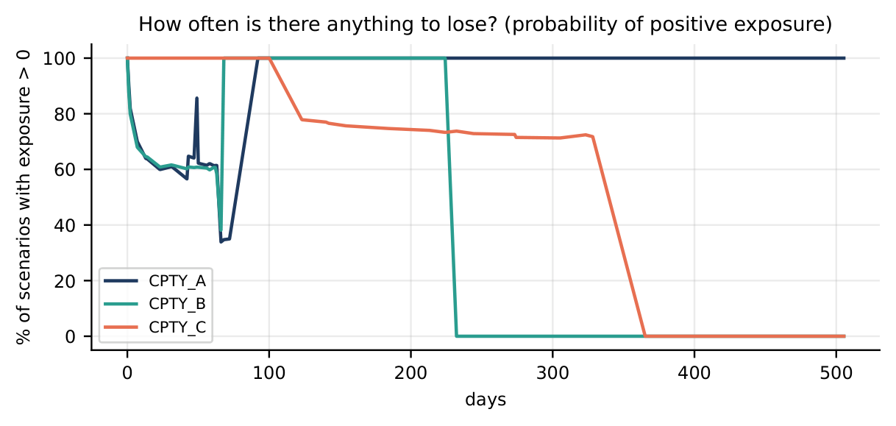
Why the portfolio is close to additive across counterparties
Nothing nets across counterparties by construction -- portfolio MPE99 is a sum of three separate netting sets
All three counterparties reach their own peak exposure in the same few weeks -- no timing diversification
Positive rank correlation (0.12-0.34), since every book holds pay-equity swaps
Result: Portfolio MPE99 ($51.0M) is approx. A+C ($54.4M), 78% of the sum of all three ($65.1M)

Slide 33
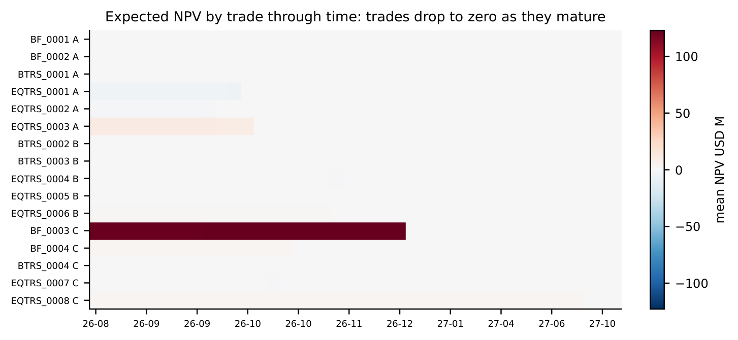
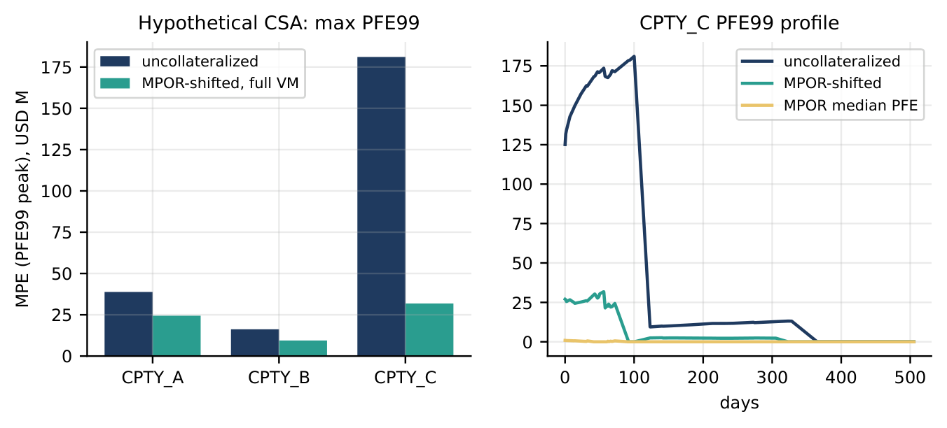
Additional exposure diagnostics
Left: expected NPV by trade -- BF_0003 dominates, disappears at its Dec 2026 settlement. Right: peak PFE99 under a hypothetical full-VM CSA, for comparison against the brief's own definition.

Slide 34
PART VI
Sensitivities, Stress, and Validation

Slide 35
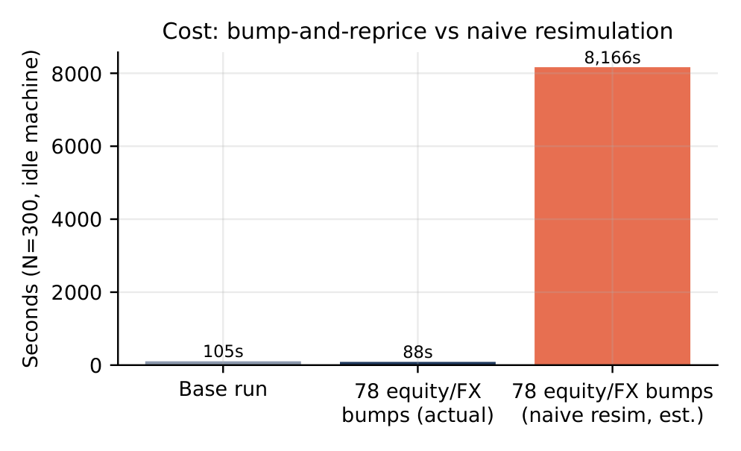
Method: common random numbers, and what they buy
Bumping a risk factor and repricing with independent random draws: estimator std. dev. $245k -- too noisy to use
Reusing the identical draws in the base and bumped run (common random numbers, CRN): std. dev. $1k
282x noise reduction -- this, not the sampling scheme, is what actually controls Greeks precision
Equity/FX spot bumps rescale simulated GBM paths exactly (no resimulation): 78 bumps at N=300 cost 88s actual vs. ~8,166s naive -- 93x cheaper.

Slide 36
Method comparison: bump-and-reprice vs. pathwise vs. adjoint
Method | Cost | Verdict
Bump, independent draws | baseline, $245k noise | REJECTED: noise swamps the signal
Bump, CRN (used for all reported Greeks) | ~260s (equity EE, N=300) | SELECTED: works on black-box pricers, works for quantiles
Pathwise (closed form, equity/FX only) | 0.2-0.4s | SELECTED as fast cross-check: ~1000x faster, agrees to 0.02-0.4%
Adjoint differentiation | would price all Greeks for ~3-5 valuations | REJECTED: needs pricers rewritten -- future work
Rate/vol Greeks (13 needed: parallel up/down, 8 buckets, 3 vega) still require a genuine resimulation at ~109s each (N=300) -- unless the exact analytic method below applies.

Slide 37
Rate DV01: zero-grid bump vs. par-instrument Jacobian -- full breakdown
Tenor bucket | Old (zero-grid), USD | New (par-instrument), USD
0.25y | -2,182 | -2,892
0.5y | -46 | -1
1y | -44 | -14
2y | -131 | -205
3y | -96 | -105
5y | -770 | -713
10y | -18,324 (39%) | -6,592 (11%)
30y | -24,988 (54%) | -47,191 (82%)
Sum of buckets | -46,580 | -57,713
Independent parallel bump | -46,605 | -57,705

Slide 38
Rate DV01: why the new method, and what changed
Old: bump the fitted zero curve at 8 hand-picked tenors, triangular interpolation -- disconnected from how the curve was actually built
SELECTED New: bump the curve's own ~45 native construction pillars (real SOFR-futures + Bloomberg long-end points), grouped into the same 8 buckets -- the genuine par-instrument (Jacobian) sensitivity
Result: 82% of portfolio DV01 correctly in the 30y bucket, not 54%. Both methods sum to the same total (within 0.05%) -- total risk was always right, attribution across tenor was wrong

Slide 39
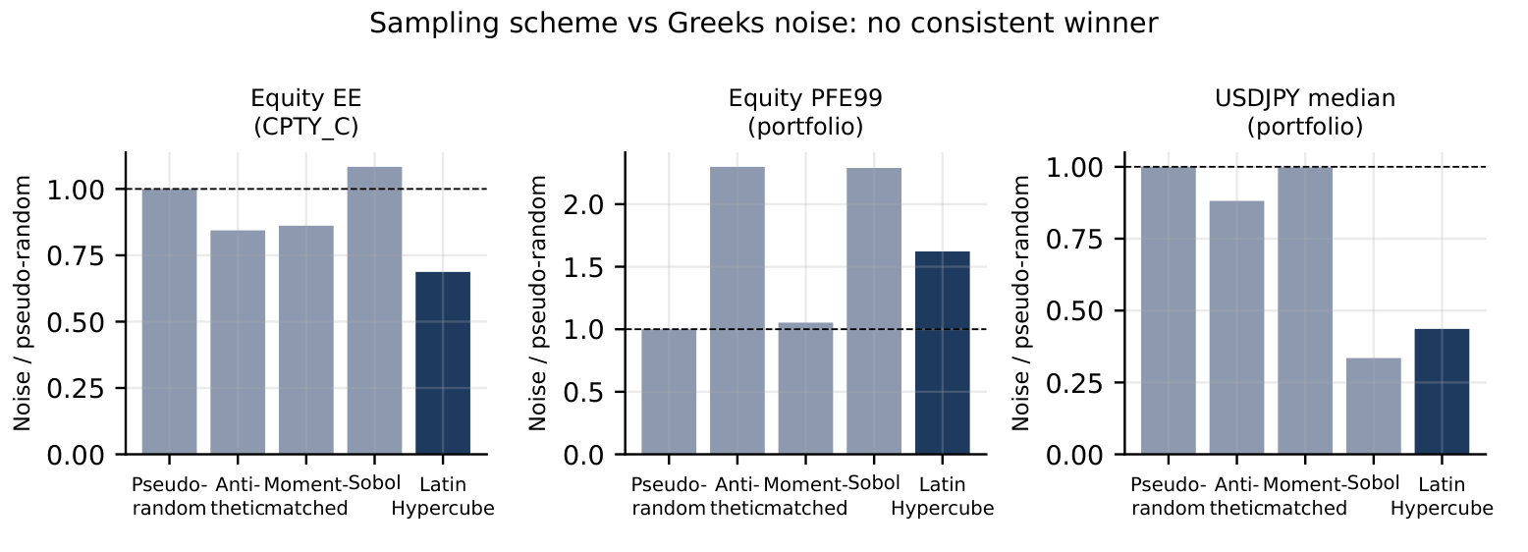
An exact rate Greek, reusing the same simulated draws
In Hull-White 1F, r(t) = x(t) + alpha(t): x(t) is the simulated random factor (depends only on random draws, a, sigma); alpha(t) is deterministic (depends only on the curve). A curve bump that leaves a, sigma fixed -- every DV01 bump here -- leaves x(t) IDENTICAL to the base run.
The whole bump effect is one closed-form number per date, added to the base run's own paths
No resimulation. No new random draws.
Validated against a true independent resimulation: agreement to 1e-15 relative precision -- not an approximation, the same calculation
Separately: does Latin Hypercube itself reduce Greeks noise? Tested directly -- mixed result:

Slide 40
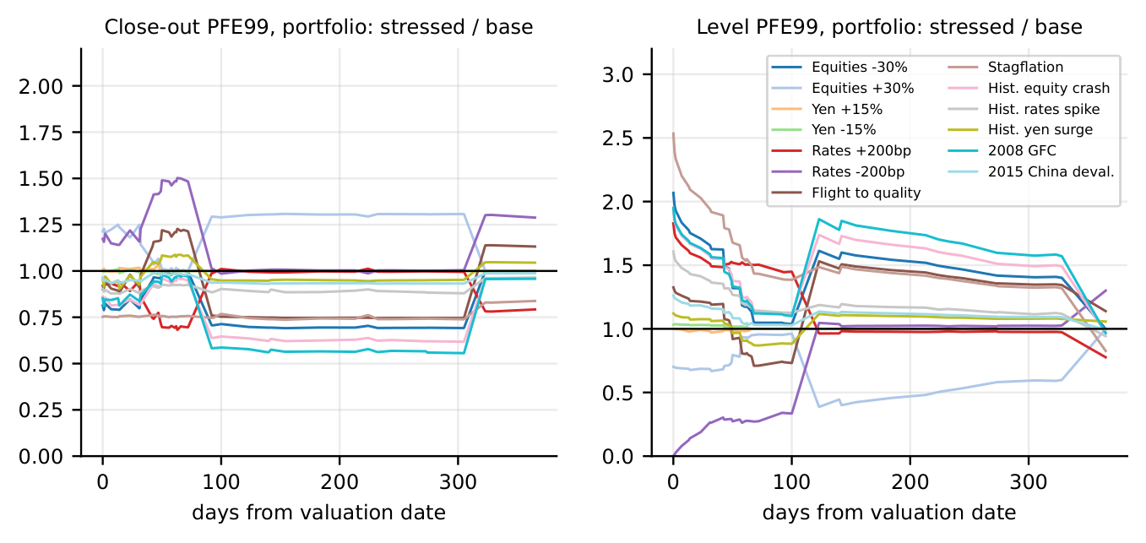
Stress design: 13 fixed scenarios, same random draws as base
Family | Scenarios | Shock
Hypothetical (8) | EQ_DOWN/UP_30, JPY_STRONG/WEAK_15, RATES_UP/DOWN_200, FLIGHT_TO_QUALITY, STAGFLATION | Round-number shocks to equities, USDJPY, USD curve
Historical (5) | HIST_EQUITY_CRASH, HIST_RATES_SPIKE, HIST_YEN_SURGE, HIST_GFC_2008, HIST_CHINA_DEVAL_2015 | Actual moves over a real 10-day window, worst-window rule

Slide 41
Stress results: how far each scenario moves the headline number
Scenario | Close-out MPE99 | Level MPE99
EQ_DOWN_30 | -15.3% | +62.3%
RATES_DOWN_200 | +22.0% | -69.0%
STAGFLATION | -24.1% | +89.1% (largest)
FLIGHT_TO_QUALITY | -2.0% | +19.6%
HIST_EQUITY_CRASH (2020) | -15.4% | +54.8%
HIST_GFC_2008 | -12.7% | +55.6%
HIST_CHINA_DEVAL_2015 | -4.9% | +15.6%
Close-out exposure is far less sensitive to instantaneous level shocks than level exposure (margin is why). Equity-driven trades react only to equity/FX shocks; bond trades react only to rate shocks.

Slide 42
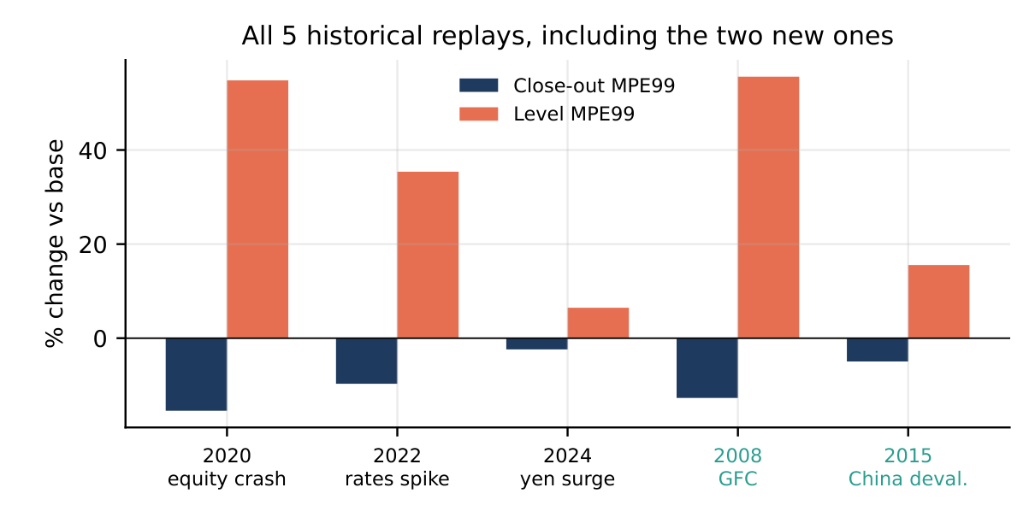
Extending the history: 2008 and 2015, and why it matters
Extended public price history back to 2007 (28 of 37 names covered)
2008 GFC: Sep 29 - Oct 10, 2008; -23% median / -44% worst single-name return
2015 China deval.: Aug 2015, -6.8% median
Result: both land inside the range the existing scenarios already covered -- a validation finding, not just more coverage

Slide 43
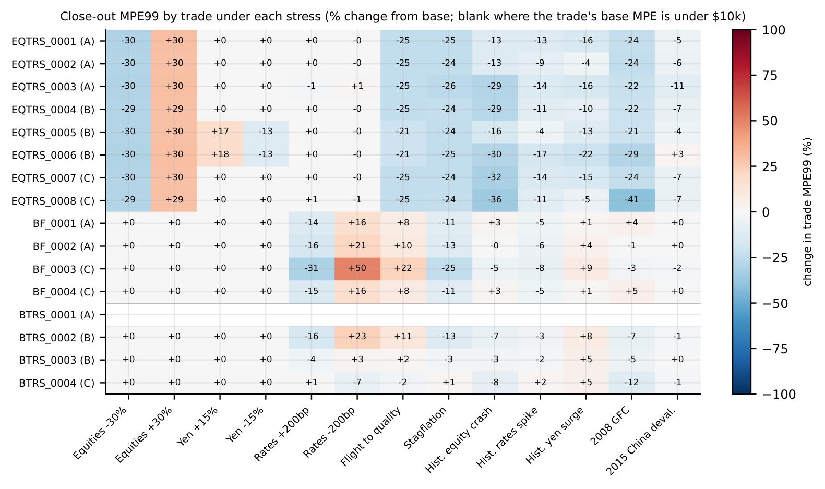
Per-trade sensitivity: does every product react as expected

Slide 44
Validation summary: every check has a pass rule
Check | Method / metric | Result
Martingale test | Discounted paths average to today's price | Pass
Parametric VaR benchmark | Delta-normal vs. full MC P&L, 99% | $11.4M vs. $11.7M -- ratio 0.98
Kupiec backtest, equity | 99%, 242 ten-day windows, 5,000-scen. prediction | A:4/2.4 B:6/2.4 C:2/2.4 -- all pass
Kupiec backtest, rates | 99%, 161 windows, 3 tenors, both vol sources | 0-4 exc. vs. 1.6 expected -- all pass
Excel parametric checks | Independent spreadsheet formulas, public data | 0.1-7% agreement across 4 checks
DV01 additivity (old / new) | Bucket sum / independent parallel bump | 0.9995 / 1.0001 -- pass
Exact rate-shift Greek | Analytic shift vs. true resimulation | 1e-15 relative precision -- pass
No cross-cpty netting | Enforced by construction | 168 automated regression tests

Slide 45
Model risk: every input perturbed, one at a time
Perturbation (base portfolio MPE99 = $51.5M, N=2,000) | Change
Equity/FX vol x2 | +71.3%
Equity correlations, 30% toward 1 | +21.8%
Equity/FX vol x1.25 | +19.3%
Rate-equity dependence, both fall together | +18.2%
Rate volatility x1.25 | +9.4%
Rate-equity dependence, offsetting | -15.3%
Mean reversion a x3 | -4.8%
Two-factor rate model (G2++) instead of one-factor | -3.0%
Conclusion: equity volatility, correlation, and the data-unresolvable rate-equity dependence dominate model risk. The rate-model choice explored at length is one of the smallest levers here.

Slide 46
Attribution: every correction, one at a time
Step | Portfolio MPE99
Earlier version (flat curve beyond 6.5y, SOFR-overnight sigma, no JPY factor, USDJPY sign error) | $45.7M
+ Corrected USDJPY drift sign | $47.8M
+ Long-end volatility fit and 10y-yield correlations | $52.7M
+ Bloomberg long end spliced onto the USD curve | $52.1M
+ JPY Hull-White factor (final model) | $51.5M
No single correction dominates; each is individually disclosed and traceable -- the model-risk study, not any one fix, is the right lens for how much the headline number could still move.

Slide 47
PART VII
Credit and Capital

Slide 48
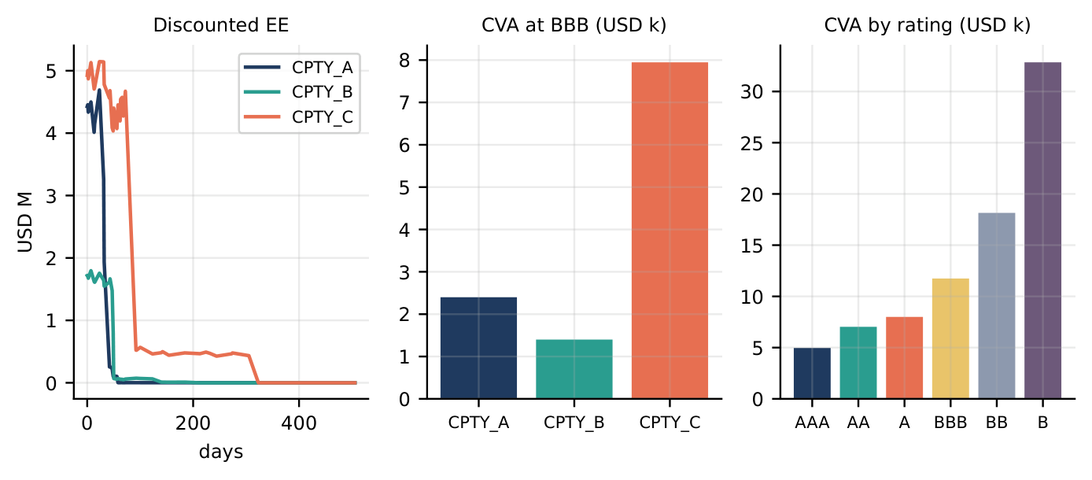
CVA: methodology and results
No CDS available -> ICE BofA bond-index OAS proxy by rating (Basel MAR50.32(3)-compliant); all 3 counterparties proxied at BBB
Credit-triangle hazard-rate survival model: hazard ~ spread / (1 - recovery), LGD 60%
CPTY_C close-out CVA $7.9k; A $2.4k; B $1.4k; total $11.7k
Rating sensitivity: AAA $5.0k, AA $7.0k, A $8.0k, BBB $11.7k, BB $18.1k, B $32.8k
Value delivered: the sensitivity chain (CVA01, rating table, SA-CVA weighted sensitivities) matters more than the point-in-time number, which is small by construction here.

Slide 49
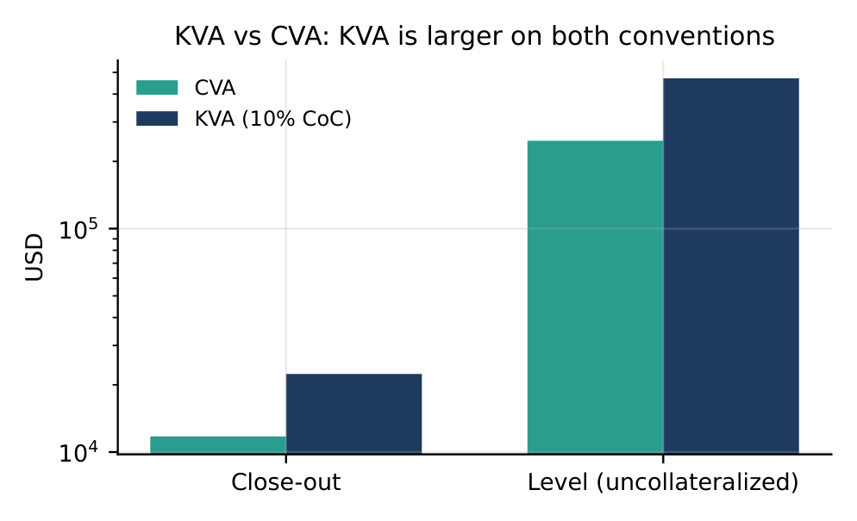
DVA, FVA, and KVA (extra credit)
 | Close-out | Level
CVA | $11.7k | $247k
DVA | $11.2k | $7.5k
FVA | $0.5k | $240.0k
KVA (10% CoC) | $22.4k | $470k
On close-out, positive/negative exposure are nearly symmetric so CVA/DVA nearly cancel; on level, the book is net in Capitolis' favour, so CVA/FCA dominate.
KVA: K(t) = 8% x RW x alpha x EPE(t), CoC swept 8/10/12% (none given). Exceeds CVA because it scales the whole EPE profile, not a small IG default probability.

Slide 50
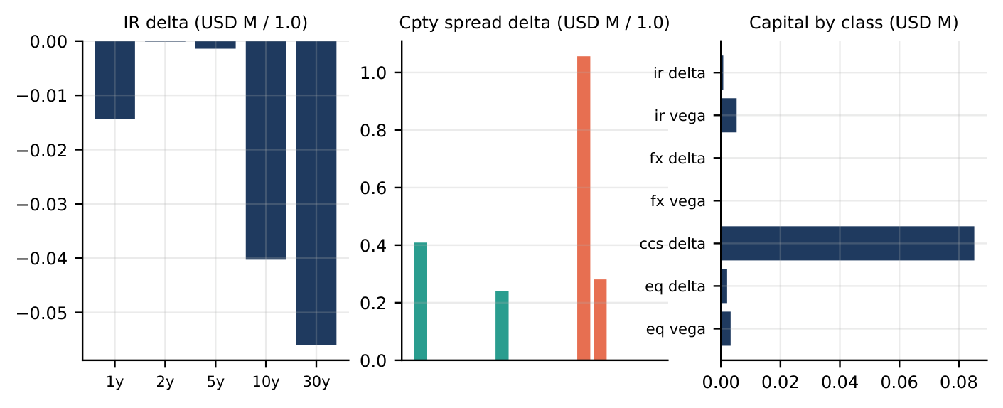
Regulatory capital: SA-CVA and SA-CCR
SA-CVA capital: $0.10M close-out / $2.23M level (RWA $1.2M / $27.8M)
Dominated by counterparty credit-spread risk on both conventions
SA-CCR exposure at default: $260M, dominated by the replacement cost of BF_0003

Slide 51
Extra credit: a risky-bond sample trade
The kickoff brief flagged "Risk bonds + CDS data for new sample trades." Delivered:
A sample risky-bond forward (25M notional, 5% BBB corporate; not part of the ESF book)
Priced and simulated with a real issuer credit curve, re-anchored at every simulated node
Same hazard-rate survival model and bond-index proxy construction as the counterparty CVA
Limitation, disclosed: no real CDS quotes were obtainable for a hypothetical issuer, so the issuer curve is a bond-index proxy, not actual CDS -- delivered in spirit, not the full ask.

Slide 52
PART VIII
Decisions, Limitations, and Conclusions

Slide 53
Full decision register
Decision | Final choice | Evidence | Trade-off
USD rate model | Hull-White 1F (1-factor LGM) | G2++ CRN gap only -3.0% at 16.1% fit error | No independent curve twist
JPY rate model | Hull-White 1F, dedicated | All 3 real a-routes invalid; $52.1M->$51.5M | One extra simulated factor
Rate vol source | Realised 2y-30y Treasury | Matches actual move; both pass Kupiec | More window sensitivity
Correlation | Full 39x39 Cholesky | PCA slower, up to 1.7% extra error | Estimation noise, 741 pairs
Sampling scheme | Latin Hypercube | 50.6x lower RMSE vs. pseudo-random | No edge on PFE99 Greeks
Path count | N=5,000 / 10,000 sign-off | Rel. SE ~1.4% at 5,000 | ~1.4% residual noise
Exposure convention | Close-out primary, level secondary | Brief's own definition | Real CSA terms unknown
Greeks method | Bump-reprice + CRN, pathwise check | 282x noise reduction; pathwise 1000x faster | Rate Greeks need resim
Rate DV01 attribution | Par-instrument Jacobian | 82% vs. 54% correctly placed at 30y | More bookkeeping
Credit spread source | ICE BofA rating-index OAS | Basel-sanctioned fallback | No sector/region, no WWR
KVA | Parametric, CoC grid | Completes xVA extra-credit ask | Not a real capital methodology

Slide 54
Why this engine
Accurate
Stable
Parametric VaR vs. MC: ratio 0.98
Kupiec backtest: all pass (equity and rates)
DV01 additivity: 0.9995 / 1.0001
CRN cuts Greeks noise 282x ($245k -> $1k)
Exact rate-shift Greek agrees to 1e-15
G2++ challenger within 3% of production on MPE99
Fast
Reproducible
Equity/FX bumps: 93x cheaper than naive resimulation
Pathwise delta: ~1000x faster than bump-and-reprice
Exact rate-shift Greek: no resimulation at all
Same seed -> identical paths and NPVs
168 automated regression tests
Every number in this deck traces to a committed result file
Explainable
Every parameter traced to a named, dated data source
Every model choice backed by a quantified trade-off
Accurate + fast + explainable + stable + reproducible -- each claim backed by a number in this deck.

Slide 55
Limitations and model risk
Area | Limitation | Effect | Mitigation / next step
Volatility | Realised (3y), constant; no smile/clustering | Vol x2 moves MPE99 +71% | Implied vols; stress overlay
Credit | BBB proxy, flat term, independence assumed | No wrong-way risk | Real ratings/CDS; sector proxy
Rates | One factor in production | Curve-twist risk not captured | G2++ kept, re-tested
Capital | KVA uses an assumed CoC grid | KVA is illustrative only | Real methodology from Capitolis
Validation | One valuation date, no rolling backtest | Model error over time unmeasured | Rolling backtest
Monte Carlo | MPE99 converges slowly | ~1.4-2.2% spread at N=5,000 | Sign-off at N=10,000

Slide 56
Decision made: production configuration
Production configuration
Rates: Hull-White 1F, a=0.0167, sigma=0.96%; JPY Hull-White 1F, a=0.001; G2++ kept as challenger
Equities / FX: correlated GBM, full 39-factor Cholesky, quanto drift for JPY names
Simulation: Latin Hypercube, N=5,000 (sign-off 10,000), common random numbers for every Greek
Exposure: close-out 10bd with t-1bd VM, per netting set: MPE99 $51.0M, peak EE $11.6M, CVA $11.7k
Monitor
Next
Book slope exposure (would trigger a G2++ re-test)
Volatility regime (implied vs. realised)
Credit proxy vs. any real counterparty CDS
Real ratings/CDS, own credit and funding spread
Real capital methodology and CoC for KVA
Sector-specific credit-spread proxy; rolling exposure backtest

Slide 57
Feedback tracker: both rounds, all 11 items
Earlier meeting
This meeting
1. Robust stress testing -- SELECTED
2. Sensitivities: method, cost, faster alt. -- SELECTED
3. PCA explainability and speed -- SELECTED
4. Final results explanation -- SELECTED
5. CVA walkthrough and set-up -- SELECTED
6. 2008 and more testing periods -- SELECTED
7. LHS to calculate sensitivities -- SELECTED
8. KVA addition -- SELECTED
9. CVA is for sensitivities -- SELECTED
10. DV01 via a Jacobian -- SELECTED
11. Excel parametric vol-bump test -- SELECTED
Detail and results for every item are in the sections above.

Slide 58
Thank You
Questions and discussion

