Slide 1
Data Wrangling Homework 1 – By Esha Singh

Slide 2
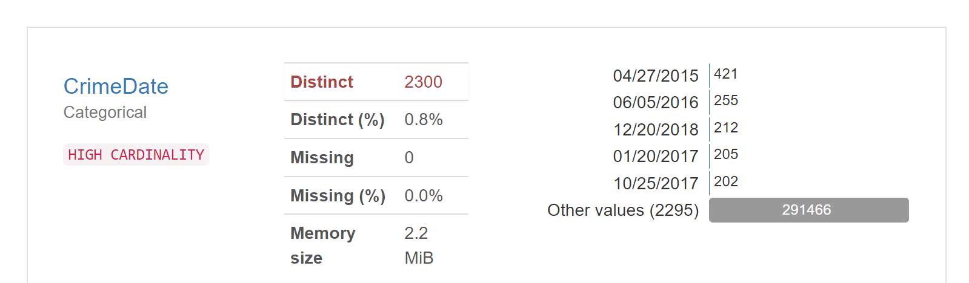
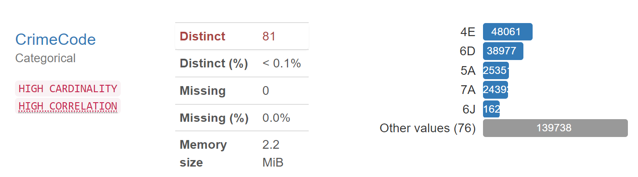
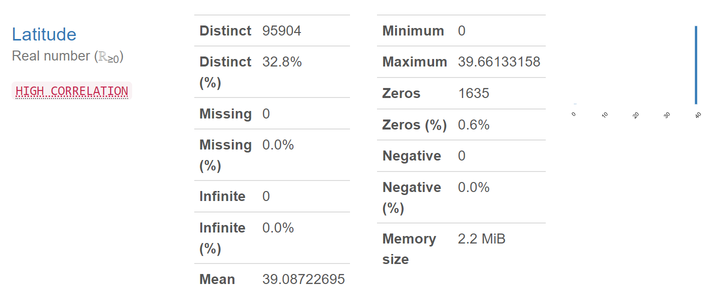
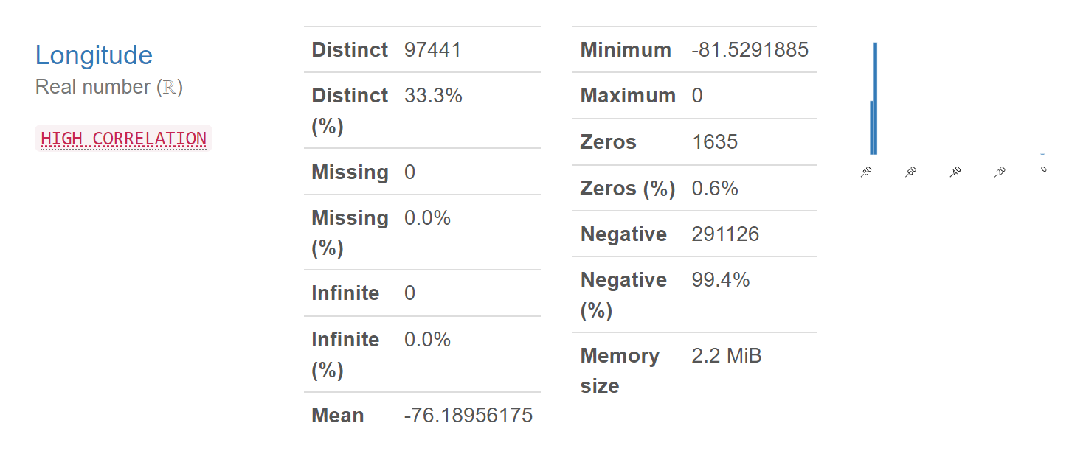
DATA PROFILING

Slide 3
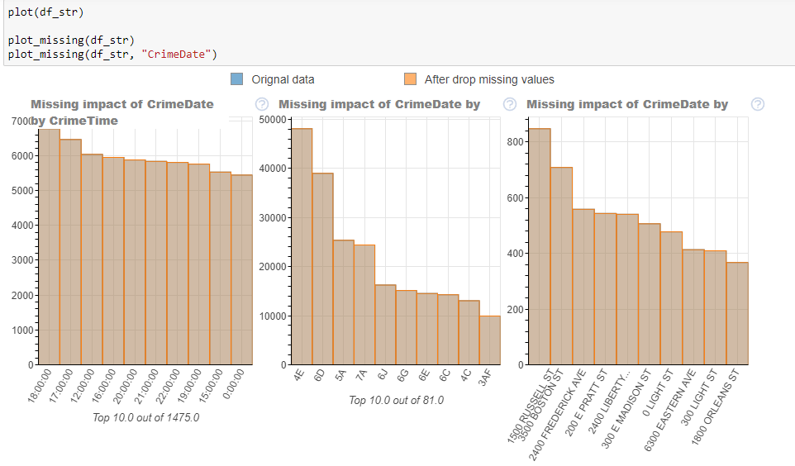
Results & Charts

Slide 4
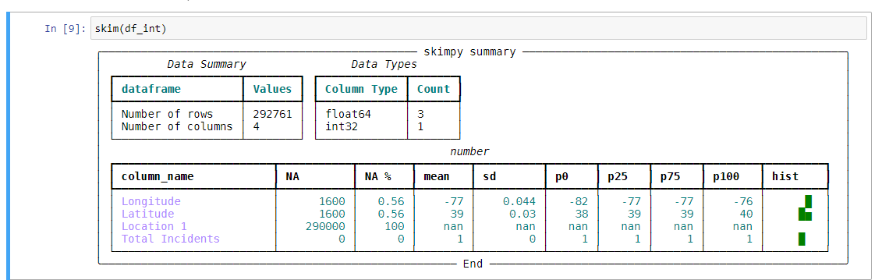
Results & Charts

Slide 5
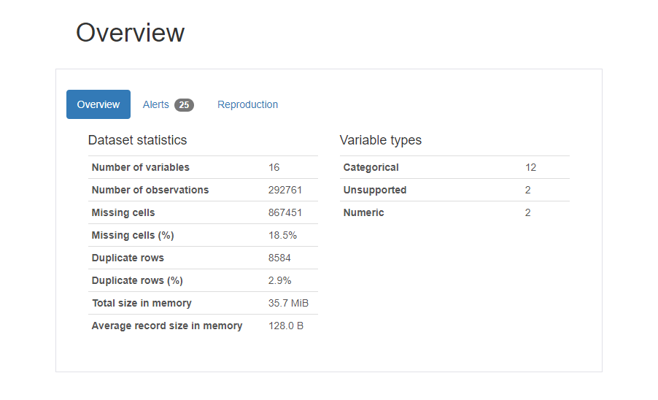
Analysis Dashboard
The dashboard has clickable buttons that can be used to see all the analysis done on the data.
The data has been brought to a single dashboard with all explanation

Slide 6
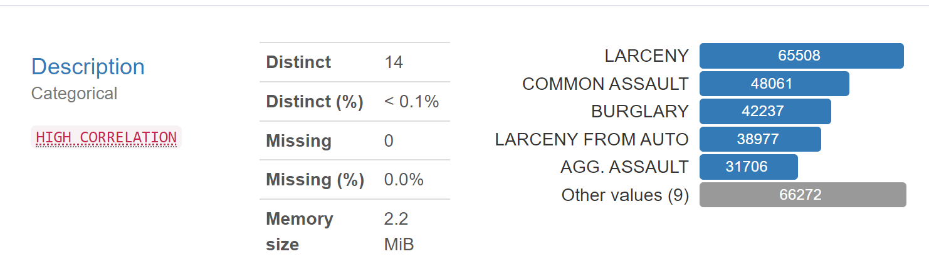
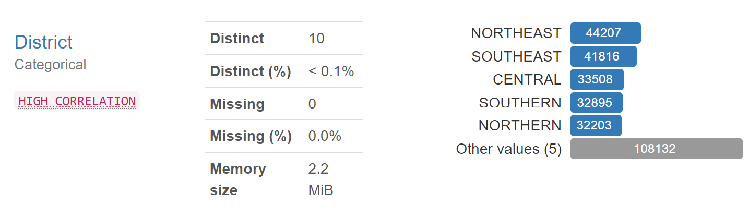
Understanding the Overall Crime distribution
As we can see larceny and common assault are most in number and we can see other types of crime aggregate to 66272.
We can see that Northeast and southeast have the highest number of cromes.

Slide 7
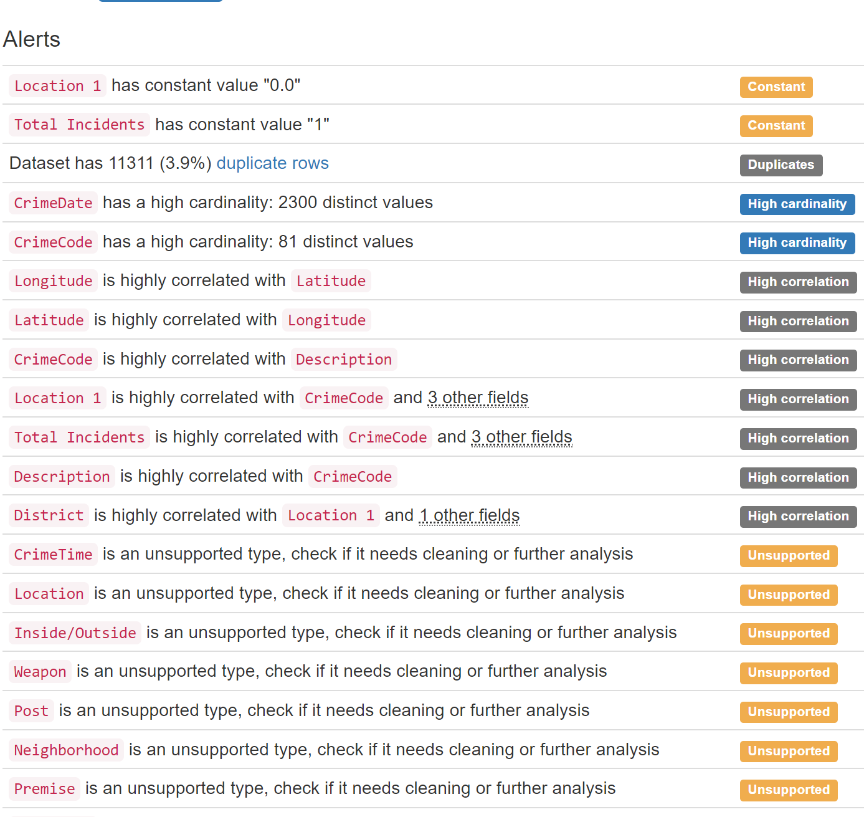
CORRELATION
This picture shows the correlation between each variable.

Slide 8
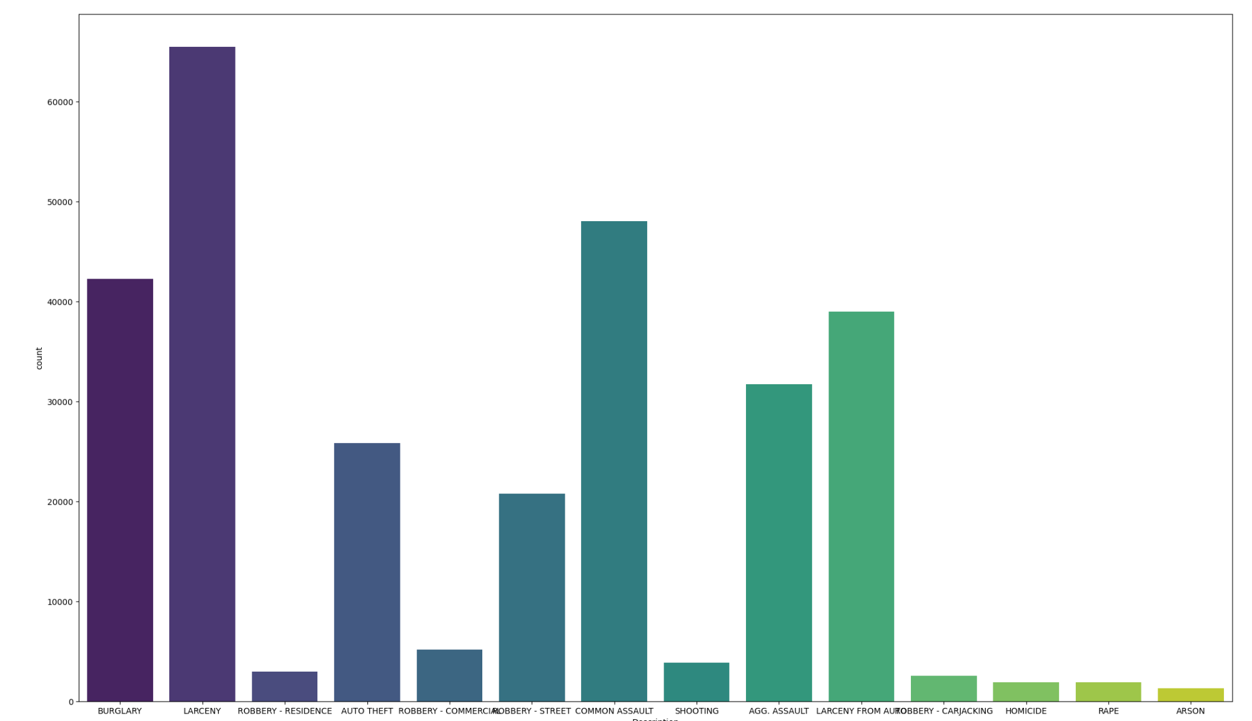
Overall Crime Distribution

Slide 9
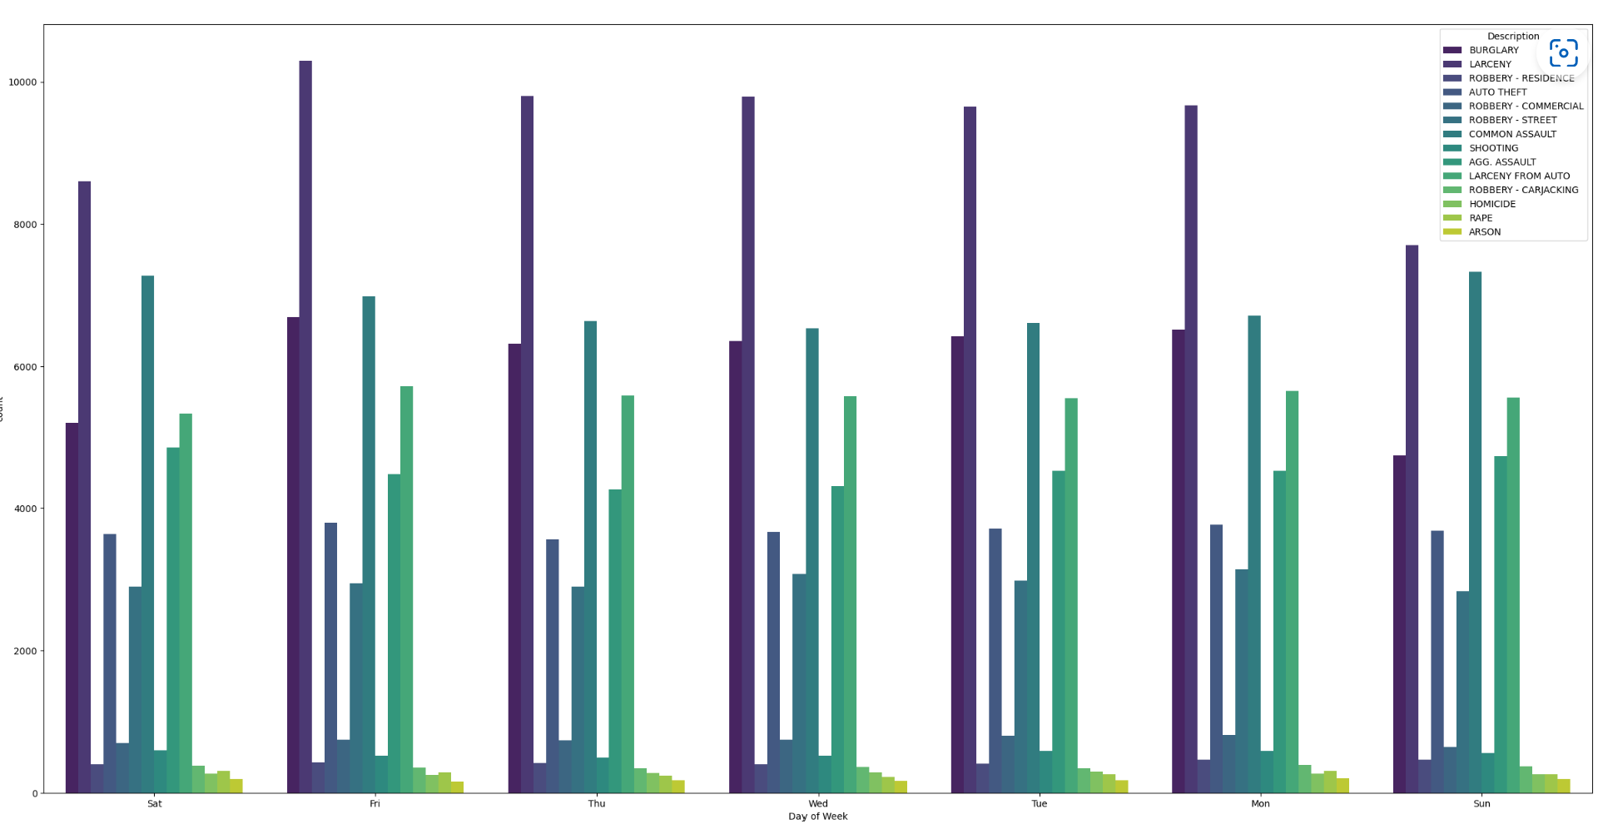
Overall Crime Distribution by day-of-week

Slide 10
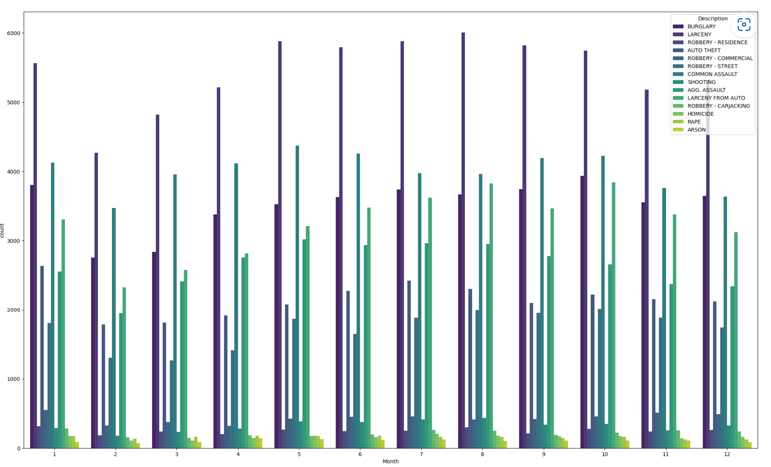
Overall Crime Distribution By Month

Slide 11
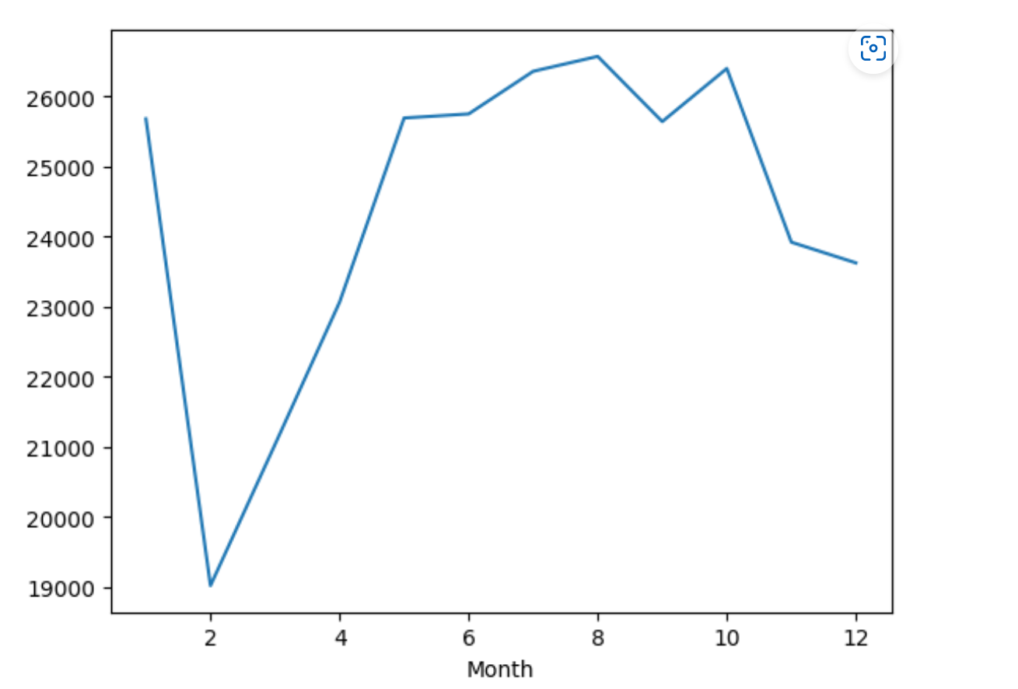
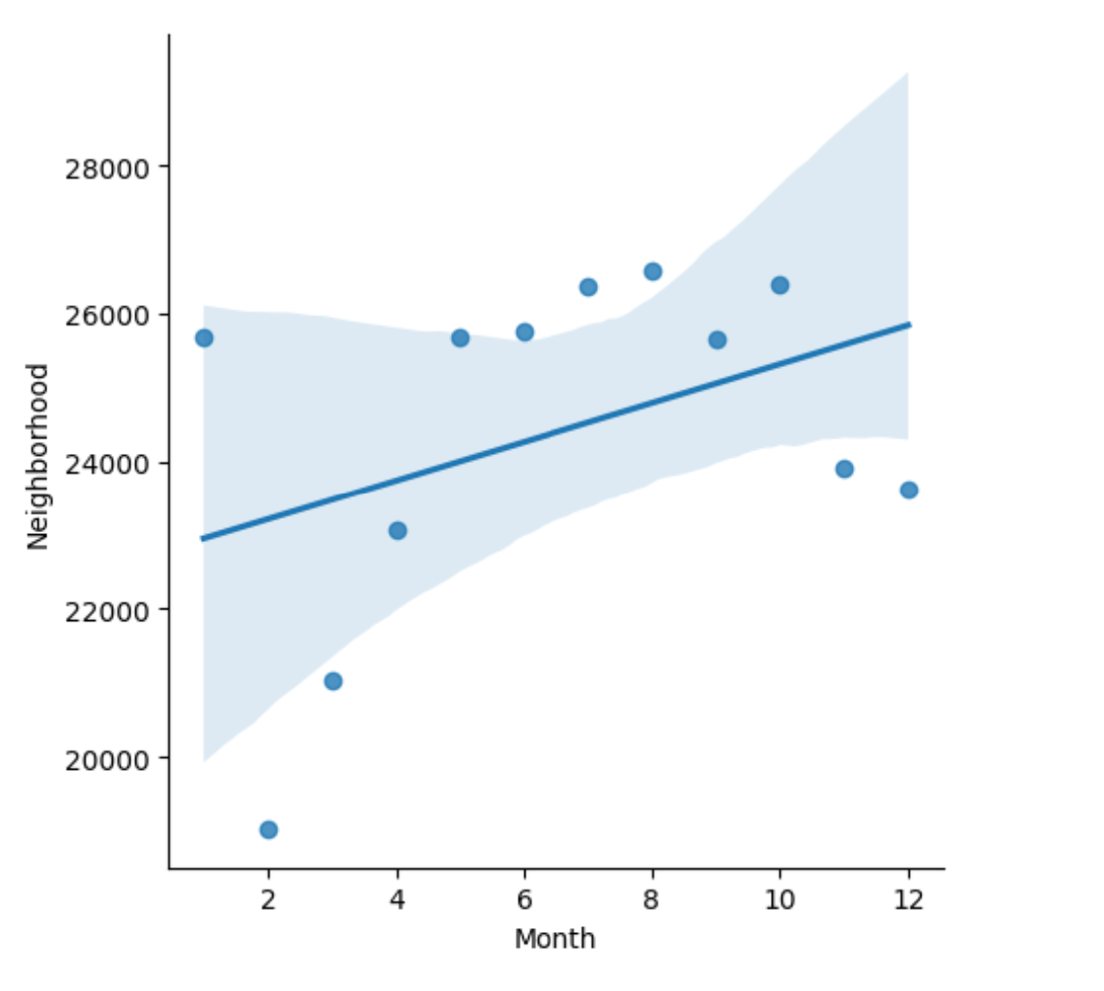
Crime over months in Neighborhood

Slide 12
Conclusion
As the amount of raw data rises, so does the amount of data that is not intrinsically usable; this increases the amount of effort required cleaning and organizing data before it can be evaluated, which is where data wrangling comes into play. The outcome of data wrangling can give crucial metadata statistics for deeper insights into the data; nevertheless, it is critical to guarantee metadata consistency otherwise it might present obstacles.
Data wrangling enables analysts to evaluate more complicated data faster, generate more accurate findings, and make better judgments as a consequence. Because of its success, many firms have shifted to data wrangling.

Slide 13
References
As coder is for code, X is for data Archived 2021-04-15 at the Wayback Machine, Open Knowledge Foundation blog post
Parsons, M. A.; Brodzik, M. J.; Rutter, N. J. (2004). "Data management for the Cold Land Processes Experiment: improving hydrological science". Hydrological Processes. 18 (18): 3637–3653. Bibcode:2004HyPr...18.3637P. doi:10.1002/hyp.5801.
"What Is Data Wrangling? What are the steps in data wrangling?". Express Analytics. 2020-04-22. Archived from the original on 2020-11-01. Retrieved 2020-12-06.
Wickham, Hadley; Grolemund, Garrett (2016). "Chapter 9: Data Wrangling Introduction". R for data science : import, tidy, transform, visualize, and model data (First ed.). Sebastopol, CA. ISBN 978-1491910399. Archived from the original on 2021-10-11. Retrieved 2022-01-12.
Kandel, Sean; Paepcke, Andreas (May 2011). "Wrangler: Interactive Visual Specification of Data Transformation Scripts". SIGCHI. doi:10.1145/1978942.1979444. S2CID 11133756.

