Slide 1

ContentForge AI
Intelligent Content Creation with Consistent Brand Voice
From Idea to Impact
CODE KALESHhfCCODE KA
KANHAIYA GUPTA
ESHA VALUNJ
KAUSTUBH BANE
JAYNI PAREKH

Slide 2

THE CHALLENGE
Content Creation Crisis
Voice Inconsistency
Time Bottleneck
Authenticity Loss
Different writers create different tones, diluting brand personality with no way to measure alignment.
6-8 hours per content piece. Creators spend 70% of their time editing, making authentic scaling impossible.
Generic AI feels fake. Personal brands get diluted when outsourcing, leading to creator burnout.

Slide 3
The Market Opportunity
$11.8B
Market Size
Growing at 20% YoY in creator economy and 35% YoY in AI marketing adoption.
50M+
500M+
50K+
Global Creators
Small Businesses
Enterprises
Creator economy participants worldwide
Requiring consistent content
Needing brand consistency

Slide 4

THE SOLUTION
How ContentForge AI Works
Four core capabilities that transform content creation from hours to seconds whilst maintaining authentic brand voice.

Slide 5

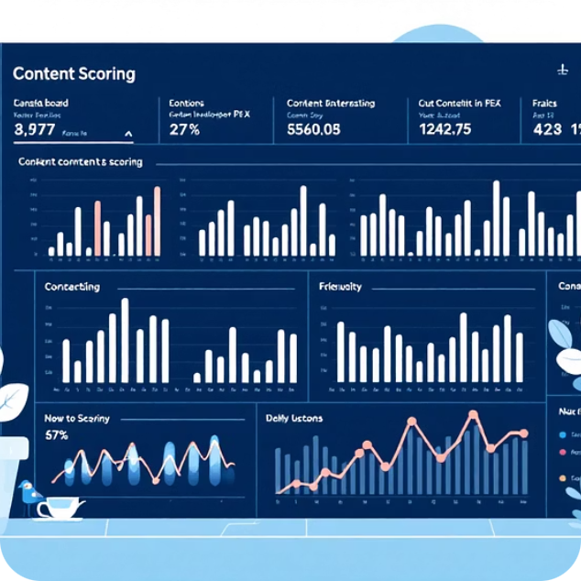

Four Core Capabilities
Learn Your Voice
Score Any Content
Auto-Correct to Voice
Paste 1-3 articles and AI extracts your brand fingerprint in 2-3 seconds. Get a measurable voice profile instantly.
Submit new content and receive a 0-100 alignment score in 1-2 seconds. See strengths and deviations clearly.
Fix off-brand content automatically. AI rewrites whilst preserving

