Slide 1
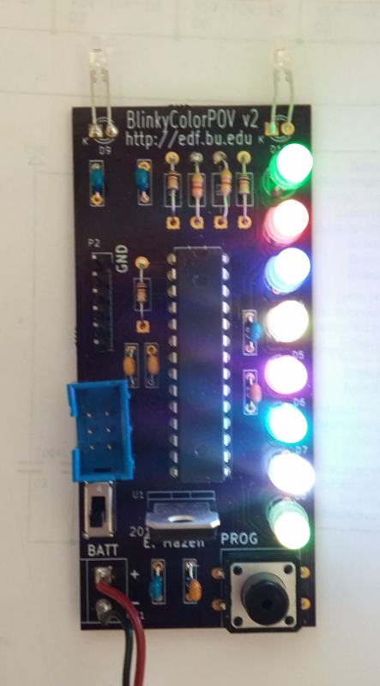
Welcome To
Science Solstice
2016
At the
Electronics
Design
Facility

Slide 2
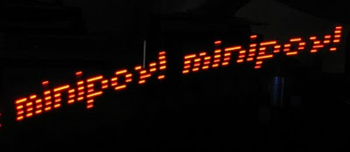
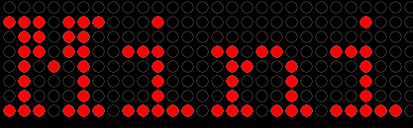
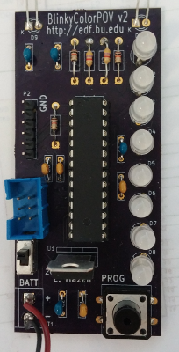
What is it? A “BlinkyPOV”
POV means
“persistence of vision”
As you wave the MiniPOV, the LEDs blink
out a message by turning on in a pattern.
Your eye sees the message because the
image of the LEDs “persists” (stays) for a while
in your eye

Slide 3
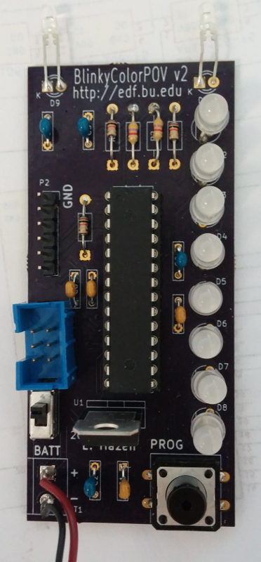
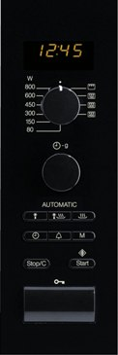
How does it work?
The black thing with all the legs
is a tiny computer called
a microcontroller
They are programmed in
a language called C
They are used in lots of
things around your house
(microwave, stereo, TV...)
Other parts are needed too...

Slide 4
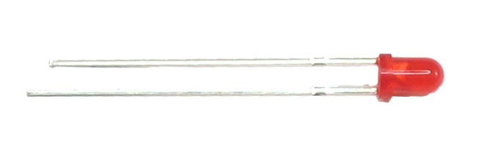
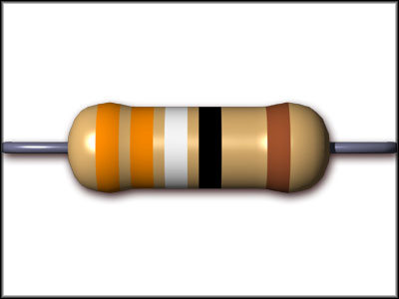
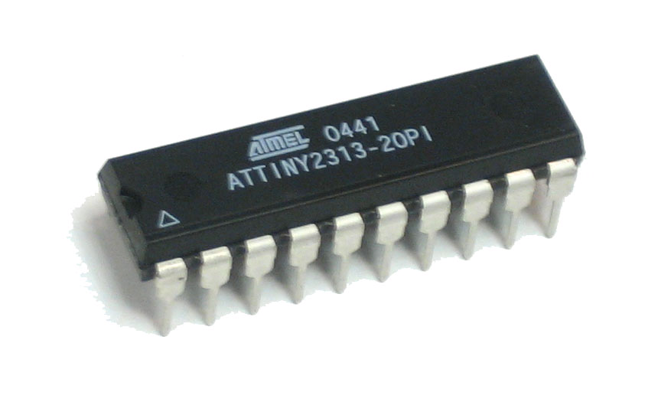
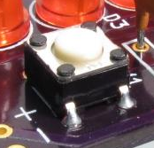
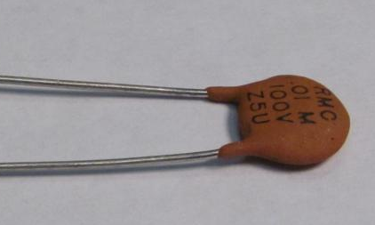
Parts, Parts, Parts!
LED (light-emitting diode)
Lights up in response to electric current
Resistor – limits the amount of
electric current in a circuit
Microcontroller – tiny computer
Each leg (pin) can be controlled
by a program in C
Switch – allows electricity to flow
when pressed
Capacitor – stores electricity
(like a battery, but for shorter times)

Slide 5
How Do We Design It?
Draw a wiring diagram (schematic)
Draw a layout
Send the design to a company to make the
printed circuit board
Solder in the parts (you get to do this!)
Program it (you get to do this too)
Test it

Slide 6
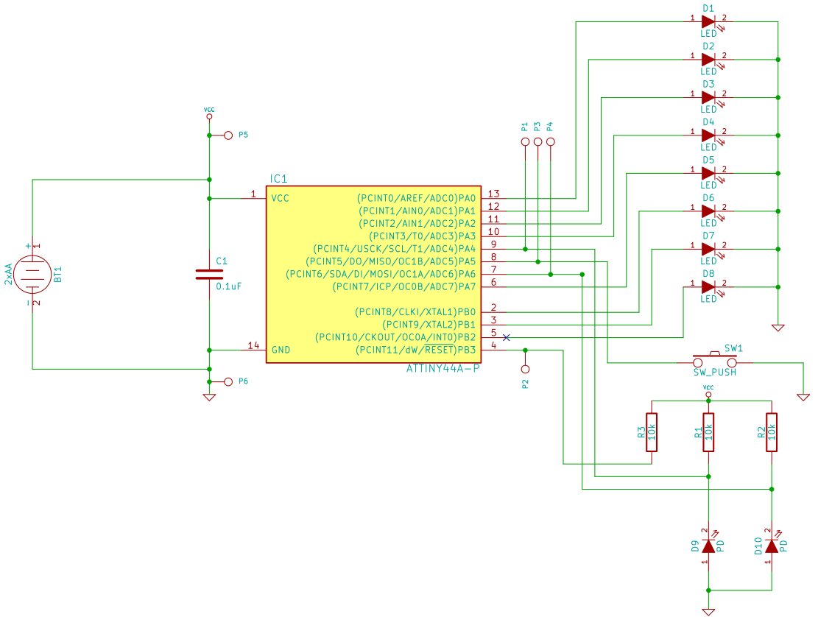
This is the
schematic
(wiring diagram)
LEDs
The red symbols
are parts
The green lines
show how the
parts are
connected
Batteries
Microcontroller
Resistors

Slide 7
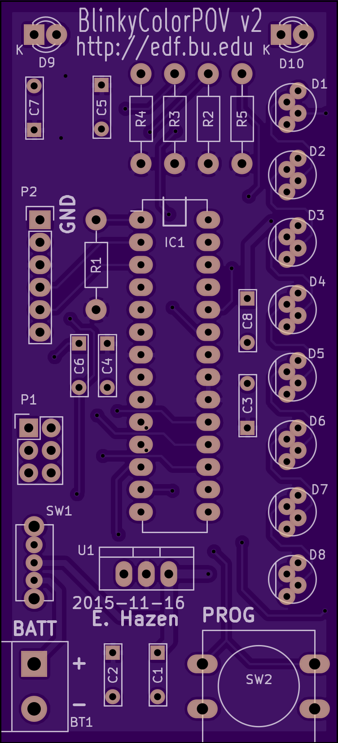
Everything is soldered
into a printed circuit board
The squiggly lines are printed
in copper on the board like wires
... they connect together the
parts to make an electric circuit

Slide 8

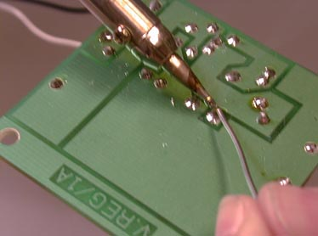
Soldering
Soldering is the joining of
metal objects together.
A filler metal (“solder”) is
melted and flowed into the joint.
Soldering was practiced in
ancient Egypt at least
7000 years ago
Soldering is used to attach
electronic components to
a board, and also for jewelery
and other applications

Slide 9
Soldering Safety
The iron gets hot!
Don't burn yourself. Careful not to splash solder
Solder is made of lead, which is poisonous
Wash your hands when you are done; don't eat or drink while soldering
Snipped component leads fly at high speeds
Close your eyes or cover board with your hands

