Slide 1
EPIC Partner Class -- 2013
Soldering
and
Arduinos

Slide 2

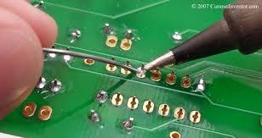
Soldering
Soldering is the joining of
metal objects together.
A filler metal (“solder”) is
melted and flowed into the joint.
Soldering was practiced in
ancient Egypt at least
5000 years ago
Soldering is used to attach
electronic components to
a board, and also for jewelery
and other applications

Slide 3
Soldering Safety
The iron gets hot!
Don't burn yourself. Careful not to splash solder
Solder is made of lead, which is poisonous
Wash your hands when you are done; don't eat or drink while soldering
Snipped component leads fly at high speeds
Close your eyes or cover with your hands

Slide 4
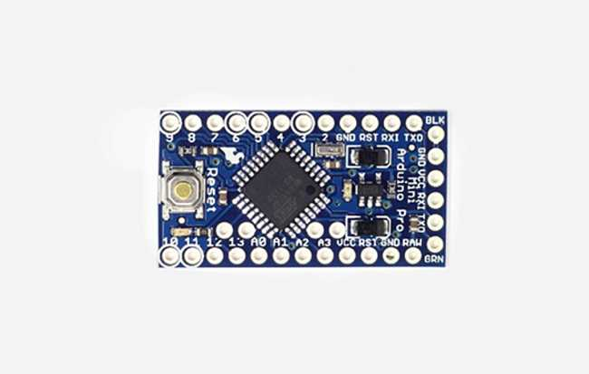
What's an Arduino?
A: A tiny computer
The black thing with all the legs
is a tiny computer called
a microcontroller
They can be programmed
in C or C++
They are used in lots of
things around your house
(microwave, stereo, TV...)

Slide 5
Micro-what?
Q: What exactly is a microcontroller (uC)?
A: Just a very small (usually single-chip) computer
Q: What features must a microcontroller have?
A: A central processing unit (CPU)
Program memory (usually flash)
Data memory (at least registers, usually RAM too)
Some input / output
Q: What other features may a uC have?
A: Counter/timer units, serial ports,
A/D and D/A converters, plus sometimes special
features such as USB, WiFi, light dimmers....

Slide 6
Essential uC Components
Program Memory
Instructions (code)
Registers
(temporary storage)
Central
Processing
Unit
Input/
Output
External
Devices
Data Memory
(variables)

Slide 7
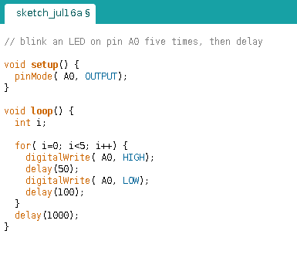
Arduino “Sketch” Example
It's almost exactly “C”, but...
No “#includes” unless you use
a special library
Special function setup()
called once when program starts
pinMode() tells the Arduino
whether a pin is for input
our output
Special function loop()
called forever after setup()
DigitalWrite() sets a pin to
a specific “logic level”:
HIGH = 5V
LOW = 0V
Special function delay()
stops the program for specified
number of milli-seconds
(1/1000 second steps)
No “printf” since there is no
keyboard / screen attached!

Slide 8
Circuit Example
Power supply
(two AA batteries)
Micro-
controller
LED
(output device)
push-button
(input device)
resistor to limit
LED current

Slide 9
More about Input and Output
Two types of devices:
  Digital
    On / Off only (like an LED or push-button)
    Sometimes used in groups (i.e. for a keypad)
    Can form a bus (special group with data and control)
    for example to control an LCD display
  Analog
    Variable level/speed (like a knob or a motor)
    For input, use an ADC (analog-to-digital converter)
    For output, use a DAC (digital-to-analog converter)
    Often used for things like ultrasonic range finders,
    light sensors or speed control of motors

Slide 10
Programming considerations
Just like programming a “real computer”, except:
  Generally C/C++ is the only language choice
  Program memory is small! Programs must be short
  Data memory is small! Only a few variables
  Often there is no keyboard or display, so functions like printf() are not useful
  Floating point math is “expensive” so best use only integers
  For efficiency, pick variables of the right size
  (use a char if 8 bits is enough)

