Slide 1
CAPSTONE TWO · FINAL PRESENTATION
APRIL 2026
SUBWAY RIDERSHIP · FORECASTING
Predicting
the next hour
of the subway.
A station-by-station, hour-by-hour ridership model for the MTA, built on roughly two years of fare-tap data spanning 2022–2024.
AUTHOR
REPOSITORY
FINAL MODEL
ESH S. CHHURA
GITHUB.COM/ESHCHHURA
LIGHTGBM · R² 0.981

Slide 2
01 · PROBLEM
PAGE 02
The problem, and who I built this for.
WHY THIS MATTERS
The MTA moves several million riders a day. Frequency and staffing decisions are largely made from historical averages and experience. I wanted to see how far a model trained on two years of fare-tap data could push that.
51M
431
HOURLY TAP ROWS
STATION IDS
THE QUESTION
Given a station and a specific hour, can I predict how many riders will tap in accurately enough that the MTA could actually plan around the answer?
~2 yrs
5
WHO THIS IS FOR
MTA operations and planning: the people deciding how many trains to run at 5 PM Tuesday, or where to station an agent during a holiday week. They care about accuracy at the station-hour grain, behavior at the peaks, and stability over time.
MAY 2022 → MAY 2024
BOROUGHS COVERED
MTA RIDERSHIP FORECASTING · CAPSTONE TWO
02

Slide 3
02 · DATA SOURCE
PAGE 03
The data, and where it came from.
SOURCE
SCHEMA · RAW
MTA Subway Hourly Ridership 2022–2024 on Kaggle, originally pulled from the MTA public open-data portal. Each row represents one station, one hour, one fare class, and one payment method, so a single hour at a busy station can produce a dozen+ rows depending on how riders paid.
transit_timestamp
datetime
transit_mode
str
station_complex_id
str
WHAT'S IN A ROW
station_complex
str
Twelve columns total. Useful raw fields: timestamp, station ID, borough, payment method (OMNY or MetroCard), fare class, ridership count, transfers, and lat/long. The redundant geo-string was dropped early.
borough
str
payment_method
str
fare_class_category
str
ridership
int
SCALE
transfers
int
~51.2M rows from May 2022 through May 2024. After cleaning, aggregation, and lag-feature creation, the modeling table holds 7,542,884 station-hour rows.
latitude
float
longitude
float
Georeference
str (dropped)
MTA RIDERSHIP FORECASTING · CAPSTONE TWO
03

Slide 4
03 · DATA WRANGLING
PAGE 04
Cleaning, wrangling, the bits I cut.
51.2M
7.54M
After aggregating from per–fare-class rows up to one row per station per hour, then adding lag features.
→
RAW ROWS
STATION-HOUR ROWS
MAIN CLEANING STEPS
01
Load 4.6 GB
Memory-conscious dtypes; downcast ints; parse timestamp once.
02
Rename for clarity
station_complex_id → station_id, etc.
03
Aggregate to station-hour
Roll up by (timestamp, station_id); sum ridership.
04
Drop leakage columns
Remove redundant geo-string; drop fare-class detail.
05
Retain payment side-data
Keep MetroCard / OMNY columns for separate analysis.
MTA RIDERSHIP FORECASTING · CAPSTONE TWO
04

Slide 5
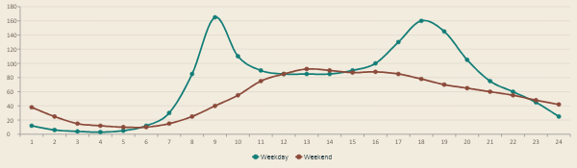
04 · EXPLORATORY ANALYSIS
PAGE 05
The day has two peaks.
On weekdays, ridership shows a sharp 8 AM peak, a midday valley, and a slightly larger 5 PM peak. On weekends, both peaks disappear and the curve becomes a single broad ridge from late morning to early evening. Any model that ignores hour-of-day will struggle and that's exactly what the linear baselines did.
FIG 01 Illustrative shape of mean ridership by hour of day. Weekday curve shows the two-peak commuter pattern; weekend is gentler and shifts later.
MTA RIDERSHIP FORECASTING · CAPSTONE TWO
05

Slide 6
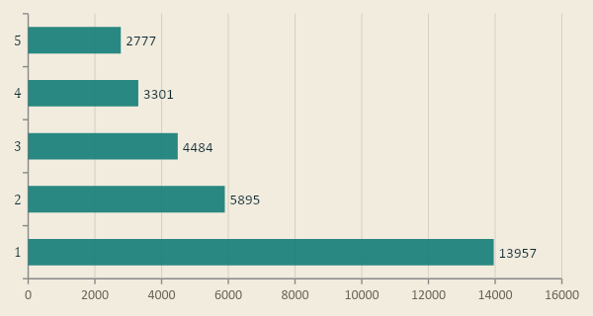
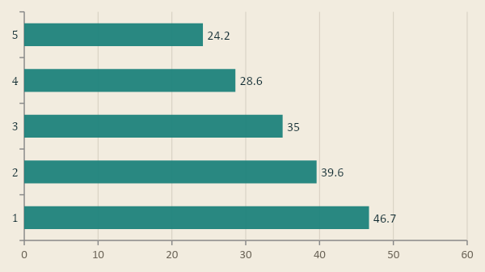
04 · EXPLORATORY ANALYSIS (CONT.)
PAGE 06
Where the riders are, and how they pay.
MANHATTAN DOMINATES VOLUME
OMNY ADOPTION VARIES BY BOROUGH
Manhattan carries the highest per-station daily volume; Queens and Brooklyn split most of the rest. Staten Island barely registers as most of its transit is the ferry and the SIR.
Manhattan riders use OMNY at nearly twice the rate of Staten Island riders. The pattern is directional but not strict because Brooklyn shows higher OMNY adoption than Queens despite Queens having higher per-station ridership.
MTA RIDERSHIP FORECASTING · CAPSTONE TWO
06

Slide 7
05 · FEATURE ENGINEERING
PAGE 07
Turning rows into features.
TIME FEATURES
LAG FEATURES
ROLLING STATISTICS
Calendar context for every station-hour.
Three lags per station carry most of the signal.
Shifted by 1h so they never see the future.
hour
lag_1h — same station, one hour ago
rolling_mean_24h
day_of_week
lag_24h — same station, day ago
rolling_std_24h
day_of_month
lag_168h — same station, week ago
month
year
is_weekend
is_holiday
PIPELINE
OneHotEncoder(handle_unknown="ignore") for categoricals → sparse matrix → StandardScaler for numerics. Tree models don't need scaling, but the pipeline applies it uniformly so the comparison is fair.
MTA RIDERSHIP FORECASTING · CAPSTONE TWO
07

Slide 8
06 · TRAIN / TEST SPLIT
PAGE 08
Time-aware splitting to avoid leakage.
This is a time series. A random shuffle would let the model see training rows from after the test rows it was trying to predict, which inflates every metric. I used a chronological 80/20 split, with three expanding-window backtest folds inside the training portion.
MAY 2022
MAY 2024
FOLD 1
FOLD 2
FOLD 3
FINAL
TRAIN
VALIDATION (BACKTEST)
HELD-OUT TEST
USED IN FINAL TRAIN FIT
FIG 02 Three expanding-window backtest folds inside the training portion. Gray segments after each validation window are still part of training data and were used when fitting the final model. The held-out test (20%) was only touched once, at the end.
MTA RIDERSHIP FORECASTING · CAPSTONE TWO
08

Slide 9
07 · MODELS
PAGE 09
Six families, one clear winner.
I tested six model families plus a baseline to map the boundary between models that can and cannot capture nonlinear time effects. Scored on MAE, RMSE, R², and WMAPE. The last is volume-weighted, the right thing to watch when station traffic ranges from a handful to several thousand riders per hour.
BASELINE
LINEAR
LINEAR
Dummy mean
Ridge
SGD
Predict the global mean. The performance floor.
Regularized linear regression. What time features alone can do.
Same idea as Ridge, fit by stochastic gradient descent.
GLM
TREES
TREES
Poisson
XGBoost
LightGBM
Log-link GLM: natural for counts, but underperforms here due to overdispersion.
Gradient-boosted trees. Workhorse of tabular regression.
Leaf-wise gradient boosting, faster on data this large. ⟵ winner
MTA RIDERSHIP FORECASTING · CAPSTONE TWO
09

Slide 10
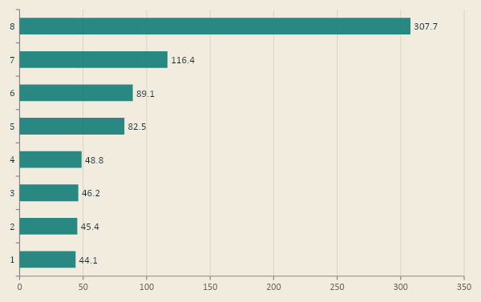
07 · MODELS (CONT.)
PAGE 10
The comparison table.
MAE · RIDERS PER STATION-HOUR · LOWER IS BETTER
WHAT THE NUMBERS SAY
MODEL | MAE | R² | WMAPE
LightGBM (final) | 44.1 | 0.962 | 14.4%
XGBoost (d8) | 45.4 | 0.960 | 14.8%
LightGBM (lr.10) | 46.2 | 0.959 | 15.1%
XGBoost (d6) | 48.8 | 0.955 | 15.9%
Ridge | 82.5 | 0.904 | 26.9%
SGD (L2) | 89.1 | 0.900 | 29.0%
Poisson | 116 | 0.372 | 37.9%
Tree models cluster around R² 0.96; linear models hit a ceiling near R² 0.90 because the relationship between time and ridership is fundamentally nonlinear.
Full RMSE values and dummy-baseline results are in the final report and Modeling notebook.
MTA RIDERSHIP FORECASTING · CAPSTONE TWO
10

Slide 11
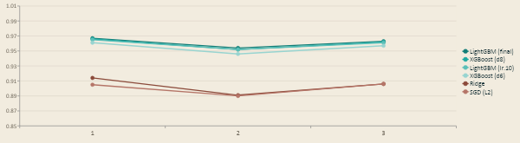
08 · BACKTESTING
PAGE 11
Holding up across time.
Validation results are encouraging, but they're one slice of time. The real question is whether the model holds up when the training window slides forward. I ran three sequential backtest folds and tracked R² and MAE on each.
0.961
MEAN R² ACROSS 3 FOLDS
FIG 03 R² across three time-ordered backtest folds. LightGBM holds near 0.96 with std dev 0.007; linear baselines sit near 0.90 with more drift between folds.
MTA RIDERSHIP FORECASTING · CAPSTONE TWO
11

Slide 12
09 · FINAL · TEST RESULTS
PAGE 12
The final scoreline.
36.4
94.5
0.981
11.5%
MAE · PER STATION-HR
RMSE
R² · HELD-OUT TEST
WMAPE
FINAL CONFIGURATION
LightGBM · 127 leaves · learning rate 0.05 · 300 trees · min_child_samples 50
On the held-out 20% of the timeline that was never touched during model selection or hyperparameter search, the model achieves an R² of 0.981 with MAE of 36.4 riders per station-hour. WMAPE of 11.5% means the model is off by about a tenth of actual volume on average.
MTA RIDERSHIP FORECASTING · CAPSTONE TWO
12

Slide 13
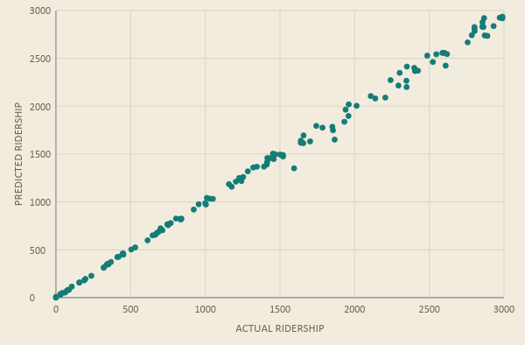
09 · FINAL · TEST RESULTS (CONT.)
PAGE 13
Where the errors live.
PREDICTIONS VS. REALITY
This is a sample of station-hours from the held-out test set. The points sit tight against the diagonal across most of the volume range. The largest errors come from rare high-volume station-hours, where ridership can spike sharply above normal patterns.
THE RESIDUALS
Errors are centered near zero. The right tail is heavier as the model undershoots some peak-hour cases rather than systematically overpredicting quieter periods. RMSE picks up most of its weight from those rare misses.
FIG 04 Random sample of ~120 station-hours from the 1,508,577-row held-out test set.
MTA RIDERSHIP FORECASTING · CAPSTONE TWO
13

Slide 14
END · THANK YOU
Thank you.
Questions?
AUTHOR
REPOSITORY
FINAL MODEL
ESH S. CHHURA
GITHUB.COM/ESHCHHURA
LIGHTGBM · R² 0.981

