Slide 1
FINAL PRESENTATION
JUNE 2026
MORTGAGE RISK · FORECASTING
PREDICTING 90+ DAY MORTGAGE DELINQUENCY, SIX MONTHS EARLY
A loan-level model that flags Fannie Mae mortgages likely to become 90+ days delinquent within six months, trained on 12.5 million monthly loan records.
AUTHOR
REPOSITORY
FINAL MODEL
Esh S. Chhura
github.com/eshchhura
Oversampled LightGBM · ROC-AUC 0.949

Slide 2
01 · PROBLEM
02
Problem Definition & Audience
WHY THIS MATTERS
12.5M
A mortgage that quietly slides toward delinquency is costly for everyone: the servicer, the investor, and the household. By the time a loan is 90 days past due, most of the good options are already gone. The useful question is the earlier one: which loans are heading there?
LOAN-MONTH ROWS
172
MODEL FEATURES
THE QUESTION
1 in 80
Given everything we know about a loan this month, can we predict whether it becomes 90+ days delinquent within the next six months, early enough to actually act on?
BECOME 90+ DAYS DELINQUENT
6 mo
WHO THIS IS FOR
FORECAST HORIZON
Servicing and credit-risk teams: the people deciding which borrowers to call first, where to target loss-mitigation outreach, and how to size reserves against the book.
MORTGAGE DELINQUENCY FORECASTING
02
Notes:
The business problem is early detection.
Once a mortgage is already 90 days delinquent, the servicer has fewer good options. At that point, the borrower may already be in serious financial stress, and the loan may require more expensive intervention.
So the more useful question is not “which loans are delinquent today,” but “which currently active loans are likely to become seriously delinquent soon?”
This matters for servicing and credit-risk teams because they have limited time and resources. A model like this could help prioritize borrower outreach, loss-mitigation review, and reserve planning.
The forecast horizon I used is six months, which gives the model a practical early-warning window

Slide 3
02 · DATA SOURCE
03
Data Source & Structure
SOURCE
SCHEMA · SELECTED FIELDS
Fannie Mae's public Single-Family Loan Performance dataset, the standard benchmark for U.S. mortgage credit research. I worked from a 10% borrower sample of loans originated in 2021 Q1–Q2, then followed each loan month by month as it performed.
loan_id
str
reporting_month
date
current_actual_upb
float
WHAT'S IN A ROW
loan_delinquency_status
str
One row is one loan in one reporting month: its current balance and delinquency status, joined to fixed origination facts such as credit scores, DTI, LTV, interest rate, loan purpose, occupancy, property type, and geography.
borrower_credit_score
int
dti
float
original_ltv / cltv
float
SCALE
original_interest_rate
float
Followed across the performance window, the sample expands to a monthly panel of 12,524,939 labeled loan-month rows.
loan_purpose / occupancy
str
property_state / type
str
seller / servicer_name
str
MORTGAGE DELINQUENCY FORECASTING
03
Notes:
Slide 3: Data Source
The data comes from Fannie Mae’s public Single-Family Loan Performance dataset.
I used Fannie Mae’s 2021 Q1 and Q2 loan-performance files, then kept a deterministic 10% loan-level sample. For every selected loan, I preserved its full monthly performance timeline.
Each row in the final dataset represents one loan in one reporting month.
That row includes monthly performance information, like current balance and delinquency status, along with fixed origination information, like credit score, DTI, LTV, interest rate, loan purpose, occupancy, property type, and geography.
After joining and cleaning the files, the final panel contained about 12.5 million labeled loan-month rows

Slide 4
03 · TARGET
04
Target Variable Definition
future_90plus_dq_6m
1 in 400
For every loan-month, I look six months ahead. If the loan reaches 90+ days delinquent at any point in that window, the row is labeled 1, otherwise 0.
LOAN-MONTHS BECOME 90+ DAYS DELINQUENT
Rows without a full six-month forward window were dropped, along with a small unlabeled tail. The remaining classes are heavily lopsided, and that imbalance is the central challenge of the whole project.
No future 90+ DQ
99.75%
Future 90+ DQ (positive)
0.25%
MORTGAGE DELINQUENCY FORECASTING
04
Notes:
The target variable is future_serious_dq_6m.
For every loan-month, I looked forward six months. If that loan became 90 or more days delinquent at any point in that future window, I labeled the row as 1. Otherwise, it was labeled 0.
Rows that did not have a full six-month future window were removed, because they could not be labeled fairly.
The most important thing about the target is the imbalance. Only about 0.25% of loan-months became seriously delinquent in the cleaned dataset, which is roughly 1 in 400.
That imbalance shaped the rest of the modeling process, especially the choice of metrics.

Slide 5
04 · DATA WRANGLING
05
Building the Loan-Month Panel
01
Join acquisition + performance
One record per loan-month, balance and status aligned to origination terms.
Raw
12.5M
02
Standardize & downcast
→
Memory-conscious dtypes; parse dates once; rename fields for clarity.
ACQUISITION + PERFORMANCE FILES
LABELED LOAN-MONTH ROWS
03
Engineer delinquency history
Each loan's static origination record is joined to its monthly performance history, then reduced to one tidy row per loan per reporting month.
Rolling 12-month counts of 30+ and 60+ day past-due spells per loan.
04
Build the forward label
Look six months ahead to set future_90plus_dq_6m for each row.
05
Drop the unlabeled tail
Remove rows lacking a full six-month forward window.
MORTGAGE DELINQUENCY FORECASTING
05
Notes:
The wrangling process converted raw acquisition and performance files into a clean loan-month panel.
First, I joined each loan’s static acquisition record to its monthly performance records.
Then I standardized the columns, parsed dates, downcasted data types to control memory usage, and renamed fields for readability.
After that, I engineered delinquency-history features, including rolling counts of recent 30-day and 60-day delinquency events.
Finally, I created the six-month forward target and removed rows that did not have enough future history to support the label.
This produced the 12.5 million labeled rows used for analysis and modeling.

Slide 6
05 · EXPLORATORY ANALYSIS
06
Credit Score: The Primary Risk Driver
90+DAY-DELINQUENCY RATE (%) BY ORIGINATION CREDIT SCORE
90+DAY-delinquency rate falls almost ten-fold from the lowest score band to the highest. It is the single strongest signal in the data. Reassuringly, it bends in exactly the direction underwriting intuition expects.
avg 0.32%
Dashed line marks the 0.33% sample-average rate. Bands above it carry above-average risk.
<692
692
714
730
745
758
770
781
791
802+
MORTGAGE DELINQUENCY FORECASTING
06
Notes:
Credit score was one of the clearest signals in the exploratory analysis.
The serious-delinquency rate was much higher in the lower credit score bands and much lower in the highest bands.
That pattern is exactly what we would expect from underwriting intuition: borrowers with stronger credit profiles tend to have lower future delinquency risk.
This was useful because it gave confidence that the data and target were behaving logically, rather than producing a random or suspicious pattern.
One thing I would fix on the slide is the dashed-line label. It still says 1.32%, but the current cleaned-data base rate is closer to 0.25% overall, and around 0.30% on the test set

Slide 7
06 · EXPLORATORY ANALYSIS (CONT.)
07
Leverage, Channel, and Recent History
LEVERAGE RISES RISK
CHANNEL MATTERS
RECENT LATENESS SHOUTS
Higher debt-to-income climbs steadily with delinquency rate, the mirror image of the credit-score curve.
Retail-originated loans run noticeably safer than broker and correspondent channels.
A loan already past due this month is the loudest near-term signal of where it heads next.
Broker
1.61%
Current
0.8%
Correspondent
1.58%
30 days late
28%
low DTI
high DTI
Retail
1.10%
60 days late
68%
MORTGAGE DELINQUENCY FORECASTING
07
Notes:
The next set of patterns also matched credit-risk intuition.
Higher DTI was associated with higher delinquency risk, which makes sense because borrowers with more debt relative to income have less financial cushion.
Origination channel also mattered. Retail-originated loans appeared safer than broker and correspondent channels in this sample.
Recent delinquency status was the strongest near-term signal. A loan that is current has much lower future serious-delinquency risk than a loan that is already 30 or 60 days late.
That tells us the model should not only use static borrower traits, but also dynamic performance behavior

Slide 8
07 · FEATURE ENGINEERING
08
Feature Construction & Preprocessing
ORIGINATION TERMS
BALANCE & PAYDOWN
DELINQUENCY HISTORY
TIME CONTEXT
Borrower & co-borrower credit scores, DTI, original LTV / CLTV, interest rate, loan purpose, occupancy.
Original and current UPB, UPB ratio, paydown %, total principal paid to date.
Rolling 30+ and 60+ day past-due counts over 12 months, prior status, status-change flags.
Loan age, months remaining to maturity, reporting month, quarter and year.
172
Pipeline. One-hot encoding for categoricals → standard scaling for numerics → a 172-column feature matrix. Trees don't need scaling, but the pipeline applies it uniformly so every model is compared on identical inputs.
MODEL FEATURES
MORTGAGE DELINQUENCY FORECASTING
08
Notes:
The final feature set had 172 model features.
I grouped the features into four main categories.
The first group was origination terms, including credit scores, DTI, LTV, CLTV, interest rate, purpose, and occupancy.
The second group was balance and paydown behavior, such as original UPB, current UPB, UPB ratio, and total principal paid.
The third group was delinquency history, including prior status, rolling delinquency counts, and status-change indicators.
The fourth group was time context, like loan age, months remaining, reporting month, quarter, and year.
The preprocessing pipeline one-hot encoded categorical variables and scaled numeric variables so that all models could be compared using the same feature matrix

Slide 9
08 · TRAIN / TEST SPLIT
09
Splitting on Time
This is a forecasting problem, so the test set has to live in the future relative to training.
TRAIN · 80%
TEST · 20%
A random split would let the model peek at later months while scoring earlier ones, inflating every metric. Instead I split chronologically: the earliest 80% of the timeline to train, the latest 20% held out and touched only once, at the very end.
◀ earliest months
latest months ▶
10.06M
2.47M
TRAINING ROWS
HELD-OUT TEST ROWS
MORTGAGE DELINQUENCY FORECASTING
09
Notes:
Because this is a forecasting problem, I used a chronological split instead of a random split.
A random split would be risky because the same loan can appear across multiple months. If later months leak into training while earlier months are in testing, the model could get an unrealistic advantage.
So I trained on the earliest 80% of the timeline and held out the latest 20% as the test set.
That gave about 10.06 million training rows and 2.47 million held-out test rows.
The test set was only used at the end to evaluate final performance.

Slide 10
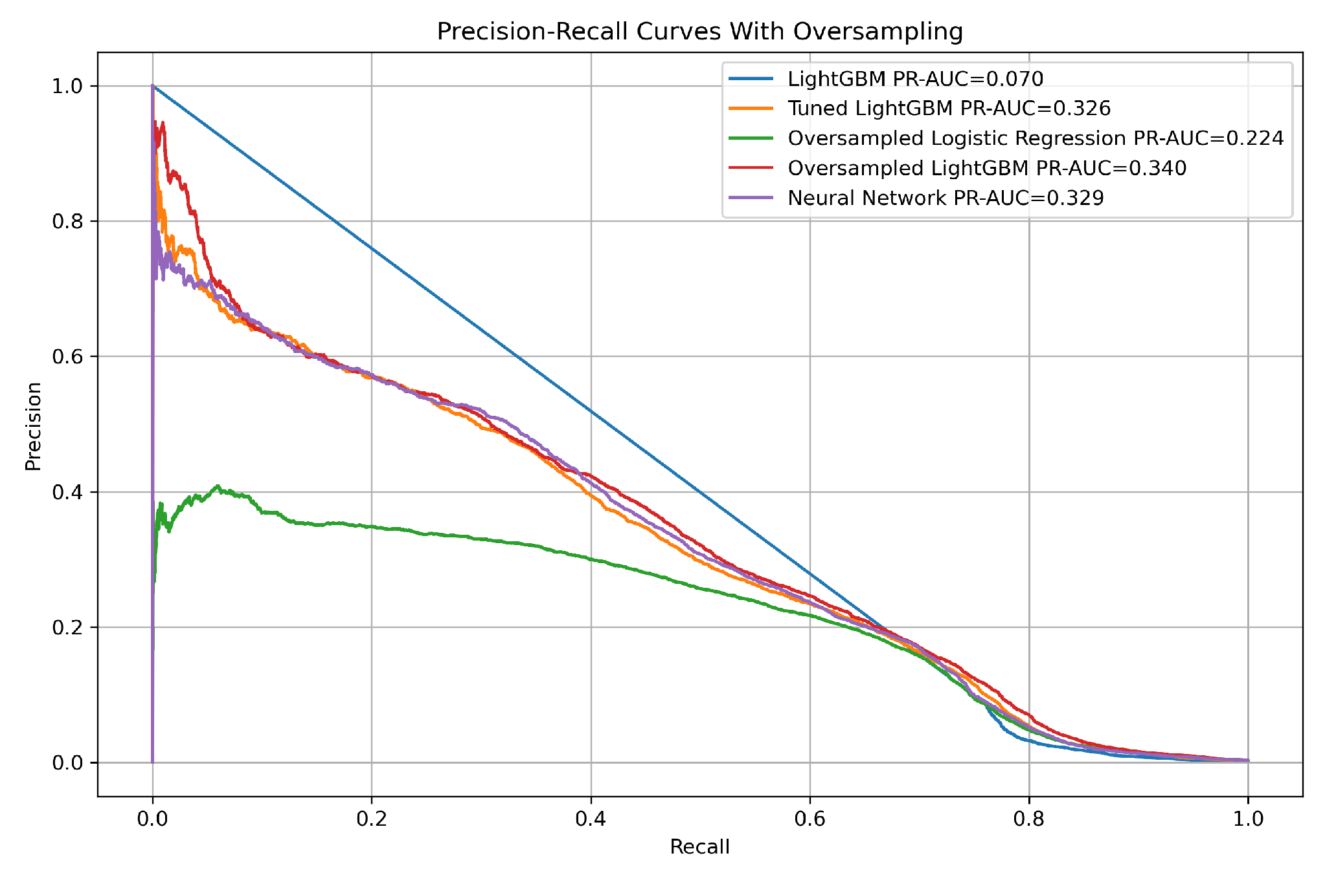
09 · IMBALANCE
10
Class Imbalance & Metric Selection
A model that simply predicts "never delinquent" for every loan scores 99% accurate and is useless. So I oversampled the rare positive class during training, and judged models on the precision–recall curve rather than accuracy.
Here ROC-AUC barely separates the models (all 0.90–0.95), because true negatives are so abundant. PR-AUC, measured against the ~1.3% base rate, is the honest yardstick for a rare-event problem.
0.30%
PR-AUC
POSITIVE BASE RATE
PRIMARY METRIC
FIG 01 Precision–recall curves on the held-out test set. Oversampled LightGBM leads on area under the curve; the no-skill floor sits near the 1.3% base rate.
MORTGAGE DELINQUENCY FORECASTING
10
Notes:
The main modeling challenge was class imbalance.
Only about 0.30% of the held-out test rows were positive, meaning the loan became seriously delinquent within six months.
That means a model could predict “not delinquent” for almost everyone and still have very high accuracy, but it would be useless for the actual business problem.
So I did not rely on accuracy.
Instead, I focused on precision, recall, and PR-AUC. PR-AUC is especially important for rare-event problems because it shows how well the model finds positives without being overwhelmed by false alarms.
The no-skill PR-AUC baseline should be close to the positive class rate, so here it is about 0.003, not 1.3%

Slide 11
10 · MODELS
11
Top Models Compared
MODEL
ROC-AUC
PR-AUC
RECALL
PRECISION
ROC-AUC clusters tightly between 0.90 and 0.95, so it can't tell these models apart. PR-AUC can: oversampled gradient-boosted trees pull clearly ahead.
Oversampled LightGBM FINAL
0.949
0.340
0.75
0.121
Tuned XGBoost
0.948
0.337
0.82
0.044
The neural network buys precision at the cost of catching only a quarter of defaults; the linear models do the reverse. Oversampled LightGBM strikes the best balance and trains fastest on data this size.
Neural Network
0.941
0.329
0.26
0.534
Oversampled Logistic Reg.
0.942
0.224
0.72
0.132
Logistic Regression
0.943
0.213
0.82
0.034
Metrics shown at the default 0.5 cutoff; the shipped operating point is tuned next.
Dummy (predict majority)
0.500
0.003
0.00
0.00
MORTGAGE DELINQUENCY FORECASTING
11
Notes:
I compared several model families, including logistic regression, XGBoost, neural networks, LightGBM, and a dummy baseline.
The final model was oversampled LightGBM.
ROC-AUC was high across the stronger models, but ROC-AUC can be misleading in rare-event problems because there are so many true negatives.
PR-AUC gave a better view of performance. Oversampled LightGBM had the best PR-AUC at 0.340, slightly ahead of tuned XGBoost.
The neural network had high precision, but its recall was too low for a recall-first early-warning use case.
The linear models caught many positives but had weaker precision-recall performance.
So LightGBM gave the best practical balance

Slide 12
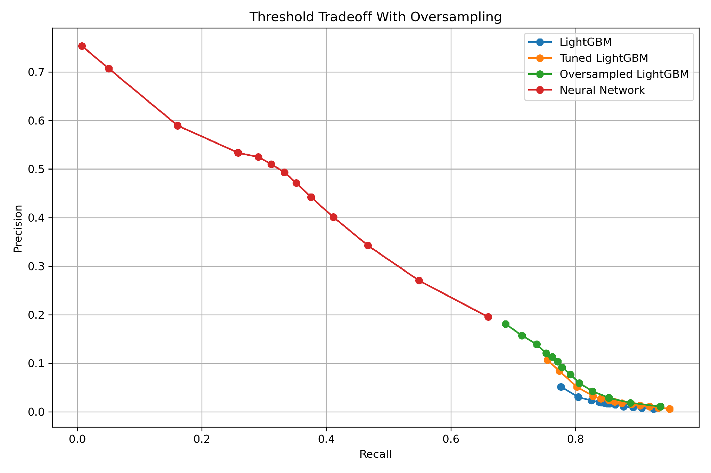
11 · THRESHOLD
12
Choosing Where to Draw the Line
The model outputs a probability; I choose the cutoff that turns it into a flag. Because the goal is to catch as many future-delinquent loans as possible, I pushed the threshold up to 0.70 , accepting more false alarms to hold recall near 0.71.
Even at that aggressive setting, the model flags under 1.4% of the book for review, keeping the queue small enough for a servicing team to actually work.
0.70
0.71
CHOSEN THRESHOLD
RECALL HELD
FIG 02 Precision against recall as the decision threshold sweeps. The recall-focused goal moves the operating point right, trading precision for coverage.
MORTGAGE DELINQUENCY FORECASTING
12
Notes:
The model outputs a probability, but the business needs a decision: flag the loan or do not flag it.
That means we need to choose a threshold.
The default 0.5 threshold is not always the best threshold, especially in an imbalanced classification problem.
Here, I chose a threshold of 0.70 because the goal was recall-first: catching a large share of future serious delinquencies while still keeping the review queue manageable.
At this threshold, recall was about 0.71, and the model flagged only about 1.36% of the book.
That makes the output more realistic as a servicing watchlist

Slide 13
12 · FINAL RESULTS
13
The Final Metrics
0.949
0.71
0.34
1.36%
ROC-AUC · HELD-OUT
RECALL
PR-AUC
FLAG RATE
5,272
28,255
TRUE POSITIVES · CAUGHT
FALSE POSITIVES · FALSE ALARMS
On 2.47 million loan-months it never saw in training, the model catches 71% of loans that go on to delinquency while flagging just 1.4% of the book. About one flagged loan in six is a true future default, more than ten times the 0.3% base rate.
2,113
2.43M
FALSE NEGATIVES · MISSED
TRUE NEGATIVES
MORTGAGE DELINQUENCY FORECASTING
13
Notes:
On the held-out test set, the final model reached a ROC-AUC of 0.949 and a PR-AUC of 0.340.
At the chosen threshold, it caught 5,272 true future serious delinquencies and missed 2,113.
It also produced 28,255 false positives and about 2.43 million true negatives.
The key practical result is that the model caught about 71% of future serious delinquencies while flagging only 1.36% of loan-months.
Because the base rate is only about 0.30% on the test set, the flagged group is much more concentrated with risk than the overall population.
That is the main value of the model: it turns a very large servicing book into a much smaller, higher-risk review queue

Slide 14
13 · DRIVERS
14
What Drives the Models
Borrower credit score
868
DTI ratio
558
Original UPB
504
The most-used features mirror the EDA story: creditworthiness at origination, leverage, loan size and how much principal is left, and the borrower's recent delinquency history.
Current UPB
459
Co-borrower credit score
442
Original interest rate
427
No single exotic feature carries the model. It's the familiar credit fundamentals, weighed together at scale and projected six months forward.
Original LTV
397
Original CLTV
393
Total principal paid
346
Months to maturity
253
MORTGAGE DELINQUENCY FORECASTING
14
Notes:
The strongest model drivers were familiar credit-risk variables.
Borrower credit score, DTI, original UPB, current UPB, co-borrower credit score, interest rate, LTV, CLTV, principal paid, and months to maturity all appeared near the top.
This is reassuring because the model is not relying on one strange or hard-to-explain variable.
It is mostly using standard credit fundamentals, loan balance behavior, and time context.
That makes the model easier to explain to a business audience and more credible as a risk-prioritization tool

Slide 15
END · THANK YOU
JUNE 2026
MORTGAGE RISK · FORECASTING
Thank you. Questions?
A recall-first delinquency model that turns 12.5 million monthly loan records into a short, workable watchlist, catching seven in ten future defaults, six months ahead.
AUTHOR
REPOSITORY
FINAL MODEL
Esh S. Chhura
github.com/eshchhura
Oversampled LightGBM · ROC-AUC 0.949

