Slide 1
The Potential of Affordance Wayfields
Emily Sheetz

Slide 2
Affordance Wayfields for Task and Motion Planning
Troy McMahon, Odest Chadwicke Jenkins, Nancy Amato

Slide 3
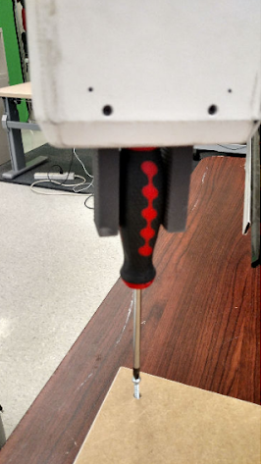
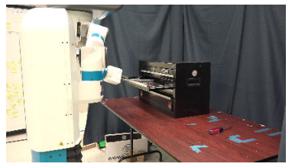
Object Affordances
Beyond pick-and-place
Action possibilities

Slide 4
Affordance Wayfields
Regions of configuration space
Objective functions mapped over configuration space

Slide 5
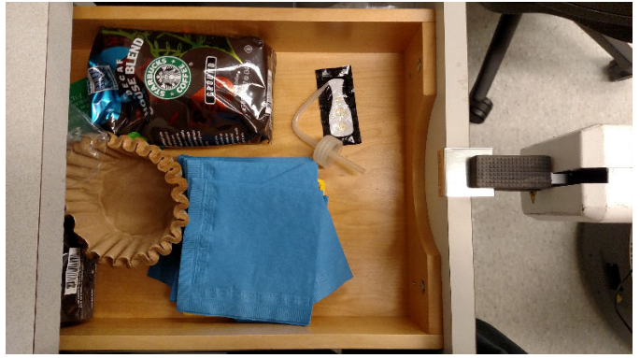
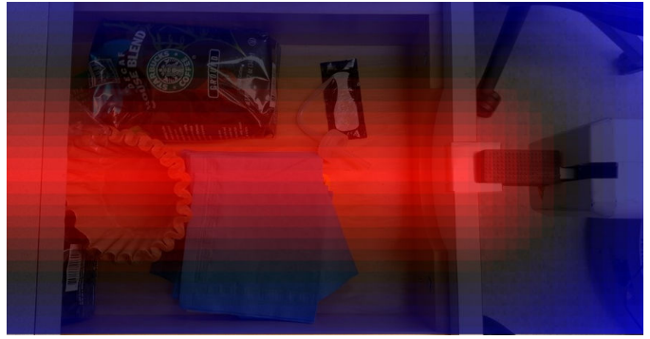

Slide 6

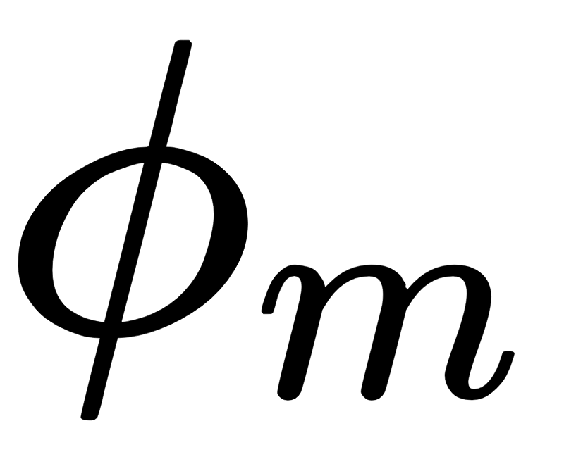

Screwdriver Task
Move along axis of motion
Move towards goal location
Move using screwing motion

Slide 7
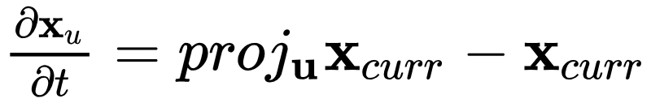
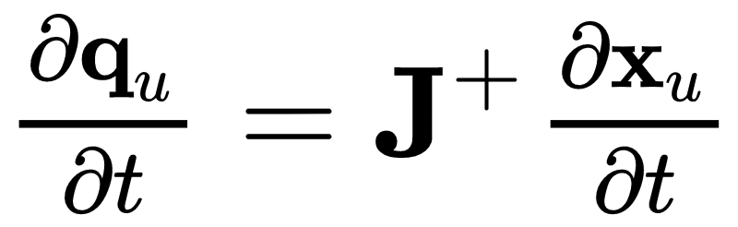
Axis Potential
Move along axis of motion

Slide 8
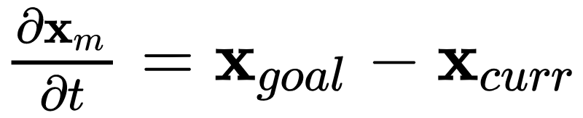
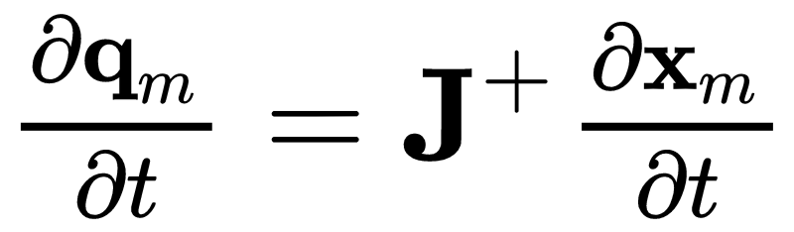
Motion Potential
Move towards goal location

Slide 9
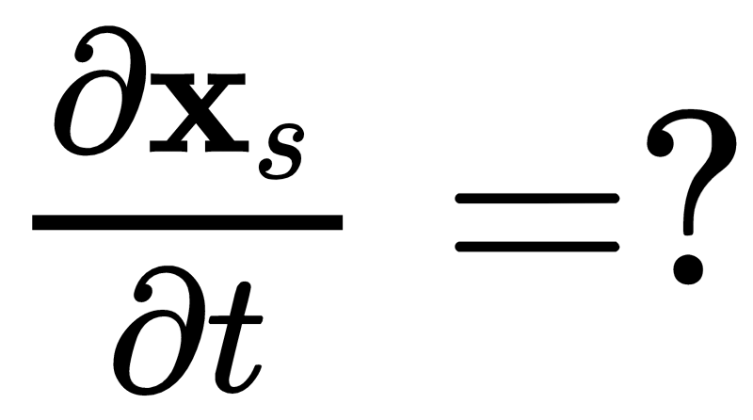
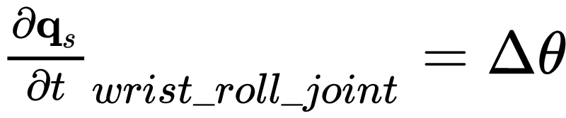
Screw Potential
Move using screwing motion

Slide 10

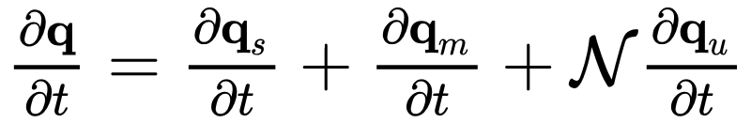
Screwdriver Task
Compose potentials
Compute total change in configuration

Slide 11
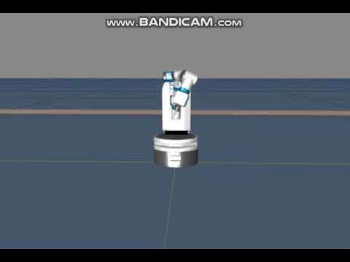

Slide 12
Drawer Task
Move along axis of motion
Move towards goal location

Slide 13

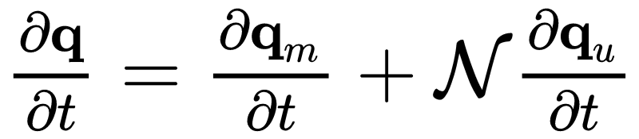
Drawer Task
Compose potentials
Compute total change in configuration

Slide 14
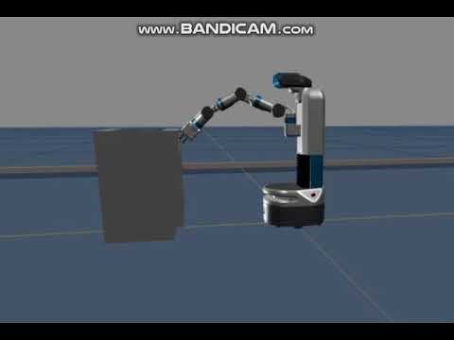

Slide 15
Conclusion
Affordance wayfields as potential functions
Importance of theoretical foundation

