Slide 1
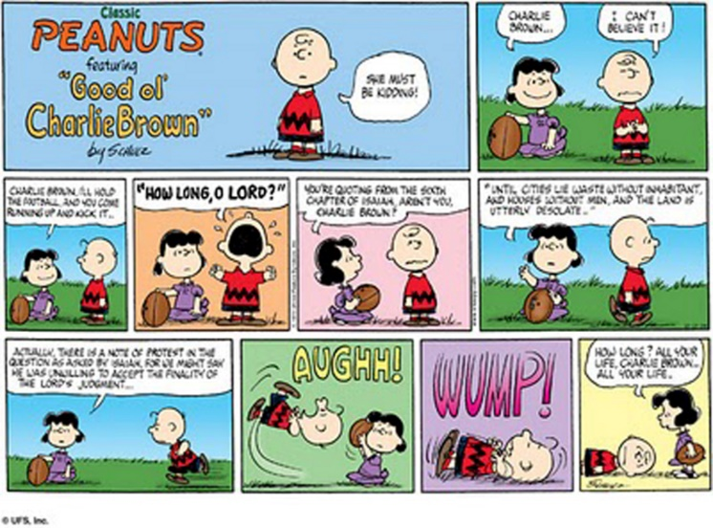
CS 118: Data Link Intro, Framing and Error Detection
George Varghese
October 2018

Slide 2

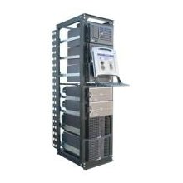
REVIEW: WHERE IS THE DATA LINK LAYER?
ROUGHLY, what happens when I click on a Web page from UCLA?
My computer
www.google.com
?
Internet

Slide 3

Web request (HTTP)
Turn click into HTTP request
GET http://www.google.com/ HTTP/1.1
Host: www.google.com
Connection:keep-alive
…

Slide 4

Name resolution (DNS)
Where is www.google.com?
My computer
(132.239.9.64)
Local DNS server
(132.239.51.18)
What’s the address for www.google.com
Oh, you can find it at 66.102.7.104

Slide 5
Data transport (TCP)
Break message into packets (TCP segments)
Should be delivered reliably & in-order
GET http://www.google.com HTTP/1.1
Host: www.google.com
Connection:keep-alive
…
3
google.c
2
p://www.
1
GET htt
“and let me know when they got there”

Slide 6
Network Layer: Global Network Addressing in IP
Address each packet so it can traverse network and arrive at host
My computer
(132.239.9.64)
www.google.com
(66.102.7.104)
Destination
Source
Data
66.102.7.104
132.239.9.64
1
GET htt

Slide 7
Network Routing in IP
Each router forwards packet towards destination
Sprint
UUNet
UCLA
www.google.com
(66.102.7.14)
Qwest
AT&T

Slide 8

Data Link scheduling (Ethernet)
Break message into frames (last lecture)
Check for errors (this lecture)
Media Access Control (MAC)
Can I send now? Can I send now?
3 lectures from now
Send frame
Receiver

Slide 9
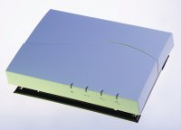
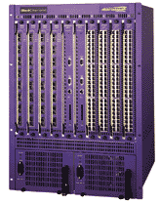
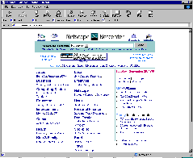
Physical layer (Lectures 3 -5)
802.11b Wireless
Access Point
2.4Ghz Radio
DS/FH Radio
(1-11Mbps)
Cat5 Cable (4 wires)
100Base TX Ethernet
100Mbps
Ethernet switch/router
To campus
backbone
62.5/125um 850nm MMF
1000BaseSX Ethernet
1 Gbps

Slide 10
PHYSICAL LAYER: SUBLAYERS
Input Stream Output Stream 01010000 01010000
Coding Sublayer
Decoding Sublayer
Coded Stream
Coded Stream
Media Transmission
Media Reception
Sublayer
Sublayer
Input Signal
Output Signal
Signal Transmission Sublayer
(SHANNON AND NYQUIST LIMITS)
3
SEMI RELIABLE 1 HOP BIT PIPE

Slide 11
Data Link Sublayers
Point−to−point Links (2 nodes)
(e.g., HDLC, Frame Relay)
Broadcast Links (>= 2 nodes)
(e.g., Ethernet, Token Ring)
Frames
Frames
ERROR RECOVERY
(OPTIONAL)
MULTIPLEXING
MEDIA ACCESS
ERROR DETECTION
ERROR DETECTION
FRAMING
FRAMING
Bits
Bits
QUASI-RELIABLE 1 HOP FRAME PIPE

Slide 12
Data Link Sublayers
Point−to−point Links (2 nodes)
(e.g., HDLC, Frame Relay)
Broadcast Links (>= 2 nodes)
(e.g., Ethernet, Token Ring)
Frames
Frames
ERROR RECOVERY
(OPTIONAL)
MULTIPLEXING
MEDIA ACCESS
ERROR DETECTION
ERROR DETECTION
FRAMING
FRAMING
Bits
Bits
QUASI-RELIABLE 1 HOP FRAME PIPE

Slide 13
Five functions of Data Link
Five functions:
Framing: breaking up a stream of bits into units called frames so that we can extra information like destination addresses and checksums to frames. (Required.)
Error detection: using extra redundant bits called checksums to detect whether any bit in the frame was received incorrectly. (Required).
Media Access: multiple senders. Need traffic control to decide who sends next. (Required for broadcast links).
Multiplexing: Allowing multiple clients to use Data Link. Need some info in frame header to identify client. (Optional)
Error Recovery: Go beyond error detection and take recovery action by retransmitting when frames are lost or corrupted. (Optional)

Slide 14
Why not do error recovery at each hop?
End-to-end argument: Need end-to-end or transport error recovery anyway. Can’t trust a series of hop-by-hop schemes because:
Crashes and other losses at intermediate nodes.
Transport must work over both reliable and unreliable links.
Thus hop-by-hop only a performance optimization
Extra cost (ack messages, buffering) not worth it when error rate is low.
Worth it (quicker recovery, less wasted resources) when error rate is high and the latency of end-to-end recovery is unacceptable (within a compute cluster or storage area network).

Slide 15
End to end vs hop by hop example
Source
Dest
R1
R2
R3
R4
Case 1: suppose no bit errors and messages are 100 bytes and acks 50 bytes. 50% overhead for hop by hop. Hop-by-hop worthless!
Case 2: Suppose half the packets are being dropped on last hop between R3 and R4. Then without hop by hop we would retransmit on all hops using only end to end (6n versus 2n) where n is number of packets Hop by hop worthwhile!

Slide 16

How can we breakup a series of bits from the physical layer into a series of frames?
Part 1: Framing

Slide 17
Why Framing
Without framing, the bit stream is reserved for one sender and one client per sender. Need frames to add multiplexing information like destination addresses and destination client names.
Frames offer a small, manageable unit for error recovery and error detection. Add checksums to frames for error detection and sequence numbers etc. for error recovery.

Slide 18
How Framing
Flags and Bit Stuffing: Use special bit patterns or flags to delimit (i.e., mark boundaries) frames. Need bit stuffing to “encode” the user data not to contain the flags. (e.g., HDLC)
Start Flags and Character Count: Use flags to indicate the start of data and a bit count to indicate end of frame. Bit stuffing not needed but less robust. (e.g., DDCMP)
Flags supplied by Physical Layer: Use special physical layer symbols to delimit frames.

Slide 19
Fixed-Length Frames
Easy to manage for receiver
Well understood buffering requirements
Introduces inefficiencies for variable length payloads
May waste space (padding) for small payloads
Larger payloads need to be fragmented across many frames
Very common inside switches/routers
Requires explicit design tradeoff
ATM uses 53-byte frames (cells)
Why 53? 48 + 5. Why 48?

Slide 20
Length-Based Framing
Start
Length
Payload
To avoid overhead, we’d like variable length frames
Each frame declares how long it is
E.g. DECNet DDCMP
What’s the issue with explicit length field?
Must correctly read the length field (bad if corrupted)
Need to decode while receiving
Still need to identify the beginning…

Slide 21
Sentinel-based Framing
Allow for variable length frames
Idea: mark start/end of frame with special “marker”
Byte pattern, bit pattern, signal pattern
But… must make sure marker doesn’t appear in data
Two solutions
Special non-data physical-layer symbol
Code efficiency (can’t use symbol for data)?
Stuffing
Dynamically remove marker bit patterns from data stream
Receiver “unstuffs” data stream to reconstruct original data

Slide 22
Stuffing Design by Sublayering
Frame
01111110
Frame
Stuffer
Destuffer
No flags in frame
011111010
Add Flags01111110
Remove Flags
to Phy
from Phy
01111110 011111010 01111110
Sublayering is a good design technique within layers as well!
What happens if input data contains 0111110. If receiver gets 111110?

Slide 23
Bit-level Stuffing
Avoid sentinel bit pattern in payload data
Commonly, sentinel is bit pattern 01111110 (0x7E)
Invented for SDLC/HDLC, now standard pattern
Sender: any time five ones appear in outgoing data, insert a zero, resulting in 0111110
Receiver: any time five ones appear, removes next zero
If there is no zero, there will either be six ones (sentinel) or
It declares an error condition!
Note bit pattern that cannot appear is 01111111 (0x7F)
What’s the worst case for efficiency?
011111100001110111011111011111001
011111010000111011101111100111110001

Slide 24
Correct Bit Stuffing
S | S | S | S | FLAG
false flag ?
Case 1
false flag ?
Case 2
false flag ?
Case 3
Case 1: Easy, or we would have added a stuffed bit
Case 2: Stuff after 0 followed by 5 1’s does not work! Counterexample?
Case 3: Flag = 01010101 and stuff a 1 after 1 after 010101 does not work!
011111 1111110
011111 01111110
false flag ?
Case 2

Slide 25
Byte Stuffing
Same as bit stuffing, except at byte (character) level
Generally have two different flags, STX and ETX
Found in PPP, DDCMP, BISYNC, etc.
Need to stuff if either appears in the payload
Prefix with another special character, DLE (data-link escape)
New problem: what if DLE appears in payload?
Stuff DLE with DLE!
Could be as bad as 50% efficient to send all DLEs
STX
HEADER
Payload
ETX
0x48
ETX
0x69
0x48
DLE
ETX
0x69

Slide 26
The cheating solution
Ask the Physical Layer for more symbols that are never used in data.
Easily possible in 4-5 coding as we have 16 data symbols but 32 possible encoded values
Even after ruling out 00000 and 111111 we still have 14 unused symbols.
Change interface to allow sending one of 16 data symbols (0000 to 1111) and special symbols for start of frame (SOF) and End of Frame (EOF)
Data Link
Data Link
0000 to 1111
0000 to 1111
and SOF, EOF
Physical
Physical
OLD INTERFACE
NEW INTERFACE

Slide 27
Useful Principles
Each layer or sublayer exacts its penalty: e.g., clock recovery coding, framing bits.
The end-to-end argument.
Lower Layers should not depend for correctness on assumptions about higher layers.
All layers have some common problems to solve: e.g., synchronization, multiplexing.
The best principles will/should be violated for pragmatic reasons.
Layering and Sublayering are a good way to understand and design new protocols.

Slide 28
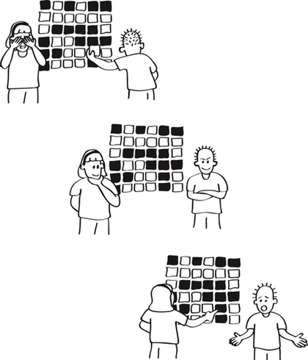
How can we add just 32 bits to a frame and detect almost any error with very high probability
Part 2: Error Detection

Slide 29
Goal: Quasi-reliability
The probability of a receiving Data Link passing up an incorrect frame to the client layer should be very, very small.
Undetected error say once in 20 years.
Needs to be so small because transport protocols do not insist on end-to-end checksums, a violation of end-to-end argument.
The probability of a receiving Data Link dropping frames sent by the sender should be small (once a day) to allow good performance.

Slide 30
Types of Errors
Random Errors. A noise spike or inter-symbol interference makes you think a 0 is a 1 or 1 to 0. Fiber: 1 in 10 ¹⁰
Burst errors: .A group of bits get corrupted because of synchronization or connector plugged in. Correlated!
Modeling Burst error: Burst error of length k → distance from first to last is k – 1. Intermediate may or may not be corrupted. Burst error of 5 starting at 50. Bits 50 ad 54 are corrupted, bits 51-53 may or may not be corrupted
Goal for quasi-reliability: Like to add checksums to detect as large a burst (say 32) and as many random (at least 3)
Comparison: Imagine a frame of size 1000 and an error rate of 1 in 1000. If random, all frames corrupted on average. If we get a burst of 1000 every 1000 frames, only 1 is lost!

Slide 31
Error Detection using Parity
Parity: ExOR of bits. Can detect all odd bit errors in a frame. Can’t detect 2 bit errors. 1011 sent as 10111.
Would like to do better than parity using so-called checksums for detecting larger number of errors (happens often). An idea called Hamming Distance explains why some codes detect and correct more bits.
Hamming Distance between two strings S and R is the number of bit positions they differ. Thus Hamming Distance of 11011 and 10111 is 2.

Slide 32
Error Detection as Coding
Computation View: add bits to the end of a frame for detecting errors. Parity adds 1, CRC adds 32
. Coding View: We take every packet P and encode it as a frame F = C(P) in any way you wish. One way is to add a checksum but there are other examples.
Triple Code: Imagine we encode every bit in P as 3 identical bits in F. 10 would encode as 111000.
Coding View after coding some codewords are valid and some are invalid. For example , in the Triple Code if we receive 101000 we know its an invalid codeword
So what? The coding view allows us to abstract across details of code and use Hamming distance.

Slide 33
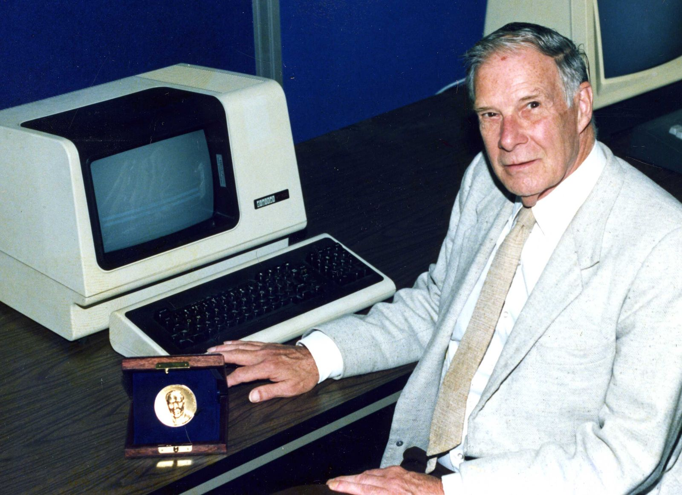
R.W. Hamming
At Bell Labs at first I sat with the mathematicians . . . then the physicists . . then the chemists
My own lesson: collect different points of view. Example: coordinate geometry turns geometry into algebra

Slide 34
Coding to Detection/Correction
Hamming Distance and Codes: Hamming distance is the smallest number of errors to convert a valid code word C to another valid code C’ causing a mistake.
Prediction: Use hamming distance to see how well a scheme can detect and even correct errors
Detection: code tells you some bit in frame has been corrupted, Response: drop frame and retransmit later
Correction: The code .tells you which bit is in error so you can correct it. Response: flip that bit
Question: Computer disks corrupt bits but use error correction while networks use detection. Why?

Slide 35
Hamming Distance, Detection, and Correction
Distance d
Can detect d random bit errors if Hamming distance is. d + 1 because flipping d bits cannot move from valid codeword (blue) to another.
Can correct d errors if Hamming distance is
2d + 1. Can draw a “ball” of radius d around each valid codeword C and assign invalid codewords within ball to C. Can also detect 2d errors with same code but cannot do both correction and detection at same time!
2 d + 1
d
d

Slide 36
Hamming Distance in action
Triple Code: Hamming distance is 3 and can either correct 1 (e.g., 110 -> 111) or can detect 2 errors but not both
Parity: Hamming Distance is 2 and can only detect 1 bit errors
Networks use only error detection: error correction too expensive. Parity cheap but inadequate,
CRCs: We now describe the form of error detection all networks use called CRC that can detect large burst errors (Its claim to fame) and many random errors.
Note: Hamming distance gives you no insight into burst error detection which is the real big deal for CRCs

Slide 37
Gentle Intro to Checksums
Telephone Exchange: Imagine you were sending you were reading a lot of numbers to a friend over a phone. 102, 205, 310 . . . At the end you also send the sum (617)
Error Detection: If the sum your friend receives is not the sum of the numbers she received, there is an error
Undetected errors: An error that corrupts two numbers so the sum works out. 101, 205, 310, 616
CRCs: Instead of being based on addition they are based on division! Also they work Mod 2. Simplest to start with ordinary division and ignore Mod 2.

Slide 38
ORDINARY DIVISION CHECKSUM
Consider message M and generator G to be binary integers.
Let r be number of bits in G. We find the remainder t of 2^{r}M when divided by G. Why not just M ? So that we can separate checksum from message at receiver by looking at last r bits.
Thus 2^{r}M = k.G + t. Thus:
2^{r}M + G − t = (k + 1)G. So we add a checksum c = G − t to the shifted message and the result should divide G.
Example: M = 110010 (50), r = 3, G = 7. After shifting 3 bits, we get 400. Remainder t = 1, checksum = 6. So we send 110010 110 which is divisible by 7 (406)
Has reasonable properties. However integer division hard to implement. Prefer to do without carries.

Slide 39
The Big Idea
In ordinary division checksums we transmitted a message plus checksum that was divisible by the generator G. Thus any errors that cause the resulting number to be not divisible by G (invalid codewords) will be detected.
In CRCs, we do the same thing except that we use Mod 2 arithmetic instead of ordinary arithmetic
Mod 2 arithmetic: addition and subtraction are XORs so there is no carry. Can implement at high speeds which we need in networks (Terabits)

Slide 40
MODULO 2 ARITHMETIC
No carries. Repeated addition does not result in multiplication. e.g. 1100 + 1100 = 0000;
1100 + 1100 + 1100 = 1100
Multiplication is normal except for no carries: e.g. 1001 ∗ 11 = 10010 + 1001 = 11011. Shift and Ex-or instead of Shift and Add as in normal arithemtic.
Similar algorithm to ordinary division. Again let r be number of bits in G. We find the remainder c of 2^{r−1}M when divided by G. Why only shift r − 1 bits this time?
Thus 2^{r−1}M = k.G + c. Thus 2^{r−1}M − c = k.G. Thus 2^{r−1}M + c = k.G (addition same as subtraction). Send c as checksum

Slide 41
Recall how ordinary division works
118
------------- 7344
62
---- 114
62
---
524
496
----
28
62
Can be viewed as repeated subtractions of multiples of 62 (i.e., 6200, 620, 496) until we get a number less than 62, which is the remainder.

Slide 42
How Mod 2 Division Works
Generator Shifted Message
1 | 1 | 1 | 1 1 | 0 | 0 | 0
 |  |  | 1 1 | 1
0 | 1 | 0
0 | 0 | 0
 | 1 | 0 | 0
 | 1 | 1 | 1
 | 0 | 1 | 1
For CRC, we need to repeatedly add (mod 2) multiples of the generator until we get a number that is r − 1 bits long that is the remainder.
The only way to reduce number of bits in Mod 2 arithmetic is to remove MSB by adding (mod 2) a number with a 1 in the same position.
While no more bits
If MSB = 1, XOR with generator (RED)
Shift out MSB and Shift in next bit (BLUE)

Slide 43
Implementing CRCs
Current Remainder
Message bits shifted in
Divisor
The current remainder is held in a register initialized with first r bits of the message.
If MSB of current remainder is 1, then EXOR current remainder with divisor; if the MSB is 0, do nothing.
Shift the current remainder 1 bit to the left and shift in next message bit.

Slide 44
CRC in Hardware: LFSR
R4
+
R3 R2
⁺ R1 R0 ⁺
Message Bits
Generator String = 1 1 0 1 0 1
Registers R0 through R4 are several single bit registers corresponding to the single multibit register in previous slide.
Ex-OR placed to right of register i if bit i set in generator.
When a message bit shifts in, all registers send (in parallel) their bit values to left, some through
Ex-OR gates. Combines left shift of an iteration with MSB check and Ex-OR of next iteration.
Ex-OR during left shift.
Avoids check for MSB: output of R4 as input to all Ex-ORs.
In practice to implement at Terabits we need to shift multiple bits per clock (say 8) cycle.
So CRCs can be implanted at high speeds. But what errors do they catch? Need a new viewpoint

Slide 45
CRC: Polynomial View
101 and 011 can be represented as X² + 1 and
X + 1. X^{i} term iff the i-th bit is 1.
Normal addition: X² + X + 2. No carries between powers. 2X is bad. Fix by using Mod 2 addition (EX-OR) to get: X² + X
Thousand bit message 1001 . . . . 11 becomes: X⁹⁹⁹ + X⁹⁹⁶ + . . . X + 1.
Can think of CRC computation as dividing a shifted message polynomial (multiplied by x^{r−1}) by CRC divisor polynomial and adding remainder.
Equivalent to arithmetic (bit) view, but polynomial view is easier to analyze.

Slide 46
Division with polynomials
Generator Shifted Message
X² + X + 1
X⁴ + X³
X⁴+ X³ + X²
X²
X²+ X + 1
X + 1
Same example with bit view (compare with 2 slides back): message is 110, checksum is 111, Shifted message is 11000 which is X⁴ + X³
Same high school algorithm to divide polynomials except subtraction is Mod 2 addition
Notice we get the same remainder 11.
Terrible to implement at Terabit speeds but nice to analyze types of errors one can catch

Slide 47
Errors in Polynomial View
Sender Channel Receiver
100001 → Flip bit 2 and 5 → 000101
Can model in polynomial view as
Sender Channel Receiver
X⁵+ 1 → Add X⁵+ X² → X² + 1
In other words, we model bit errors in positions i, j, and k etc. as the channel adding an error polynomial X^{i} + X^{j} + X^{k} + . . .
Since the message polynomial divides the generator the error will not be detected iff the error polynomial does not divide the generator.
Or in other words if one cannot multiply the generator by another polynomial to get the error polynomial. Undetected errors are bad news!

Slide 48
CRC PROPERTIES
CRC-16: X¹⁶ + X¹⁵ + X² + 1 = 11000000000000101
Error results in adding in a polynomial. Use normal polynomial multiplication intuition.
Single bit errors: result in addition of x^{i} say x¹⁰⁰⁰ If G(x) has at least two terms, any multiple of G(x) will have two terms. Multiplying CRC-16 by X¹⁰⁰ + X¹⁰ will have at least two terms: X¹¹⁶ + X¹⁰
Two bit errors correspond to adding x^{i} + x^{j}, which will not divide if G(x) does not divide x^{k} + 1 for sufficiently large k. Done by design. See notes
Odd bit error polynomials are never divisible by
x + 1. Why? If P(X) = (X + 1) R(X) then if we plug in 1, we get P(1) = 1 on LHS but 0 on RHS. So make G have x + 1 as a factor to detect odd bit errors.
But what makes CRCs shine are detecting burst errors as we will see next.

Slide 49
CRC AND BURSTS:
THE BIG DEAL
Consider a 1000 bit message with a 16 bit burst error starting in bit 900
The error polynomial could be something like:
X⁹⁰⁰ + X⁸⁹⁰ + . . X⁸⁸⁵
Factoring we get:
X⁸⁸⁵ (X¹⁵ + X⁵+ . .1)
But X¹⁵ + X⁵+ . .1 cannot divide CRC-16 which is
: X¹⁶ + X¹⁵ + X² + 1. Thus CRC-16 can catch any 16 bit or smaller burst
In general, burst errors of length k adds x^{i}(x^{k−1} + ..1). Can catch if k ≤ generator degree.Any multiple of generator will have a term of x^{k} or higher
So CRC-32 can catch any 32 bit burst error for sure but we will see in HW that it will only miss larger burst errors with very small probability: 1/ 2³²

Slide 50
Lessons from Framing and CRCs
End-to-end argument.
Sublayering is a powerful tool: bit stuffing implementation, error recovery on top of framing. Sublayers extract their penalty
Common problems at layers and exploiting solutions at other layers: coding, bit and frame synchronization, getting extra symbols from physical layer.
Arguing by Analogy: ordinary division and CRC. Helps when trying to do CRC multiple bits at a time.
General and abstract approaches help: error detection in terms of coding.
Having Multiple Views: Bit string view for CRC computation and polynomial view for analysis.

