Slide 1



CS118: Lecture 2, Networking Overview, Take 2
George Varghese
WORLDWIDE
INTERNET

Slide 2
Lecture Outline
Prize Question on Layering
Hourglass model
Overview of email transfer
Begin Physical Layer

Slide 3
PRIZE QUESTION 1
How can we detect congestion at network level and send it to TCP at the sender without violating strict layering

Slide 4
PROBLEM BEING SOLVED
Communications is complicated
Modulation and encoding bits
Splitting sequences of bits into packets
Routing
Recovering from lost messages etc….
Really hard to think about all of this and get it right
Not all applications need all of it
How to achieve interoperability?

Slide 5
LAYERING IS MODULAR DESIGN
Sub-divide the problem
Each layer relies on services from layer below
Each layer exports services to layer above
Interface between layers defines interaction
Hides implementation details (encapsulation)
Layers can change without disturbing other layers (modularity)
Interface among peers in a layer is a protocol
If peers speak same protocol, they can interoperate

Slide 6
KEY DESIGN DECISION IN IP
How do you divide functionality across the layers?
End-to-end argument [Saltzer84]
Functionality should be implemented at a lower layer iff it can be correctly and completely implemented there. Incomplete versions of a function can be used as a performance enhancement, but not for correctness
Early, and still relevant, example
ARPAnet provided reliable link transfers
Was this enough for reliable communication?
No, packets could still get corrupted on host-switch link, or inside of the switches
Hence, still need reliability at higher layers (TCP)

Slide 7
TCP SUCCESSFUL > 40 years
FTP
HTTP
Video
Applications
TCP
UDP
Transport
IP
“Thin Waist”
Fiber
Network
Cable
Data Link
Wireless
Physical
Innovation? Science?
The Hourglass Model
Q: Why was TCP/IP successful?
A: IP addressing (Lecture 12)
Socket interface (Lecture 17)
Notes:
Is networking merely plumbing? What can possibly be cool about plumbing compared to deep learning and computation ecology? What is left to do after 40 years of Internet design besides mere engineering and tinkering? Where is the innovation? Where is the science

Slide 8
MAIL FROM ASKEW TO MARIA
mail chuck@maria
Hi!
ASKEW
MARIA
IP
ROUTER
The setting and the characters in the play

Slide 9
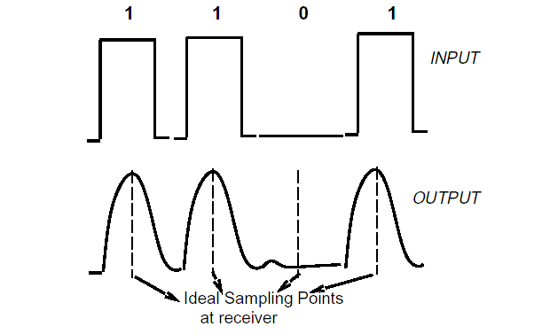
Sending Bits
We can send bits as energy at the sender and we recover bits by sampling at receiver
Q: How do we where to sample?
A: Clock recovery (Lecture 4)

Slide 10
Framing Bits
We need to group bits into frames to attach headers. Easy on Ethernet
Energy
No Energy
No Energy
Q: How do we do it only with bits?
A: Bit Stuffing (Lecture 6)

Slide 11
SYNCHRONIZING SENDERS
(on the old Ethernet)
askew
jim
sally
D1
D2
Boom!
Jim
Backs off
router
askew Wins
D2
Q: How do we detect collisions/backoff?
A: Multi-access LANs (Lecture 9)

Slide 12
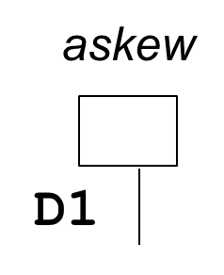
IP AND ETHERNET ADDRESSES
128.21.7.8
128.20.16.13
maria
D3
D4
Network 128.21.*
Network 128.20.*
128.21.8.2
128.21.11.4
IP ROUTER
Q: Why two different addresses?
A: UIDs vs Hierarchy (Lecture 12)

Slide 13
FORWARDING, ADDRESS RESOLUTION
R1
ASKEW
R2 ROUTER
R3
D2
D3
MARIA
D1
D4
Whois R2?
R2 is D2
Remember R2 is D2
D2 R3 TH MH Hi
Who is R3?
Remember
R3 is D4
D4 R3 TH MH Hi
Q: How to avoid a table of all IP addresses
A: Prefix Lookups (Lecture 13)

Slide 14
TRANSPORT (TCP) CONNECTIONS
Local Extension
socket
Well−known Extensions
ASKEW
TCP PROGRAM
MARIA
TCP PROGRAM
NETWORK
Q: Are there other IPC abstractions
A: Yes, say RPC (Lecture 17)
11

Slide 15
TRANSPORT (TCP) CONNECTIONS
ASKEW
TCP PROGRAM
MARIA
TCP PROGRAM
Local Extension x
Mail Extension ?
Connected ME,x
ME,x,Data,Seq 1
ME,x,Ack,Seq 1
Shut Down ME,x
OK
Q: Why a 3 way handshake to start?
A: Delayed Duplicates (Lecture 18)
12

Slide 16
MAIL PROTOCOL IN ACTION
ASKEW MAIL PROGRAM
MARIA MAIL PROGRAM
Let’s boogie
OK
Deliver to "Chuck" OK
Text is "Hi"
OK
Gotta run
OK
Q: What happens if one end crashes
A: Need application state (not in course)
13

