Slide 1
CS118: Lectures 3-4, Physical Layer
George Varghese
Oct 2019

Slide 2
Prize Question 2 Solution
TCP Set Bit IP
TCP
IP
IP Set Bit TCP

Slide 3
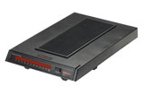
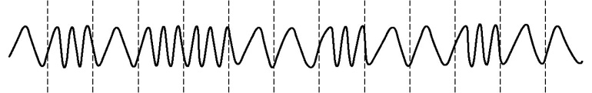
The Foundation: Sending Bits
A three-step process
Take an input stream of bits (digital data)
Modulate some physical media to send data (analog)
Demodulate the signal to retrieve bits (digital again)
Anybody heard of a modem (Modulator-demodulator)?
digital data (a string of symbols)
digital data (a string of symbols)
modulation
demodulation
a signal
0101100100100
0101100100100

Slide 4
What does the Physical Layer Do?
RECEIVER 1
bits
RECEIVER 1
SENDER
PHYSICAL LAYER
RECEIVER 1
A possibly faulty, single-hop, bit pipe that connects a sender to possibly multiple receivers
1

Slide 5
Morse Code Analogy
Example bit pipe: sending Morse Code to receivers using a flashlight. Issues:
Fundamental Limits: Brain-eye system processing limits leads to Inter Symbol Interference
Media Issues: Flashlight, semaphore
Coding: Morse code, getting in synch, knowing receiver rate.
2

Slide 6
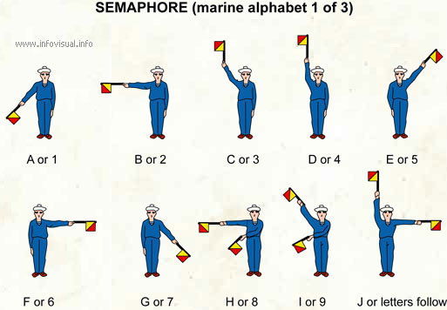
Signaling with Semaphores

Slide 7
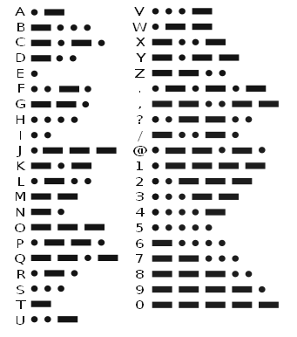
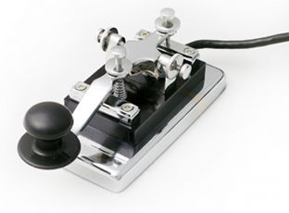
Morse Code Transmission

Slide 8
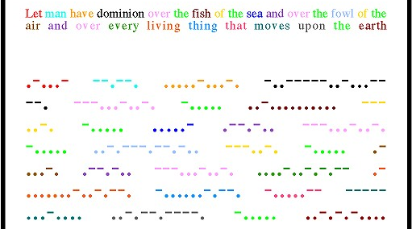
Morse Code Message

Slide 9
PHYSICAL LAYER: SUBLAYERS
Input Stream Output Stream 01010000 01010000
Coding Sublayer
Decoding Sublayer
Coded Stream
Coded Stream
Media Transmission
Media Reception
Sublayer
Sublayer
Input Signal
Output Signal
Signal Transmission Sublayer
(SHANNON AND NYQUIST LIMITS)
3

Slide 10
Why understand the Physical Layer in Sublayers?
The bottom sublayer is really describing the essential properties of the media (frequency response, bit error rate). These influence data transmission rates (Nyqvuist, Shannon limits). This lecture.
The middle sublayer describes properties of particular media — e.g.. satellites, coaxial cable, fibre.
The top sublayer is about things like clock recovery, synchronization etc.
Sublayers can be studied independently. Separate concerns. Each sublayer exacts its price!
4

Slide 11
1.0 Bottom Sublayer: Signal Transmission and Limits
How fast can you send and what prevents you from sending faster?
5

Slide 12
Sending bits to a receiver
Goal: to send a sequence of 0’s and 1’s from a sender to a receiver by sending energy (e.g., light, electricity) over a channel (e.g., fiber, cable). One coding: 0 = no energy, 1 = energy.
Problem: Real channels distort input energy signals. Leads to two questions.
Q1: How can we predict what a given channel will do to an input signal given some properties of the channel. Answer: Fourier Analysis.
Q2: How does distortion affect maximum bit rate? Answer: Nyqvuist (sluggishness) and Shannon (noise) limits.
6

Slide 13
Signals, and channels
Amplitude
2V
1.5V
1V
Time
Continuous
Time
Discrete
Period
Time
Periodic
Signal: energy (e.g., voltage, light) that varies with time. Continuous and Discrete. Periodic. Period and frequency.
Channel: physical medium that conveys energy from a sender to a receiver (e.g., a fiber link) with possible distortion.
7

Slide 14
Sine Waves
Amplitude
0
1.5 V
90
180
360
Time
1 msec
Sine waves are special because all signals can be rewritten in terms of sine waves.
Mathematically: A sin(2πft + θ), A is max value,
f is frequency, is initial phase shift
Example: Frequency 1 Hz, θ = 0. Values at t = 0 and t = 1/4. Use calculator but express angle in radians!
8

Slide 15
Fourier Analysis: the big picture
If we forget about noise, most channels are “nice” to sine waves. A sine wave of frequency f is always scaled by a fixed factor s(f ) and phase shifted by a fixed amount p(f ) regardless of amplitude.
Thus we can completely describe a channel by plotting the values of s(f ) (frequency response) and p(f ) (phase response) for all values of frequency f .
To find what happens to arbitrary signal S, we i)Use Fourier Analysis to rewrite S as a sum of sine waves of diff frequencies ii) Use frequency and phase response to see effect of each sine wave iii) Add scaled sine waves to find output signal.
9

Slide 16
Frequency and Phase Response Examples
Scaling Factor _{FREQUENCY} RESPONSE
 |  | Frequency (Hz)
2
200 Hz
1200 Hz
Phase Shift
PHASE RESPONSE
180
90
Frequency
(Hz)
100 200 Hz
Bandwidth: range of frequecies for which channel passes signal through. Not very precise.

Slide 17
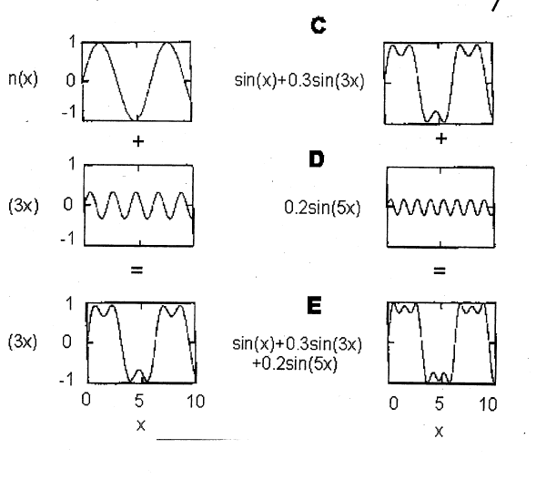
More bandwidth, more fidelity

Slide 18
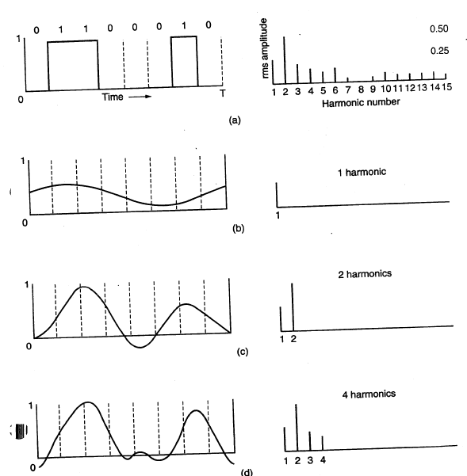
More fidelity, better recovery of bits

Slide 19
Sluggishness and Noise
Most channels are sluggish (they take time to respond) because they turn a deaf hear to higher frequencies in the input signal. Thus lower bandwidth channels are more sluggish.
What about noise? Different models for different channels. Simplest and common model: white noise (uniformly distributed at all frequencies and normally distributed within a frequency)

Slide 20
Sampling Bits
1 0
1
1
INPUT
OUTPUT
Ideal Sampling Points at receiver
Receivers recover the bits in the input signal by sampling output signal close to middle of bit period.
Two limits to bit rate: channel bandwidth (Nyquist) and noise (Shannon).

Slide 21
Frequency →
1/T
Sender
Receiver
By Fourier
Analysis
INPUT BIT
OUTPUT BIT (SINC)
T
Time →

Slide 22
INPUT BIT
OUTPUT BIT
T
So how fast can we send next (blue, green) bit without
Intersymbol-interference?
Sending every T clearly works

Slide 23
INPUT BIT
OUTPUT BIT
T
But Nyquist noticed that sending
Every T/2 also works because
peak of current lines up with
zeroes of past bits for sinc
Since bandwidth = 1/T, max bit
Rate = 2/T = 2 * bandwidth

Slide 24
6V
OUTPUT = 11
T
4V
OUTPUT = 10
T
2V
OUTPUT = 01
T
But we can play with the y-axis
(amplitude) to send more bits

Slide 25
Baud Rate and Bit Rate
To prevent ISI, we cannot send “symbols” faster than 2B times per second. Nyquist rate is max rate of sending symbols not bits (baud rate)
But as we saw each symbol in a signal can carry multiple bits. For example: 0, 2, 4 and 6 V . 4 possible values and 2 bits per symbol.
With L signal levels, bit rate is log L times baud rate.
So why can’t we transmit at terabits over a phone line? Noise will make one output level look like a nearby one.

Slide 26
6V
OUTPUT = 11
Noise can pull down
T
Noise can pull up
4V
OUTPUT = 10
T
How much noise can we tolerate?

Slide 27
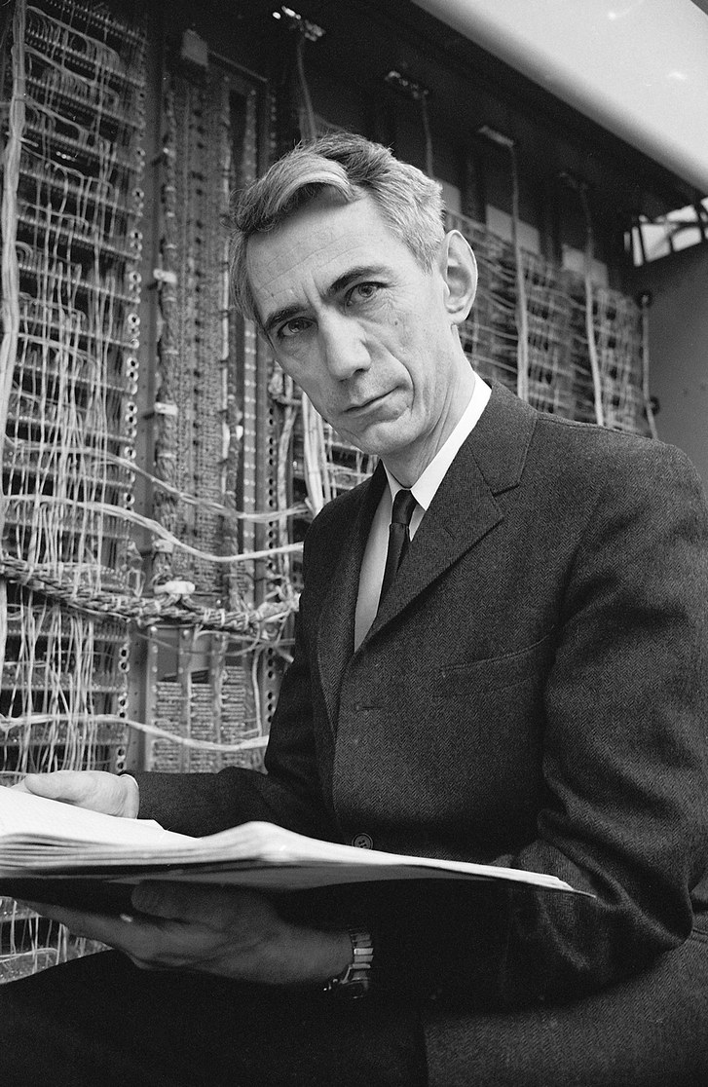
The Man: Claude Shannon

Slide 28
THE SHANNON BOUND
0
N N
1
S
2
3
S = Maximum Signal Amplitude
N = Maximum Noise Amplitude
log(S/2N) bits per signal
2 B signals/sec (Nyquist)
Naive Bound = 2 B log(S/2N)
Shannon Bound = B log(1 + S/2N)

Slide 29
More on Shannon Bound
The real Shannon bound does not have the factor of 2 and has an extra 1 added
This is because our simple model was only for a simple coding and for fixed deterministic noise
Shannon bound works for any coding scheme (frequency, phase modulation) and for Gaussian additive noise. Needs a deep probabilistic argument
. Telephone line (not DSL) with SNR of 30dB bandwidth 3kHz, we get a maximum data ratte of 30 kbps.
.

Slide 30
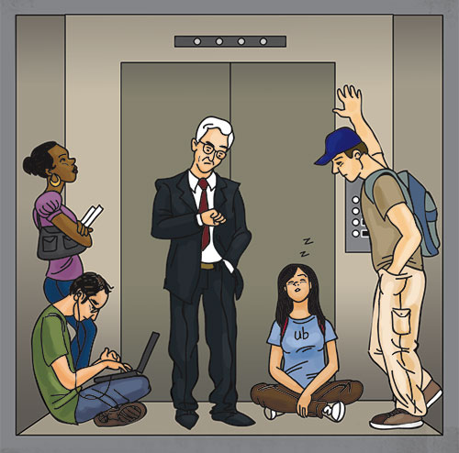
PRIZE QUESTION 3
SLOW ELEVATOR PROBLEM: HOW TO DEAL WITH PROBLEM MORE CHEAPLY THAN BUYING A NEW ELEVATOR

Slide 31
2.0 Top Sublayer: Clock Recovery
How does a receiver know when to sample bits and how can the sender help?

Slide 32
Who needs a clock anyway?
 |  |  | 1 | 1 | 1 | 1
0 | 0 | 0
0 0
 |  | 1 | 1
0 | 0
0
How to initially synchronize receiver clock with sender clock? Initial Training Bits
Problem: All real physical clocks drift over time. Crucial at high speeds. Small drift leads to sampling error. How to keep in synch? Transitions

Slide 33
Transitions and Coding
Parse: nohewontgosoon. Need spaces and punctutations to parse speech.
Stream of bits without transitions (change in signal value) equally hard to parse.
Real data may contain all 0’s. How can you ensure transitions. Coding. Adds cost.
Code to ensure that every n bits you get at least m transitions. Different coding schemes parameterized by n and m.

Slide 34
PHYSICAL LAYER: SUBLAYERS
Input Stream Output Stream 01010000 01010000
Coding Sublayer
Decoding Sublayer
THIS LECTURE
Coded Stream
Coded Stream
Media Transmission
Media Reception
Sublayer
Sublayer
Input Signal
NEXT LECTURE
Output Signal
Signal Transmission Sublayer
(SHANNON AND NYQUIST LIMITS)
LAST LECTURE
3

Slide 35
Asynchronous Coding
START BIT
5−8 DATA BITS
PLUS PARITY
1−2 STOP BITS
IDEAL SAMPLING POINTS
Codes a character (5-7) bits at a time. ASCII. Adds parity bit.
Character is framed using a start bit and one or two stop bits. 1 is encoded as lowe voltage, 0 as high.

Slide 36
PRIZE QUESTION 4
SLOW CLOCK PROBLEM: HOW MUCH SLOWER CAN THE RECEIVER CLOCK BE WITHOUT CAUSING BIT ERRORS

Slide 37
"SYNCHRONOUS" TRANSMISSION
Upto 12000 Bits
Lots of Start Bits (Preamble)
Lots of Stop Bits (Postamble)
same as asynchronous except
larger frame sizes . It requires better clock tolerance and more sophisticated coding.

Slide 38
Why Synchronous Transmission
For Clock Recovery, receiver must know when to start its receive clock (phase). Then can sample the line at periodic intervals at the same rate as sender clock with some help from transitions in data.
In asynchronous, receiver gets locked in phase when the voltage goes from low to high (start bit). Need to have fairly large idle time between characters for receiver to get locked in phase for each character; slows transmission and limits it to low rates.
Two overheads to start bits: extra bit but also extra time needed for reliable detection. (Starting up receiver clock is expensive)
In synchronous, we put a large number of start bits at the start of a large number of data bits. This allows the startup overhead to be amortized.

Slide 39
Manchester Encoding
Signal to Data
High to low transition ⇨ 1
Low to high transition ⇨ 0
Comments
Solves clock recovery problem
Only 50% efficient ( ½ bit per transition)
Still need preamble (typically 0101010101… trailing 11 in Ethernet)
Bits
0
0
1
0
1
1
1
1
0
1
0
0
0
0
1
0
NRZ
Clock
Manchester

Slide 40
Getting locked in phase
S1
S2
Time
In asynchronous you get in phase by a single 0 to 1 transition. Not very reliable in the presence of noise.
In Manchester, you get in phase by sending a preamble or group of start bits of the form 010101 in which the only transitions are at mid bit; easy to recognize and get locked in phase.

Slide 41
Phase Locked Loops
RECEIVER SAMPLING CLOCK
OBSERVED TRANSITIONS IN DATA
Once you lock in at the start of a data unit, you can rely on accuracy of receiver clock frequency (as in asynchronous). Can’t do that if data unit is large (as in synchronous).
Could try resetting receiver clock on every observed transition. Susceptible to noise. Better to use more gradual adjustment.
Phase Locked Loops measure phase difference and speed up or slow down receiver clock to reduce phase difference. Commonly used.

Slide 42
Eye Patterns
0 1 0 1 0 1
0 1 0 1 0 1
Superpose to get
eye pattern
In a perfect system, we will have a well-defined eye. Should sample at center of eye. Nice visual test of line quality.

Slide 43
What makes a code good?
0
1
0
0
1.5
NRZL
−1.5
1.5
Manchester
−1.5
Time
Evaluation Criteria
Coding Efficiency(Real Bits/Coded Bits) Signal to Noise Ratio
DC Balance Implementation Complexity

Slide 44
Broadband Coding
(So far) Baseband Coding using energy levels such as voltage or light. In broadband coding information is modulated on a carrier wave of a certain frequency. Used by modems.
Modulation refers to changing the properties of the carrier to convey the required information.
Frequency Shift Keying (FSK): high frequency encodes a 1 and low a 0, Amplitude Shift Keying (ASK): high amplitude encodes a 1. QAM (multiple amplitudes and phases)

Slide 45
Clarifications from Students
Edge Detector: A hardware gadget used to tell whether a 0 goes to a 1 or a 1 to a zero that we abstract as a function to tell where a transition is
Why 11 in Manchester: Because the receiver gets locked in after a variable number of preamble bits and so counting does not work, need a pattern in data
Eye Pattern: A way to superimpose arbitrary bit sequences on screen as opposed to sending them in parallel

Slide 46
Baseband versus Broadband
Baseband modulation: send the “bare” signal
E.g. +5 Volts for 1, -5 Volts for 0
All signals fall in the same frequency range
Broadband modulation
Use the signal to modulate a high frequency signal (carrier).
Can be viewed as the product of the two signals
Amplitude
Amplitude
Signal
Carrier
Frequency
Modulated
Carrier

Slide 47
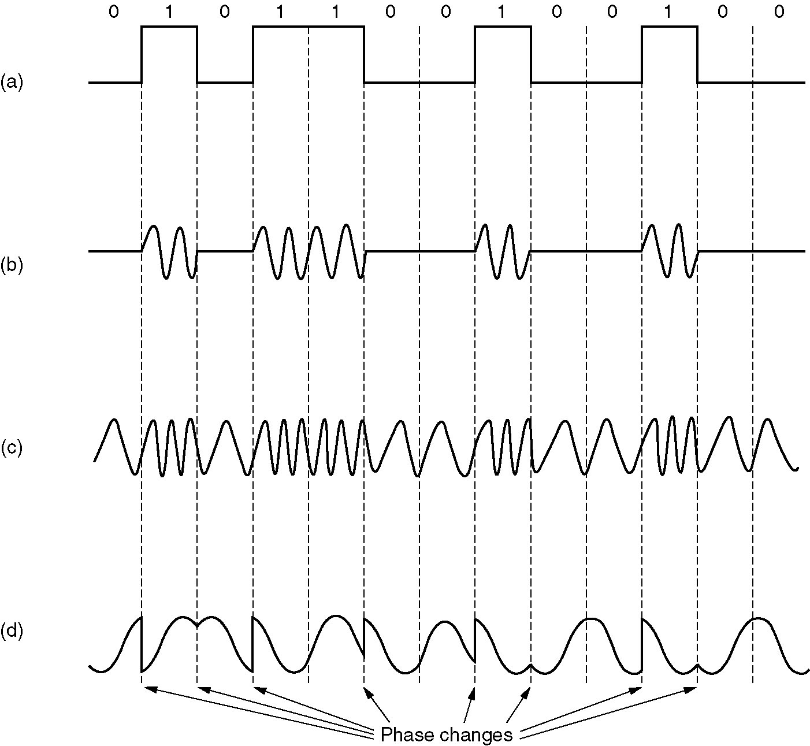
Digital Modulation Methods (from Tanenbaum)
Input Signal
Amplitude Shift Keying
(ASK)
Frequency Shift Keying
(FSK)
Phase Shift Keying
(PSK)

Slide 48
Three Levers for Modulation
FDMA
power
frequency
TDMA
time
power
frequency
CDMA
time
power
time
frequency
Courtesy Takashi Inoue

Slide 49
MULTIPLEXING (SHARING)
S1
S1
S2
S1 S2 S1 S2 . . .
S2
TIME DIVISION MULTIPLEXING (TDM)
S1
S1
S2
S2
FREQUENCY DIVISION MULTIPLEXING (FDM)
and Wavelength division multiplexing for fiber

