Slide 1
CS118: Lecture 5, Physical Layer
George Varghese
October 2018

Slide 2
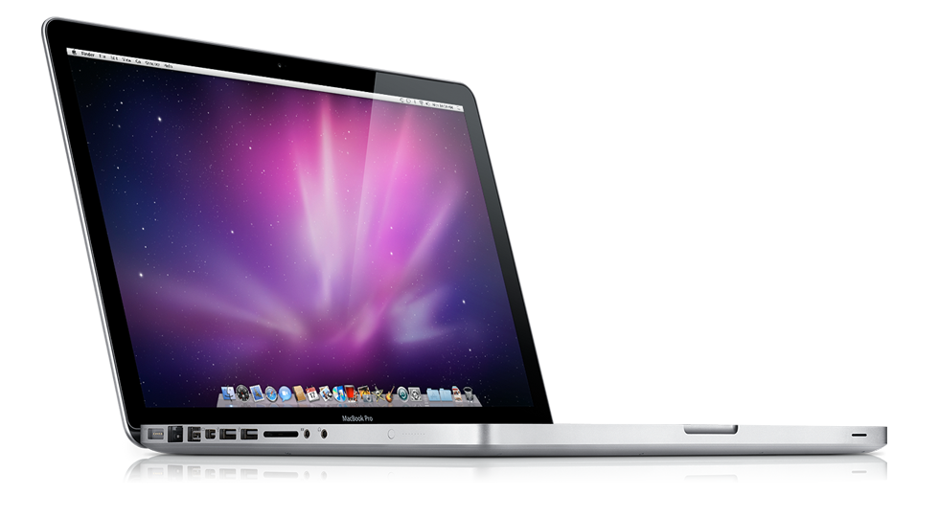
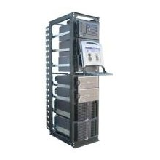
REVIEW: WHERE IS THE PHYSICAL LAYER?
ROUGHLY, what happens when I click on a Web page from UCLA?
My computer
www.google.com
?
Internet

Slide 3
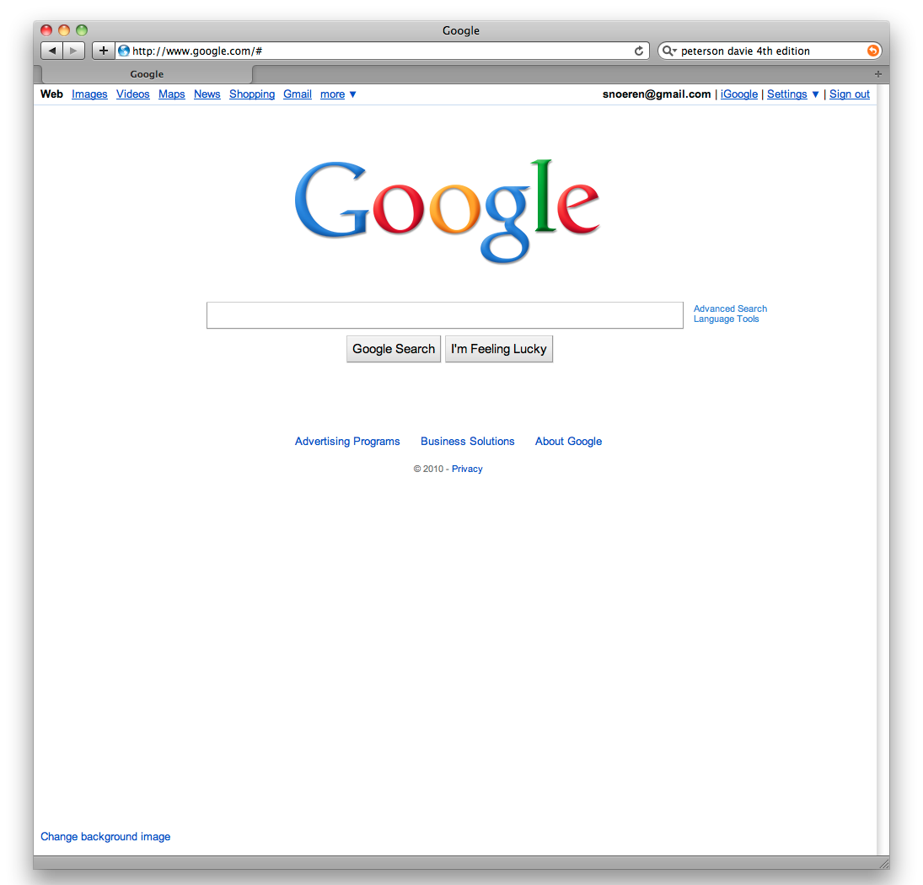
Web request (HTTP)
Turn click into HTTP request
GET http://www.google.com/ HTTP/1.1
Host: www.google.com
Connection:keep-alive
…

Slide 4

Name resolution (DNS)
Where is www.google.com?
My computer
(132.239.9.64)
Local DNS server
(132.239.51.18)
What’s the address for www.google.com
Oh, you can find it at 66.102.7.104

Slide 5
Data transport (TCP)
Break message into packets (TCP segments)
Should be delivered reliably & in-order
GET http://www.google.com HTTP/1.1
Host: www.google.com
Connection:keep-alive
…
3
google.c
2
p://www.
1
GET htt
“and let me know when they got there”

Slide 6
Network Layer: Global Network Addressing in IP
Address each packet so it can traverse network and arrive at host
My computer
(132.239.9.64)
www.google.com
(66.102.7.104)
Destination
Source
Data
66.102.7.104
132.239.9.64
1
GET htt

Slide 7
Network Routing in IP
Each router forwards packet towards destination
Sprint
UUNet
UCLA
www.google.com
(66.102.7.14)
Qwest
AT&T

Slide 8

Data Link scheduling (Ethernet)
Break message into frames
Media Access Control (MAC)
Can I send now? Can I send now?
Send frame
Receiver

Slide 9
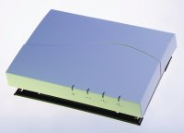
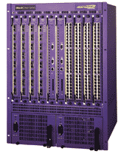
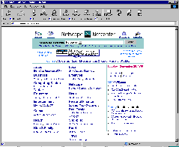
Physical layer
802.11b Wireless
Access Point
2.4Ghz Radio
DS/FH Radio
(1-11Mbps)
Cat5 Cable (4 wires)
100Base TX Ethernet
100Mbps
Ethernet switch/router
To campus
backbone
62.5/125um 850nm MMF
1000BaseSX Ethernet
1000Mbps

Slide 10
PHYSICAL LAYER: SUBLAYERS
Input Stream Output Stream 01010000 01010000
Coding Sublayer
Decoding Sublayer
Coded Stream
Coded Stream
Media Transmission
Media Reception
Sublayer
Sublayer
Input Signal
Output Signal
Signal Transmission Sublayer
(SHANNON AND NYQUIST LIMITS)
3

Slide 11
Why Study Media
Media affects Protocol Design
Reinforced Concrete to Skyscapers
We need to understand media tradeoffs when architecting networks
Think of flashlights versus semaphores

Slide 12
Media Affects Protocols
Low Bandwidth led to tight encoding:
Early Phone lines, not needed on LANs
Broadcast LANs led to use of Multicast:
Initialization and free copies, to IP multicast.
Building wiring led to Switching: Wiring closets to hubs to ATM switches.
Fiber led to rings: Point-to-point fibers lead to rings.
Fiber led to Digital: Long haul telephone network becomes digital.
Wireless leads to low bandwidths again:
Laptops. Need Ipv6 compression on wireless links!

Slide 13
Wireless
Widely varying channel bandwidths/distances
Extremely vulnerable to noise and interference
AM
FM
Twisted
Pair
Coax
Microwave
TV
Satellite
Fiber
Freq (Hz)
10⁴
10⁶
10⁸
10¹⁰
10¹²
10¹⁴
Radio
Microwave
IR
Light
UV

Slide 14
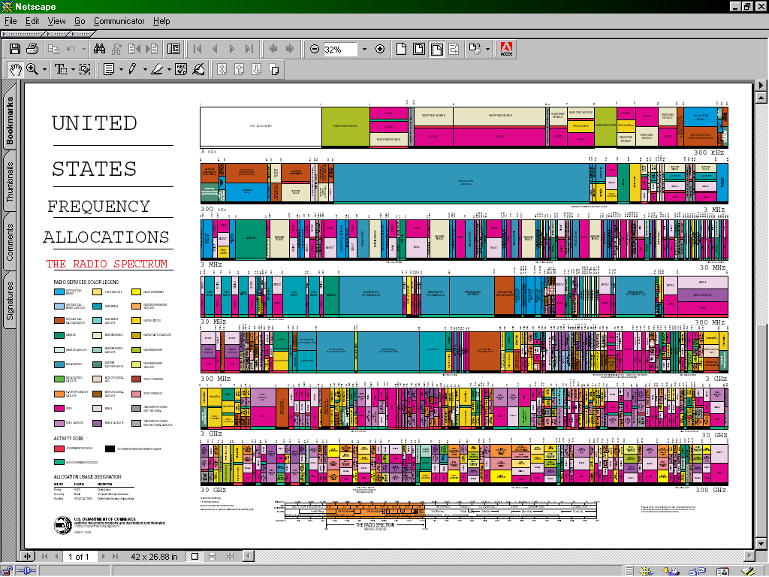
Spectrum Allocation
Policy approach forces spectrum to be allocated like a fixed spatial resource (e.g. land, disk space, etc)
Reality is that spectrum is time and power shared
Measurements show that fixed allocations are poorly utilized
Frequency (Hz)
Hot topic: Whitespace communication
Time (min)

Slide 15
TWISTED PAIR COPPER
CPU
CPU
MODEM
MODEM
UART
UART
Twisted Pair
RS−232
Low bandwidth
Cheap, Easy to Install

Slide 16
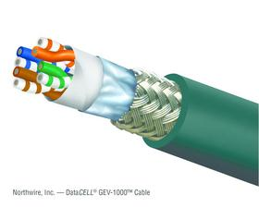
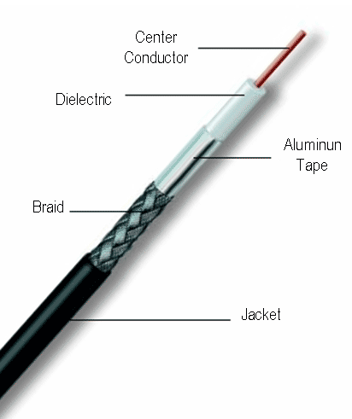
TWISTED PAIR INSIDER VIEW
Typical examples
Category 5/6 Twisted Pair 10M-10Gbps 50-100m
Coaxial Cable 10-100Mbps 200m
twisted pair
coaxial
cable
(coax)
copper core
insulation
braided outer conductor
outer insulation

Slide 17
Using Twisted Pair for Higher Rates Today
Standard twisted pair is limited by loading cables by telephone company to 4 Mhz. Shannon limit is around 56 Kbps (not counting compression). Two alternatives:
Better quality twisted pair cables for local area networks e.g., Cat 3 (10 Mbps, Manchester), Cat 5 (100 Mbps, 100 Mhz bandwidth uses 4-5 coding)
Telephone company removes loading cables, reduces your length, and gives you ADSL. Asymmetrical.

Slide 18
BASEBAND CABLE (e.g. ETHERNET)
CPU
Transceiver
Transceiver
CPU
Adaptor
Adaptor
Coaxial Cable
TERMINAL
CPU
High bandwidth (10−100 MHz)
Hard to tap, expensive to Install Small Distance (1 − 3 km without repeaters)

Slide 19
Using Coaxial Cable Today
Coaxial cable has high bandwidth. Used for original 10 Mbps Ethernet but very clunky. Twisted pair (e.g. Cat 5) used today.
Cable still used in cable networks for cable TV and for data via cable modems. Divide bandwidth into 6 Mhz channels for each TV channel and one 6 Mhz channel for downstream data. Theoretically can reach 30 Mbps but beware other users and bandwidth limits. Upstream much less.

Slide 20
FIBRE OPTICS
Slow Signal
Direct Signal
LED
Laser
Photodiode
Huge Bandwidth (10 Million Mhz!)
Almost Imposible to Tap Point−to−point Secure
Excellent Electrical Isolation
Thin and Easy to Install
Optics still expensive Unidirectional

Slide 21
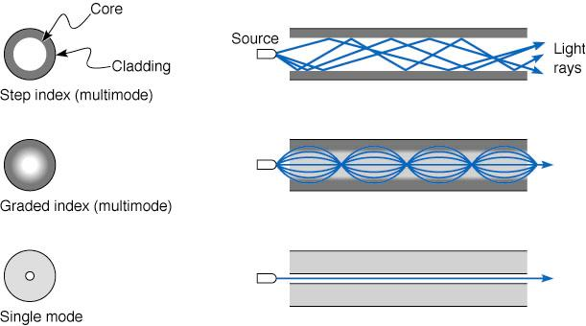
Fiber Optics: more physical view
Typical examples
Multimode Fiber 100Mbps-10Gb 500-2000m
Single Mode Fiber 1-100Gbps 100m-40km
Cheaper to drive
(LED vs laser) &
terminate
Longer distance
(low attenuation)
Higher data rates
(low dispersion)

Slide 22
MICROWAVE
CROWDED CITY
TOWER
TOWER
Avoids Right of Way
May be cheaper than installing cable Reasonable Bandwidth
Has problems with Rain
Upto 100 km distance

Slide 23
SATELLITE
DISH
DISH
Avoids Right of Way Good Bandwidth (500 Mhz) World Wide
Large Latency Antenna Cost

Slide 24
Wireless Data Options
802.11: Wireless LANs using a wireless access point (AP) at hot spot using unlicensed frequency band 2.4 to 4.485 Ghz (radio frequency) 100 metres. 11 Mbps with 802.11b. Needs hotspot but becoming common and very cheap!
Bluetooth: ad hoc personal area networks with no AP. Master-slave. 4 Mbps
WiMax: broader geographical range smaller bandwidth of a few Mbps
3 G (Cellular telephone networks carrying data) at a few Mbps such as EVDO. Unlimited geographical range and true mobility

Slide 25
802.11b in some more detail
AP configured with a SSID that you can see when doing View Available Networks and a channel number from 1 to 11. Non-overlapping channels (1 6, 11) can be used to triple bandwidth
Each AP periodically sends a beacon containg SSID.
Each AP scans all 11 channels looking for beacons to get a list of networks. Some choice of AP and then mobile sets up an association
Access protocol to send data tricky because of hidden terminal problem. Mobile A can send to base station and so can Mobile B, but A and B cannot hear each other but can interfere at base station. Needs careful protocol design (later)

Slide 26
MEDIA PROS AND CONS
Medium | Speed | Distance Span | Pros | Cons
Twisted Pair | 1 Mps -1 G (Cat 1 – Cat 5) | 1 – 2 Km | Cheap, easy to install | Low distance
Digital Coax | 10-100 Mbps | 1- 2 km | broadcast | Hard to install in building
Analog Coax | 100-500 Mbps | 100 Km | Cable companies Use it now | Expensive amplifiers
Fiber | Terabits | 100 km | Security, low noise, BW | No broadcast, Needs digging
Microwave | 10-100 Mbps | 100 km | Bypass, no right Of way need | Fog outages
Satellite | 100-500 Mbps | worldwide | Cost independent of distance | 250 msec delay Antenna size
RF/Infrared | 1 – 100 Mbps, < 4 Mbps | 1 km 3 m | wireless | Obstacles for infrared

Slide 27
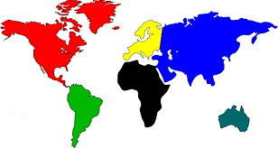


Crowded City Bottleneck,
Microwave, Radio
Trans-oceanic Bottleneck fiber, satellite
Last Mile
Bottleneck
Twisted Pair, cable, radio
PUMPING BITS GLOBALLY

Slide 28
ETHERNET SUBLAYERS
Input Bit Stream Output Bit Stream 01010000 01010000
Manchester
Decoding
Synchronous Coding
Coded Bit Stream
Coded Bit Stream
Media Transmission
Media Reception
Sublayer
Sublayer
Input Signal
Output Signal
MEDIA (COAXIAL CABLE)

Slide 29
Problems in all layers
Resource Sharing: FDM/TDM
Addressing: TDM time slots
Synchronization: clock recovery, spacing apart levels
Interconnection Physical layer repeaters are called hubs

