Slide 1

Notes:
Good morning, distinguished panel. My name is Eshiet Owoabasi Paul, registration number 21/SC/CO/1110. My project is titled "Development of an NLP-Driven Curriculum Recommendation System for NUC CCMAS 30% Localised Curriculum Customisation", supervised by Mr Dan Ambrose. The system I built is called SkillBridge. In simple terms, it reads job adverts and policy documents, finds the skills and topics employers keep asking for, checks whether the NUC core already teaches them, and suggests topics the department can use for its own 30% of the curriculum.

Slide 2
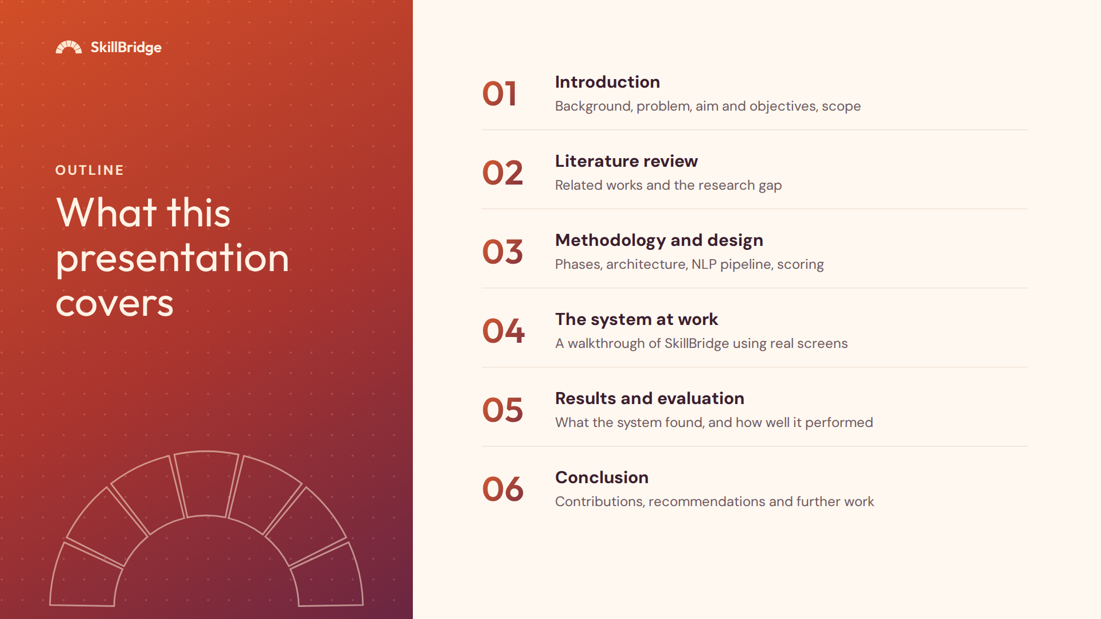
Notes:
This is how I will take you through the work. First, the background and the problem. Then what other researchers have done and the gap I found. Then how I designed the system. After that I will show the working system with real screens, then the results, and finally my conclusion and recommendations.

Slide 3
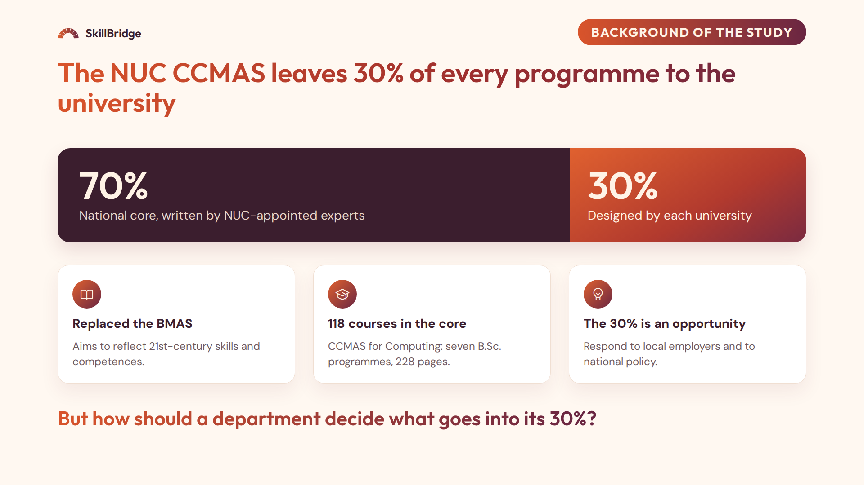
Notes:
The National Universities Commission replaced the old BMAS with the Core Curriculum and Minimum Academic Standards, the CCMAS. Its key feature is this split. About 70% of each programme is a national core written by NUC experts. The remaining 30% is left to each university to design for local needs and its own strengths. For Computing, the core has 118 courses in a 228-page document covering seven B.Sc. programmes. The 30% is a real opportunity to respond to employers and to national policy such as the National Digital Economy Policy. The question my project answers is: how should a department decide what goes into that 30%?

Slide 4
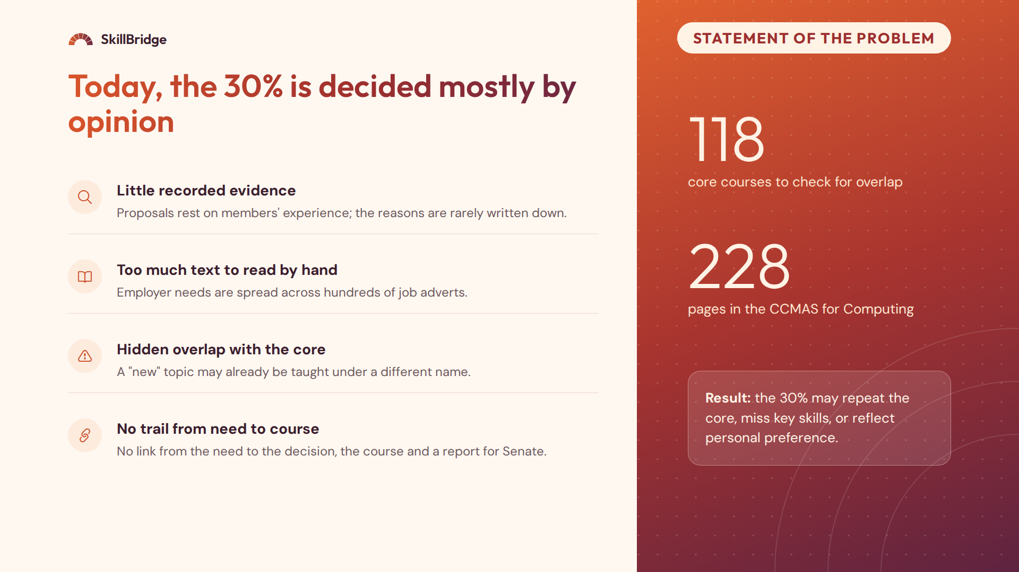
Notes:
The CCMAS gives universities this responsibility but no method or tool for deciding the 30%. That creates four problems. One: decisions rest mainly on the opinions of committee members, and the evidence is rarely recorded. Two: employer needs are buried in large amounts of unstructured text such as job adverts, and no committee can read hundreds of them. Three: a topic that looks new may already be taught in one of the 118 core courses under a different name, and checking a 228-page document by hand is error-prone. Four: there is no link from the need, to the decision, to the course, and no report to show Senate. As a result, the 30% can duplicate the core or miss what employers need, which feeds the skills gap reported in studies of Nigerian graduates, for example Pitan and Adedeji, 2012, and Okolie and others, 2020.

Slide 5
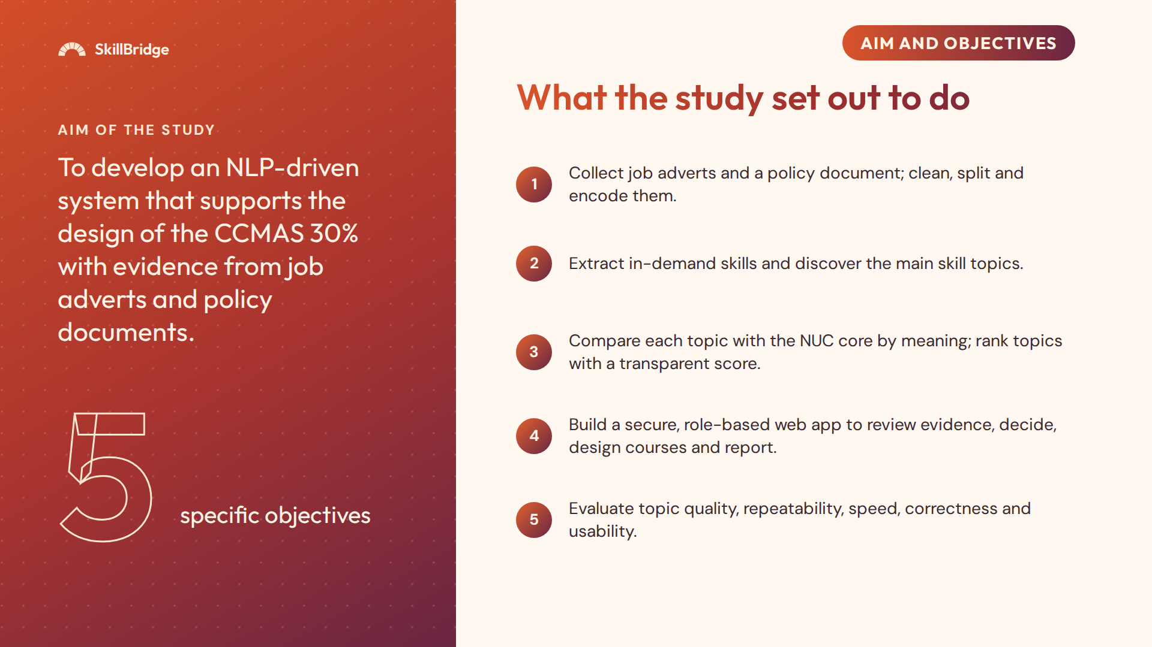
Notes:
The aim is to develop an NLP-driven curriculum recommendation system that supports the design of the CCMAS 30% with evidence from job adverts and policy documents. To reach it I set five objectives. First, build the corpus and a pipeline that validates, cleans, splits and encodes documents. Second, extract skills using rule-based named entity recognition and discover topics using BERTopic. Third, compare each topic with the NUC core courses by meaning, and rank the topics with a score anyone can inspect. Fourth, build a secure web application with roles, where planners review the evidence, record decisions, design courses and generate reports. Fifth, evaluate the system. I will come back to these five at the end and show how each one was met.

Slide 6
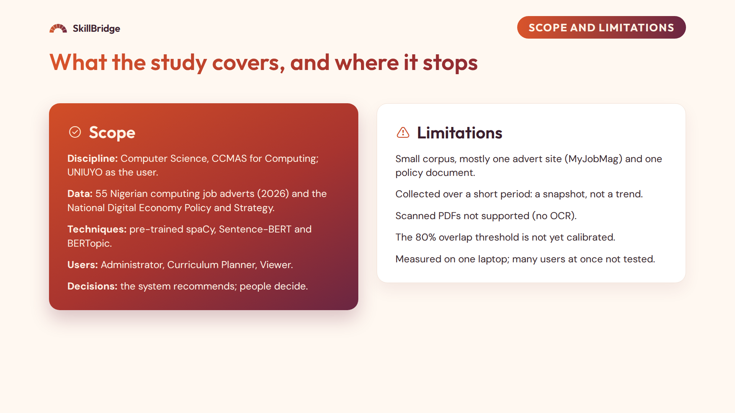
Notes:
On scope: the study focuses on Computer Science and the CCMAS for Computing, with the Department of Computer Science, University of Uyo, as the intended user. The data are 55 Nigerian computing job adverts collected in 2026 and the National Digital Economy Policy and Strategy. I used only pre-trained models, so no model was trained from scratch. There are three user roles, and the system only recommends; people make the decisions. On limitations: the corpus is small and mostly from MyJobMag; it is a snapshot in time; scanned PDFs are not supported; the 80% threshold for "already in the core" still needs calibration with human labels; and everything was measured on one laptop with two cores and no GPU.

Slide 7
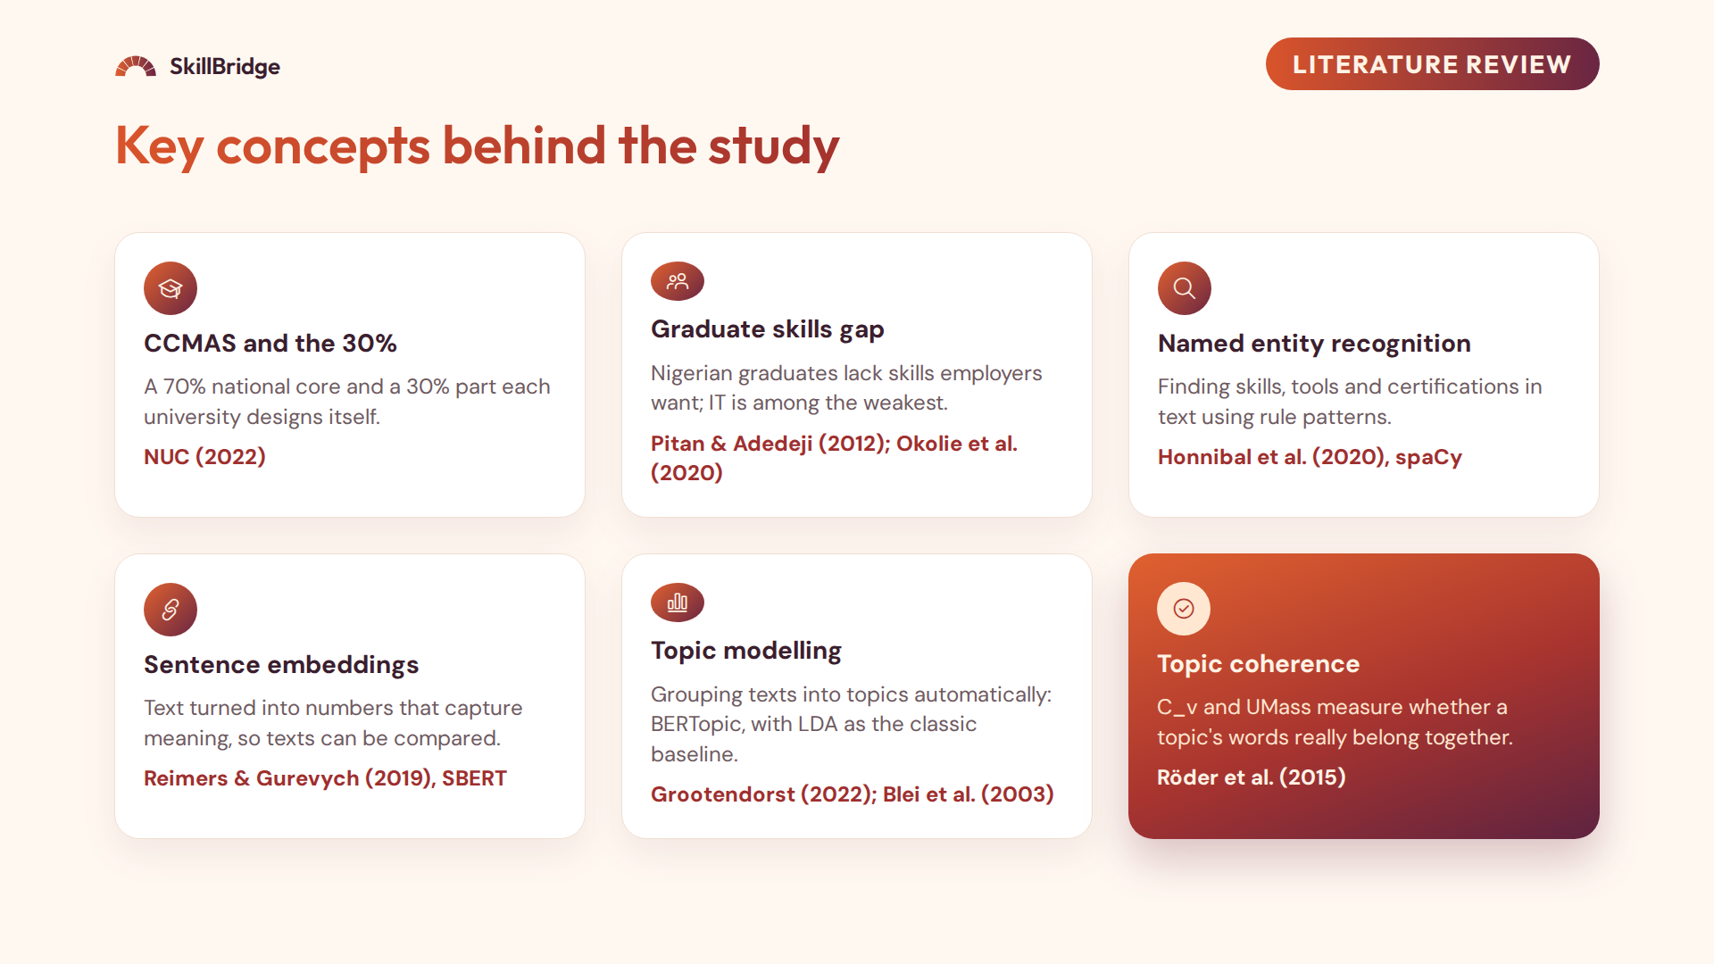
Notes:
Before the related works, the key concepts from the literature review in Chapter Two. First, the CCMAS: the NUC's 2022 curriculum, with a 70% national core and a 30% part each university designs. Second, the graduate skills gap: studies such as Pitan and Adedeji, and Okolie and others, report that Nigerian graduates lack the skills employers want, with IT among the weakest areas. Third, named entity recognition, which finds named items such as skills, tools and certifications in text; I used rule patterns in spaCy. Fourth, sentence embeddings: Sentence-BERT turns a passage into numbers that capture its meaning, so passages can be compared by meaning. Fifth, topic modelling: BERTopic groups related passages into topics, and LDA is the classic method I compare against. Finally, topic coherence, measured with C_v and UMass, tells us whether the words in a topic really belong together.

Slide 8
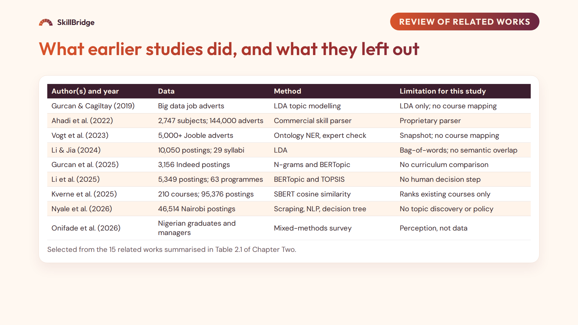
Notes:
This table summarises the related works. Gurcan and Cagiltay used LDA on big data job adverts to build a competency map, but did not map topics to courses. Ahadi and others compared thousands of subjects with 144,000 adverts using a commercial parser. Vogt and others built a data science competency profile with ontology-based NER, but it was a snapshot with no course mapping. Li and Jia compared syllabi with postings using LDA, which works on word counts rather than meaning. Gurcan and others in 2025 used BERTopic to find 26 skill topics but did not compare them with a curriculum. Li and others combined BERTopic with TOPSIS ranking, but there was no human decision step. Kverne and others used SBERT to compare courses with postings, but only ranked existing courses rather than suggesting new topics. Nyale and others studied 46,514 Nairobi postings without topic discovery or policy documents. And the Nigerian study by Onifade and others is a survey of perceptions, not an analysis of labour-market text.

Slide 9
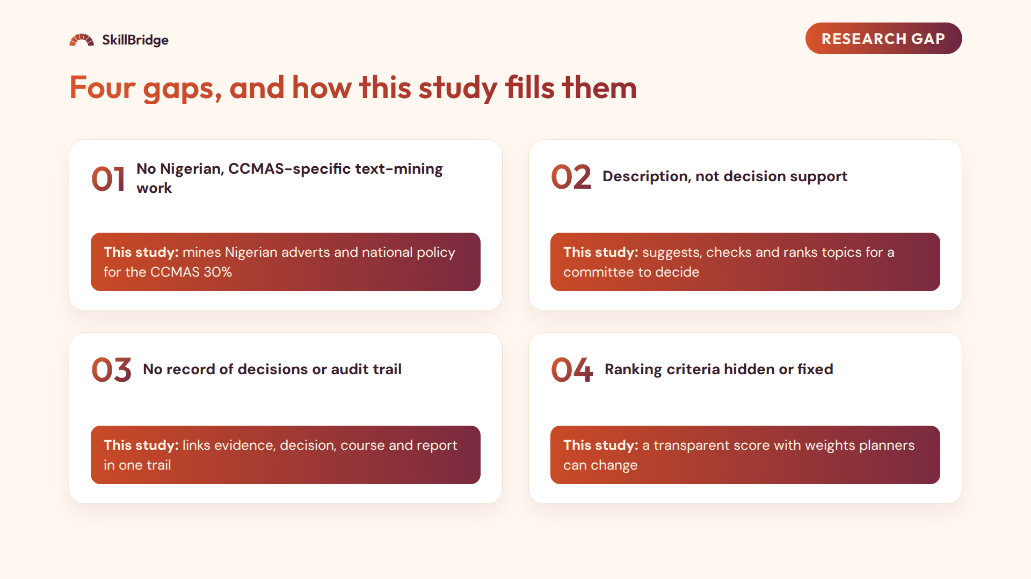
Notes:
From the review, I found four gaps. One: no study text-mines Nigerian job adverts or Nigerian policy documents to inform the CCMAS 30%; Nigerian studies rely on surveys. My system does exactly that. Two: most studies stop at describing skill demand. My system goes further: it suggests topics, checks each one against the NUC core by meaning, and ranks them for a committee to decide. Three: none of the reviewed systems records which suggestions were accepted or rejected. SkillBridge links the evidence, the decision, the designed course and the report in one audit trail. Four: where ranking is used, the criteria are hidden or fixed. My score is transparent and the weights can be changed by the planner.

Slide 10
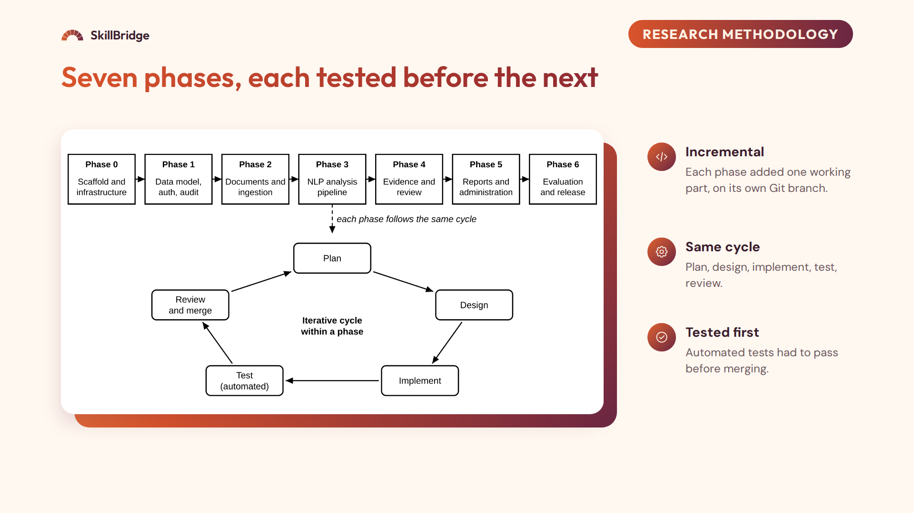
Notes:
I used an incremental, phase-based methodology. The work was split into seven phases, numbered 0 to 6. Phase 0 set up the basic server, worker and Docker environment. Phase 1 added the database, sign-in, roles and the activity log. Phase 2 handled documents: upload checks, reading PDF, Word and text files, cleaning, splitting into extracts, and embeddings. Phase 3 built the analysis pipeline. Phase 4 added the evidence pages, decisions and course design. Phase 5 added reports, the dashboard and administration. Phase 6 was evaluation on real data and the final release. Within every phase I followed the same cycle: plan, design, implement, test and review. I chose this approach because each part could be tested properly before the next was built on top of it.

Slide 11
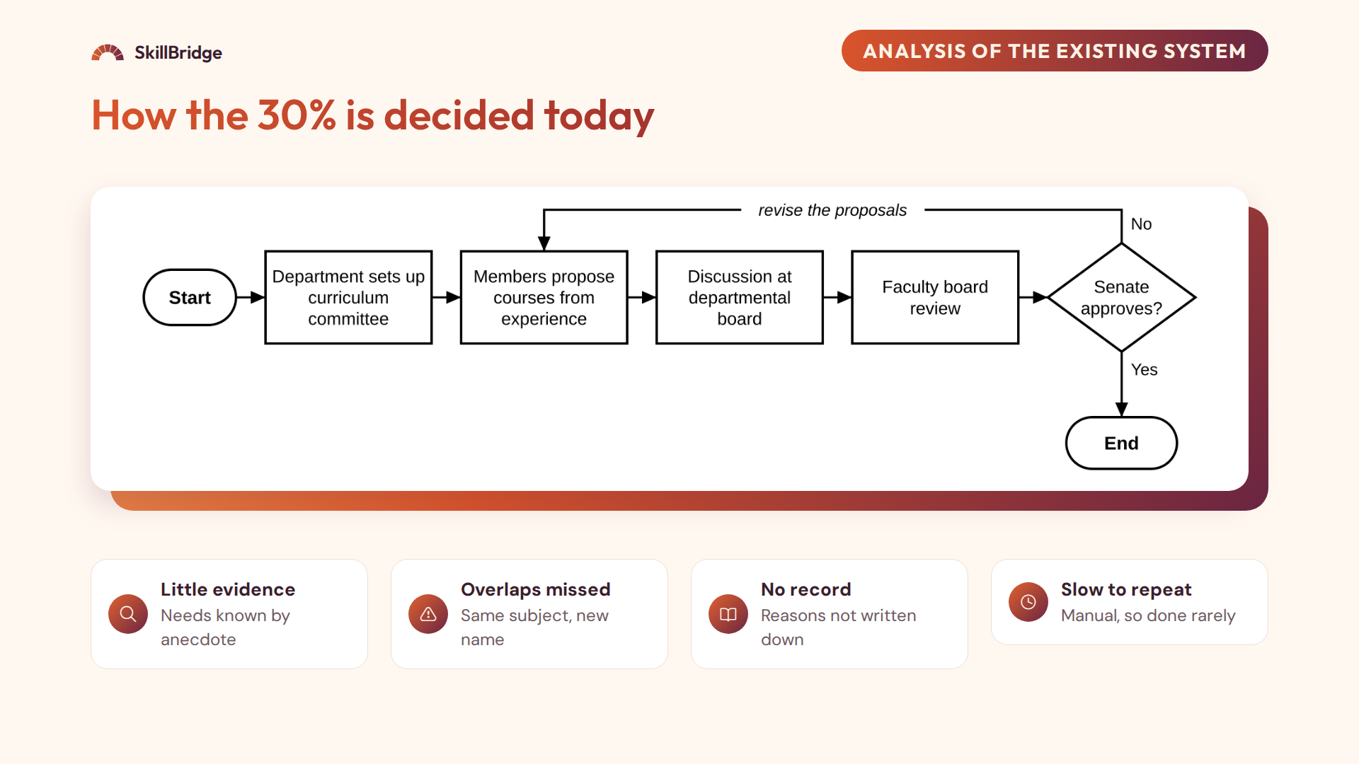
Notes:
This flowchart shows how the 30% is decided today. The department sets up a curriculum committee. Members propose courses from their own knowledge and contacts. The proposals go to the departmental board, the faculty board and finally Senate. If Senate does not approve, they go back to the committee. The process has four weaknesses: little evidence, because nobody can read hundreds of adverts; overlaps with the 118 core courses are easily missed; the reasons for decisions are not recorded; and because it is manual, it is slow and rarely repeated.

Slide 12
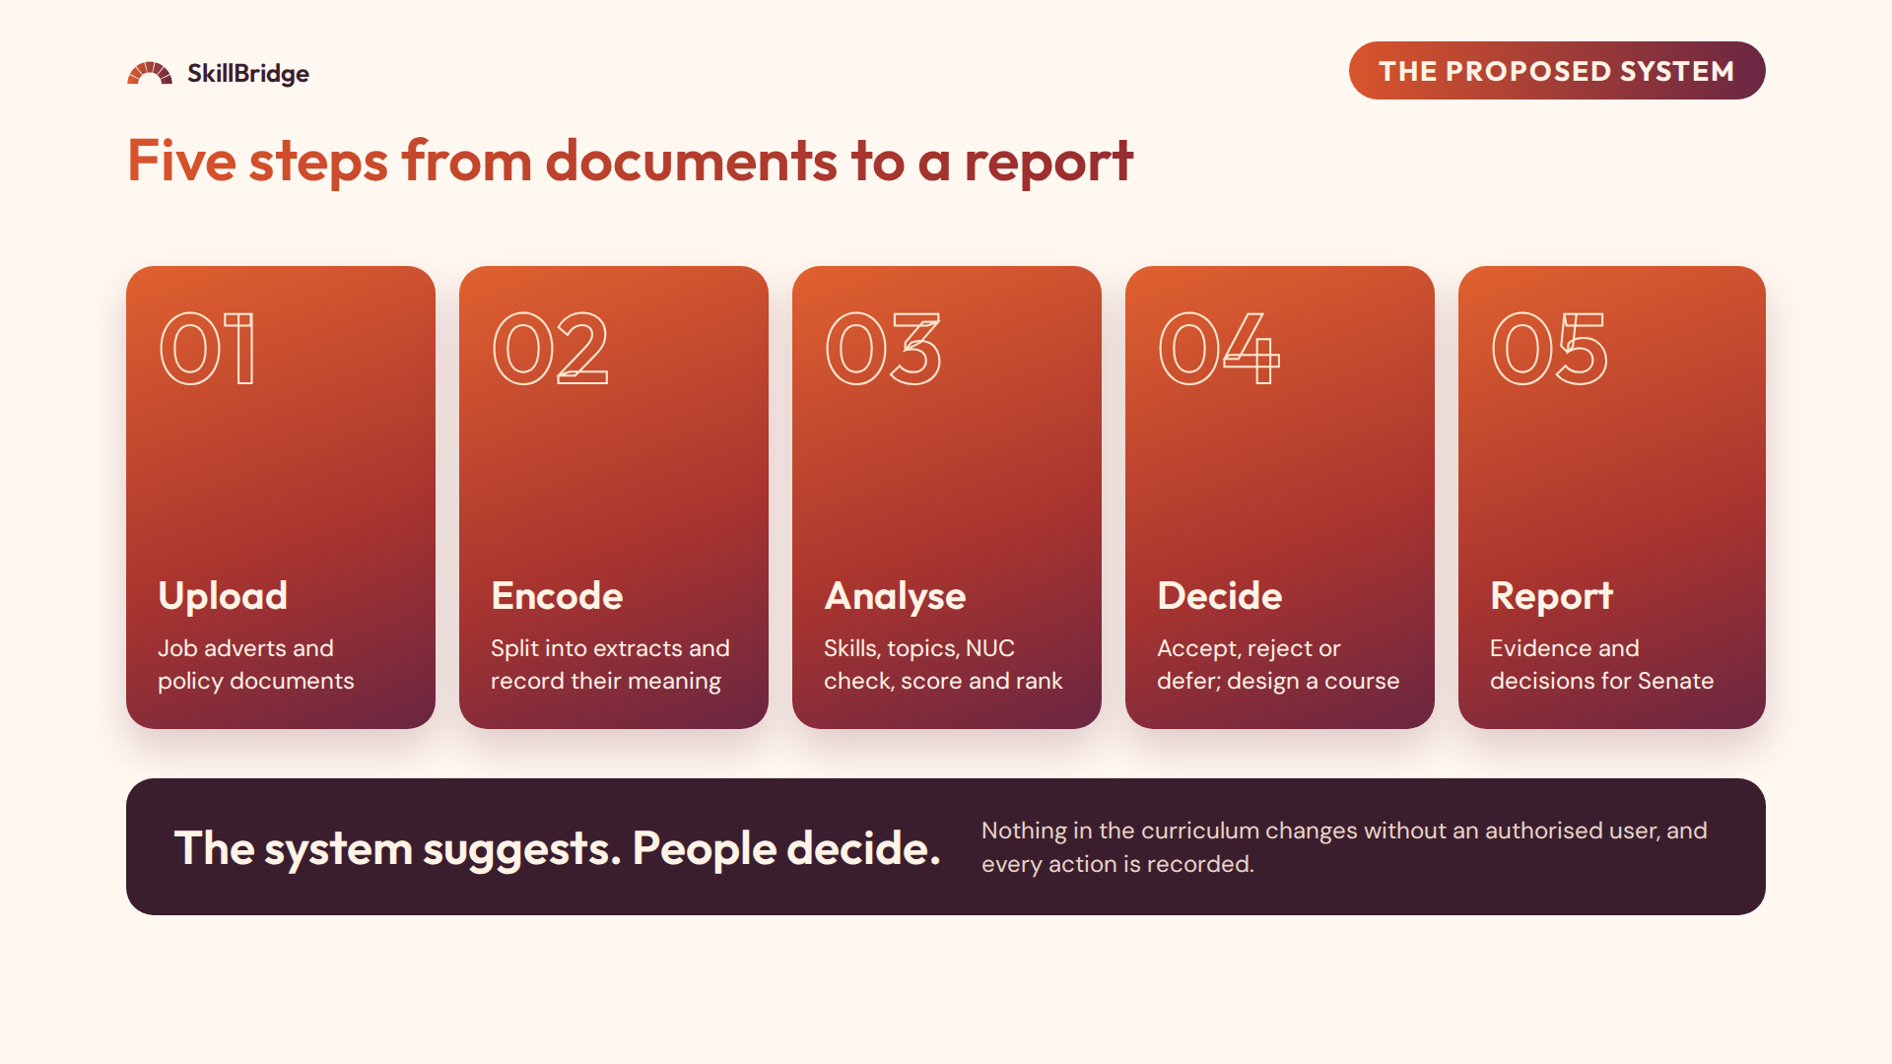
Notes:
The proposed system, SkillBridge, brings evidence into that process in five steps. One, authorised users upload job adverts and policy documents. Two, the system splits each document into short passages called extracts and records their meaning as numbers, called embeddings. Three, when a planner starts an analysis, the system finds the skills, groups the extracts into topics, compares every topic with every subject course in the NUC core, and ranks them with a clear score. Four, the planner reviews the top topics with their evidence and accepts, rejects or defers each one, then designs a course for accepted topics within the credit units available. Five, the planner downloads a report. The key principle: the system only suggests; the committee still decides, and every action is logged.

Slide 13
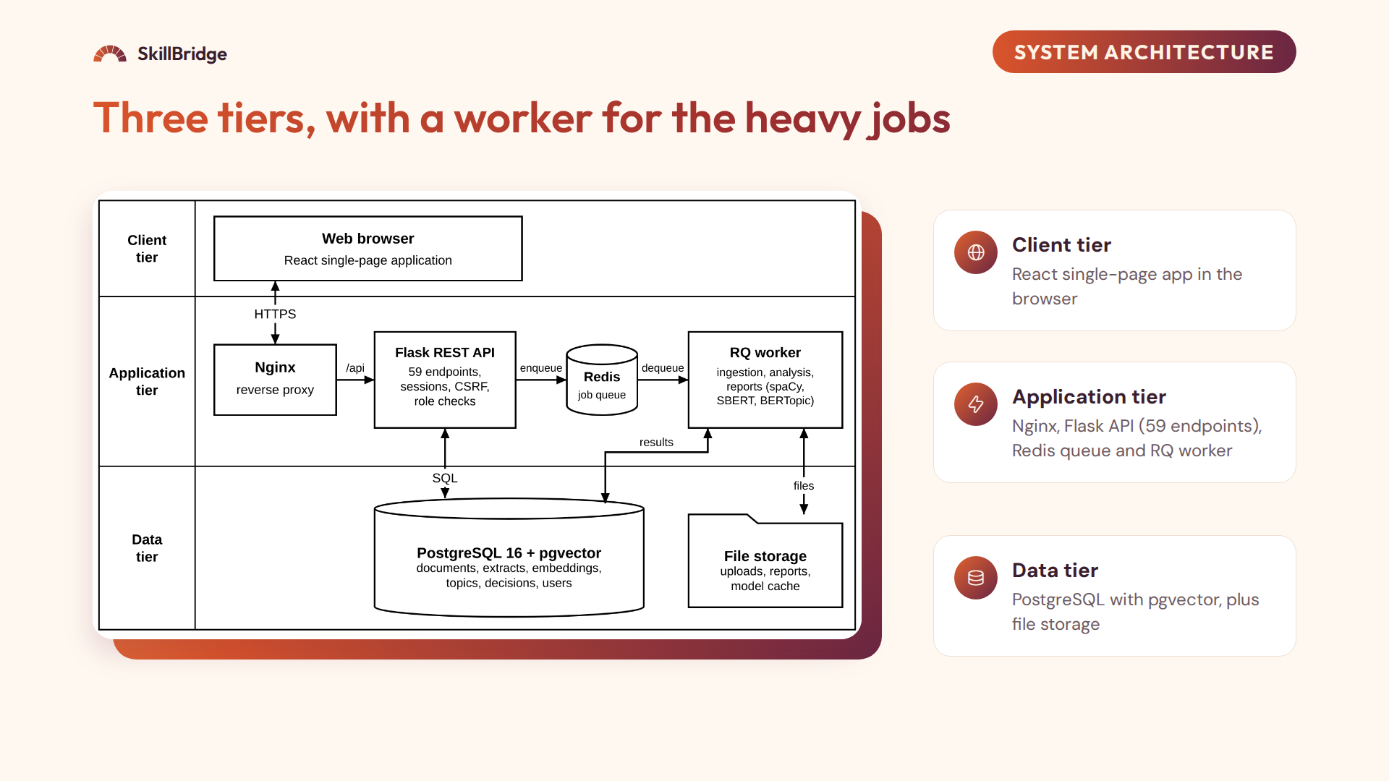
Notes:
The system uses a three-tier architecture. The client tier is what the user sees: a React and TypeScript single-page application in the browser. The application tier is the logic: Nginx is the single entry point; it sends API requests to the Flask API, which has 59 endpoints, checks who the user is and what their role allows, and records important actions. Long tasks such as reading documents and running analyses are placed on a Redis queue, and a separate RQ worker does the heavy work. That way an analysis that takes minutes does not slow down other users, and the screen can show progress. The data tier is PostgreSQL with the pgvector extension, which stores the embeddings of every extract and every NUC course, plus file storage for uploads and reports.

Slide 14
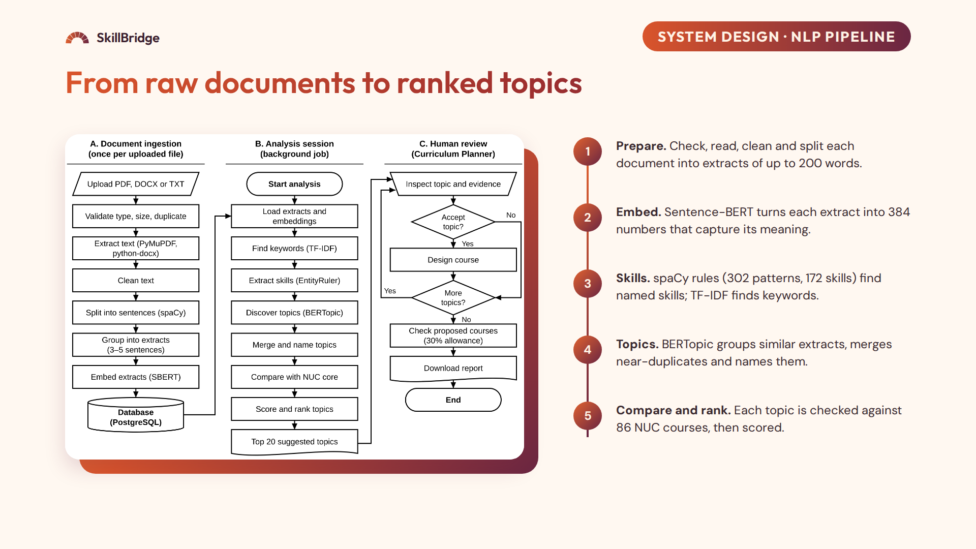
Notes:
This is the heart of the system. First, each uploaded document is validated, read, cleaned and split into extracts of three to five sentences, up to 200 words. Second, Sentence-BERT, the all-MiniLM-L6-v2 model, turns each extract into a list of 384 numbers, an embedding, so that extracts with similar meaning have similar numbers. This is done once at upload. Third, during an analysis, spaCy's EntityRuler, with 302 patterns covering 172 skills, finds named skills such as Linux, Azure or ITIL, and TF-IDF finds important keywords. Fourth, BERTopic groups similar extracts into topics using UMAP and HDBSCAN; near-duplicate topics above 0.83 similarity are merged, and topics are given course-style names. Fifth, each topic is compared by cosine similarity with 86 subject courses of the CCMAS for Computing; 32 generic courses such as SIWES, projects and general studies are left out. Finally every topic is scored and ranked.

Slide 15
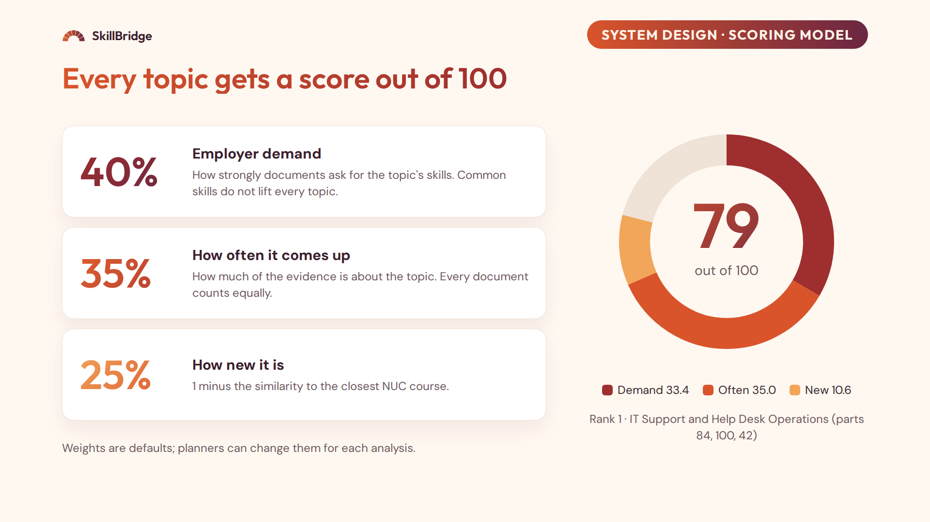
Notes:
Every topic gets a score out of 100 made of three parts. Employer demand, 40%, measures how strongly the documents ask for the topic's skills: for each of its top skills we count the documents that mention it, multiplied by the share of that skill's mentions inside this topic, so a very common skill like SQL does not raise every topic equally; a logarithm reduces extremes. How often it comes up, 35%, is the topic's share of the evidence, with every document counting equally so one long document cannot dominate; the square root stops the biggest topic from overshadowing the rest. How new it is, 25%, is one minus the similarity to the closest NUC course. The first two parts are scaled from 0 to 1 across the topics. The ring on the right is the real example: the top topic scored 84, 100 and 42 on the three parts, which gives 33.4 plus 35 plus 10.6, that is 79 out of 100. Demand has the biggest weight because the 30% exists to respond to employers and the nation. The weights are defaults that a planner can change, and the full calculation is visible in the app under "Show calculation".

Slide 16
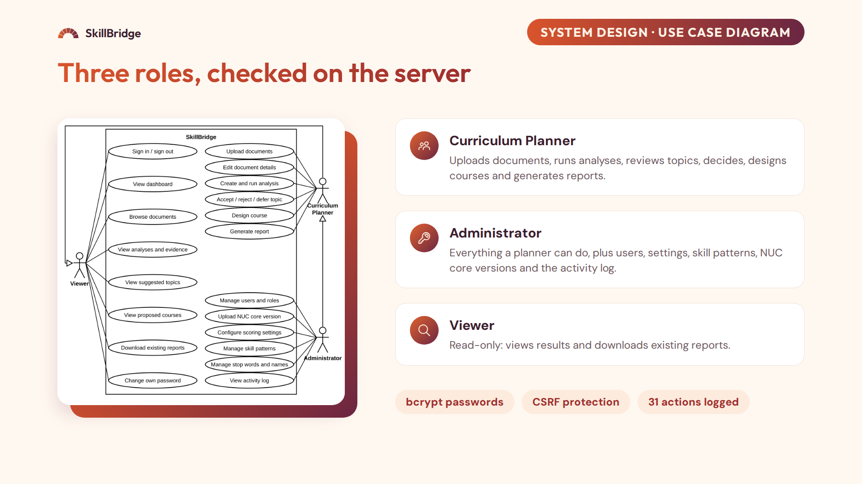
Notes:
This use case diagram shows the three kinds of users. The Curriculum Planner does the main work: uploading documents, running analyses, reviewing topics, recording decisions, designing courses and generating reports. The Administrator can do all of that, and also manages users, settings, skill patterns, NUC core versions and the activity log. The Viewer, for example a Dean or an external reviewer, can see everything and download existing reports, but cannot change anything. Importantly, the roles are enforced on the server, not only by hiding buttons. Passwords are stored as bcrypt hashes, every change requires an anti-forgery token, and 31 kinds of action are written to the activity log with who did it and when.

Slide 17
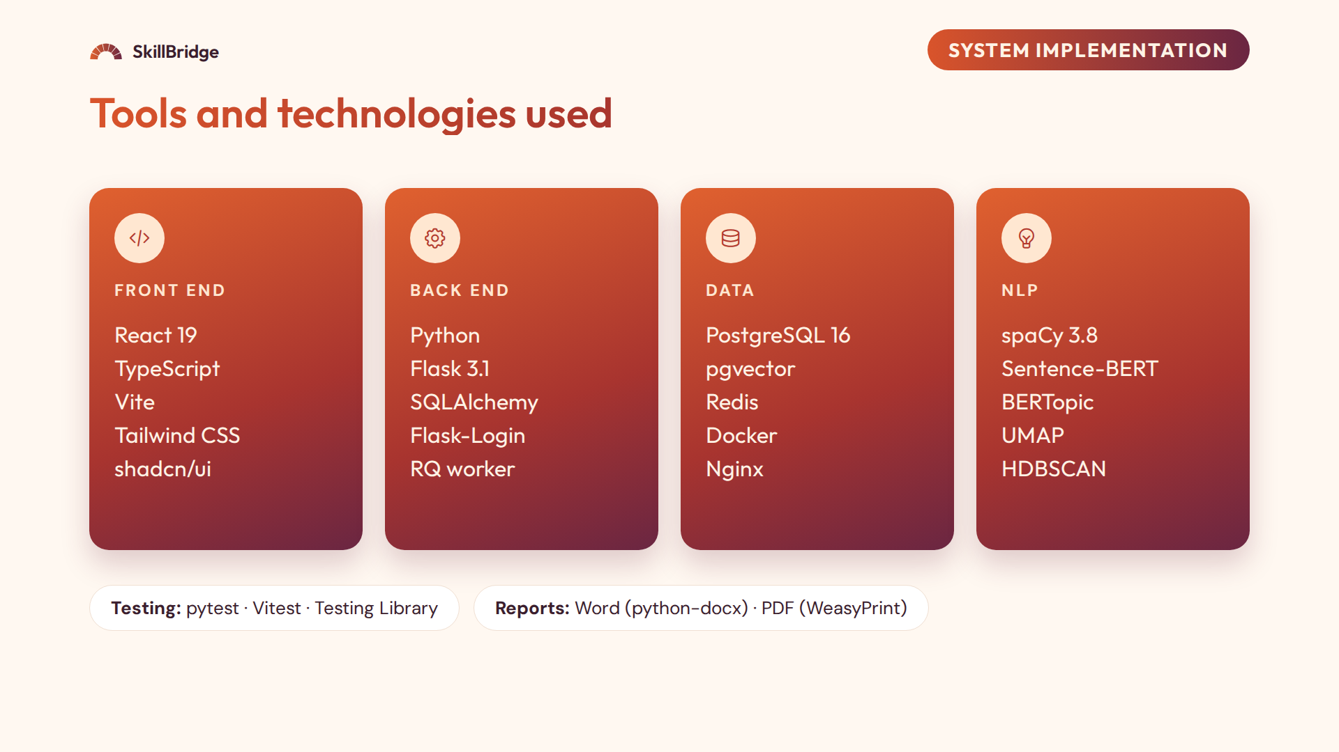
Notes:
For implementation, the front end is React 19 with TypeScript, built with Vite and styled with Tailwind CSS and shadcn components. The back end is Python with Flask 3.1, SQLAlchemy for the database, Flask-Login for sessions, and an RQ worker for background jobs. Data is stored in PostgreSQL 16 with pgvector, with Redis as the job queue, all running in Docker behind Nginx. The NLP side uses spaCy for skill extraction, Sentence-BERT for embeddings, and BERTopic with UMAP and HDBSCAN for topics. Testing used pytest for the back end and Vitest for the front end. Reports are produced in Word and PDF.

Slide 18
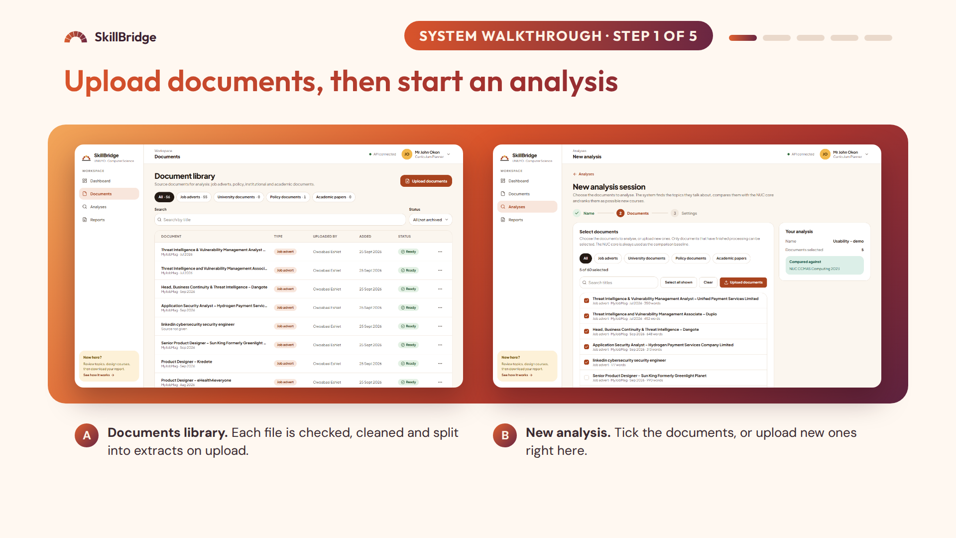
Notes:
Now let me show the working system. On the left is the documents library. A planner uploads job adverts or policy documents in PDF, Word or text format. On upload, each file is checked, for example duplicates and invalid files are rejected, then it is cleaned, split into extracts and its embeddings are stored. On the right, the planner creates a new analysis and ticks the documents to include; here five are selected. If a document is missing, the planner can upload it directly from this step with the Upload documents button; it is processed in the background and ticked automatically once it is ready. Then the planner starts the analysis. The analysis runs in the background worker, and the screen shows which stage it has reached.

Slide 19
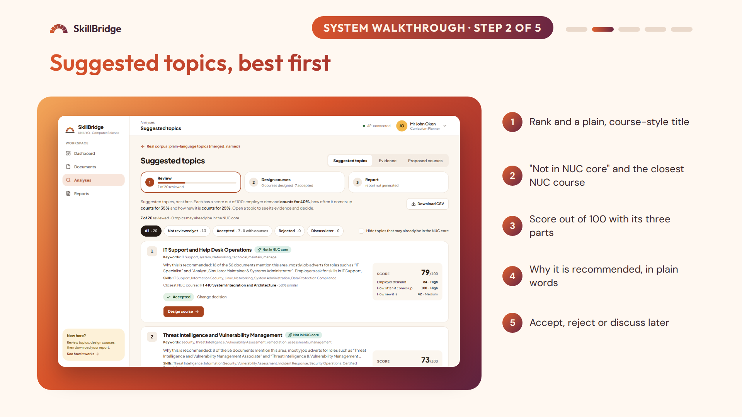
Notes:
When the analysis finishes, the planner sees the suggested topics, best first. Each card shows the rank and a course-style title, such as "IT Support and Help Desk Operations". It shows whether the topic may already be in the NUC core, and names the closest NUC course with its similarity, here IFT 410 at 58%. On the right is the score out of 100 with its three parts: employer demand, how often it comes up and how new it is. There is a plain-language reason, for example "16 of the 56 documents mention this area". The planner can accept, reject, or mark it to discuss later, and the progress bar at the top shows how many topics have been reviewed.

Slide 20
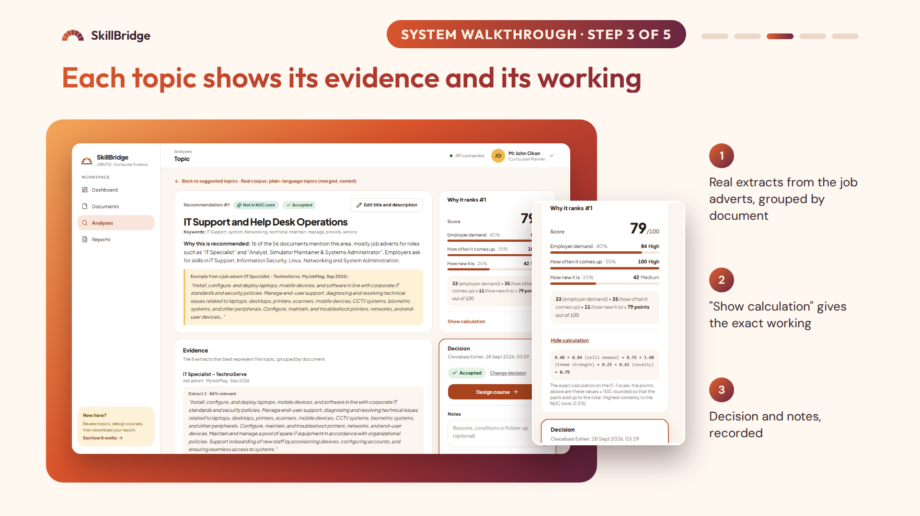
Notes:
Opening a topic shows its full evidence. Here is the top topic. It explains why it is recommended, shows an example from a real job advert, in this case an IT Specialist advert from MyJobMag, and lists the extracts that best represent the topic, grouped by document, with how relevant each one is. On the right the planner records the decision, adds notes, and can go straight to designing a course. The small panel is "Show calculation", which shows the exact working for each part of the score. So nothing is a black box: a committee member can see exactly why a topic ranks where it does.

Slide 21
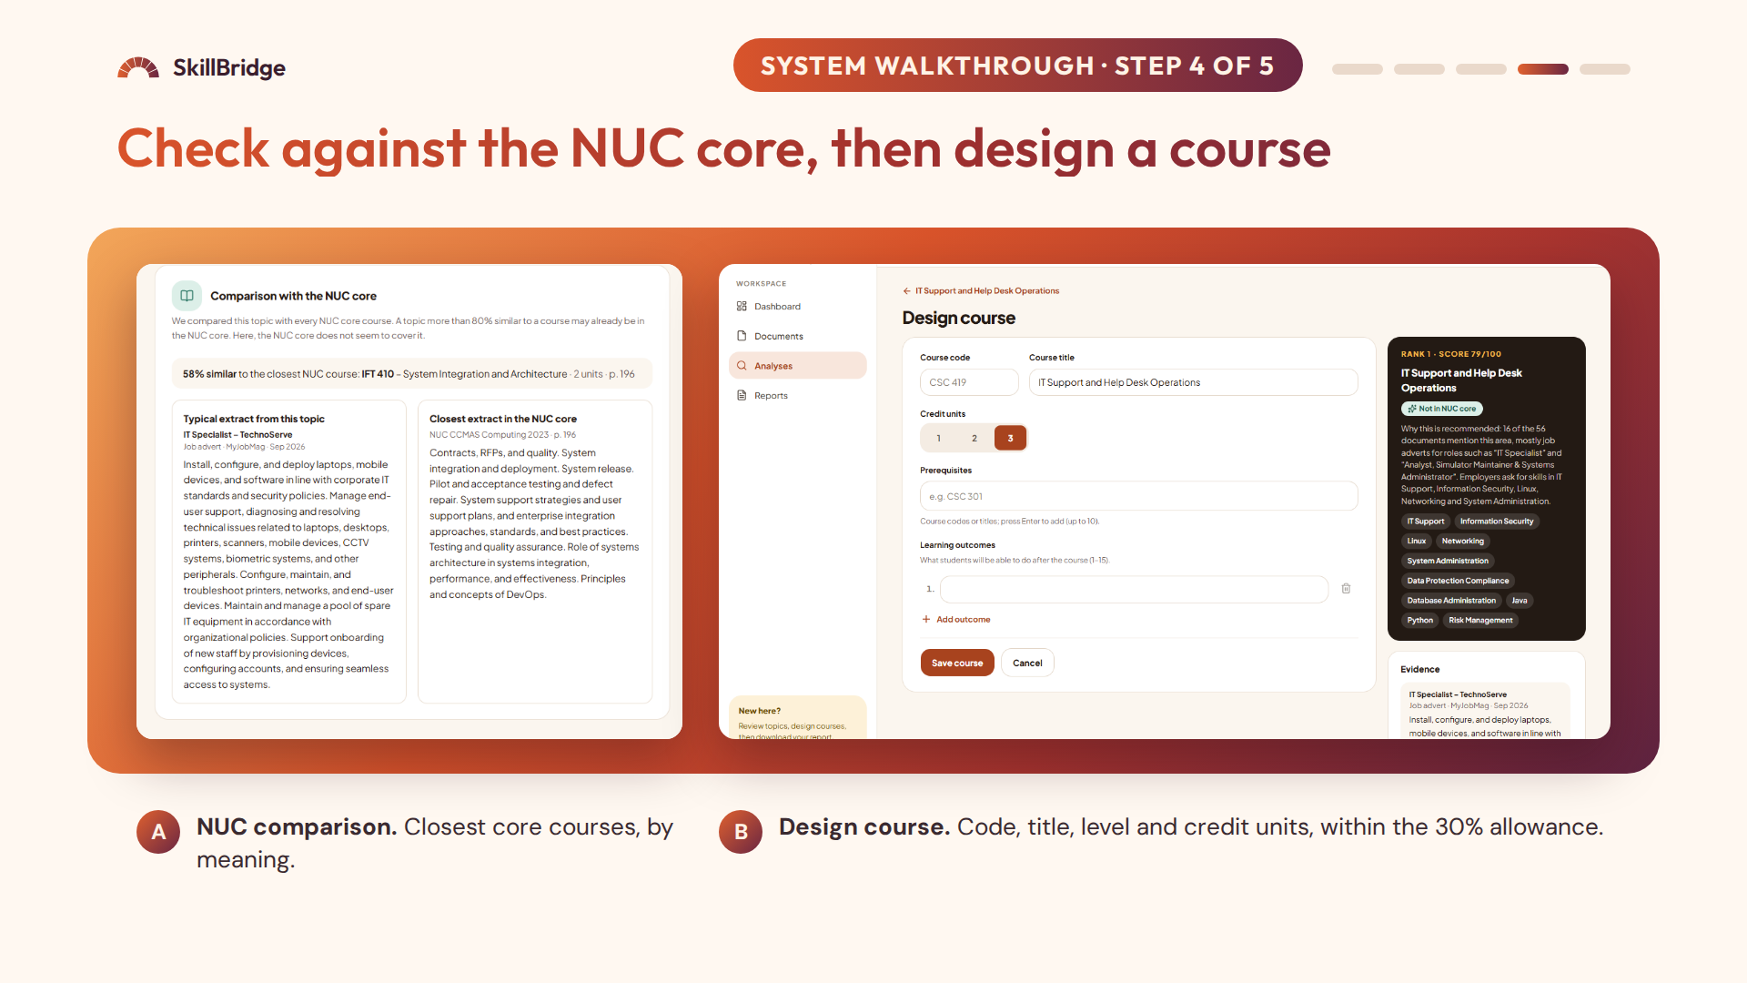
Notes:
On the left, the NUC comparison. For each topic the system lists the closest courses in the NUC core by meaning, not just by title, with their similarity. If the similarity were above 80%, the topic would be labelled "May already be in NUC core". On the right, once a topic is accepted, the planner designs a course from it: course code, title, level and credit units. The system keeps the total within the credit units available for the 30% component. In an earlier analysis, an accepted topic was designed as the course CSC 418, a three-unit course, which shows the complete path from evidence to proposed course.

Slide 22
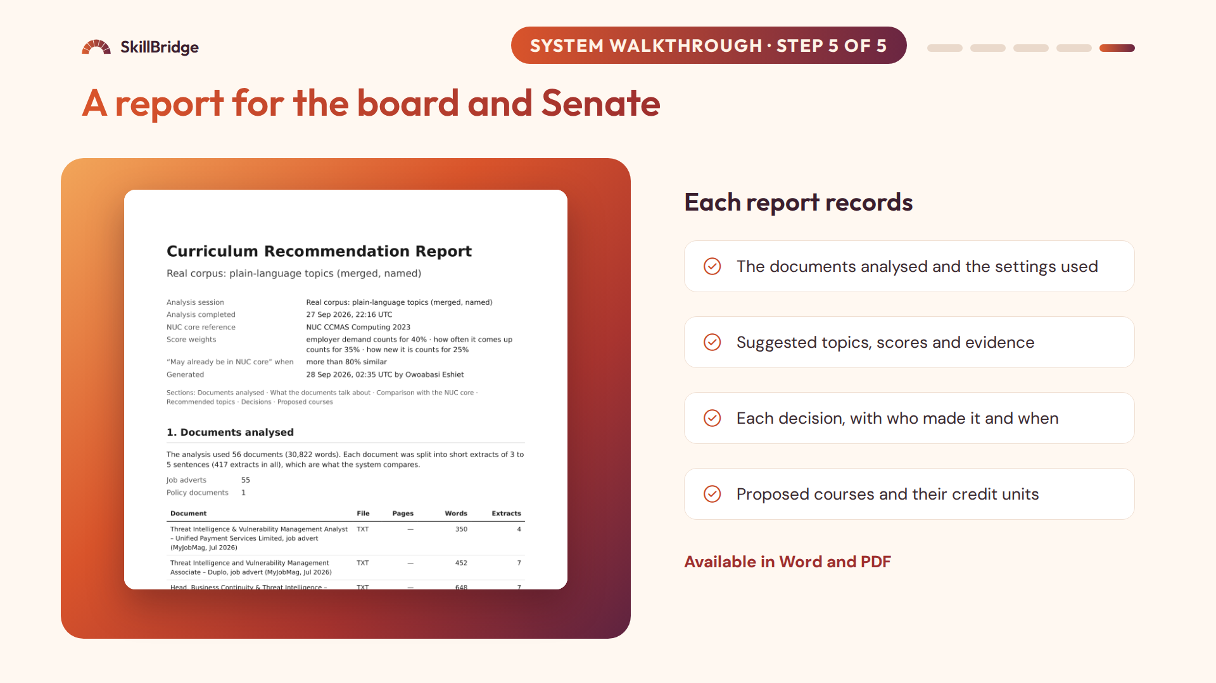
Notes:
Finally, the planner generates a report in Word or PDF. It documents what was analysed, the suggested topics with their scores and evidence, the decisions taken with who made them and when, and the proposed courses. This is the audit trail that the existing process lacks: the committee can take this to the departmental board, the faculty board and Senate, or show it to an accreditation panel.

Slide 23
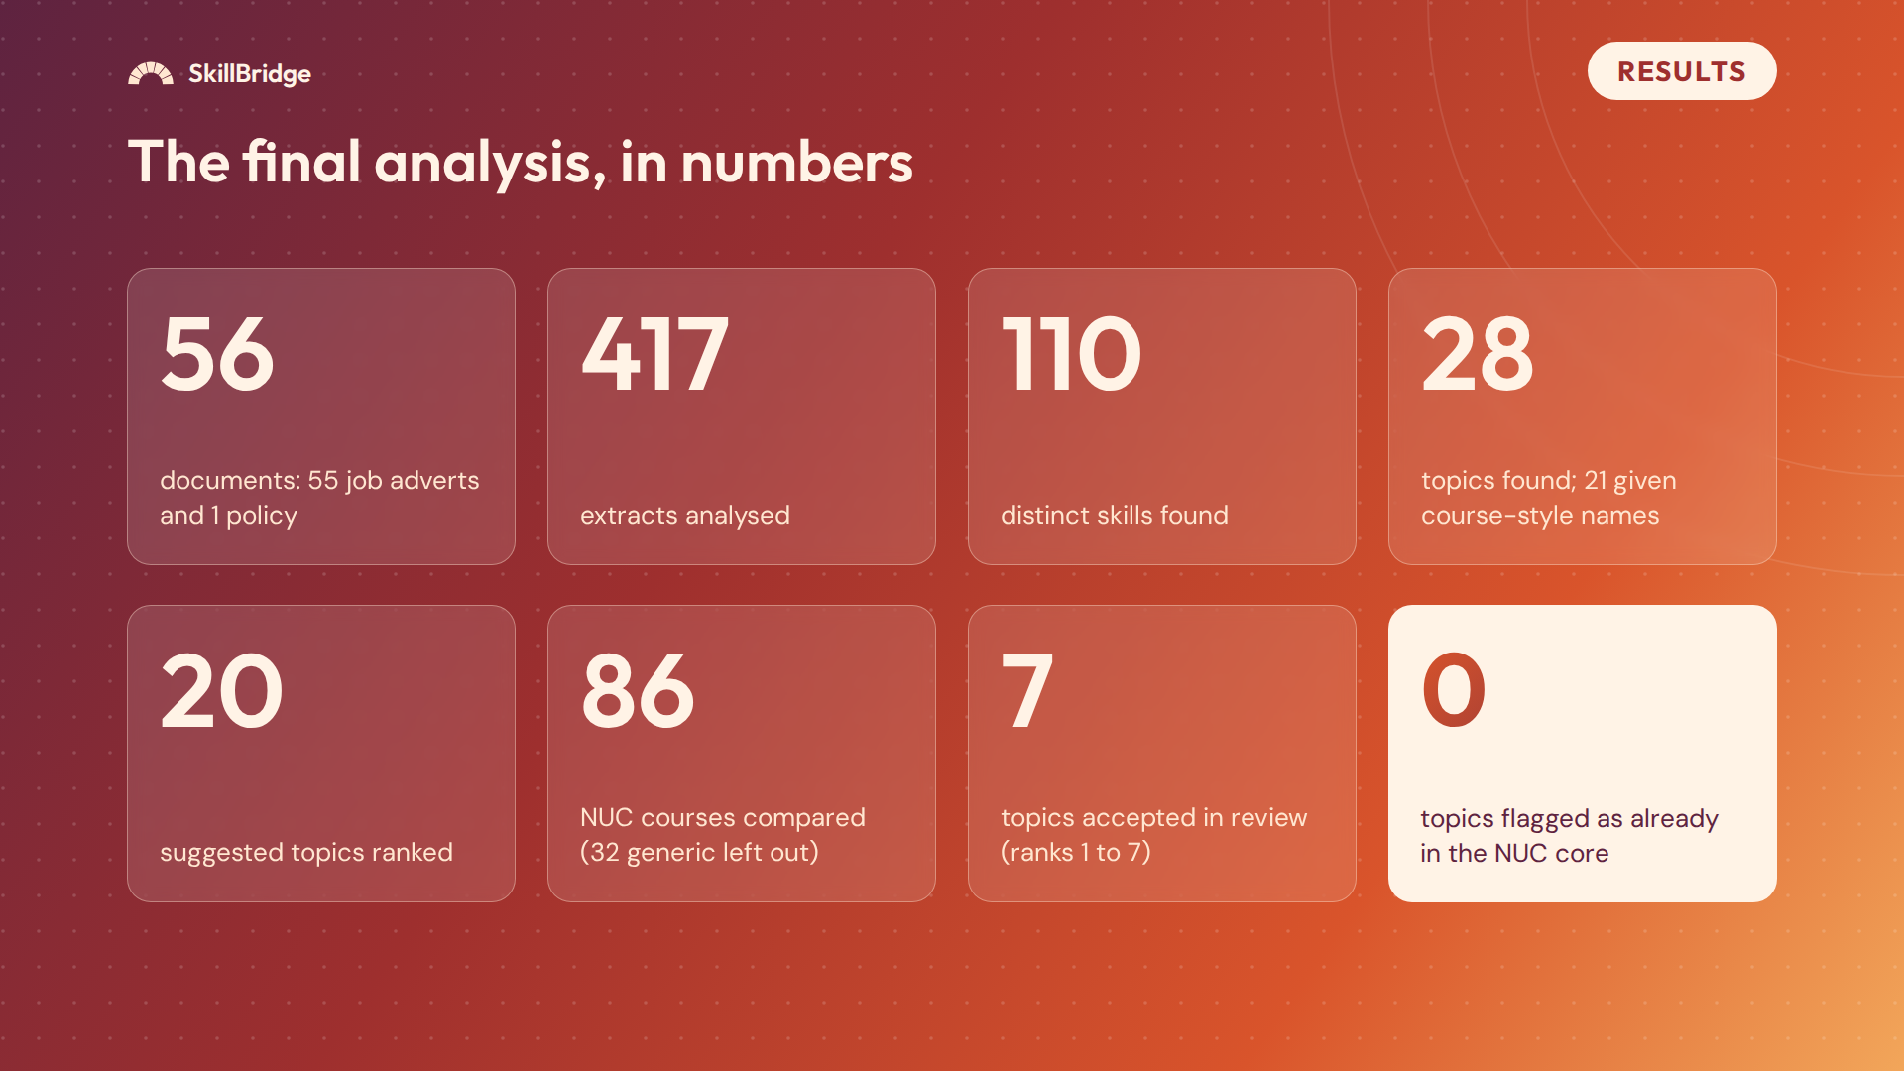
Notes:
Now the results. The final analysis processed 56 documents: 55 Nigerian computing job adverts and the National Digital Economy Policy and Strategy. These became 417 extracts. The system found 110 distinct skills and 28 topics after merging near-duplicates, and 21 of those were given course-style names. The top 20 were kept as suggested topics. Each was compared with 86 subject courses of the CCMAS for Computing; 32 generic courses such as SIWES, projects and general studies were left out because they distort the comparison. During review, I accepted the top seven topics. And no topic crossed the 80% line for "already in the NUC core".

Slide 24
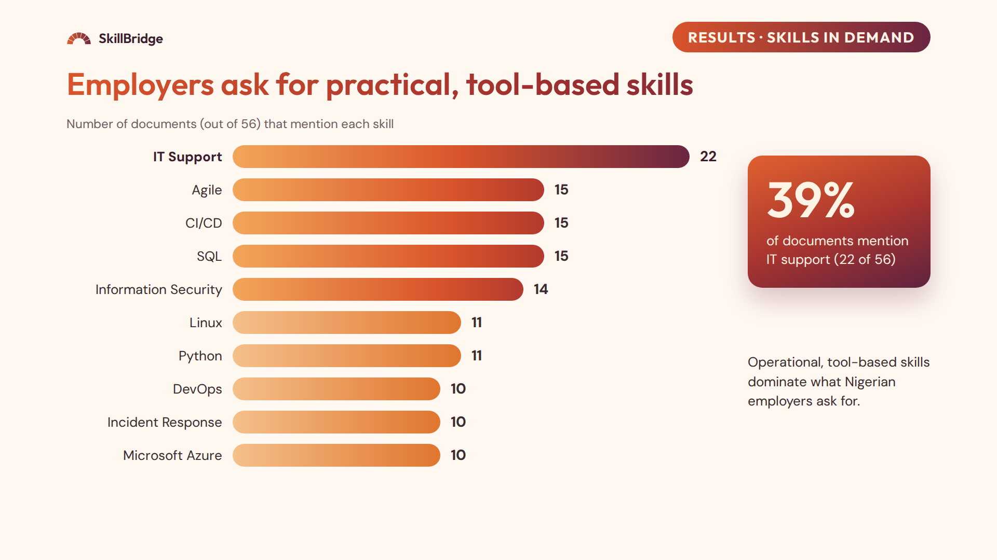
Notes:
This chart shows the ten skills mentioned in the most documents. IT support was the most widespread, in 22 of the 56 documents, which is about 39%. Next were Agile methodologies, CI/CD and SQL, at 15 each, and information security at 14. Then Linux and Python at 11, and DevOps, incident response and Microsoft Azure at 10 each. The message is that Nigerian employers are asking for practical, operational, tool-based skills. This agrees with earlier findings that IT skills are among the weakest areas of Nigerian graduates.

Slide 25
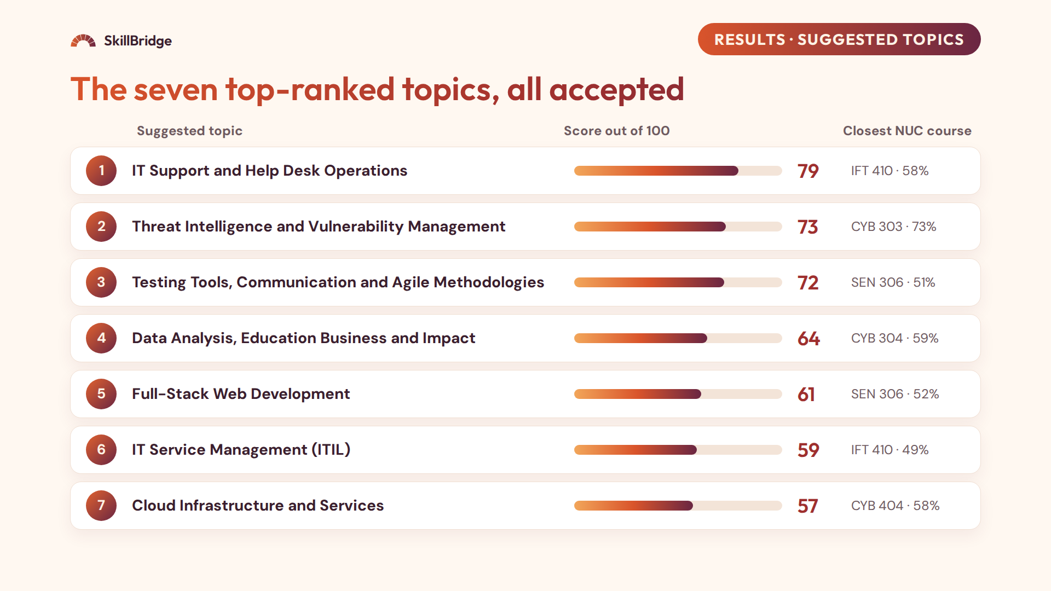
Notes:
These are the seven top-ranked topics, all accepted during review. First is IT Support and Help Desk Operations, with 79: strong demand and the highest prevalence, 16 of the 56 documents. Second is Threat Intelligence and Vulnerability Management, 73. It has the highest employer demand, but the lowest novelty among the top topics, because its closest course, CYB 303 Cybersecurity Risks Analysis, is the closest match of any topic at 73%. That shows the overlap check working: the system recognises it is partly covered. Then testing and Agile practice, data analysis, full-stack web development, IT service management with ITIL, and cloud infrastructure. Ranks 8 to 20, not shown here, include DevOps, data engineering, mobile development and Linux administration. The two topics from the policy document ranked lowest, because one document counts the same as one advert and names few technical skills.

Slide 26
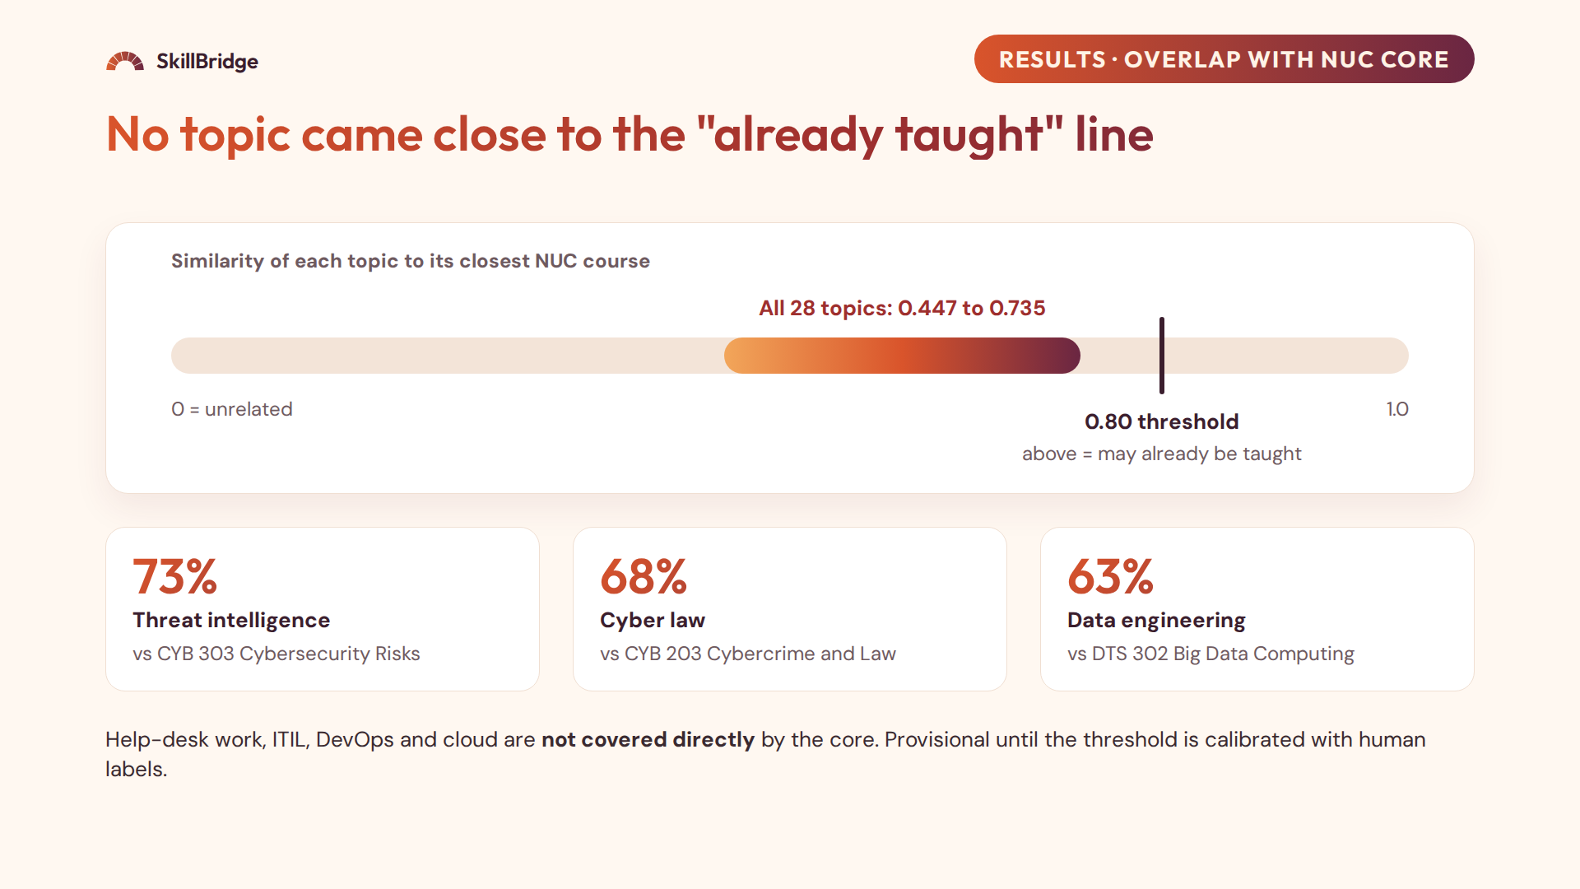
Notes:
This slide shows the overlap check. The line runs from 0, unrelated, to 1, identical. The threshold for "may already be in the NUC core" is 0.80. All 28 topics fell between 0.447 and 0.735, so none crossed it, and all suggested topics are labelled "Not in NUC core". The highest similarities make sense: threat intelligence against CYB 303 at 73%, cyber law against CYB 203 at 68%, and data engineering against DTS 302 Big Data Computing at 63%. So the practical areas employers ask for, like help-desk operations, IT service management, DevOps and cloud infrastructure, are not covered directly by the national core, which makes them strong candidates for the 30%. I treat this as provisional, because the 0.80 threshold still needs to be calibrated with human-labelled pairs.

Slide 27
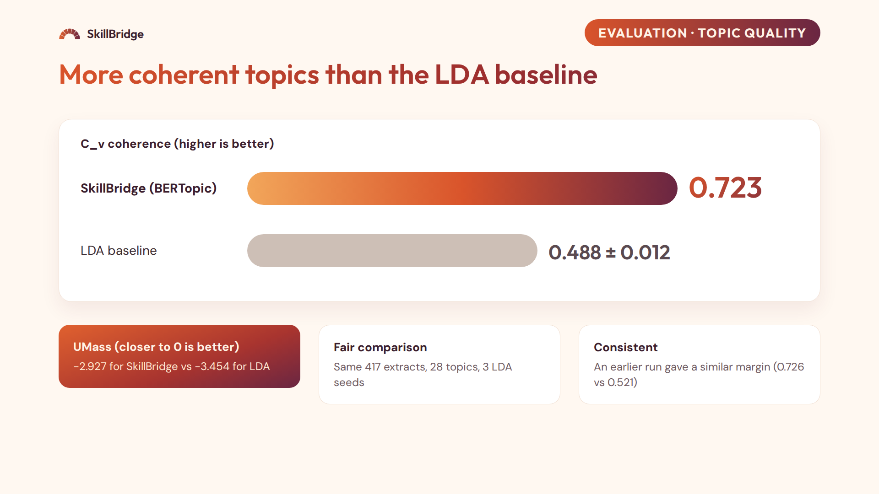
Notes:
To judge topic quality, I compared my topics with LDA, the classic topic model, trained on the same 417 extracts with the same number of topics, 28, over three random seeds. I measured coherence with Gensim, using the top ten words of each topic. Coherence tells us whether the words in a topic really belong together. On C_v, higher is better, SkillBridge scored 0.723 against 0.488 for LDA. On UMass, where closer to zero is better, SkillBridge scored minus 2.927 against minus 3.454. An earlier comparison, before merging topics, gave a similar margin, 0.726 against 0.521, so the advantage is consistent.

Slide 28
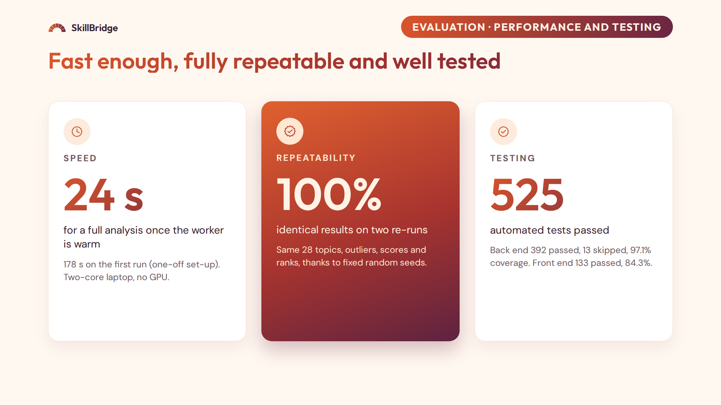
Notes:
Three more measures. Speed: the first analysis after the worker starts took 178 seconds, about three minutes, because the UMAP and HDBSCAN libraries compile their code the first time they run. After that, the same analysis took only 24 seconds, well within my target of 60 seconds. This was on an ordinary two-core laptop without a GPU. Repeatability: I ran the same analysis twice more, and both gave exactly the same topics, outliers, scores and ranks, because the random seeds are fixed. That matters because a committee must be able to reproduce its evidence. Testing: 525 automated tests passed in total. On the back end, 392 passed and 13 were skipped because they could not run on the development laptop, with 97.1% code coverage. On the front end, 133 tests passed with 84.3% coverage.

Slide 29
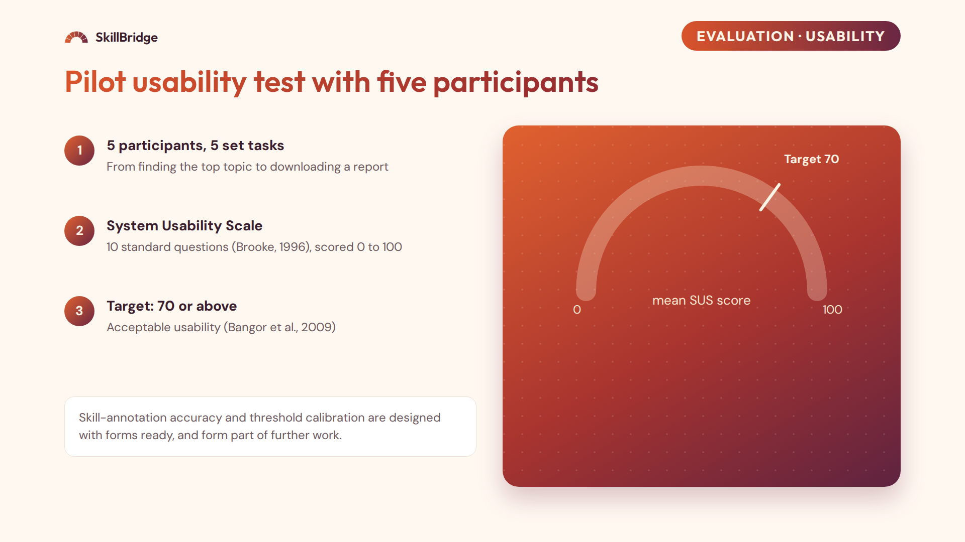
[__._]
Rating: [______]
[_] of 5 completed all tasks · average [__] min
Notes:
To test usability, I ran a pilot study with five participants. Each completed five set tasks in the system, such as finding the top suggested topic and its closest NUC course, accepting and rejecting topics, designing a course and downloading a report. Afterwards they filled in the System Usability Scale, a standard ten-question survey by Brooke, which gives a score from 0 to 100. My target was 70 or above, which Bangor and colleagues describe as acceptable. [Say the result: the mean SUS was __, rated __; __ of 5 completed all tasks.] Because five is a small number, I present this as a pilot. The skill-annotation study and the calibration of the overlap threshold are fully designed with forms ready, and they are part of my further work.

Slide 30
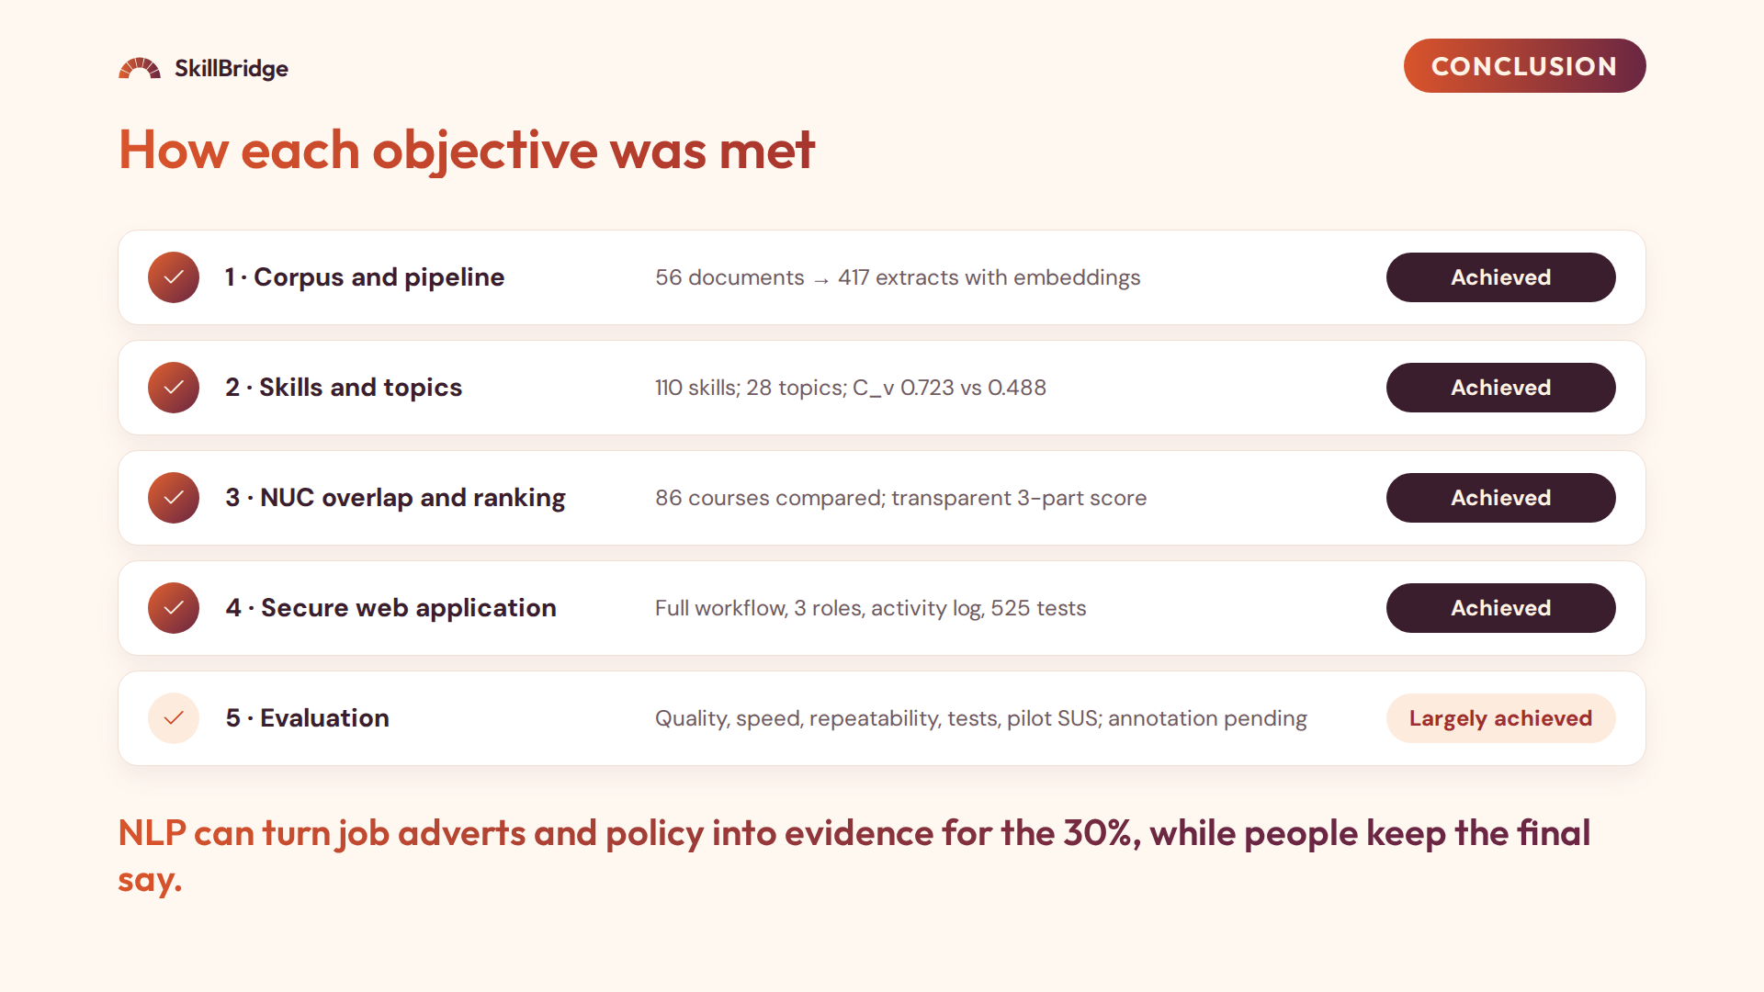
Notes:
To conclude, here is how each objective was met. Objective one: the system built and processed a corpus of 56 real documents into 417 extracts with embeddings. Objective two: it extracted 110 distinct skills and discovered 28 topics that were clearly more coherent than LDA. Objective three: every topic was compared with the 86 subject courses of the CCMAS and ranked with a transparent score. Objective four: the web application supports the full workflow from upload to report with server-enforced roles and an activity log, and passed 525 automated tests. Objective five is largely achieved: topic quality, speed, repeatability, correctness and a usability pilot are done, while the skill-annotation study and threshold calibration are still to be completed. The overall conclusion: natural language processing can turn job adverts and policy documents into evidence for the 30%, while the committee keeps the final decision.

Slide 31
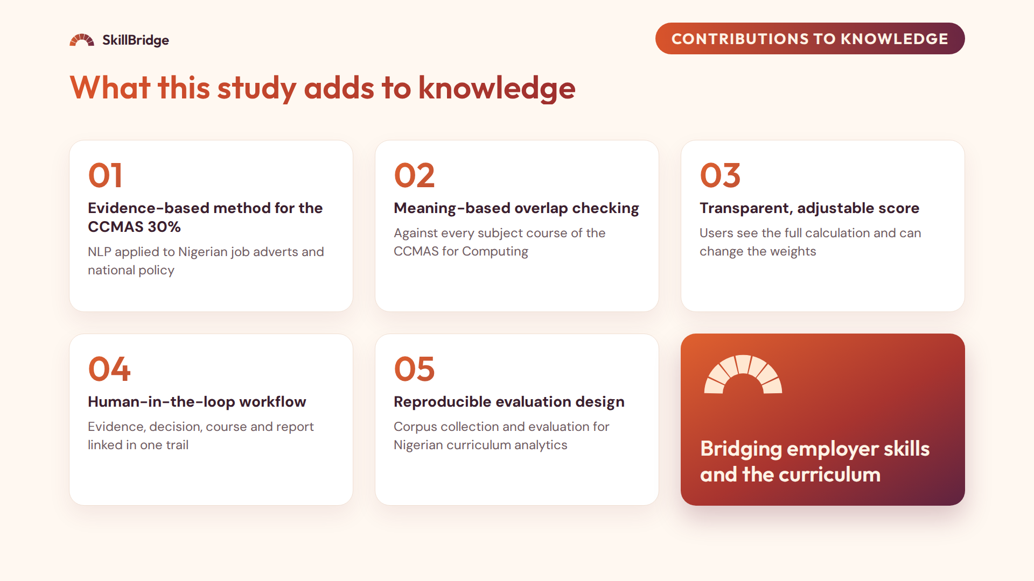
Notes:
The study makes five contributions. First, to the best of my knowledge from the sources reviewed, it is the first system to apply transformer-based NLP to Nigerian job adverts and a national policy document for designing the CCMAS 30%. Second, it checks topics by meaning against every subject course of the CCMAS for Computing, with a principled exclusion of generic courses like SIWES and projects. Third, it provides a transparent ranking score whose weights can be adjusted and whose calculation is visible. Fourth, it links each suggestion to a recorded decision, a designed course and a report, which gives an audit trail for Senate and accreditation. Fifth, it provides a reproducible method for collecting adverts and evaluating such systems in a Nigerian context.

Slide 32
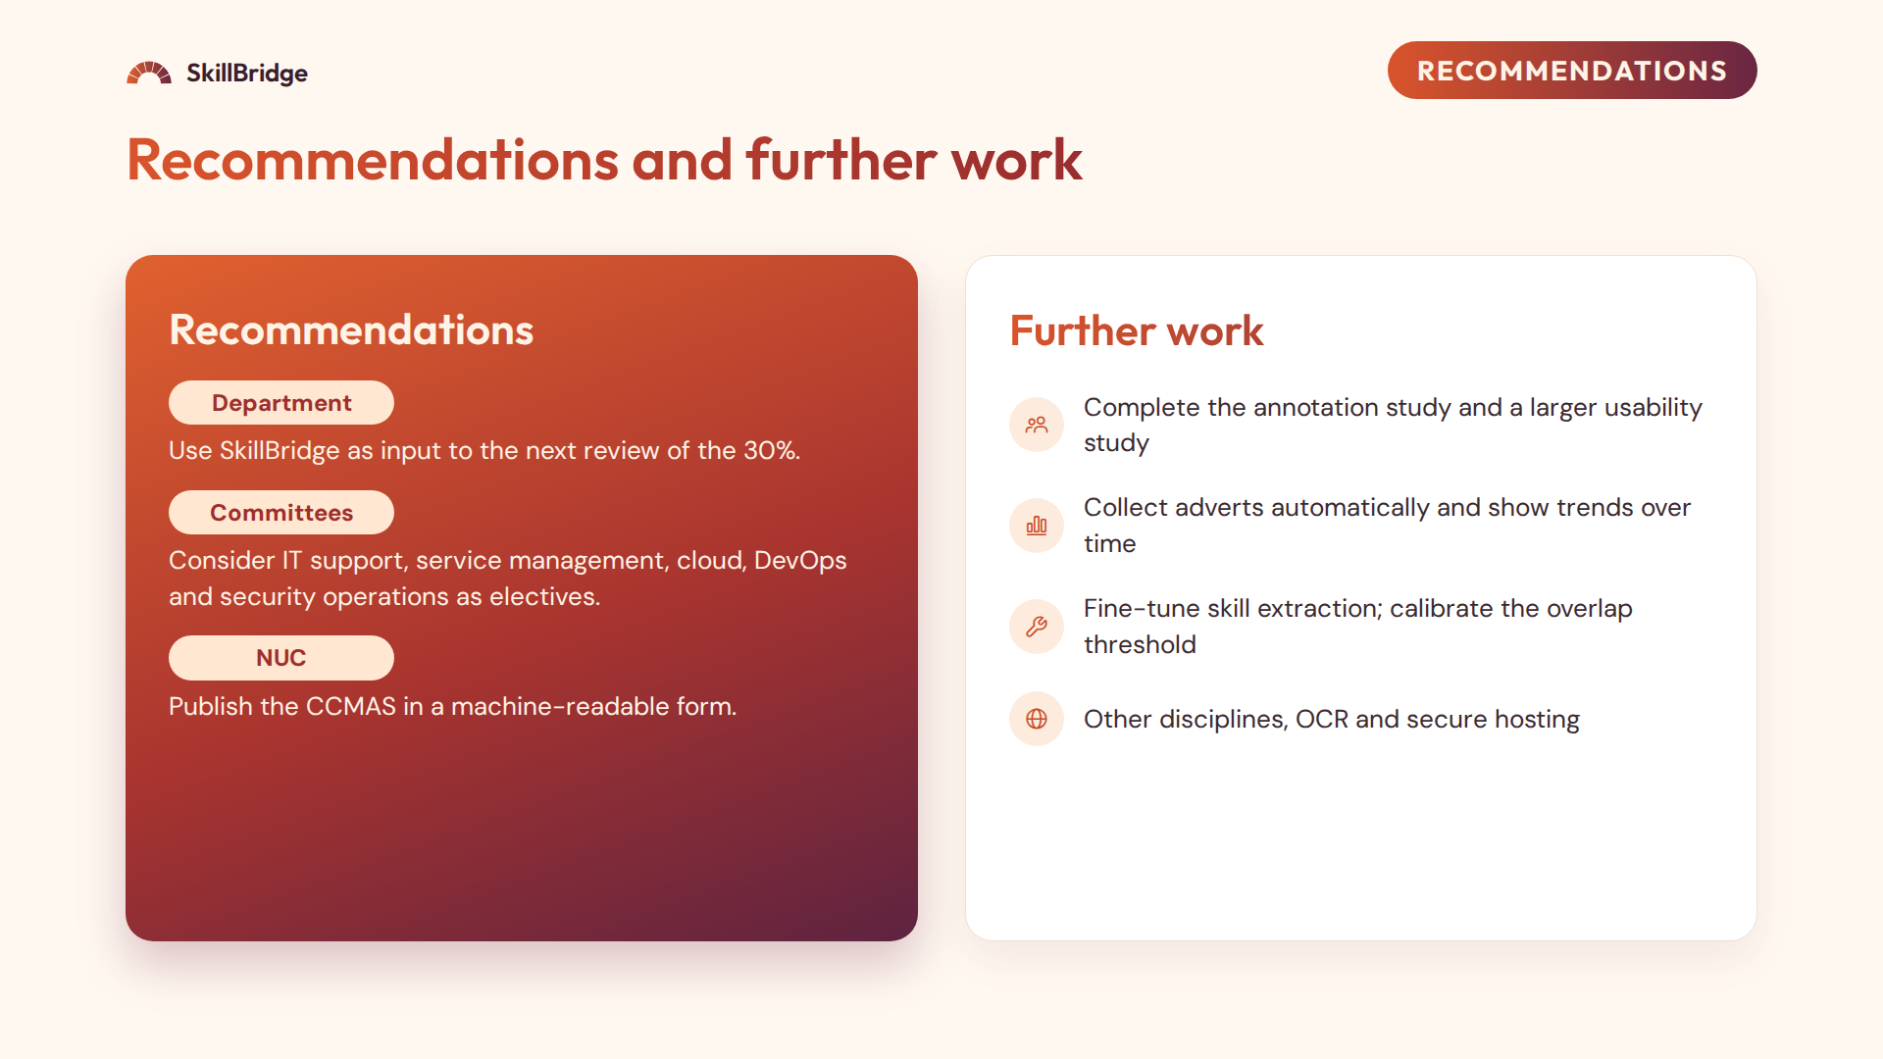
Notes:
My recommendations. To the Department of Computer Science, University of Uyo, and similar departments: use the system as an input to the next review of the 30%, and record the committee's decisions in it. To curriculum committees: consider the operational, tool-based areas the analysis highlighted, such as IT support and service management, cloud and DevOps, security operations and testing, as electives or specialisations. To the NUC: publish the CCMAS in a structured, machine-readable form, which would make tools like this easier to build. And to the system's administrators: broaden the corpus before relying on the results. For further work: complete the human evaluation with more participants, collect adverts automatically to show trends, fine-tune the skill extraction and calibrate the overlap threshold, extend it to other disciplines, add OCR for scanned documents, and deploy it securely with HTTPS and sign-in rate limiting.

Slide 33

Notes:
Thank you for listening. I welcome your questions and comments. Likely questions to prepare for: why BERTopic instead of LDA (it captures meaning with SBERT embeddings and gave much higher coherence); why the weights 40/35/25 (employer demand matters most for the 30%, and planners can change them); why only 55 adverts (collected politely from one site in a short time; the pipeline scales and broadening the corpus is a recommendation); how accurate is skill extraction (the annotation study is designed and forms are ready; results will be added); and why no topic crossed 0.80 (the core is conceptual and employers ask for operational skills; the threshold still needs calibration).

