Slide 1


CHALLENGE 7
Analyze Growth and Present Insights to the Telangana Government.

Slide 2
AGENDA
About Challenge.
Objectives
Primary Insights.
Stamp Registration
Transportation
Ts-Ipass
4. Secondary Research.

Slide 3
1 ABOUT CHALLENGE.
The challenge is to analyze Telangana's growth among different sectors quantitatively using real-time data from the Telangana government. The goal is to provide insights that can help the government make data-informed decisions to further support the state's growth.

Slide 4
OBJECTIVES
OBJECTIVES
01
Explore Stamp Registration, Transportation and Ts-Ipass Datasets.
Analyze trends and patterns within each department.
02
01
Identify growth opportunities and areas needing attention.
03
04
Find correlation among these departments and report the overall growth of the state through insights and relevant visuals such as shape maps.

Slide 5
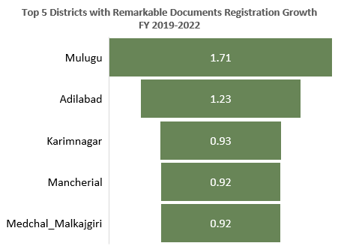
How does the revenue generated from document registration vary across districts in Telangana? List down the top 5 districts that showed the highest document registration revenue growth between FY 2019 and 2022.
PRIMARY INSIGHTS
STAMP REGISTRATION
Districts like Rangareddy, Medchal_Malkajgiri, Hyderabad, Sangareddy and Hanumakonda have generated highest document registration revenue.
Top 5 districts of the document registration revenue growth between FY2019-22 are Mulugu, Adilabad, Karimnagar and Medchal_Malkajgiri.

Slide 6
2. How does the revenue generated from document registration compare to the revenue
generated from e-stamp challans across districts? List down the top 5 districts where e-stamps
revenue contributes significantly more to the revenue than the documents in FY 2022?
PRIMARY INSIGHTS
STAMP REGISTRATION
For FY 2022, e-stamps challan revenue is more in compare to document registration revenue which means that people have positively reacted towards e-stamps.

Slide 7
3. Is there any alteration of e-Stamp challan count and document registration count pattern since
the implementation of e-Stamp challan? If so, what suggestions would you propose to the
government?
PRIMARY INSIGHTS
STAMP REGISTRATION
SUGGESTIONS :
Educational Initiatives : Propose educational initiatives aimed at enlightening users about the advantages and correct utilization of e-stamps challan.
User-Friendly Interfaces: Create user-friendly interfaces so that it is easy for users to access e-stamping system.
Communicate with Stakeholders: Communicate with relevant stakeholders, which includes government officers, and users of the system, to gather information.

Slide 8
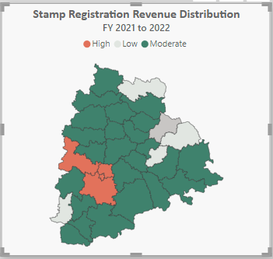
4. Categorize districts into three segments based on their stamp registration revenue generation
during the fiscal year 2021 to 2022.
PRIMARY INSIGHTS
STAMP REGISTRATION
Rangareddy, Medchal_Malkajgiri, Hyderabad and Sangareddy are high revenue generating districts on stamp registration; Revenue>10Bn
Green ones are the districts generating moderate amt. of revenue in between 1Bn and 10Bn.
Grey ones are the districts generating lowest revenue amt. by stamp registration; Revenue<1Bn

Slide 9
5. Investigate whether there is any correlation between vehicle sales and specific months or seasons in different districts. Are there any months or seasons that consistently show higher or lower sales rate, and if yes, what could be the driving factors? (Consider Fuel-Type category only)
PRIMARY INSIGHTS
TRANSPORTATION
June and October are months with highest sales. One of the reason for high sales in June is because of monsoon season offers and high in October because of festive season.
Low sales in April and May because of holiday season.

Slide 10
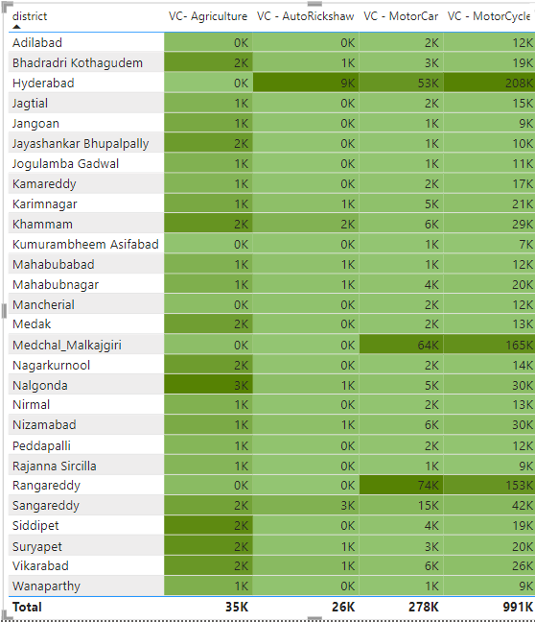
6. How does the distribution of vehicles vary by vehicle class (MotorCycle, MotorCar, AutoRickshaw, Agriculture) across different districts? Are there any districts with a predominant preference for a specific vehicle class? Consider FY 2022 for analysis.
PRIMARY INSIGHTS
TRANSPORTATION
Highly preferrable vehicles are Motorcycle followed by Motorcar, Agriculture and Autorickshaw.
Hyderabad has dominating preference of Autorickshaw, Motorcar, Motorcycle.

Slide 11
7. List down the top 3 and bottom 3 districts that have shown the highest and lowest vehicle sales growth during FY 2022 compared to FY 2021? (Consider and compare categories: Petrol, Diesel and Electric)
PRIMARY INSIGHTS
TRANSPORTATION

Slide 12
8. List down the top 5 sectors that have witnessed the most significant investments in FY 2022.
PRIMARY INSIGHTS
Ts-Ipass
In FY 2022, investments were made in total 19 sectors; out of which following 5 are the top sectors with highest investments.

Slide 13
9. List down the top 3 districts that have attracted the most significant sector investments during FY 2019 to 2022? What factors could have led to the substantial investments in these particular districts?
PRIMARY INSIGHTS
Ts-Ipass
Rangareddy, Sangareddy and Mechal_Malkajgiri has in all more than 50% of total investments.
Factors that led to substantial investments in these districts.
Proximity of Capital i.e Hyderabad.
Ts-Ipass system makes the process fast and creates best environment for work.
Proximity to key markets, ports or transportation hubs.

Slide 14
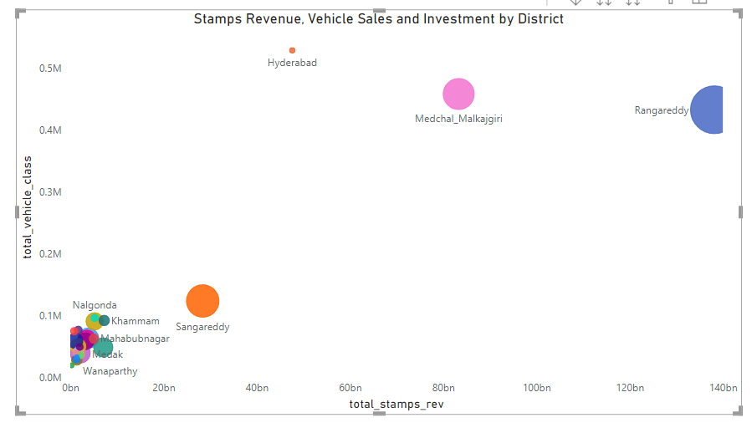
10. Is there any relationship between district investments, vehicles sales and stamps revenue within the same district between FY 2021 and 2022?
PRIMARY INSIGHTS
Ts-Ipass
Rangareddy, Medchal_Malkajgiri and Sangareddy are under top districts with high investments, stamp revenue and vehicle sales.

Slide 15
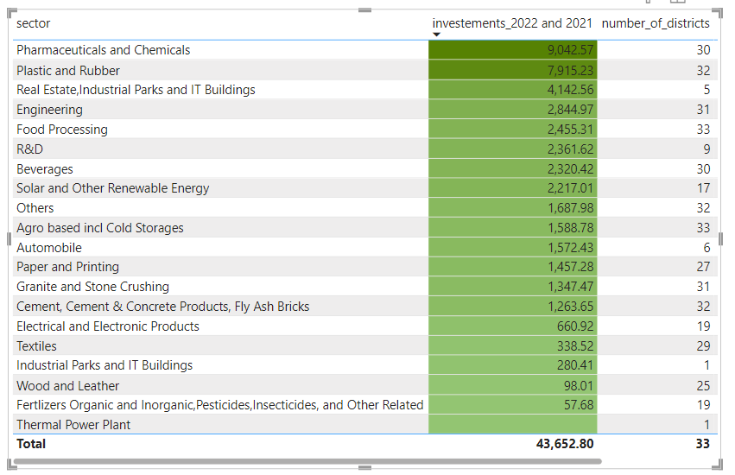
11. Are there any particular sectors that have shown substantial investment in multiple districts between FY 2021 and 2022?
PRIMARY INSIGHTS
Ts-Ipass
Substantial investment in multiple districts between FY 21 and FY 22 was seen in “Pharmaceuticals & Chemicals” with striking 9042.57 cr; followed by “Plastic & Rubber” with 7915.23 cr, and “Real Estates, Industrial Parks and IT bldgs.” with 4142.56 cr.

Slide 16
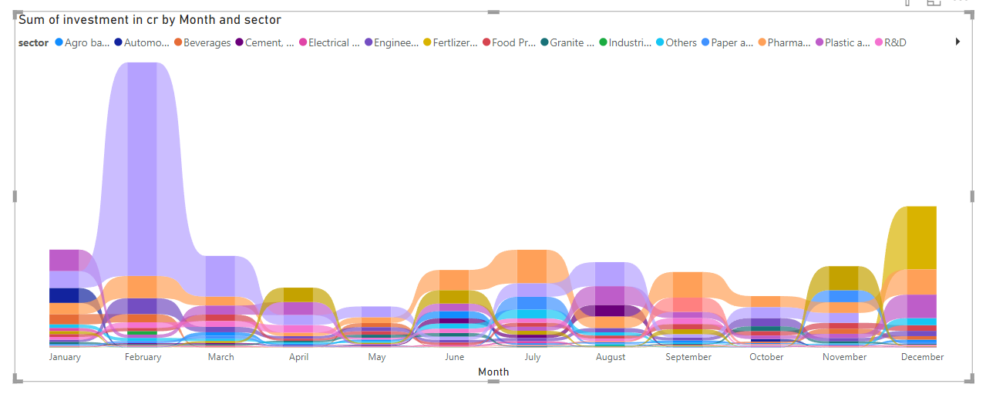
12. Can we identify any seasonal patterns or cyclicality in the investment trends for specific sectors? Do certain sectors experience higher investments during particular months?
PRIMARY INSIGHTS
Ts-Ipass
No seasonal pattern or cyclicality in the investment of sectors was found.
Real Estate, Industrial Parks and IT buildings had highest investment of 17843.85 Cr in Feb 2020.
Pharmaceuticals and Chemicals sector had high investments during Feb, July, Sept and Dec.
Plastic and Rubber sector had high investments in Jan, Aug and Dec.

Slide 17
SECONDARY RESEARCH.
1. What are the top 5 districts to buy commercial properties in Telangana? Justify your answer.
RANGAREDDY
MEDCHAL MALKAJGIRI
Close proximity to Hyderabad and received high investments in Real Estate, Industrial Parks and IT buildings sector
home to a number of major industries, including IT, manufacturing, and pharmaceuticals.
1
3
5
2
4
HYDERABAD
SANGAREDDY
YADADRI BHUVANAGIRI
Capital of Telangana and considered as the IT & TECH Hub.
Received highest investments in Pharmaceutical and Chemical sector.
Home to many manufacturing, logistics, warehousing.

Slide 18
SECONDARY RESEARCH
2. What significant policies or initiatives were put into effect to enhance economic growth, investments, and employment in Telangana by the current government? Can we quantify the impact of these policies using available data?
TS-iPASS: The Telangana State Industrial Project Approval and Self-Certification System (TS-iPASS) is a single-window clearance system for industrial projects. It has made it much easier and faster for businesses to set up shop in Telangana.
TS-bPASS: The Telangana State Business Process Approval and Self-Certification System (TS-bPASS) is a similar system for businesses in the services sector.
Startup Telangana: The Telangana government has launched a number of initiatives to support startups and entrepreneurs in the state. These initiatives include providing financial assistance, mentorship, and other resources.
These are just a few of the many initiatives that the Telangana government has put in place to enhance economic growth, investments, and employment in the state. As a result of these initiatives, Telangana has become one of the fastest-growing economies in India.
For eg: In the annual report for 2023, released in January, IT minister K.T. Rama Rao had claimed that TS-iPASS helped Telangana attract investments worth Rs 3.3 lakh crore, which resulted in the creation of over 22.5 lakh jobs.

Slide 19
SECONDARY RESEARCH
3. Provide top 5 Insights & 5 recommendations to Telangana government for sustained growth in the next 5 years based on your analysis.
I N S I G H T S
E-stamp challans > Document Registration.
Agro based incl. Cold Storages sector and Food Processing sector have investments in all the districts of Telangana.
Real Estate, Industrial Parks, IT buildings sector, Pharmaceutical & Chemicals sector and Plastic & Rubber sector are the sectors that are creating high investment opportunities.
Hyderabad has highest number of vehicle sales across Telangana.
Rangareddy, Medchal Malkajgiri, Hyderabad and Sangareddy are top districts generating stamp revenue
R E C O M M E N D A T I O N S
Provide people with the knowledge and skills
they need to engage with social issues and
make a difference.
2) Develop transportation, logistics, and digital
infrastructure to create a more efficient and
connected state, and to make it easier for
businesses to operate and thrive.
3) Develop cities that are resilient to climate
change and other challenges, and that are
attractive to businesses and tourists.
4) Leverage the state's cultural, historical, and
natural attractions to boost tourism.
5) A robust healthcare system not only improves
public well-being but also supports economic
productivity.

Slide 20
THANK YOU
-ESHIKA ATUL SHAH.

