Slide 1

CHAMELI DEVI GROUP OF INSTITUATION DEPARTMENT : IT 4TH SEM
Submitted To : Submitted By:
Ms. Nidhi Agrawal Divyanshee Shrivastav(0832IT221016)
Divyanshi Pal(0832IT221017)
Eshika Depale(0832IT221019)
Gourav Giri(0832IT221020)
Harsh Bairagi(0832IT221022)

Slide 2
SUBJECT : MATHEMATICS-3
SUBJECT CODE : BT401
TOPIC NAME : BINOMIAL DISTRIBUTION

Slide 3
CONTENT
Introduction
What is Binomial Distribution?
Definition of Binomial Distribution.
Assumption of Binomial Distribution
Problems

Slide 4
INTRODUCTION
Binomial Distribution was discovered by JAMES BERNOILLI in 1738.
This is discrete probability distribution.
A discrete probability distribution can be encoded by a discrete list of the probabilities of the outcomes, known as a probability mass function.

Slide 5
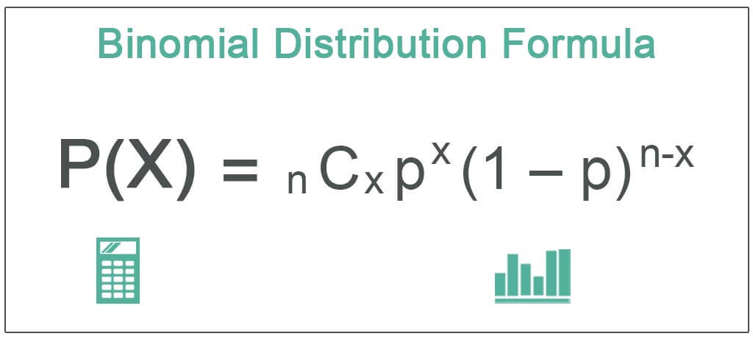
DEFINE BINOMIAL DISTRIBUTION
If ‘X’ is a discrete random variable with probability mass function.
Where x = 0,1,2,3……n & q=1-p, then ‘x’ is a binomial variate and the distribution of ‘X’ is called Binomial Distuibution.

Slide 6
What is Binomial Distribution?
The word “binomial” literally means “two numbers”. A binomial distribution for a random variable X is one in which there are only two possible outcomes, success and failure, for a finite number of trials.
Note that however we define success and failure, the two events must be mutually exclusive and complementary ; that is, they cannot occur at the same time(exclusive) and the sum of their probabilities is 100%(complementary).
Notes:
A

Slide 7
ASSUMPTION OF BINOMIAL DISTRIBUTION
For each trial there are only two possible outcomes on each trial , S(success) and F(failure).
The number of trials n is finite.
For each trial, the two outcomes are mutually exclusive.
P(S) = p is constant. P(F) = q = 1-p
The trials are independent, the outcomes of a trial is not affected by the outcomes of any other trial.
The probability of a success ,p , is constant from trail to trail.

Slide 8
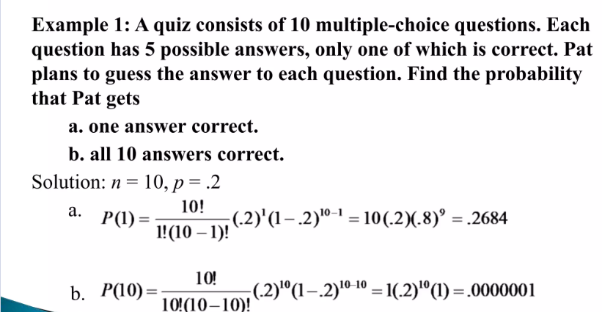
Problem

Slide 9
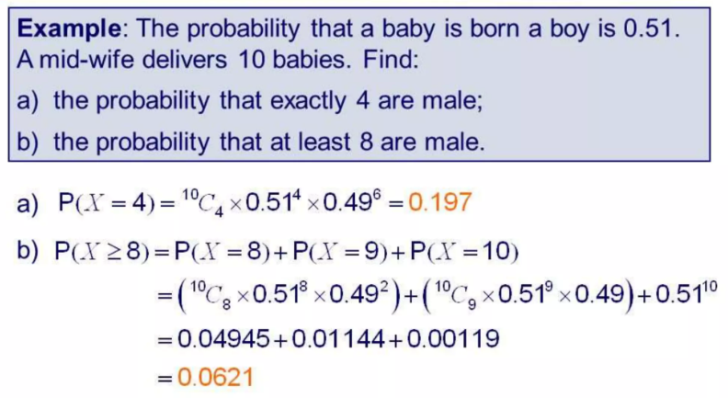

Slide 10
THANK YOU…!

