Slide 1
Diagonals and Bootstrapping
22 - 29 April 2026

Slide 2
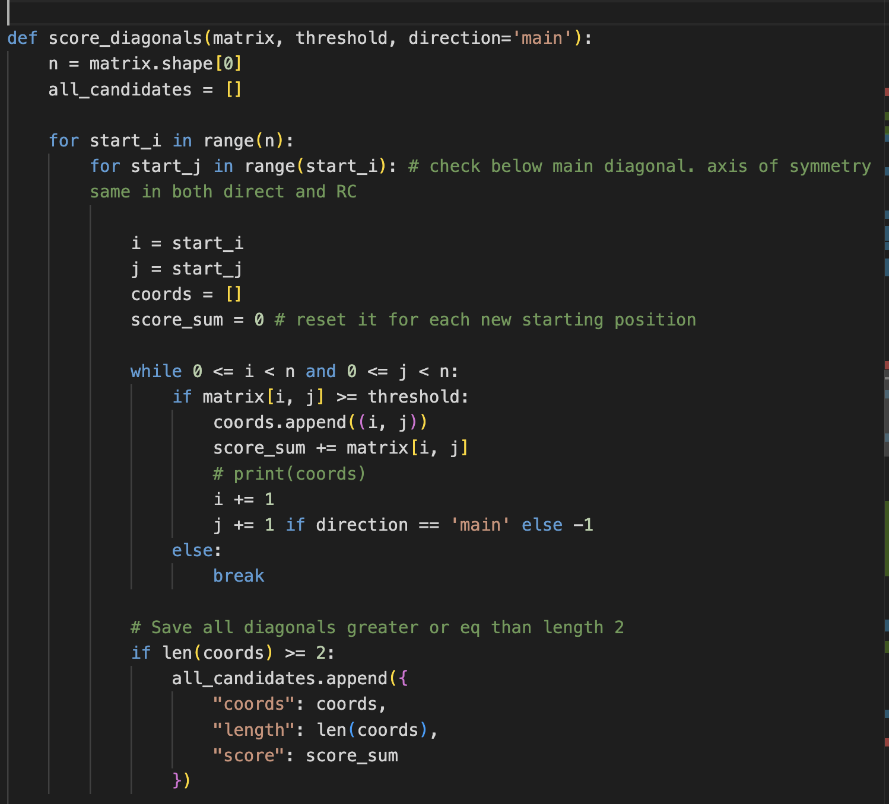
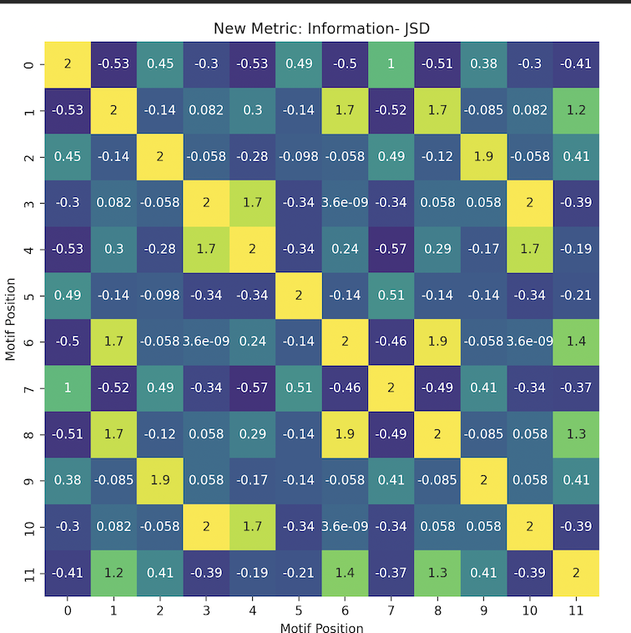
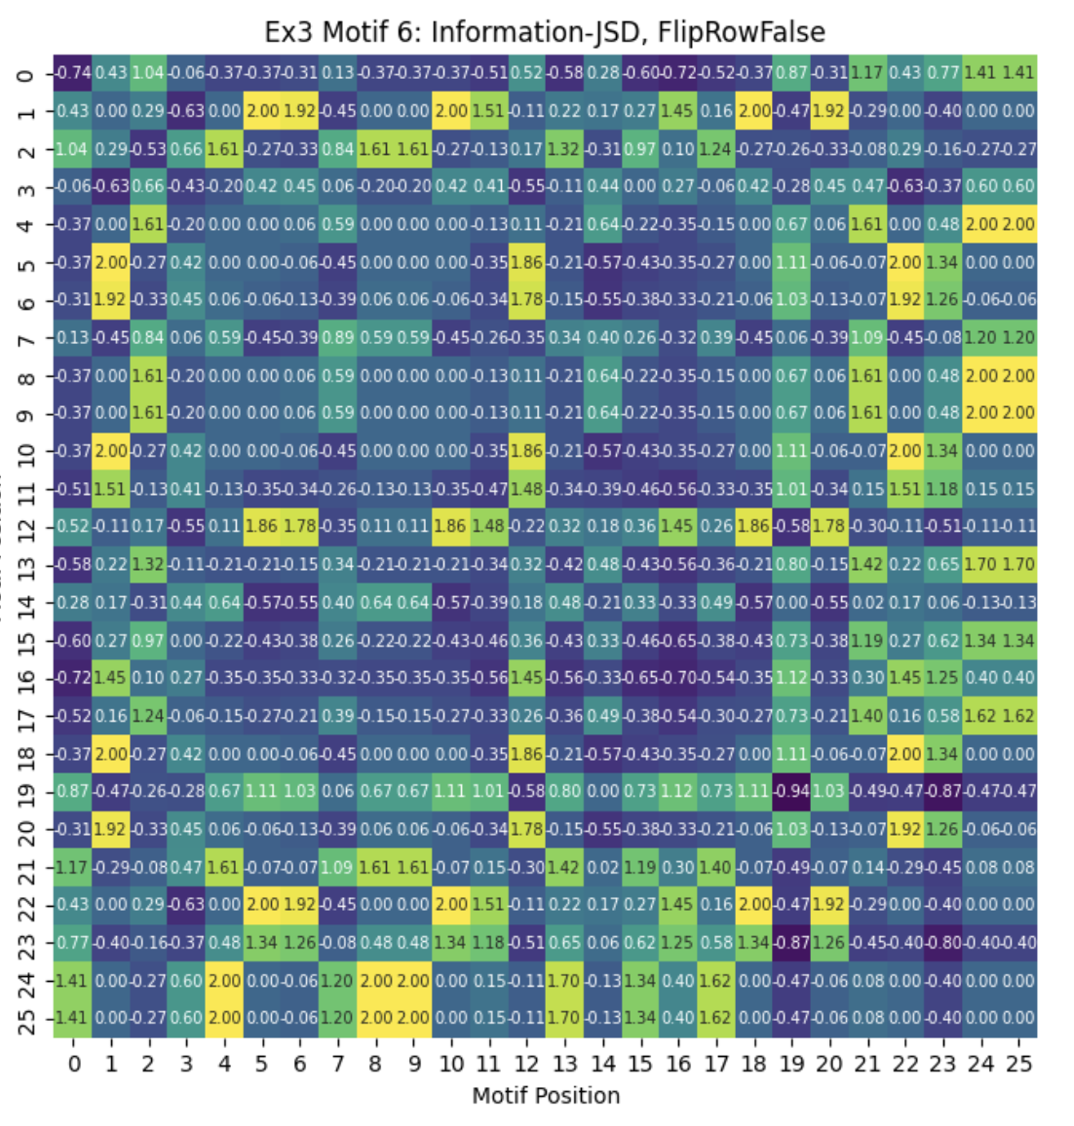
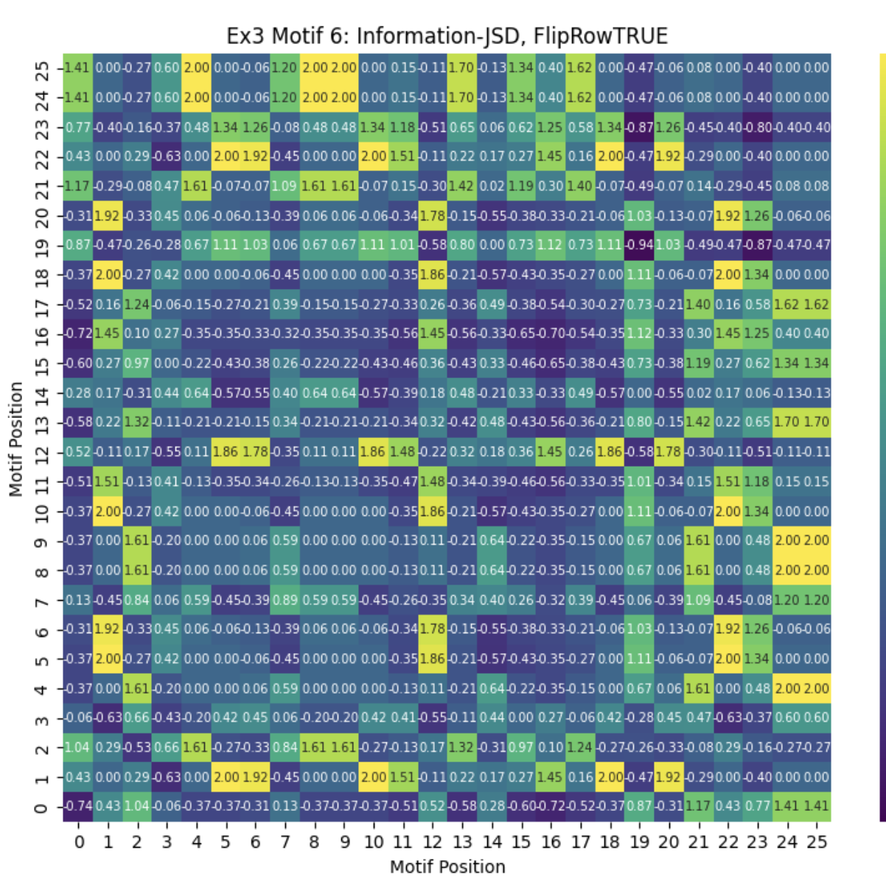

Slide 3
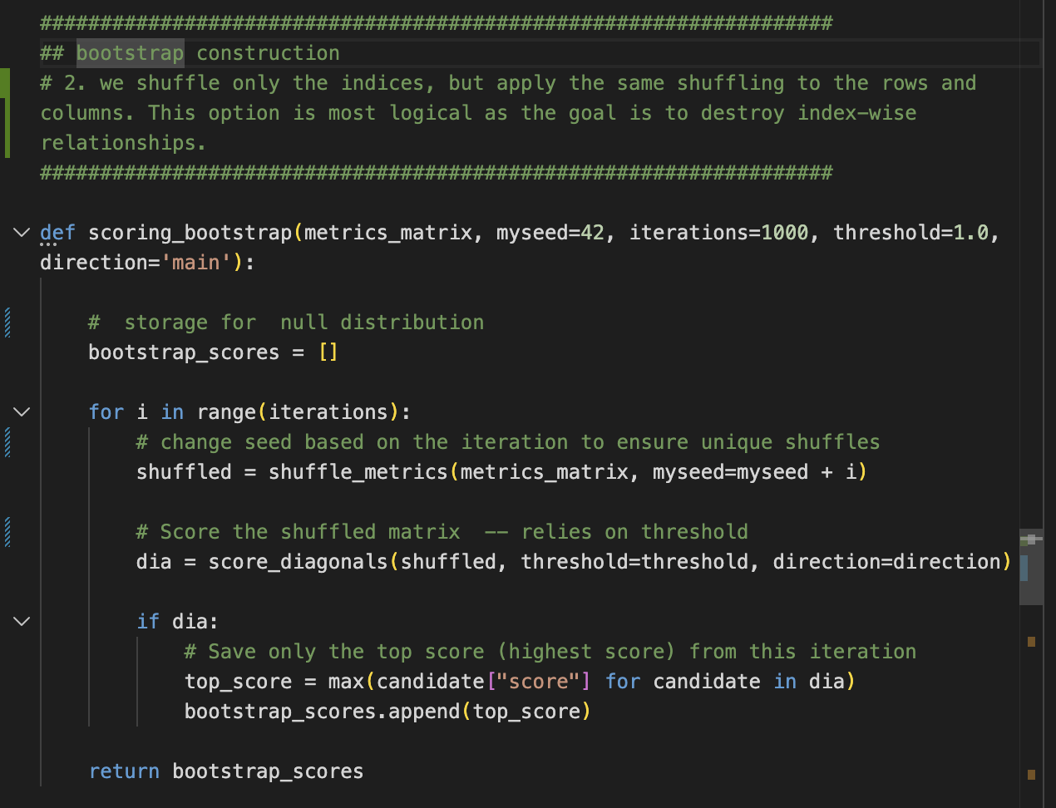
Bootstrap logic
Inherits threshold and direction args from diagonal scoring function, probably need to make a class so that we don’t need to keep specifying the same args

Slide 4
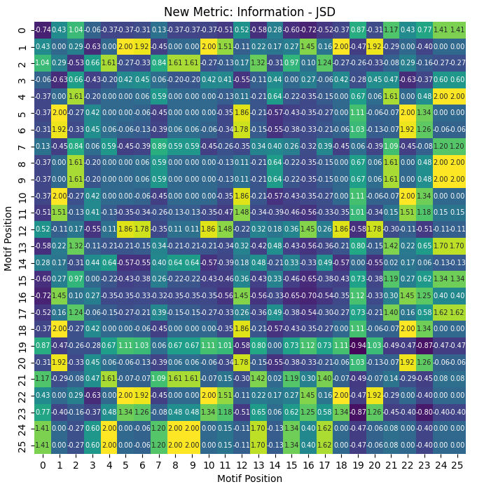
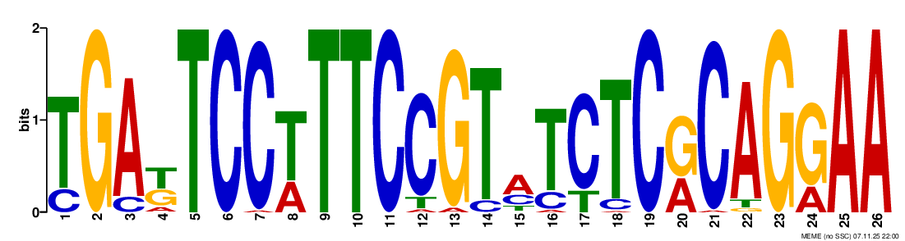

Ex3 Motif 6 - RC
TTCC...GGAA
[(22, 11), (23, 10), (24, 9), (25, 8)]
Sum IC-JSD: 6.845

Slide 5
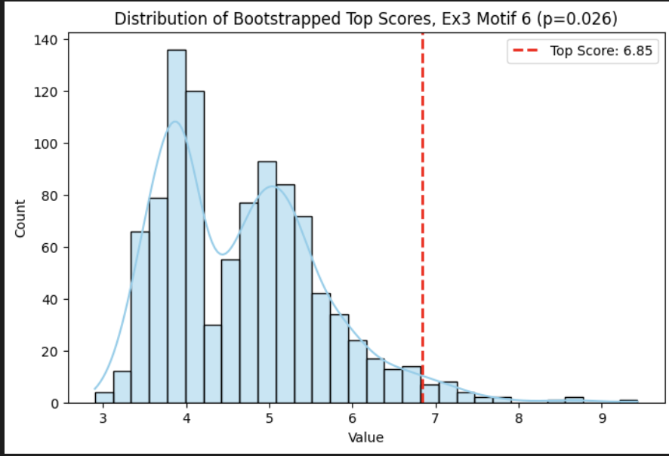
Bootstrap Distribution (n=1000)
Possible binomial fit
This was already a relatively weak signal, so result makes sense

Slide 6
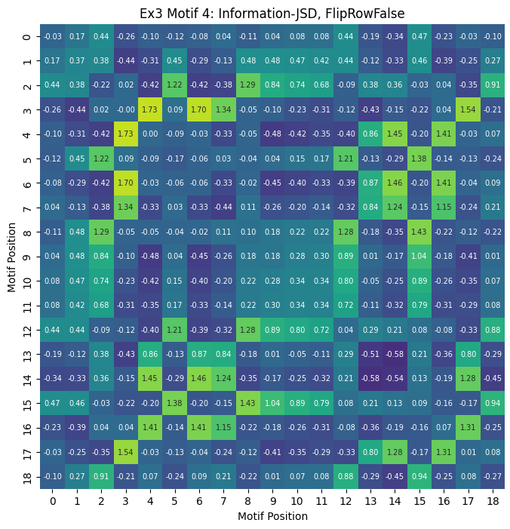
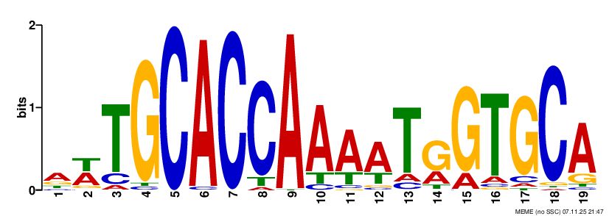

Ex3 Motif 4 - RC
GCACCA…TGGTGC
[(14, 6), (15, 5), (16, 4), (17, 3)]
Sum IC-JSD: 5.79

Slide 7
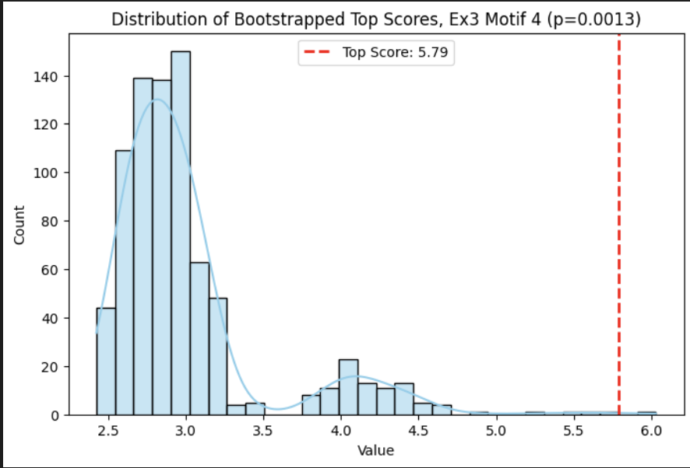
Bootstrap Distribution (n=1000)
Binomial shape more obvious
Stronger RC signal

Slide 8
Next steps
Test on more examples – now that we have pipeline it should be easier to run en masse
Power analysis https://stats.stackexchange.com/questions/369637/determining-power-of-statistical-test-through-bootstrapping

Slide 9

Ex3 Motif 4 - Direct
AAAA
[(14, 4), (15, 5), (16, 6)]
8.065600973930767

