Slide 1
Child Mind Institute — Problematic Internet Use
Team 8:
Anvesh Kumar Chavidi
Eshita Gupta
Neha Thakur
Padhma Cebolu Srinivasan
Saumya Varshney
Sneha Karri
DATA – 255: Deep Learning Technologies
Professor: Simon Shim

Slide 2
Introduction
Problematic internet use among youths is a serious public health problem that affects mental health and development processes.
Traditional diagnostic procedures are usually complex clinical assessments, which can be inaccessible and expensive.
Novel Strategy: Use the measures of physical activity as an indirect measure for problematic internet use.
Hypothesis: Excessive technological engagement emerges through observable changes in physical behaviors and fitness indicators.
Predictive models using physical activity might enable early interventions and support strategies for the prevention of poor mental health.

Slide 3
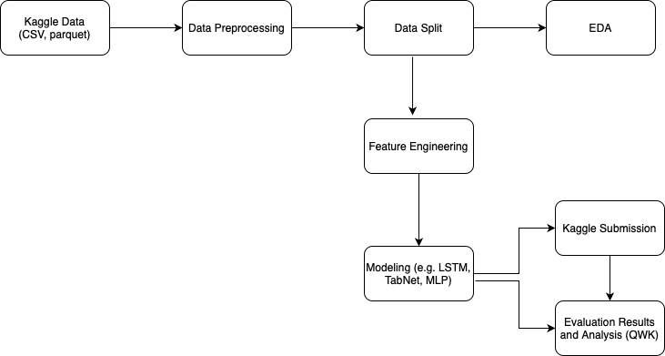
Project Workflow

Slide 4
Literature Review/ Related Work
Author name with publication year | Type of models used | Focus of the paper
Koczkodaj et al. (2023) | CNNs with Differential Evolution Algorithms | Predicting dangerous internet use patterns using a hybrid deep learning architecture combining differential evolution algorithms with CNNs.
Cai et al. (2022) | Regression models used | Establishing connections between internet use behaviors and mental health outcomes like stress, anxiety, and depression using regression models.
Pontes et al. (2021) | Deep Neural Networks (DNNs) | Classifying teenagers into PIU profiles based on behavioral and psychosocial traits using multi-dimensional data.
Montag et al. (2020) | MLPs, RNNs | Investigating the role of addictive design features in problematic internet use (PIU) and predicting self-identified internet use (SII).
Tokunaga, R. S. (2015) | RNNs, LSTMs | Examining self-regulation and media use patterns in PIU, and linking internet behaviors to psychosocial outcomes.

Slide 5
Data Overview
The dataset comes from the Healthy Brain Network, which consists of data from 5000 participants between age 5 to 22 years.
Key features include physical activity data obtained through accelerometer (actigraphy) recordings, as well as in-depth clinical and research questionnaire responses.
The target variable is Severity Impairment Index (SII), a standardized measure to quantify problematic internet use.
SII is derived from participant responses to the Parent-Child Internet Addiction Test (PCIAT) and classifies individuals into four categories: None (0), Mild (1), Moderate (2), and Severe (3).

Slide 6
Data Overview (continued)
The data consists of two formats - tabular data and time-series data.
The tabular data, stored in CSV format, comprises numerous instruments and associated fields., including demographic profiles (e.g., age, sex, enrollment season), physical measurements, fitness test results and responses to questionnaires. It also has data related to internet use such as hours of daily computer or internet activity, offer insights into participants online behavior.
The time-series data is saved in parquet format, and it consists of continuous wrist-worn accelerometer recordings spanning multiple days.

Slide 7
Problem Formulation
The Healthy Brain Network (HBN) has presented a comprehensive dataset with clinical samples for about 5000 volunteers aged 5-22 years who have undergone clinical and research screening. Target: "Severity Impairment Index (sii)" Levels: None, Mild, Moderate, Severe
Challenges
Approach
Dataset comprises of demographic information, physical movement metrics, and metrics from clinical test
Dataset also provides time series data from an accelerometer to track physical movements
The primary metric SII measures the increasing levels of severity for the metal or social impairment
Training and Test Datasets don't match in terms of feature columns as information about Parent-Child Internet Addiction Test is missing in test dataset
Dataset is highly imbalanced with 58.2% data for sii as "none"
Accelerometer data is timeseries and it needs to be combined with the primary dataset. That is also available only for 966 participants
Advanced preprocessing techniques are needed to handle issues with the data
Understanding the key relationships between different features in the data
Use advanced machine/deep learning models to map the complex relationships in the data and generate a predictive model
Solution should be able to generalize well on wide range of age groups while accounting for developmental differences.
Key Insights
This study will be significant in research of state of the art tools for early identification/intervention for mental and social disorders.

Slide 8
Data Cleaning and Preprocessing
Handling Missing Values: Numerical features imputed with KNN imputer (using K nearest neighbors).
Categorical features replaced with "unknown" and converted to categorical data type.
Feature Engineering: Aggregated features by calculating descriptive statistics.
Encoded categorical features using custom mappings to prevent data leakage.
Scaled features using Standard scaler
Addressed target variable imbalance using Borderline-SMOTE.

Slide 9
Feature Engineering
CSV files and Time-series data stored in multiple Parquet files are merged into a single data frame using ID column.
Purpose
Static Features: train.csv and test.csv provide demographic, physical, and questionnaire-based data.
Time-Series Features: The Parquet files contain actigraphy data for a subset of participants.
Result: Combining these sources ensures that both static and time-series features are available for modeling, capturing both participant-specific and time-varying aspects of the data.
Benefits
Improved feature relevance and interpretability.
Effective handling of high-dimensional time-series data.
Minimized impact of missing values on model performance.

Slide 10
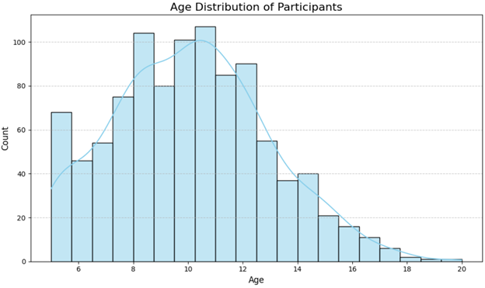
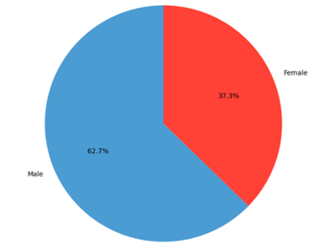
Exploratory Data Analysis
Gender Distribution Of participants
Age Distribution Of Participants

Slide 11
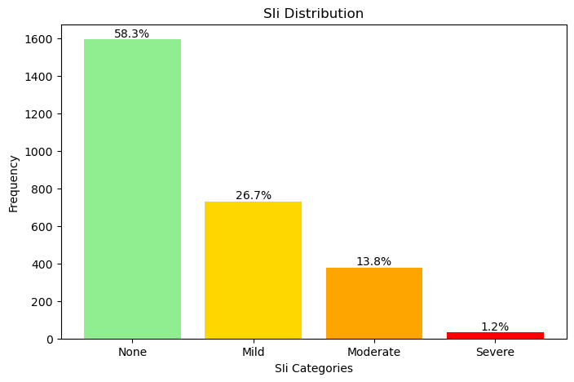
Severity Impairment Index (SII) Distribution in Training Dataset

Slide 12
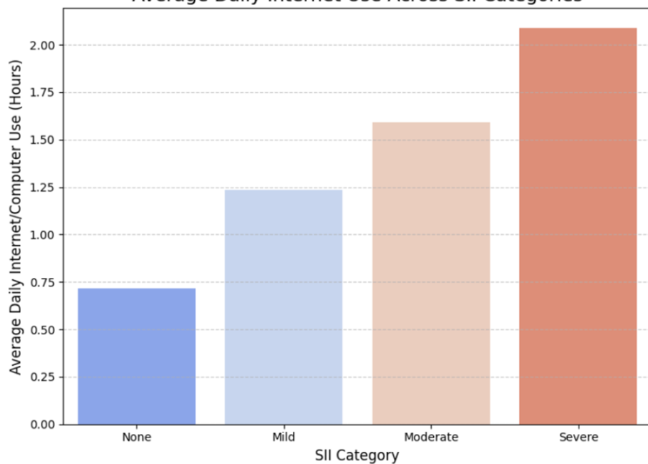
Average Daily Internet usage across SII Categories

Slide 13
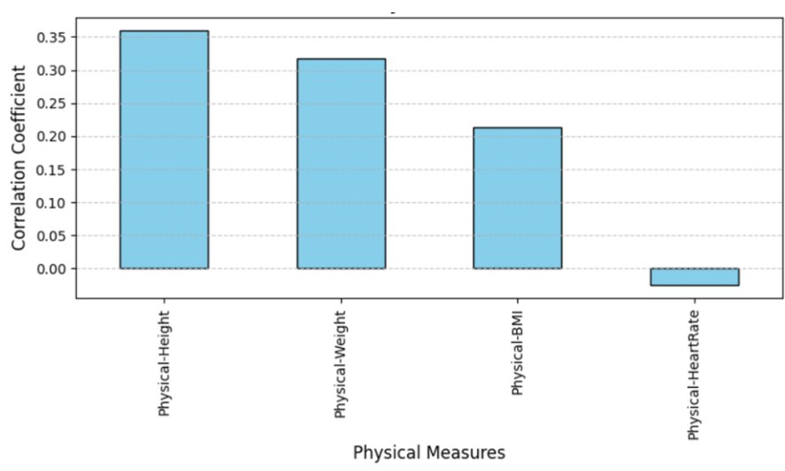
Relationship between Physical Measures with SII​

Slide 14
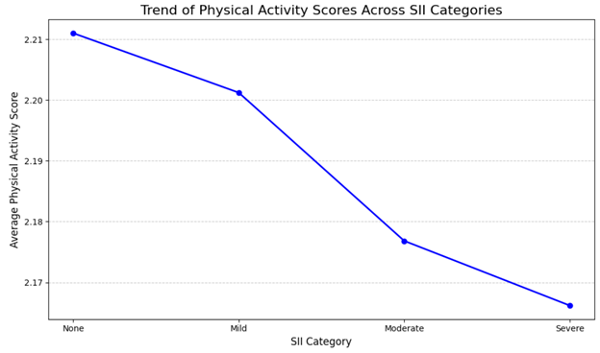
Effect of Physical Activity across SII categories

Slide 15
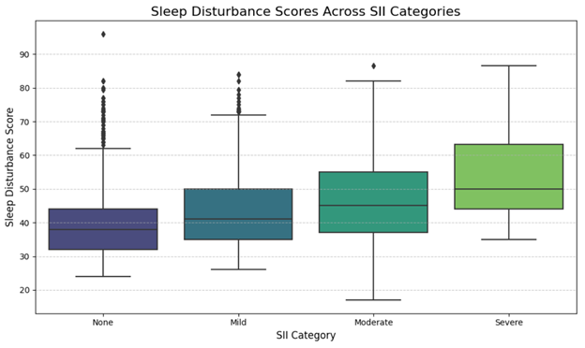
Sleep Disturbance Score Analysis

Slide 16
Models
Models used for this competition are:
TabNet Ensemble Classifier
Custom implementation of a TabNet Regressor
Implementation of Multi-Layer Perceptron (MLP)
Implementation of Long Short-Term Memory (LSTM)
Implementation of Siamese Long Short-Term Memory (LSTM)
Ensemble of Voting Regressor with TabNet

Slide 17
Ensemble of Voting Regressor with TabNet
Combines LightGBM, XGBoost, CatBoost and TabNet using a Voting Regressor to leverage individual model strengths.
Dimensionality Reduction: Autoencoder compresses time-series features into meaningful representations.
Voting Regressor:
Combines model outputs to enhance final prediction.
Optimization: Threshold tuning and cross-validation refine predictions.
Feature Importance: Tree-based regressors provide interpretability for contributing features.
Prediction and Evaluation
Best QWK Score: 0.494 achieved with threshold optimization.
Residual Analysis and confidence interval estimation validate predictions.
Results highlight the ensemble's robustness in improving accuracy.

Slide 18
Model Evaluation
Quadratic Weighted Kappa (QWK)
QWK was used as the primary evaluation metric, ensuring the model's predictions align closely with the ground truth on a weighted scale.
Threshold optimization improved the QWK score by finding the best class mapping for continuous predictions.
Cross-validation results
Mean Train QWK: Evaluated model fit on training data.
Mean Validation QWK: Assessed generalization on unseen data.
Threshold Analysis
Thresholds were iteratively optimized for each hyperparameter configuration to test the model's ability to predict binary classes effectively.

Slide 19
Result Analysis
Best Performance
The TabNet Voting Regressor Ensemble achieved the highest QWK Score (0.480) and Kaggle Submission Score (0.494), showcasing superior prediction alignment and robustness. TabNet Ensemble Classifier achieved QWK score of (0.42) and Kaggle submission score of (0.39).
TabNet Regressor using Wrapper
Strong QWK Score (0.477) but relatively low Kaggle Score (0.303) indicates potential overfitting or lack of generalization.
Multi-Layer Perceptron (MLP)
Achieved moderate QWK score (0.3694) but got low Kaggle score (0.361) which indicates overfitting or differences in data distribution.
Sequential Models
LSTM and Siamese LSTM underperform in QWK but achieve moderate Kaggle scores, with Siamese LSTM at 0.327.
Overall
The ensemble approach effectively combines predictions, outperforming standalone models.

Slide 20
Result Analysis
Model Name | TabNet Ensemble Classifier | TabNet wrapper | LSTM | MLP | Siamese LSTM | TabNet Voting Regressor Ensemble
QWK (Quadratic Weighted Kappa) Score | 0.4271 | 0.477 | 0.3283 | 0.3694 | 0.297 | 0.48
Kaggle Submission Score​ | 0.391 | 0.303 | 0.310 | 0.316 | 0.327 | 0.494

Slide 21
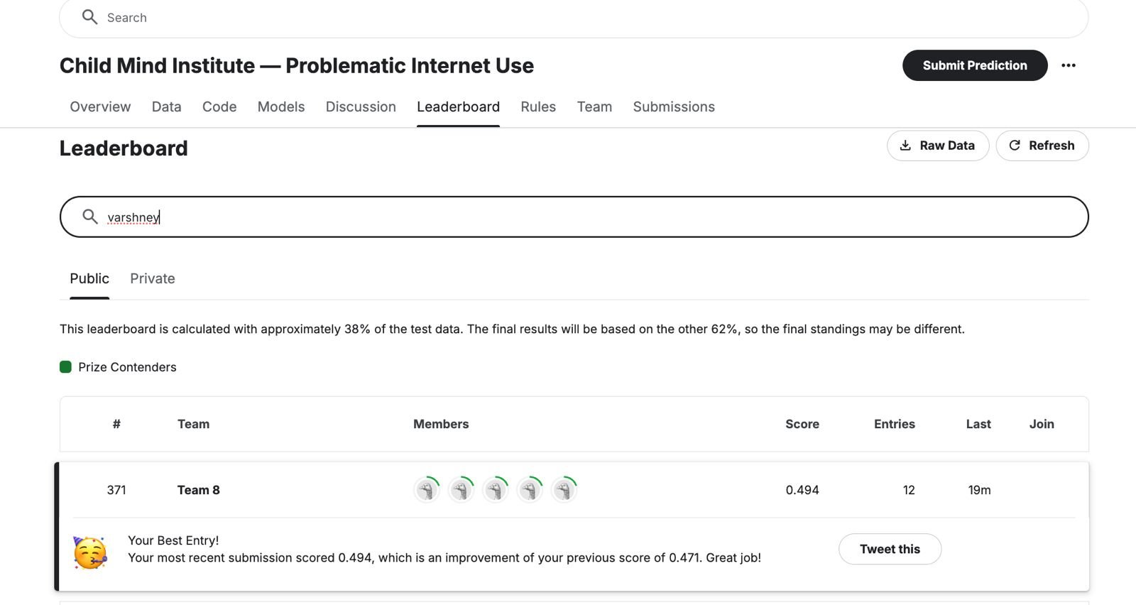
Kaggle Leaderboard

Slide 22
Conclusion
To conclude, this project demonstrated the effectiveness of leveraging advanced machine learning models, TabNet and its custom wrapper, alongside sequential models like LSTM and MLP, for tackling multi-class classification problems with tabular and time-series data.
The TabNet Voting Regressor Ensemble emerged as the most robust model, achieving the best Quadratic Weighted Kappa (QWK) and Kaggle scores, highlighting the power of ensemble methods in enhancing predictive performance.

Slide 23
Thank You

