Slide 1
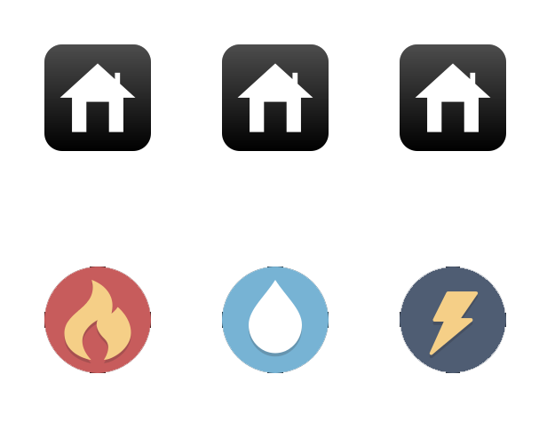
Connect all 3 houses to all 3 utilities without any crossings

Slide 2
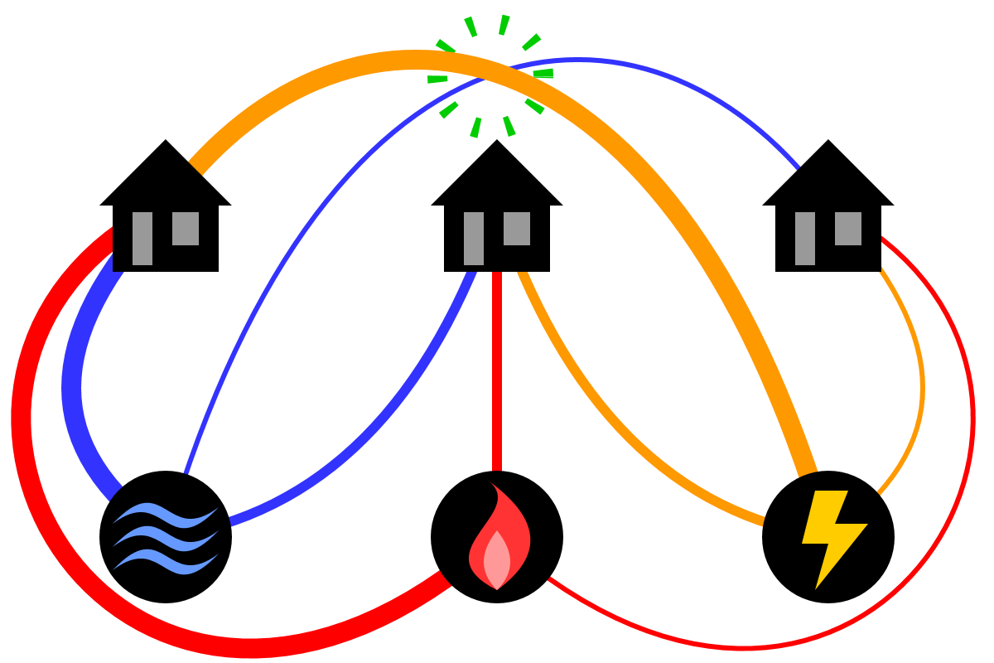

Slide 3
What would a solution look like?
9 edges to place
A new edge connects to a new node, or closes a cycle
9 edges, 6 nodes, 4 closed cycles
Complete puzzle: 4 cycles -> 5 regions (including outside)
Minimum cycle is 4 edges
5 regions * 4 edges = 20 edges...
Each edge borders 2 regions -> 10 edges needed!
Notes:
https://www.youtube.com/watch?v=VvCytJvd4H0&t=1054s

Slide 4
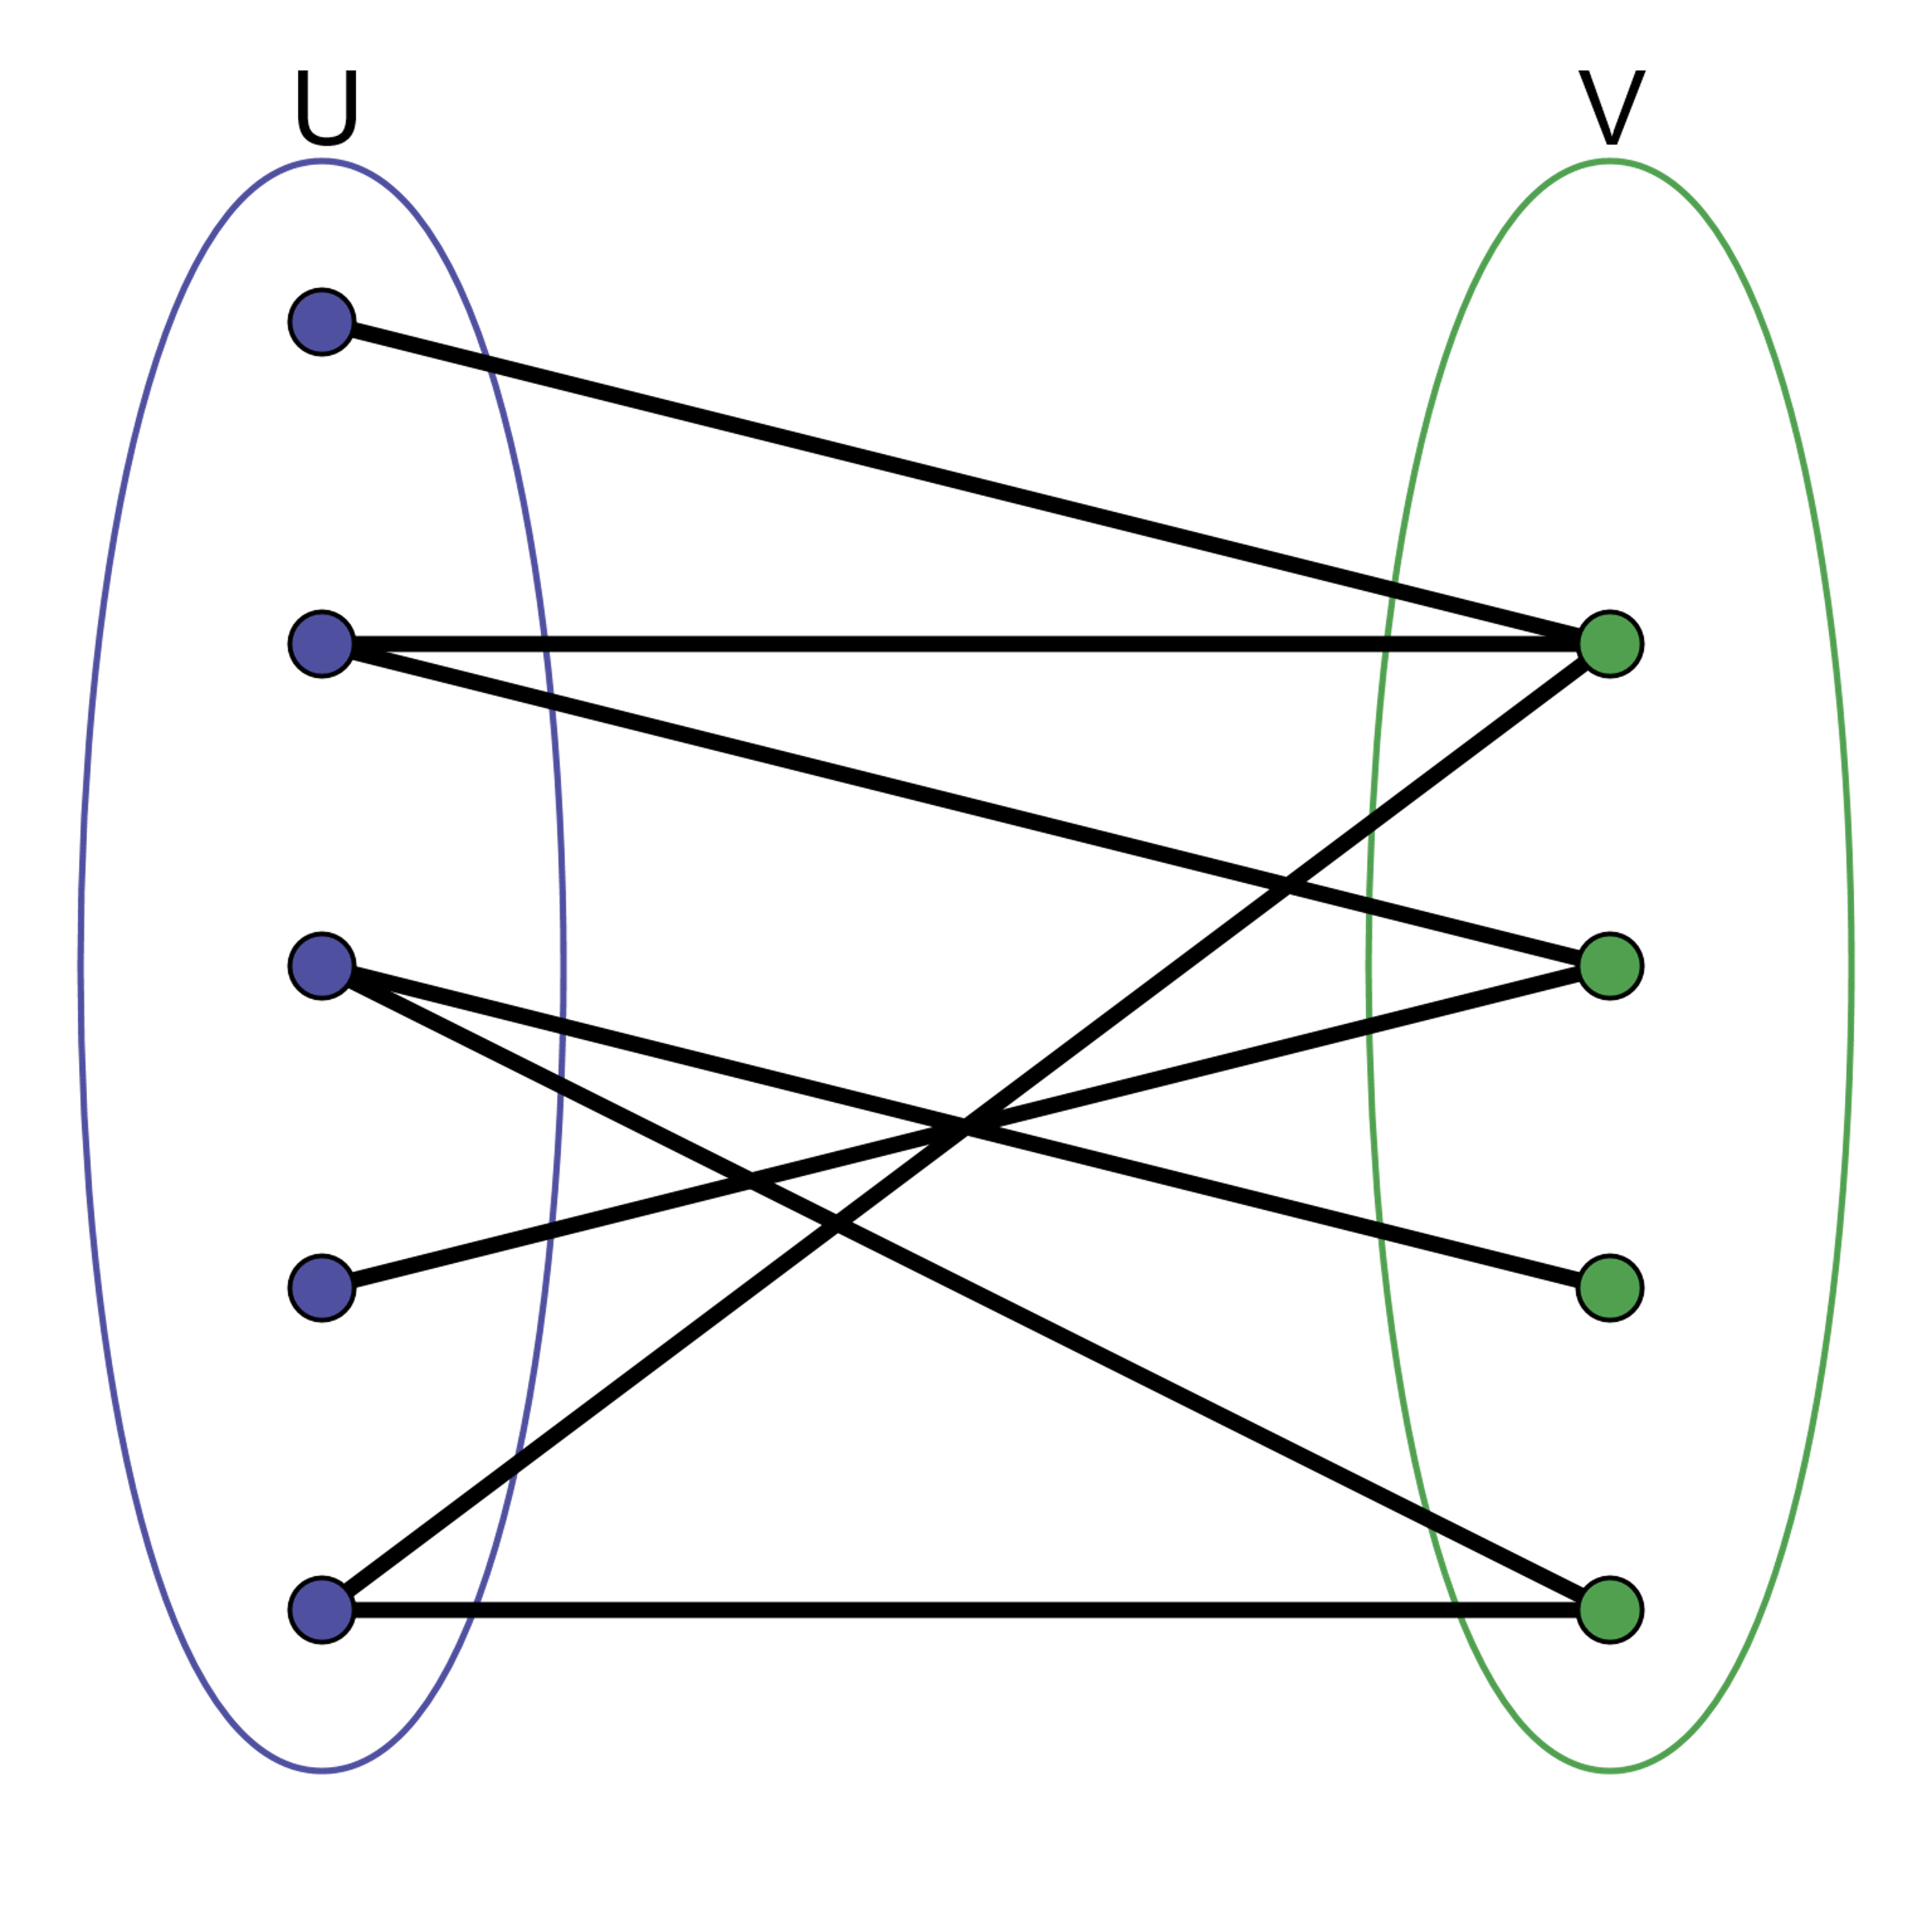
Bipartite graphs
Separate nodes in 2 groups so that edges only exist between those groups
Arise naturally when describing relations between two different groups e.g.
Sports players and teams
Trains and train stops
People and jobs
May allow use of specialized (faster) algorithms

Slide 5
Planar graphs and embeddings
Nodes have no coordinates
Embedding: generate N-dimensional coordinates for all nodes
All nodes as far away from each other as possible
Bonded nodes should be close together
(ideally) no crossing edges
Useful for drawing graphs
Planar graph: graph that can be embedded in 2D such that no edges cross

Slide 6
Embedding
Spring layout:
Connect all nodes with springs, and throw the thing on the ground
Kamada-Kawai layout:
Springs between all pairs of nodes
Planar layout:
A layout that guarantees no edges cross (if possible)
Circular layout: all nodes in a circle
Spiral layout: all nodes in a spiral
Spectral layout: next week

Slide 7
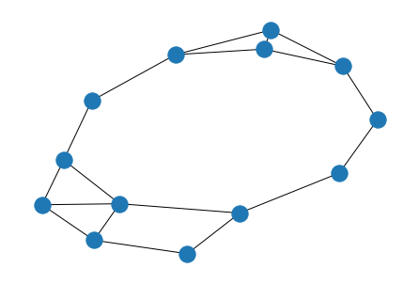
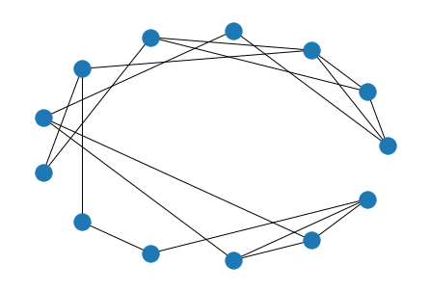
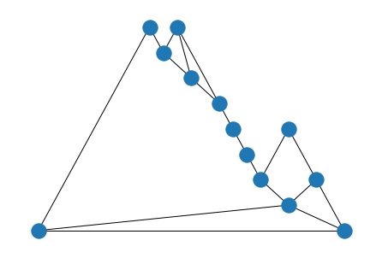
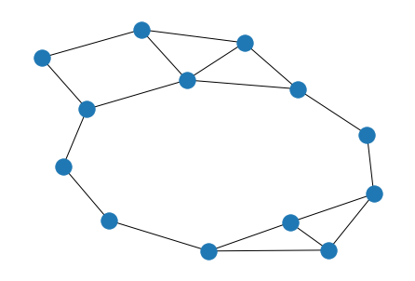
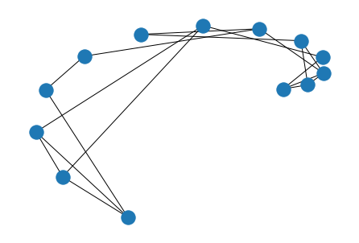
Notes:
The best one? Depends on your graph

Slide 8
Map colouring
A map is a graph :)
Countries that share a border are connected
It's a planar graph (why?)
How many colour do you need, so that no 2 neighbouring countries have the same colour?
Vertex colouring: assign colours to nodes so that no 2 neighbouring nodes have the same colour
Chromatic number: minimum number of colours needed
Similarly, edge colouring
Notes:
You need 4 colour. The proof for 5 colouring is much much easier though, see GTCN

Slide 9
Graph colouring
Example: scheduling
Classes as nodes
Edges between classes if they are followed by the same students (or taught by the same teacher)
Colours are time slots

Slide 10
Break here
Back at 11:15

Slide 11
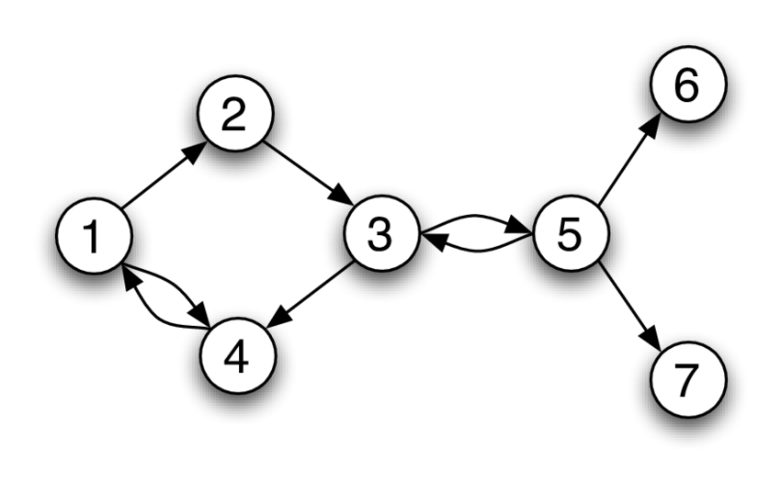
DiGraphs
Directed graph, recap:
G = (V, E)
(u, v) ∈ E; (u, v) ≠ (v, u)
Indegree (v): number of edges pointing to node v
Outdegree (v): number of edges leaving node v

Slide 12
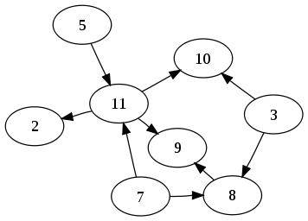
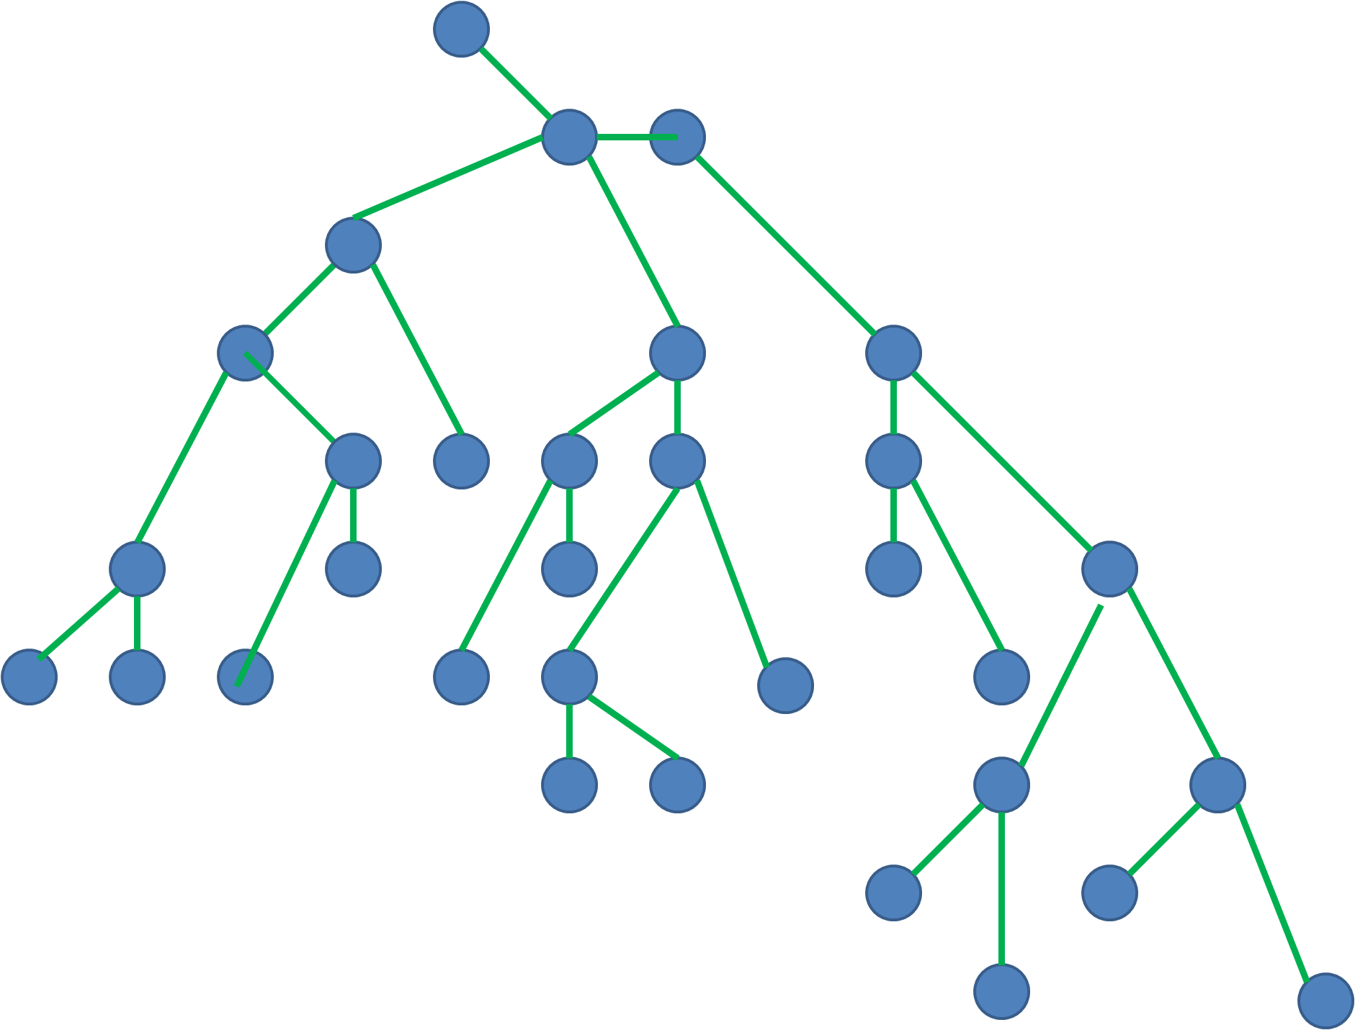
DAGs and trees
Directed Acyclic Graph (DAG)
Dependencies
family trees
citation networks
Scheduling with ordering constraints
Compare with trees:
Connected, acyclic, undirected graph
Common (recursive) data structure (file system)
Notes:
Tree: https://jeremykun.com/2012/09/16/trees-a-primer/

Slide 13
Reachability
Reachability: there exists a path from u to v.
Strongly connected: every node is reachable from all other nodes
Weakly connected: the underlying undirected graph is connected

Slide 14
Topological sorting
Given a DAG: order nodes to form [v₀, v₁, …, v_{i}, …, v_{k}], such that no node in [v₀, …, v_{i-1}] is reachable from v_{i}
Only for DAGs (why?)
[3, 5, 7, 8, 11, 9, 2, 10]
Useful to make sure all dependencies are fulfilled
You'll implement Kahn's algorithm on Friday

Slide 15
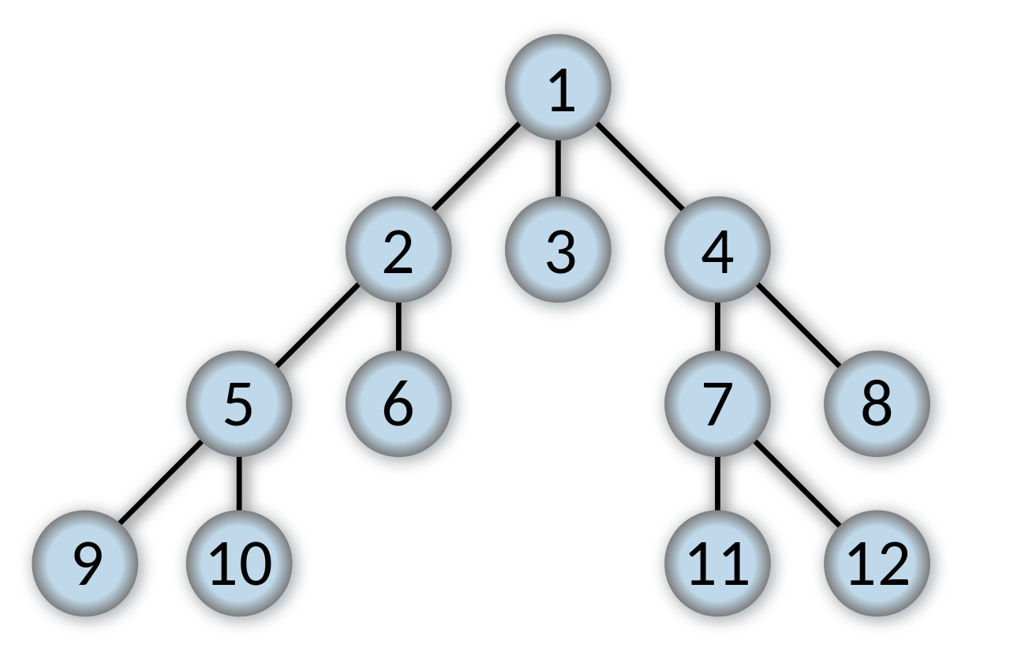
Breadth-first search (BFS)
Traversal strategy for graphs
procedure BFS(G, root) is
let Q be a queue
label root as explored
Q.enqueue(root) # Queue: first-in-first-out
while Q is not empty do
v := Q.dequeue()
if v is the goal then
return v
for all edges from v to w in G.adjacentEdges(v) do
if w is not labeled as explored then
label w as explored
Q.enqueue(w)
Notes:
https://jeremykun.com/2013/01/22/depth-and-breadth-first-search/

Slide 16
Kahn's algorithm
L ← Empty list that will contain the sorted elements
S ← Set of all nodes with no incoming edge
while S is not empty do
remove a node n from S
add n to L
for each node m with an edge e from n to m do
remove edge e from the graph
if m has no other incoming edges then
insert m into S
if graph has edges then
return error (graph has at least one cycle)
else
return L (a topologically sorted order)

