Slide 1
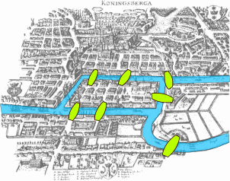

Slide 2
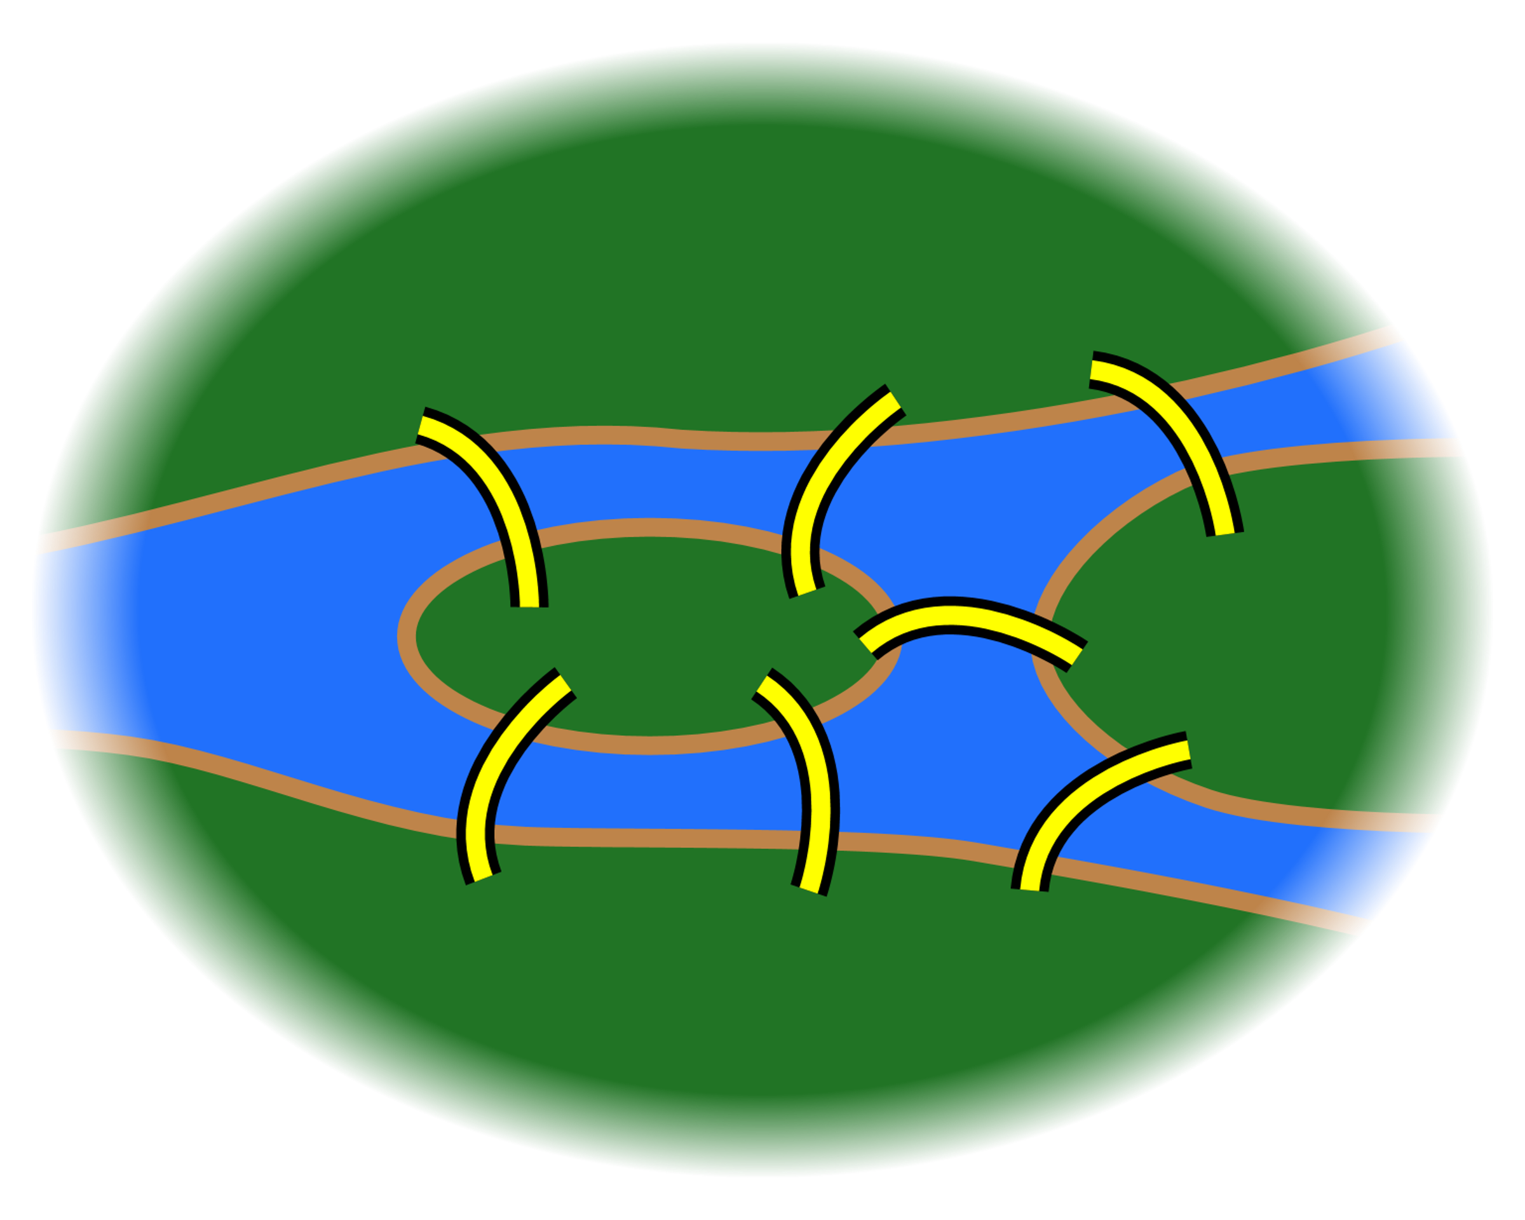
Find a path that crosses each bridge exactly once

Slide 3
Graph Theory
Peter

Slide 4
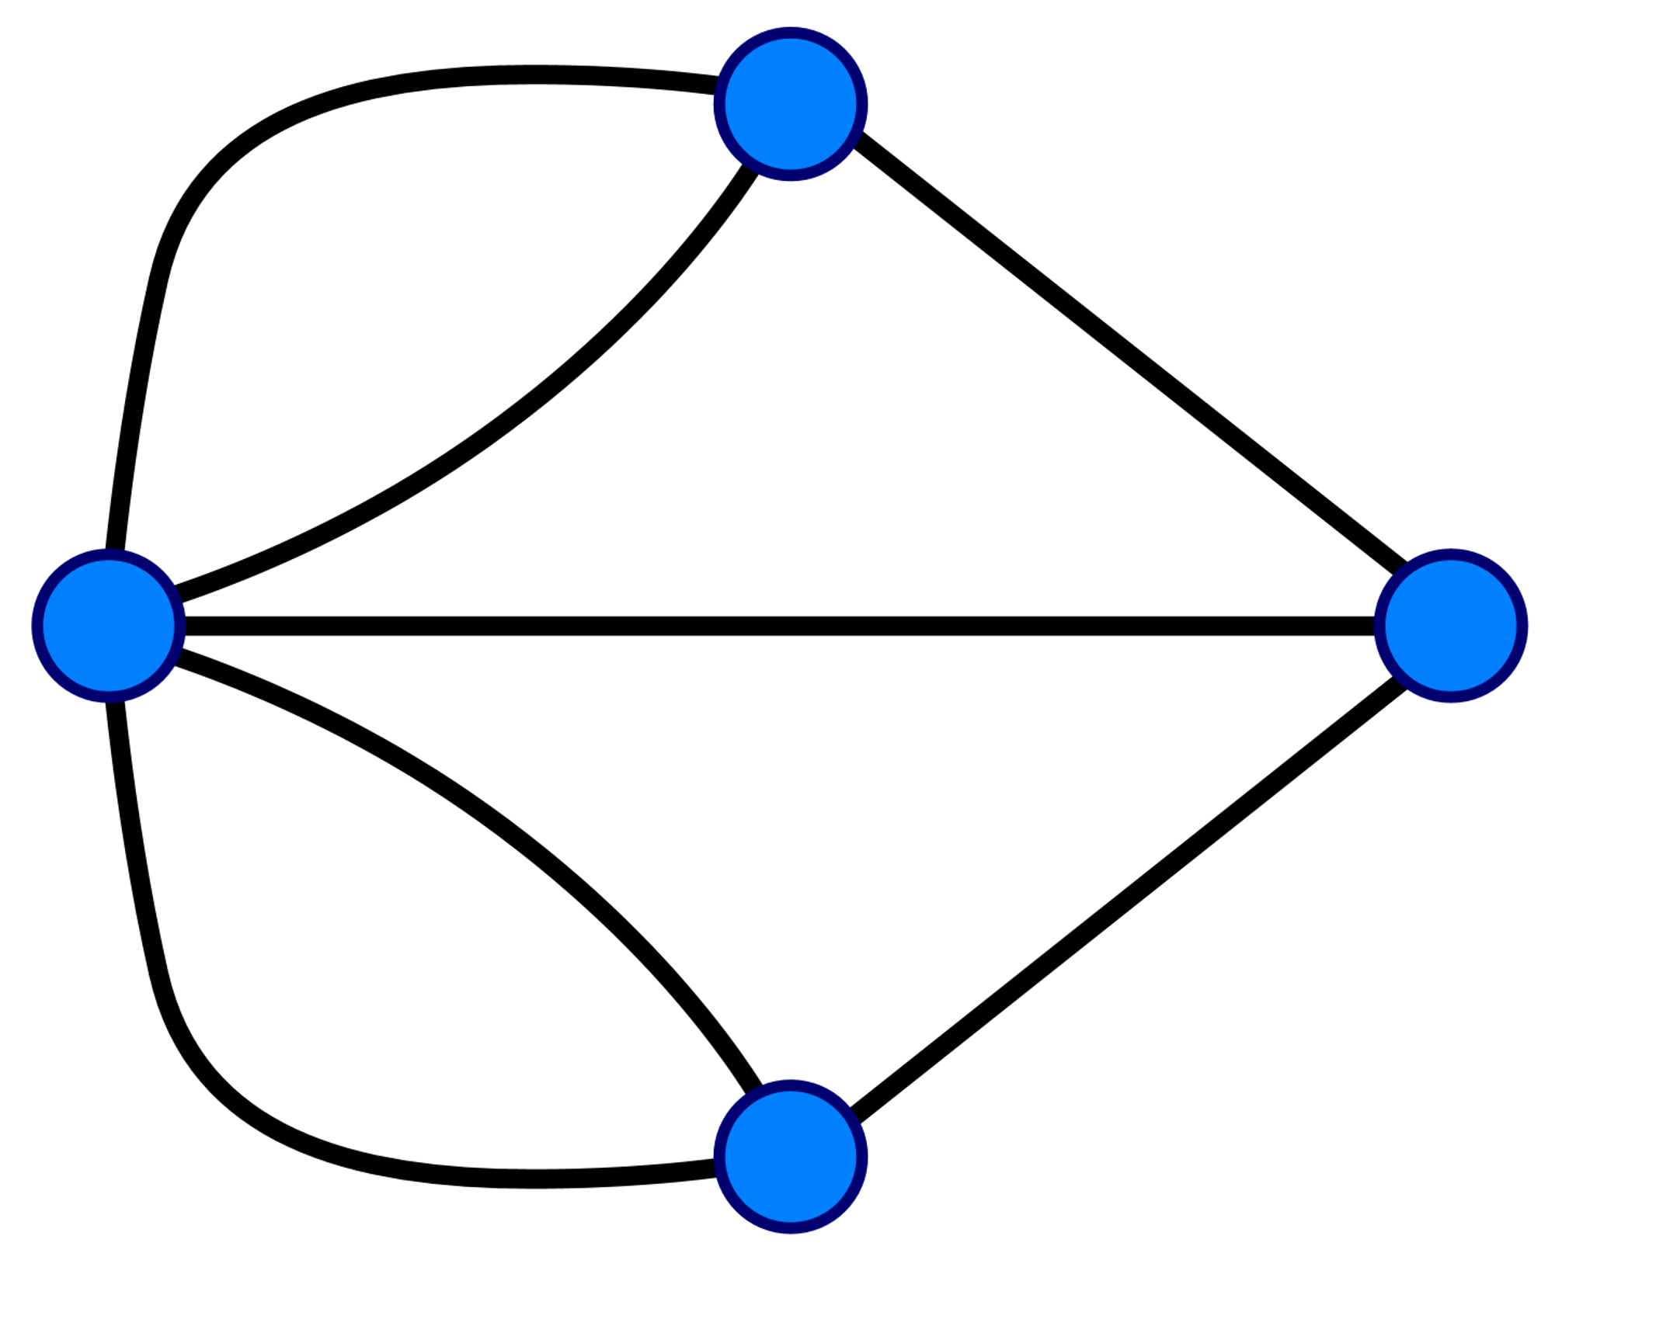

Slide 5
3
1) Entering a node costs an edge
2) Leaving a node costs an edge
-> 0 or 2 nodes must have odd degree
-> 4 nodes have an odd degree
-> Impossible!
5
3
3

Slide 6
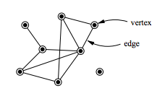
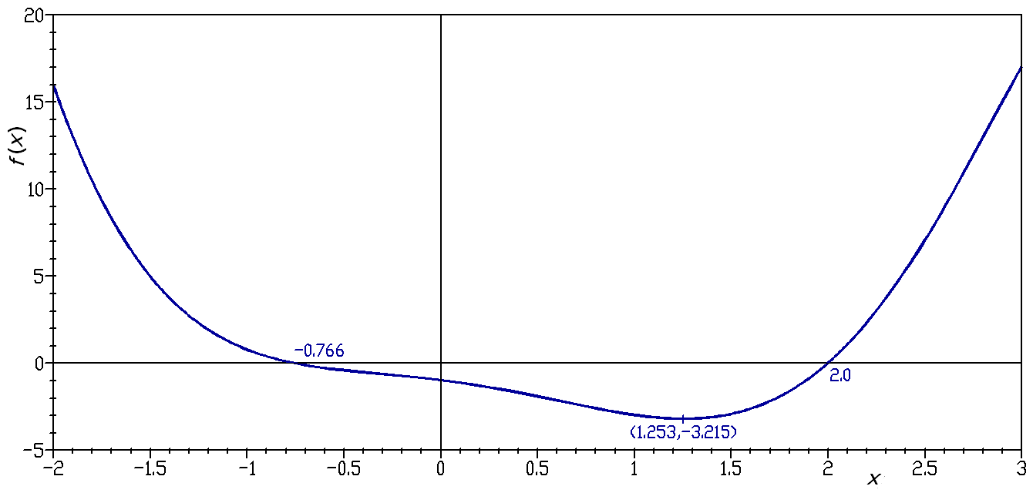
Graph?

Slide 7
Graphs
G = (V, E)
Collection of nodes connected by edges

Slide 8
Graphs
G = (V, E)
Collection of nodes connected by edges
Found everywhere:
Electrical diagrams
The internet (both routing and webpage links)
Molecules
Gene networks
Social relations
Citations
Pipelines and dependencies
Street plans
Food webs
Blood vessels
Brain

Slide 9
Algorithmic complexity
Everything is a graph
A lot of problems can be described as graph problems
Assuming P != NP: a lot of graph algorithms scale horribly

Slide 10
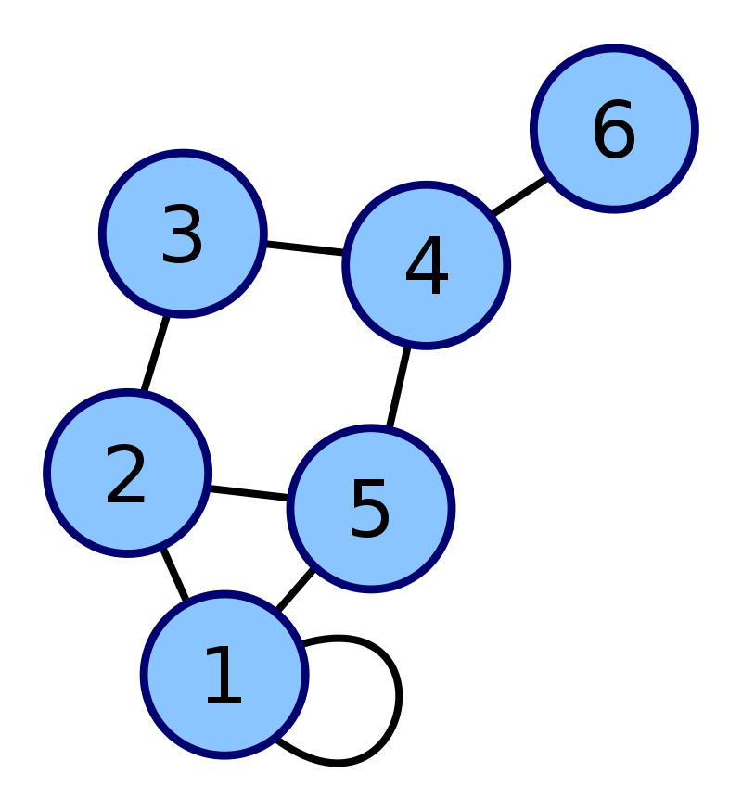
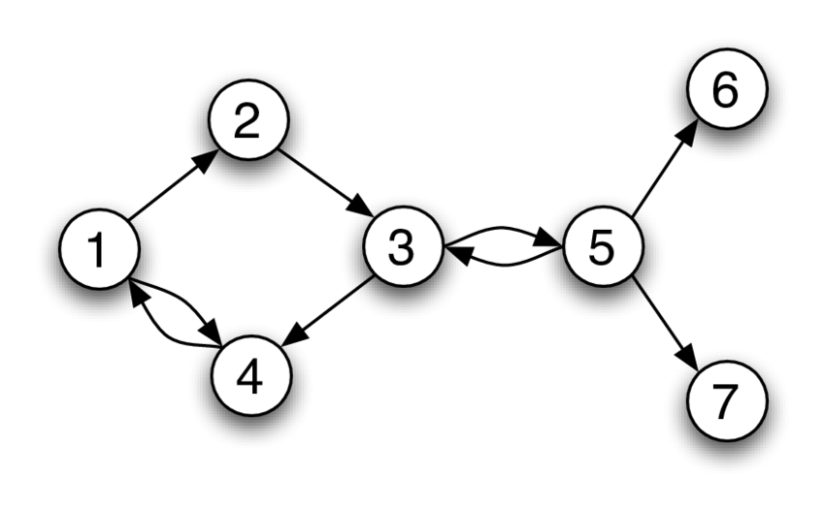
Graph types
Undirected graph
Edge (u, v) = (v, u)
Directed graph (DiGraph)
Edge (u, v) ≠ (v, u)
Self-loops
There can be an edge (u, u)
Multigraph
There can be multiple edges (u, v)
Hypergraph
Edges can connect more than 2 nodes

Slide 11
Programming graphs
[0, 0, 1, 1, 1, 0],
[0, 0, 0, 0, 0, 1],
[1, 0, 0, 0, 0, 0],
[1, 0, 0, 0, 0, 1],
[1, 0, 0, 0, 0, 0],
[0, 1, 0, 1, 0, 0]
Adjacency matrix
1 -> edge, 0 -> no edge
Edge lists
[[2, 3, 4], [5], [0], [0, 5], [0], [1, 3]]
[(0, 2), (0, 3), (0, 4), (1, 5), (3, 5)]
Dictionary based
{0: {2: {}, 3: {}, 4: {}}, 1: {5: {}}, 2: {0: {}}, 3: {0: {}, 5: {}}, 4: {0: {}}, 5: {1: {}, 3: {}}}
Edge attributes in inner dictionaries
Nodes also dictionary with attributes

Slide 12
Networkx
Python library for graphs
Dictionary based
g = nx.Graph()
g.add_nodes_from(range(6))
g.add_edges_from([(0, 2), (0, 3), (0, 4), (1, 5), (3, 5)])
print(dict(g.nodes))
print(g[0])
# Note: these are not /actually/ dicts, but do behave like them. To avoid confusion I add dict() calls where needed.

Slide 13
Mathematical notation
G = (V, E)
Definition 2.2: For any graph G and vertex v ∈ V(G), the neighbor set N(v) of v is the set of vertices (other than v) adjacent to v, that is:
N(v)= { w ∈ V(G) | v ≠ w, ∃ e ∈ E(G) : e = (w, v) }

Slide 14
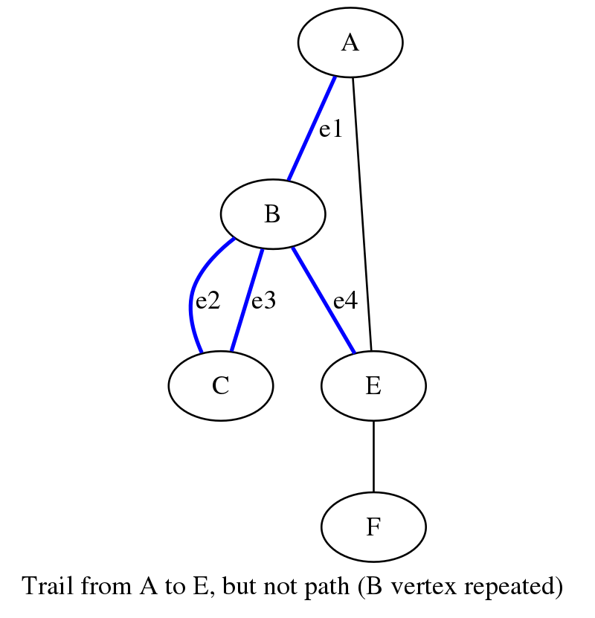
Walks and paths
Walk: sequence of connected nodes
A-B-C-B-E
e1-e3-e3-e4
Trail: Walk with unique edges
A-B-C-B-E
e1-e2-e3-e4
Path
Trail with unique nodes:
A-B-E
Closed walk, tour, cycle
The same but with the same start and end

Slide 15
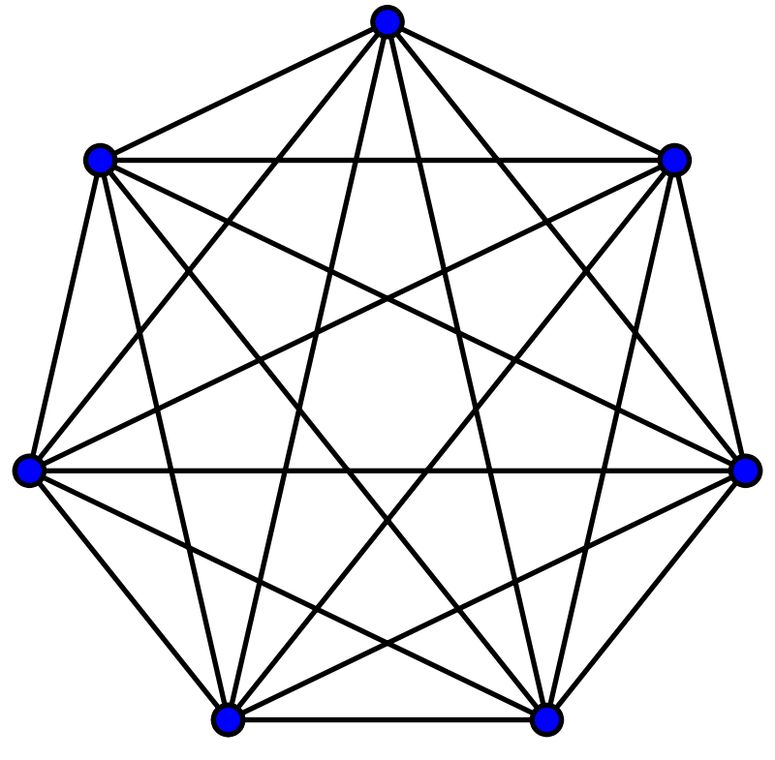
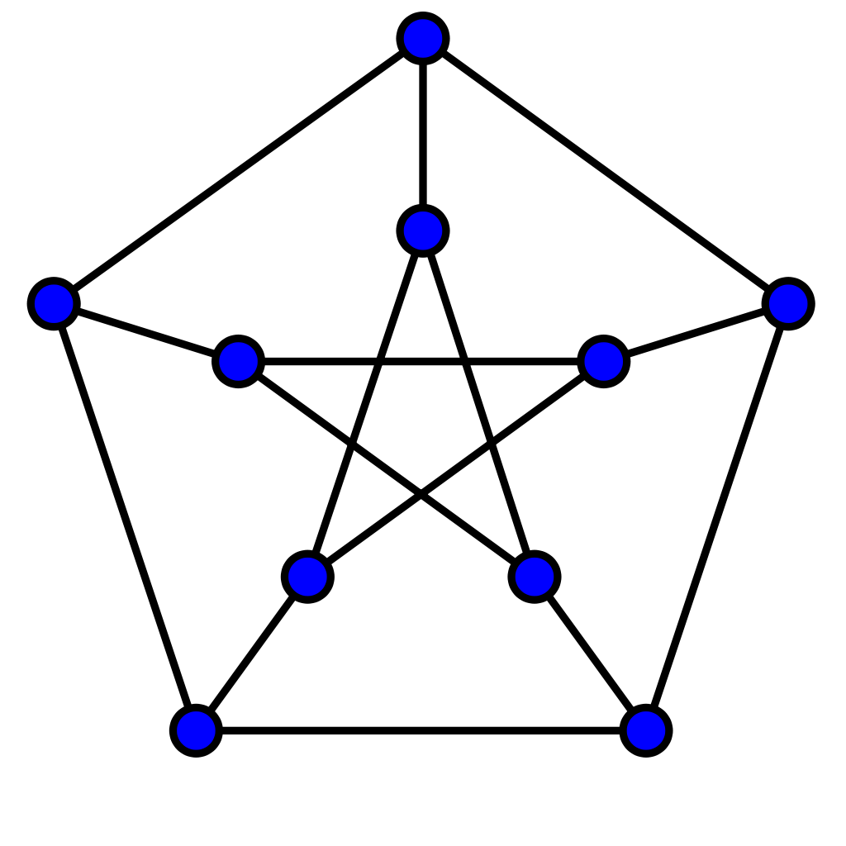
Jargon for this week
Graph, node, edge, degree
Walk, trail, path
Closed walk, tour, cycle
Euler trail/tour and Hamilton path/cycle
Edge weight
Complete graph
Petersen graph
Notes:
Degree = number of edges a node has
Walk = sequence of connected nodes (alternative, sequence of [v0, e0, v1, e1, … vi, ei, …, vn] where ei is the edge between vi and vi+1)
trail = walk with unique edges
path = trail with unique nodes
Closed walk = walk where v0 = vn
Tour = trail where v0 = vn
Cycle = path where v0 = vn
Edge weight = a value associated with an edge, such as distance or similarity
Euler trail/tour = trail (or tour) that contains every edge in the graph
Hamilton path/cycle = path (or cycle) that contains every node in the graph
Complete graph = graph in which each node is connected to every other node
Peterson graph = the bottom graph on the slide. Don't learn what it looks like, know that it exists and is a great test-case for algorithms.

Slide 16
Homework
Read Dijkstra's paper "A Note on Two Problems in Connexion with Graphs"
On Blackboard
We (you) will implement the second algorithm (shortest path) on Thursday
Do the algorithm on paper for your favourite graph (not Petersen!)
Time permitting: convert the algorithm to pseudocode

