Slide 1
LunaAura: An Explainable Machine Learning Framework
for Hormonal and Emotional Health Analysis
Eshita Rai | er8137@srmist.edu.in
Guide: Mrs. P. Sivakamasundari
Department of Computing Technologies | SRM IST, Chennai
Review 3 | Batch B904
Eshita Rai | er8137@srmist.edu.in
Guide: Mrs. P. Sivakamasundari
Department of Computing Technologies | SRM IST, Chennai
Review 3 | Batch B904

Slide 2
Abstract
Abstract
Emotional wellbeing depends on sleep, stress, hormonal cycles, and daily habits
— but most wellness apps treat these in isolation with no depth.
LunaAura combines a transparent risk formula with calibrated ML,
quantile regression, and SHAP explainability in one platform.
It tracks six daily inputs, computes personalized risk and wellness scores,
and delivers actionable insights through a longitudinal dashboard.
Tested on 105 synthetic users (470 daily records) + 40-day case study.
Positioned as a research prototype — no clinical diagnostic claim.

Slide 3
Motivation
Motivation
970 million people worldwide live with a mental health condition (WHO, 2022)
University students face compounding pressures — irregular sleep,
academic stress, financial strain — often unnoticed until crisis.
Current wellness apps fall short:
• Assess each factor in isolation (sleep alone, stress alone)
• Ignore the menstrual cycle despite decades of clinical evidence
• Never explain why a score was generated
→ Need for a smarter, multi-dimensional, explainable, cycle-aware system

Slide 4
Problem Statement
Problem Statement
Emotional wellbeing fluctuates with lifestyle and hormonal context.
Existing platforms have critical gaps:
• No integrated behavioral + hormonal analysis
• Limited predictive capability — mostly descriptive tools
• No explainable ML insights — users get numbers without reasons
• No gender-adaptive logic for equitable analytics
→ A personalized, transparent, cycle-aware framework is needed
that provides actionable wellness insights with explainability.

Slide 5
Research Objectives
Research Objectives
1. Design a transparent 6-factor composite risk scoring formula
2. Incorporate menstrual cycle phase modifiers from chronobiology
3. Build gender-adaptive weight normalization for all users
4. Train calibrated ML models on PHQ-9 data
5. Implement SHAP-based per-instance explainability
6. Develop a full-stack interactive dashboard with history tracking
7. Validate on a reproducible 105-user synthetic cohort

Slide 6
Literature Survey
Literature Survey
Mental Health Screening:
• PHQ-9 (Kroenke, 2001) — gold standard depression measure
• Arefin & de Roux (2020) — ensemble classifiers for depressive text
Digital Phenotyping:
• Saeb et al. (2015) — phone sensors predict PHQ-9 variation
• Torous et al. (2019, 2021) — data quality and interpretability gaps
Explainable AI:
• SHAP (Lundberg & Lee, 2017) — game-theoretic feature attribution
• EmotionSense (Rachuri, 2010) — contextual feedback boosts engagement
Cycle-Aware Health:
• Baker & Driver (2007) — sleep disruption in luteal phase
• Kiesner (2012) — individual variation in cycle-mood effects

Slide 7
Research Gap
Research Gap
No existing platform combines all of these:
✗ Multi-factor behavioral risk scoring
✗ Menstrual cycle phase awareness in scoring models
✗ Gender-adaptive weight normalization
✗ Calibrated probabilistic ML with uncertainty estimation
✗ Per-instance SHAP explainability
✗ Longitudinal tracking with rolling temporal features
LunaAura integrates all six in a single framework.
The novelty is in the integration, not a new algorithm.

Slide 8
SDG Alignment
SDG Alignment
SDG 3 — Good Health & Well-Being
• Mental health awareness through accessible, personalized analytics
SDG 5 — Gender Equality
• Cycle-phase-aware scoring designed specifically for women's health
• Gender-adaptive design ensures equal depth for all users
SDG 9 — Industry, Innovation & Infrastructure
• Novel hybrid deterministic + ML + SHAP architecture
SDG 10 — Reduced Inequalities
• Free, browser-based — no expensive hardware needed

Slide 9
Phase 1 — What LunaAura Started As
Phase 1 — What LunaAura Started As
The initial prototype had:
• Basic HTML input forms for wellness data
• Simple heuristic scoring — no ML pipeline
• Static Chart.js visualizations with hardcoded ranges
• Login attempt without persistent user profiles
• Single-page dashboard, limited interactivity
• No longitudinal tracking — each session was independent
• No cycle-aware scoring or gender logic
• Generic, copy-paste recommendations for every user

Slide 10
Phase 2 — Problems We Identified
Phase 2 — Problems We Identified
Honest engineering reflection:
• Static charts did not update with real user data
• No personalization — same output for every user
• No backend persistence — data lost on page refresh
• No historical analytics — no trend tracking over time
• Generic outputs — recommendations felt shallow
• No explainability — scores with no context
• Gender logic broken — Male selection removed all inputs
• No research or analytics module for population insights

Slide 11
Phase 3 — Improvements Implemented
Phase 3 — Improvements Implemented
Complete system overhaul:
• SQLite backend with persistent user profiles
• 105 pseudo-users across three risk strata
• 470 daily log entries with realistic distributions
• Dynamic charts that update in real-time
• 30-40 day longitudinal history tracking
• Gender-adaptive dashboard (hides only cycle elements for males)
• Analytics endpoint for population summaries
• Model Insights page with feature importance
• Research Mode for deeper exploration
• Professional UI with responsive layout

Slide 12
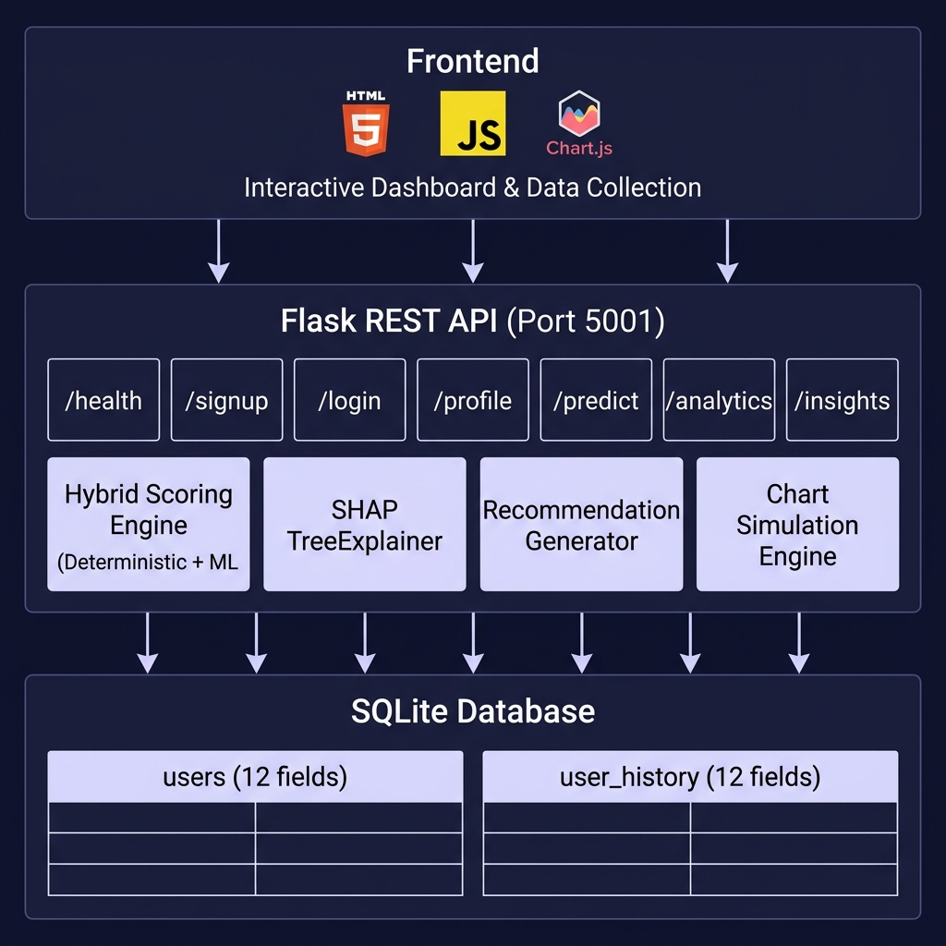
System Architecture
Three-tier: Frontend (HTML/JS/Chart.js) → Flask REST API (7 endpoints) → SQLite Database

Slide 13
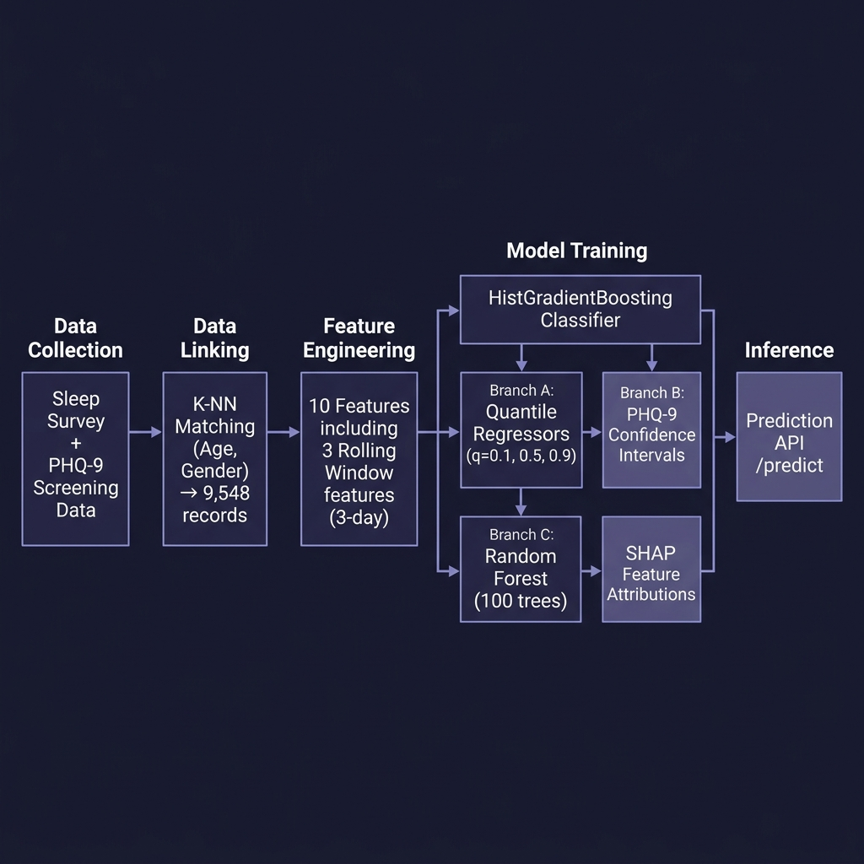
Machine Learning Pipeline
Data Collection → KNN Linking → Feature Engineering → 3 Model Branches → Prediction API

Slide 14
Behavioral Inputs Collected Daily
Behavioral Inputs Collected Daily
Six daily behavioral signals:
• Sleep Duration — hours slept (8h optimal)
• Perceived Stress — ordinal 1-10
• Physical Activity — minutes/day (60 min target)
• Anxiety Level — ordinal 1-10
• Water Intake — litres/day (2.5L target)
• Menstrual Cycle Day — day 1-28 (female only)
Plus demographics: Age, Gender, Height, Weight, Cycle Length

Slide 15
Composite Risk Scoring Formula
Composite Risk Scoring Formula
R = Stress(35%) + SleepDeficit(25%) + Anxiety(20%)
+ ActivityDeficit(10%) + Hydration(5%) + Baseline(5) + Phase(±5-8)
Cycle Phase Modifiers (female only):
Menstrual (Day 1-5): +5 Follicular (Day 6-13): -5
Ovulatory (Day 14-16): -8 Luteal (Day 17-28): +8
Male/Other: phase = 0, sleep weight rises 25% → 30%
Severity Tiers:
Low (R < 35) | Moderate (35 ≤ R < 65) | High (R ≥ 65)
Design: no single factor alone triggers High severity

Slide 16
Wellness Score Estimation
Wellness Score Estimation
W = Σ αⱼ × x̂ⱼ (each x̂ⱼ normalized to [0,100])
Female (8 factors):
Sleep 25% | Stress 20% | Activity 15% | Anxiety 15%
Cycle 10% | Water 5% | Age 5% | Stability 5%
Male/Other (6 factors — cycle removed, weights redistributed):
Sleep 30% | Stress 25% | Activity 20%
Anxiety 15% | Water 5% | Age 5%
Normalization: Sleep penalizes deviation from 8h optimum
Stress inversely mapped; Activity scaled to 60-min target

Slide 17
Machine Learning Models
Machine Learning Models
1. Calibrated Classifier
HistGradientBoosting (100 rounds, 31 leaves, η=0.05)
Platt scaling via 5-fold stratified CV
Target: PHQ-9 referral flag (n₀=5,054 / n₁=4,494)
2. Quantile Regressors (×3)
HistGradientBoosting (150 rounds, pinball loss)
q = 0.10, 0.50, 0.90 → PHQ-9 confidence intervals
3. SHAP Explanation Proxy
RandomForest (100 trees, depth 5)
TreeExplainer → exact Shapley values per feature
Top 3 attributions shown as plain-language insights
Training corpus: 9,548 records × 28 columns

Slide 18
Technical Novelty
Technical Novelty
What sets LunaAura apart (honestly stated):
✦ Hybrid Architecture — deterministic (auditable) + ML (probabilistic)
✦ Cycle-Aware Scoring — first prototype with hormonal phase modifiers
✦ Gender-Adaptive Normalization — re-normalized weights, not removed features
✦ Longitudinal Features — 3-day rolling means capture behavioral momentum
✦ Instance-Level Explainability — SHAP insight cards on dashboard
We do not claim a new ML algorithm.
Our novelty is the integration framework.

Slide 19
Database Design — SQLite
Database Design — SQLite
Database: lunaaura.db
Table: users (12 fields)
id, username, password_hash, age, gender, height, weight,
cycle_length, sleep_target, cohort_group, source, timestamps
Table: user_history (12 fields per entry)
id, user_id (FK), date, sleep_duration, stress_level,
mood_score, cycle_day, phase, activity, wellness_score,
predicted_risk, anxiety_level, water_liters
Cohort: 105 users (86F / 14M / 5O) | 470 daily logs
Ages 18-55 (mean 36.5) | Eshita: 85 entries, 40+ days

Slide 20
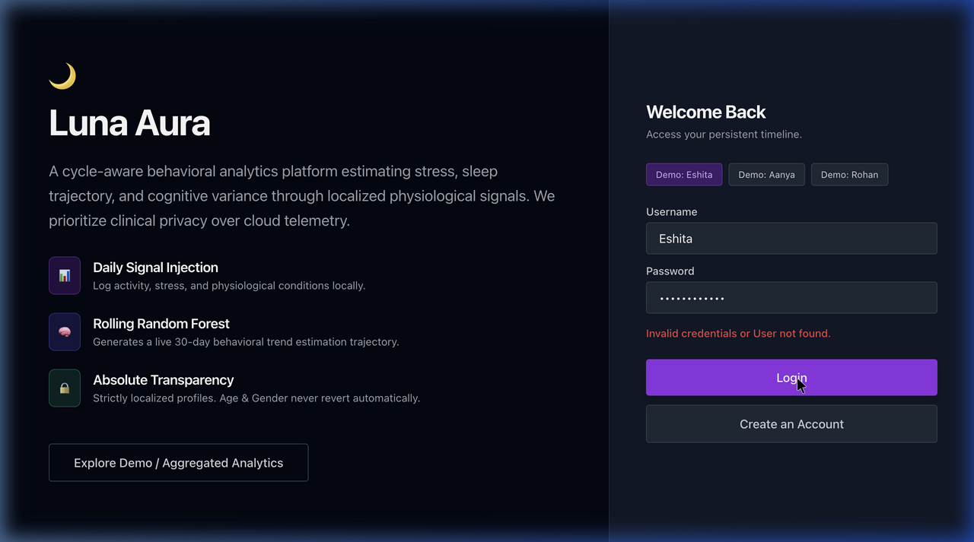
User Interface — Login & Authentication
Secure login with demo user profiles for testing

Slide 21
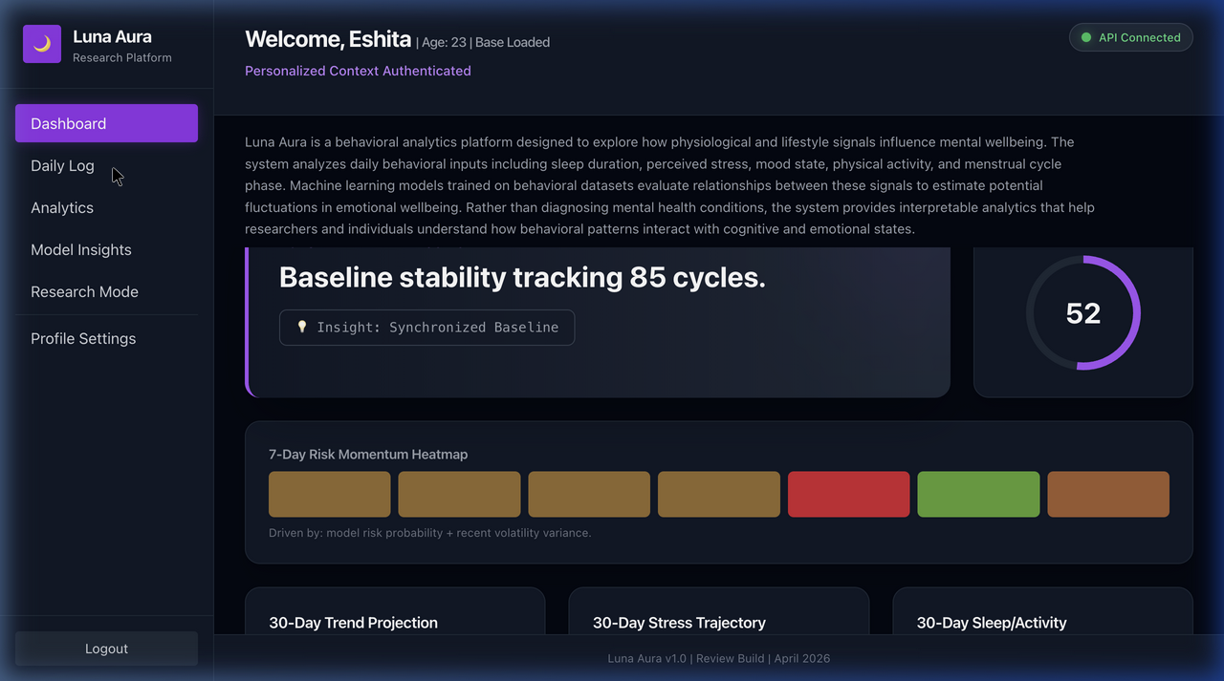
User Interface — Daily Behavioral Logging
Slider-based input for sleep, stress, activity, anxiety, water, cycle day

Slide 22
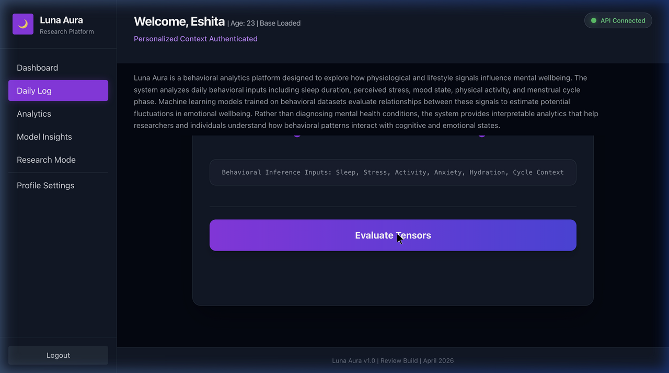
User Interface — Dashboard Results
Real-time chart rendering after data submission

Slide 23
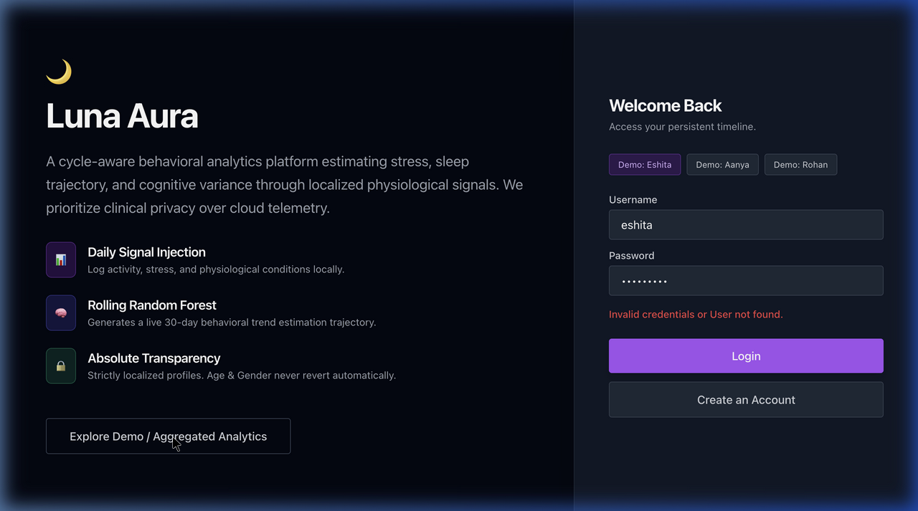
Analytics & Model Insights
Population-level summaries and model metadata

Slide 24
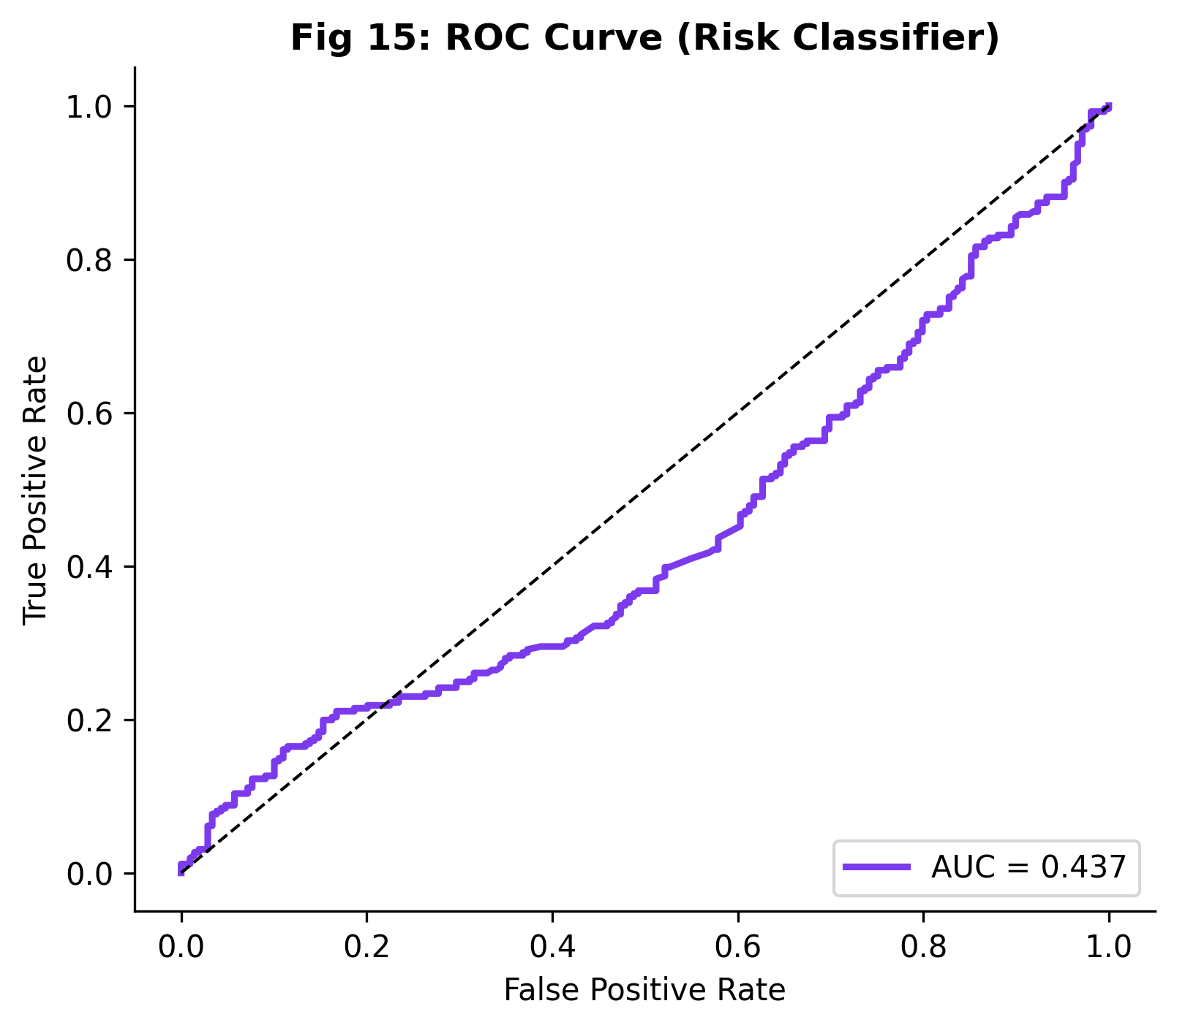
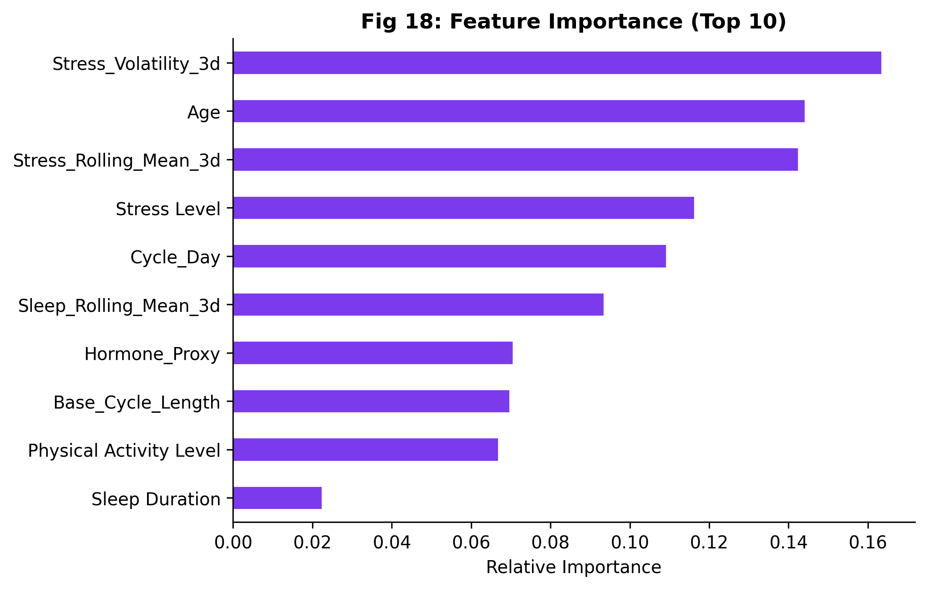
Results — Model Performance

Slide 25
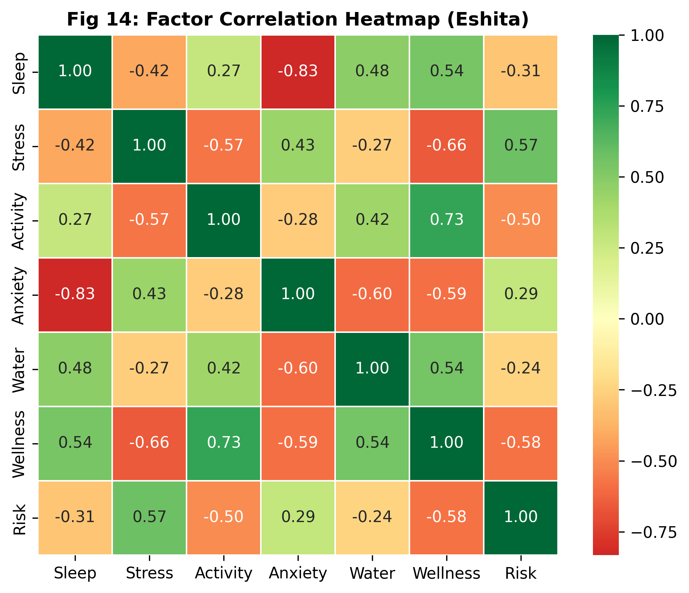
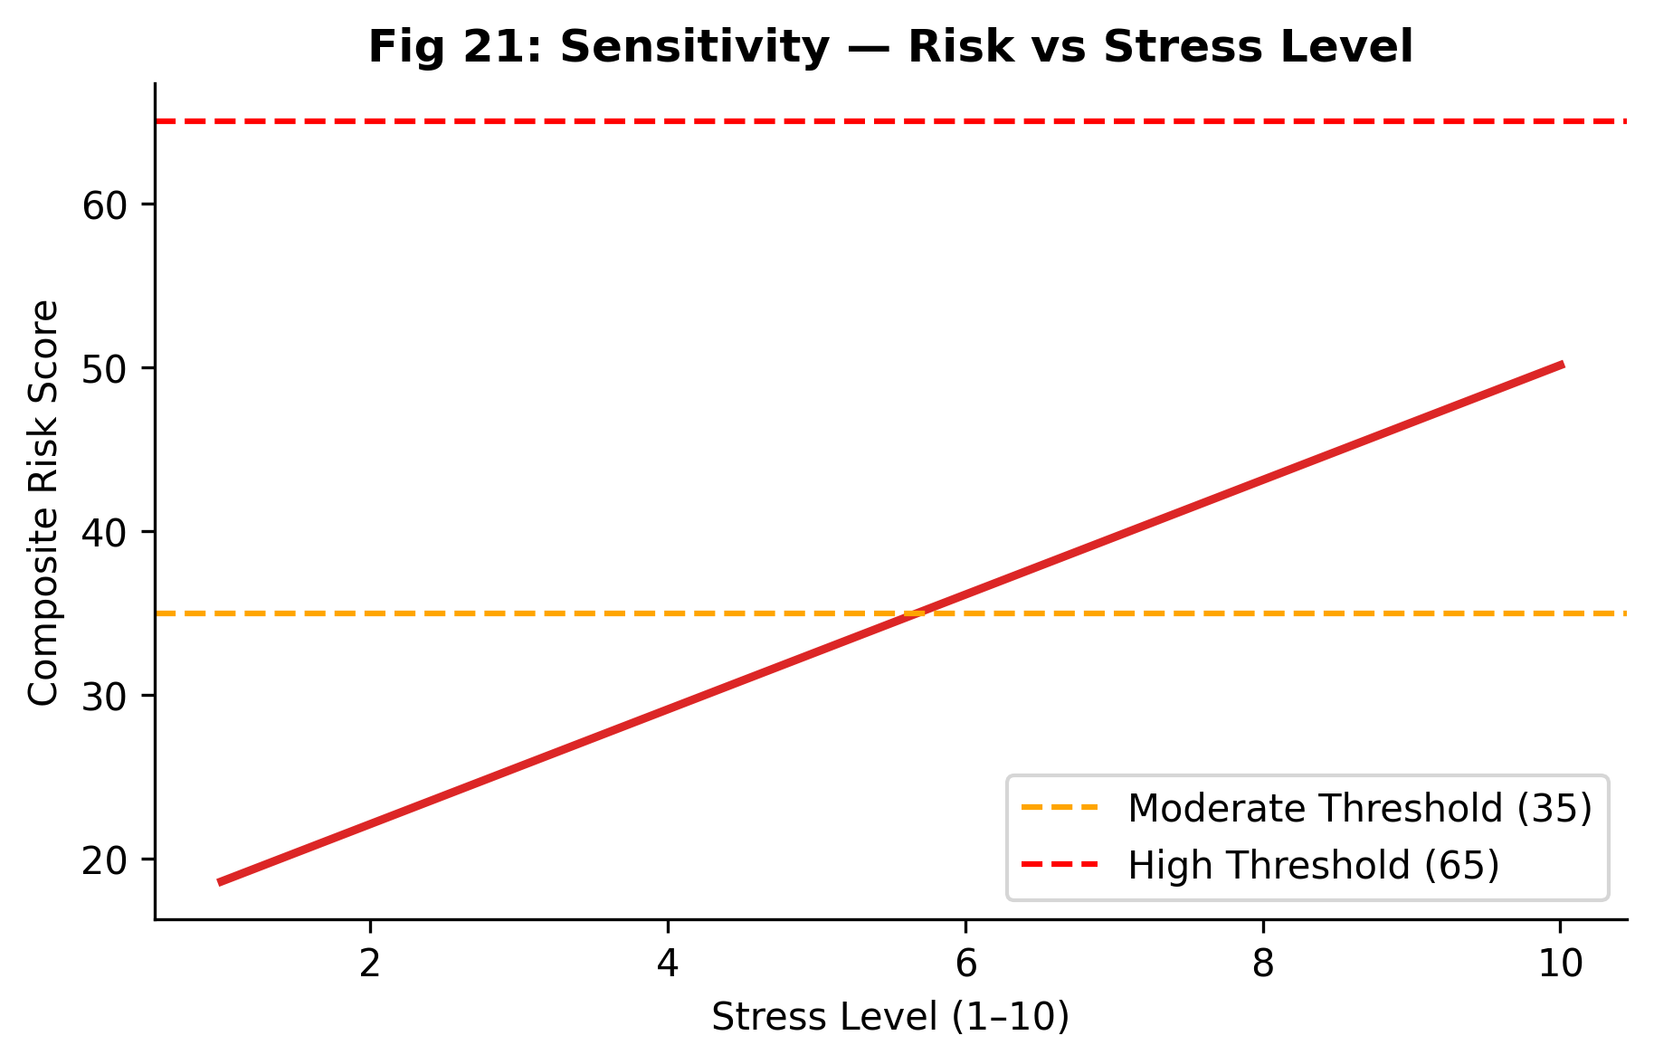
Results — Validation Charts

Slide 26
Results Interpretation
Results Interpretation
Classifier: AUROC ≈ 0.567 | Brier Score = 0.245
Modest but honestly reported — reflects cross-dataset noise
Feature Importance: Age > Stress > Cycle Day > Sleep
Rolling temporal features contribute meaningfully
Sensitivity Analysis:
Risk vs Stress is monotonic and clinically plausible
Moderate threshold crossed at stress ≈ 5.5
High tier requires multi-factor adversity
Cycle Phase Impact: 16-point spread (Ovulatory -8 to Luteal +8)
Intentionally modest — modulates, does not dominate

Slide 27
Limitations & Validation
Limitations & Validation
Limitations:
• Synthetic cohort (seed=42) — not clinically collected
• Formula weights are expert heuristics, not data-optimized
• ML AUROC reflects heterogeneous data bridging
• Cycle modifiers are population averages
• System produces Wellness Estimates — NOT clinical diagnoses
Validation Performed:
✓ Sensitivity analysis — monotonic, directionally correct
✓ Correlation heatmap validates formula weighting
✓ All 7 API endpoints tested
✓ Frontend works for Female, Male, Other profiles
✓ Database integrity: 105 users, 470 logs, FK constraints
✓ Charts validated against formula outputs

Slide 28
Economic & Financial Feasibility
Economic & Financial Feasibility
Development Cost: ₹0 — student-built, open-source tools
Technology Stack (all free):
• Python + Flask — backend
• SQLite — zero-config database
• scikit-learn — ML models
• SHAP — explainability
• Chart.js — visualization
• HTML/CSS/JS — frontend
Deployment: runs on any laptop | scalable to cloud
SQLite → PostgreSQL migration for production
Affordable, reproducible, student-feasible solution

Slide 29
Ethics & Privacy
Ethics & Privacy
1. No Clinical Claims
Output labeled as Behavioral Wellness Estimate
2. Privacy-First Design
All data stored locally — no external transmission
User consent required for real-world deployment
3. Explainable AI
SHAP provides transparent per-instance attribution
Users understand why they received their score
4. Bias Awareness
Synthetic data disclosed; population-level modifiers acknowledged
Gender-adaptive design prevents analytical disparity
5. SDG 3 Alignment — Good Health and Well-Being

Slide 30
Methodology — End-to-End Pipeline
Methodology — End-to-End Pipeline
User Input (6 signals + demographics)
↓
Flask API /predict receives JSON payload
↓
Deterministic Risk Formula → R ∈ [0,100]
↓
ML Inference:
• Calibrated Classifier → probability
• Quantile Regressors → PHQ-9 confidence interval
• SHAP Proxy → top-3 feature attributions
↓
Recommendation Engine → priority-tagged suggestions
↓
SQLite Logging → entry persisted
↓
Dashboard Rendering → all modules update (< 2 seconds)

Slide 31
Research Paper Publication
Research Paper Publication
Title: LunaAura: An Explainable ML Framework for
Hormonal and Emotional Health Analysis
Authors: Eshita Rai, Mrs. P. Sivakamasundari
Format: IEEE conference paper (6 pages, two-column)
Contents:
• 11 formal equations
• 5 publication-ready figures
• 2 data tables
• 18 scholarly references
Status: Complete, formatted, submission-ready

Slide 32
Conclusion
Conclusion
Problem: Wellness tools lack multi-factor scoring,
cycle awareness, and explainability
Solution: LunaAura — hybrid deterministic + ML framework
Objectives Achieved:
✓ Transparent 6-factor risk formula with auditable weights
✓ Cycle-phase modifiers from published chronobiology
✓ Gender-adaptive weight normalization
✓ Calibrated classifier + quantile regression + SHAP
✓ Full-stack dashboard with longitudinal tracking
✓ Validated on 105-user cohort (470 logs, 40-day study)
Outputs: AUROC 0.567 | Brier 0.245 | 9,548 training records

Slide 33
Future Scope
Future Scope
Planned extensions:
• Clinical validation with real datasets under IRB approval
• Wearable integration — HRV, actigraphy, sleep staging
• Federated learning for privacy-preserving training
• Bayesian weight optimization on clinical outcomes
• Native mobile app for continuous monitoring
• Individualized cycle-length modeling (replace 28-day fixed)
Source code and model artifacts available on GitHub
for independent replication and extension.

Slide 34
Thank You
Questions Welcome
Eshita Rai | er8137@srmist.edu.in
Guide: Mrs. P. Sivakamasundari
SRM Institute of Science and Technology, Chennai
Batch B904
Questions Welcome
Eshita Rai | er8137@srmist.edu.in
Guide: Mrs. P. Sivakamasundari
SRM Institute of Science and Technology, Chennai
Batch B904

