Slide 1




SMART INDIA HACKATHON 2026
TITLE PAGE
  Problem Statement ID – 26190
  Problem Statement Title - Secure Digital Document Management System for Legal and Investigation Documents
  Theme - Blockchain & Cybersecurity
  PS Category - Software
  Team ID -
  Team Name - CrimeNet

Slide 2
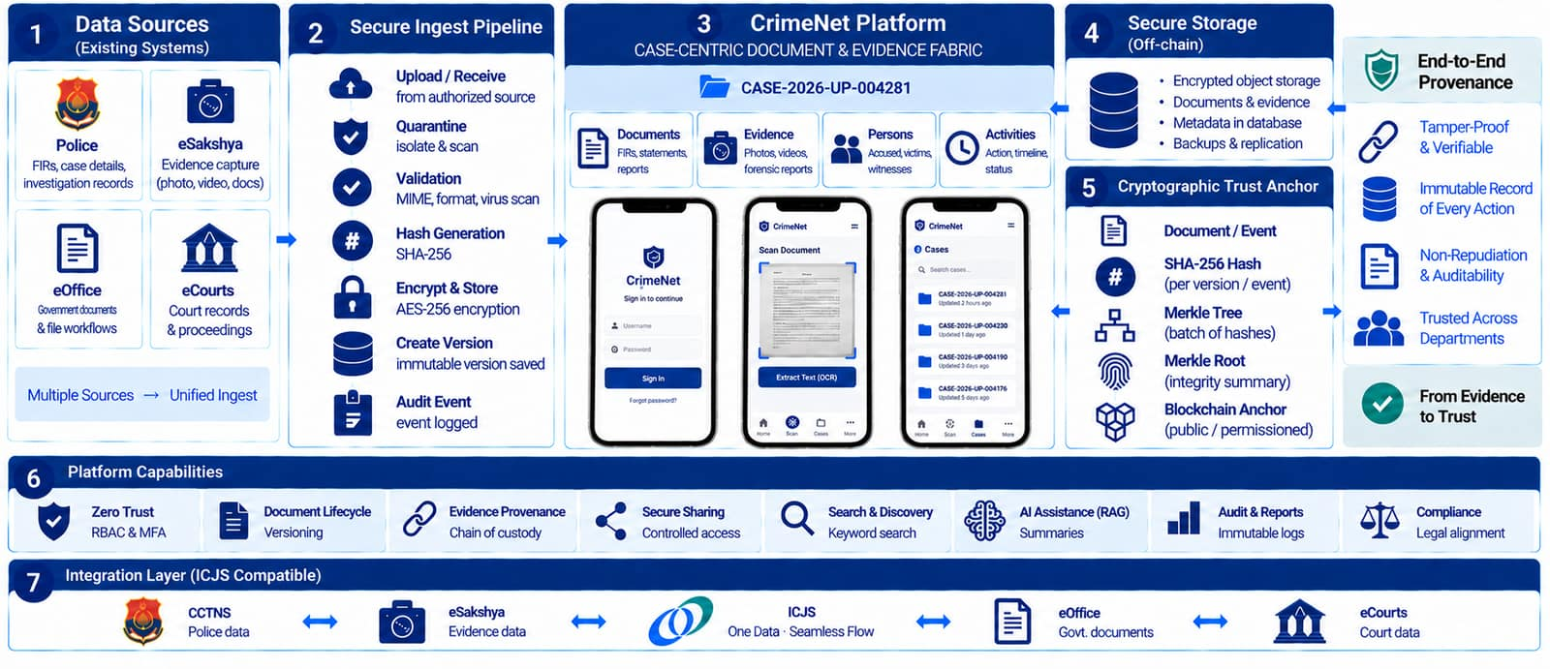
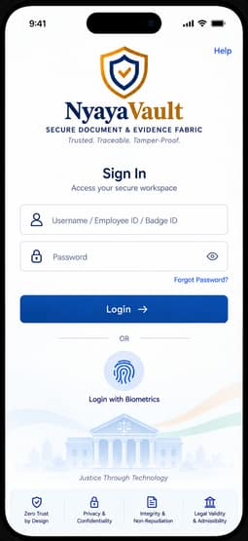
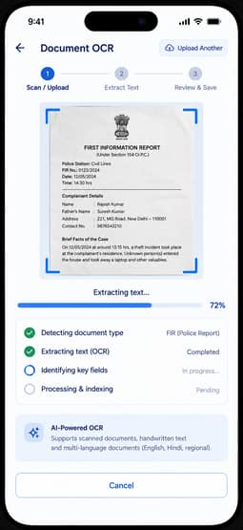
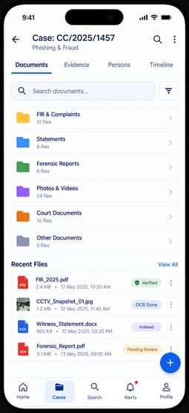
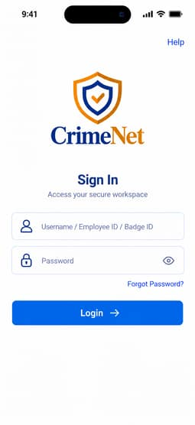
CrimeNet
CrimeNet
PROPOSED SOLUTION: CrimeNet — Zero-Trust Investigation & Evidence Fabric
• Strategic Ecosystem Alignment: CrimeNet does NOT attempt to replace existing national databases (CCTNS, eCourts, eSakshya, eOffice). Instead, it sits above them as a Zero-Trust Document, Evidence Provenance, and Intelligence Fabric enforcing end-to-end cryptographic integrity across the criminal justice lifecycle.
• Case-Centric Unified Dossier: Aggregates FIRs, witness depositions, forensic laboratory reports, CCTV bitstream images, and judicial filings into an immutable case workspace indexed by cryptographic hash identifiers.
• PostgreSQL Row-Level Security (RLS) & AES-256-GCM: Multi-tenant department isolation ensures witness and victim PII entries in database tables are strictly partitioned. Unassigned officers or external queries return zero rows directly at the database engine level.
• Pessimistic Custody Locking (SELECT ... FOR UPDATE): Strict row-level locking eliminates split-brain custody handover race conditions during physical and digital evidence transfers between police stations, forensic labs, and court registries.
• Automated Document Versioning & Audit Chains: Full immutable version tracking (v1, v2) with cryptographic diff verification, preventing unauthorized retroactive modifications while keeping a permanent audit trail of every modification.
• Field-Ready Mobile PWA with Document OCR: Progressive Web App installable directly on officers' smartphones with offline support, biometrics, dynamic island status, and AI-assisted OCR extracting legal metadata from scanned FIRs in seconds.
2
Notes:
null

Slide 3
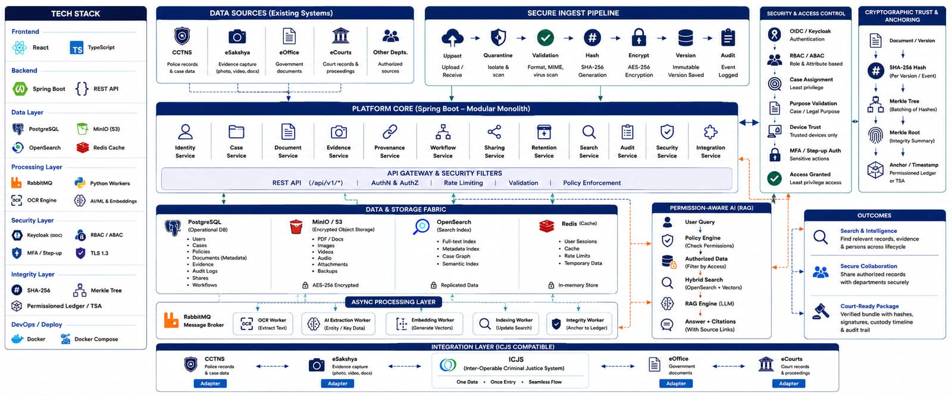
TECHNICAL APPROACH
CrimeNet
TECHNICAL ARCHITECTURE & HIGH-LEVEL SYSTEM FLOW
• Enterprise Core & Microservices: Engineered on Spring Boot 3 (Java 21) with Keycloak OAuth2/OpenID Connect for clearance-based access tokens, and Spring Data JPA with row-level security enforcement.
• Immutable Storage Tier (WORM Object Locking): MinIO / AWS S3 distributed object storage with Write-Once-Read-Many (WORM) Object Lock. Active legal-hold files cannot be deleted or modified, even by system administrators.
• Asynchronous Event Fabric & Fast Search: RabbitMQ worker queues decouple document uploads from CPU-intensive OCR extraction and blockchain anchoring. OpenSearch distributed cluster enables sub-second full-text investigation queries across millions of pages.
• Blockchain Merkle Provenance (Polygon Amoy Testnet): Document Provenance Anchor smart contract (DocumentProvenanceAnchor.sol) deployed live on Polygon Amoy (Chain ID 80002) at 0x6B76859551315E47041064F48E201b0c2E5832a7. Merkle batching aggregates thousands of document actions into a single on-chain root hash.
• Hexagonal Integration Gateway (ICJS / CCTNS / eSakshya): Ports-and-Adapters integration fabric connecting to National Crime Records Bureau (NCRB) ICJS pillars over NICNET/SWAN with 2-way mTLS X.509 client certificates and automated mock-to-live profile toggles.
3
Notes:
null

Slide 4
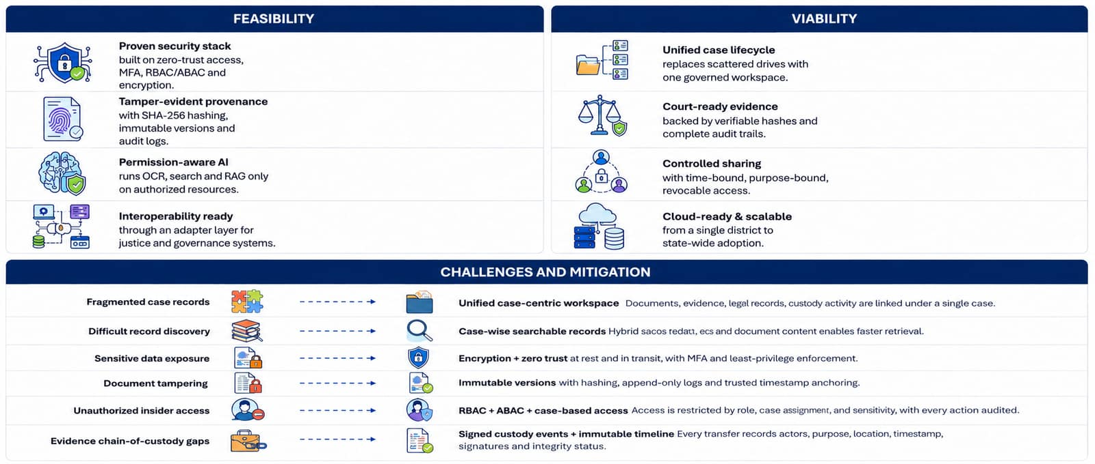
FEASIBILITY AND VIABILITY
CrimeNet
FEASIBILITY, DEPLOYABILITY & ECONOMIC VIABILITY
• 100% Free & Open-Source Stack: Zero proprietary license fees. Built entirely on industry-standard open-source technologies (PostgreSQL, MinIO, Redis, RabbitMQ, OpenSearch, OpenPDF, ZXing, Web3j). No recurring vendor lock-in costs for government agencies.
• Cost-Effective Blockchain Anchoring: By utilizing Merkle tree roots, CrimeNet compresses up to 10,000 document audit events into a single on-chain transaction. On Polygon L2 or state government private EVM subnets, transaction cost per evidence piece is less than ₹0.01.
• Horizontal Scalability & High Availability: Stateless Spring Boot backend services scale horizontally behind standard reverse proxies and load balancers. Redis caching provides sub-5ms token and permissions resolution.
• Deployable on NIC MeghRaj Cloud & Air-Gapped Police Servers: Containerized using Docker Compose and Kubernetes Helm charts. Fully operational in secure state datacenters, NIC government clouds, or completely offline air-gapped forensic environments.
• Frictionless Officer Onboarding: Zero client installation required. Officers access the system via standard web browsers or add the PWA directly to mobile home screens with biometric TouchID/FaceID and hardware PIN clearance.
4
Notes:
null

Slide 5
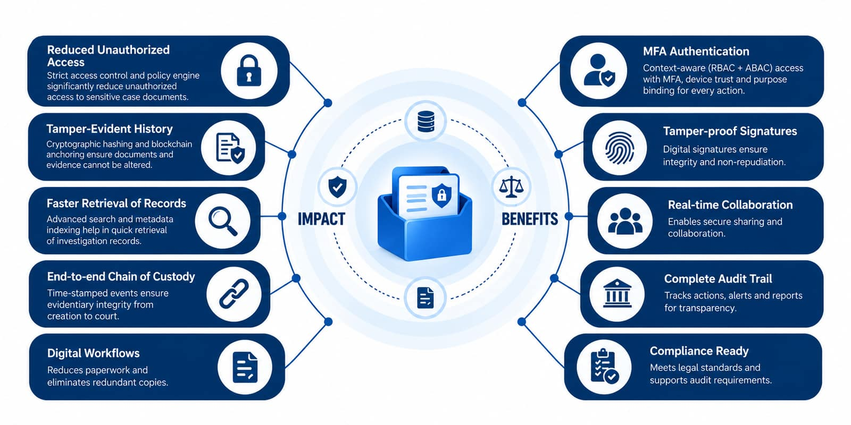
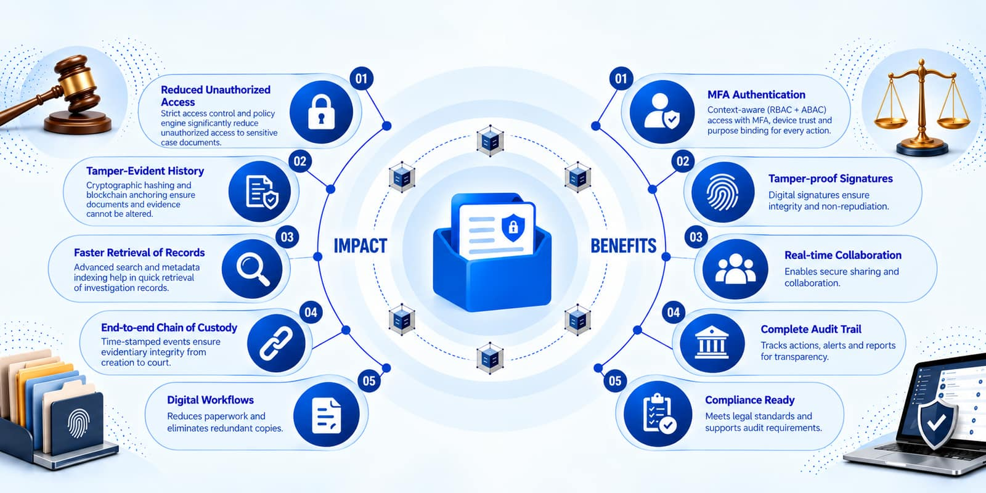
IMPACT AND BENEFITS
CrimeNet
IMPACT, LEGAL ADMISSIBILITY & OPERATIONAL BENEFITS
• Statutory Admissibility (Bharatiya Sakshya Adhiniyam 2023 §65B): Generates court-ready Section 65B Electronic Admissibility Certificates in PDF format with forensic SHA-256 hashes, device provenance, full custody history, verification QR code, and officer RSA digital signature seal.
• Elimination of Evidentiary Tampering & Chain Disputes: Every evidence movement, forensic handover, and document modification is immutably timestamped on-chain, eliminating allegations of evidence tampering in sessions and high court proceedings.
• Radical Reduction in Investigation Cycle Times: Eliminates paper file transit delays between police stations, forensic science laboratories (FSL), public prosecutors, and court registries with cryptographically authenticated instant digital handovers.
• Guaranteed Victim & Informant Privacy: Row-Level Security (RLS) guarantees that sensitive witness identities and survivor statements cannot be leaked or browsed by unauthorized officers, maintaining judicial confidentiality.
• Instant Field Ingestion with AI OCR: Field officers can scan physical FIRs, panchnamas, and charge sheets with their smartphone camera, automatically extracting legal entities and indexing them into case files within seconds.
5
Notes:
null

Slide 6
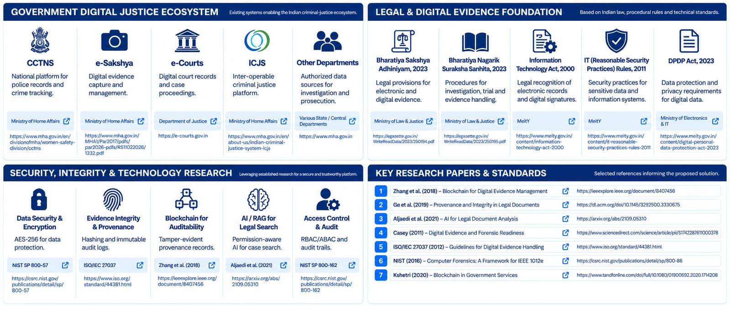
RESEARCH AND REFERENCES
CrimeNet
STATUTORY FRAMEWORK, RESEARCH & REFERENCES
• Bharatiya Sakshya Adhiniyam (BSA) 2023 §65B: Mandatory statutory framework for admissibility of electronic records in Indian judicial proceedings, requiring proof of device integrity, hash identity, and custody.
• Bharatiya Nagarik Suraksha Sanhita (BNSS) 2023 §105: Statutory requirement for mandatory audio-video electronic recording of search and seizure operations and forensic evidence collection by law enforcement agencies.
• Inter-operable Criminal Justice System (ICJS) — NCRB / MHA: Ministry of Home Affairs guidelines for data integration across Police (CCTNS), Courts (eCourts), Prisons (ePrisons), Forensics (eForensics), and Prosecution (eProsecution).
• eSakshya Digital Evidence Management — NCRB: Operational nationwide across 15,899+ police stations in 35 States/UTs for recording evidence hashes, media storage, and API data exchange.
• Information Technology Act 2000 (§66C, §66D) & BNS 2023: Statutory provisions governing electronic evidence authentication, identity theft, and cyber forensics.
• RFC 6962 & NIST SP 800-88 / 800-57: Cryptographic standards for Certificate Transparency, Merkle hash tree auditability, and digital signature key management.
6
Notes:
null

