Slide 1
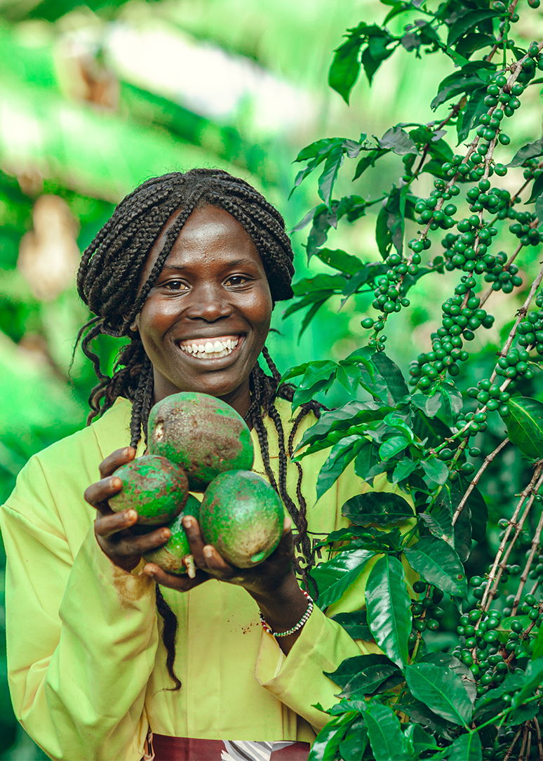
World Food Day 2026
Innovate today. Nourish tomorrow.
GAIN campaign concept: team briefing
October 2026
Notes:
Good morning, everyone, and thanks for making time. Today I want to walk you through our plan for World Food Day, which is on Friday 16 October. FAO's theme this year is "Innovate today. Nourish tomorrow." That is a gift for us, because innovation is what GAIN does every day. This is a working concept, not a final plan, so I want your input as we go.

Slide 2
What we'll cover today
Looking back: World Food Day 2025
This year's theme and our concept
Three pillars, tied together by AI
Content plan and rollout
How we inform, educate and influence
Bringing in our country teams
What we need from you
Notes:
Here's what we'll cover. First, a quick look back at what we did last year. Then this year's theme and our concept, the three pillars that hold the campaign together, our content plan and rollout, how we want to inform, educate and influence our audiences, how we bring in our country teams, and finally what I need from each of you. It should take about 15 minutes, with time for questions at the end.

Slide 3
Looking back
What we did for World Food Day 2025
Notes:
Let's start by looking back at World Food Day 2025, so we build on what worked.

Slide 4
World Food Day 2025: actors, actions, achievements
WHAT WE DID
WHAT WE CARRY INTO 2026
FAO theme: Hand in Hand for Better Foods and a Better Future
GAIN's angle: the actors, actions and achievements behind food systems change
Community Table: an interactive wall for thanks, commitments and photos
Opinion brief: Why We Work on Food, Nutrition and Development
Bite the Talk podcast: the Food Systems Dashboard
Keep an interactive element, such as a virtual wall
Give the story a clear structure: three pillars
Build new content, not just re-share last year's
Set measures upfront so we can report results
Notes:
Last year FAO's theme was "Hand in Hand for Better Foods and a Better Future". Our angle was actors, actions and achievements: the people and partners behind food systems change. We ran a Community Table, an interactive wall where people could thank someone who supports their food journey, make a commitment and share photos. We published an opinion brief, "Why We Work on Food, Nutrition and Development", by Rosalia Kaluki Muia and Steve Godfrey, and a Bite the Talk episode on the Food Systems Dashboard with Jessica Fanzo and Ty Beal.
What we carry into this year: the interactive element was a good idea, so let's keep one, such as a virtual wall. Last year's story was broad; this year we want a clearer structure. We'll create new content rather than only re-sharing last year's. And we'll agree on measures before we launch, so we can report results afterwards.

Slide 5
This year
Innovate today. Nourish tomorrow.
Notes:
So, to this year. "Innovate today. Nourish tomorrow."

Slide 6
GAIN's evidence, data and business innovation already put more nutritious, safe food on people's plates. Innovate today: the tools. Nourish tomorrow: the people and diets they reach.
Our working concept: Innovation that nourishes
Notes:
Our working concept is "Innovation that nourishes". The idea is simple: we answer FAO's theme with proof. GAIN's evidence, data and business innovation already put more nutritious, safe food on people's plates. "Innovate today" is the tools we've built. "Nourish tomorrow" is the people and the diets those tools reach. Our guiding principle is quality over quantity: a few items, each told well.

Slide 7
What we want to achieve, and with whom
OBJECTIVES
MAIN AUDIENCE
Position GAIN as a practical, leading innovator in food systems
Showcase a few tools, each with a clear story: what it is, who it helps, what changed
Drive audiences to one campaign web page linked to FAO
Give country offices and partners ready-to-use content
Governments and policymakers
Also reaching:
  Donors and investors
  Food businesses and MSMEs
  Researchers
  The public and young people
Notes:
We have four objectives. Position GAIN as a practical, leading innovator in food systems. Showcase a small number of tools, each with a clear story: what it is, who it helps and what changed. Drive everyone to one campaign web page that links to FAO's World Food Day site. And give country offices and partners content they can use straight away.
Our main audience is governments and policymakers, because they can take these tools to scale. We'll also reach donors and investors, food businesses and MSMEs, researchers, and the wider public, especially young people.
IF ASKED WHY GOVERNMENTS AND POLICYMAKERS ARE THE MAIN AUDIENCE:
They can take these tools to scale. The Food Systems Dashboard and diet quality data feed national planning, DFQT+ serves fortification regulators, and the Nutrition Futures Initiative works through social protection programmes. One government decision can change what millions of people eat.
It fits our content. Two of our three pillars, evidence and data, and systems that deliver, speak most directly to policymakers, and our strongest proof point is a government one: the Ugandan commissioner finding that small millers don't have to fortify flour.
It fits the moment. World Food Day is a UN and FAO day with events in nearly 150 countries, so ministries are paying attention that week.
It matches GAIN's role. We mostly work through governments and businesses, so we target the people who can act on our work.
Other options, depending on what success looks like: donors and investors if the priority is funding; food businesses and MSMEs if it's participation in the innovation challenges; the public and young people if it's reach and visibility. We can switch if the team prefers.

Slide 8
Three pillars, one story
1. KNOW WHAT NOURISHES
2. MAKE SYSTEMS DELIVER
3. BACK THE INNOVATORS
Evidence and data
Lead: Priority Micronutrient Density list (Ty Beal)
Supporting: Food Systems Dashboard; Diet Quality Questionnaire (DQQ)
Podcast clip: EP 26
Technology and policy
Lead: DFQT+ digital fortification tracking
Supporting: Nutrition Futures Initiative
Podcast clip: EP 30
Businesses and youth
Lead: NourishNext youth innovation challenge
Supporting: N3F; MSME Week stories
Podcast clip: EP 33 (Aida Eyasu)
Climate angle: Nutribaik; I-CAN (Anthony)
Notes:
To stop this from feeling scattered, everything sits under three pillars that tell one story: we know what nourishes, we make food systems deliver it, and we back the people who build it.
Pillar one, Know what nourishes, is evidence and data. It's led by Ty Beal's Priority Micronutrient Density list, with the Food Systems Dashboard and the Diet Quality Questionnaire in support.
Pillar two, Make systems deliver, is technology and policy. It's led by DFQT+, our digital tool for tracking fortification quality from factory to market, with the Nutrition Futures Initiative in support.
Pillar three, Back the innovators, is businesses and youth. It's led by the NourishNext youth innovation challenge, with N3F and our MSME Week stories in support. Each pillar has a podcast episode we can clip from. We also heard that climate and the environment were missing, so we bring that out through the Nutribaik story, bicycle-based last-mile delivery in Mozambique, and through Anthony's I-CAN work.

Slide 9
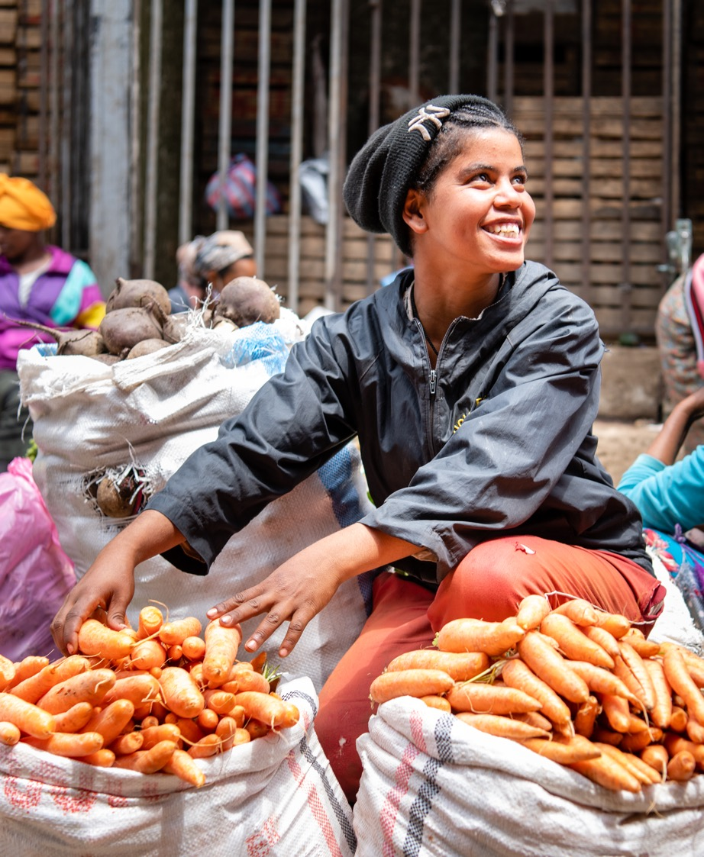
GAIN's AI strategy runs through all three pillars: design, deliver, scale
Notes:
You might ask where AI fits. GAIN's AI strategy isn't a separate item; it runs through all three pillars, and its three areas line up with them. Design, meaning better targeting, sits with pillar one; for example, the Food Systems Dashboard is adding AI search. Delivery, including checking fortification compliance, sits with pillar two alongside DFQT+. Scale, spreading what works faster, sits with pillar three. Each pillar's posts will carry one short line on what AI adds next, and the flagship video will close on it. That's our "Nourish tomorrow" moment.

Slide 10
Content plan: one flagship video, the rest repurposed
FLAGSHIP VIDEO
MSME WEEK
PODCAST CLIPS
EXPERT VOICES
60 to 90 seconds
Problem, innovations, result
Cut-downs: 30-second teaser, 15-second clips
Re-cut 2 or 3 innovator profiles
Kennie O. Cold Chain (Nigeria)
Whey2Value (Pakistan)
Nutribaik (Mozambique): climate and environment story
30 to 60 second audiograms
EP 26: Food Systems Dashboard
EP 30: Nutrition Futures Initiative
EP 33: Start Where You Are
Ty Beal on micronutrient-dense foods (we have)
Stella on data
DFQT+ spokesperson (to confirm)
Notes:
For content, one flagship video anchors everything, 60 to 90 seconds: the problem, the innovations and the result, with a 30-second teaser and short clips cut from it. We'll re-cut two or three innovator profiles from MSME Week, such as Kennie O. Cold Chain, Whey2Value and Nutribaik, which also carries our climate and environment story. We'll pull 30 to 60 second clips from three podcast episodes. And we'll have expert voices: we already have Ty Beal on micronutrient-dense foods, Stella will speak on data, and we still need to confirm a DFQT+ spokesperson.

Slide 11
Inform, educate, influence
INFORM: 12 TO 16 OCT
EDUCATE: 16 TO 23 OCT
INFLUENCE: 16 OCT ON
Get noticed
Pillar teasers, flagship video, #WorldFoodDay
Lead with a striking fact, not GAIN's name
Measure: reach and video views
Help people understand
Explainers, carousels, podcast clips, web page
Problem, what GAIN built, what changed
Measure: page visits, clicks to tools
Prompt action
One clear ask per audience
Trusted messengers: Ty Beal, partners, founders
Measure: sign-ups, requests, applications
Notes:
How do we move people from seeing our content to acting on it? Three steps.
Inform, from 12 to 16 October: get noticed. Pillar teasers, the flagship video and #WorldFoodDay. Lead with a striking fact, not with GAIN's name, for example "Is the fortified flour you buy really fortified?" We measure reach and views.
Educate, from 16 to 23 October: help people understand. Explainers, short carousels, podcast clips and the web page, always in the same structure: the problem, what GAIN built and what changed. We measure page visits and clicks through to the tools.
Influence, from 16 October onwards: prompt action. Each audience gets one clear ask, for example governments using the Dashboard or investors backing N3F, delivered by messengers they trust. We measure sign-ups, partner requests and applications.

Slide 12
Rollout: from teasers to deep dives
One story, told in the same order everywhere: pillar 1, 2, 3
12-14 Oct
12-15 Oct
Web page finalised (Gloria)
Teasers: one day per pillar
16 Oct
17-23 Oct
Flagship video and web page go live
Deep dives for each pillar
ONE COLOUR PER PILLAR. ONE CARD TEMPLATE.
ONE CAMPAIGN HASHTAG.
Notes:
Here's the rollout. Gloria finalises the web page from 12 to 14 October when she's back from leave. From 12 to 15 October we run teasers, one day per pillar. On 16 October the flagship video and the web page go live. Then from 17 to 23 October we run deeper posts for each pillar.
To keep it cohesive: one colour and icon per pillar, one card template for every post, one campaign hashtag alongside #WorldFoodDay, and the same pillar order everywhere.

Slide 13
Bringing in our country teams
PHOTO COMPETITION
VIRTUAL WALL
FAO EVENTS
SUPPORT KIT
Starting idea: team photo with a Happy World Food Day placard
Your ideas wanted on this call
Send by 14 Oct; collage on 16 Oct
30-second phone video or photo on the campaign wall
Prompt: What innovation is nourishing your country?
Best entries shared on social
Join the local FAO World Food Day event, where one is planned
Post from the event with #WorldFoodDay, tagging GAIN and FAO
Share photos with global comms
One-page toolkit: placard, post copy, hashtags, deadlines
One comms focal point per country
A shared chat group for quick help
Notes:
Now, something we know matters: bringing in our country teams. Last year we asked them for video submissions and posts on the wall, but we didn't have a clear way to involve them. This year I'm proposing four simple things.
First, a photo competition. Our starting idea is a team photo holding a Happy World Food Day placard, sent by 14 October and posted as a collage on the day. But we want your ideas on how to run it, so please share them on this call.
Second, the virtual wall. Teams and their partners can upload a 30-second phone video or a photo answering one prompt: what innovation is nourishing your country? We share the best entries on social media.
Third, FAO events. FAO is running events in nearly 150 countries. Where a country team can attend its local event, we'd like them to post from it with #WorldFoodDay, tag GAIN and FAO, and send photos to global comms.
Fourth, what we give them so this is easy: a one-page toolkit with the placard, ready-made post copy, the hashtags and the deadlines; one comms focal point per country; and a shared chat group for quick questions. The aim is to brief country teams this week so they have time to plan.

Slide 14
Next steps and what we need from you
Country teams: share your ideas on this call
Internal email to all staff before World Food Day to prepare them
Budget for World Food Day (Tanvi Sood)
Confirm available content: NourishNext (Tanvi), DFQT+ (Theodore, Gloria), DQQ (Ebow), N3F (Yetunde)
Help us cut, and suggest a campaign hashtag
Coming next: how GAIN's evolving strategy fits in
Notes:
Finally, next steps and what I need from you. Country teams: please share your ideas on this call, for the photo competition and anything else you'd like to do. Before World Food Day we'll send an internal email to all staff so everyone is prepared. Tanvi will prepare a budget for World Food Day. Please confirm which content we already have: Tanvi for NourishNext, Theodore and Gloria for DFQT+, Ebow for the Diet Quality Questionnaire and Yetunde for N3F. Help us cut, and suggest a campaign hashtag. And coming soon: how GAIN's evolving strategy fits into the campaign.

Slide 15
Thank you
Notes:
Thank you. Let's open it up: what's missing, what should we cut, and who can help with what?

