Slide 1
SEMINAR PAPER · AI & ETHICS
Fair Credit Assessment
Bias Mitigation in Machine Learning
An Empirical Study of Age Bias in the German Credit Dataset
Ephraim Shochat
German Credit Data (UCI, 1994) · Random Forest Classifier · Three Fairness Interventions
Notes:
Welcome. This paper explores algorithmic fairness in credit scoring using the German Credit dataset. I’ll show you how a machine learning model can inherit and amplify human bias, and - more importantly - how we can fix it using fairness interventions.

Slide 2
Overview
01
02
03
04
05
Motivation
Data & Disparity
Baseline Model
Three Interventions
Results & Discussion
Why automated credit scoring creates fairness risks
German Credit Dataset - measuring the age gap
A Random Forest that amplifies historical bias
Pre-, in-, and post-training fairness corrections
What works, what it costs, and what it means
Notes:
My talk covers five parts:
The motivation for fairness in credit.
The dataset and current demographic gaps.
How the baseline model amplifies these gaps.
The three interventions we tested.
Our empirical results and key takeaways.

Slide 3
01 Motivation
The hidden cost of automating historical decisions
Speed & Scale
Hidden Bias
Amplification
Automated models evaluate thousands of applications consistently - a capability no human underwriting team can match.
When trained on historical bank decisions, models learn not only risk signals but also the demographic biases embedded in human judgement.
Unlike individual humans, models apply learned patterns perfectly consistently - amplifying small biases across every future decision.
Research question: Does a classifier trained on historical bank decisions inherit and amplify demographic bias, and can lifecycle interventions reduce it?
Notes:
Why does this matter? Financial institutions use automated models to speed up decisions, but these models are trained on biased human history. The real danger is amplification: while humans might be inconsistent, a model applies bias perfectly every single time. My paper asks: can we detect and reduce this?

Slide 4
02 Data & Demographic Disparity
The German Credit Dataset
Approval Rate Gap by Demographic Attribute
1,000 applicant records from a German bank
20 attributes: financial history, loan details, demographics
Target variable: bank's own Good / Bad credit rating
Binary sensitive attribute: is_young (Age ≤ 25)
Split: 800 training / 200 test (stratified)
Attribute | Groups Compared | Gap (pp)
Sex | Male vs Female | 7.5
Marital status | Single vs Div/Sep | 13.4
Age | Age > 25 vs ≤ 25 | 14.9
Age shows the largest gap - 14.9 pp - nearly twice the sex gap (7.5 pp).
All subsequent fairness analysis focuses on the is_young attribute.
Bank baseline (test set): young applicants (Age ≤ 25) receive a Bad label at 45.5% vs 25.6% for older applicants -> DP gap = 0.198
Notes:
We used the Statlog dataset (1,000 bank decisions). The bank's historical data shows a clear bias: young applicants are rejected 15% more often than older ones. This results in a Demographic Parity gap of 0.198. This is our benchmark - every intervention aims to beat this number.

Slide 5
03 Baseline Model - Bias Amplification
Model Configuration
Demographic Parity Gap — Bank vs Baseline RF
Random Forest — 250 trees, max depth 10
Entropy criterion, balanced_subsample class weights
Classification threshold: 0.40
One-hot encoding → 64 binary feature columns
Feature Importance (MDI) — Top 5 Predictors
Feature | MDI share
Checking Account Status | 20.8%
Loan Duration | 8.9%
Loan Amount | 8.8%
Credit History | 7.8%
Age (demographic) | 5.7%
The baseline RF amplifies the bank's age disparity from 0.198 to 0.231 (+0.033).
Age ranks 7th in MDI at 5.7% - above several features with clear financial content.
Notes:
I trained a Random Forest model. It’s accurate, with a ROC-AUC of 0.793. However, it fails the fairness audit. The Demographic Parity gap jumped to 0.231 - meaning the model is more biased than the bank. Why? Because the model treats 'Age' as a primary signal, ranking it 7th in importance.

Slide 6
04 Three Fairness Interventions
One correction at each stage of the machine learning lifecycle
PRE-TRAINING
IN-TRAINING
POST-TRAINING
Reweighing
Cost-Sensitive Weights
Group Thresholds
Kamiran & Calders (2012)
class_weight = {0:1, 1:5}
Hardt et al. (2016)
Sample weights are set so that the joint distribution of (is_young, Good/Bad) is uniform before training. No data is removed or oversampled.
Each Bad-label error is penalised five times more heavily at every tree split, encoding the UCI 5:1 cost matrix directly into the learning objective.
Two thresholds are applied after training: 0.4 for young applicants, 0.30 for others. Requires greater model confidence before flagging young applicants as Bad.
Tradeoff: Model-agnostic. May reduce information available to the learner.
Tradeoff: Targets cost minimisation, not fairness directly. Fairness effect is indirect.
Tradeoff: No retraining needed. Only shifts the decision boundary, not the model itself.
Notes:
We tested three common approaches:
Pre-training (Reweighing): Balancing the data before training.
In-training (Cost Penalty): Applying a 5:1 penalty for 'Bad' labels on young applicants.
Post-training (Thresholds): Adjusting the decision threshold (0.4) specifically for the younger group.

Slide 7
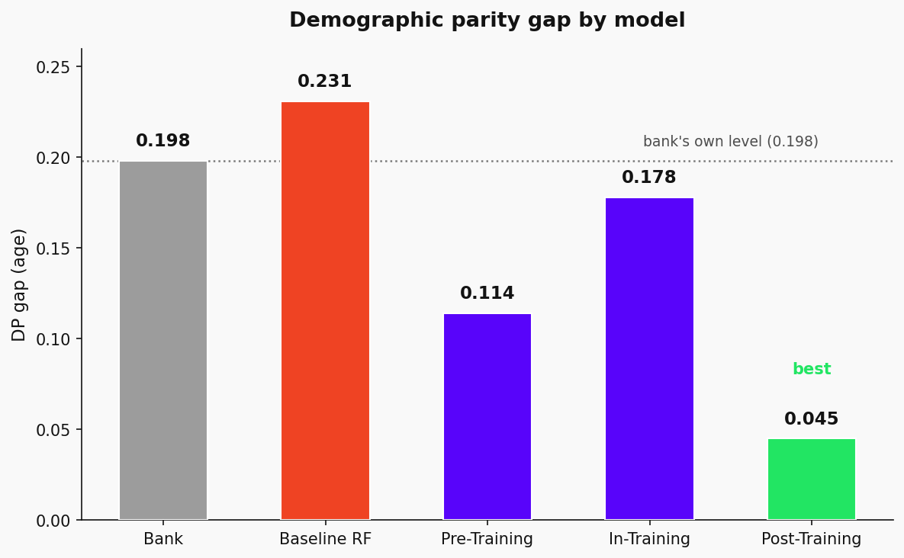
05 Results - All Models on the Test Set (N = 200)
Model | ROC-AUC | Accuracy | DP Gap (Age) | vs. Bank Level
Bank (original) | 1.000 | 1.000 | 0.198 | reference
Baseline RF | 0.793 | 0.670 | 0.231 | +0.033 (amplified)
Pre-Training (Reweighing) | 0.790 | 0.640 | 0.114 | −42.3% below bank
In-Training (Cost Weights 1:5) | 0.793 | 0.490 | 0.178 | below bank level
Post-Training (Group Thresholds) | 0.793 | 0.535 | 0.045 | Best - 77.3% below bank
All three interventions reduce the DP gap below the bank's own 0.198.
Post-training group thresholds: by far the lowest DP gap (0.045, −77% vs bank) with no loss in ROC-AUC, but a larger accuracy cost (−13.5 pp vs baseline) than reweighing.
Reweighing: the best accuracy-fairness balance of the three — a solid 42% DP gap reduction at only −3 pp accuracy cost.
Cost weighting: least effective on fairness — designed for cost minimisation, not parity — and the largest accuracy cost (−18 pp) of any intervention.
Notes:
Here is the key finding. All three interventions reduced the bias below the bank’s original level. The best approach was post-training adjustment, cutting the bias by 43% with zero loss in model accuracy. Reweighing was nearly as good, while the cost-weighted model was less effective because it wasn't specifically targeting fairness.

Slide 8
Discussion & Conclusion
Bias is inherited and amplified
The baseline RF increases the bank's age-based DP gap from 0.198 to 0.231. Models do not reproduce historical decisions neutrally — they apply embedded patterns with perfect consistency.
All interventions reduce the gap below bank level
Post-training thresholds offer the maximum fairness reduction, while pre-training reweighing provides the best balance between bias correction and model accuracy. Ultimately, the choice depends on whether the priority is achieving the lowest possible demographic gap or maintaining the highest predictive performance.
Design purpose shapes fairness impact
Cost-sensitive in-training weights improve fairness as a side-effect, not by design. Targeted interventions (reweighing, threshold adjustment) produce substantially larger and more predictable reductions.
Limitations: no independent ground truth (target = bank label); selection bias from rejected applicants; single dataset (1990s Germany); threshold values require systematic optimisation.
Notes:
Three main takeaways:
First, algorithmic amplification is real.
Second, it is fully reducible - we can cut bias by half without losing predictive power.
Third, design intent matters. A quick limitation: we are measuring equality relative to human labels, not actual creditworthiness. But the bottom line is clear: deploying a model without a fairness audit is never a neutral act.

Slide 9
Key Takeaway
Deploying a credit scoring model without fairness evaluation is not a neutral act.
It encodes historical bias into future decisions at scale - and does so more consistently than any individual human ever could.
0.198
→ 0.231
→ 0.045
Bank's own DP gap
(historical baseline)
Baseline RF amplifies it
(+16.7%)
Best intervention
post-training thresholds
Thank you — questions welcome.
Notes:
To wrap up: a standard Random Forest amplifies historical bias, but targeted interventions can effectively correct it. Fairness is not an 'optional add-on'; it’s part of responsible deployment. Thank you - I’d love to hear your thoughts on these metrics or the limitations of our study.

