Slide 1
Triggers study on HI 2022 run
Eslam Shokr
7-3-2023

Slide 2
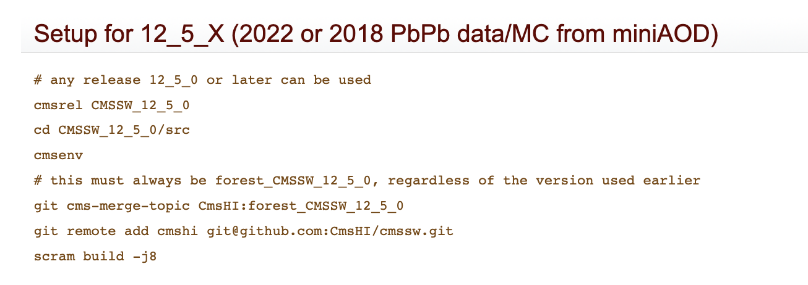
1- Extract UPC
I found away to do so using HIForest (Thanks to Arash and Stefnaos) (https://twiki.cern.ch/twiki/bin/viewauth/CMS/HiForestSetup)

Slide 3
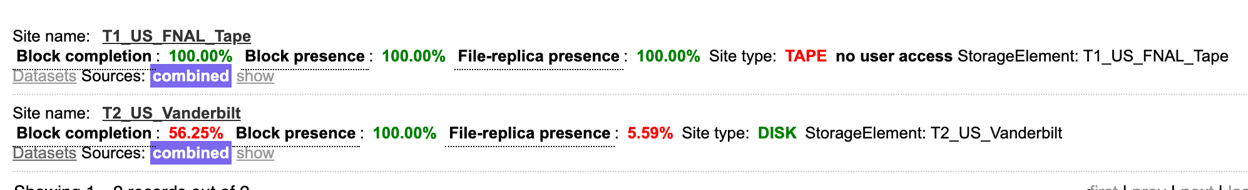

1.1 DataSets
Almost all the HI 2022 run datasets are on Teir1; but I found some files of /HITestRaw0/HIRun2022A-PromptReco-v1/AOD on teir2
Selected files: $\sim$22.5k events
'root://cms-xrd-global.cern.ch//store/hidata/HIRun2022A/HITestRaw0/AOD/PromptReco-v1/000/362/219/00000/d0a95156-a786-4e2c-8549-2a39e5f293c0.root',
'root://cms-xrd-global.cern.ch//store/hidata/HIRun2022A/HITestRaw0/AOD/PromptReco-v1/000/362/229/00000/c5e5fbc5-b1c4-4920-9422-5116256f7fdf.root',
'root://cms-xrd-global.cern.ch//store/hidata/HIRun2022A/HITestRaw0/AOD/PromptReco-v1/000/362/243/00000/27d8b18f-2261-4c21-8a16-2dd50fcc4373.root'

Slide 4

1.2 Configuration File
CMSSW_12_5_2_patch1/src/HeavyIonsAnalysis/Configuration/test/forest_miniAOD_run3_DATA.py
1.3 Triggers
1- HLT_HIZeroBias_v4: $\sim$16.5k events
2- HLT_HIMinimumBias_v2: $\sim$5.4k events
3- HLT_HIUPC_* : no events passed; Maybe more data needed (CRAB could be used)

Slide 5
Thanks

