Slide 1
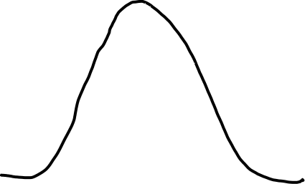



IVT
e.g. V
y₀=0, M₀, V₀
y₁=$\frac{w}{2√2}$ , M₁, V₁
y₂=$\frac{w}{√2}$ , M₂, V₂
y₃=$\frac{3w}{2√2}$, M₃, V₃
y
S (gridspacing)
w (‘width’ parameter i.e. ‘peakness’ of curve)

